Slide 1
GANGS
SOCIAL PERSPECTIVES
Y7&8
11-13 years

Slide 2
H I P H O P S A V E D
M Y L I F E
W E E K 3
15 M I N U T E S

Slide 3
In this lesson, students will:
THINK!
Think about and explore some of the links between hip-hop and gang culture
Understand how gang culture can be a positive addition to a community
Explore and unravel some of the cultural perceptions of gang culture and hip-hop within different communities and cultures
FEEL!
CONNECT!

Slide 4
P R E L E S S O N
R E F L E C T I O N S
3 – 5 M I N U T E S +

Slide 5
Introduce the following REFLECTIVE QUESTIONS for students to consider during the lesson (maybe write them up or read them aloud and ask students to think about their own responses):
What are the links between hip-hop and gang culture?
How can music bring people together?
What are other positive ways to make groups come together in positive rivalry?

Slide 6
T H E R U B B L E K I N G S
5 M I N U T E S +

Slide 7
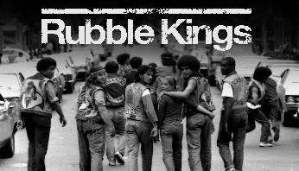
Watch the short trailer (2.15 mins) for a feature length film about New York Gangs directed by Shan Nicholson entitled:
Rubble Kings
click on the link above for the hyperlink

Slide 8
Allow students a few minutes to respond to the film with people sitting near to them.
After sharing their initial responses, ask them to think about the following questions:

Slide 9
What is the film trying to show about Hip-hop?

Slide 10
T H E M A N Y S I D E S
O F H I P H O P
1 0 M I N U T E S +

Slide 11
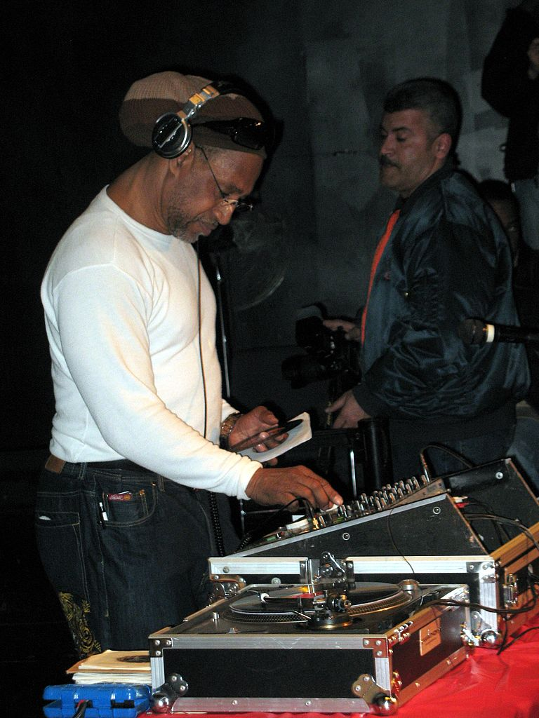
Hip-Hop emerged in the 1970’s with the arrival in New York of a man named Mr Clive Campbell aka Kool Herc.
Kool Herc migrated to the United States from Kingston, Jamaica and settled in the West Bronx of New York.
He was a disc jockey and attempted to incorporate his Jamaica style of disc jockeying into the local scene, which involved reciting improvised rhymes over reggae records.

Slide 12
New York wasn’t really interested in his reggae, so Kool Herc had to find another sound to try to please his audiences…which he did.
He adapted a new style, and chanted over the top of instrumental sections of the popular music of the day.
He learned that by taking two identical records using an audio mixer, he could play the popular instrumental segment over and over and over…
After Kool Herc’s early work, rap music began to spread throughout the urban community of New York.
Many people began to use it as a form of expression as it offered unlimited opportunities for being creative. There were no set rules, except to be original and to rhyme to the beat of the music.

Slide 13
Hip hop is made up of four key elements:
DJ
Graffiti
MC
Breakdance
If time allows, watch a short 2 minute montage of the 4 pillars of hip-hop by clicking the link: https://youtu.be/1Qyfvc0UHtU

Slide 14
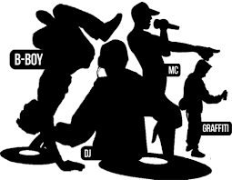
MC-ing (rapping) and DJ-ing were at the core of this emerging culture, but hip-hop was always much bigger than just the music…
Hip-hop was b-boying, breaking or breakdancing, a gymnastic dance-style that calls for improvised, angular athleticism rather than choreographed fluidity.
Hip-hop was also graffiti, a new form of expression that employed spray paint as the medium and subway walls as the canvas.

Slide 15
Much of the culture of hip-hop has been defined by frustration, in particular by people’s anger at being marginalised by society because of being:
poor
black
disenfranchised
abused
stereotyped
blamed
mistreated
ignored.

Slide 16
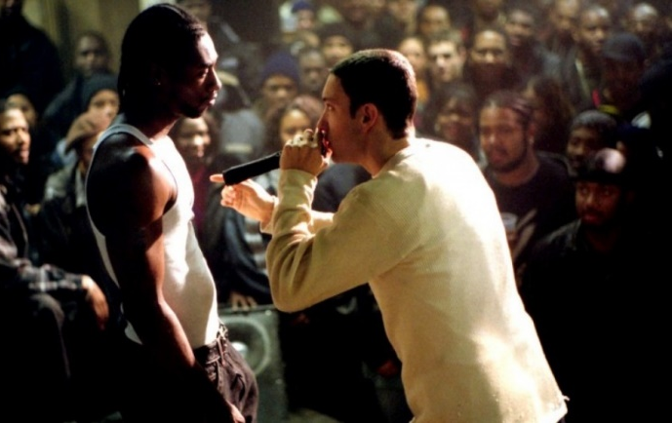
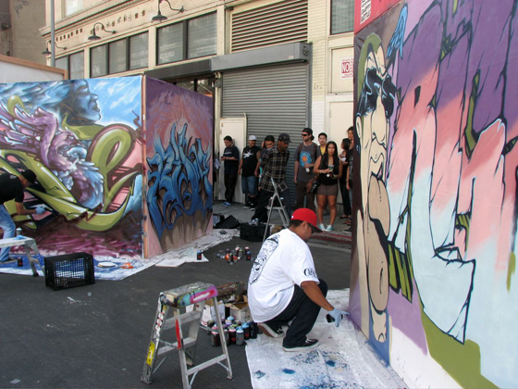
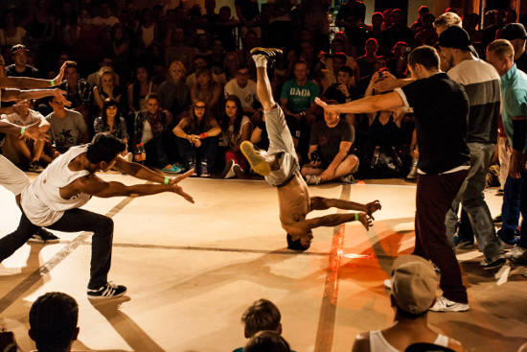
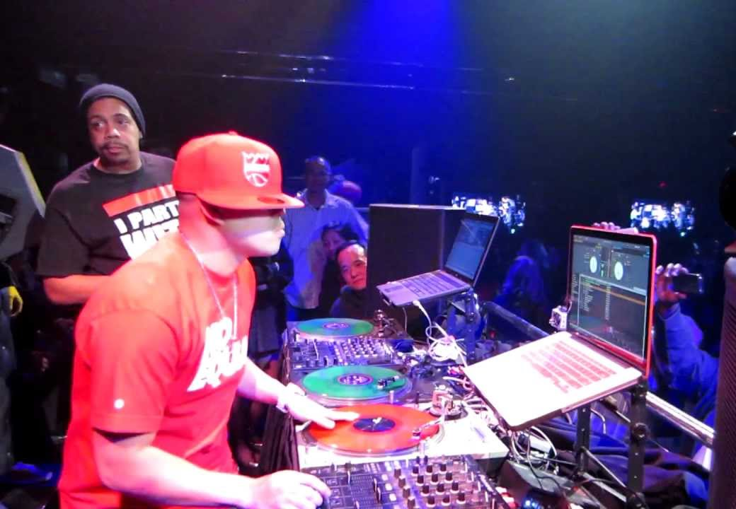
Think about a time when you have been frustrated or annoyed, and try to remember how you felt - think about the feelings in your body as well as in your mind and your heart.
Having somewhere to go with this feeling is part of how the four pillars of hip-hop have emerged, firstly allowing frustrations to be voiced, and secondly to allow tensions between gangs, crews and groups to be played out through “battles” rather than battles.
Rap-battle
Graffiti-battle
Dance-battle
DJ-battle

Slide 17
How is hip hop positive for our societies?

Slide 18
G A N G S
T H I S S O R T O F L E A R N I N G
C A N ’ T W A I T

