Slide 1
CONNECTING TO | OURSELVES, SOCIETY, NATURAL WORLD
Exploring Our World
How are coronavirus and climate change connected?

Slide 2
WHAT DO YOU THINK?
What curiosity questions can you ask?
e.g. Where did coronavirus come from? What causes pandemics? How might climate change lead to more pandemics? Is the health of humans and environment related? Who is most affected by coronavirus and climate change and why? How has the virus helped emphasise the inequalities in our societies? How does coronavirus impact our carbon emissions? What is the impact of globalisation on coronavirus and on climate change?
THINK
How might different people feel?
e.g. How has this pandemic made you feel? What has been the impact of lockdown on your life? What emotions have you noticed in people around you? What are some of the different emotions you have experienced? How might it feel to have no choice but to go to work and risk catching the virus? How does it make you feel when you see how some species have flourished whilst humans have been staying at home?
FEEL
What links can you start to make?
e.g. How do you think the virus spread all over the world? What made it spread so quickly? Why is the virus showing inequality in our societies? What are the links between climate inequality and coronavirus inequality? How might the pandemic change human behaviour to be more caring for the environment?
CONNECT

Slide 3
PART 1 | IMMERSE
Exploring Our World
Where did coronavirus come from and how did it spread?

Slide 4
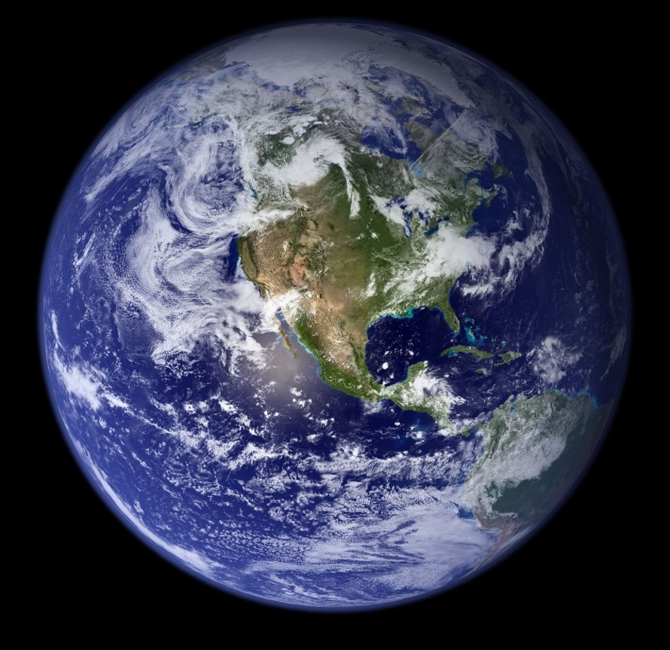
What is a pandemic?
A pandemic is a disease with an outbreak that has spread all over the world. The word ‘pandemic’ originates from the Greek word ‘pan,’ which means ’all’ and ‘demos’ meaning ‘people’. Therefore, it is a global phenomena and affecting all countries in the world with ‘all people’ involved.
Typically, pandemics originate from an epidemic, which is the outbreak of one specific disease in just one country or a larger area. The coronavirus, or Covid-19 virus, is a pandemic as it has become a global situation. A pandemic is caused by a new virus spreading easily from human to human and usually causing severe illness to the body. Due to the virus not being in contact with the human population before or, for a long time, the human immune system is not prepared to tackle it.

Slide 5
What is a virus and how do viruses work? Take a look at this short video (4:30 mins) to learn more:

Slide 6
There have been several pandemics during the last century. Do you know any other pandemics from history? What were their impacts?

Slide 7
Many countries have taken preventative measures to reduce the intensity of the Covid-19 outbreak. At the core, the most important measure was to reduce human contact to help reduce the transaction of the virus amongst people.
Reflection 1:
The ‘new normal?’
Some countries were very prompt in responding to the dangers of the pandemic and announced a lockdown, which usually included the closing of schools, shops, restaurants and public institutions. People are required to stay home and restrict any contact with people outside of their household. Many countries used the lockdown strategy, which successfully resulted in controlling the rate of the infection. Other countries followed a more liberal approach and used a concept called herd immunity. This concept is following the approach that the majority of the population would get naturally infected as the virus moves amongst the population.

Slide 8
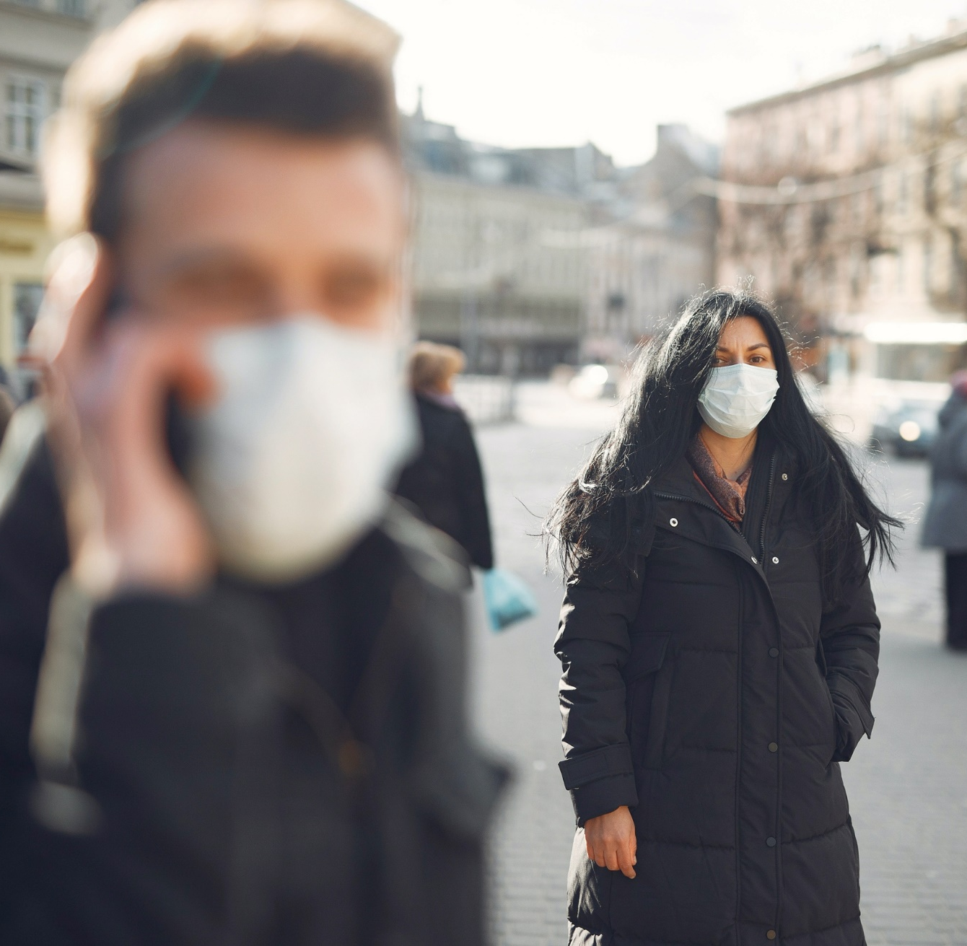
Reflection 1: The ‘new normal?’
The danger a viruses poses is only over if nearly the whole society becomes immune, or if there is a vaccination for it. When viruses are new or fast moving and changing, it sometimes takes a long time for researchers to create a vaccination against the disease.
For that reason, when the infection rate begins to stabilise, countries can attempt to slowly reduce the restrictive measures taken place to bring people out of lockdown.
In most cases, the reopening of places are bound by certain hygiene and safety standards, for example being required to wear a mask in public or keeping a two metre distance at all times between two people (unless they are from your household).

Slide 9
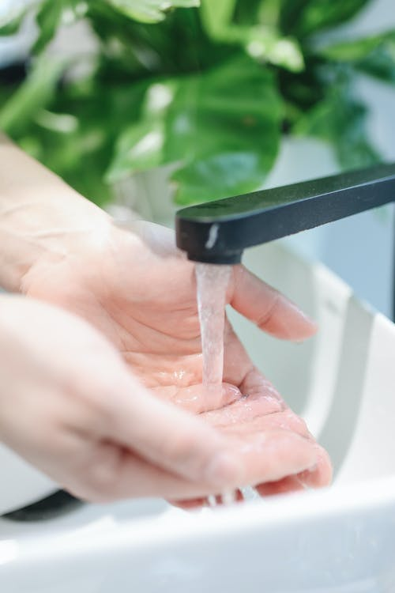
Reflection 1: The ‘new normal?’
“The new normal,” is a term that is getting more and more popular in our current language.
Because a vaccination or alternative solution to respond to Covid-19 may take researchers a while to discover, people are beginning to take into account that things most likely will not go back exactly to how they were before the pandemic hit.
These changes could range from basic hygienic practices to larger shifts in our societies.

Slide 10
How has Covid-19 changed your life? How difficult or easy has it been for you to adapt?
Why not list all of the things that have changed in your life since ‘lockdown’ and next to each one note down whether this has been a positive or negative change (or something else).

Slide 11
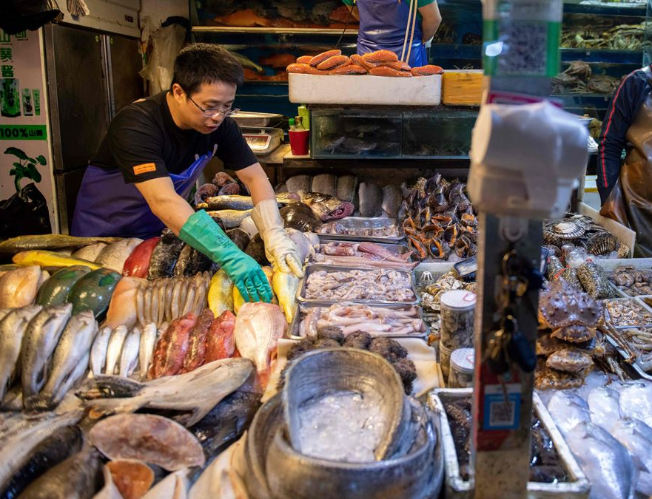
Reflection 2: Animals and the origins of viruses
Whilst the origin of the coronavirus is not yet determined, it is most likely that someone
was infected with the virus during an
interaction with an animal that was being sold
in one of the food markets in Wuhan, China.
In China, there are many food markets – most of these markets are similar to the street markets we see in communities across the world. However whilst rare, some of the food markets in China also sell wild animals. The Huanan market in Wuhan, for example, had a wild animal section, where live and slaughtered animals were for sale.

Slide 12
Reflection 2: Animals and the origins of viruses
There are many calls to close the food markets in China, especially because some of them include the trade of wild animals, which could be the cause for most of the spreading of lethal viruses.
Trade in wildlife in food markets in China took off during the reforms of the economy. Consequently, in 1970, the country faced widespread food shortages, starvation in some areas and a dismantling of collective farms. Some families then decided to trade wild animals on the markets, as these animals had a relatively high return.
What can be said therefore, is that the Chinese population was forced to take up wild animals as part of rural farming, due to political changes. Closing the markets is maybe too easy, because many people depend on these markets for their income and subsistence.

Slide 13
What are some of the reasons the virus spread around so quickly do you think?
Talk together about some of the ways that viruses can spread from one human to another once they have been caught by humans.

Slide 14
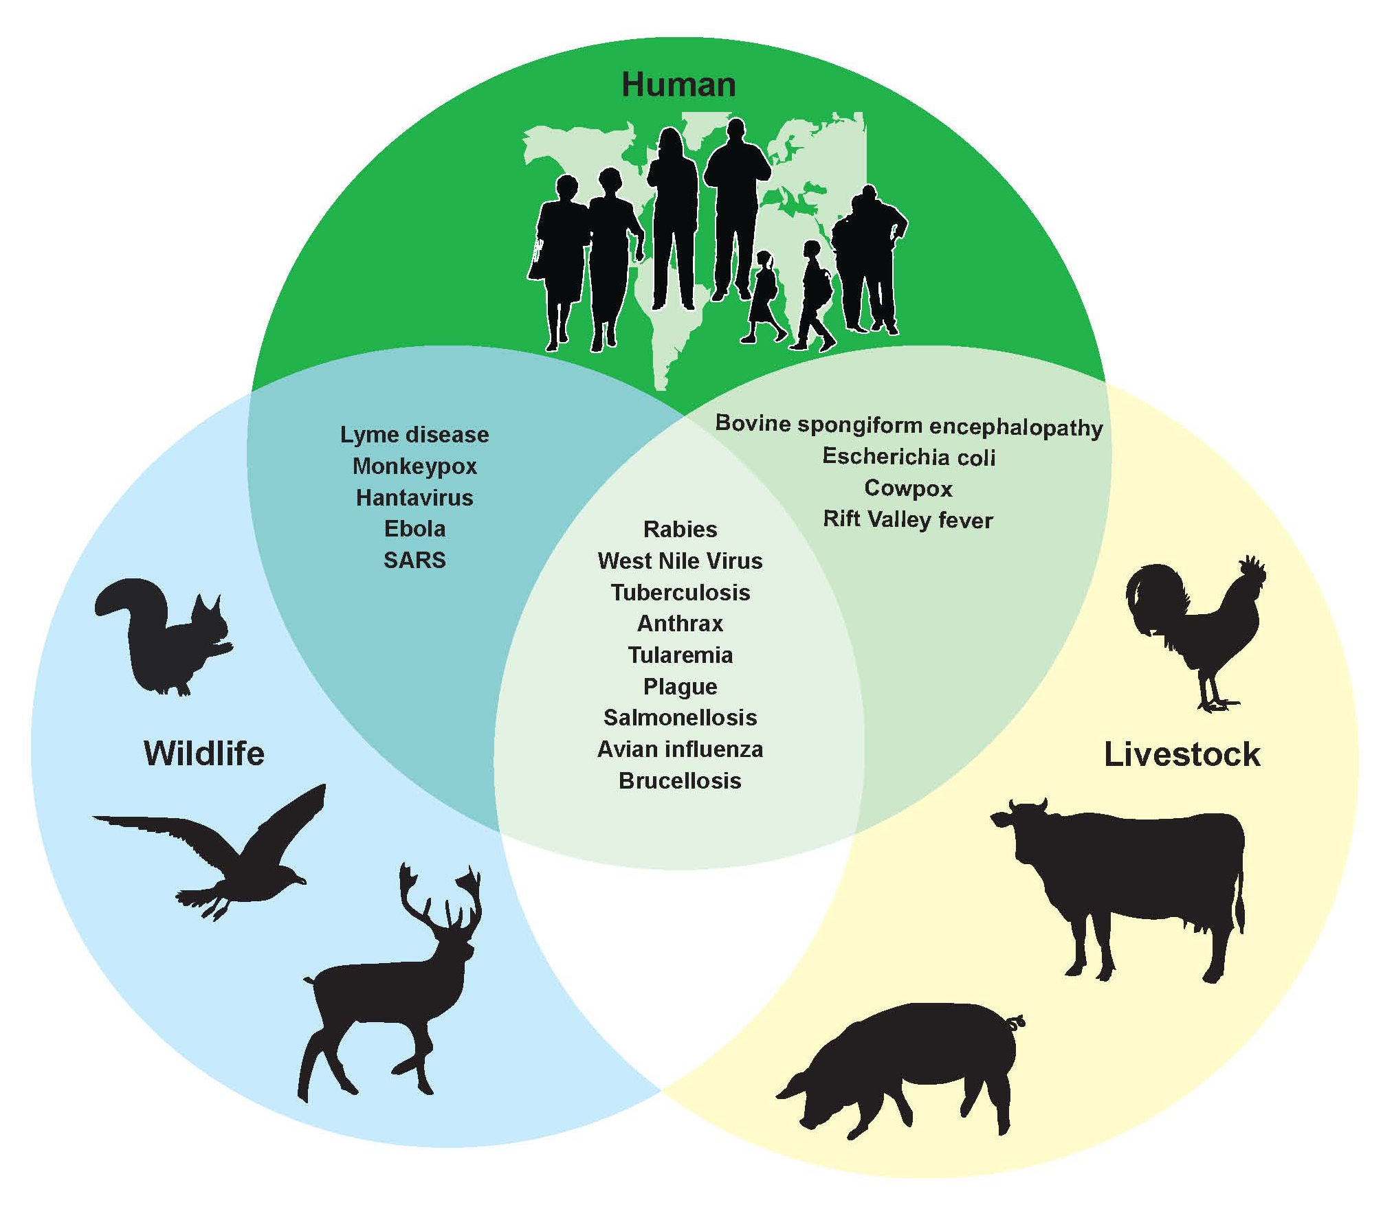
Reflection 2: Animals and the origins of viruses
This is not the first coronavirus infection, as there have been other cases in the past. On multiple occasions in the past, the coronavirus infection has come from an animal which, after coming in contact with a human, was then transferred to the human. In 2003, for example, the Sars-Cov (caused by a coronavirus) has most likely been found to have originated from a type of bat in China.
However, the coronavirus is not the only infection which originates from animals. There are about 150 illnesses that can be called ‘’zoonoses’’ (see diagram on the left) of which the disease comes from an animal. 13 of those are responsible for 2.2 million deaths worldwide.
A recent example is the Ebola outbreak in 2014, that originated from African fruit bats, which crossed over to humans through the bush meat trade.

Slide 15
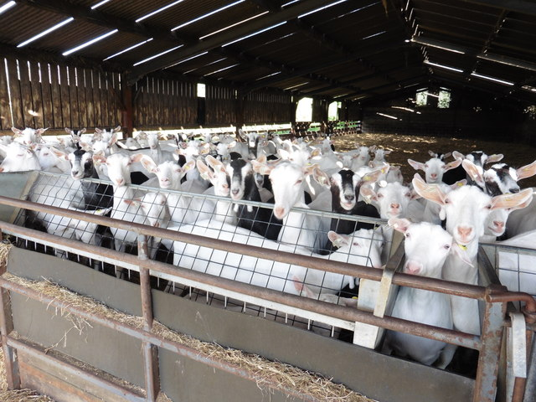
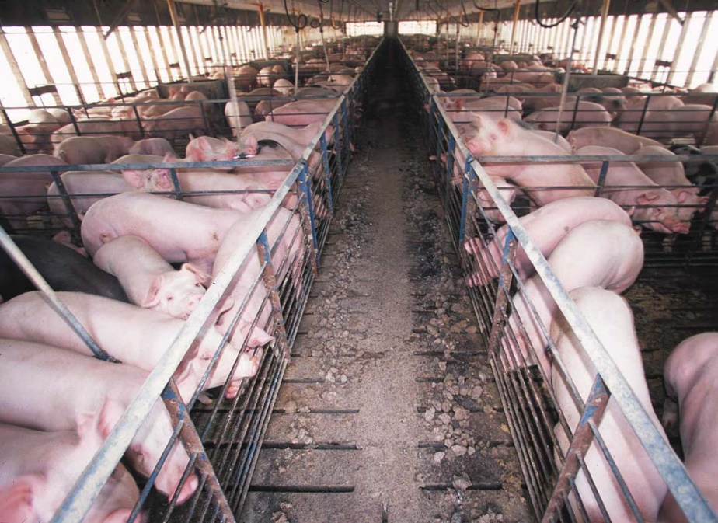
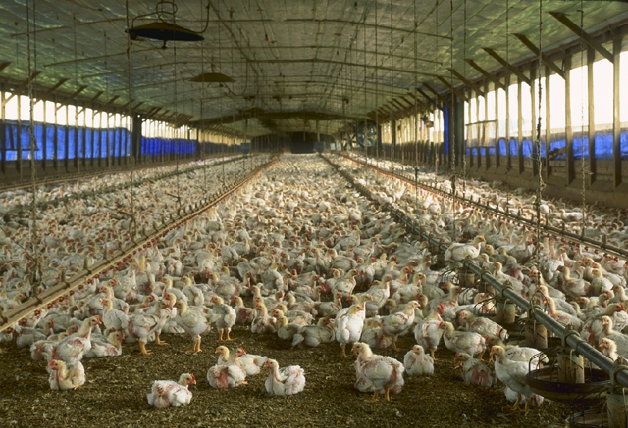
Reflection 2: Animals and the origins of viruses
The underlying cause of these sorts of illnesses transmitted to humans is not related to the animal itself, but more in the way we treat our animals. Keeping animals in large numbers in small areas increases the chance of infections spreading. Scientists predict that if we do not change our relation towards animals, zoonoses will increase in frequency and amount. As humans, we need to start thinking more eco-centered with our actions, rather than only human-centered or "anthropocentric.” This means to see animals not as beings that we can dominate and exploit, but to see them as fundamentally equal to humans. This will require a different perception of the place of humans, seeing us not with a special status, but as part of the whole ecosystem on the planet.

Slide 16
Reflection 2: What is the relationship between the way we treat animals and the spread of viruses?
Oftentimes we look for quick or simple solutions to fix a problem or to blame for a problem.
However, when it comes to complex problems (and coronavirus is a complex problem) the ‘solutions’ are not quite so simple…
Is closure of the food markets in China the solution to prevent other viruses from infecting humans? Why?

Slide 17
How could we relate differently to animals in ways that support the wellbeing of people and planet?
How does it make you feel to see animals in tight enclosures and sold on food markets?
Think about some of the ways that our own actions and behaviours can help to develop positive solutions to prevent further spreads of viruses in the future.

Slide 18
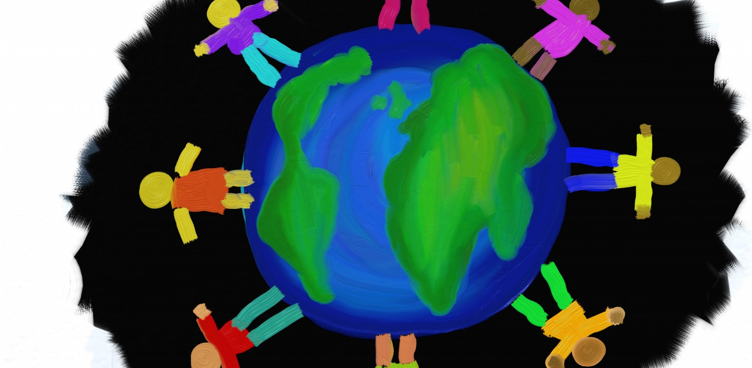
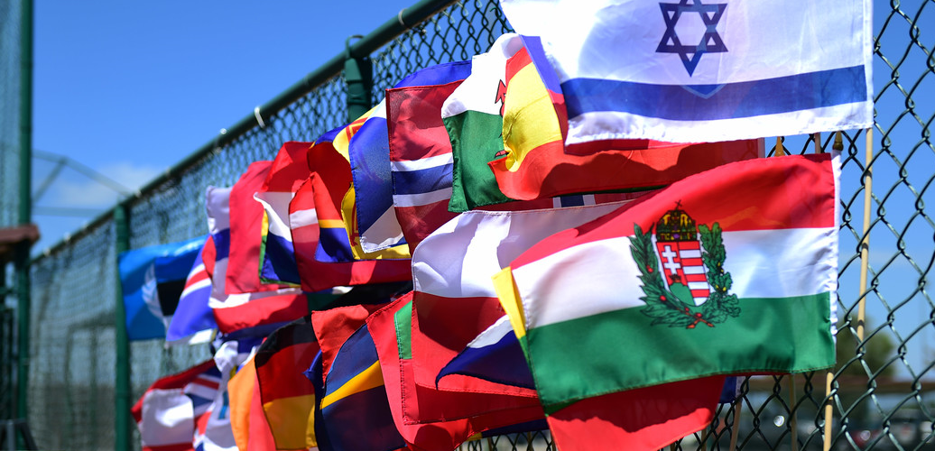
Reflection 3: Globalisation and the virus
We live in a globalised world, this means that our world’s economies, cultures and populations have become interdependent on one another, whether it is through cross-border trade in goods and services, flows of investments, or the movement of people and information. This video gives a good impression of what globalisation involves.
There are many sides to globalisation. There are positive
aspects, such as how our cultures enrich one another and how we as people have become much closer and connected.
However, globalisation also has its downsides. If we
didn’t travel as much, for example, the coronavirus
may have stayed a local disease instead of a global
pandemic.

Slide 19
Reflection 3: Globalisation and the virus
As a consequence of our interconnected world, the coronavirus could spread through air travel rapidly around the world. As you can see on the interactive map, it began at the end of December in Wuhan, China, and spread across the globe in less than one month.

Slide 20
Reflection 3: Thriving in a globalised world?
Pros
…
…
Cons
…
…
…
What are the pros and cons of globalisation?
Try and identify all the possible pros of globalisation versus the cons. How many can you think of? Use the resources in the ‘Take it further section’ to help you.
After you identified as many as you can, you may want to reflect on the following:
If you look to the pros and cons you identified, which of the two are more important to you? Why? --------------------------------------------------------------------------------------------------------------------------------
------------------------------------------------------------------------------------------------------------------------------------------------------------------------------------------------
Globalisation

Slide 21
Reflection 3: Thriving in a globalised world?
Pros?
…
…
Cons?
…
…
…
What are the pros and cons of localisation?
Try and identify all the possible pros of localisation - how many can you think of? Use the resources in the ‘Take it further section’ to help you.
After you identified as many as you can, you may want to reflect on the following:
If you look to the pros and cons you identified, which of the two are more important to you? Why? --------------------------------------------------------------------------------------------------------------------------------
------------------------------------------------------------------------------------------------------------------------------------------------------------------------------------------------
Localisation

Slide 22
If you were the world’s leader and you could choose a more localised world or a globalised world after the pandemic, what would you choose and why?
Think about some of the positive and negatives of each of these systems and why you might choose one over the other if given that choice.

Slide 23
PART 2 | UNDERSTAND
Why might climate change
cause more viruses in the future?
EXPLORE OUR NEXT INQUIRY

Slide 24
This sort of learning can’t wait
THOUGHTBOXEDUCATION.COM

