Slide 1
CONNECTING TO | OURSELVES, SOCIETY, NATURAL WORLD
Exploring Our World
How are coronavirus and climate change connected?

Slide 2
WHAT DO YOU THINK?
What curiosity questions can you ask?
e.g. Where did coronavirus come from? What causes pandemics? How might climate change lead to more pandemics? Is the health of humans and environment related? Who is most affected by coronavirus and climate change and why? How has the virus helped emphasise the inequalities in our societies? How does coronavirus impact our carbon emissions? What is the impact of globalisation on coronavirus and on climate change?
THINK
How might different people feel?
e.g. How has this pandemic made you feel? What has been the impact of lockdown on your life? What emotions have you noticed in people around you? What are some of the different emotions you have experienced? How might it feel to have no choice but to go to work and risk catching the virus? How does it make you feel when you see how some species have flourished whilst humans have been staying at home?
FEEL
What links can you start to make?
e.g. How do you think the virus spread all over the world? What made it spread so quickly? Why is the virus showing inequality in our societies? What are the links between climate inequality and coronavirus inequality? How might the pandemic change human behaviour to be more caring for the environment?
CONNECT

Slide 3
PART 2 | UNDERSTAND
Exploring Our World
Why might climate change cause more viruses in the future?

Slide 4
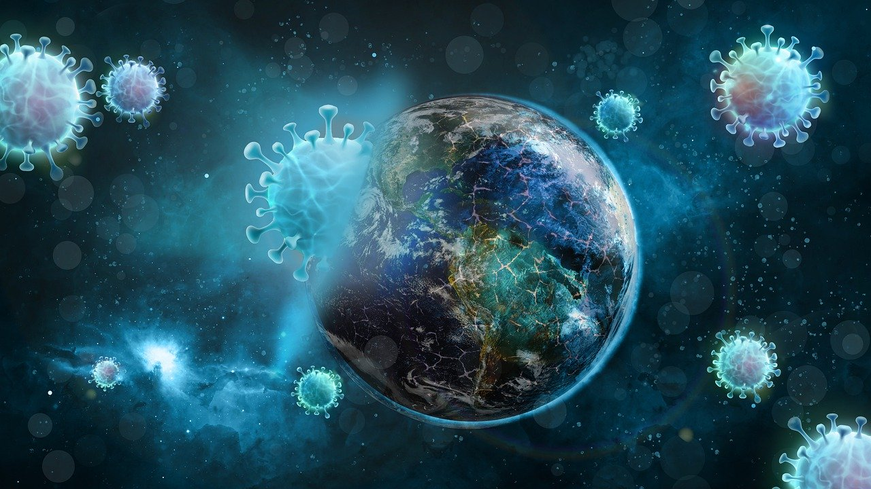
Reflection 1: Rising temperatures and pandemics
We are now learning more about the links between climate change and viruses and how climate change can lead to more viruses in the future.
Temperatures on the Earth are rising because of climate change and our global emissions.
This change in temperature has many consequences for life on the planet - the expected increase in pandemics is one of them.

Slide 5
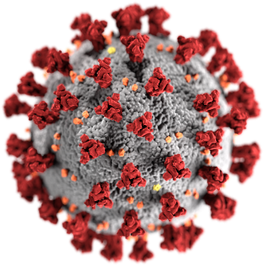
Reflection 1: Rising temperatures and pandemics
Viruses spread through an interaction - or ‘’spillover’’ - where a disease ‘spills’ from an animal over to a human or the other way around. Spillover can happen in two ways, direct and indirect. It can happen directly - through animal bites or consumption of raw or undercooked animal meats or milks, or through contaminated water.
It can happen indirectly, when humans come into contact with a surface that has been contaminated by an infected animal.
Climate change may increase the chance of both direct and indirect spillovers in a variety of ways.

Slide 6
How might climate change be likely to cause more viruses in the future?
Think about some of the ways that these ‘spillover’ moments may occur again.

Slide 7
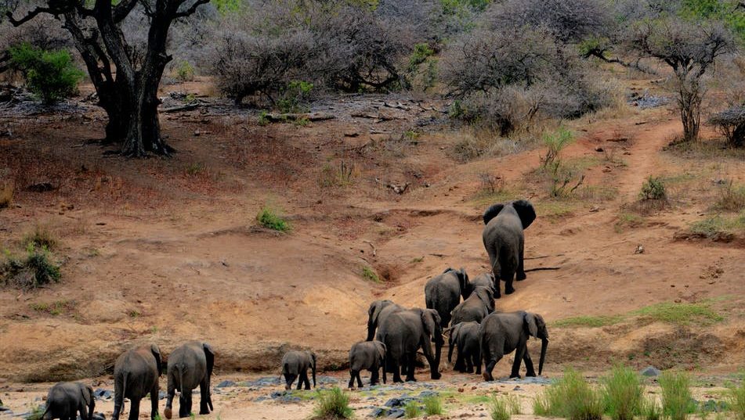
Reflection 1: Rising temperatures and pandemics
The first reason for why climate change may lead to a spread of viruses is the MIGRATION of species. As temperatures increase and rainfall levels change, some species are forced to leave their natural habitat to seek for new places. When land-based animals move, they bring viruses with them that will likely spread into areas populated by humans – with the mix between wild and ‘tamed’ environments.

Slide 8
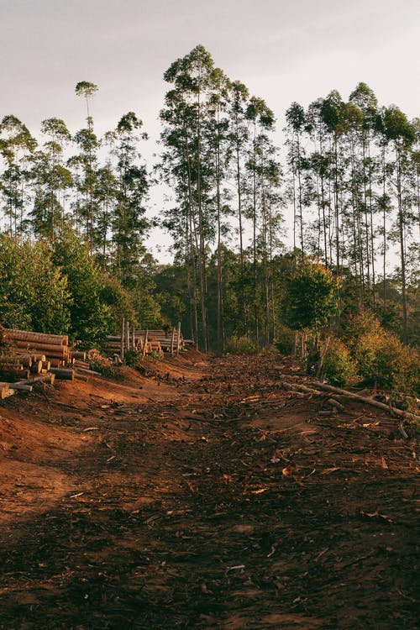
Reflection 1: Rising temperatures and pandemics
The migration of species is not only a consequence of rise in temperatures, but also due to habitat loss as a consequence of our land-use. The destructive ways in which we use land is one of the main causations of climate change.
As we change the natural landscape, for example through deforestation, species are forced to move and may come into closer proximity to humans, leading to a higher risk of virus spillover.
The Ebola epidemic in West Africa likely happened because the Ebola-carrying bats lost their homes due to humans cutting down forests for agriculture – destroying the bats’ habitats. Humans inadvertently pushed the bats into new places that were closer to humans, which lead to spillover.

Slide 9
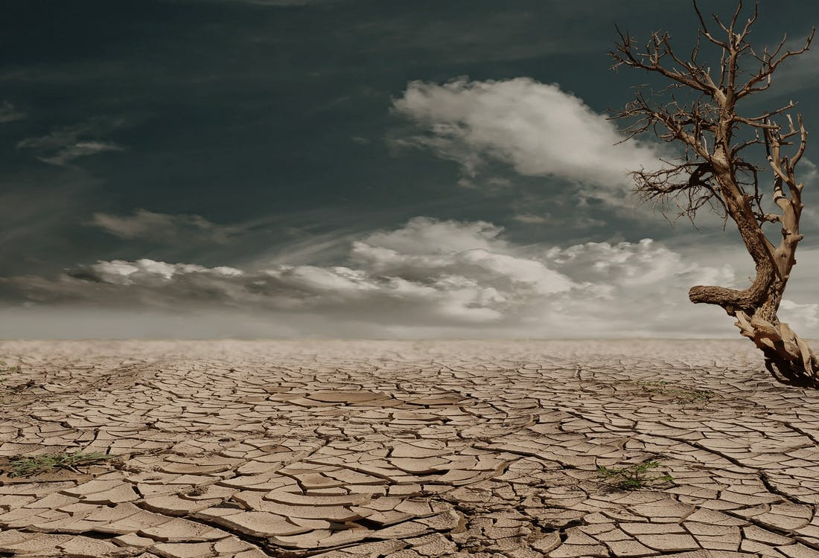
Reflection 1: Rising temperatures and pandemics
Rising temperatures also means more droughts, reducing the likelihood of land being able to be used for continued agriculture.
This may force some human populations that already have difficulty with food production to move habitats, or be forced or find their food through killing wild animals or animal species they would normally not eat. This would also lead to spillover of viruses.

Slide 10
Reflection 1: Rising temperatures and pandemics
As temperatures increase across the planet, this will also influence the resistance of viruses to our immune systems. Our immune systems fight off diseases through heating our body temperature up using a defense mechanism known as a fever.
A hotter climate will make bacteria and viruses stronger as they will adapt to higher temperatures, meaning our bodies may become less effective at fighting off the virus naturally.

Slide 11
What can we do to support healthy immune systems?
Think about some of the habits that we can introduce to our own lives (e.g. the food we eat, fresh air, exercise, good sleep, healthy activities, etc.)

Slide 12
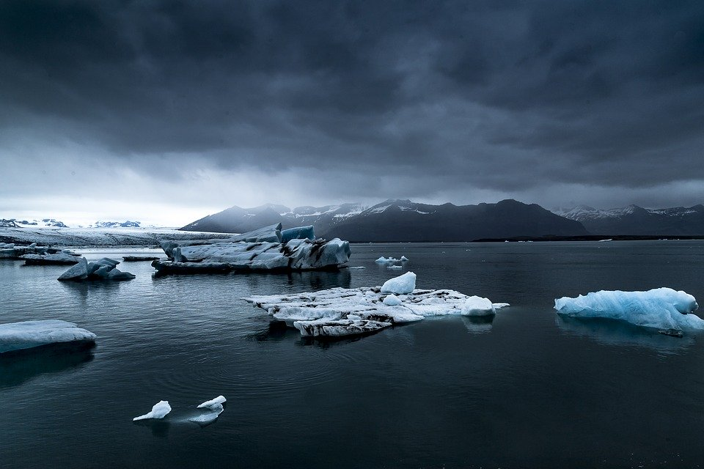
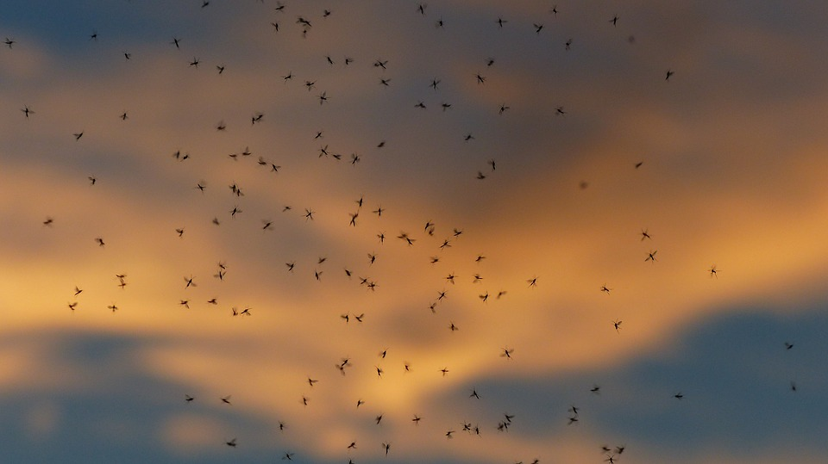
Reflection 1: Rising temperatures and pandemics
Climate change will also improve living conditions for tropical diseases. One of these is malaria, a disease which is transmitted by mosquitoes that kills over 400,000 people a year.
Rises in temperature may also set free unknown bacteria and viruses in the arctic permafrost, a vast area of land which continues to melt every day as temperatures rise.

Slide 13
Reflection 1: Rising temperatures and pandemics
As we have seen, there are many different consequences of climate change that could lead to more pandemics. The following slides show a summary diagram of how climate change might lead to pandemics. Using the sentences in the word bank, try and guess the events in the correct order. You can check the slide afterwards to see the completed diagram.
Activity 1

Slide 14
Word Bank
Migration of species
Human land-use change and exploitation of natural resources
(including deforestation)
Climate Refugees
Bushmeat hunting
Less effective immune system
Droughts and stress on farming/food production

Slide 15
Habitat and biodiversity loss
???
???
Spread of tropical viruses and release of frozen viruses
CLIMATE CHANGE
Change in global temperatures
Direct/Indirect spill-over
PANDEMICS
???
Wildlife markets
???
???
???

Slide 16
Habitat and biodiversity loss
Human land-use change and exploitation of natural resources (including deforestation)
Migration of species
Spread of tropical viruses and release of frozen viruses
CLIMATE CHANGE
Change in global temperatures
Direct/Indirect spill-over
PANDEMICS
Less effective immune system
Wildlife markets
Droughts and stress on farming/food production
Bushmeat hunting
Climate refugees

Slide 17
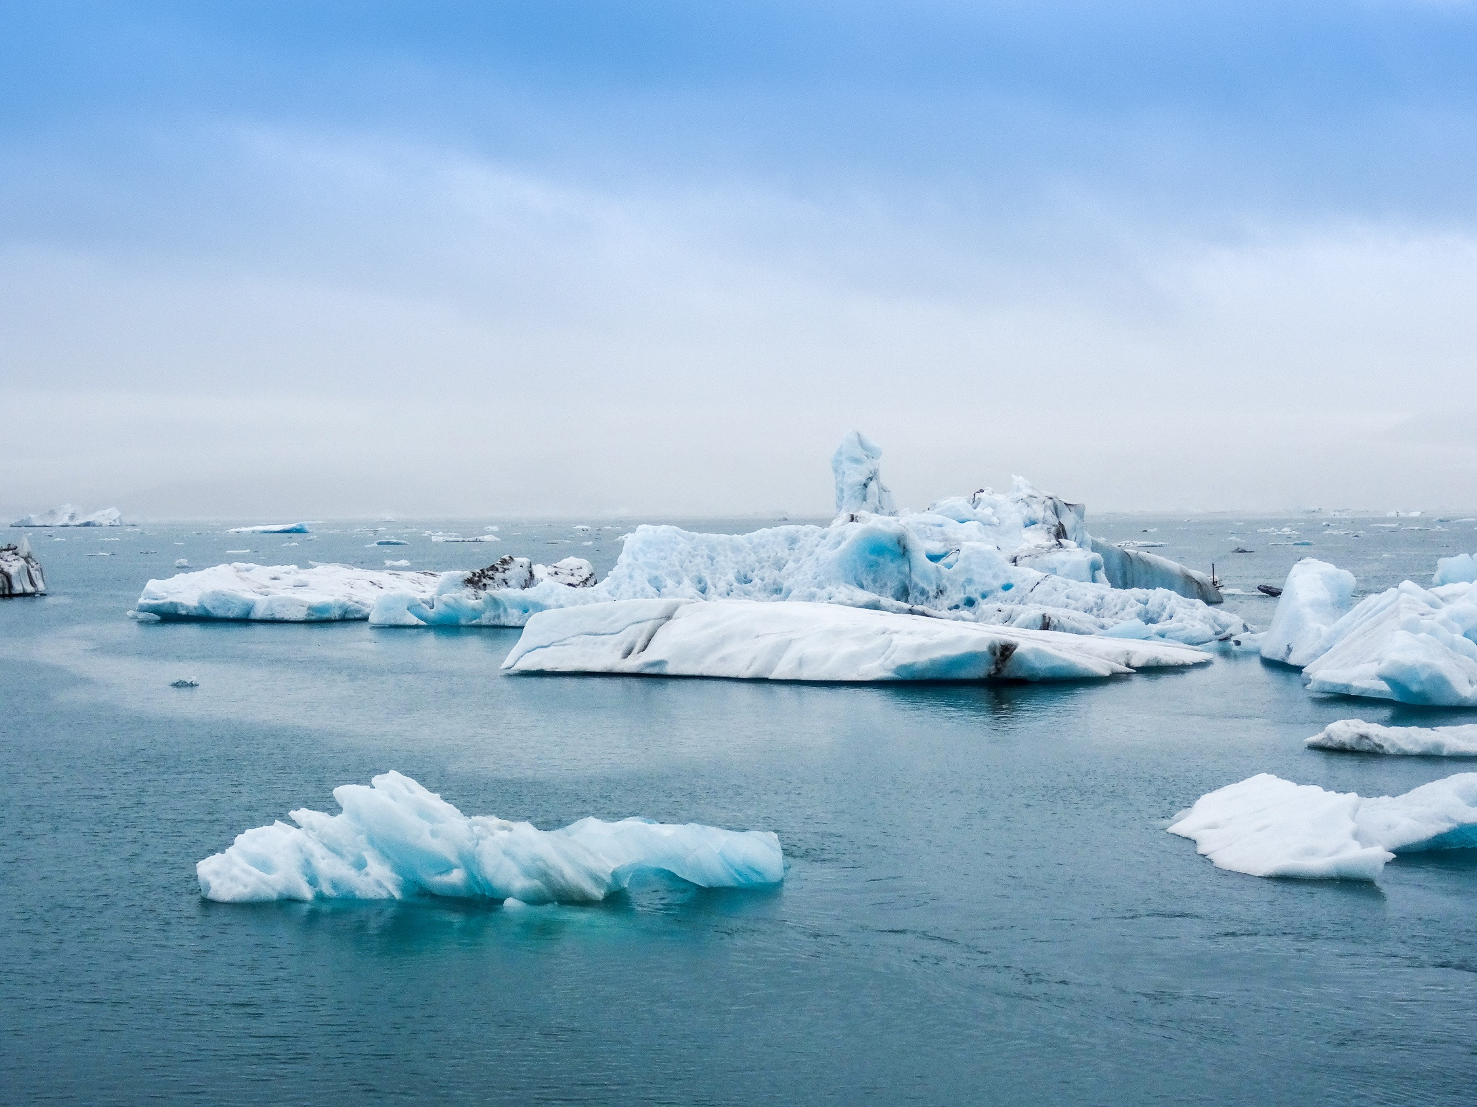
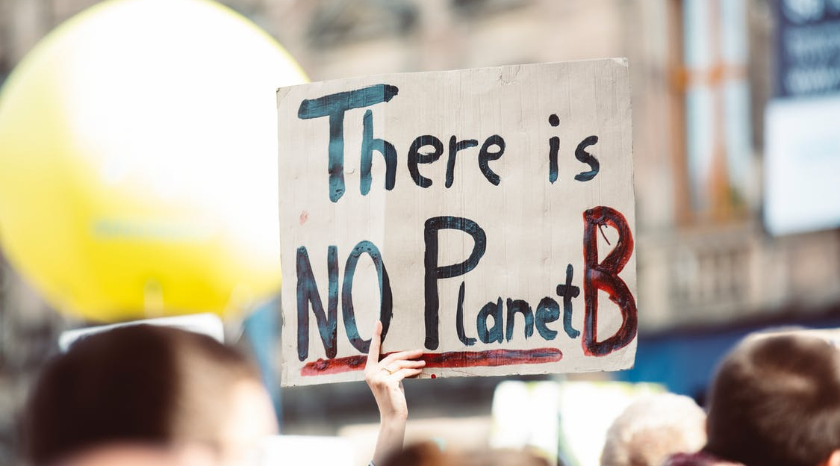
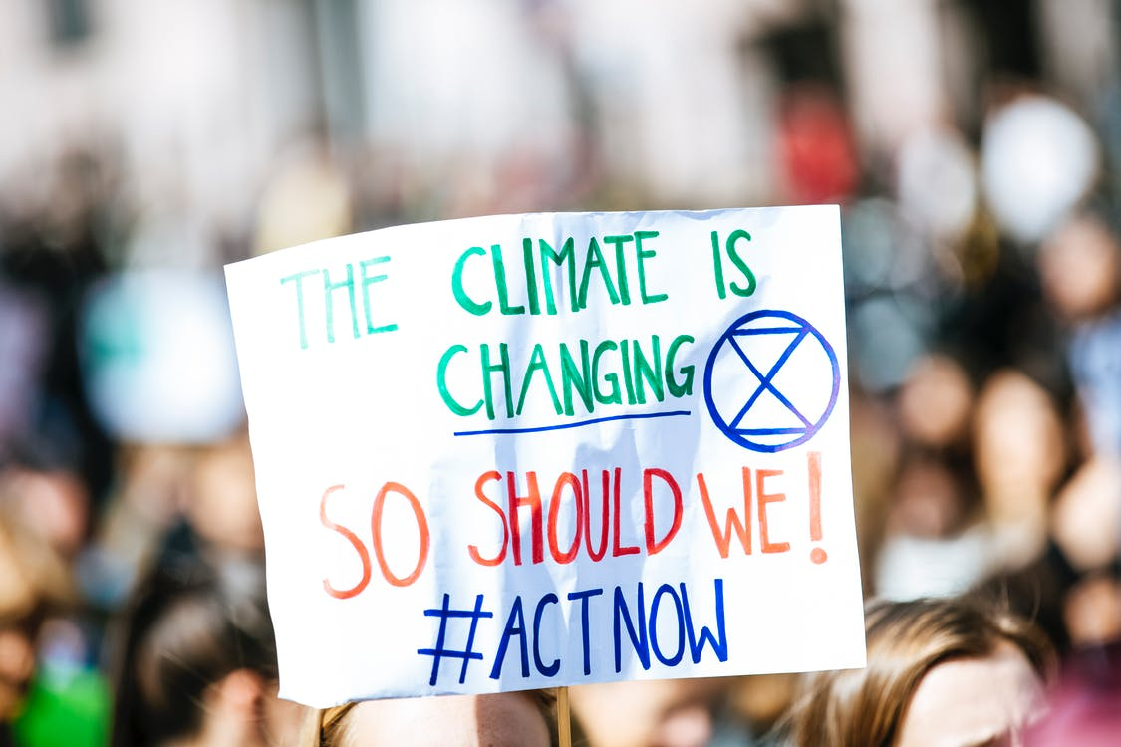
Reflection 2: Our response to Covid-19 and Climate Change
Despite ice sheets melting at high speed, increased temperatures leading to heavier storms, the extinction of species, enormous forest fires and increased droughts, we don’t yet treat climate change with the same urgency and level of attention or action as we now see with our response to Covid-19.

Slide 18
Why might we be responding more drastically to coronavirus compared to climate change?
What could we learn from our responses to coronavirus to help us respond to climate change?
Think about some of the actions you have seen regarding coronavirus and the inaction you have noticed regarding the climate crisis.

Slide 19
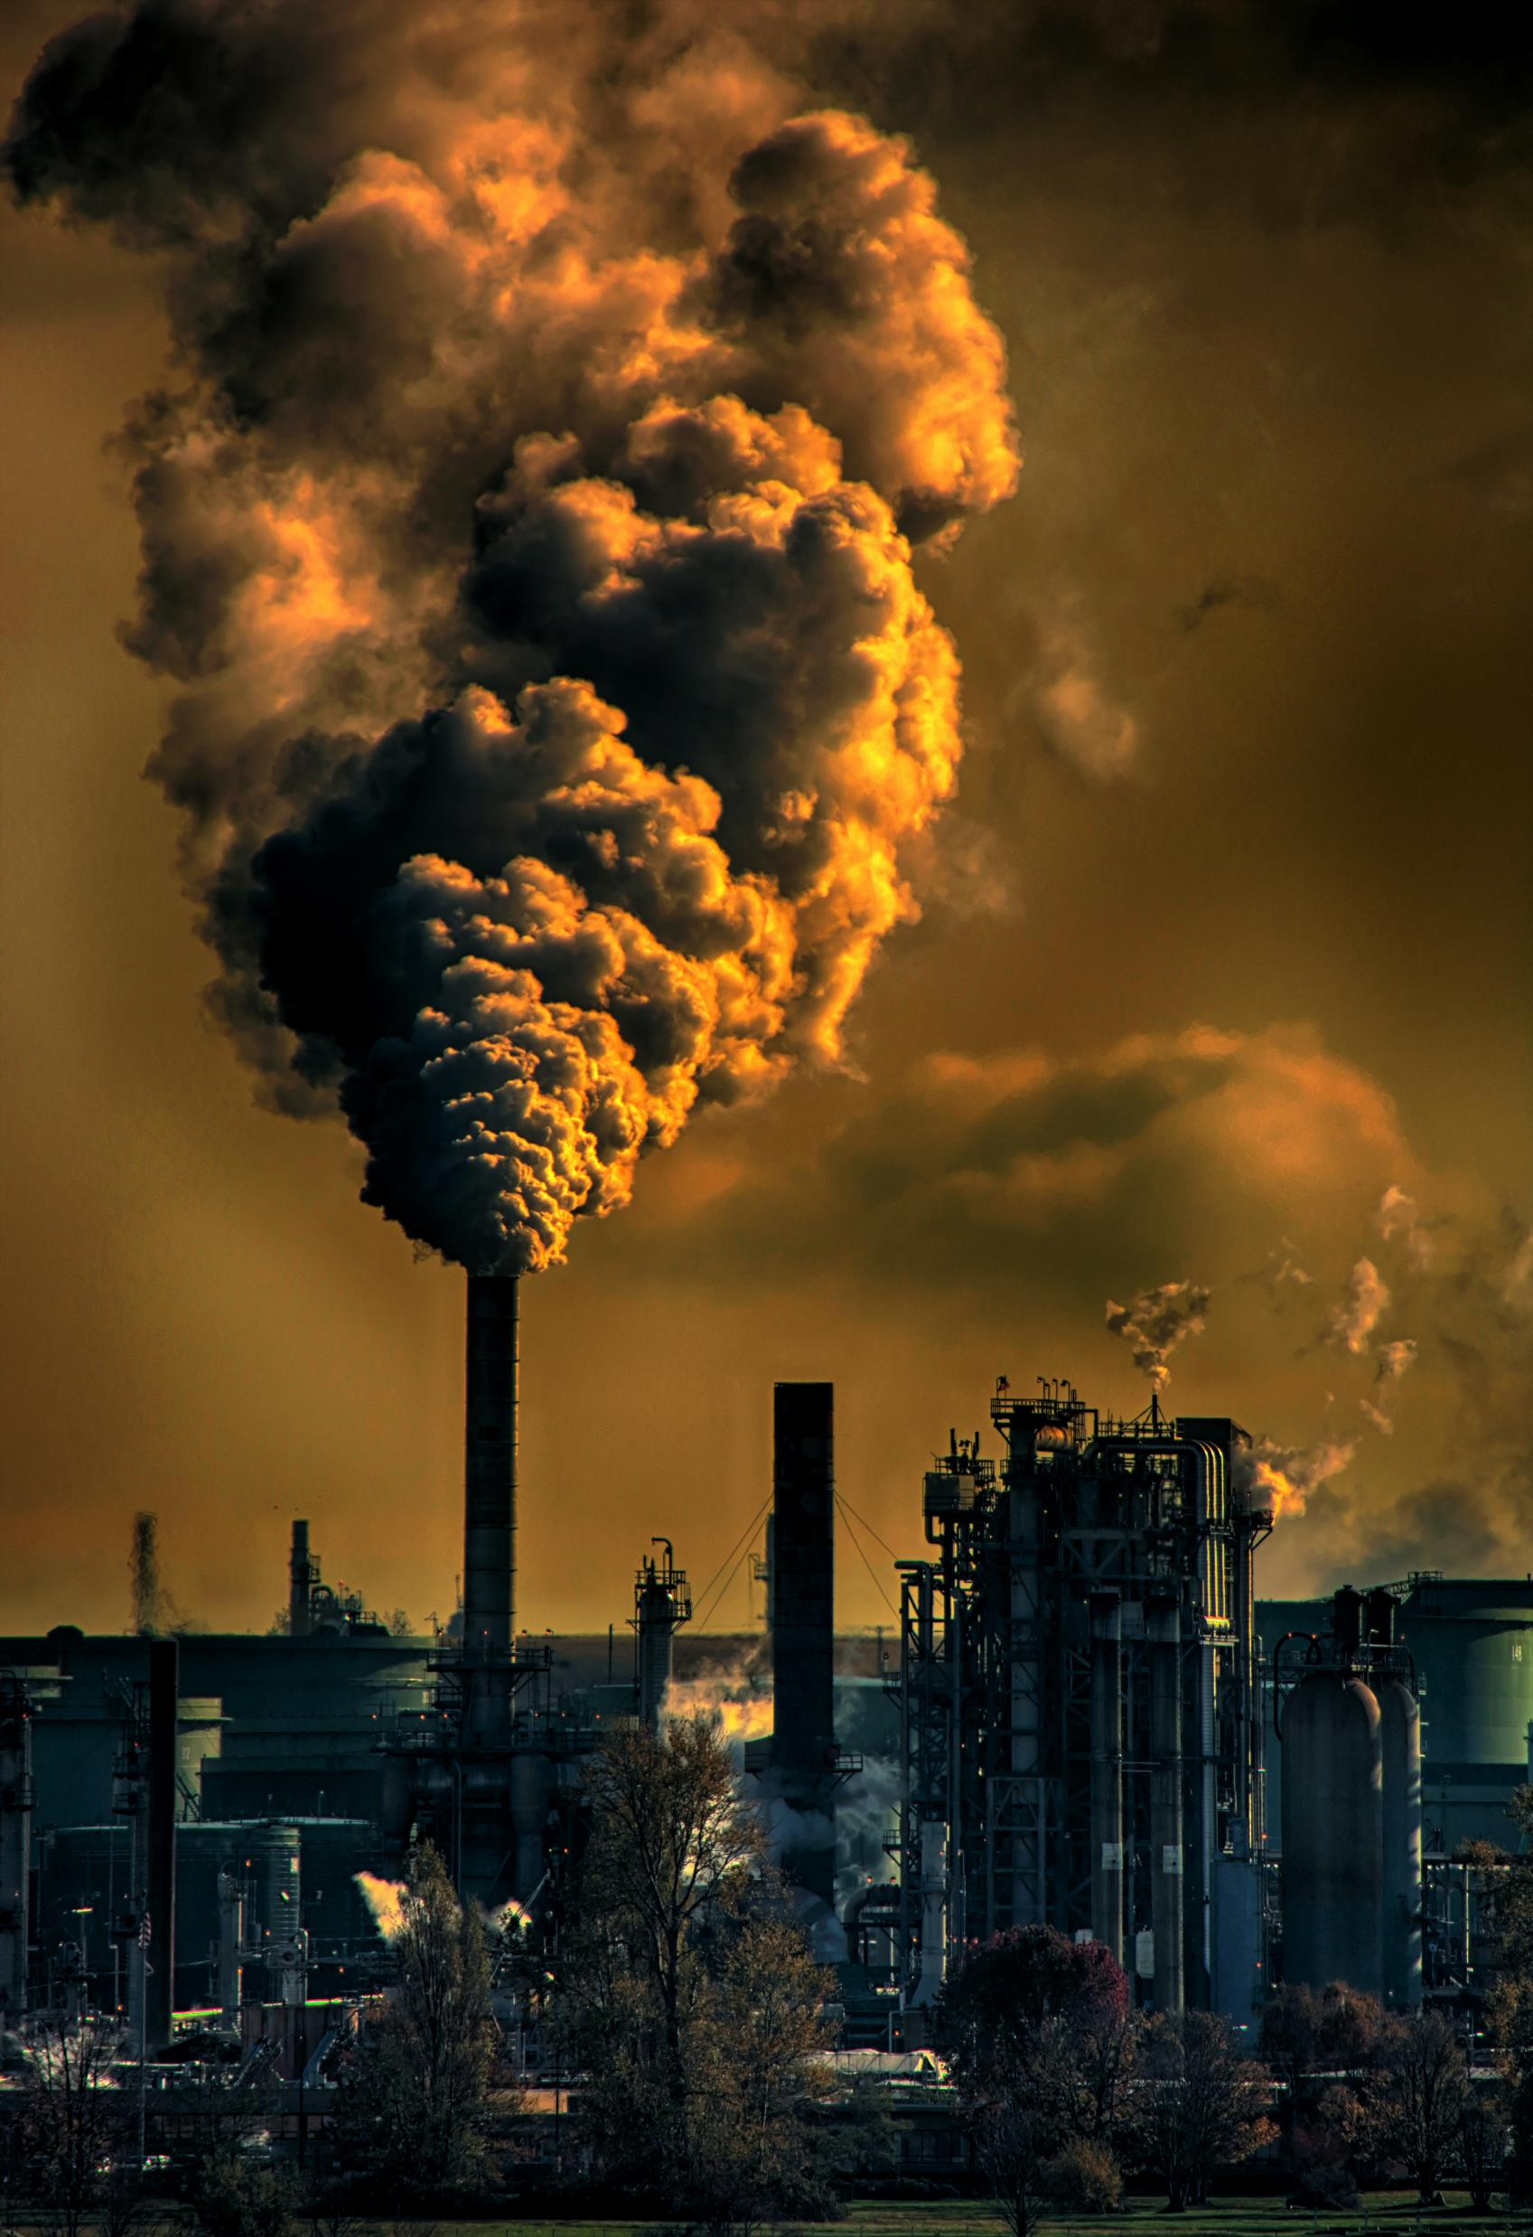
Reflection 2: Our response to Covid-19 and Climate Change
Two reasons for the difference in response between Covid-19 and Climate Change are time and clarity. The virus is an illness and it is much clearer how this will affect us right now, if we do not act. There is a clear connection between cause and effect, leading to a direct response.
This connection is not as clear for climate change as it builds slowly and it isn’t as clear as to how it will affect us as individuals if we don’t act immediately.
The effects of climate change are more likely to be indirect, through increasing storms, heatwaves or pollution. As a consequence, climate change is still seen as something abstract.
Nonetheless, the climate crisis is already costing lives. Air pollution alone, according to the World Health Organisation, is responsible for the death of 7 million people a year and we are starting to see links between high levels of air pollution and higher impact of coronavirus.

Slide 20
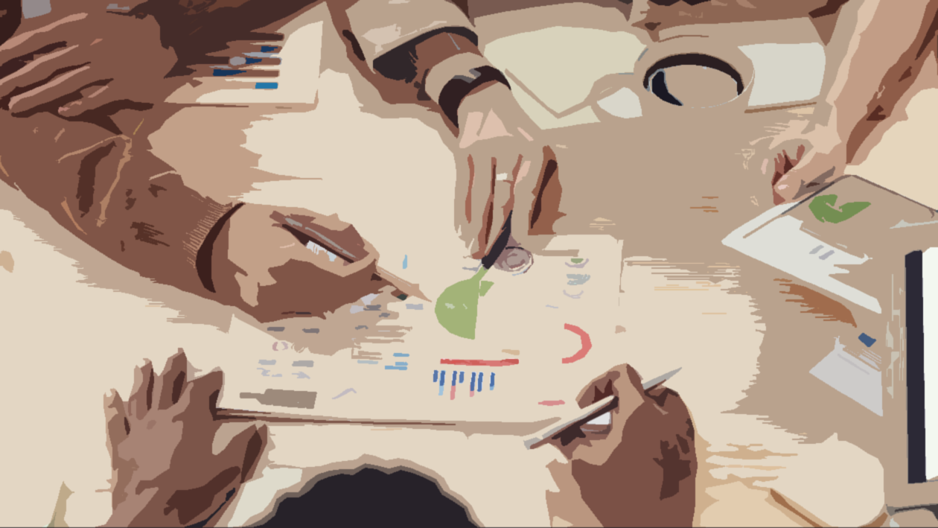
Reflection 2: What can we learn from the coronavirus?
There is a stark difference in our responses to the coronavirus and climate change - however, that doesn’t mean we cannot learn from our response to Covid-19. In our response to the virus we see that many of the regulations and measurements that are being taken are also very positive for mitigating, or tempering, climate change. For example global carbon emissions are already dropping massively this year.

Slide 21
What other responses to coronavirus could also help us to respond to climate change?
Think about some of the lessons we have seen come out of the virus – maybe note down some of the actions and positive consequences you have noticed.

Slide 22
Reflection 2: Three examples of how Covid-19 shows us how to treat climate change.
1. Economic slowdown
2. Localisation versus Globalisation
3. Immediate & radical governmental action
The coronavirus shows us a version of unplanned degrowth of the economy. Degrowing the economy is a way of slowing the continued growth and reliance of fossil fuel industries, until the economy is operating within the limits of the Earth.
The virus has forced us to create more connections online from our homes, helping us to minimise travel unless necessary and leading to a decline in carbon emissions. We have also all become much more local in our living.
We have seen that our governments are capable of making necessary radical actions if there is a crisis - coronavirus has shown that action on crisis can be done incredibly quickly and dramatically to support change.

Slide 23
Where have you seen examples of these happening in your community?
Take each of these three examples and look for simple examples of these in the place that you live – if you can find them.

Slide 24
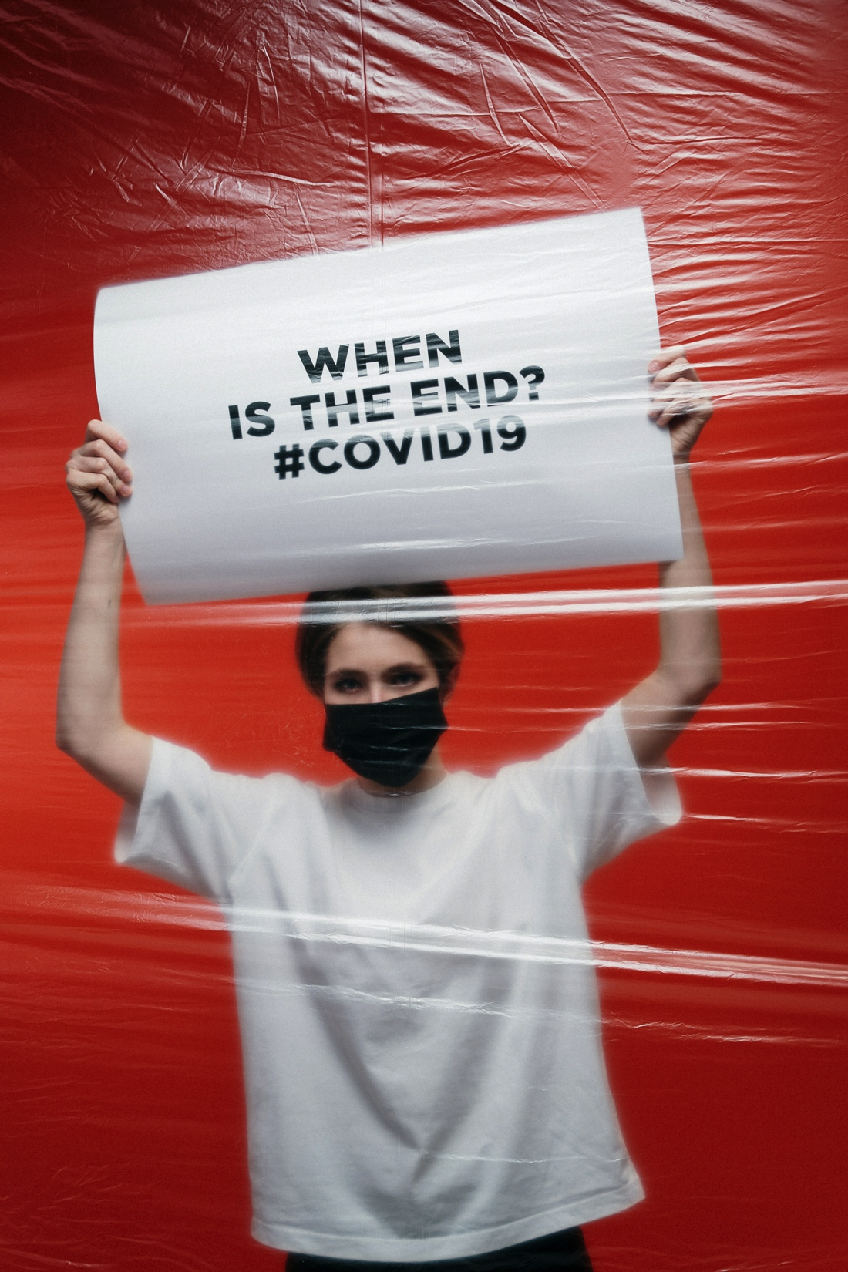
Reflection 3: Coronavirus and the spread of emotions
During the last months our lives have undergone rapid changes: daily activities and structures disrupted, schools and shops closed, public life reduced to a minimum, and mass social distancing. This pandemic is confronting us with a situation of great uncertainty. This uncertainty was present in many areas of life and also in the aspect of how long this situation will last.
This situation has a big impact on our emotions and how we feel. The problem is that uncertainty is triggering the fear centres in our brain and in that way is comparable to the spread of a virus: both fear and viruses are invisible and easy to spread, and they have big impacts on our physical and emotional wellbeing.

Slide 25
Where have you seen examples of fear being spread in response to Covid-19?
Think about some of the conversations you have had with friends and family over the past few months as well as what you may have seen, heard or read about.

Slide 26
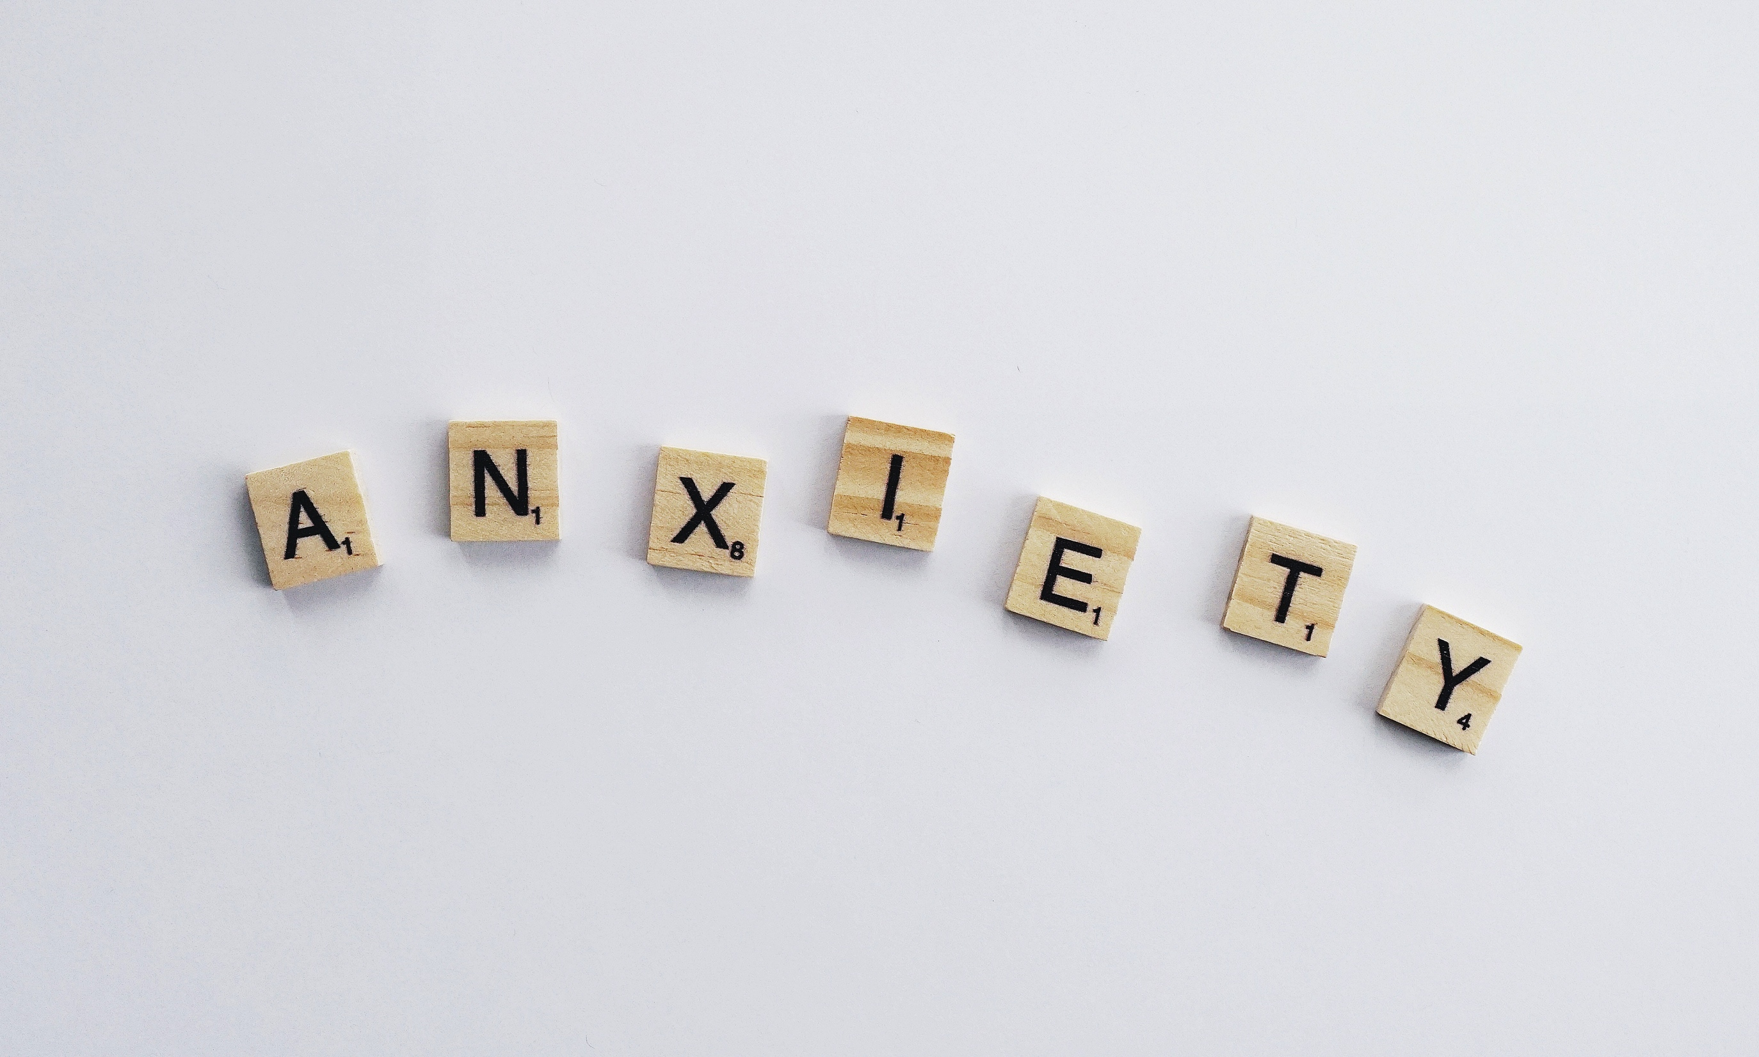
One way to deal with the upcoming uncertainty and fear is to understand it better. Fear is a reaction and a basic human mechanism to help us survive. When a situation is scaring us, it triggers us with fear to help us avoid the danger in the future. In the past, fear has helped us to survive various threats, for example being able to run away from saber-tooth tigers.
Today we are in a different situation: the world is facing a situation of a global pandemic where the health of people is endangered and we have to take measures against that.
This global pandemic is not a visible threat we can just escape from. The uncertainty and fear that is mixing in this situation can lead to anxiety - and the problem with anxiety is that is can quickly spread from person to person.
If this starts happening more and more in our communities, it can quickly lead to a sense of panic.

Slide 27
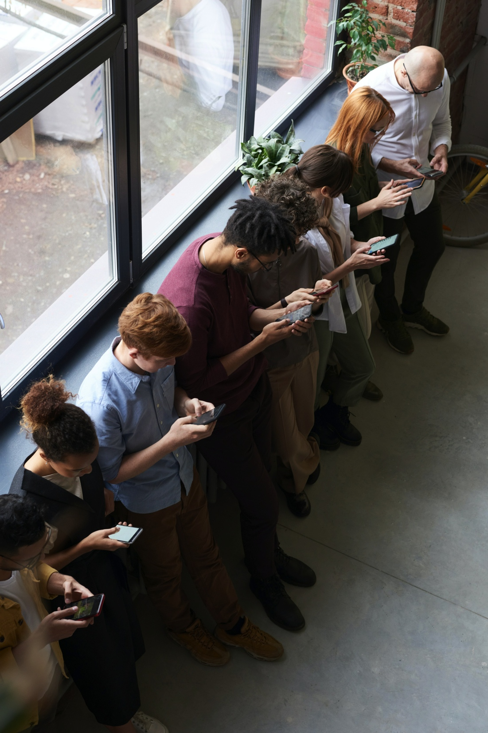
Nowadays it is very easy to get ‘infected’ by someone else’s emotions: social media is a tool that is widely used to spread information and ideas – and with that comes emotions.
The more we read about anxiety and fear in response to Covid-19, the more likely it sticks with us and we spread it as well. These emotions are also hindering us from thinking straight, therefore fear doesn’t help to overcome the danger, but leaves us frozen or overwhelmed.
The good thing is there are ways to stop this anxiety cycle. Panic and fear is not helping anyone in a situation like this, so it’s good to know how to deal with these emotions and come back to a calm space of mind. One really helpful way is mindfulness. This is a practice that helps you to calm down your mind by being present in your body.

Slide 28
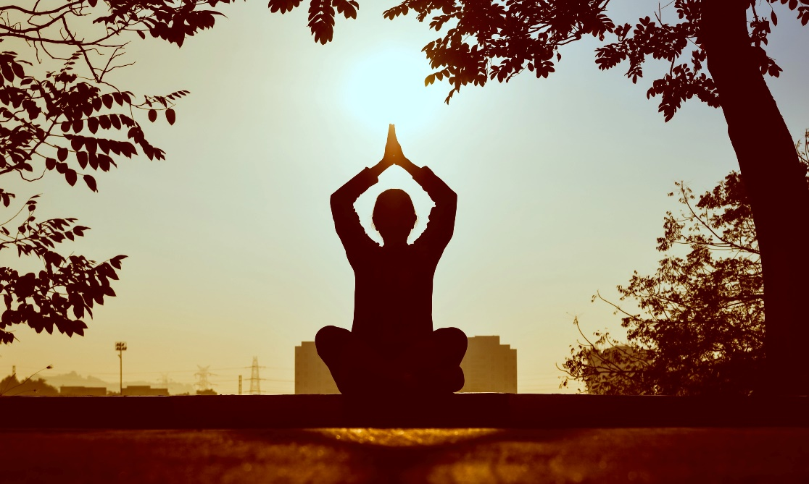
Mindfulness Exercises
Activity 2
One simple practice when you feel fear or panic in your body and mind is to focus on your breathing – and only that. Sit down calmly and try to breathe deeply in and out with your stomach. Make your outbreath longer, and feel how the slow rhythm of your moving breath gently calms down your whole body.
Another exercise is to focus on a part of your body that feels good. For example, if your chest feels tight or your back hurts, you will find a part of your body that feels good, for example your feet, your hands or you legs. Focus on that part and see how it changes your perception about your other feelings.

Slide 29
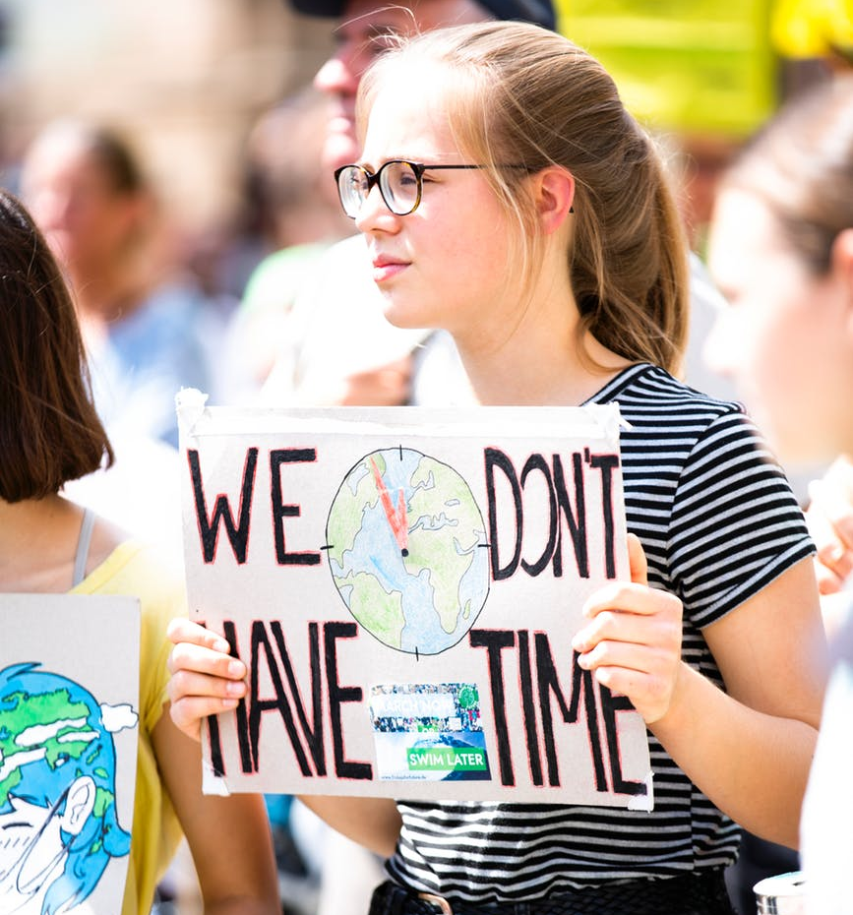
The Invisibility of Coronavirus and Climate Change
Fear and anxiety are often emotions which come up when we talk or think about the climate crisis. Thinking about its effects can be overwhelming and is sometimes fearful to think about these ideas in too much detail. Climate change is a global problem, and therefore – like Covid-19 – is another experience of great uncertainty which naturally triggers fear. Like the virus, climate change is not directly visible. We may experience intense weather changes but we can’t see carbon emissions – just like we can experience symptoms of coronavirus but we can’t see the virus in the air.
Luckily, we can change the way we think and feel about climate change and move from anxiety to empowerment. It helps to explore the problem and know more about it, but also by finding ways to get active and participate in a solution. Mindfulness practices are always helpful. To support further with these ideas, why not download our free Changing Climates programme for 5 year olds to adults.

Slide 30
PART 3 | PERSPECTIVES
What are the connections between who climate change and coronavirus affects the most?
EXPLORE OUR NEXT INQUIRY

Slide 31
This sort of learning can’t wait
THOUGHTBOXEDUCATION.COM

