Slide 1
CONNECTING TO | OURSELVES, SOCIETY, NATURAL WORLD
Exploring Our World
How are coronavirus and climate change connected?

Slide 2
WHAT DO YOU THINK?
What curiosity questions can you ask?
e.g. Where did coronavirus come from? What causes pandemics? How might climate change lead to more pandemics? Is the health of humans and environment related? Who is most affected by coronavirus and climate change and why? How has the virus helped emphasise the inequalities in our societies? How does coronavirus impact our carbon emissions? What is the impact of globalisation on coronavirus and on climate change?
THINK
How might different people feel?
e.g. How has this pandemic made you feel? What has been the impact of lockdown on your life? What emotions have you noticed in people around you? What are some of the different emotions you have experienced? How might it feel to have no choice but to go to work and risk catching the virus? How does it make you feel when you see how some species have flourished whilst humans have been staying at home?
FEEL
What links can you start to make?
e.g. How do you think the virus spread all over the world? What made it spread so quickly? Why is the virus showing inequality in our societies? What are the links between climate inequality and coronavirus inequality? How might the pandemic change human behaviour to be more caring for the environment?
CONNECT

Slide 3
PART 3 | EXPLORE
Exploring Our World
Why do coronavirus and climate change affect some people more than others?

Slide 4
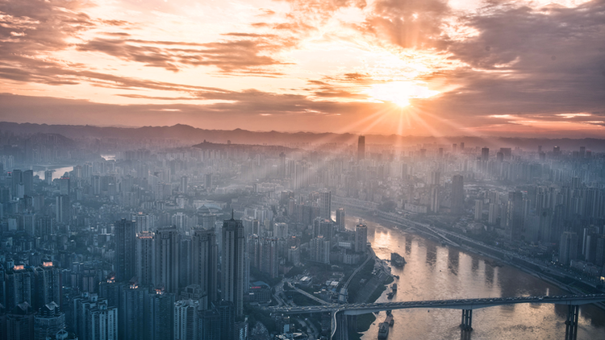
Covid-19 and Injustice
On the surface, it may appear as if the coronavirus is a leveller, that ‘’we are all in this together’’ and everyone is equally affected by it. We might presume this when Prime Ministers, musicians, Hollywood actors and other prominent people have made it to the headlines because they are infected with the virus.
However, digging a little deeper, and seeing who is really affected by the virus (and why and how) revels some of the inequalities and injustices at large in our societies.

Slide 5
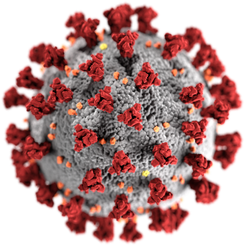
Reflection 1: The injustice of Covid-19
Coronavirus is highlighting the profound inequalities that exist in our societies and have existed for a long time. For example, the three seemingly simple pieces of advice we have all been given:
1) Wash your hands 2) Keep your distance 3) Stay at home
are not that simple for some people and communities around the world…

Slide 6
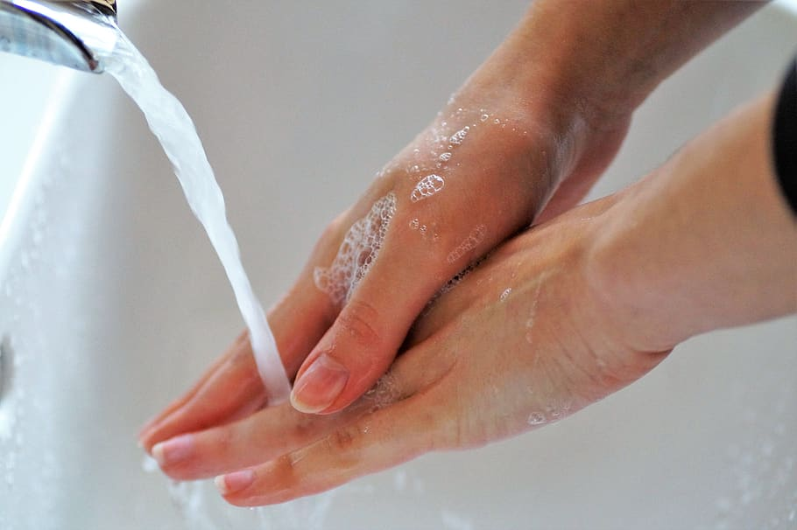
Reflection 1: The Injustice of Covid-19 | Water
In order to wash your hands, you need access to clean water. However, not everyone has access to clean, running water - especially those living in slums and the outskirts of large cities, which often lack sanitary facilities. In some places, like South Africa, water is privatised, and not even considered a public resource.
Water scarcity is also an issue in many regions around the world, which contributes to the difficulty for those people to stay sanitary. In many ways Covid-19 sheds light on the unequal accessibility to water across different people and communities.

Slide 7
Do you know – or can you think of - any examples of water inequality in a community around the world?
Think about people or places where water is scarce, or polluted or not free to use.

Slide 8
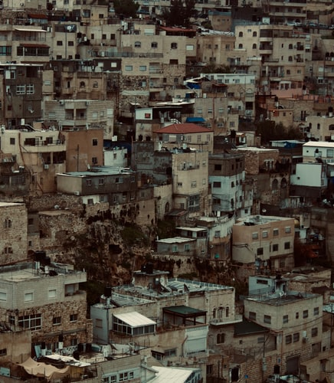
Reflection 1: The Injustice of Covid-19 Social -distancing
Social distancing is also not a practice that can be done easily by everyone. It is particularly difficult for those living in dense, low quality housing. Some examples are the slums in Rio de Janeiro in Brazil, poorer housing areas in the UK, and climate refugee camps in France and Greece or densely populated cities such as New York City and Manila. Lower and middle-income neighborhoods in Africa and Asia’s largest cities and the slums in South America often share overcrowded quarters that are impossible for 2-meter distancing to take place. Not only is social distancing difficult for those living in dense areas, but it is also nearly impossible for people who are still needing to go to work. These people include grocery store clerks, nurses, doctors, teachers, etc.

Slide 9
Do you know – or can you think of - any examples of housing communities which would struggle to adhere to social distancing?
Think about places where people live in cramped houses with limited space.

Slide 10
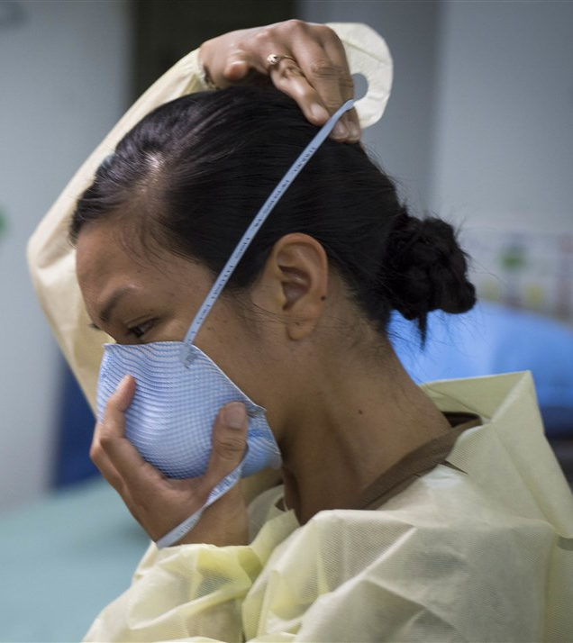
Reflection 1: The Injustice of Covid-19 | Lockdown
Not everyone has the luxury to be able to follow the lockdown regulations and stay at home. Although work for some people has changed to working from home, many people still have to go to their physical workplace. These people include doctors, nurses, police officers, firefighters, EMTs, delivery workers, grocery store workers, and much more.
In the UK, for example, BAME (Black, Asian, minority ethnic) communities are four times more likely to die from the virus than white people. One major reason for this is that typically these people work in key-worker jobs and sectors. For some these jobs are also low paid and bring poverty inequalities into the picture.
A key worker told the BBC:
“I have no options. Either I starve because I don't have a job, or I catch the virus”

Slide 11
Do you know – or can you think of - anyone who has been forced to make a tough decision between catching the virus and earning a living?
Think about key workers or people who are unable to gain support from their governments if they don’t go to work.

Slide 12
Reflection 1: The Injustice of Covid-19
Not everyone is able to protect themselves from the virus in an equal way, because there seem to be many pre-existing inequalities in our societies that are being exposed by the coronavirus. There are fundamental differences in people’s income, jobs, housing, place in society, access to water, living spaces etc. that all affect people’s ability to follow the safety guidelines. Often it is certain populations within a society that are disadvantaged, and therefore become more likely to be infected by the virus. Whilst it may seem that the virus is hitting everyone, some people are suffering and being affected more harshly because of societal pre-existing inequalities.

Slide 13
Can you see examples of the inequalities in your city, town or local community?
Think about some of the different people, housing, systems and demographics in your local area.

Slide 14
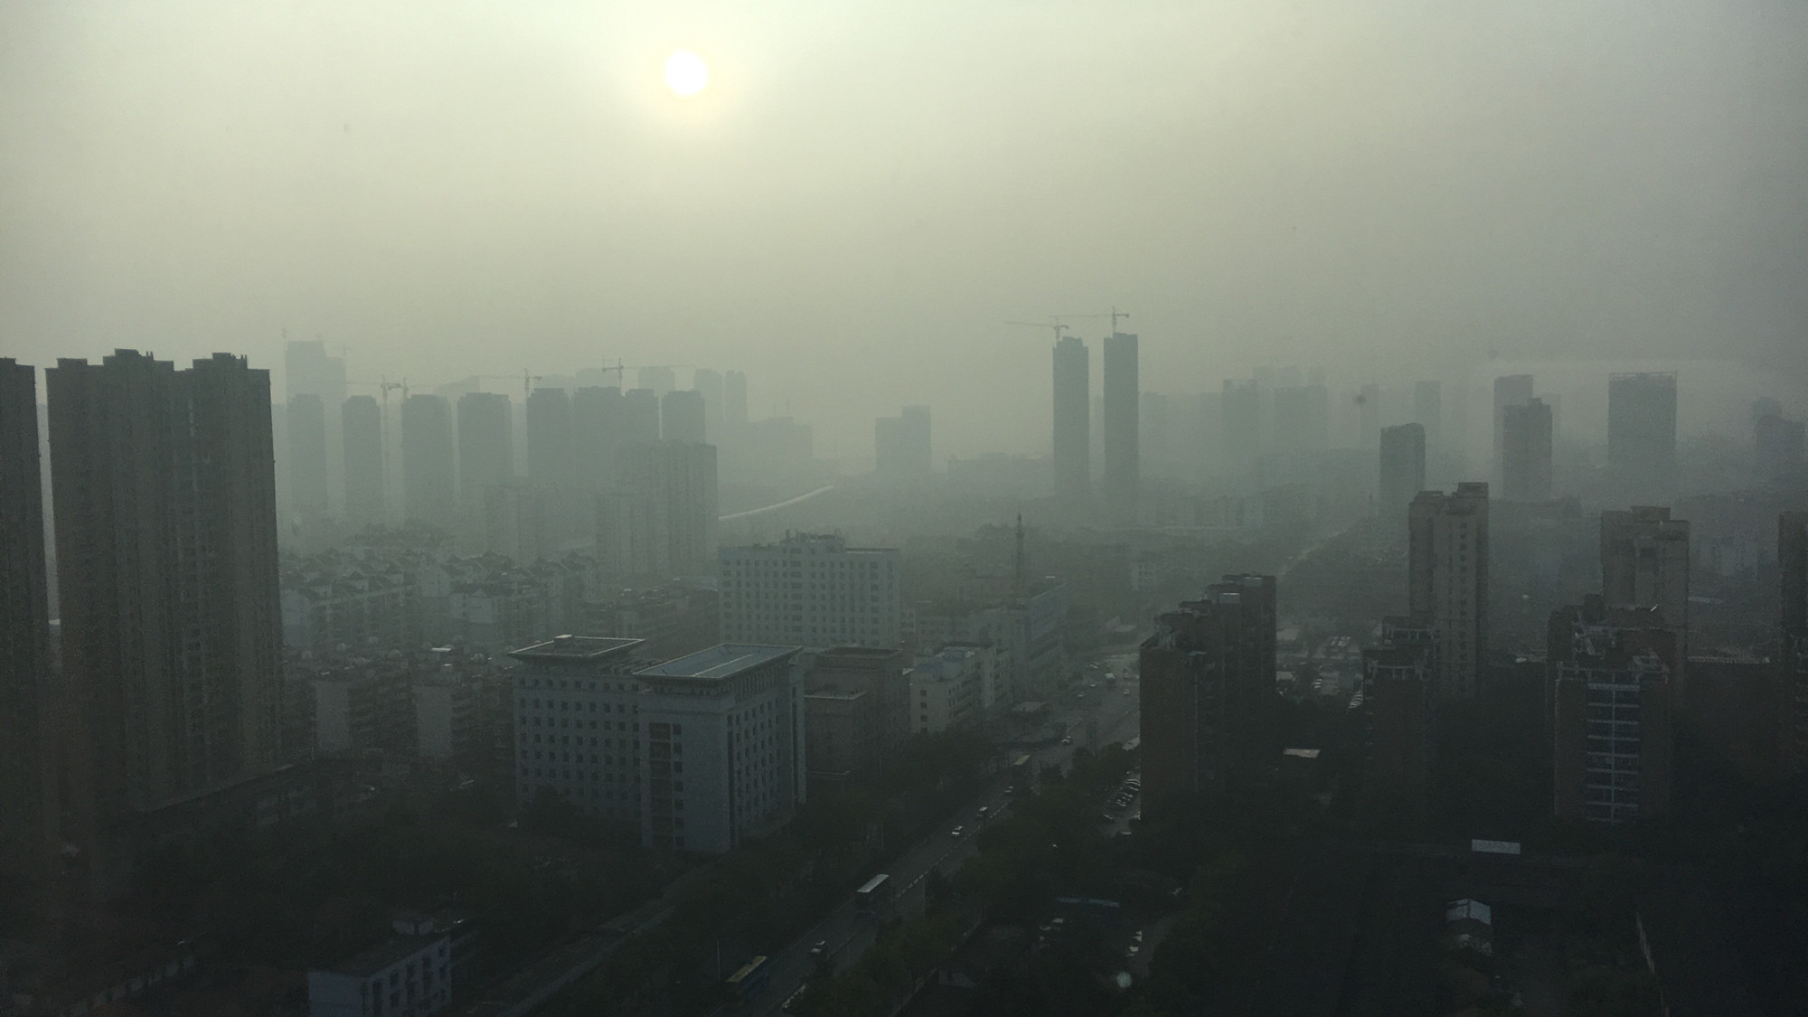
Reflection 2: Climate injustice and Covid-19
Climate change, similarly, is affecting the world in an unequal way. Some populations in the world have to face more severe consequences than other communities, while some countries might even see improvements from the change in climates. Whilst this might not seem to relate to Covid-19, it may well be that the ones that are hit the most from climate change may also be currently some of the most vulnerable to be infected by the virus. We are also seeing how social injustices and inequalities have allowed some people in our communities to be suffering more than others through global crises.

Slide 15
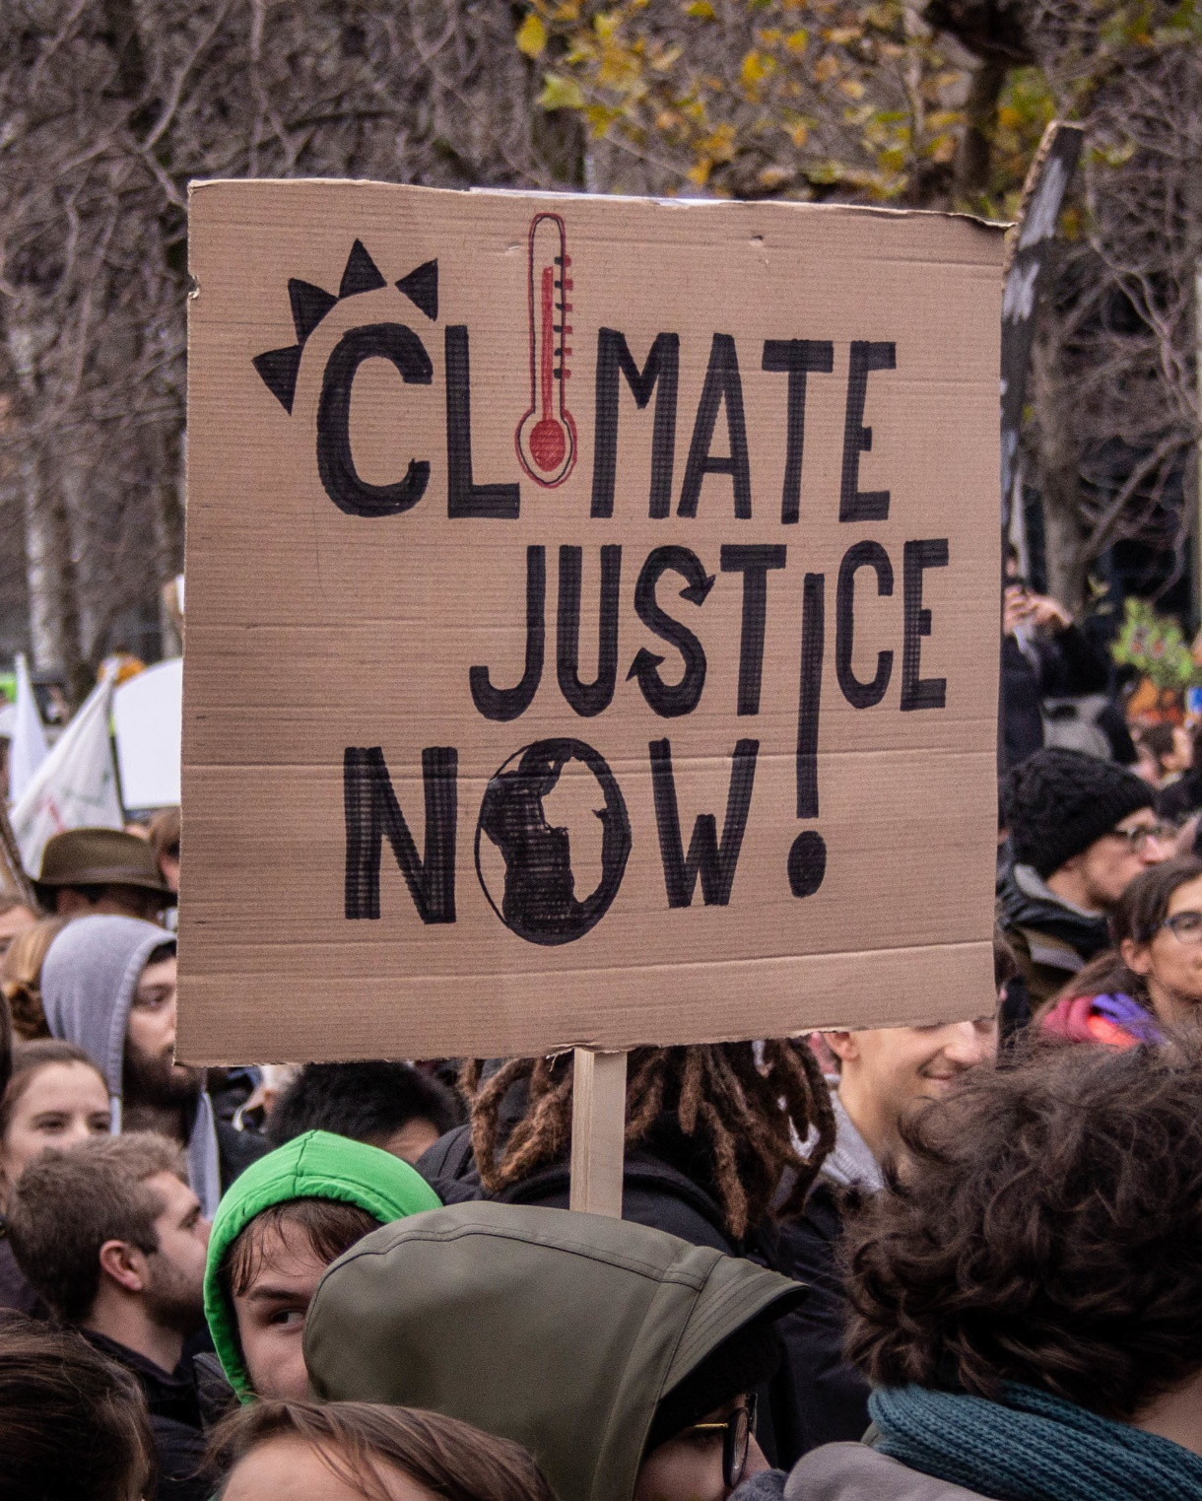
Reflection 2: Climate injustice and Covid-19
Climate justice connects to the unequal outcomes for different people, communities and countries due to being more vulnerable to the effects of climate change.
Some people are directly exposed to the impacts of climate change - from sea level rise to extreme weather events – and in these places, certain communities will be hit harder than others. For example people that live on the coastline are much more vulnerable to sea level rise than people living more inland.
Vulnerability isn’t a natural state. For example many people don’t get to decide where they live - this is often a result of a person’s position in society. Vulnerability is largely determined by a mix of social, economic, environmental and cultural factors. The context in which people live shapes their ability to respond to crises as well as potentially increasing their risk to threats.

Slide 16
In other words, someone’s ability to respond to a crisis is largely determined by a person’s vulnerability, which is affected by many different factors such as the pre-existing inequalities discussed before. In this way, for every sort of major crisis, the same people are often affected the most due to their limited ability to respond because of the social injustices around them.

Slide 17
What are the links between racial inequalities and public health in our communities?
This short video may be a useful introduction to how inequalities are often embedded within our systems – it is based in the US but can be applied to other areas.

Slide 18
Reflection 2: Climate injustice and Covid-19
It can be argued that Covid-19 is also an issue of climate injustice. Take a look at this short video (5:19mins) to understand more on this.

Slide 19
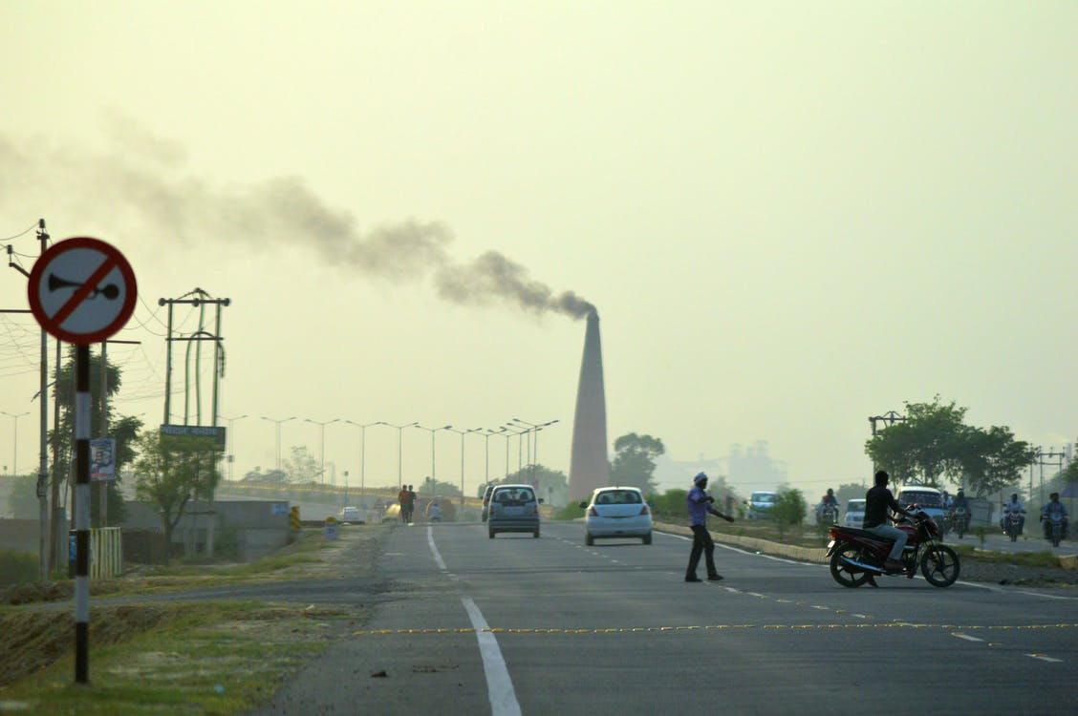
Reflection 2: Climate injustice and Covid-19
One example of how climate injustice may result in injustice of Covid-19 infections can be seen in the state of Louisiana, USA.
Most of the people in Louisiana that are affected by the virus typically live in the highest air-polluted areas of the United States. Those people – mostly BAME - who make up 32% of the state account for 71% of the state’s Coronavirus deaths. People here who already have many respiratory illnesses, because of the air pollution, are consequently more vulnerable to the harsher impacts of Covid-19.
As one resident from the area in Louisiana states:
“The situation is scary because people are dying all around. Our immune systems are compromised due to all the pollution here. Everybody I know has respiratory illnesses. We are more susceptible to getting this. Between all of the chemicals and the virus, we are doomed. I am sitting here waiting to die.” Mary Hampton

Slide 20
What links are there between air pollution and Covid-19? What are some of the biggest causes of air pollution and chemicals in the air in our societies?

Slide 21
TAKE IT FURTHER: This interview from Dr Zach Bush gives an interesting and insightful overview of the links between air pollution, pesticide use and coronavirus. It is a long video (1 hour 20 minutes) but shares some very engaging reflections.

Slide 22
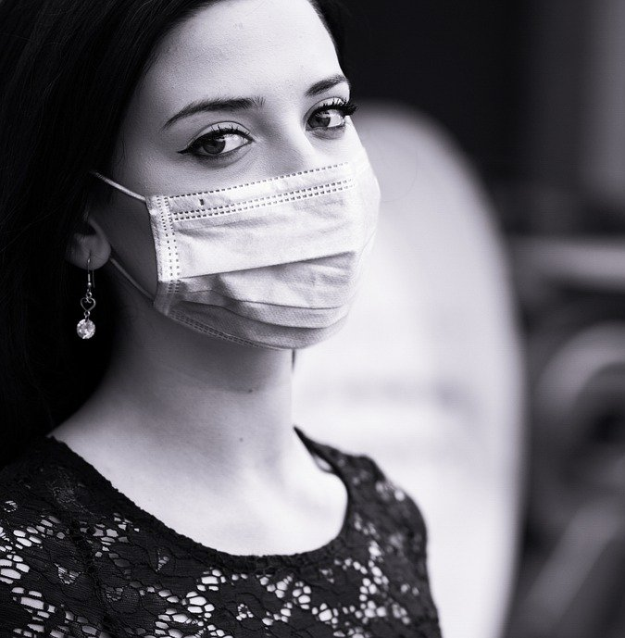
Reflection 2: Climate injustice and Covid-19
One interesting reflection is to think about whether it is the virus itself that is causing such high levels of mortality, or whether people are mostly dying from their current state of poor health and wellbeing; largely determined by contextual factors, such as pre-existing injustices that determine people’s vulnerability and ability to respond to the virus.
If we choose to look, we can see the same communities impacted by climate injustice are now being impacted by coronavirus, leading to an unjust spread of infections across our communities. These injustices have been created by our societies which means they can be changed if we choose to act.

Slide 23
What is the link between coronavirus and poor levels of health and wellbeing? What connections can you see?

Slide 24
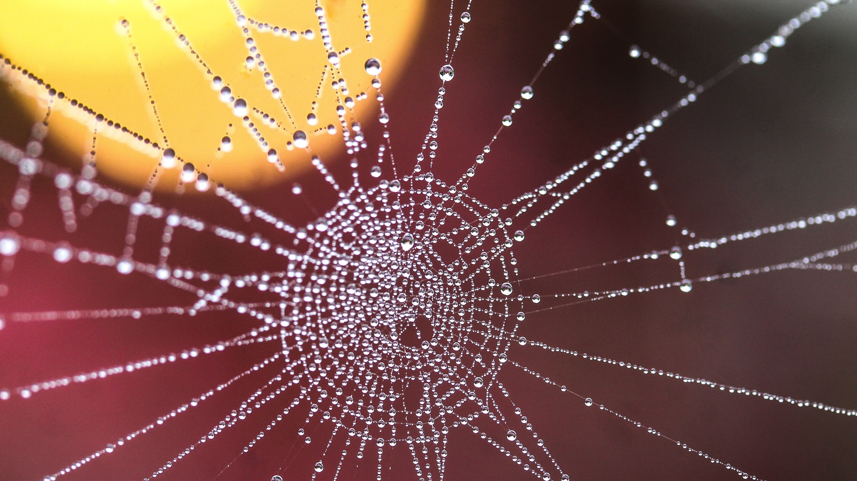
Reflection 3: Different stories, same virus | Empathy without borders

Slide 25
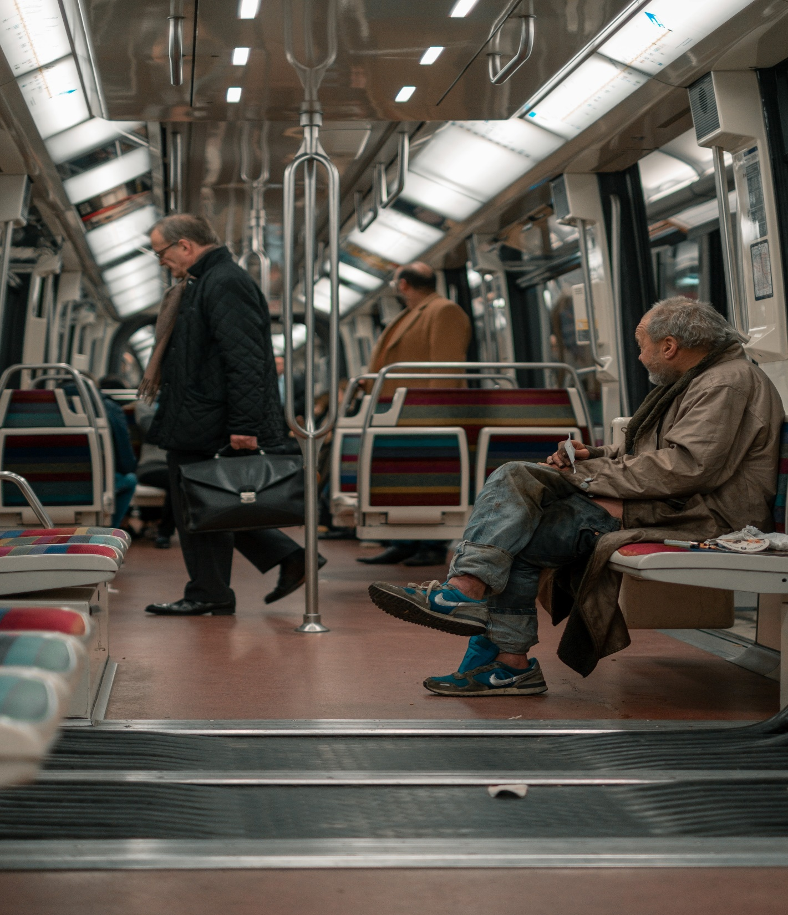
Reflection 3: Same virus, different stories
In these times of uncertainty, we can often feel overwhelmed by how complex these ideas are and how confusing it can feel. The good thing about this experience is that we are not alone with it, we are all in this together. This is a global pandemic which has affected every single country in the world and everyone is confronted with these changes and challenges in daily life. We are all facing this crisis as we are all facing the crisis of climate change – and we can learn from each other in so many ways.
When we see the news we may listen to numbers of the infection rates or how things are developing in particular countries but how often do we see the faces and stories behind the scenes? Who are people across the world being affected by the crisis and how do they deal with it Let’s take a moment to meet some people from all over the world to start to understand more deeply the personal stories in different places and how we are united by these challenges and how we can learn from and support each other.

Slide 26
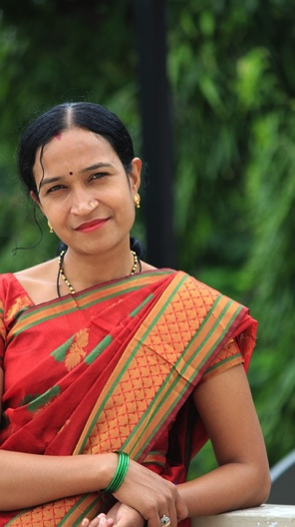
Smita, India, Aged 45
“For me, the coronavirus is a huge challenge and also danger, maybe the biggest we had so far. My husband lost his job, and now we are facing just living from the small savings, and we don’t know for how long. Also, my two kids are stuck at home for several weeks now, and they are completely bored. I try to cheer them up and create small activities in the home, but they are just really used to spent lots of time in school and with their friends.
We are all afraid by the uncertainty. And also, India already has so many problems, how should it manage this? We are so many people, and social distancing is hardly working in crowded cities. Anyway, I try to stay hopeful. I started to raise my own vegetables in the backyard and other women in my area, too. The plants are giving me hope. That’s what we need.”
*NB: We have not used their actual image to respect privacy. You can read more stories by visiting https://www.spreadstoriesnotthevirus.com/

Slide 27
Jackson, South Africa, Aged 34
“The last months has been really challenging. Me and my family are living in a really small house, with just two rooms, in the suburbs of Johannesburg. To distance from each other is not possible, and also our house is really close to the next one.
On the street you usually always meet people. The police tries to put into order that people keep distancing, but it’s just so little space. Also, we live in constant fear of getting infected, we don’t have any sanitizers. My wife made some self-made masks, but it will not protect us completely. I hope there will be solutions soon, we can’t live like this much longer. “
*NB: We have not used their actual image to respect privacy. You can read more stories by visiting www.spreadstoriesnotthevirus.com/

Slide 28
Felipe, Spain, Aged 25
“ At first I couldn’t really believe when my studies were completely stopped and the university asked us to leave to our home countries within one week. I was studying my Master’s at a University in the UK. Suddenly I had to go back to Spain, where I didn’t had a proper place anymore. So I had to move back with my parents. This was both challenging and nice. We didn’t spend much time during the last years.
Living together during lockdown came with arguments, fights, but also deep conversations and funny moments. I started to learn cooking from my mother, and I play chess with my dad. I think even if I am separated from my friends in UK, the virus made my connect much deeper with my family. “
*NB: We have not used their actual image to respect privacy. You can read more stories by visiting https://www.spreadstoriesnotthevirus.com/
*NB: We have not used their actual image to respect privacy

Slide 29
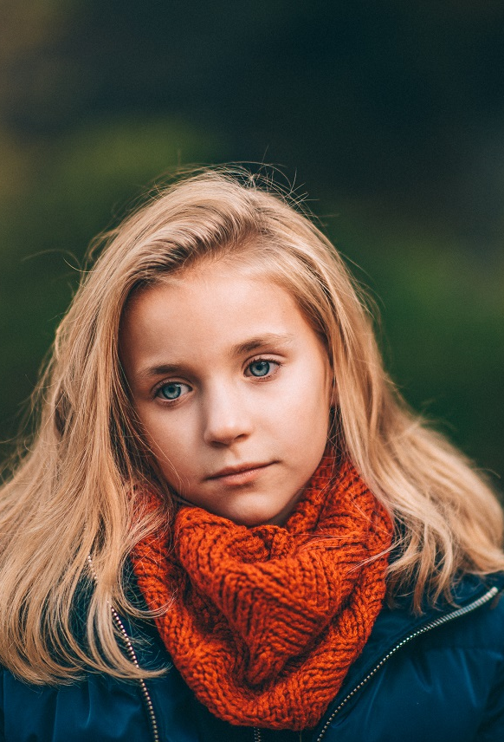
Ida, Denmark, Age 9
“It was not easy to understand what was going on at the beginning. I felt that things are changing, and my parents were worried more and more about things happening in the world. The virus also had arrived in Denmark. Everything happened really quickly, and the schools shut down. We have to stay home so we don’t infect ourselves, me and my brother Soeren.
The teachers send our parents some sheets and exercise online, and we should read in our books every day. I miss my friends a lot. It is just so boring. I am fighting a lot with my brother. And we are watching much more movies in these times. Sometimes a teacher calls us for checking how our learning is going. I hope we can return to school soon, I miss my friends so much. But also, I am happy that my family is healthy and we can stay together in this time.”
*NB: We have not used their actual image to respect privacy

Slide 30
When thinking about the different stories you just read, which one touched you the most and why?
How has the peception of your own situation changed by reading about the stories of other people?
If you are interested in more stories, you can find more by visiting the following website: spreadstoriesnotthevirus.com

Slide 31
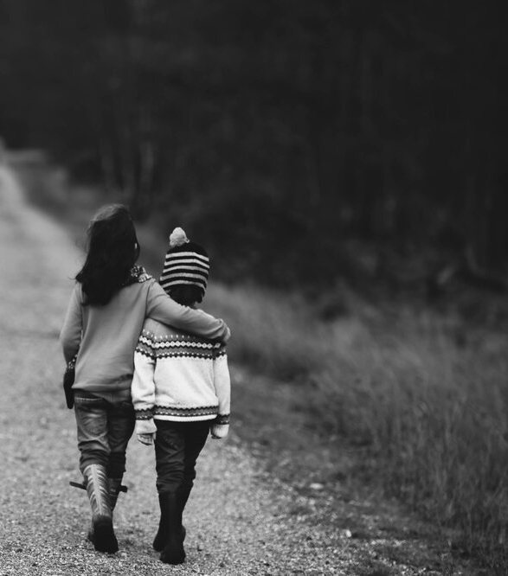
Reflection 3: Same virus, different stories
Why not take a moment to write about your own experience during the past few months of lockdown, perhaps as a diary or letter to keep for the future to remember your feelings during this experience. _____________________________________________________________________________________________________________________________________________________________________________________________________________________
_______________________________________________________________________________________________________________________________________________________________________________________________________________________

Slide 32
PART 4 | EMPOWER
What can we learn from coronavirus to empower our responses to climate change?
EXPLORE OUR NEXT INQUIRY

Slide 33
This sort of learning can’t wait
THOUGHTBOXEDUCATION.COM

