Slide 1
CONNECTING TO | OURSELVES, SOCIETY, NATURAL WORLD
Exploring Our World
How are coronavirus and climate change connected?

Slide 2
WHAT DO YOU THINK?
What curiosity questions can you ask?
e.g. Where did coronavirus come from? What causes pandemics? How might climate change lead to more pandemics? Is the health of humans and environment related? Who is most affected by coronavirus and climate change and why? How has the virus helped emphasise the inequalities in our societies? How does coronavirus impact our carbon emissions? What is the impact of globalisation on coronavirus and on climate change?
THINK
How might different people feel?
e.g. How has this pandemic made you feel? What has been the impact of lockdown on your life? What emotions have you noticed in people around you? What are some of the different emotions you have experienced? How might it feel to have no choice but to go to work and risk catching the virus? How does it make you feel when you see how some species have flourished whilst humans have been staying at home?
FEEL
What links can you start to make?
e.g. How do you think the virus spread all over the world? What made it spread so quickly? Why is the virus showing inequality in our societies? What are the links between climate inequality and coronavirus inequality? How might the pandemic change human behaviour to be more caring for the environment?
CONNECT

Slide 3
PART 4 | EMPOWER
Exploring Our World
What can we learn from coronavirus to empower our responses to climate change?

Slide 4
As we start to emerge from global lockdown, we can reflect on the virus in many different ways. We can see the terrible impact it has on people’s health, how it has been affecting the economy and radically changing people’s lives during the last couple of months. At the same time, we can begin to see some of the positive ripples coming out of lockdown, listen to some of the messages that we can learn from this time about how our societies operate, and explore ways to bring about changes that offer a healthier future for people and planet.

Slide 5
Stop. Just stop. It is no longer a request. It is a mandate.
We will help you. We will bring the supersonic, high speed merry-go-round to a halt We will stop the planes the trains the schools the malls the meetings.
You have not been listening.
We will help you
Despite what you might think or feel, we are not the enemy. We are Messenger. We are Ally. We are a balancing force. We are asking you to stop, to be still, to listen;
As the health of a tree, a river, the sky tells you about quality of your own health, what might the quality of your health tell you about the health of the rivers, the trees, the sky, and all of us who share this planet with you?
Ask us what we might teach you about illness and healing, about what might be required so that all may be well. We will help you, if you listen.
An imagined letter from Covid-19 to Humans
by Kristin Flyntz

Slide 6
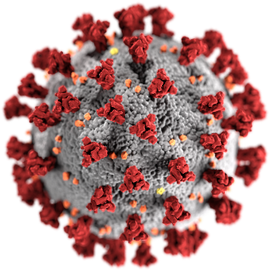
Reflection 1: Coronavirus and the benefits for the planet
Covid-19 has put a stop to much of our regular activities and habits through countries going into lockdown (or hibernation) and has brought many hopeful benefits to the natural world, the world around us – a world we are a part of and on which we depend. This time has allowed many of us to reflect on which of our old habits we can leave behind to focus on healthier futures for people and planet.

Slide 7
Can you think of some examples of the benefits of Covid-19 to the natural world?
Think about some of the positive effects that have been seen around us during lockdown.

Slide 8
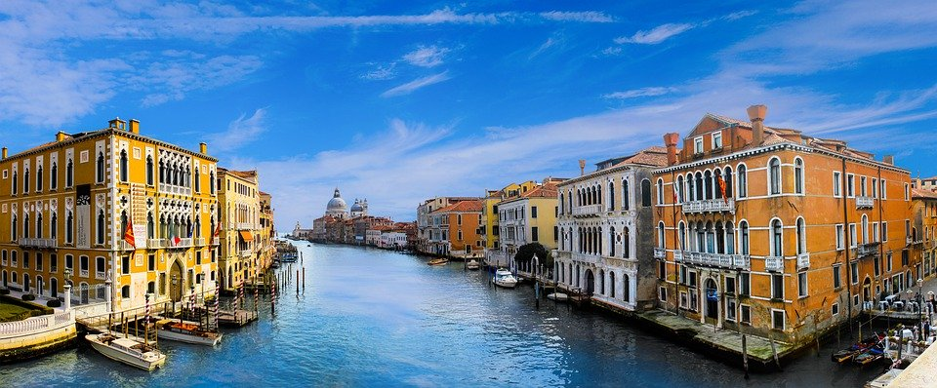
Example 1: Venice
With the cruise ships and motorboats gone, the usually dark and murky water in Venice became blue and clear and calm like a pond. Venice is a city that depends on a mass-tourism model, however in current times of the pandemic, the streets and waterways are empty. This allows for cleaner air, the return of wildlife - such as fish, swans and ducks - and a visualisation of what Venice could be in potential. Venice as a result is now considering a more sustainable kind of tourism.

Slide 9
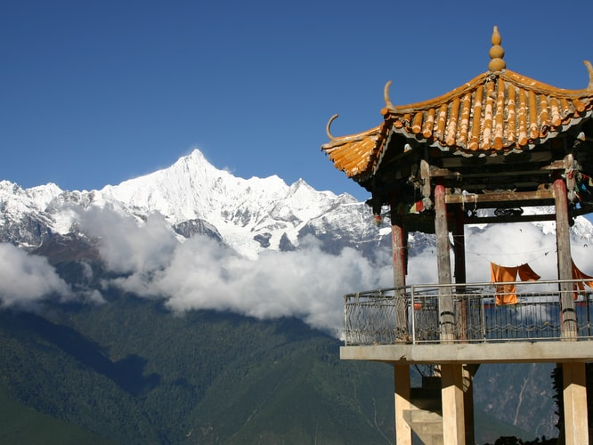
Example 2: Pollution
As transport use has dropped significantly (due to closed cities, countries and borders) air pollution has seen a drop across Europe and China. People in Northern India can now see the Himalayas for the first time in 30 years simply due to the drop in air pollution.
There is also significantly less noise pollution in our communities, meaning it is a lot quieter. As a result people in cities can hear sounds that were once muffled by traffic noise, such as birds chirping and the wind in the trees. These quieter conditions positively affect our mental health and wellbeing.

Slide 10
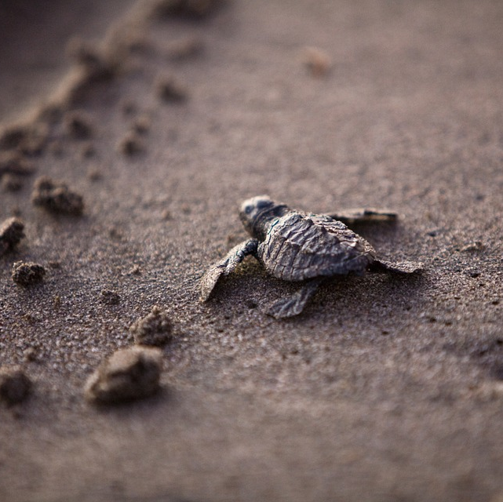
Example 3: Animal populations
Many animals are benefiting from the lockdown with examples found all over the world. From Florida to Thailand, sea turtles are nesting on empty beaches – a rare occurrence - for in Thailand there had seen no single nest over the past five years. Animals are entering the cities in lockdown, including deer on zebra crossing, monkeys playing on empty roads, penguins roaming around the pavements and goats wandering around empty shopping streets. Marine life is venturing into places where they haven’t been for decades, due to less noise and activity. Watch this video to see how nature is thriving during coronavirus lockdowns.

Slide 11
This short video (2:12 mins) reveals how wild animals have been reclaiming the streets in communities across the world:

Slide 12
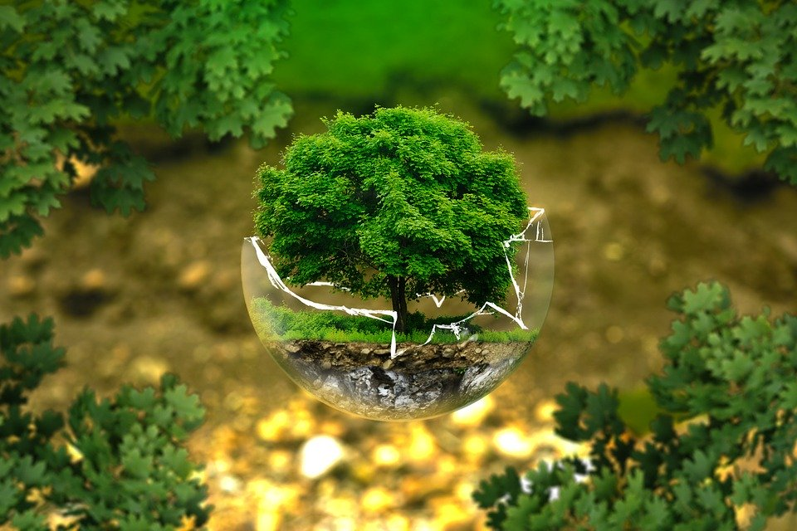
Reflection 1: Coronavirus and the benefits for the planet
The Earth - as seen in the past few examples -can restore itself if it is given the chance. According to the ‘Gaia hypothesis, the Earth acts like a living organism, always looking into ways to keep systems into balance in order to create the perfect conditions for life to be maintained.
All organisms play a part in keeping the global temperature stable and the levels of oxygen in the atmosphere steady through interactions with one another.

Slide 13
What does it mean for the planet to ‘restore itself’? Where else have you seen examples of this happening?
Think about some of the positive effects that have been seen around us during lockdown.

Slide 14
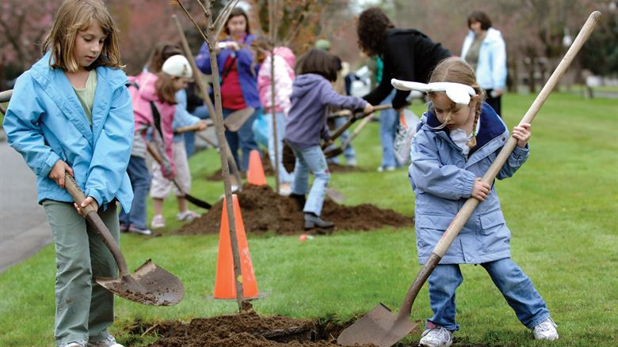
Reflection 1: Coronavirus and the benefits for the planet
We have now seen with Covid-19 that when humans stand back and give it space, the Earth can start its process of restoration, and we can help in that process. This is a very hopeful fact and offers us an empowering role in that process.

Slide 15
What are some of the actions that you can take to help restore the Earth?
Think about a particular action that you can do in your daily life or in your community.

Slide 16
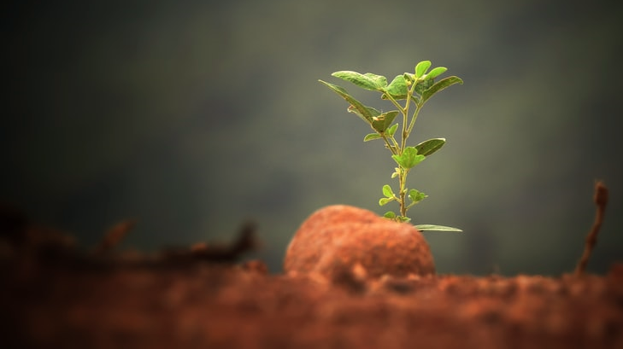
Reflection 2: A new world for people and planet
Covid-19 has shown us the vulnerability of our society when there is a crisis and has uncovered many of the underlying inequalities that are embedded in our systems. Racial and economic inequalities are being exposed in our societies and allowing us to see and understand some of the injustice that exists more clearly.
We are being invited to think about how we can change the way we organise our societies after Covid-19 so that both people and planet will flourish.

Slide 17
Watch this short video (4 mins) of a bedtime story inviting us to think about the possibilities for change which can come from the disruptions of Covid-19:

Slide 18
What sort of world can you start to imagine after Covid-19?
Why not spend some time doing a ‘visioning’ exercise of what you would like a post-covid world to look like: maybe draw or map out some of the ideas that you hope for.

Slide 19
Reflection 2: A new world for people and planet
For a world where both people and planet flourish, we need to think beyond sustainability and aim for something that is called regeneration. While sustainability aims for zero damage to the earth, a regenerative culture aims to restore ecosystems and engage us as nature in everything we do.
As we see with the pandemic, our current culture is not crisis-proof, it is more reaction based.
In a post-Covid world, our society needs to become more resilient - which means the ability to recover and bounce back from any type of breakdown - in order to cope with future crises.

Slide 20
Reflection 2: A new world for people and planet
Thinking regeneratively means re-inventing our systems and local environments, developing healthy systems to help make our communities a place where both humans and the planet can flourish.
A regenerative culture is about community and connectedness, working in collaboration and acting as though we are part of the natural world, rather than separated from it.

Slide 21
Take a look at this short video (1:33 mins) exploring a change from sustainability to restorative design in our thinking about a post-covid world:

Slide 22
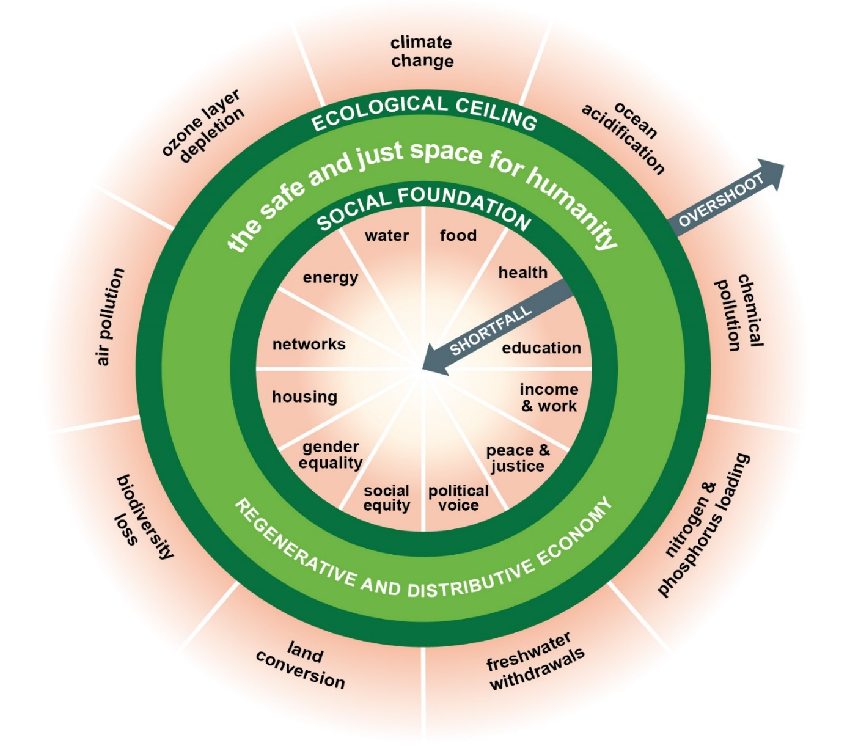
Reflection 2: A new world for people and planet
Amsterdam has announced it will embrace the‘doughnut model of economics after the coronavirus. This model developed by Kate Raworth is an economic structure that strives to be in balance with the boundaries of our planet. It is an alternative to the growth economies that most countries use, which aim for infinite growth on a limited- or finite- planet.
The minimum standards for every human being are found in the centre of the doughnut. It is important that there is a social foundation, yet at the same time this foundation should avoid damaging the climate, soils, ozone layer, fresh water and biodiversity loss. This design helps us to stay in balance between our requirements as humans and the planetary boundaries of the Earth.
For more information on this new economic model take a look at this short Ted-talk by Kate Raworth.

Slide 23
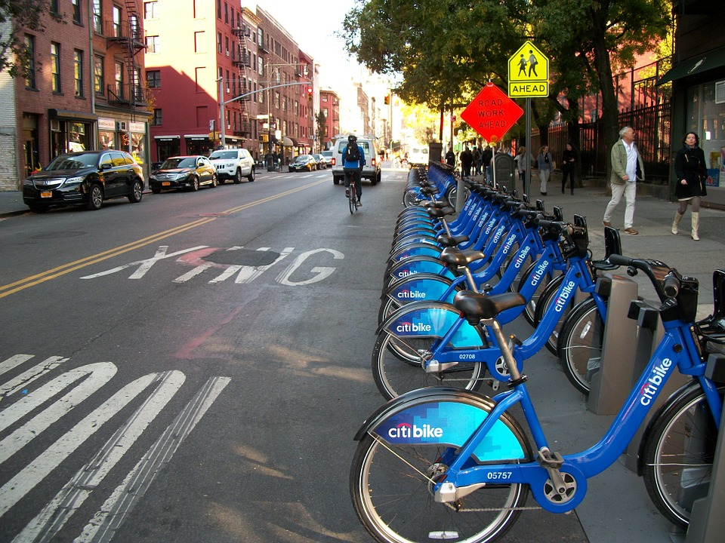
Reflection 2: A new world for people and planet
Another example of a city using Covid-19 as an opportunity and inspiration to make changes is Milan, Italy. They announced that 35km of streets that were once used for cars will now be transformed into cycling and walking space with the aim of reducing car traffic and air pollution.
A deputy mayor of Milan shared how reduced car use and an increase in pedestrians and cyclists will also support local bars, artisans, and restaurants. In the future, cities with increased space for walking and cycling will offer more advantages to help boost a local economy.

Slide 24
More examples…
In London the mayor Sadiq Khan announced a new plan for large areas of the city to be car-free for safe walking and cycling. In the Colombian capital, Bogatá, 120 km of streets that were offered to cyclists once a week will now be changed to traffic-free 7 days per week. Another 75 km of cycle lanes will also open with the aim to reduce public transport use and air pollution. Community gardens in cities are growing in popularity during the pandemic - mayors from C-40 cities, including Barcelona, Melbourne, Hong Kong, London, New York are all focusing on healthy, equitable and sustainable economic recovery, instead of going back to business as usual, in order to mitigate climate change.

Slide 25
What examples do you know of happening in your local area? What can you find out about?
Think about some of the community actions you have seen during the lockdown.

Slide 26
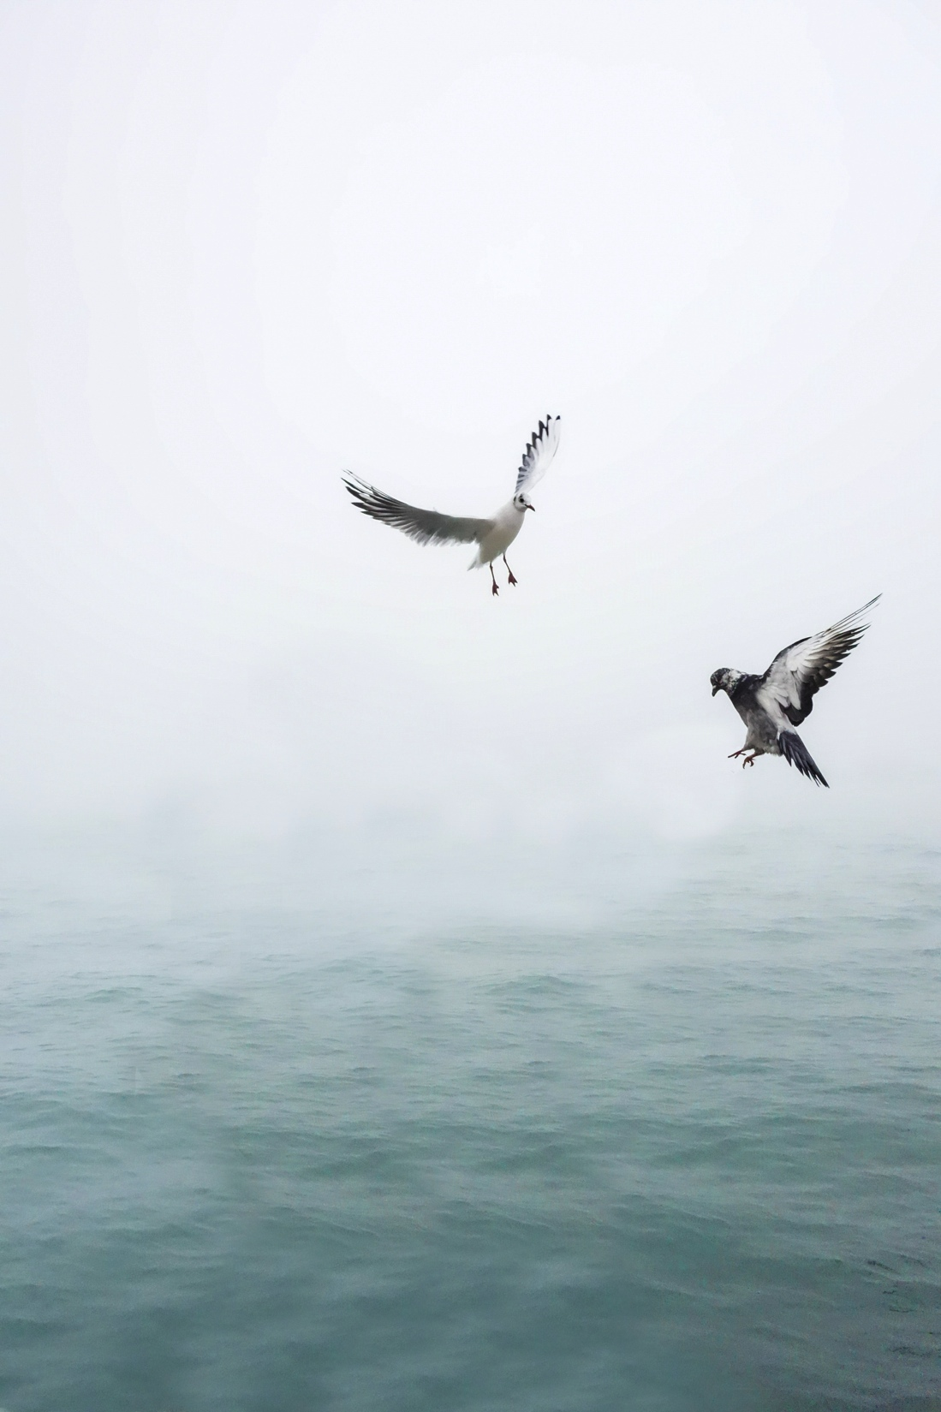
Reflection 3: From Reflection to Action
During this inquiry we have explored how coronavirus and climate change are strongly interrelated and also primed by huge complexity.
We have seen how human and natural systems are intertwined, how the virus is embedded in a larger system, and also how to deal with information and emotions that are coming up by responding to change and complexity.
The pandemic has shown us how we are living in an interconnected and globalised world where qualities like empathy, systems thinking and critical thinking are more important than ever.

Slide 27
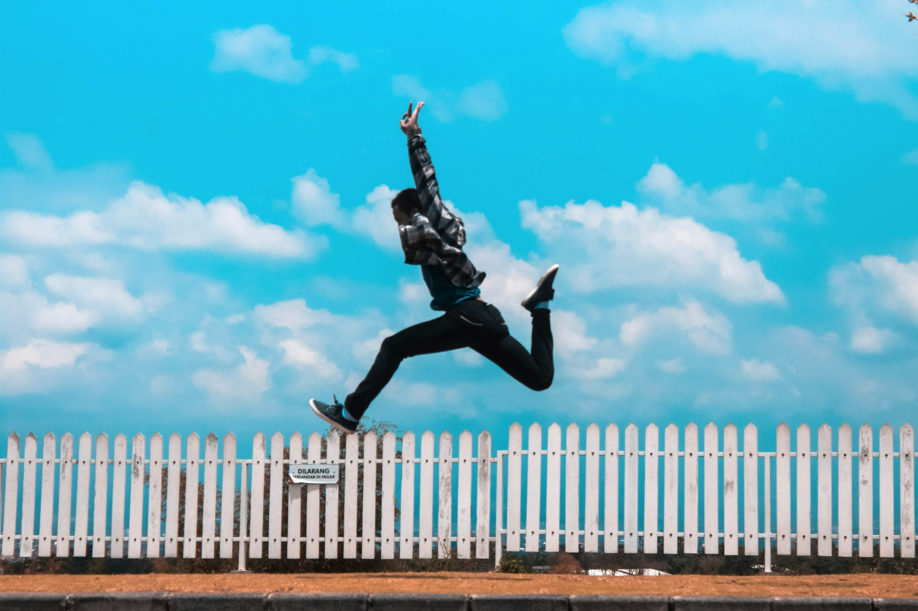
Reflection 3: From Reflection to Action
Thinking back over this four-part inquiry, take a moment to think about which questions and thoughts were most interesting to you or which you felt most passionate about and why:
________________________________________________________________________________________________________________________________________________________________________________________________________________________________________________

Slide 28
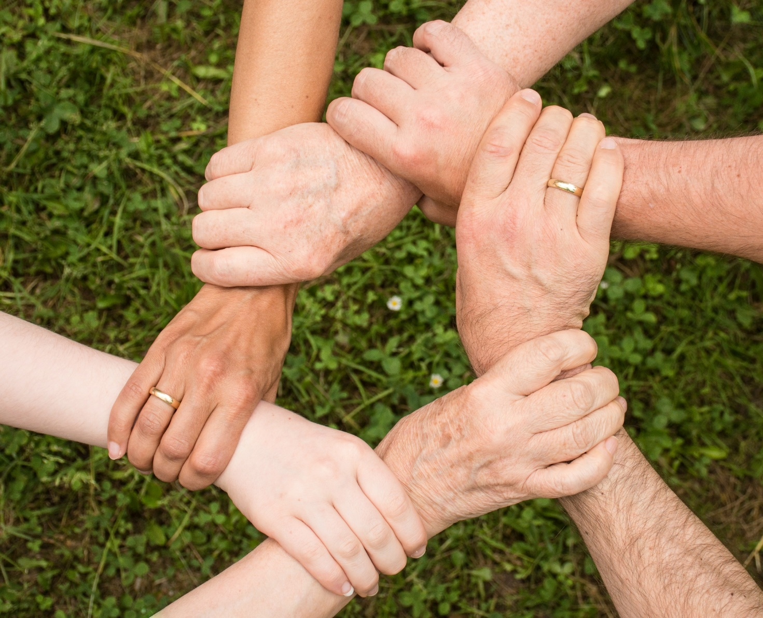
Maybe it was the topic of local food markets, how to deal with emotions and thoughts, or how to transform our systems. This area of interest can be your anchor point – starting with this topic or area, you can start to look at what is needed in your community. For example helping someone to take care of their food shopping or gardening, joining a local environmental group, engaging in the local food scene or learning more about mindfulness and then teaching it to others. There are plenty of ways to make change happen in your own place, small or big. And don’t forget - you don’t have to do it alone. Often the easiest way to initiate your own project or engage in a process of positive change is to do it with the help of others.

Slide 29
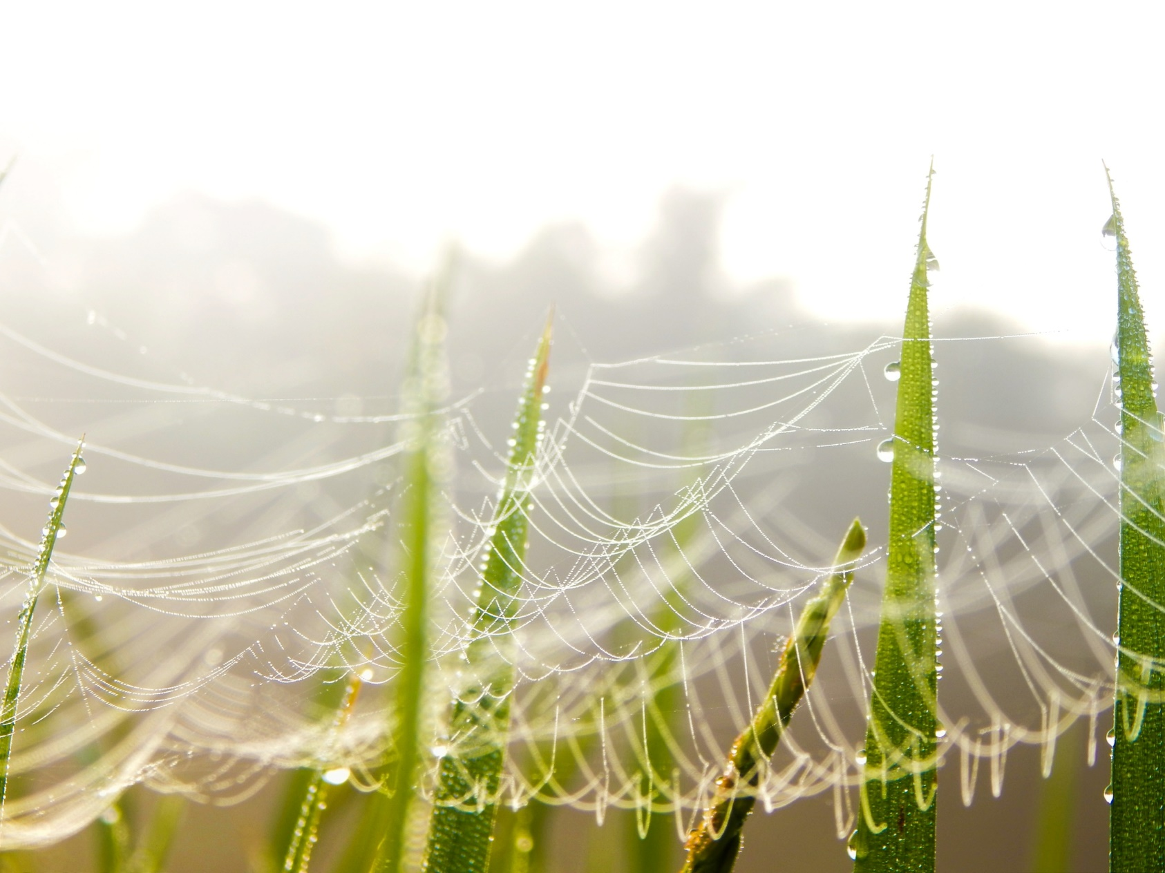
Reflection 3: From Reflection to Action
During this inquiry we have learned about different approaches which have helped develop an understanding of the complexity and interrelatedness of both coronavirus and climate change. It is useful to remember the different approaches for future challenges:
Critical Thinking: Asking questions about a topic or issue, thinking beyond what is seen and known and being curious.
Systems Thinking: Not only looking at a problem, but looking at it from a broader perspective and looking at the different elements which are influencing it.
Empathy building: Trying to step out of your own perception and step into someone else’s shoes to understand different realities and appreciate how we are all connected.

Slide 30
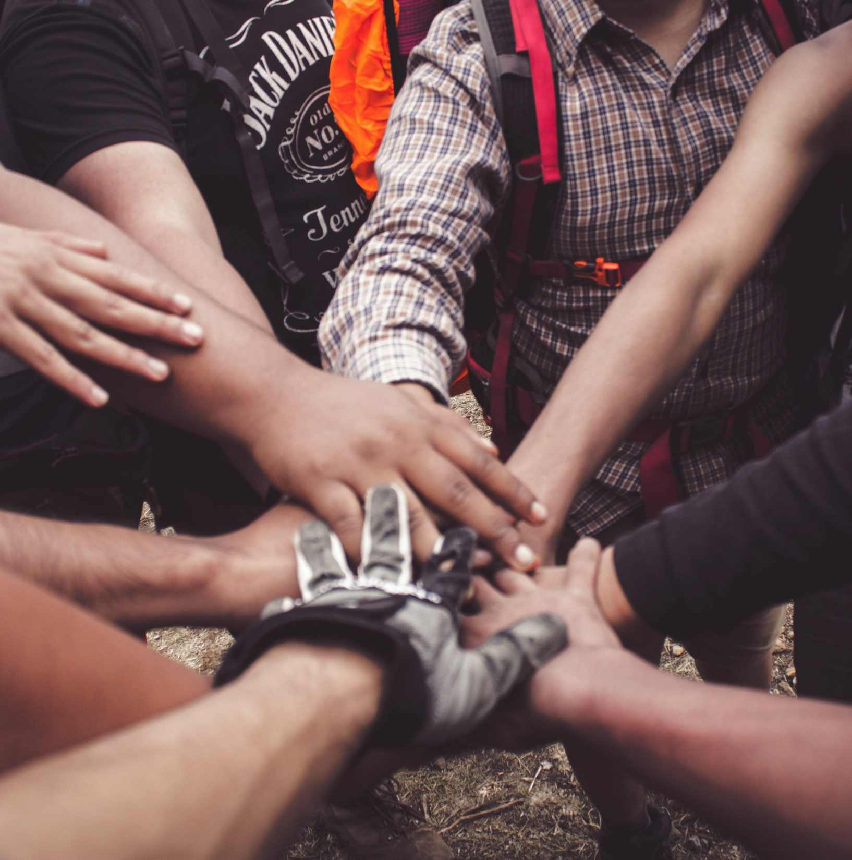
Collaboration: humans are social beings who need each other to thrive. Therefore, making things happen together is the key to create healthier and happier futures for ourselves and the planet.
Resilience: When crisis and change are happening, it’s easy to feel overwhelmed. Be aware of the fact that there are different ways and practices to deal with mental and emotional overwhelm, such as talking with others, quiet time in nature, meditation and other practices.

Slide 31
What skills or interests can you connect with and carry forward?

Slide 32
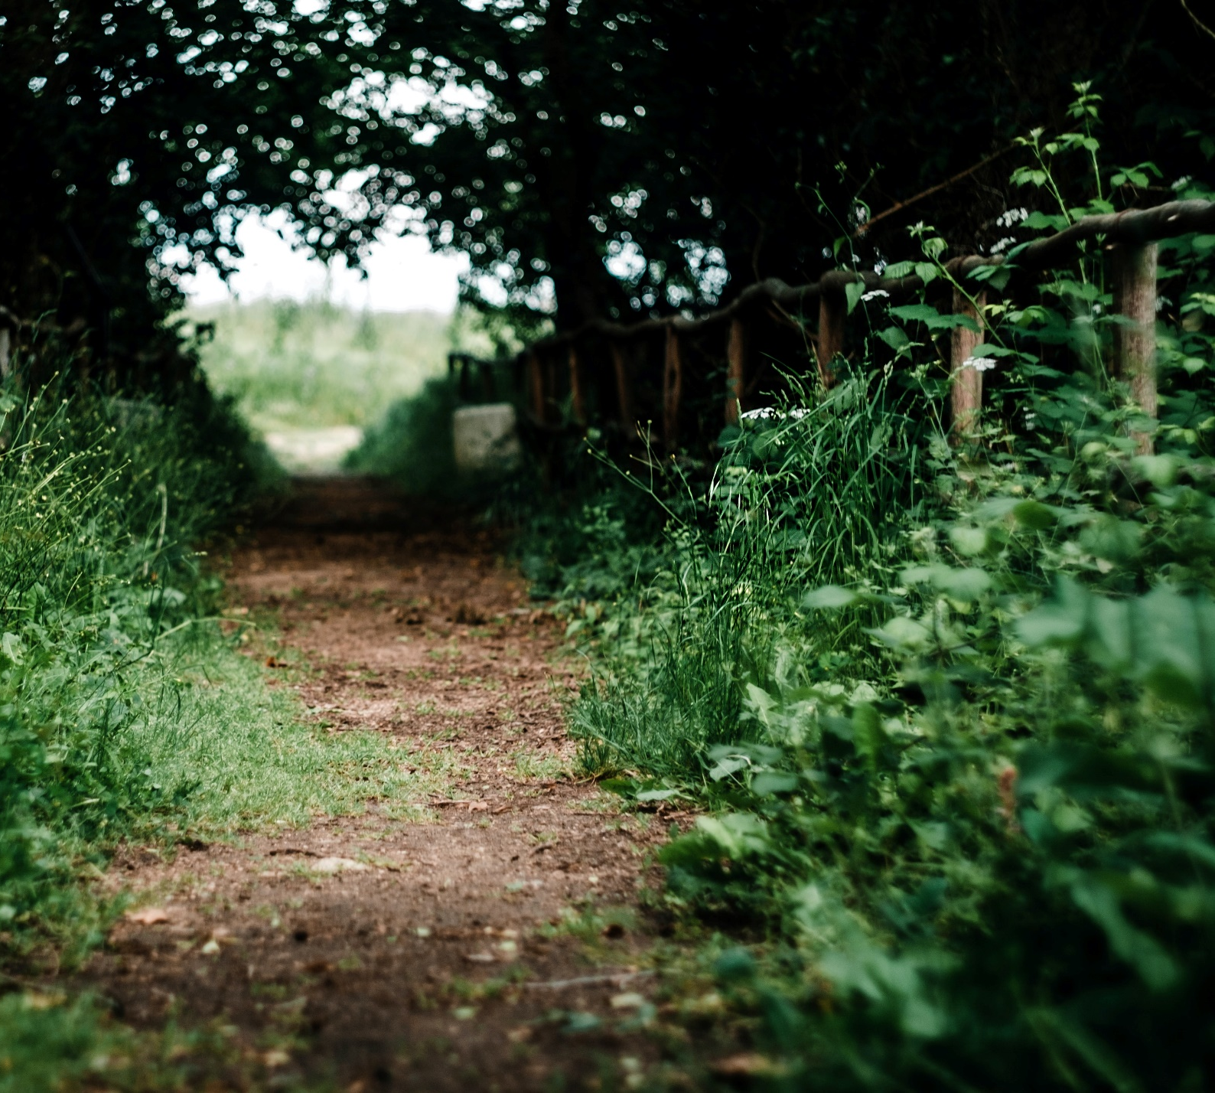
During the pandemic, many of us are thinking about our own health and the health of those around us. It has become clear that we need to support each other to be well for our own sake as well as the sake of others – in other words, by helping others to be healthy we are helping ourselves to stay healthy too.
This is a great lesson to help think about climate change too – it can allow people to understand why keeping the planet healthy is the only way to keep us all healthy too in the future.

Slide 33
What is one action you can take to help yourself to be more healthy moving forward?
What is one action you can take to help the planet to be more healthy moving forward?
You might want to note these down as a pledge to yourself and to the planet.

Slide 34
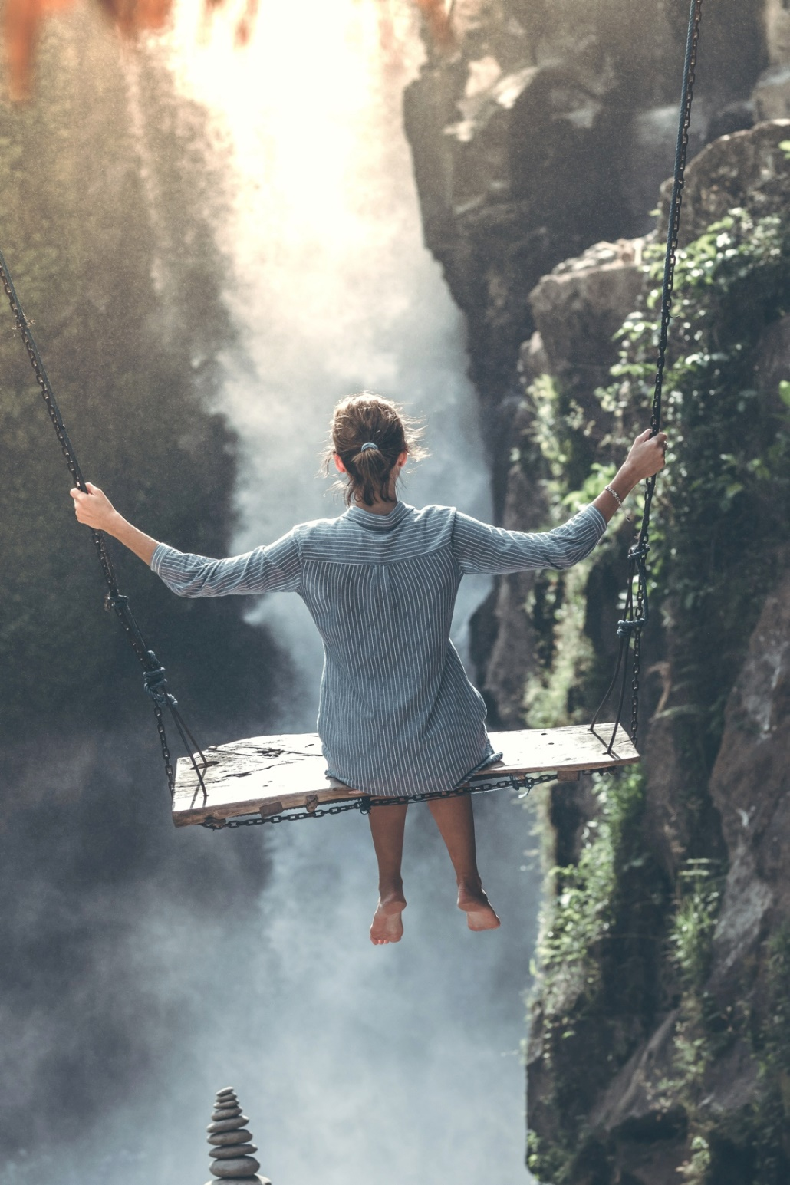
Reflection 3: Final Thoughts
We hope you are feeling empowered by this inquiry and perhaps a little more curious about some of the different topics concerning ourselves, our societies and the natural world around us - and how they are all interconnected.
Take a moment to share your reflections of this journey. Either think quietly or note down what you will take away from this process, how it has changed your perception of both coronavirus and climate change and how you would like to become active in being part of a more resilient and sustainable future.
____________________________________________________________________________________________________________________________________________________________________________________________________________________________________________________________________________________________________________________________________________________________________________

Slide 35
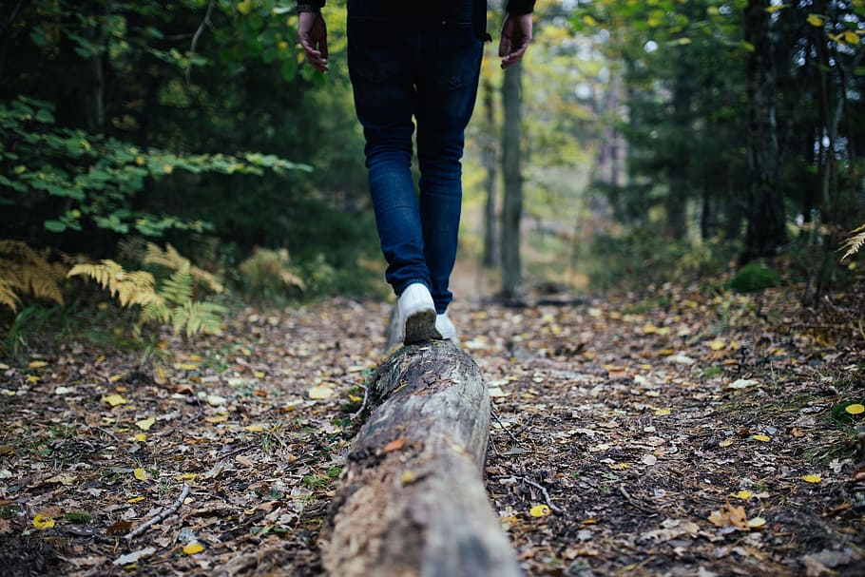
There are many lessons we can learn from the global pandemic moving forward. Using the skills of critical thinking, empathy and systems thinking – which you have practised in this inquiry - can help to understand many more of the connections between coronavirus and climate change. Why not keep thinking and exploring some of the other connections that you can find in the world around you? Stay curious ☺

Slide 36
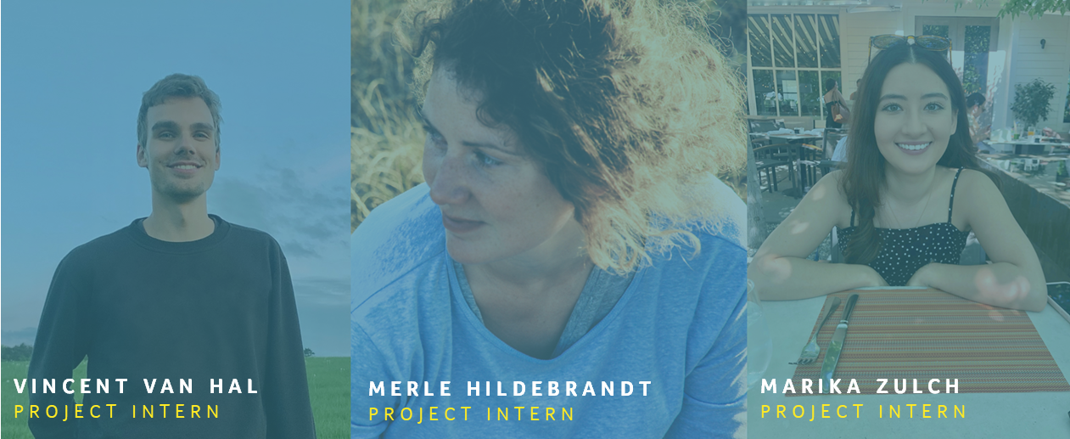
With thanks and appreciation to MA students Vincent, Merle and Marika from Schumacher College for their design ideas, content and collaboration on this ThoughtBox learning inquiry.

Slide 37
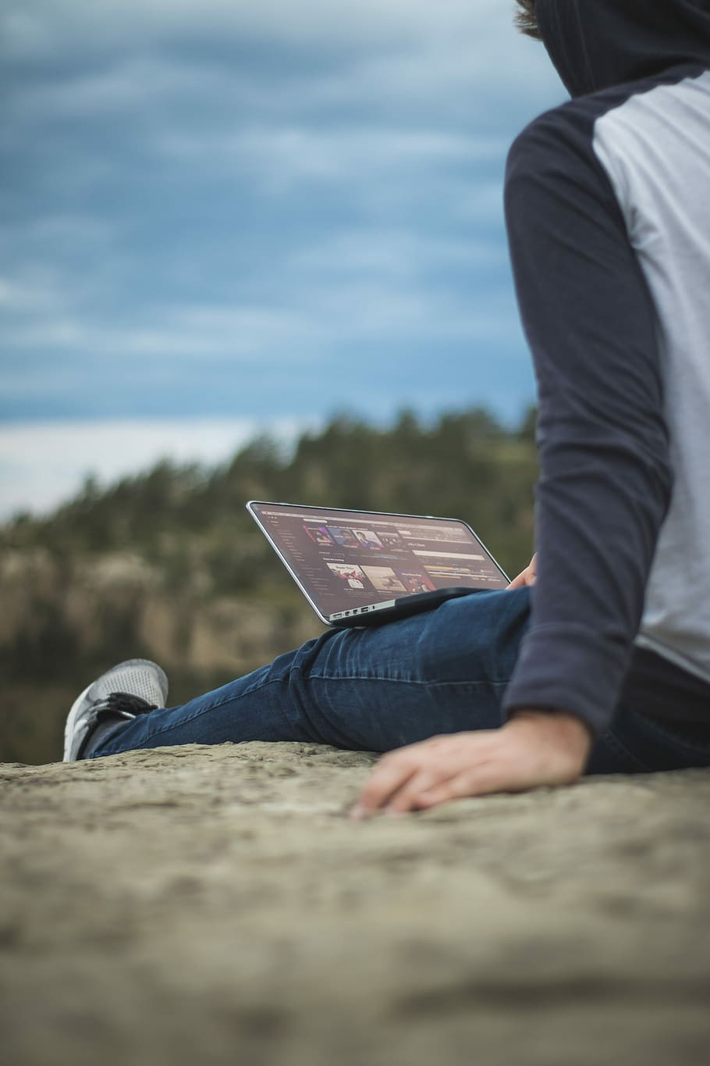
The Great Realisation
4 minute video | Tom Foolery
Evolutionary virus discussion
90 minute video | Zach Bush
THINGS TO WATCH
How we changed during coronavirus 5 minute video| Now this news
Coronavirus Is Our Future
17 minute video |TED Talk
What the Coronavirus teaches us about Climate Change 9 minute video | Our changing climate
Globalisation Explained 4 minute video | Explainity Channel
BAME and coronavirus 5 minute video | Guardian
Why Pandemics Will Increase With Climate Change 10 minute video | Buzz Feed

Slide 38
Why does climate justice matter?
Article | Climate Just
Sustainability is not enough
Article | Resilience
THINGS TO READ
Globalization: Causes, Pros & Cons Article | Environmental conscience
Post-Coronavirus recovery
Article & Website | Guardian
Climate Change and Human Health
Article & Website | WHO
Racial injustice and Covid-19 Article | Methodist
Coronavirus has exposed our arrogant relationship with nature Article | Financial Times
The impact of Covid-19 is all down to inequality
Article |Open Democracy

Slide 39
‘Shut it down’
Article | Independent
Spread the stories, not the virus
Campaign | Spread the stories
THINGS TO INSPIRE
Changing Climates
Discussion-based curriculum | ThoughtBox
#facetheclimateemergency
Campaign| Fridays for Future
Evolutionary virus discussion
90 minute video | Zach Bush
What coronavirus can teach us about climate change
Article | Financial Times

Slide 40
This sort of learning can’t wait
THOUGHTBOXEDUCATION.COM

