Slide 1
GANGS
SOCIAL PERSPECTIVES
Y11-13
15-18 years

Slide 2
G A N G S O F
E L S A L V A D O R
W E E K 2
60 M I N U T E S

Slide 3
In this lesson, students will:
THINK!
Think about and discuss the pressures within society that encourage people to join gangs
Understand how social inequality and political corruption can influence behaviour within particular cultures and countries
Explore and unravel some of the stereotypes that exist within our perceptions of gang members and gang culture
FEEL!
CONNECT!

Slide 4
P R E L E S S O N
R E F L E C T I O N S
3 – 5 M I N U T E S +

Slide 5
Introduce the following REFLECTIVE QUESTIONS for students to consider during the lesson (maybe write them up or read them aloud and ask students to think about their own responses):
What is “gang loyalty” and what do you think it means?
Can a gang’s behaviour influence a societal change?
What links are there between gang violence and societal dysfunction?

Slide 6
R I V A L R I E S
B E H I N D B A R S
2 5 M I N U T E S +

Slide 7
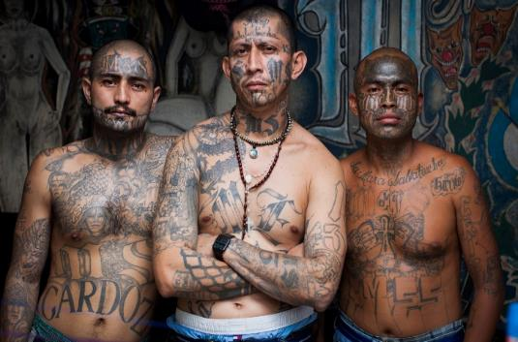
Watch the short documentary (23 minutes) made by Adam Hinton looking at the Mara Salvarucha gang in El Salvador entitled:
MS-13
Click on the link above or copy and paste this hyperlink:
https://vimeo.com/137759704)
Please note that this video contains footage
that some may find disturbing, including the
funeral of a gang member and the dead
body of a young baby. It also contains footage of gang members smoking marijuana and brandishing guns.

Slide 8
Allow students a few minutes to respond to the film with people sitting near to them.
After sharing their initial responses, ask them to think about the following questions:

Slide 9
What did you learn within the film about gang culture in El Salvador?
What did you learn within the film about society in El Salvador?
What did you find most surprising or shocking within the film? Why

Slide 10
T A K E A C L O S E R
L O O K
2 5 M I N U T E S +

Slide 11
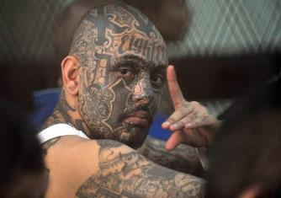
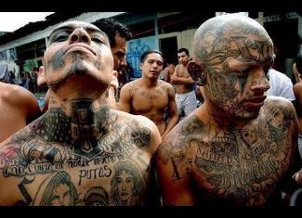
*Images courtesy of Adam Hinton
There are two main rival gangs working in El Salvador:
Split the class into half and give one side MS-13 and one side 18th street. Working in pairs or small groups, give each group one of the following information sheets on the two gangs working in El Salvador.
Ask students to read and share their learning (or alternatively read together as a class)
18th Street
MS-13

Slide 12
*Images courtesy of Adam Hinton
Fact-file on MS13 (click here)
Fact-file on 18th Street (click here)
*or alternatively read the fact files together on the following slides

Slide 13
18th Street Fact-file
1. 18th Street Gang is a multi-ethnic organisation that started as a street gang in Los Angeles, California. They are also known as Barrio 18.
18th Street Gang
2. While some accounts trace its origins to the late 1950s, the gang began to take its current form in the 1980safter splitting from the Clanton 14 gang.
3. The 18th Street gang has grown by expanding its membership to other nationalities and races, and it was among the first multiracial, multi-ethnic gangs in Los Angeles.

Slide 14
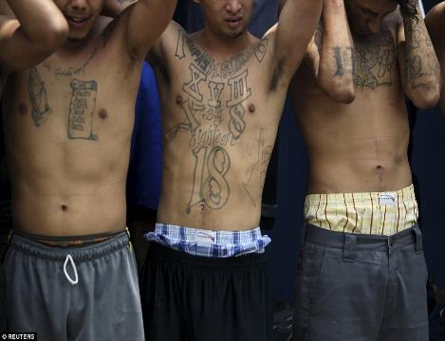
4. In the beginning, they were made up largely of second-generation Hispanics but as they began to battle with more established Hispanic gangs, they began to recruit outside the Hispanic community.
5. Mass deportation of Central Americans allowed gang numbers to grow rapidly. Most Members of 18th Street are now Central American mainly Salvadoran, Guatemalan, and Honduran.
6. The 18th Street gang became a bitter rival of MS-13, another prominent gang, as both gangs wanted the top spot in Central America.
18th Street Gang

Slide 15
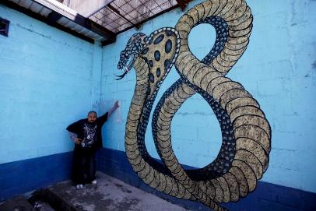
7. 18th Street gang members are required to abide by a strict set of rules. Failure to obey the word of a gang leader, or to show proper respect to a fellow gang member, may result in an 18 second beating, or even execution for more serious offenses
8. 18th Street gang members often identify themselves with the number 18 on their clothing and use the symbols XV3, XVIII, X8, 666, 99 (9+9=18), and 3-dots in their graffiti and tattoos.
18th Street Gang
9. 18th Street colours are blue and black; blue is to represent and to pay tribute to The Mexican Mafia, and black is to represent the original colour for the gang.

Slide 16
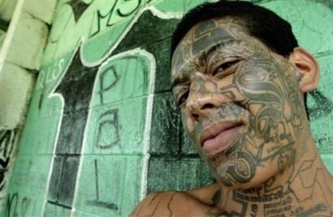
10. The 18th Street gang is occasionally referred to as the Children's Army because of its recruitment of elementary and middle-school aged youth. They also
allow other races to join their ranks making the gang Multi-ethnic.
11. In El Salvador it is common for members of the gang to be tattooed on the face with a large "18". In many cases the tattoo covers the entire face.
12. Throughout the region, the gang is known for a strict insistence on loyalty in its ranks, and often kills to punish transgressions.
18th Street Gang

Slide 17
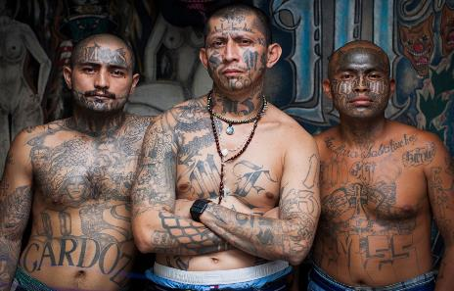
Mara Salvatrucha (MS-13) Fact-file
1. The MS-13 was founded in the “barrios” of Los Angeles in the 1980s. The gang was initially made up of refugees from El Salvador living in the Pico Union neighbourhood.
2. The name comes from El Salvador: Marais a Central American term for gang; Salvarefers to El Salvador; Trucha, (which means “trout” in English) is a slang term for “clever” or “sharp.”
Mara Salvatrucha (MS-13)
3. MS-13 has spread to other parts of the United States, Canada, Mexico, and Central America. The majority of the gang is ethnically composed of Central Americans(mostly Salvadorans)

Slide 18
4. They are notorious for their use of violence and a binding moral code of allegiance.
5. Entry to the gang is often violent, including a 13 second beating that can often end in tragedy.
6. Originally, the gang's main purpose was to protect Salvadoran immigrants from other, more established gangs of Los Angeles.
Mara Salvatrucha (MS-13)

Slide 19
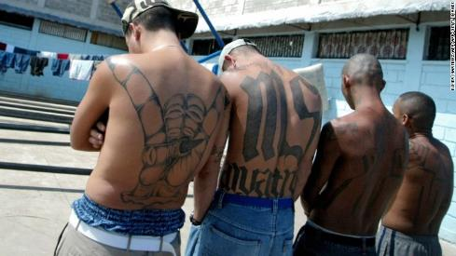
7. The gang is estimated to have 30,000 to 50,000 members and associate members worldwide, 8,000 to 10,000 of whom reside in the United States.
8. The leaders are known as palabreros, which is translated to mean “those who have the word.” These leaders control what are known as cliques, the cells that operate in specific territories
Mara Salvatrucha (MS-13)
and can control the actions of these cliques from afar.
9. Many Mara Salvatrucha members cover themselves in tattoos. Common markings include "MS", "Salvatrucha", the "Devil Horns", the name of their clique, and other symbols.

Slide 20
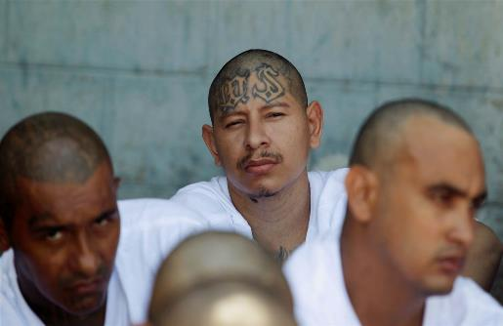
10. As well as distinguishing themselves by tattoos covering their body and also often the face, they have a unique brand of sign language.
11. One of the most commonly displayed hand signs is the devil's head which forms an 'M' when displayed upside down.
12. The MS-13 is enemies with 18th Street Gang (or Barrio 18), another street gang with an extensive presence in Central America, Mexico and the United States.
Mara Salvatrucha (MS-13)

Slide 21
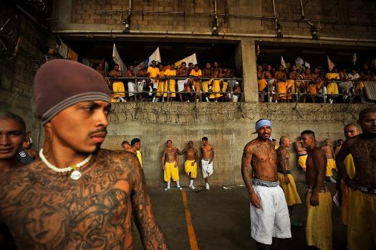
*Images courtesy of Adam Hinton
The Penas Ciudad Barrios is a maximum security prison for members of the Mara Salvatrucha Gang, or MS, in the South of El Salvador.
It was built for 800 inmates and now house's over 2500. The prison is practically run internally by the gang who have organised a bakery, basic rehabilitation and are even left to run the hospital.
As you enter the prison you soon realise that there are no guards around. They only stay on the outside and let the gang run the place.

Slide 22
The Izalco jail in south west El Salvador is very similar to the Penas Cuidad jail, but this jail is run by the opposing gang, the 18th Street.
Click here to watch a short (2.39mins) introduction to the Izalco jail (home to 18th Street)
Click here to watch a short (3.24mins) introduction to the Penas Ciudad Barrios (home to MS-13)

Slide 23
On September 2, 2004 the El Salvadorian government made it public policy to have exclusive prisons for the country's two principal gangs -- a risky move that no other country in the region has dared to replicate.
The decision of El Salvador’s government to assign exclusive jails to the MS-13 and Barrio 18 gangs is a measure now considered by academics and researchers as one that facilitated the evolution of the gangs, but very few opposed it while it was happening.
Now, the question is whether reversing the segregation is viable or not.

Slide 24
After watching the short videos and reading the fact-files, discuss the following questions in small groups:
Why might the government have allowed the gangs to take over the prisons?
What have you learned about gang loyalty from these two gangs? What are your reactions?

Slide 25
In March 2016, El Salvador declared a state of emergency in regard to the gang warfare.
Look at the following short article from The Guardian r covering the story (or click here to read online) and discuss your responses with the person sitting next to you.

Slide 26
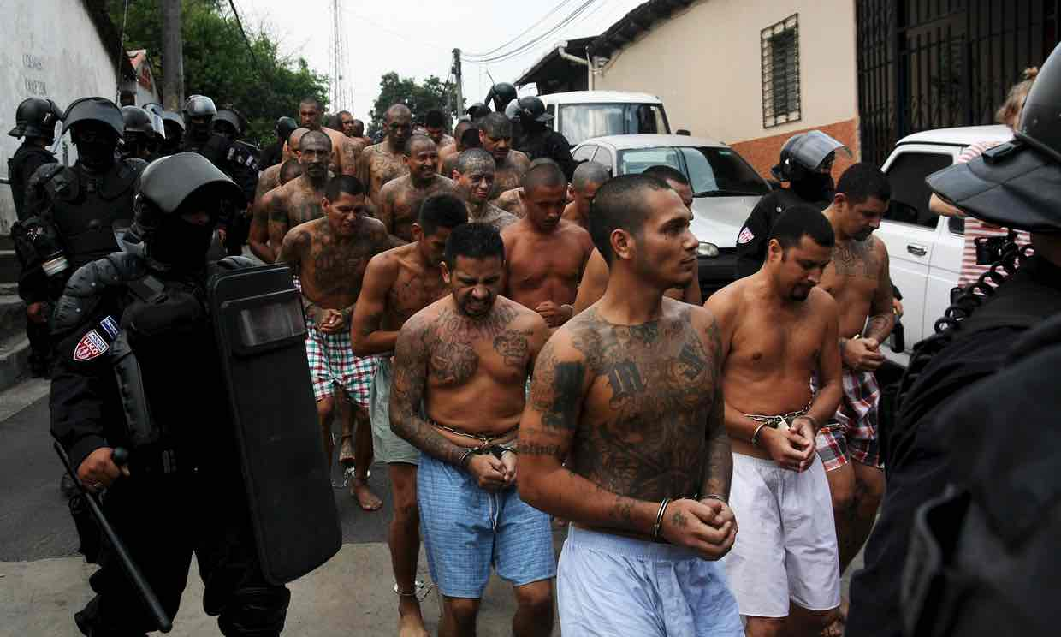
El Salvador declares state of emergency at seven prisons in gang crackdown
El Salvador has declared a state of emergency at seven prisons and transferred 299 high-ranking gang members at the start of “extraordinary measures” that the government has promised to take against gangs.
A package of additional measures was to be presented to the legislature on Wednesday.

Slide 27
Mauricio Ramírez Landaverde, the minister of justice and public security, said at a news conference that the targeted gang leaders were transferred to a prison 25km (about 15 miles) west of the capital.
The emergency declaration puts inmates on lockdown and suspends family visits for 15 days.
“They are going to be subjected to a higher security regimen, with greater control to make sure communication from inside the prison system is stopped,” Ramírez said. “They have been identified as those most involved in communicating with the outside, in directing and coordinating illegal activities of the criminal groups.”
He said mixed units of police and soldiers will handle security inside and outside El Salvador’s prisons.

Slide 28
President Salvador Sánchez Cerén said earlier this month that he was considering steps to combat gang violence. His administration has roundly rejected an apparent weekend offer by the gangs for negotiations.
A video message from masked men claiming to represent the country’s three most powerful street gangs said they had told their members to stop killing. In exchange, they demanded that the government not proceed with the measures to combat the gangs.
On Tuesday, the presidential spokesman, Eugenio Chicas, said the administration would present an initial package of “extraordinary measures” to the legislature on Wednesday. They could include deploying more soldiers in a security role, declaring states of emergency in conflict zones and imposing stiff fines on phone companies that Chicas said have refused to lower cellphone signal strength around prisons.

Slide 29
He said the measures would “guarantee the population’s security and be a hard blow against criminality”.
Chicas acknowledged that homicides had dropped significantly since the release of the gang video. However, he said it was just a way for the gangs to put a gun to the populace’s head, threatening to resume killings if the government doesn’t negotiate.
This article was printed in the Associated Press in San Salvador on Wednesday 30 March 2016

Slide 30
T H I N K B E F O R E
Y O U K N O W
1 0 M I N U T E S +

Slide 31
There are many contributing factors from the wider issues affecting society in El Salvador that have led to the dominance of gangs within society.
Ask students to think back to what they have learned and discuss in brief what they know about:
Social problems in El Salvador
Environmental problems in El Salvador
Governmental problems in El Salvador
Economic problems in El Salvador
NB: The country profile (click here) can offer a little more information if required

Slide 32
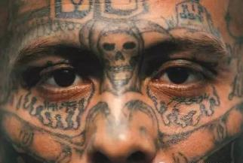
A person’s actions go a long way towards allowing us to relate – or to repel – from that person. But what we rarely get to see or know (when we make our assumptions and judgements) is what happens to someone to lead up to them taking these actions.
Everyone has a story – everyone has a past that has taken them to their present, no matter how harsh their present may be.
Part of what it means to build empathy is to try to listen to these stories, or to try to understand why people are doing what they are doing and how they ended up there.

Slide 33
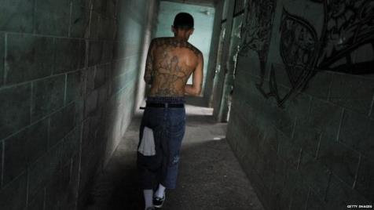
Seeing a person for their history, their context and their environment (not just judging them on their appearance and their present situation) is an important part of developing empathy.
Although these men have all been arrested for committing crimes, understanding why they ended up in this situation is an important step in understanding how our societies need to focus more on supporting (rather than persecuting) the marginalised.
By trying to understand why people might be doing what they are doing and how they ended up there, we are often able to understand better how to work to help people have different choices in the future.

Slide 34
To finish, take a look at some of the prisoners and try to see beyond the stereotype and stigma of the crime that they represent.

Slide 35
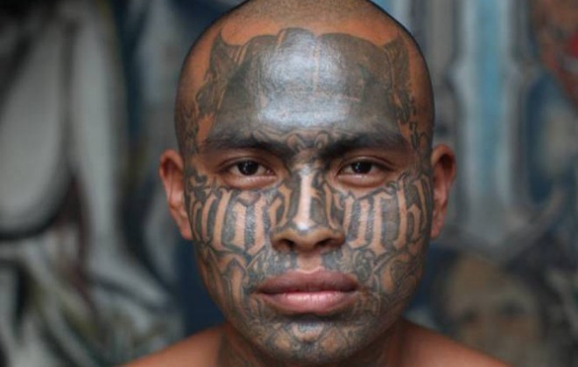

Slide 36
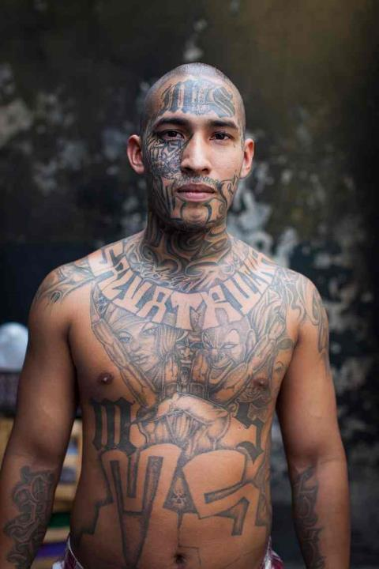

Slide 37
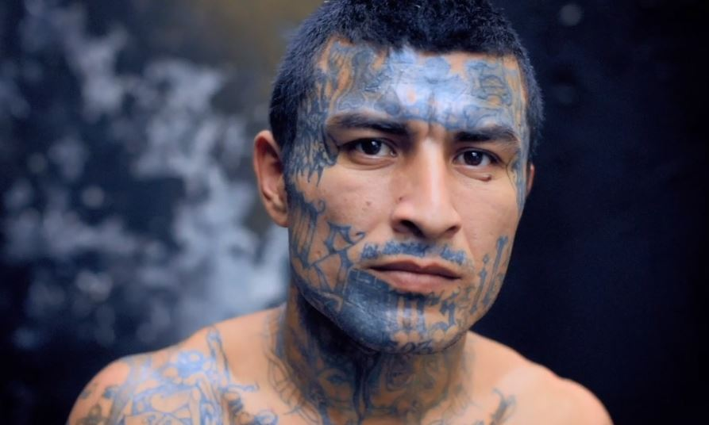

Slide 38
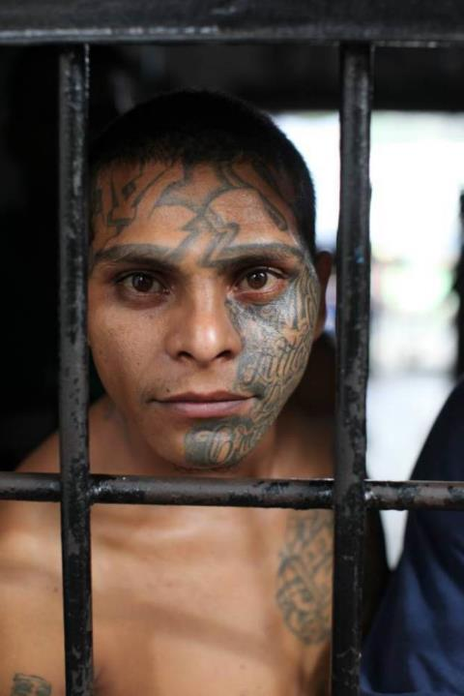

Slide 39
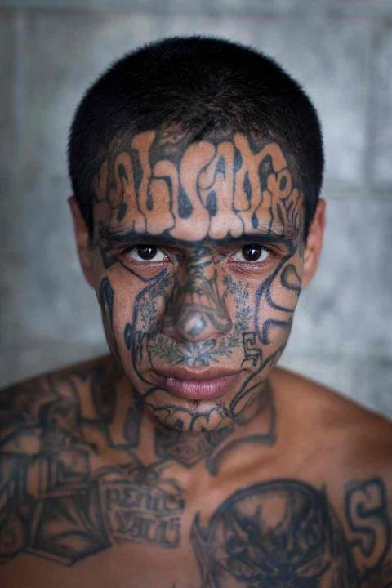

Slide 40
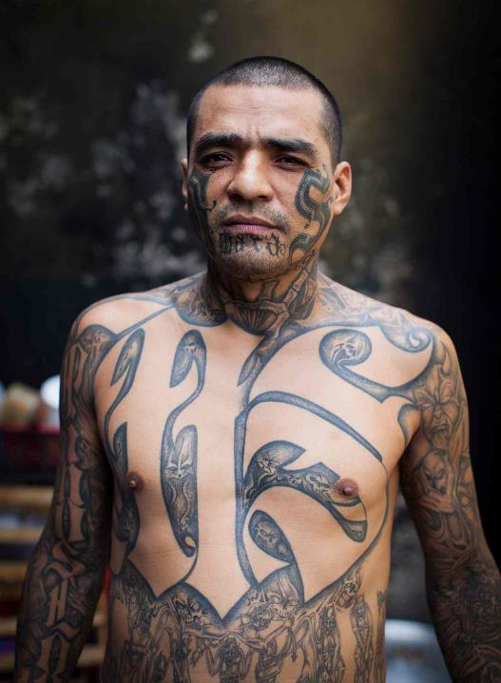

Slide 41
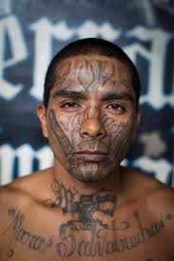

Slide 42
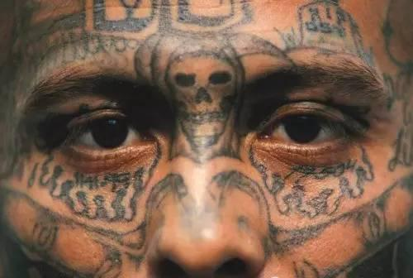

Slide 43
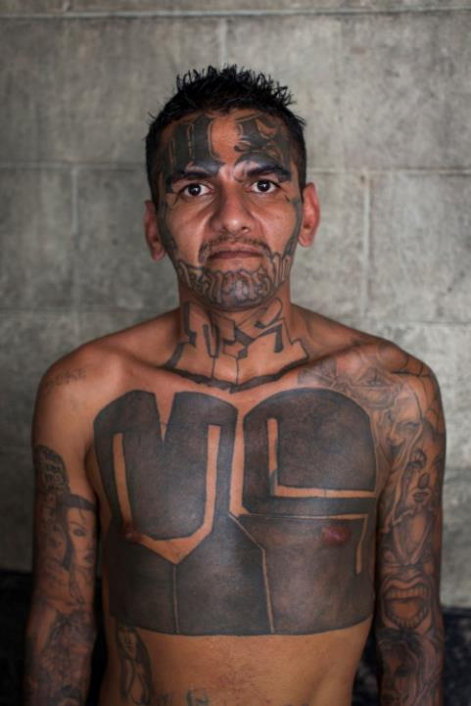

Slide 44
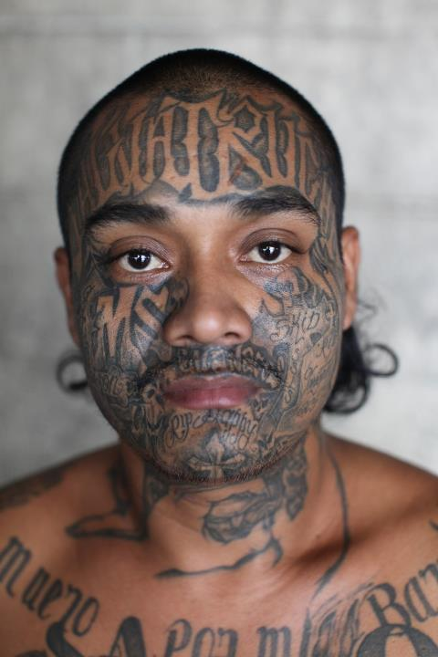

Slide 45
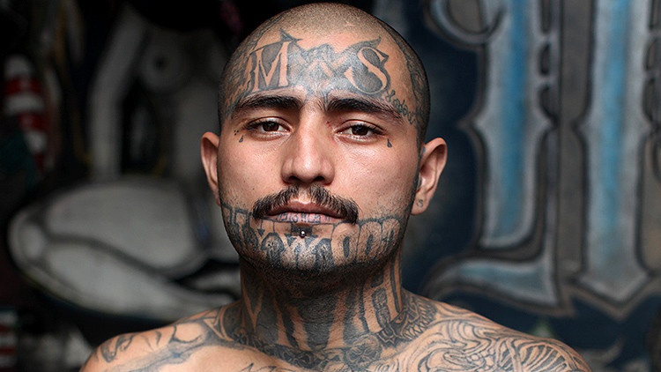

Slide 47
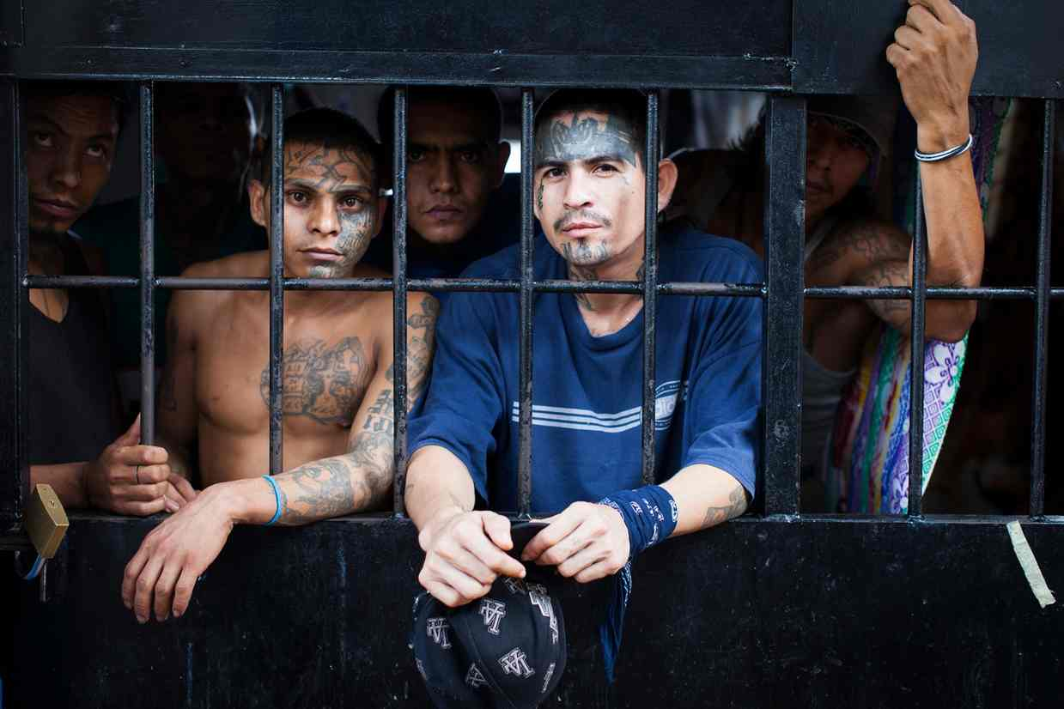

Slide 48
G A N G S
T H I S S O R T O F L E A R N I N G
C A N ’ T W A I T

