Slide 1
HOMELESSNESS
SOCIAL PERSPECTIVES
Y11-13
15-18 years

Slide 2
W H A T I S H O M E ?
W E E K 1
1 5 M I N U T E S

Slide 3
In this lesson, students will:
THINK!
Think about and discuss our understanding of the word home and what it means to different people
Understand and explore our fundamental human need to have a home and the psychological effects of not having one
Explore and unravel some of our pre-conceived ideas of what it means to have a home and what home means for people across the world
FEEL!
UNLEARN!

Slide 4
P R E L E S S O N
R E F L E C T I O N S
3 – 5 M I N U T E S +

Slide 5
Introduce the following REFLECTIVE QUESTIONS for students to consider during the lesson:
What does home mean to you?
What is the difference between a house and a home?
Can home be found anywhere?
Is having a home a fundamental human need?
What might it mean to not have a home?

Slide 6
W H A T I S H O M E ?
5 M I N U T E S +

Slide 7
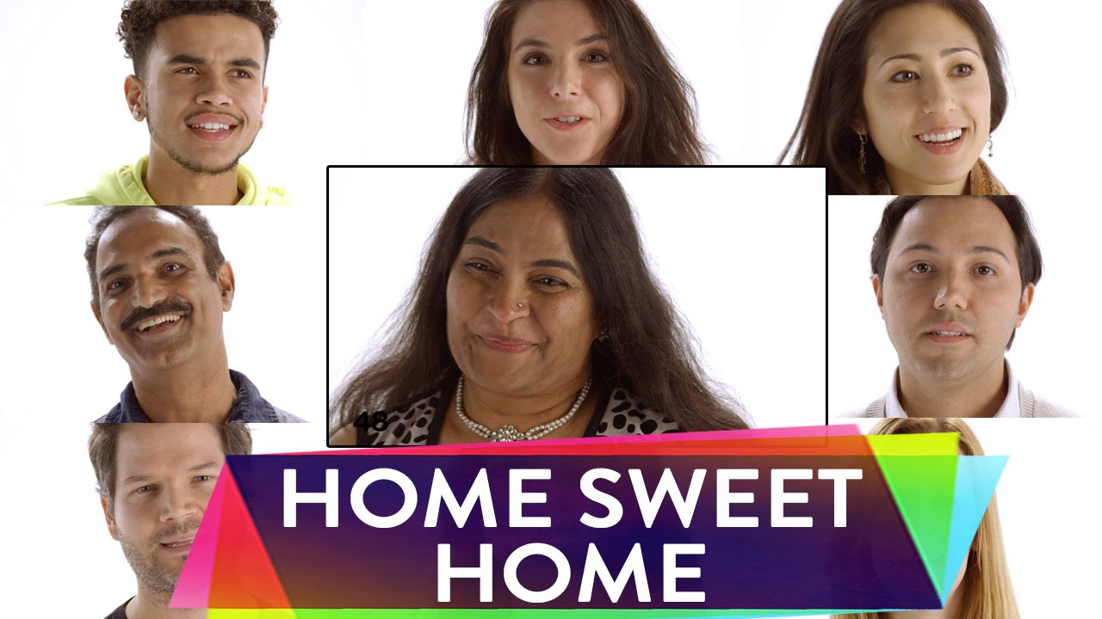
Watch the short video (2.38 mins) made by Soul Pancake featuring people aged from 1-100 sharing their thoughts and ideas on the question:
What does Home mean to you?
Click on the link above to open the film

Slide 8
Allow students a few minutes to respond to the film with people sitting near to them.
After sharing their initial responses, ask them to consider the following questions:

Slide 9
Can you have a home without having a house?
Can you be homeless yet live in a house? Why?

Slide 10
I S H A V I N G A HO M E A H U M A N N E E D?
1 0 M I N U T E S +

Slide 11
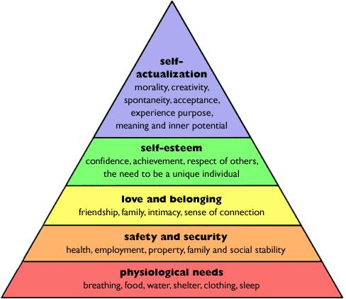
Abraham Maslow's Hierarchy of Needs is a simple way of understanding human needs.
His philosophy states that people are unable to focus on any needs higher than their current level on the following pyramid.
If a person is unable to meet their needs at the very basic level (food, shelter, clothing, education, and hygiene), they will be incapable of moving up in the pyramid to reach greater goals (job security, sobriety, mental health, and self actualization etc.).

Slide 12
The most basic human needs are our physiological needs.
If we don’t feel safe and are not basically healthy, we are unable to think beyond the desire to satisfy these basic needs.
Would you agree? Why?

Slide 13
In what way could having a home (or some form of shelter) be seen as a psychological need?
What might some of the psychological and physiological issues be from not having a home?

Slide 14
HOMELESSNESS
T H I S S O R T O F L E A R N I N G
C A N ’ T W A I T

