Slide 1
EXPLORING NATURAL WORLD
THE

Slide 2
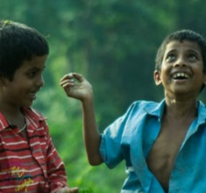
Y11-13 | AGES 15-18
AT A GLANCE | CHANGING CLIMATES| Lesson 1 – Our Changing Climate
20 minutes
A VISION OF CLIMATE CHANGE: Explore the feelings related to climate change through ours and others’ art.
Only got 40 minutes?
We recommend exploring the first two sections of this lesson – and, if time, finishing with nature connection (the final activity in the lesson plan).
Only got 30 minutes?
We recommend exploring the first section of this lesson, and exploring some impacts of climate change from the second section.
20 minutes
WHY IS OUR CLIMATE CHANGING?: Explore some of the effects and causes of human-caused climate through videos and information.
20 minutes
TRAVELLING THROUGH DEEP TIME: Perceiving human history within the history of the Earth through Deep Time in order to better situate human’s responsibility for human-led climate change. This will give an important perspective to support the topic’s explorations.

Slide 3
YEARS 11-13 | KS4/5| Ages 11-13
CHANGING CLIMATES
EXPLORING THE NATURAL WORLD

Slide 4
In this lesson you will need:
Internet access
Speakers
Pens or coloured pencils
ThoughtBox Thought-Books* or paper
Large sheets of paper (optional for final task)
Here is a list of resources you will need for this lesson.
*We recommend students have a journal-style book for ThoughtBox lessons, in order to capture notes, ideas, drawings, reflections, inspiration and learnings.

Slide 5
LESSON 1 | CHANGING CLIMATES
OUR CHANGING
CLIMATE
60 MINUTES

Slide 6
In this lesson, we will:
Understand the importance of recognising emotional responses to climate change and find ways to express our feelings about it.
Think about some of the causes and effects of human-caused climate change.
Explore ideas around ‘Deep Time’ and human activities to help us understand the importance of changing some of our habits as humans.

Slide 7
Before we start this topic, take five minutes in your ThoughtBox Journal to answer these three questions:
When you think of ‘climate change’, how does it make you feel?
What does ‘climate change’ make you think about?
How does climate change impact your life, do you think? And of others?
You may write down words, phrases, doodle or draw your answers!

Slide 8
A VISION OF CLIMATE CHANGE
20 MINUTES

Slide 9
First, we are going to do a very quick activity...
The next slide contains a word. When everyone is ready, have one person count from 1 to 3 and then show the phrase in the next slide.
This kind of exercise allows us to react with our subconscious, which can sometimes be quite surprising.
You’ll then have to be very quick - you will turn to the person next to you and say the first word that comes to your mind when you think of that word.
Are you ready? Start the countdown…!

Slide 10
The word is…
‘CLIMATE’
‘CLIMATE CHANGE’
Quickly - turn to the person next to you and say the first word that comes to mind.

Slide 11
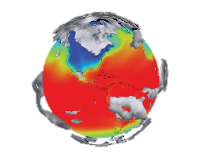
You might all have said different words, which can give you interesting information about how your class feels about ‘climate’.
In itself, ‘climate’ is a neutral word, but it has lately been related to ‘climate change.’ Although climate change is a natural phenomena, the phrase has become used more and more to describe events that are actually quite scary, overwhelming and sad.

Slide 12
It can be difficult to put words to these emotions, or even to feel them.
Art has been one way to express not only these emotions, but also the scale of an issue that can be hard to grasp.
Let’s take a look at the following eight slides, all depicting artistic responses to climate change from various angles and perspectives.
Think about how each image makes you feel and what it makes you think of.

Slide 13
Notes:
Ed Hawkins Average global temperatures from 1850-2018

Slide 14
How does this image make you feel? What does this image make you think of?
Notes:
Ed Hawkins Average global temperatures from 1850-2018

Slide 15
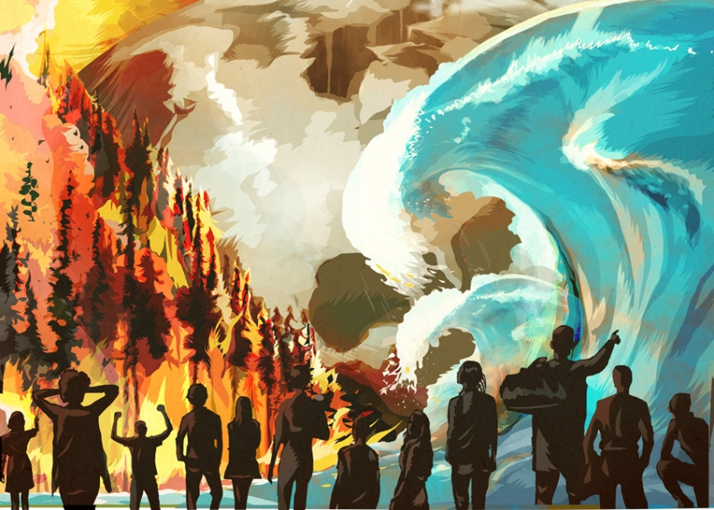
Notes:
Illustration by Matthew Laznicka

Slide 16
How does this image make you feel? What does this image make you think of?
Notes:
Illustration by Matthew Laznicka

Slide 17
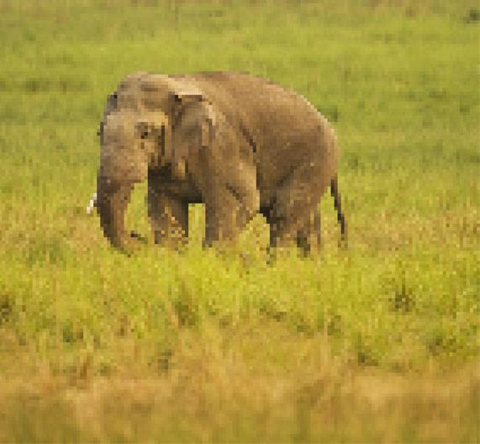
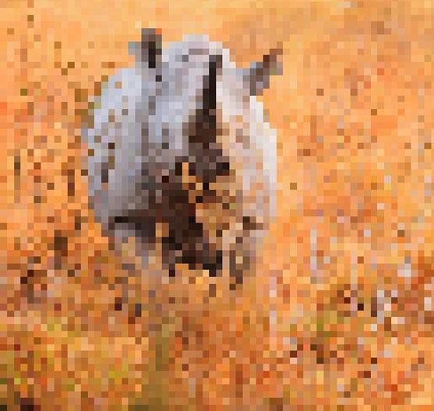
*These pictures are composed of as many pixels as the number of animals still alive in the species
Indian Elephant. Between 20000-25000 remain
Black Rhino. Estimated about 5000 remain

Slide 18
*These pictures are composed of as many pixels as the number of animals still alive in the species
How do these images make you feel? What do these images make you think of?
Indian Elephant. Between 20000-25000 remain
Black Rhino. Estimated about 5000 remain

Slide 19
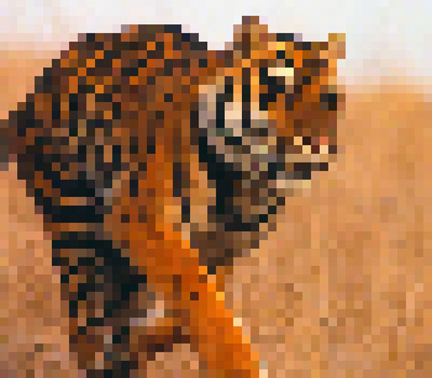
*These pictures are composed of as many pixels as the number of animals still alive in the species
Bengal Tiger. Estimated about 2500 remain
Amur Leopard. Estimated about 60 remain

Slide 20
*These pictures are composed of as many pixels as the number of animals still alive in the species
How do these images make you feel? What do these images make you think of?
Bengal Tiger. Estimated about 2500 remain
Amur Leopard. Estimated about 60 remain

Slide 21
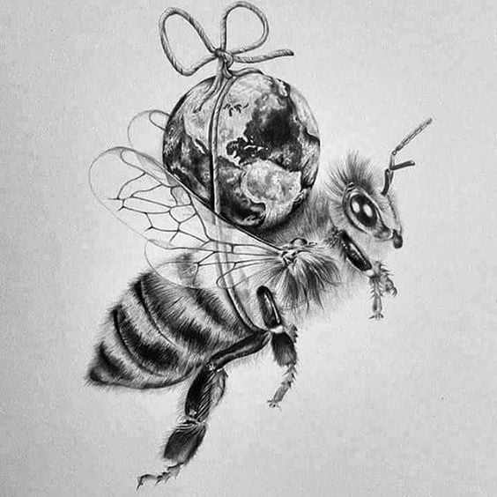
Unknown artist

Slide 22
How does this image make you feel? What does this image make you think of?
Unknown artist

Slide 23
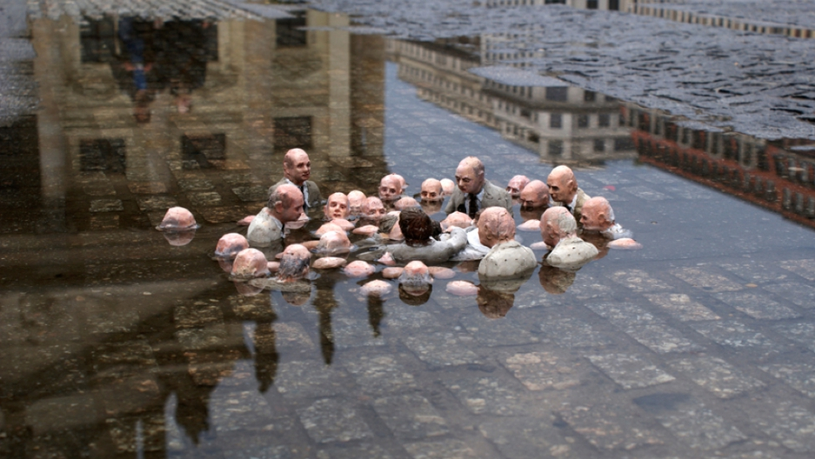
Isaac Cordell sculpture “Follow the leaders”

Slide 24
How does this image make you feel? What does this image make you think of?
Isaac Cordell sculpture “Follow the leaders”

Slide 25
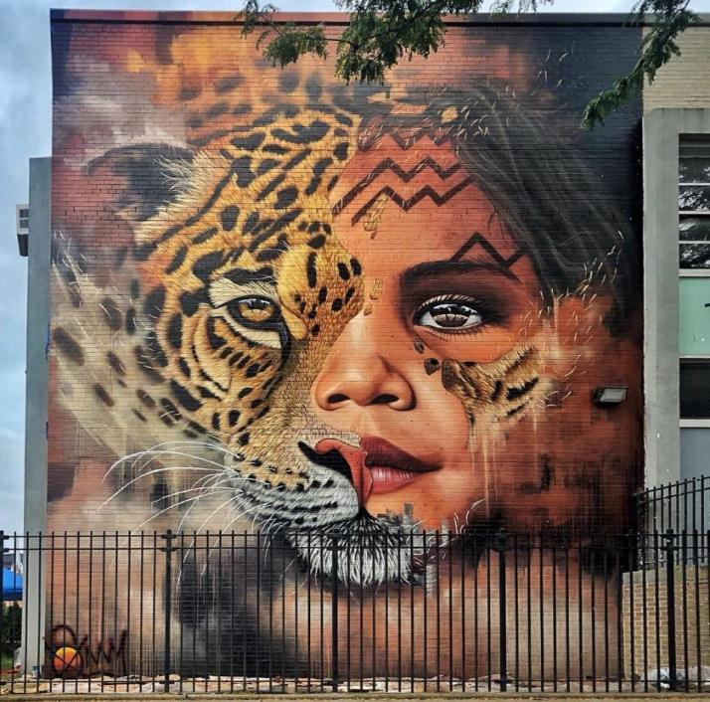
Mural in, Brooklyn by
South African artist Sonny

Slide 26
How does this image make you feel? What does this image make you think of?
Mural in, Brooklyn by
South African artist Sonny

Slide 27
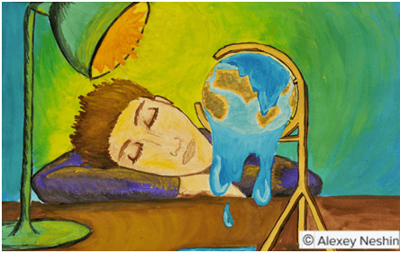

Slide 28
How does this image make you feel? What does this image make you think of?

Slide 29
Art has the capacity to represent what is often too complex for words, such as emotions that can`t be expressed with spoken or written language.
Each of these images shows a different response – some are scientific representations of ‘data’, some are empathic calls for action, some are capturing political inaction or destructive impacts.

Slide 30
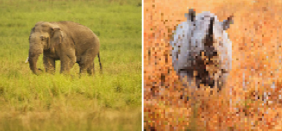
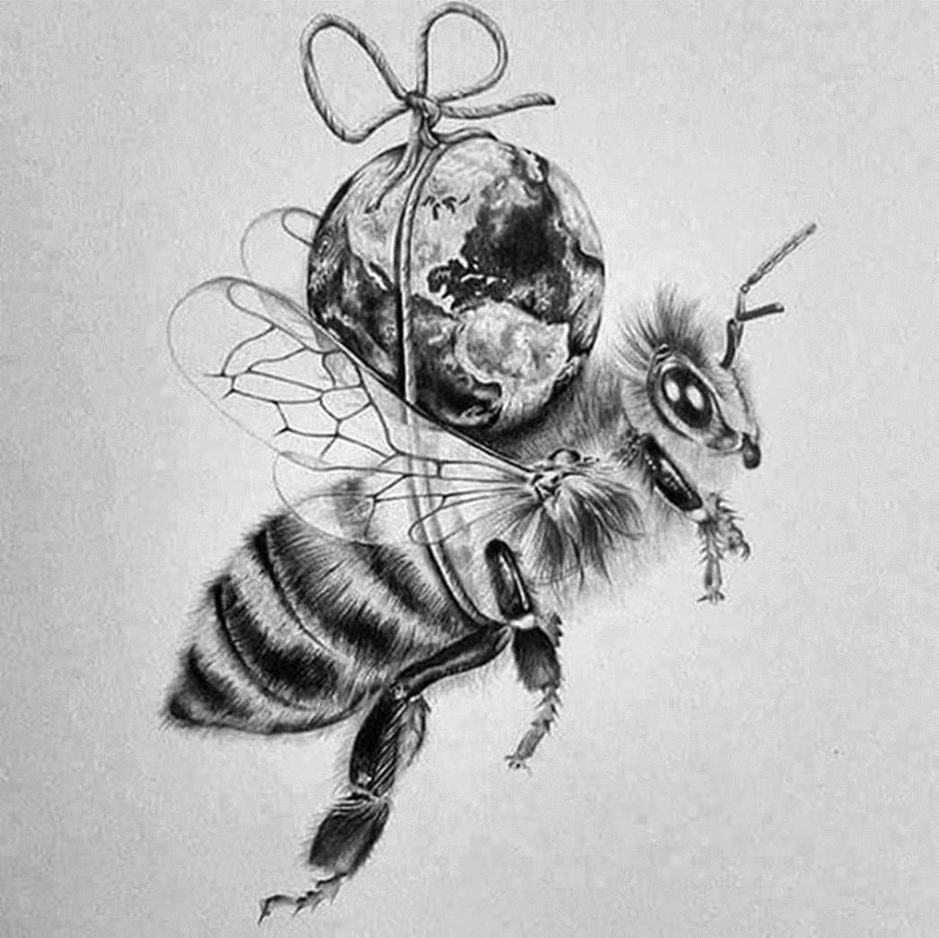
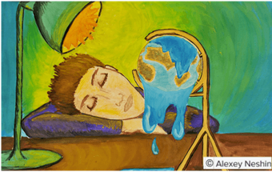
Take a moment to look again at these images and, in pairs, share the thoughts and/or feelings that you experienced in response to some of them.

Slide 31
Now, as a class, reflect on why these art pieces might be important in reflecting about climate change.

Slide 32
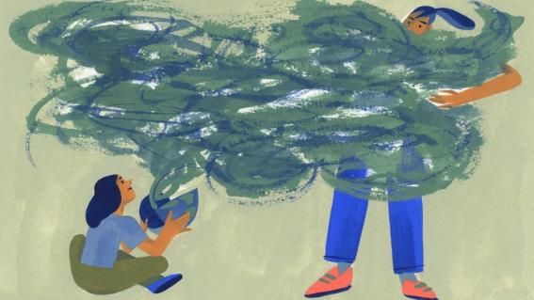
Considering what we’ve just explored, we are going to express how we feel about ‘climate change’ specifically.
There will be many different emotions in the room – from overwhelm and anxiety to innovation, apathy, excitement or empowerment.
There may not even be an awareness of what your feelings are at this present moment.

Slide 33
Your emotions themselves will also fluctuate depending on your mood or what is happening around you.
All of your emotions and responses are valid and important in shaping how you are responding to the changing world around you.
You are now invited to spend five minutes doodling, drawing or/and writing your current emotional response to climate change.
Instructions continue in the next slide

Slide 34
Try not to overthink your response. Simply take an A4 piece of paper or your ThoughtBox Journal and allow the pencil and paper to represent your emotions.
NB: You can choose to show this at the end of the exercise or keep it for yourself.

Slide 35
In this topic, we will be exploring and understanding the cause, effect and the physical impact of climate change. Yet, although this is important, it is also vital to consider our emotional responses and begin to understand other people’s – especially when they differ from our own.
For people whose lives are being affected by climate change, it is already having a significant emotional impact. And for those living in areas currently sheltered from immediate effects, the impact of eco-anxiety is already being seen and felt.

Slide 36
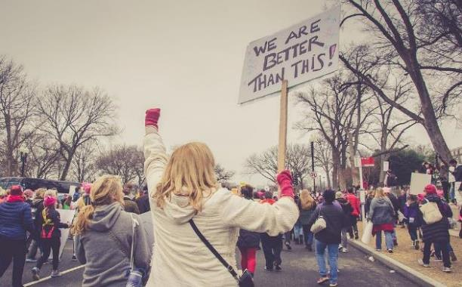
We will be exploring ways to move from anxiety to empowerment whilst learning about self-care and supporting our emotional and ecological responses to climate change.

Slide 37
WHY IS OUR CLIMATE CHANGING?
20 MINUTES

Slide 38
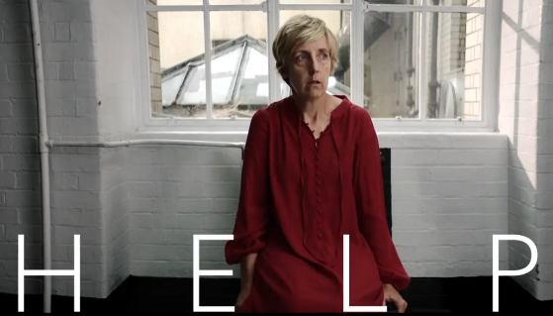
Watch the short video (1:51 minutes) made by Wilder Films for Parents for Future entitled:
Help
(Click on the link above for the hyperlink)

Slide 39
You might be feeling a bit overwhelmed right now, or equally you may be feeling excited about these ideas. However you are feeling, let’s have a few minutes to reflect.
Removing outside stimuli can allow us to be better in touch with how we feel. If you like, take a moment to close your eyes or put your head onto your hands or on the table, and think about how this video made you feel.
When you’re ready, silently put you head back up until everyone is ready.

Slide 40
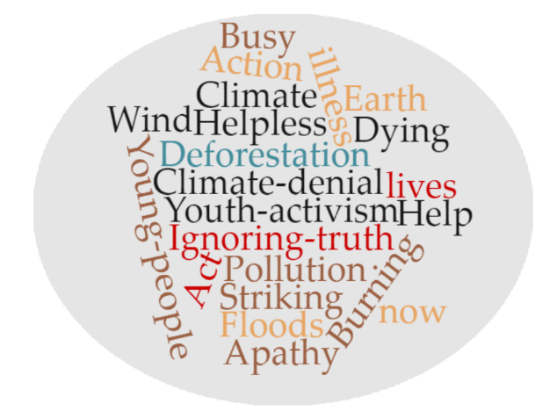
Now take a look at these words and share what you think some of the messages are that the video we just watched, Help, is introducing:

Slide 41
Many people across the world are waking up to the realities of climate change and more and more people are having conversations about cause and effect.
Recent global campaigns such as the Youth Climate Strikes and Extinction Rebellion and many more, have also brought these issues into the public conversation. You may be very informed about some of the science or you may not have much of an idea. So let’s start with some of the basics.

Slide 42
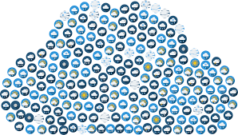
What is
‘climate change’?
Share what you already know and understand. Take a look at the following slides as a refresher if you need to.

Slide 43
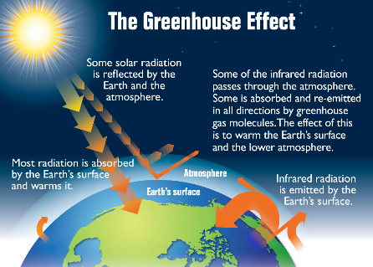
Life on Earth is possible because of the warmth of the Sun. While some of the incoming light, heat and radiation from the Sun bounces right back into space, some of it is trapped by the greenhouse gases that make up our atmosphere. These layers of greenhouse gases are the Earth’s ‘insulation’.

Slide 44
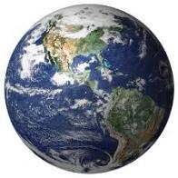
Without this layer of insulation, Earth would simply be a frozen rock hurtling through space – thus this is a really important layer. However, it has got far too thick due to the excess of greenhouse gases.
Greenhouse gases affect both the weather and the climate in different places in the Earth.

Slide 45
There is a difference between climate (what you expect) and weather (what you get).
Weather is the day to day conditions.
It’s what you see outside on any given day.
Weather events include snow, rain, sun and wind. These happen in a particular place and can vary across a local area.
Climate is the big picture.
It’s the average weather conditions over a long period of time.
Climate covers a large region, sometimes a whole country.

Slide 46
Thus, even though there have been natural changes in the climate throughout time, scientists have discovered that the current changes are due to human activity. They have been observing that climate is changing faster than at any other time from their studies of Earth's history.
Currently, climates across the world are becoming unpredictable. There have been not only rising average temperatures, but also extreme weather events, shifting wildlife populations and habitats, rising sea levels and a range of other impacts.

Slide 47
Burning fossil fuels (coal, oil and gas) releases high levels of carbon dioxide into our atmosphere as does deforestation, whilst intensive animal agriculture releases high levels of methane.
At this moment, the Earth’s greenhouse gases are higher than at any time in the last 800,000 years, for the most part due to human activities.
Having too much of these greenhouse gases causes the Earth's atmosphere to trap more and more heat which in turn causes the planet to warm up.

Slide 48
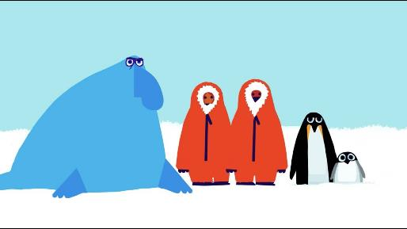
This short film (2:51 minutes) made by Emily Shuckburgh (an oceanographer at the British Antarctic Survey) and Chris Haughton (author and illustrator) explains how the Earth’s climate has changed over time and introduces the history of climate change:
Message from Antarctica
(Click on the link above for the hyperlink)

Slide 49
Look at the image on the next slide for a few minutes. Working in pairs, take it in turns to teach each other about the cause and effect of each point on the picture.
Use the ideas we’ve just explored about greenhouse gases and human-caused climate changes to help you. Start with ones that you know and move onto the harder images.

Slide 50
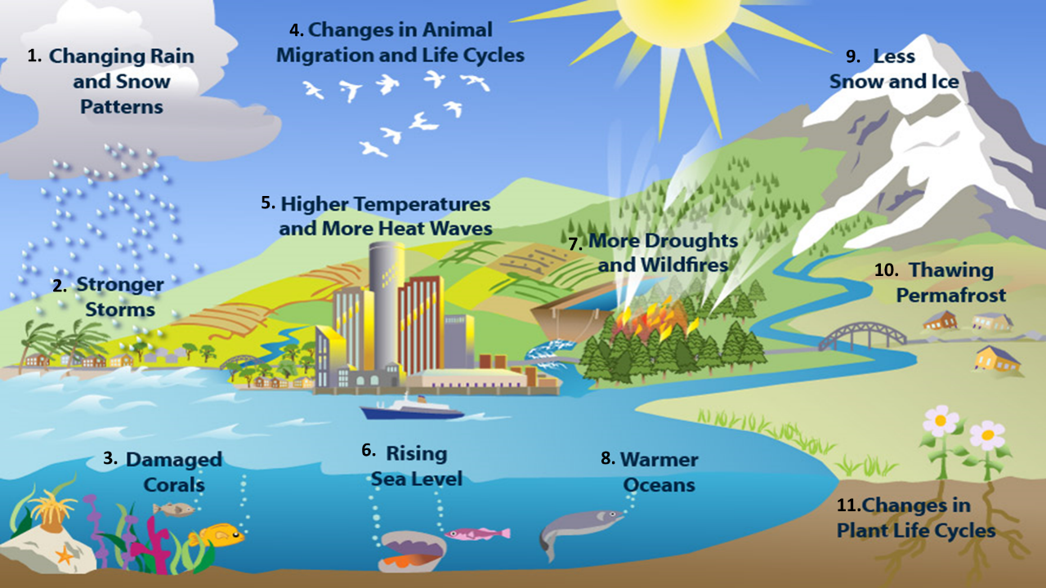

Slide 51
Earth has experienced changes in climate before, but these changes happen over a very long period of time.
The previous image shows how Earth is having trouble adapting with human-caused climate change because it’s happening so quickly.
In order to understand just how quickly human-caused climate change really is, we have to understand time in Earth’s perspective. Let’s do that now.

Slide 52
TRAVELLING THROUGH DEEP TIME
20 MINUTES

Slide 53
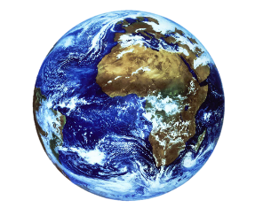
In pairs, take a couple of moments to discuss the following questions:
Have you ever heard the phrase ‘Deep Time’?
What do you think it could mean?

Slide 54
‘Deep Time’ is the amount of time that the Earth has existed:
This number is so huge, it is really difficult for us humans to grasp. When our life expectancy is usually less than 100 years, it’s almost impossible for us to imagine something so vast as ‘Deep Time’.
The Earth is roughly 4.6 billion years old!

Slide 55
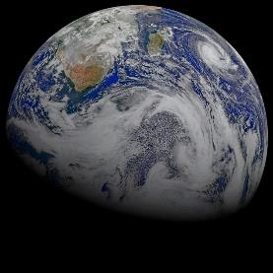
The best way to imagine Deep Time is through metaphors.
We’re going to explore the concept of ‘Deep Time’ and think a little bit more about the history of planet Earth and the role humans play on this planet.
To start, watch the short video (3:39 minutes) made by Business Insider entitled:
The History of Earth
(Click on the link above for the hyperlink)
N.B.: Although this video is about much more than human history, the events chosen to be mentioned for human history are debatable. The importance they are given here does not reflect these events’ importance in human history.

Slide 56
In pairs, take a few minutes to discuss the following questions:
How could understanding Deep Time help us to respond to the changing climate?
Were you aware of how recent human beings are to the Earth? How does this make you feel?

Slide 57
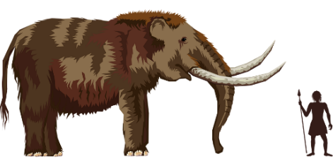
When we start to think about Deep Time, we can understand that humans are relatively new to the planet. Most of the history we learn about in school focuses on human history and stories of our own life on Earth.
Yet the Earth has a history long before humans came along, long before dinosaurs came along and so long before that it is hard for us to imagine.
Understanding this allows us to think about how quick and impactful human-led activity has actually been in terms of the Earth’s history.

Slide 58
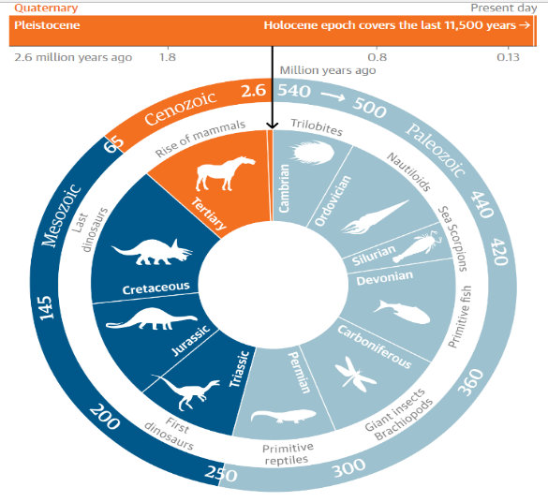
The recent ecological era – the Holocene – marked 12,000 years of stable climate since the last ice age.
However, due to the acceleration of CO₂ emissions, sea level rise, species extinction and deforestation, there has been a call for a new geological epoch to classify humanity’s impact on the Earth in this current time.

Slide 59
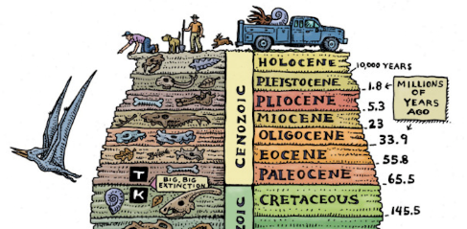
This new geological epoch is called the Anthropocene.
“Anthropocene” comes from anthropo - for “man,” and cene - for “new”.

Slide 60
Thinking about Deep Time and that other epochs lasted thousands and thousands of years, reflect on how you feel about the name of a new epoch of Earth being referred to mankind.

Slide 61
Trying to understand Deep Time is really hard, as it is almost impossible for the human brain to think about that amount of time. Yet, it can be important to recognise the impact of human-led activities. These metaphors can help us understand Deep Time a little more.
*Each of these can be an individual project or a class project – you may just want to look at them today and come back to them another time.
1. Draw a timeline or map of the history of the Earth, using the information on the next slide (slide 45)
2. Draw a clock of Deep Time, using the slide 46 to help you
3. Take a Deep Time walk using slide 47 NB: this would take a few hours and could be a great school trip or class outing that you may wish to arrange if possible

Slide 62
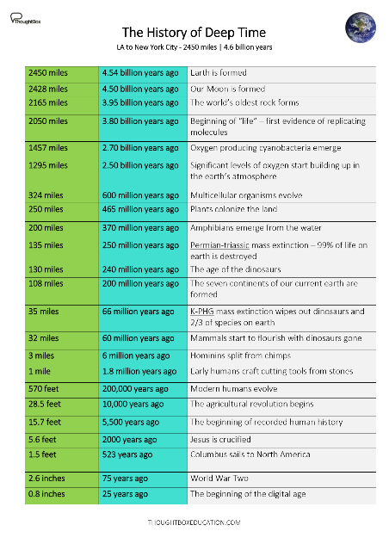
Here are all of the different stages and measurements of time (and distance) from the LA to New York journey in the film that you watched. *click on the image for a larger version or to download
Why not take huge piece of paper (or stick several together) and create a timeline to go around the classroom? For each moment in time, you could add images and pictures as well as noting down what was happening.

Slide 63
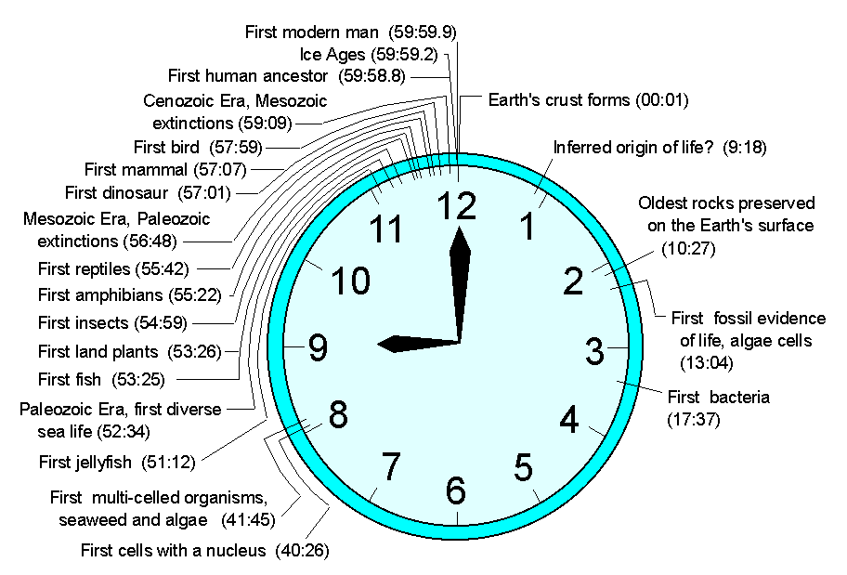
2. Create a Deep Time clock
Here is an example of Deep Time using a clock – why not have a go at making your own?

Slide 64
Take a Deep Time Walk
Experience a history of the Earth like never before with the award-winning Deep Time Walk app.
The dramatised Deep Time Walk can be experienced anywhere in the world. Walk 4.6km through 4.6bn years of Earth history, learn about key concepts from Earth’s evolution and experience a unique perspective of Deep Time
Designed using appropriate technology, the Deep Time Walk app calculates your speed and distance as you journey across 4.6bn years of time, enabling you to learn about key evolutionary events as they occur over the history of the earth.
You can learn more here and download the app for free.
www.deeptimewalk.org

Slide 65
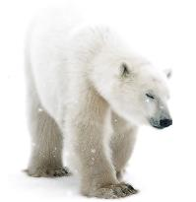
There is much we can do to prevent many of these future issues from happening and lots of really positive things that we can do (and that people across the world are already doing).
In order to think about ways to change the human habits which are not good for the planet, we need understand fully what we are doing that is harmful – and why - so we can learn which behaviour patterns or habits we perhaps need to most urgently change.
This is what we’ll be exploring through out this topic.

Slide 66
TURN IDEAS INTO ACTION!
One great characteristic of nature is that the natural world can make us feel connected – after all, humans are part of nature!
If at any time you’re feeling scared, overwhelmed, or angry, take a moment to breathe in and out and focus on what is alive around you. You might want to go to a nearby park, or simply walk over to a tree, or listen to a bird sing. You can choose to look inside, and focus on your breathing and what is keeping you alive. You may even choose to make an art piece from it. These actions can help you
feel calmer.

Slide 67
In this lesson, we explored the reasons and consequences for human-led climate change as well as a Deep Time perspective.
Next lesson we are going to learn more about the human actions that are causing climate change. By understanding what and how some actions might be harmful for the planet and ourselves, we can identify which actions we can all work towards instead.

