Slide 1
EXPLORING NATURAL WORLD
THE

Slide 2
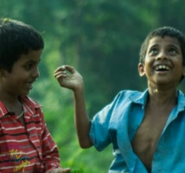
Y11-13 | AGES 15-18
AT A GLANCE | CHANGING CLIMATES| Lesson 2 – Cause and Effect
15 minutes
WHY IS OUR CLIMATE CHANGING?: Understand how humans’ separation from the natural world triggered human development as well as the development of human-caused climate change.
15 minutes
INFINITE GROWTH ON A FINITE PLANET: Explore the ways and the reasons why many humans today are over-producing, over-consuming and polluting.
Only got 45 minutes?
We recommend exploring the first, the third and the fourth sections.
Only got 30 minutes?
We recommend exploring first and third sections, finishing with the last slide (‘Turn Ideas Into Action’).
20 minutes
UNDERSTANDING CUASE AND EFFECT: In small groups, choose from eight consequences of human actions and explore the causes, effects and wider impacts of this, and make connections between them.
10 minutes
HOW DID WE GET HERE? With videos and questions, connect the dots on some of the actions and apathy being seen in governmental responses to climate change.

Slide 3
YEARS 11-13 | KS4/5| Ages 15-18
CHANGING CLIMATES
EXPLORING THE NATURAL WORLD

Slide 4
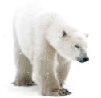
In this lesson you will need:
Internet access
Speakers
A3 paper
ThoughtBox Thought-Books* or paper
Pens and/or pencils
Here is a list of resources you will need for this lesson.
*We recommend students have a journal-style book for ThoughtBox lessons, in order to capture notes, ideas, drawings, reflections, inspiration and learnings.

Slide 5
LESSON 2 | CHANGING CLIMATES
CAUSE AND EFFECT
60 MINUTES

Slide 6
In this lesson, we will:
Understand the impacts of some of our actions on the human and non-human world and the different emotions experienced.
Think about and learn to question some of the assumptions we have made about human progress, exploring the history of our separation from the natural world.
Connect the dots on some of the actions and apathy being seen in governmental responses to climate change.

Slide 7
WHY IS OUR CLIMATE CHANGING?
15 MINUTES

Slide 8
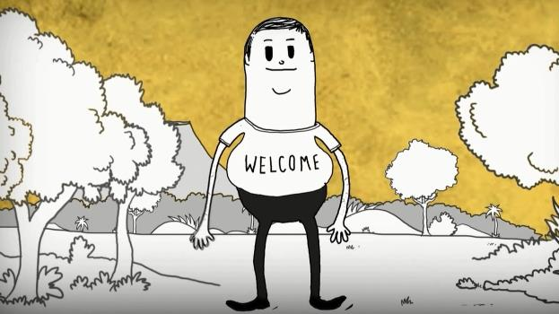
Last lesson we explored elements of ‘Deep Time’ which can help us to put into perspective the rapid impact that humans have had on the planet.
Watch this short video (1:23 minutes) made by illustrator and activist Steve Cutts entitled:
Man (Click on the link above for the hyperlink)
Disclaimer: Some of the content may be disconcerting.
Notes:
Video URL: https://www.youtube.com/watch?v=WfGMYdalClU

Slide 9
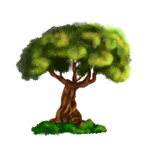
As young people, you have inherited a planet that is facing many challenges. As we’ve mentioned last lesson, it is important to recognise these feelings as valid and not supress them. Remember to be mindful of your feelings and needs throughout this lesson.
If you need a break, look outside the window at the sky, or connect to something in your classroom that is part of the natural world. Even a wooden desk can help us remember how important and beautiful nature can be.

Slide 10
Although exaggerated for comedic effect, this video highlights how humans have altered their relationship to the natural world and the planet as a whole.
Not all humans have followed this pathway. There are different communities and cultures who live in balance with the natural world. We explore this to more extent in other ThoughtBox topics.

Slide 11
Humans across the world have evolved from our early state - where we were taking just enough to satisfy our needs and stay in balance with the ecosystem - to a system of over-consumption - where we are living separately from (and in many ways dominating) the natural world.
Spend a few minutes talking with the person next to you and then share ideas with the rest of the class.
What do you think caused humans to start to separate from the natural world?

Slide 12
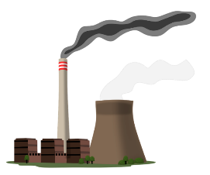
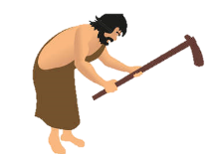
Over the course of humankind’s development, there have been two significant developments which fundamentally changed the way that we live on Earth and which can be identified as triggers for our changing global climate:
1. The Agricultural Revolution
2. The Industrial Revolution

Slide 13
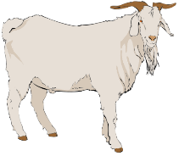
Humans began productively using the Earth’s resources for their nutrition around ten thousand years ago, when Neolithic agriculture began around 3200 BCE (Before Common Era).
The Neolithic Revolution was the first transition period for humans from nomadic hunter-gatherers to permanent settlers. The experimentation and introduction of food storage allowed for the production of extensive food surplus, and thus an ability to settle.
This was also when humans first began experimenting within the husbandry of plants and animals.

Slide 14
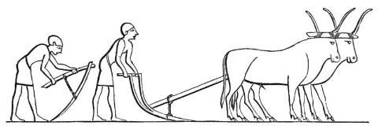
Humans thus started taking active control and ownership over the natural environment through the cultivation of food crops, the action of deforestation, the husbandry of animals and the implementation of irrigation systems.
This allowed a significant shift in behaviour as humans moved from basic survival towards to possibilities gained from a more sedentary existence. Communities were now able to start turning their attentions beyond their previous focus on survival (finding food, water and shelter each day).

Slide 15
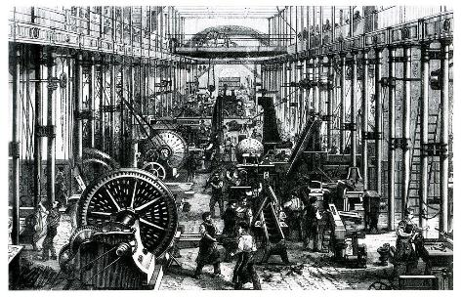
Moving forward in time, the Agricultural Revolution in the seventeenth to nineteenth centuries was fundamental in triggering the Industrial Revolution.
This period allowed a vast increase in agricultural productivity across parts of the world, in particular the United Kingdom.
It was a time of invention and discovery, much of which changed daily life for many people in different countries. Machines were starting to replace work that had been done by hand, saving time and human labour.

Slide 16
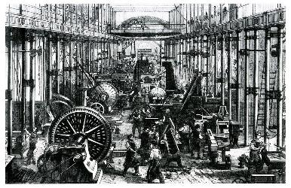
During this time, huge innovations in transport and energy were being developed and created, including railroads, cotton gins and electricity.
These developments emphasised the sense of ownership of (and separation from) the natural world.

Slide 17
These turning points were significant in many ways, not just for human development but for humans’ role in changing global climates.
In brief, these trigger points led to:
A sedentary state (shifting from a nomadic state).
A change in many humans’ relationship with the Earth (from living in balance to living in dominance).
An over-reliance and consumption of natural resources.
Rapid global population growth.
Many humans’ gradual disconnection from the natural world.

Slide 18
This is the definition of development from the Cambridge Dictionary:
Development: The process in which someone or something grows or changes and becomes more advanced.
In groups of three, take a couple of minutes to discuss the use of the word ‘development’ for some human processes, such as for the Agricultural and Industrial Revolutions.
Discuss in which ways it might make sense and in which it might not.

Slide 19
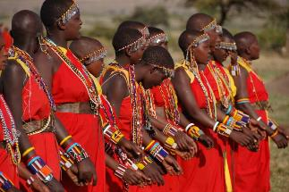
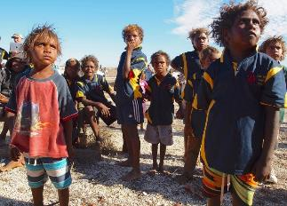
There are many people and cultures across every continent of the world who didn’t separate from the natural world as many cultures did, and who are living in ways which respect the balance of eco-systems and the connectivity of nature.
You will perhaps be familiar with many Indigenous or Aboriginal communities and cultures, whilst there are many you may not be aware of.
There is great wisdom in many Indigenous cultures and traditions about living in balance with nature and being a part of the natural world, rather than trying to dominate, control or own.

Slide 20
There is so much that we can learn with Indigenous and Aboriginal communities and cultures, but most importantly, we must learn to respect and honour their wisdom and care for the world.

Slide 21
As a class, take a couple of minutes to discuss the following question:
Why is humans’ separation from the natural world a significant issue in our current global environment?

Slide 22
INFINITE GROWTH ON A FINITE PLANET
15 MINUTES

Slide 23
Three main areas of humans’ interaction with the planet that have led to high levels of destruction of the Earth’s natural resources and eco-systems are:
1. CONSUMPTION
2. PRODUCTION
3. POLLUTION

Slide 24
Working with a partner or in small groups, spend two minutes coming up with one example of a human action within each of these three areas.
For example: Air travel
After five minutes, share your ideas together as a class and make a list on the board.

Slide 25
Now look at the list on the board and take a moment to discuss:
Which of these human actions lead to high concentrations of greenhouse gases in the atmosphere? How?

Slide 26
When humans first started consuming, producing and polluting, we didn’t realise the full impact or the ripple effects that these actions would create. We were also much fewer in numbers as our population on Earth was much smaller.
However, as industrial development allowed for a huge population swell across the world, there are now so many people living on the planet that are carrying out these actions, that the Earth can no longer cope with the demand we are placing.
This is why we are being asked to adapt or rethink some of our actions and habits as humans.

Slide 27
Take a moment to re-watch Steve Cutts’ video ‘Man’ and note down some of the actions or habits that are shown.
Categorise them into three lists as you watch:
1. PRODUCTION 2. CONSUMPTION 3. POLLUTION
Man (Click on the link above for the hyperlink)

Slide 28
Discuss these three questions together as a class. You may wish to use the images on the following three slides to help.
What are some of the ways in which we are consuming the planet?
What are we producing which is harmful to the planet?
How (and why) are we polluting the planet?

Slide 29
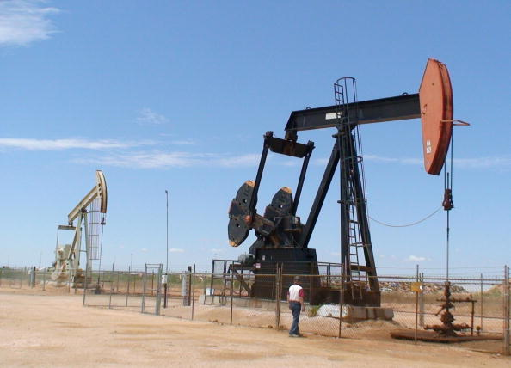
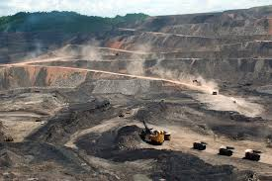
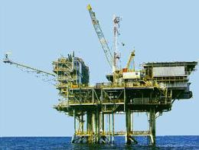
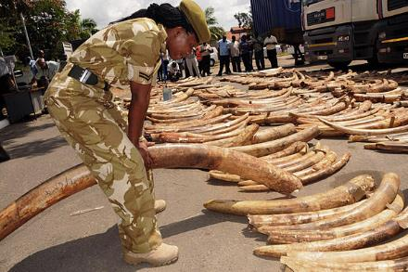
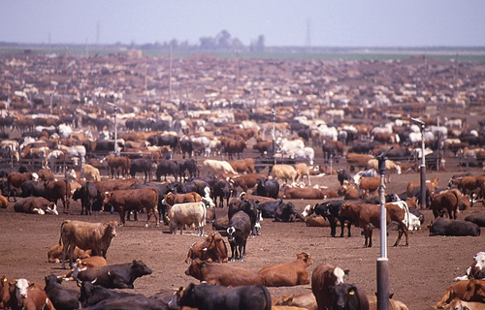
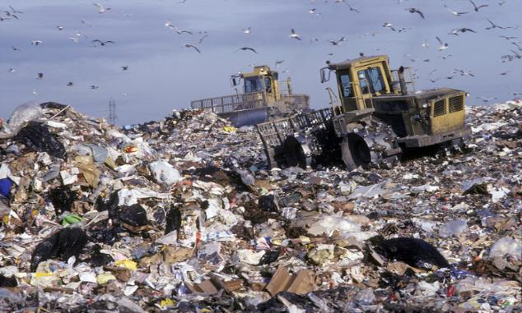
What are humans consuming in these images?

Slide 30
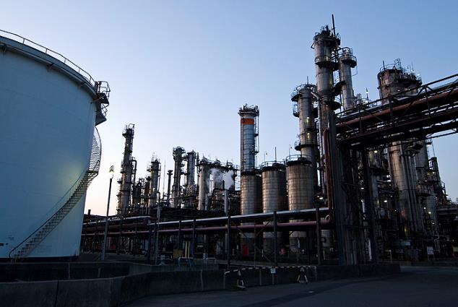
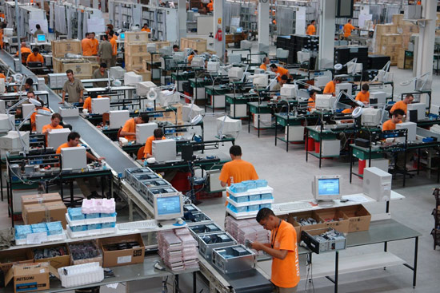
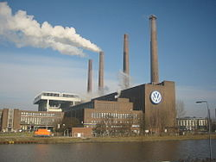
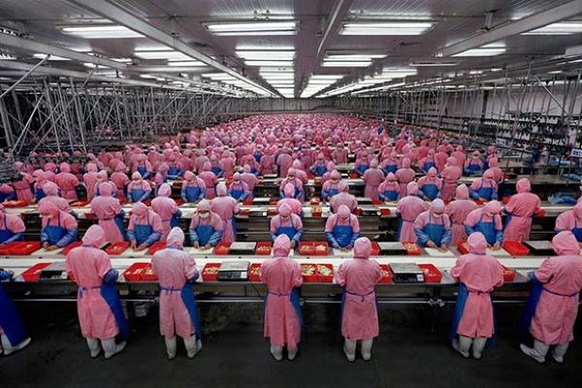
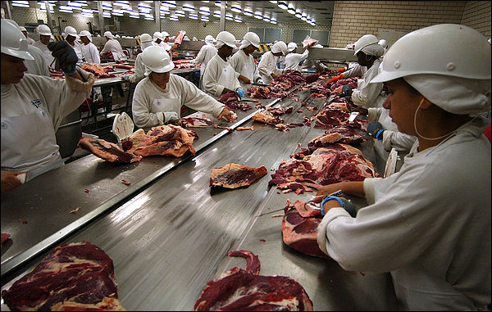
What are we producing in each of these images?

Slide 31
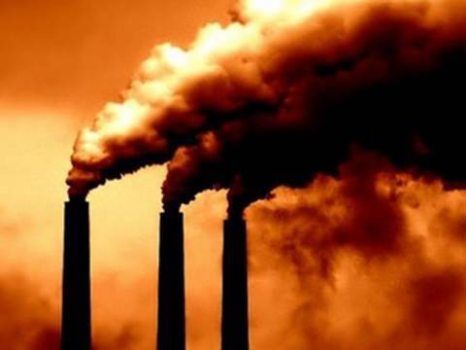
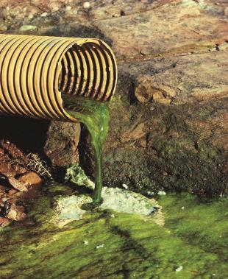
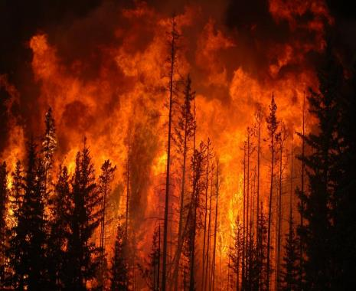
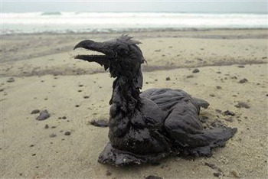
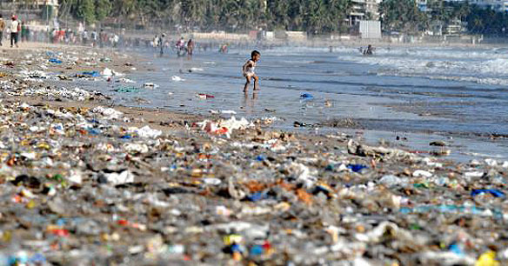
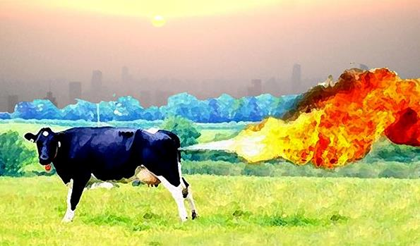
What sort of pollution is each of these images showing?

Slide 32
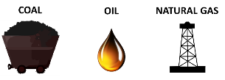
One of the biggest problems in the current consumption, production and pollution cycle is the overuse and overreliance on fossil fuels (a non-renewable energy source) as well as an increase in greenhouse gases caused by many of our actions. Humans have developed amazing systems that continuously take fossil fuels from the ground but we have no way of ever replacing them, meaning they will eventually run out.

Slide 33
As these actions are being carried out on such a mass scale, they have become unsustainable and the Earth can no longer cope.
Because the industrialised world is developing at such a rapid rate, and the rest of the world is being encouraged to follow, we find ourselves at a crossroads where we cannot sustain what we have started.

Slide 34
Take a moment to reflect on how you are feeling. Your body can give you important signs about your emotions; your heart might be racing or might have slowed down, your posture might have slumped a little or you might have sat a little straighter, your muscles might have relaxed or tensed.
However you are feeling, take a moment to take a couple of breaths before we move on.

Slide 35
UNDERSTANDING CAUSE AND EFFECT
20 MINUTES

Slide 36
The next slide shows eight of the most significant impacts of human actions caused by our imbalance with natural systems.
Many of these effects are a consequence of humans’ use of fossil fuels and increased production of greenhouse gases across the planet.

Slide 37
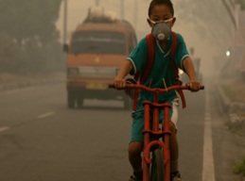
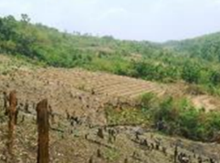
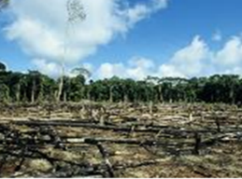
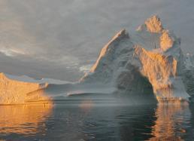
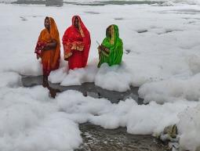
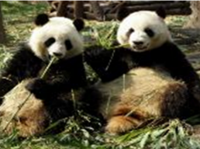
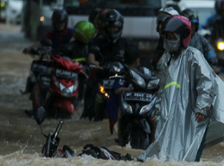
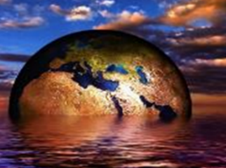
1. AIR POLLUTION | 2. SOIL EROSION | 3. BIODIVERSITY LOSS | 4. SEA-LEVEL RISES
5. WATER POLLUTION | 6. SPECIES EXTINCTION | 7. EXTREME WEATHER | 8. OCEAN ACIDIFICATION

Slide 38
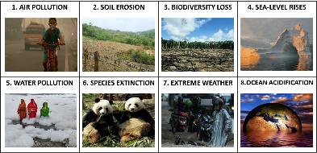
Working in small groups, choose one of the impacts and work together to create a chain of impact using these three questions:
What is causing this problem?
Think about the actions and the resources.
What is the immediate effect of this problem?
Think about the short-term noticeable impact on the human and non-human world.
What are some of the wider implications of this?
Think about the longer-term impact on the human and non-human world.
Go to the next slide for an example

Slide 39
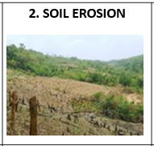
For example, let’s take the issue of SOIL EROSION.
What is causing soil erosion in many parts of the world?
What are some of the human actions that are making the soil unfit to grow crops? Why is this happening?
What is the immediate effect of soil erosion?
What happens to the crops and the people growing them? What happens to the landscape and biodiversity in the region?
What are some of the wider implications of soil erosion?
If land is no longer fertile, what happens to the people who live there and need to grow food? What happens to the non-human environment in the area?
Instructions continue on the next slide

Slide 40
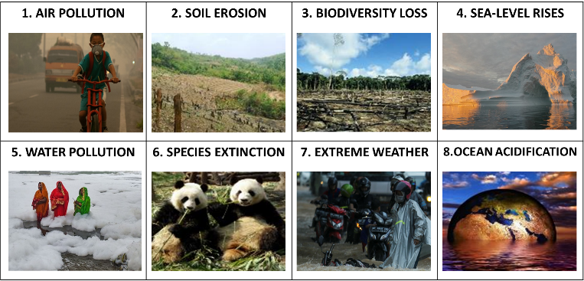
Working in small groups, spend 10 minutes discussing and noting down your ideas together. Use a large piece of A3 paper to note down your thoughts and ideas.
Each group then spend 1 minute presenting your ideas to the rest of the class.

Slide 41
As a class, take a moment to discuss how one of these impacts might be connected to another one, or more.
For e.g. Soil erosion causes a biodiversity loss because many plants will stop growing and many animals and birds won’t have shelter or food, which may also cause species extinction.

Slide 42
In pairs, take a couple of minutes to discuss the following question in terms of human-caused climate change:
How do you think it is important to understand the causes, effects and wider impacts of human action?

Slide 43
HOW DID WE GET HERE?
10 MINUTES

Slide 44
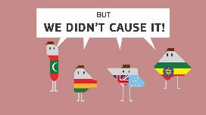
Watch this short video (1:23 minutes) made by Norwegian climate research organisation Cicero entitled:
The History of Climate Change Negotiations in 83 seconds
(Click on the link above for the hyperlink)
Notes:
Video URL: https://www.youtube.com/watch?v=B11kASPfYxY

Slide 45
Read this quote by Aminath Shauna, Minister of Environment, Climate Change and Technology of the Maldives, at the U.N. climate summit and discuss your thoughts as a class:
One of the themes expressed in this video is the difference between economically richer countries and those that are less economically rich.
For us, this is a matter of survival. Please do us the courtesy to acknowledge that it does not bring hope to our hearts but serves as yet another conversation where we put our homes on the line, while those who have other options decide how quickly they want to act to save those who don’t.
@Here's what world leaders agreed to — and what they didn't — at the U.N. climate summit

Slide 46
There are many individuals, groups, communities, countries and governments around the world working tirelessly to inspire positive changes and develop innovative ways for humans to live sustainably on the planet.
However, not everyone is on board - and many countries seem to be going backwards in their actions and responses. As a class, take a moment to discuss:
Why do you think some governments are not acting more on climate change?

Slide 47
There are endless ripple effects to consider when changing human actions to tackle climate change, as it is such a huge, complex issue.
For example, a country that wants to stop using coal as fuel to generate electric power might not have the economic means for other resources and/or infrastructure. That country might also not want to go into debt (or further debt).
Furthermore, if coal is no longer used, what happens to all of the people employed in the mines and whose livelihoods depend on the fossil fuel industry? Can an alternative be set in place in a timely and effective manner so that these people would not suffer large consequences?

Slide 48
Because climate change is such a complex issue, there isn’t a ‘quick fix solution’. As such, there are many disputes about how best to respond. There are also many reasons for political apathy or inaction, some perhaps more transparent than others.
However, there are even more significant ripple effects from doing nothing, which we are now starting to see right across the world.

Slide 49
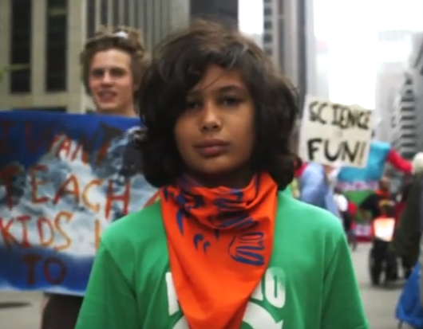
Watch this short video (3:39 minutes) made for Nononsense videos by Richard Roaf and Danny Chivers:
What’s really been going on?
(Click on the link above for the hyperlink)
Notes:
Video URL: https://www.youtube.com/watch?v=ucUmaClSWQw&feature=youtu.be

Slide 50
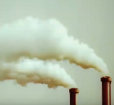
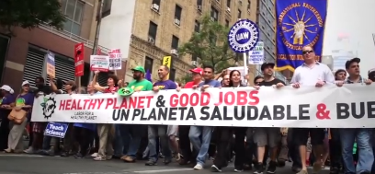
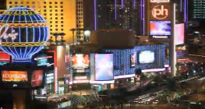
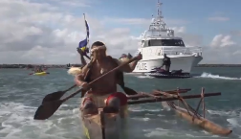
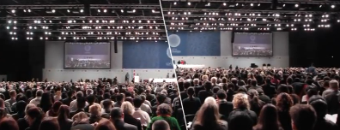
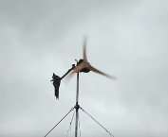
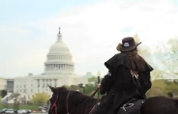
Take a moment to reflect on how your body responded to the different parts of the video. If you like, share this with the person sitting next to you or as a class.

Slide 51
TURN IDEAS INTO ACTION!
Choose one or do both!
ACTION 1: Pick a spot where you can observe living things – you can go to a park or simply observe a pot of plant or a line of ants.
Observe what you’ve chosen for at least five minutes.
Then, think about how this living being consumes, produces or pollutes.
Write down your reflections or share with a friend.
ACTION 2: Take one hour of your day (or the entire day if you like) and list what you consume, produce or pollute.
Next to each item, think about how you could change that so it is better for the planet, and yourself.
Write down your reflection or share with a friend.
Try to make at least one of those changes.

Slide 52
In this lesson, we explored the cause & effect of climate change, understanding the influence of human activities over time.
In the next lesson on Changing Climates we will be meeting some inspiring Changemakers taking action.

