Slide 1
EXPLORING NATURAL WORLD
THE

Slide 2
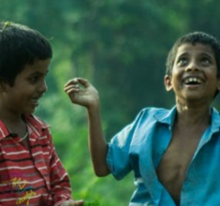
Y11-13 | AGES 15-18
AT A GLANCE | CHANGING CLIMATES| Lesson 3 – The Ripple Effects
15 minutes
NATURE CONNECTION: Explore the emotions and how we might feel connected to the natural world and the impacts of nature connection.
15 minutes
EXTREME WEATHER: Explore various impacts of human-caused climate change around the world through a video, images and questions.
Only got 45 minutes?
We recommend exploring the first three sections, meet one changemaker from the final section and finish with the last activity: ‘Turn Ideas Into Action.’
Only got 30 minutes?
We recommend exploring the first two sections and the last activity: ‘Turn Ideas Into Action.’
10 minutes
SPECIES EXTINCTION: Explore the serious consequences of species extinction from climate change and global initiatives that are working to push for change.
20 minutes
THE POSITIVE RIPPLES: In small groups, meet changemakers from around the world and explore their actions and work.

Slide 3
YEARS 11-13 | KS4/5| Ages 15-18
CHANGING CLIMATES
EXPLORING THE NATURAL WORLD

Slide 4
In this lesson you will need:
Internet access
Speakers
A4 paper
Pens and pencils
ThoughtBox Thought-Books* or paper
Images of the natural world (click here to open)
Fact-sheets for Global Changemakers (click here to print)
Here is a list of resources you will need for this lesson.
*We recommend students have a journal-style book for ThoughtBox lessons, in order to capture notes, ideas, drawings, reflections, inspiration and learnings.

Slide 5
LESSON 3 | CHANGING CLIMATES
THE RIPPLE EFFECTS
60 MINUTES

Slide 6
In this lesson, we will:
Understand and explore some of the consequences of climate change on different species, communities and countries.
Think about some of the impacts of climate change on the human and non-human world, and explore positive responses and actions.
Connect the dots on the ripple effects of human actions and the connectivity and interdependence of different species.

Slide 7
NATURE
CONNECTION
15 MINUTES

Slide 8
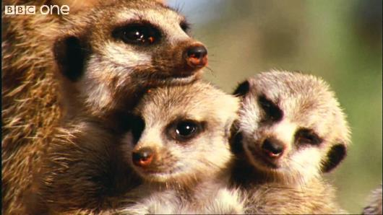
To begin, let’s watch the short video (2:00 minutes) made by the BBC featuring David Attenborough entitled:
What a Wonderful World
(Click on the link above for the hyperlink)
Notes:
Video URL: https://youtu.be/auSo1MyWf8g

Slide 9
In pairs, discuss the following questions:
Does the natural world inspire any emotions in you? Why? And if so, which?
How do you feel after watching this video? Why?
Then, take a look at these 10 images (click here). Pause at each image and think about what each one makes you think about and how it makes you feel.
Notes:
Images URL: https://static1.squarespace.com/static/595caeca2e69cf0e4a94010f/t/5dd6effd3ce4261ee21c165a/1574367242874/The+Natural+World.pdf

Slide 10
Last lesson we explored some of the ways that humans have become disconnected from the natural world and the consequences of this disconnection.
Disconnection can be seen as a major contributor to climate change – by being disconnected from the natural world, we are more able to carry out actions that are destructive or harmful.

Slide 11
It is for that reason that these lessons have encouraged some kind of connection with nature, such as this invitation from Lesson 1:
These practices may be very familiar to some of us, and very unfamiliar and even uncomfortable or silly to others. Being aware of these feelings and the concept of disconnection from nature is the first step to what can be important and insightful conversations and reflections.

Slide 12
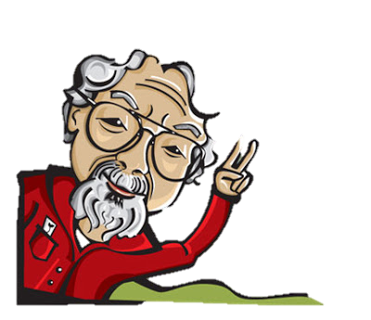
For example, some people argue that we feel less inclined to protect what we don’t first love, and so if we want to encourage more people to take action on climate change, we need to encourage more people to connect to the natural world.
Unless we are willing to encourage our children to reconnect with and appreciate the natural world, we can’t expect them to help protect and care for it.
David Suzuki |Academic & Activist

Slide 13
Read the poem ‘May we raise children who love the unloved things’ by Nicolette Sowder. As a class, take a couple of minutes to share some of your reflections.
May we raise children who love the unloved things Nicolette Sowder
May we raise children who love the unloved things – the dandelion, the worms & spiderlings. Children who sense the rose needs the thorn & run into rainswept days the same way they turn towards sun…
And when they’re grown & someone has to speak for those who have no voice may they draw upon that wilder bond, those days of tending tender things and be the ones.

Slide 14
Do you think nature connection is important in encouraging positive climate action? Why or why not?
Many doctors today are prescribing “nature time” to patients, as it has been scientifically proven that nature is good for our mental, physical & spiritual health.

Slide 15
In trios, take a couple of minutes to discuss what nature connection means to each of you individually, and to list specific activities that you would personally enjoy doing that would strengthen a sense of connection with nature.

Slide 16
EXTREME WEATHER
15 MINUTES

Slide 17
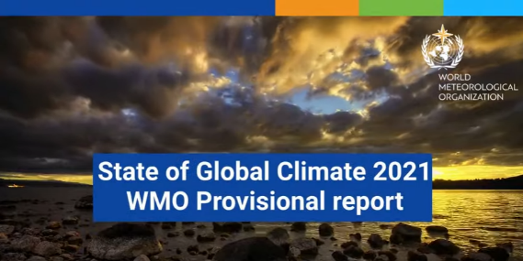
To begin, let’s watch the short video (1:44 minutes) made by World Meteorological Organization - WMO, entitled:
WMO State of the Global Climate 2021 Provisional report (Click on the link above for the hyperlink)
Notes:
Video URL: https://www.youtube.com/watch?v=uy8NP18IsFc

Slide 18
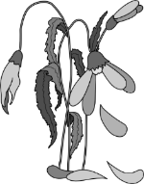
In trios, or as a class, take a couple of moments to discuss the following questions:
What impacts are you seeing of climate change where you live? Have you experienced any direct impacts?
How have you felt about the impacts of climate change elsewhere in the world?

Slide 19
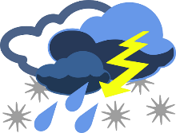
Extreme weather is becoming much more common in every country across the planet, with wilder weather and unpredictable changes in our climates.
Changes in climate due to human actions are caused by many habits that we have as humans that are harmful to the planet. Humans’ use of fossil fuels and the increase of carbon dioxide and methane into the atmosphere are the biggest culprits.
There have been exponential cases of extreme weather conditions affecting communities across the world – in the Global North and the Global South:

Slide 20
Wildfires
Greece

Slide 21
Winter storms Texas

Slide 22
Flooding
New South Wales

Slide 23
Dust storm
China

Slide 24
Hurricane Ida
USA

Slide 25
Heat dome
Pacific Northwest

Slide 26
Monsoon floods
India and Nepal

Slide 27
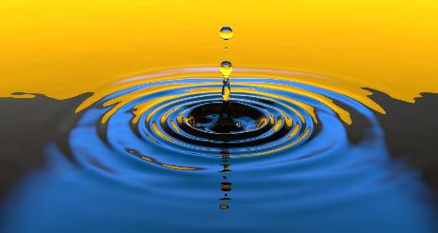
We can clearly see how these cases of extreme weather affects the humans in these particular places.
However, these cases have systemic effects; they affect many other species and lead to mass migrations of many living beings – insects, mammals, birds and humans – impacting ecosystems and communities all over the world, from the origins to the destinations.
To find out a little more of each of these weather events, click here

Slide 28
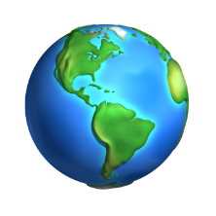
Already across the world, species are having to adapt to changing climates by moving, migrating or ‘fleeing’ areas which are no longer habitable for them.
We are also seeing this same pattern in human behaviour, as different communities across the world are having to adapt to climate change and move, migrate or flee from the impact or to find new land to grow food.
Species are moving on average 17km further north or south in the world to find cooler climates every 10 years.
Species are moving on average 11km higher up in their environments to find cooler climates every 10 years.

Slide 29
There are already millions of climate migrants across the world – people having to adapt to the changing climate and move to cooler, safer or more fertile areas to live, often away from the coastline or from land that is no longer fertile.
We have been seeing the impact of this for several years in sub-Saharan Africa, South Asia, and Latin America, but it is now impacting people and communities in countries across the world in both the Global North and Global South.

Slide 30
In trios, brainstorm a couple of answers to the following questions:
Do you know of any cases of humans moving because of climate change?
What are some of the future ripple effects of growing numbers of climate migrants?

Slide 31
Now, as a class, take a few minutes to discuss the following questions:
Why do you think climate change might affect the global south more? How do you think it affects the whole world (north and south)?

Slide 32
Take a moment to reflect on how you are feeling. Notice how your body has been reacting to this information and discussions. Be mindful of what you might need at this moment.
However you are feeling, take a moment to take a couple of breaths before we move on.

Slide 33
SPECIES EXTINCTION
10 MINUTES

Slide 34
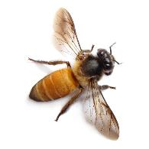
One of the biggest effects of climate change during this new era of the Anthropocene is species extinction, and many scientists state that we have entered the Sixth Mass Extinction.
Already across the world, we are seeing plant, animal and insect numbers dwindle and entire species disappear from the face of the Earth, due for the most part to the rise in use of pesticides, our use of fossil fuels and the increase in greenhouse gases.

Slide 35
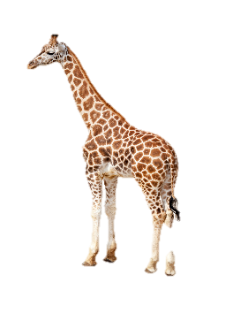
Many creatures are on the endangered species list and ever-growing numbers are facing threats to their population levels. Species at risk include whales, giraffes, butterflies and bumblebees.
News outlets across the world are now sharing stories of the rapid rate of extinction and helping us to understand the impact on people and planet:

Slide 36
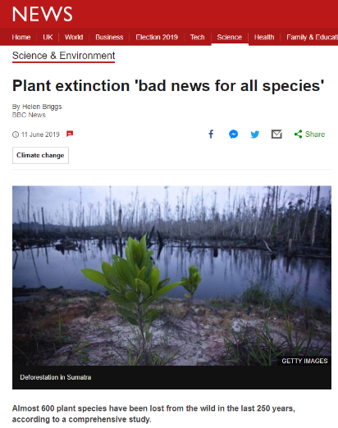
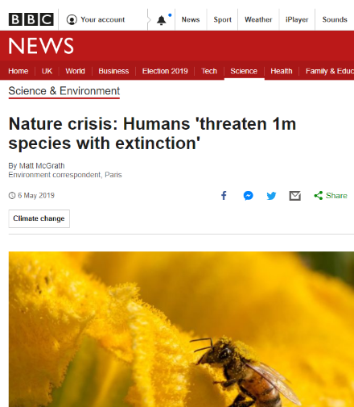
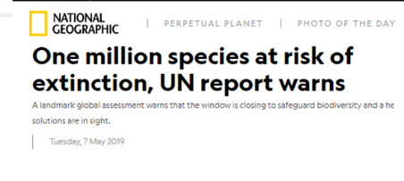
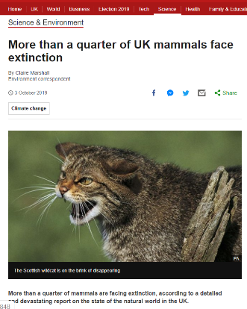
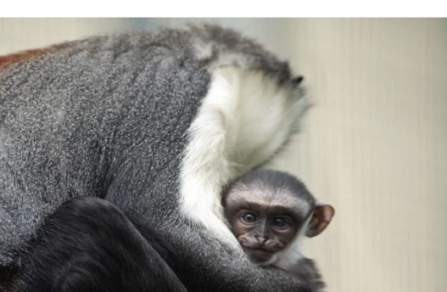
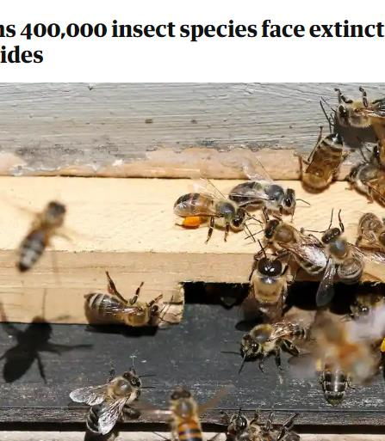
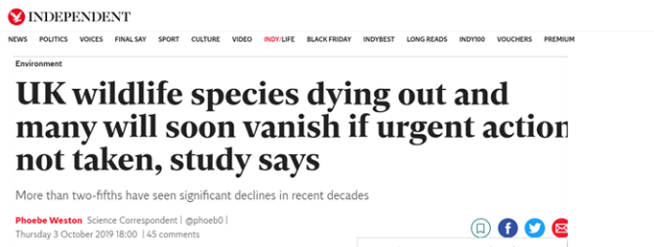
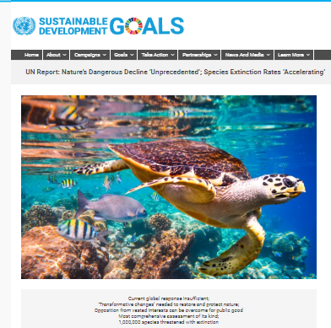
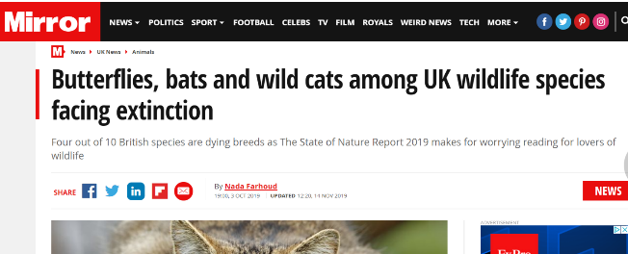
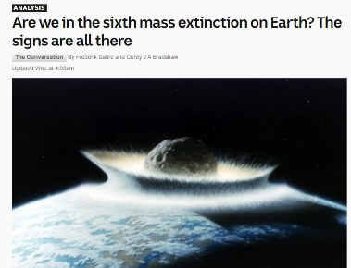

Slide 37
It may seem that species being threatened with extinction is an emotional problem – after all, a world which no longer contains elephants, butterflies, orangutans or bumble bees feels quite a sad world to live in.
But why else does this matter? Why should an insect, plant or little mouse disappearing from the Earth matter to us all?
As a class, take a moment
to discuss:
What do you know or understand about the balance of the ecosystem? Why is it important?

Slide 38
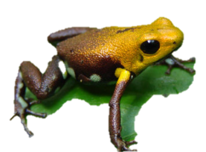
Human beings are embedded in ecosystems all over the world and are dependent on them in the same way as every other species on the planet. Every species plays a significant role within their ecosystem.
The accelerated extinction of species will have a dramatic knock-on effect through the collapse of ecosystems, impacting humans and our ability to maintain food production, access clean air and water and stay healthy.

Slide 39
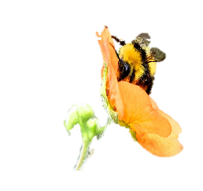
In particular, pollinators (bees, wasps, ants, flies, butterflies, beetles etc.) are vital to creating and maintaining the habitats and ecosystems that we and other species rely on for food and shelter. Virtually all of the world’s seed plants need to be pollinated. Without pollinators, ecosystems would not survive – and yet pesticides are destroying vast numbers of insects daily, even though many pesticides they are deemed as positive.
Insects are by far the most varied and abundant species on the planet. The good news is that insects and other invertebrates can recover quickly if we stop destroying them and restore the habitats they need to thrive.

Slide 40
As a class, take a couple of moments to brainstorm answers for the following questions:
What initiatives are you aware of that are helping to rejuvenate pollinators? Why are they important?

Slide 41
If time and interest allows, read a letter from naturalist Chris Packham to British TV presenters Ant & Dec encouraging them to rethink one of the challenges on their popular TV programme “I’m a Celebrity – Get me out of here”. Please re-think the Bush Tucker Trials (Click on the link to read the letter).
Do you agree with Chris’s thoughts? Why?
Notes:
Letter URL: https://static1.squarespace.com/static/595caeca2e69cf0e4a94010f/t/5dd193801a63bd7bd1a470f7/1574015873992/Chris+Packham+Letter+to+Ant+&+Dec.pdf

Slide 42
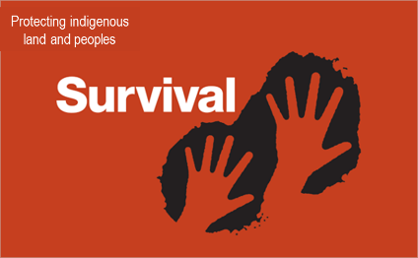
There are hundreds of global initiatives working to push for significant change in government policy and practice to preserve land and natural habitats.
You can explore a few of these inspiring initiatives and organisations by clicking on the images (if time and interest allows).
Notes:
URLs:
https://www.wildlifetrusts.org/nature-recovery-network
https://www.survivalinternational.org/
https://earthrights.org/
https://www.stopecocide.earth/polly-higgins

Slide 43
THE POSITIVE RIPPLES
20 MINUTES

Slide 44
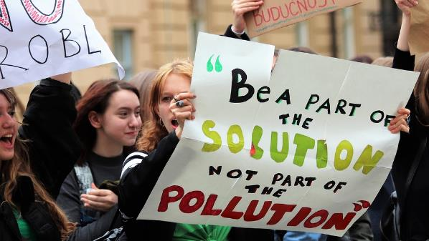
Not only are there organisations, but hundreds of thousands of individuals and groups of people across the world working on ideas, inventions, solutions and new systems to address the climate crisis, and there are new possibilities for changing humans’ habits popping up across the world.
In the face of distress, anxiety and despair, now is the time for innovation, creativity and possibility – and there are so many exciting possibilities for us all to explore!

Slide 45
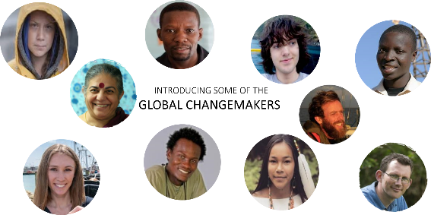
Here are just ten of the millions of people working on healthy alternatives to some human habits, developing ideas which are good for both people and planet.
Either split into small groups and each meet one of the ‘changemakers’ or explore a few together as a class.
Think about and discuss which problem they are addressing and how their work may benefit people and planet.
NB: Simply click on the image on the next slide of the person you wish to meet to find out who this changemaker is and what they are doing to change the world for the better!

Slide 46
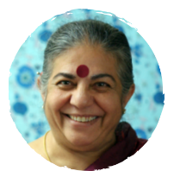
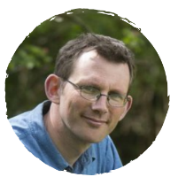
INTRODUCING SOME OF THE GLOBAL CHANGEMAKERS

Slide 47
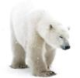
Just like so many species across the world, humans will also have to adapt and make changes to respond to and prevent escalating climate change.
In the next lesson on Changing Climates, we are going to explore ways we can all feel empowered and take actions which will have positive ripple effects across the world.
And that is why people across the world are changing habits on an individual, local, national and global scale and doing exciting and empowering things to help support the next generation to thrive.

Slide 48
Actions we make as individuals may seem small, but they all have huge ripple effects and chain reactions that we may never even know about. You are never too small to make a difference.

Slide 49
TURN IDEAS INTO ACTION!
Choose one or do both!
ACTION 1: Empathy with others
Notice as many living beings (human or non-human) that are being impacted by climate change.
Take a moment to empathise how it might be for them.
Brainstorm how these perceptions can influence the way you normally do something in your life.
ACTION 2: The small actions
Notice as many people, groups and actions around you that support the wellbeing of Earth – small or big.
Identify a characteristic that they have in common.
Brainstorm how these can inspire and influence the way you normally do something in your life.

Slide 50
In this lesson, we explored nature connection and empathised with the impact of climate change on human and non-human communities in different contexts and environments.
Next lesson, we are going to explore what kind of actions make sense for each of us individually and collectively for a healthier planet.

Slide 51
