Slide 1
EXPLORING NATURAL WORLD
THE

Slide 2
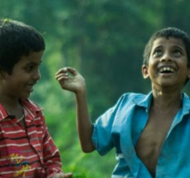
Y7&8 | AGES 11-13
AT A GLANCE | CHANGING CLIMATES| Lesson 1 – Our Changing Climate
15 minutes
WEATHER OR CLIMATE?: Discuss and learn about the difference between weather and climate in order to understand natural and human-led climate change.
15 minutes
WHY IS OUR CLIMATE CHANGING?: Explore greenhouse gases in order to understand the reasons for human-led climate change. Teach each other through a knowledge swap.
Only got 45 minutes?
We recommend exploring the first three sections of this lesson – and, if time, finishing with nature connection (the final activity in the lesson plan).
Only got 30 minutes?
We recommend exploring the first two sections of this lesson, and exploring some impacts of climate change from the third section.
15 minutes
HOW IS OUR CLIMATE CHANGING?: Working in small groups, explore different impacts of climate change for four different species.
15 minutes
TRAVELLING THROUGH DEEP TIME: Enhance our perspective of human history within the history of the Earth through ‘Deep Time’, so that we can better situate human’s responsibility for human-led climate change.

Slide 3
YEARS 7&8 | KS3| Ages 11-13
CHANGING CLIMATES
EXPLORING THE NATURAL WORLD

Slide 4
In this lesson you will need:
Internet access
Speakers
Pens or coloured pencils
ThoughtBox Thought-Books* or paper
Large sheets of paper (optional for final task)
Here is a list of resources you will need for this lesson.
*We recommend students have a journal-style book for ThoughtBox lessons, in order to capture notes, ideas, drawings, reflections, inspiration and learnings.

Slide 5
LESSON 1 | CHANGING CLIMATES
OUR CHANGING
CLIMATE
60 MINUTES

Slide 6
In this lesson, we will:
Understand the impacts of weather on humans, plants and animals.
Think about and discuss the difference between weather and climate.
Explore ‘Deep Time’ and the age of the planet, to begin making the connection between human activity and climate change.

Slide 7
Before we start this topic, take five minutes in your ThoughtBox Thought-Book to answer these three questions:
When you think of ‘climate change’, how does it make you feel?
What does ‘climate change’ make you think about?
How does climate change impact your life, do you think? And of others?
You may write down words, phrases, doodle or draw your answers!

Slide 8
WEATHER OR CLIMATE?
15 MINUTES

Slide 9
First, we are going to do a very quick activity!
The next slide contains a phrase. When you’re ready, your teacher will count from 1 to 3 and then show you the phrase in the next slide.
This is the part where you will have to be quick! You will turn to the person next to you and say the first word that comes to your mind when you think of that phrase.
Ready? 1….2….3….!
QUICK!!!!

Slide 10
The phrase is…
‘CLIMATE CHANGE’
‘CLIMATE CHANGE’
Quickly! Turn to the person next to you and say the first word that comes to mind!

Slide 11
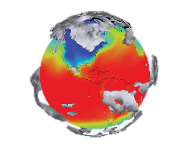
Have you been hearing a lot about ‘climate change’ lately? Maybe you have heard about it at school, or in the news, or maybe you and your friends talk about it. Maybe you have noticed many changes in the weather where you live, or maybe around the world.
But how is that linked to the climate and how is that different to the weather?
And what does the phrase ‘climate change’ actually mean?

Slide 12
Take a couple of seconds to think about this question:
What is the difference between climate and weather?

Slide 13
The main difference between climate and weather is:
TIME
Weather is the conditions on a short time-scale – minutes, hours, days, seasons.
Climate is the weather pattern over a long time-scale.

Slide 14
In brief, climate is what you expect, weather is what you get.
Weather is the day to day conditions.
It’s what you see outside on any given day.
Weather events include snow, rain, sun and wind. These happen in a particular place and can vary across a local area.
Climate is the big picture.
It’s the average weather conditions over a long period of time.
Climate covers a large region, sometimes a whole country.

Slide 15
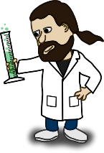
Throughout time, there have been natural changes in the climate. Yet, scientists have discovered that the current changes are due to human activity.
The reason scientists and many other folks are concerned is that Earth's global climate is changing and our planet is warming up fast — faster than at any other time scientists know about from their studies of Earth's history.

Slide 16
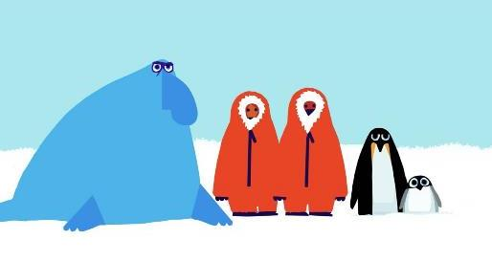
Watch the short film (2:51 minutes) made by Emily Shuckburgh, an oceanographer at the British Antarctic Survey, and Chris Haughton, author and illustrator, entitled:
Message from Antarctica
(Click on the link above for the hyperlink)
Notes:
Video URL: https://www.youtube.com/watch?v=931drXJDqT4

Slide 17
This video explores some difficult ideas.
You might be feeling a bit overwhelmed right now or equally you may be feeling excited about these ideas. However you are feeling, let’s have a few minutes of quiet time to reflect.
Put your head onto your hands on the table, close your eyes and think about how this video made you feel. When you’re ready, silently put you head back up until everyone is ready.

Slide 18
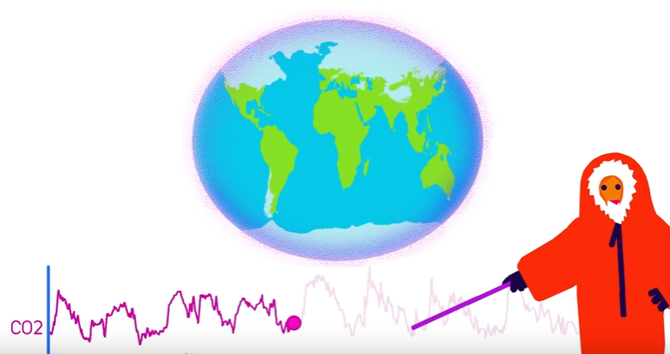
The video ‘Message from Antarctica’ explains how the Earth’s climate has changed over time and introduces the history of climate change.
It shows that the more CO₂, the warmer the Earth – CO₂ is low during ice ages, and CO₂ is high during warm periods.

Slide 19
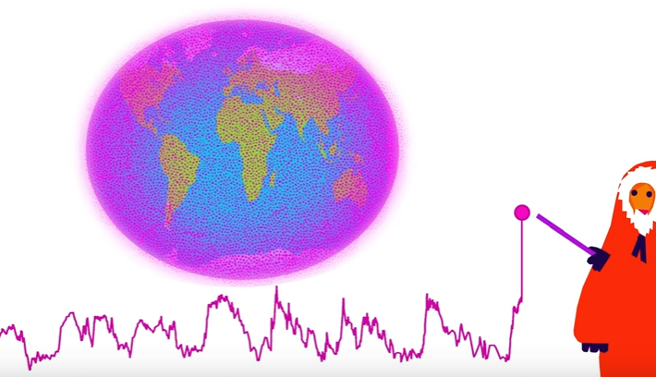
But we are recording much higher levels of CO₂ today...

Slide 20
As a class, take a couple of moments to reflect on the following question:
What is the difference between natural climate change and human-caused climate change?

Slide 21
WHY IS OUR
CLIMATE CHANGING?
15 MINUTES

Slide 22
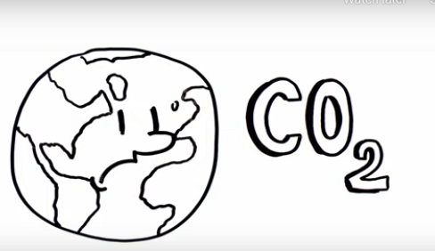
Watch the short film (1:42 minutes) made by NASA Climate Change, entitled:
NASA's Earth Minute: Gas Problem
(Click on the link above for the hyperlink)
Notes:
Video URL: https://www.youtube.com/watch?v=K9kga9c0u2I

Slide 23
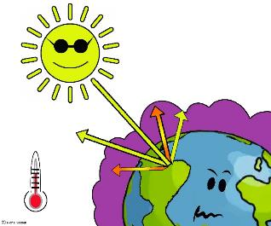
Understanding the greenhouse gases
Life on Earth is possible because of the warmth of the Sun. While some of the incoming light, heat and radiation from the Sun bounces right back into space, some of it is trapped by the greenhouse gases that make up our atmosphere. These layers of greenhouse gases are the Earth’s ‘blanket’.
Without this layer of insulation, Earth would simply be a frozen rock hurtling through space. Therefore, the ‘blanket’ is a really important layer.
However, it has got far too thick and is now causing problems across the globe.

Slide 24
There are six main greenhouse gases in the Earth’s atmosphere that make up ‘Earth’s blanket’. These are:
CARBON DIOXIDE
WATER VAPOUR
METHANE
OZONE
NITROUS OXIDE
CHLOROFLOROCARBONS

Slide 25
Carbon dioxide and Methane are two greenhouses gases that humans are making too much of – they are making the ‘blanket’ too thick. Let’s take a closer look.
Can you name a couple of human activities that create these gases?
CARBON DIOXIDE
METHANE

Slide 26
Carbon dioxide (CO₂) is the most important gas in this blanket of insulation surrounding the Earth.
Right now, we have extremely high levels of CO₂ in the atmosphere which are causing our polar regions to warm and melt.
Carbon is stored all over the planet — in plants, soil, the ocean, and even us. We release it into the atmosphere as carbon dioxide through breathing which is a natural occurrence and in balance with the Earth.

Slide 27
One reason that we are experiencing climate change at the moment is in part due to humans creating unnatural levels of CO₂ in the atmosphere.
We are releasing too much CO₂ into the atmosphere through activities such as burning fossil fuels (like coal, oil and gas) and deforestation – the chopping down of trees.
We trees are one of the best things on the planet for ‘capturing carbon’!

Slide 28
Methane (CH₄) is another greenhouse gas that humans are creating too much of. Methane doesn't stay in the atmosphere as long as carbon dioxide, but it is far more harmful to the climate initially because of how effectively it absorbs heat.
There are 1.4 billion cattle in the world, and that number is growing as demand for meat and dairy increases.
Methane levels have risen because of humans in part due to the growing demand for meat. Animals such as cows and sheep produce large amounts of methane when they digest their food. The growing demand for meat means more cows and sheep, and more amounts of methane.

Slide 29
Quick ocean fact!
Did you know that the Earth’s oceans soak up around 30% of the carbon dioxide emitted into the atmosphere? The ocean also does a great job of absorbing excess heat from the atmosphere, stored in the top part of the sea.
If the sea water is too acidic, many of us are unable to make strong shells to protect ourselves.
However, when the ocean absorbs a lot of CO₂, the water becomes more acidic, which affects many oceanic living beings.

Slide 30
Three fast greenhouse-gas facts!
Trees help to regulate the climate by absorbing carbon dioxide from the atmosphere. This can’t happen if
we cut down trees & forests, which also releases the carbon stored in the trees.
Animal agriculture increases emissions as cows and sheep produce large amounts of methane when they digest their food.
Burning fossil fuels (coal, oil and gas) produces carbon dioxide and nitrous oxide.

Slide 31
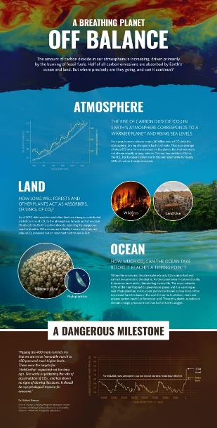
If you’d like to learn more about the importance of keeping the planet in balance, take a look at this infographic.
You can click here to open a larger version online.
Notes:
Infographic URL: https://climate.nasa.gov/climate_resources/136/infographic-earths-carbon-cycle-is-off-balance/

Slide 32
It’s time for a knowledge swap!
One of the best ways to learn new ideas is by teaching each other. In pairs, each pick one of the following questions to teach each other in turns. Help each other out if you get stuck. If there’s time, you can choose more than one question to teach!
What is the greenhouse effect?
Why are forests and oceans important?
What is ‘climate change’?
What is the difference between weather and climate?

Slide 33
We are becoming ever-more aware of human-caused climate change and some of the effects and impacts. All of us, no matter where we live in the world, will have started to see or experience these.
What about you?
What have you seen, experienced or heard about that are examples of the impacts of climate change?

Slide 34
HOW IS OUR CLIMATE CHANGING?
15 MINUTES

Slide 35
We are going to explore how climate change affects humans, plants, animals and birds.
Split into small groups and each group is going to become one of these species (you can have more than one group with the same species.)
Species 1: Plants
Species 2: Humans
Species 3: Animals
Species 4: Birds

Slide 36
In the next couple of slides, you are going to see five examples of the impact of climate change around the world.
For each image, take a couple of minutes to discuss how this impact of climate change affects the species your group picked. Think about shelter, food and water.
Species 1: Plants
Species 2: Humans
Species 3: Animals
Species 4: Birds
Instructions continue in the next slide

Slide 37
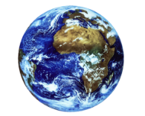
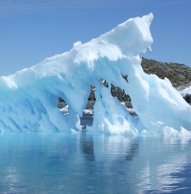
When thinking about the effects, think locally and globally!
Climate change might seem like it affects a specific place (local), but it could have impacts all over the world (global).
For e.g.: Icebergs might melt in Antarctica, but as a consequence, ocean levels all over the world can rise. That would affect many different species!

Slide 38
Icebergs melting

Slide 39
Take a minute to talk about how this impact of climate change affects your group’s species.
Remember to think:
Locally and globally.
About shelter, food and water.
Species 1: Plants
Species 2: Humans
Species 3: Animals
Species 4: Birds

Slide 40
Forest fires

Slide 41
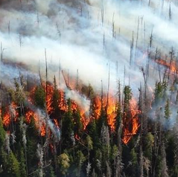
Take a minute to talk about how this impact of climate change affects your group’s species.
Remember to think:
Locally and globally.
About shelter, food and water.
Species 1: Plants
Species 2: Humans
Species 3: Animals
Species 4: Birds

Slide 42
Drought

Slide 43
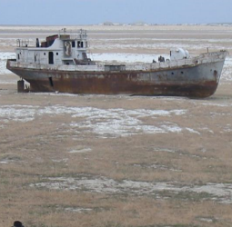
Take a minute to talk about how this impact of climate change affects your group’s species.
Remember to think:
Locally and globally.
About shelter, food and water.
Species 1: Plants
Species 2: Humans
Species 3: Animals
Species 4: Birds

Slide 44
Flooding

Slide 45
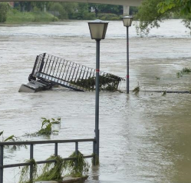
Take a minute to talk about how this impact of climate change affects your group’s species.
Remember to think:
Locally and globally.
About shelter, food and water.
Species 1: Plants
Species 2: Humans
Species 3: Animals
Species 4: Birds

Slide 46
Crop failure

Slide 47
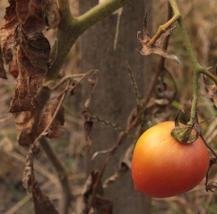
Take a minute to talk about how this impact of climate change affects your group’s species.
Remember to think:
Locally and globally.
About shelter, food and water.
Species 1: Plants
Species 2: Humans
Species 3: Animals
Species 4: Birds

Slide 48
Icebergs melting
Forest fires
Drought
Flooding
Crop failure
Each group share one reflection about how one of these impacts affects your group’s species.
Species 1: Plants
Species 2: Humans
Species 3: Animals
Species 4: Birds

Slide 49
Plants, birds and animals are adapted to the weather where they live, as well as us humans – we know what to wear at different times of the year, when we need to put more clothes on, when we can spend time outdoors comfortably and what we need to do to survive through different seasons.
This gets really hard to do if the weather starts changing drastically because of climate change!

Slide 50
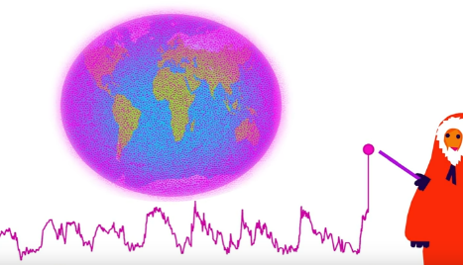
As we have seen in the previous sections, Earth has experienced changes in climate before. But these changes happen over a very long period of time.
Earth is having trouble adapting with human-caused climate change because it’s happening so quickly.
In order to understand just how quickly human-caused climate change really is, we have to understand time in Earth’s perspective. Let’s do that now!

Slide 51
TRAVELLING THROUGH DEEP TIME
15 MINUTES

Slide 52
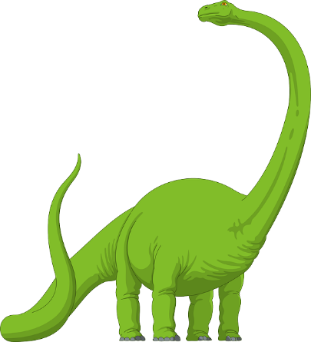
Most of the history we learn about in school focuses on human history and stories of our own life on Earth.
Yet the Earth has a history long before humans came along, long before dinosaurs came along and so long before, that it is hard for any of us to really imagine it.

Slide 53
In pairs, take a moment to discuss the following question:
Have you ever heard the phrase ‘Deep Time’?
What do you think it could mean?

Slide 54
‘Deep Time’ is the amount of time that the Earth has existed:
This number is so huge, it is really difficult for us humans to grasp. When our life expectancy is usually less than 100 years, it’s almost impossible for us to imagine something so vast as Deep Time.
The Earth is roughly 4.6 billion years old!

Slide 55
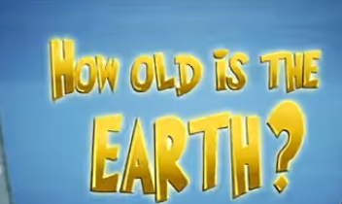
To better understand and imagine Deep Time, we can think about a couple of metaphors.
Watch the short video (3:44 minutes) made from TED-Ed, entitled:
Four ways to understand the Earth's age
(Click on the link above for the hyperlink)
Notes:
Video URL: https://www.youtube.com/watch?v=tkxWmh-tFGs

Slide 56
Thinking about Deep Time helps us to understand that human beings are relatively new to the planet. In pairs, take a moment to discuss:
Were you aware of how recent human beings are to the Earth?
How does this make you feel? Why?

Slide 57
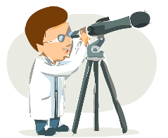
It’s important to think about the life span of the planet Earth, as this is one of the reasons scientist believe that the causes and the rate of climate change is due to the actions of humans.
The history of the Earth – not just of humans – also shows that the current change in climate is much faster than at any other time scientists know about.

Slide 58
The video we watched showed us a couple of ways to understand Deep Time. Choose one or both of the following journeys and travel together as a class.
*Each of these can be an individual project or a class project – you may just want to look at them today and come back to them another time.
1. Draw a clock of Deep Time, using the second slide to help you.
2. Take a Deep Time walk using the second slide. NB: This would take a few hours and could be a great school trip or class outing that you may wish to arrange if possible.

Slide 59
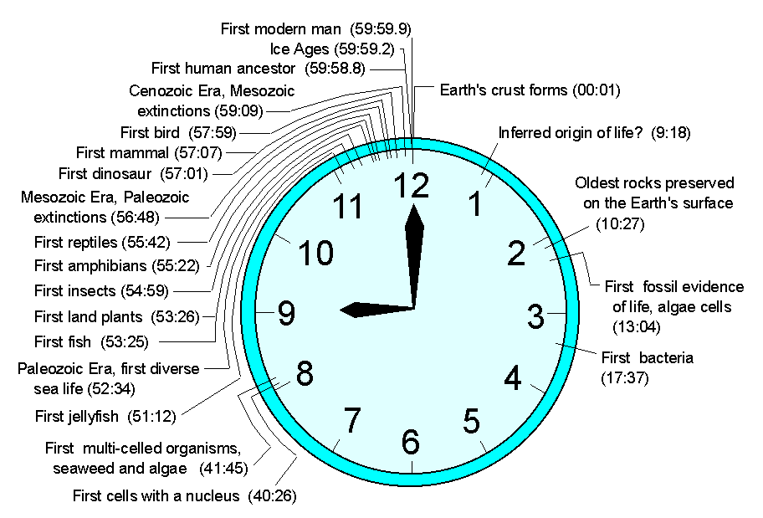
1. Create a Deep Time clock
Here is an example of Deep Time using a clock – why not have a go at making your own?

Slide 60
2. Take a Deep Time Walk
Walk 4.6 km through 4.6 billion years of Earth history, learn about key concepts from Earth’s evolution and experience a unique perspective of Deep Time with a Deep Time app.
Designed using appropriate technology, the Deep Time Walk app calculates your speed and distance as you journey across 4.6 billion years of time, enabling you to learn about key evolutionary events as they occur over the history of the Earth.
The dramatised Deep Time Walk can be experienced anywhere in the world! You can learn more here and download the app for free.
www.deeptimewalk.org
Notes:
URL: https://www.deeptimewalk.org/

Slide 61
As a class, take a few minutes to reflect on the following question:
Why might Deep Time help us to respond to the changing climate?
If you can, think about some concrete examples.

Slide 62
We explored a lot in this lesson but climate change can be a difficult topic to talk about. It can inspire feelings of sadness, anger, confusion, apathy, etc.
It is important to recognise these feelings as valid and to not supress them.
Throughout this topic, remember to be mindful of your feelings and needs.

Slide 63
TURN IDEAS INTO ACTION!
One great characteristic of nature is that the natural world can make us feel connected – after all, humans are part of nature!
If at any time you’re feeling scared, overwhelmed, or angry, take a moment to breathe in and out and focus on what is alive around you. You might want to go to a nearby park, or simply walk over to a tree, or listen to a bird sing. You may even choose to look inside, and focus on your breathing and what is keeping you alive! These actions can help you feel calmer.

Slide 64
In this lesson, we explored the reasons and consequences for human-led climate change as well as a Deep Time perspective.
Next lesson we are going to learn more about the human actions that are causing climate change. By understanding what and how some actions might be harmful for the planet and ourselves, we can identify which actions we can all work towards instead.

Slide 65
