Slide 1
EXPLORING NATURAL WORLD
THE

Slide 2
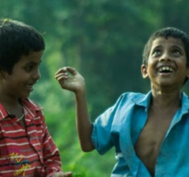
Y7&8 | AGES 11-13
AT A GLANCE | CHANGING CLIMATES| Lesson 2 - Cause and Effect
15 minutes
THE HUMAN INFLUENCE: Recognise our responsibility as humans by exploring human actions that cause climate change. Includes a reminder on the importance of self-care.
15 minutes
HUMAN HABITS: Working in small groups, identify habits that are harmful for the planet through images and questions.
Only got 45 minutes?
We recommend exploring the second, third and last section.
Only got 30 minutes?
We recommend exploring the third and fourth section.
20 minutes
THE PROBLEM WITH FOSSIL FUELS: Learn about the Industrial Revolution and fossil fuels, the problems of unrenewable energies and pollution. In small groups, use a fact sheet to explore different human habits.
10 minutes
RENEWABLE ENERGY: Explore some of the dis/advantages of some of our global habits, their connection to fossil fuels and alternatives.

Slide 3
YEARS 7&8 | KS3| Ages 11-13
CHANGING CLIMATES
EXPLORING THE NATURAL WORLD

Slide 4
In this lesson you will need:
Internet access
Speakers
Large paper
ThoughtBox Thought-Books* or paper
Coloured pens or pencils
Factsheets on human habits (click here to print)
Here is a list of resources you will need for this lesson.
*We recommend students have a journal-style book for ThoughtBox lessons, in order to capture notes, ideas, drawings, reflections, inspiration and learnings.

Slide 5
LESSON 2 | CHANGING CLIMATES
CAUSE AND EFFECT
60 MINUTES

Slide 6
In this lesson, we will:
Understand how some of our actions and habits as humans are influencing climate change.
Learn about and discuss what fossil fuels are and explore some human habits which rely on them.
Connect the dots on how some modern human habits have resulted in increased use of fossil fuels and how this impacts the planet.

Slide 7
THE HUMAN INFLUENCE
15 MINUTES

Slide 8
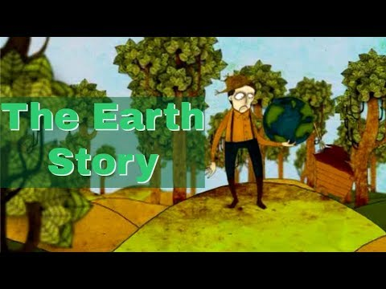
Watch the short video (1:36 minutes) made by Indian energy & resources institute TERI, entitled:
How climate change started: The Earth Story
(Click on the hyperlink above to open)
Notes:
Video URL: https://youtu.be/QG9ZcsL4lNc

Slide 9
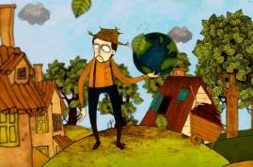
There are many ideas that are shown in this short animation, but we’re not told anything. Working in pairs, watch the video again as a class and each pair note down all of the human actions that you notice in the cartoon which could be causes of climate change.
For example, driving cars.
VIDEO LINK: How climate change started: The Earth Story
Notes:
Video URL: https://youtu.be/QG9ZcsL4lNc

Slide 10
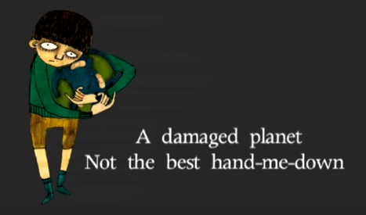
In trios, take a couple of minutes to discuss the following question:
What is the meaning of the message at the end of the cartoon? What is your reaction to this?

Slide 11
There are several ‘habits’ that us humans have introduced into our lives that we now realise are not good for the planet or for us in the long term.
We will be exploring some of these in this lesson - but can you guess some human habits that are harming the planet?
Take a couple of minutes to brainstorm a list of these human habits as a class.
See how many you can list.
Check if everyone agrees with them, or not*.
*Some human actions may be clearly bad for the planet and for humans themselves, but it’s not always so clear. It’s important to respect differences of thought as the starting point of meaningful conversations.

Slide 12
As young people, you have inherited a planet that is facing many challenges. As we’ve mentioned last lesson, it is important to recognise these feelings as valid and to not supress them. Remember to be mindful of your feelings and needs throughout this lesson and topic.
If you need a break, look outside the window at the sky, or connect to something in your classroom that is part of the natural world. Even a wooden desk can help us remember how important and beautiful nature is!

Slide 13
HUMAN HABITS
1 5 M I N U T E S

Slide 14
These are three habits that many humans take part in that cause harm to the planet:
1. CONSUMPTION
2. PRODUCTION
3. POLLUTION

Slide 15
Working in small groups, take a look at the images on the next slides and note down your answers for the following three questions:
SLIDE 1: What are humans consuming in these images?
SLIDE 2: What are humans producing in each of these images?
SLIDE 3: What sort of pollution is each of these images showing?

Slide 16
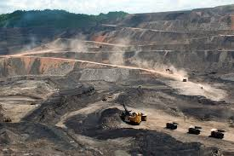
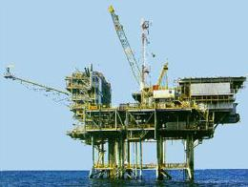
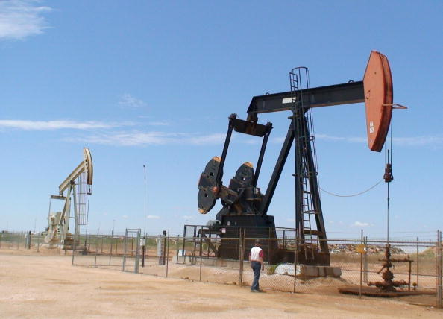
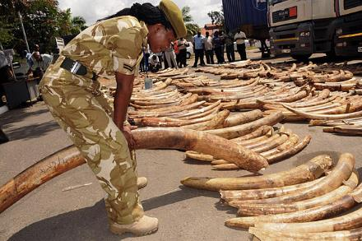
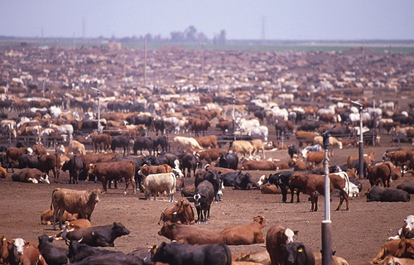
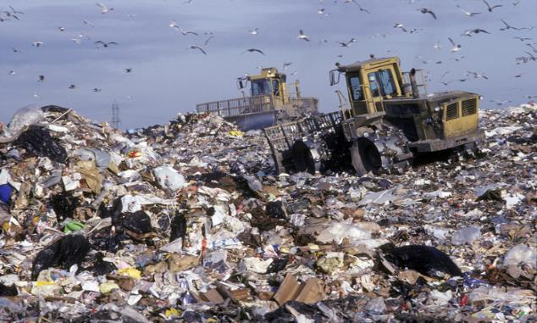
What are humans consuming in these images?

Slide 17
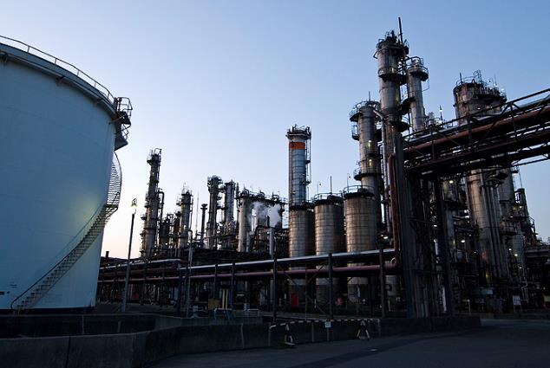
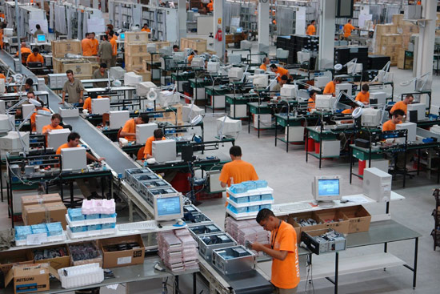
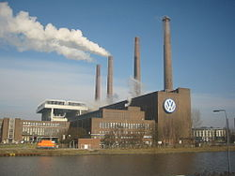
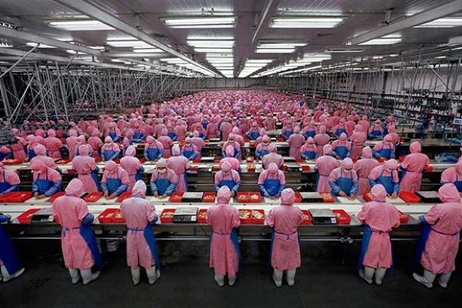
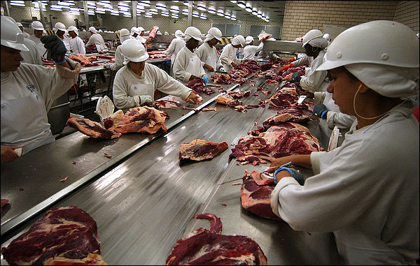
What are humans producing in each of these images?

Slide 18
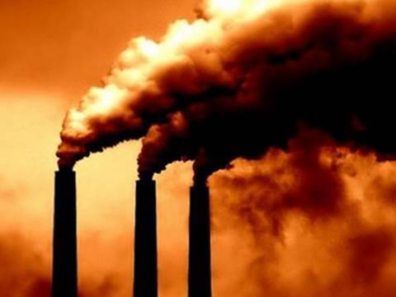
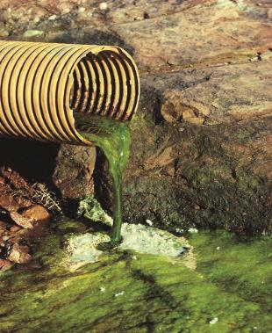
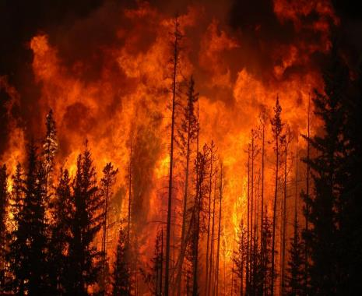
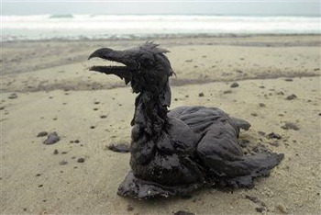
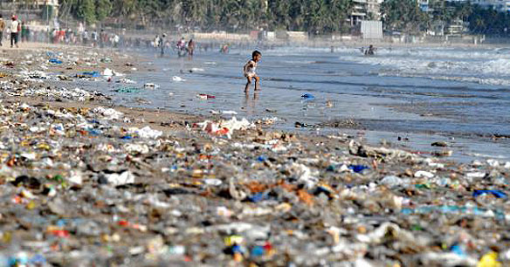
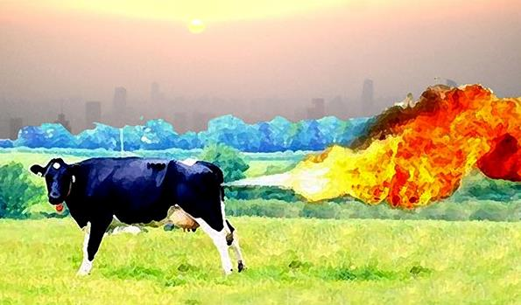
What sort of pollution is each of these images showing?

Slide 19
When humans first started consuming, producing and polluting in this way, we perhaps didn’t realise the full impact. We were also much fewer in numbers as our population on Earth was much smaller.
However, there are now many people on the planet carrying out these actions, continuing not to recognise the consequences for the Earth and for humans. The Earth can no longer cope with the large demand we are placing on it. This is why we are being asked to adapt or rethink our habits.

Slide 20
As a class, take a few minutes to discuss the following question:
Do you think it’s difficult to recognise all the impact we cause in the planet through consuming, producing and polluting? Why?

Slide 21
THE PROBLEM WITH FOSSIL FUELS
20 MINUTES

Slide 22
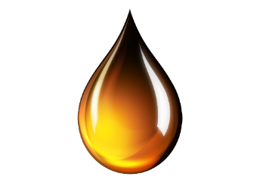
One of the biggest problems with humans’ current consumption, production and pollution is our overuse and overreliance on fossil fuels:
COAL
OIL
NATURAL GAS

Slide 23
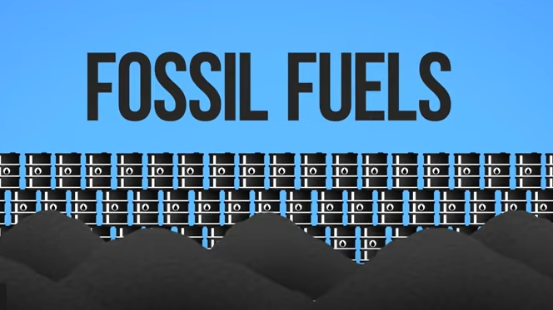
Watch this short video (2:42 minutes) by Student Energy to learn a bit about Fossil Fuels:
Fossil Fuels 101
(click on the hyperlink above to open)
Notes:
Video URL: https://www.youtube.com/watch?v=zaXBVYr9Ij0

Slide 24
Many of our everyday habits and things we take for granted today originated in the 18th century when the Industrial Revolution began.
We inventors were very clever and creative. We came up with lots of new inventions to make life easier.
It was an exciting time of invention and discovery, much of which changed daily life for many people in different countries.
Machines were starting to replace work that had been done by hand, saving time and human labour.

Slide 25
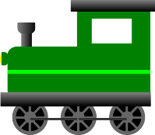
It was during this time that all of these items (and many more) were invented:
Humans still use modern versions of many of our inventions today.
battery
typewriter
steam engine
photography

Slide 26
Fossil fuels played a major role in the Industrial Revolution, for they were used as energy for factories and for transport. This meant that humans could travel more and make things more quickly using machinery. In order to be more productive, humans starting using more and more fossil fuels.

Slide 27
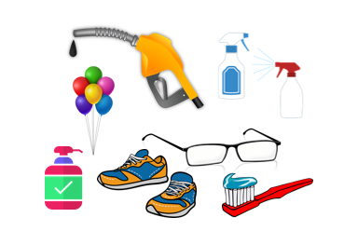
Today many people are consuming large amounts of fossil fuels to make lives more productive.
Something that was considered revolutionary for humans is now causing problems for the whole planet.
Although the everyday lives of many people are reliant on fossil fuel use, it is one of the biggest problems for the planet.

Slide 28
Not all humans across the world use fossil fuels – you can learn more about different communities and cultures in some of our other ThoughtBox topics.

Slide 29
There are so many ways that humans currently use fossil fuels that we might not even realise in which ways that might be. To find alternatives, we must first understand how we use them, why and for what.
Let’s look at four habits and explore how they relate to fossil fuel use.

Slide 30
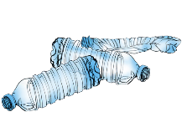
Four human habits that rely on fossil fuel use:
BUYING SINGLE USE PLASTICS
DAILY MEAT CONSUMPTION
FREQUENT FLYING
WASTING
FOOD
HABIT CHANGES
HABIT CHANGES

Slide 31
These activities may not have started off as habits that harm the planet and humans.
For example, at one point plastic was considered a revolution and a way to make life easier by being a cheap, versatile material with many amazing uses. Air travel was a revelation for humans, allowing us to access countries and places all across the world.
However, a lot of our habits are reliant on fossil fuel use. As we have seen, fossil fuels are used too much and are tipping the carbon in the atmosphere out of balance, which in turn is causing an increase in temperature, through the greenhouse effect.

Slide 32
In pairs or small groups, choose one of the following habits:
BUYING SINGLE USE PLASTICS
DAILY MEAT CONSUMPTION
FREQUENT FLYING
WASTING
FOOD

Slide 33
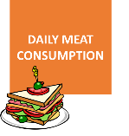
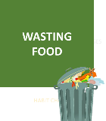
Think about your chosen habit in your pair or group. Using the fact sheet to help you (plus your own ideas) create a spider diagram for each of the following questions:
What are the advantages of this as a global habit?
Which fossil fuels are involved and where do they come from?
What are the disadvantages of this as a global habit? *For example, these could be about pollution, impact on different species, health impacts, etc.

Slide 34
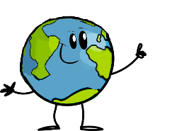
As a class, take a couple moments to think about the following question:
Can you think of some ways to change some of these harmful habits into actions that don’t harm the planet?

Slide 35
RENEWABLE ENERGY
10 MINUTES

Slide 36
Fossil fuels are a non-renewable energy source.
Humans have developed amazing systems that continuously take fossil fuels from the ground, but we have no way of ever replacing them, which means they will eventually run out. In other words, they can’t be renewed.
This is the
non-renewable problem.

Slide 37
We also now know that how we are using these fossil fuels can be very harmful to the planet as a huge amount of carbon dioxide or (CO₂₎ is emitted when fossil fuels are burned. We know that carbon dioxide (CO₂) is a major contributor to the greenhouse effect and climate change.
This is the pollution problem.
Other harmful gases such as nitrogen and sulphur oxides are released too.
Burning fossil fuels also causes air pollution and smog.

Slide 38
So what can we do? What are the alternatives?
Share some ideas with the class:
What are some of the renewable* energy sources that you are aware of?
*Renewable forms of energy can be naturally produced within a human time scale.

Slide 39
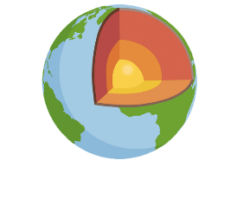
Many people across the world are already switching to renewable energy sources which are much less harmful for the planet and for people. These include:
SUNLIGHT WIND WAVES GEOTHERMAL

Slide 40
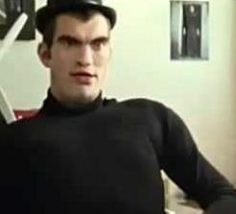
Watch this short video (2:04 minutes) made by energy firm Epuron entitled:
Mr. W
(Click on the link above for the hyperlink)
Notes:
Video URL: https://www.youtube.com/watch?v=2mTLO2F_ERY

Slide 41
As a class, take a couple of minutes to discuss the following questions:
Do you think shifting to renewable energy is a positive step in addressing the climate crisis? Why?
How did you feel about Mr. W, or ‘the wind’, by the end of the film?

Slide 42
Climate change is a big problem and we can no longer pretend that we can just carry on as normal. However, there are lots and lots of exciting, creative and innovative solutions out there, and many people taking positive actions already.
We will be revisiting our habits in Lesson 4, when we will explore ideas for changing behaviours to help with climate change.

Slide 43
TURN IDEAS INTO ACTION!
Choose one or do both!
ACTION 1: Pick a spot where you can observe living things – you can go to a park or simply observe a pot of plant or a line of ants.
Observe what you’ve chosen for at least five minutes.
Then, think about how this living being consumes, produces or pollutes.
Write down your reflections or share with a friend.
ACTION 2: Take one hour of your day (or the entire day if you like) and list what you consume, produce or pollute.
Next to each item, think about how you could change that so it is better for the planet, and yourself.
Write down your reflection or share with a friend.
Try to make at least one of those changes.

Slide 44
In this lesson, we explored the cause and effect of climate change, understanding the influence of human activities over time.
Next lesson we are going to be empathising with the impact of climate change on human and non-human communities in different contexts.

Slide 45
