Slide 1
EXPLORING NATURAL WORLD
THE

Slide 2
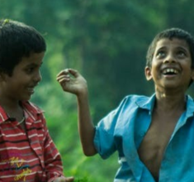
Y9&10 | AGES 13-15
AT A GLANCE | CHANGING CLIMATES| Lesson 1 – Our Changing Climate
15 minutes
WHY IS OUR CLIMATE CHANGING?: Explore greenhouse effect in order to understand the reasons for human-led climate change.
15 minutes
A VISION OF CLIMATE CHANGE: Explore the feelings related to climate change through ours and others’ art.
Only got 45 minutes?
We recommend exploring the first three sections of this lesson – and, if time, finishing with nature connection (the final activity in the lesson plan).
Only got 30 minutes?
We recommend exploring the first two sections of this lesson, and exploring some impacts of climate change from the third section.
15 minutes
WHAT CHANGES ARE WE SEEING?: Through different images, explore various impacts of climate change to more concretely understand the reasons and consequences.
15 minutes
TRAVELLING THROUGH DEEP TIME: Enhance our perspective of human history within the history of the Earth through ‘Deep Time’, so that we can better situate human’s responsibility for human-led climate change.

Slide 3
YEARS 9&10 | KS3&4| Ages 13-15
CHANGING CLIMATES
EXPLORING THE NATURAL WORLD

Slide 4
In this lesson you will need:
Internet access
Speakers
Pens or coloured pencils
ThoughtBox Thought-Books* or paper
Large sheets of paper (optional for final task)
Here is a list of resources you will need for this lesson.
*We recommend students have a journal-style book for ThoughtBox lessons, in order to capture notes, ideas, drawings, reflections, inspiration and learnings.

Slide 5
LESSON 1 | CHANGING CLIMATES
OUR CHANGING
CLIMATE
60 MINUTES

Slide 6
In this lesson, we will:
Understand the importance of exploring the emotions arising from climate change and of finding ways to express how we feel.
Think about some of the causes and effects of human-caused climate change.
Explore ideas around ‘Deep Time’ and human activities to help us understand the importance of changing some of our habits as humans.

Slide 7
Before we start this topic, ‘Changing Climates’, take five minutes in your ThoughtBox Thought-Book to answer these three questions:
When you think of ‘climate change’, how does it make you feel?
What does ‘climate change’ make you think about?
How does climate change impact your life, do you think? And of others’?
You may write down words, phrases, doodle or draw your answers!

Slide 8
WHY IS OUR
CLIMATE CHANGING?
15 MINUTES

Slide 9
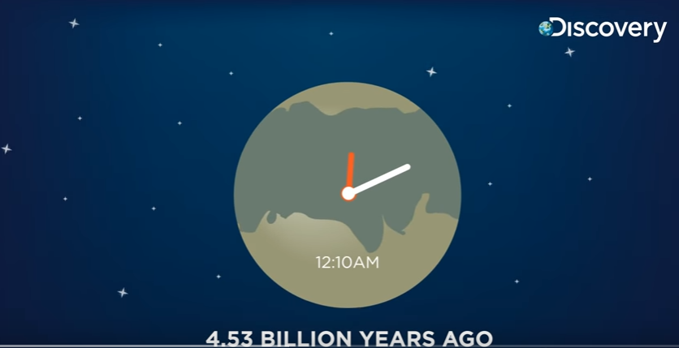
Watch the short film (1:51 minutes) made by DiscoveryChannelInd, entitled:
What if Earth existed for only 24 hours?
(Click on the link above for the hyperlink)
Notes:
Video URL: https://www.youtube.com/watch?v=jtNs5k2KHXU

Slide 10
In pairs, take a couple of minutes to discuss the following question:
Were you aware of how recent human beings are to the Earth? What is your response to this?

Slide 11
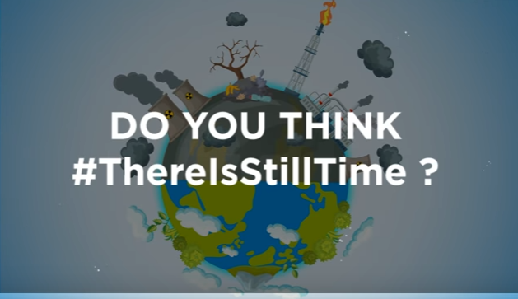
This video explores a perspective of time that can make us think differently about time, about the Earth and about the power of our impacts as humans – both negatively and positively.
As a class, take a moment to discuss the question from the final slide of the video:

Slide 12
Climate change can be a difficult topic to talk about because it can inspire feeling of sadness, anger, confusion, apathy, etc. It is important to recognise these feelings as valid and not to supress them. Throughout this topic, keep checking in with yourself and remember to be mindful of your feelings and needs.

Slide 13
It is also important to recognise there are many possibilities in dealing with climate change and that part of finding solutions is to know in understand what humans are doing that is harmful – and why – so we can start thinking about what some alternative habits are that we can all work towards instead.
There is much we can do to prevent many of these future issues from happening and lots of really positive things that we can do (and that people across the world are already doing).
This is what we will start exploring now and throughout this topic!

Slide 14
Throughout time, there have been natural changes in the climate and there have been changes to carbon-dioxide (CO₂) levels over the Earth’s history. Yet, scientists have discovered that the current extreme changes are mostly due to human activity.
There have been particular ways in which humans have been adding increasing levels of CO₂ in our atmosphere, such as through burning fossil fuels and deforestation.

Slide 15
The reason scientists and many other folks are concerned is that Earth's global climate is changing and our planet is warming up fast — faster than at any other time scientists know about from their studies of Earth's history.
Increased levels of CO₂ cause global warming because of the
greenhouse effect.
Turn to the person next to you and share what you already know about the greenhouse effect and what this means.

Slide 16
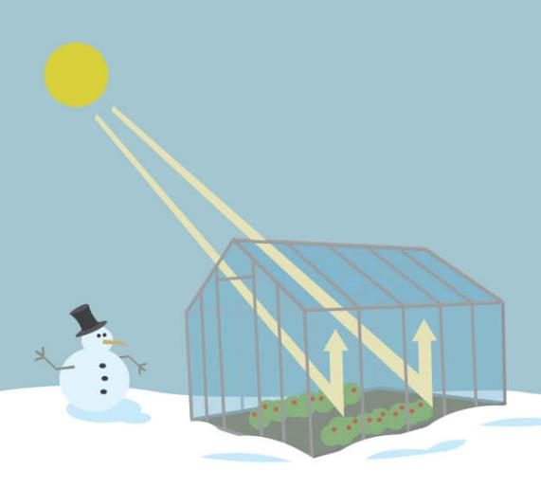
How does the greenhouse effect work?
As you might expect from the name, the greenhouse effect works just like a greenhouse (a glass building used to grow fruits, vegetables and plants).
A greenhouse stays warm inside, even during the winter, because the glass walls of the greenhouse trap the Sun's heat and keep some of it contained inside.

Slide 17
The greenhouse effect works much the same way on Earth as it does in a greenhouse. The Earth has a layer of heat-trapping gases in the atmosphere (like the roof of a greenhouse). These heat-trapping gases are known as the greenhouse gases.
During the day, the Sun shines through the atmosphere. Earth's surface warms up in the sunlight.
At night, Earth's surface cools, releasing heat back into the air. While some of the incoming light, heat and radiation from the Sun bounces right back into space, some of it is trapped by the greenhouse gases that make up our atmosphere.

Slide 18
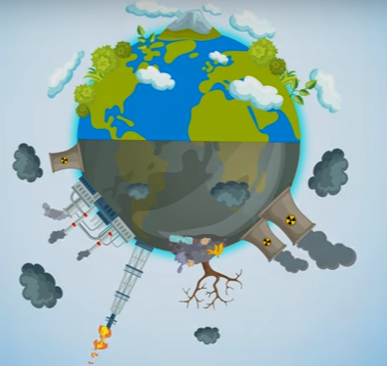
Without this layer of insulation, Earth would simply be a frozen rock hurtling through space. Therefore, this ‘insulation’ is a really important layer. However, it has got far too thick and is now causing problems across the globe.

Slide 19
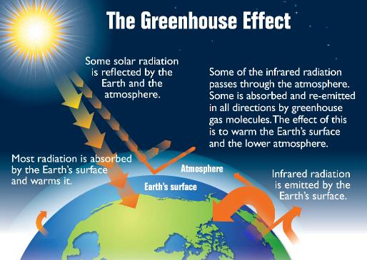
Having too much of these greenhouse gases causes the Earth's atmosphere to trap more and more heat which in turn causes the planet to warm up.
At this moment, the Earth’s greenhouse gases are higher than at any time in the last 800,000 years, for the most part due to human activities.

Slide 20
So let’s find out more about how climate change happens.
There are six main greenhouse gases in the Earth’s atmosphere that make up Earth’s ‘greenhouse roof’. These are:
CARBON DIOXIDE
METHANE
NITROUS OXIDE
WATER VAPOUR
OZONE
CHLOROFLOROCARBONS

Slide 21
As a class, take a try in answering the following questions:
Which of these are humans currently producing too much of?
Do you know about any of these gases? If so, what?

Slide 22
These are four facts about greenhouse gases. Read through each of these and suggest some things humans could do differently to produce less of these gases:
Trees help to regulate the climate by absorbing carbon dioxide from the atmosphere. When we cut down trees & forests, their beneficial effect is lost, whilst carbon stored in the trees is released.
Animal agriculture increases emissions as cows and sheep produce large amounts of methane when they digest their food.
Burning fossil fuels (coal, oil and gas) produces carbon dioxide and nitrous oxide.
Fertilisers which contain nitrogen produce nitrous oxide emissions.

Slide 23
A VISION OF CLIMATE CHANGE
1 5 M I N U T E S

Slide 24
Take a look at the following slide of an image representing global warming.
Talk to the person next to you about how or what the data in this image might be showing. Share your thoughts with the class.

Slide 26
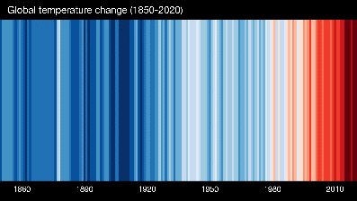
This image was made by a climate scientist called Ed Hawkins. He decided to represent each year’s average temperatures from 1850-2020 using data from the UK Met Office and put that into a simple image. The stripes of colour range from blue (cold ) to red (hot) and are visual representations of the change in temperature over time.
Ed and his team have been using weather data from countries across the world to produce images for individual countries and regions, and then collating all of this together to produce the image for the entire globe.

Slide 27
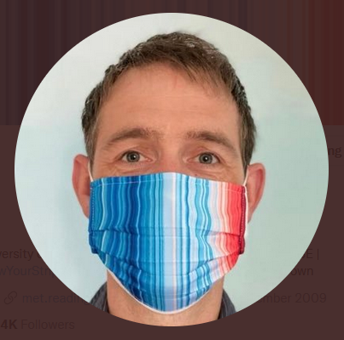
I wanted to communicate temperature changes in a way that was simple and intuitive, removing all the distractions of standard climate graphics so that the long-term trends and variations in temperature are crystal clear.
- Ed Hawkins
Image @ Ed Hawkins (@ed_hawkins) / Twitter

Slide 28
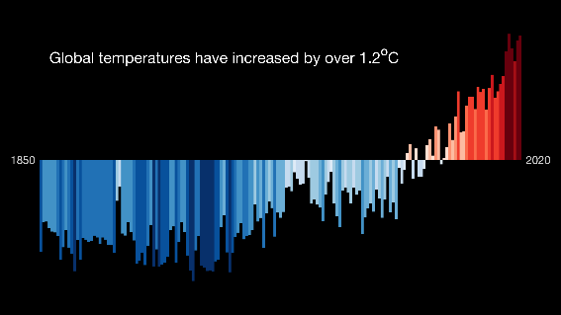
If you have interest in exploring the ShowYourStripes website, you can find not only visual representations of global temperatures, but of different regions:
Bar charts are also available.

Slide 29
Now take a look at the three pictures on the following slide, which are artistic responses to climate change.
Talk with the person next to you about your thoughts and feelings about each image and what messages each image is expressing.

Slide 30
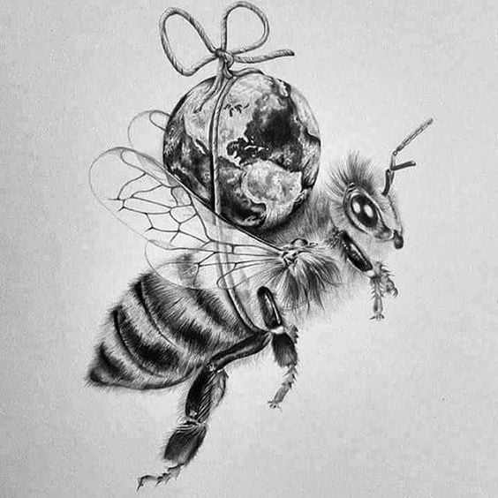
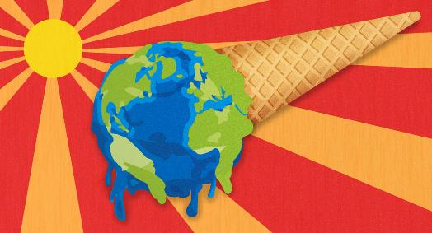
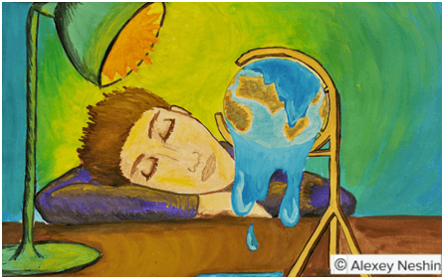
E. Otwell.
Unknown

Slide 31
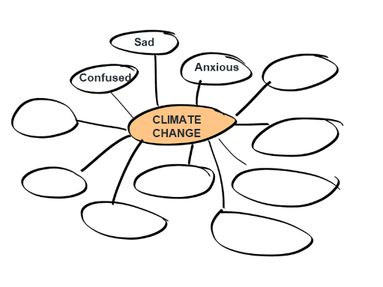
We all have very different responses and very different emotions regarding climate change.
Working together as a class, make a quick mind-map on the board of some different moods, emotions and reactions that people have about climate change. Each person can offer a word to add to the map.

Slide 32
Now, individually, spend five minutes drawing your own response to the phrase ‘climate change’. There is no right nor wrong here, so there’s no need to overthink your response. Simply take a piece of paper, or use your ThoughtBox Journal, and see what comes out!
Your drawing might represent information and facts, represent how you feel, what others are feeling and/or what you think about when you hear the phrase.
You can choose to show this at the end or keep it to yourself.

Slide 33
WHAT CHANGES ARE WE SEEING?
1 5 M I N U T E S

Slide 34
We are becoming ever-more aware of human-caused climate change. All of us, no matter where we live in the world, will have started to see some of the impacts or effects of climate change.
What about you?
What have you seen, experienced or heard of that are examples of impacts of climate change?

Slide 35
Take a look at the five images in the following slides, all showing examples of the impact of climate change around the world.
For each image, think about and then share with the class:
Where in the world do you think this may be happening?
Why do you think this is happening?
Who or what is impacted by this?

Slide 37
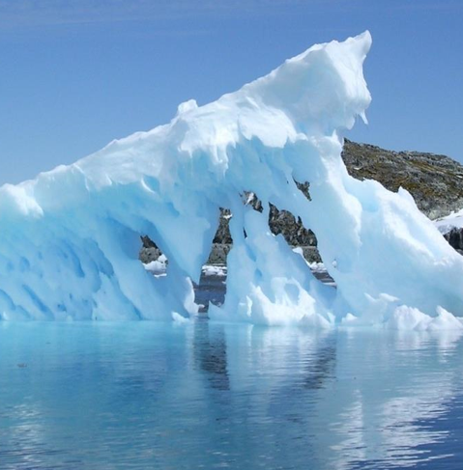
Think about and then share with the class:
Where in the world do you think this may be happening?
Why do you think this is happening?
Who or what is impacted by this?

Slide 39
Think about and then share with the class:
Where in the world do you think this may be happening?
Why do you think this is happening?
Who or what is impacted by this?

Slide 41
Think about and then share with the class:
Where in the world do you think this may be happening?
Why do you think this is happening?
Who or what is impacted by this?

Slide 43
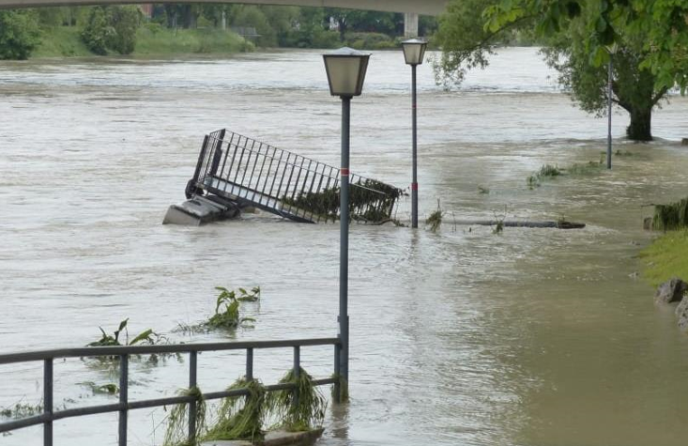
Think about and then share with the class:
Where in the world do you think this may be happening?
Why do you think this is happening?
Who or what is impacted by this?

Slide 45
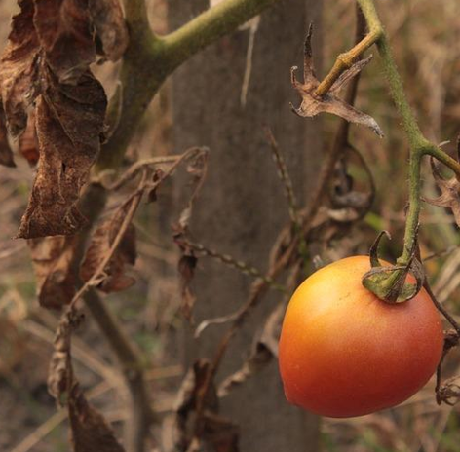
Think about and then share with the class:
Where in the world do you think this may be happening?
Why do you think this is happening?
Who or what is impacted by this?

Slide 46
You were shown images of:
Icebergs melting
Forest fires
Drought
Flooding
Crop failure
Why and how are these caused by climate change?
Think about what we explored earlier.

Slide 47
As we have seen in the previous sections, Earth has experienced changes in climate before. But these changes happen over a very long period of time.
The previous images show how Earth is having trouble adapting with human-caused climate change because it’s happening so quickly.
In order to understand just how quickly human-caused climate change really is, we have to understand time in Earth’s perspective.

Slide 48
TRAVELLING THROUGH DEEP TIME
1 5 M I N U T E S

Slide 49
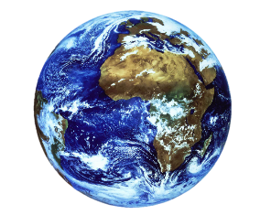
Take a moment to think about the video we watched at the beginning of the class (What if Earth existed for only 24 hours?)*. In pairs, take a couple of moments to discuss the following questions:
Have you ever heard the phrase ‘Deep Time'? What do you think this might mean?
*If you need, watch the video again here.
Notes:
Video URL: https://www.youtube.com/watch?v=jtNs5k2KHXU

Slide 50
Most of the history we learn about in school focuses on human history and stories of our own life on Earth.
Yet the Earth has a history long before humans came along, long before dinosaurs came along and long before any of us can really imagine.

Slide 51
‘Deep Time’ is the amount of time that the Earth has existed:
This number is so huge, it is really difficult for us humans to grasp. When our life expectancy is usually less than 100 years, it’s almost impossible for us to imagine something so vast as Deep Time.
The Earth is roughly 4.6 billion years old!

Slide 52
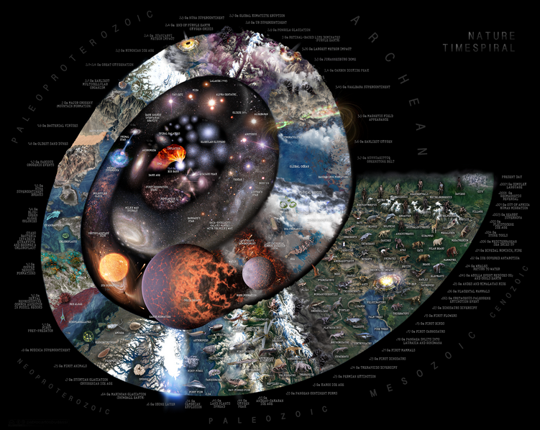
There are many ways to view and try to understand Deep Time, such as the clock metaphor from the video or this ‘Nature Time Spiral’.
If there’s time and interest click on the link to explore the details as a class!
Emergence of modern human
Notes:
Video URL: https://upload.wikimedia.org/wikipedia/commons/6/66/Nature_Timespiral.png

Slide 53
When you start to think about Deep Time, you realise how new human beings are to Earth.
Does Deep Time make you think differently about human-made climate change? In which way?

Slide 54
Here are two different ways that we can try to understand Deep Time. Choose one (or both) of these journeys and travel together as a class.
*Each of these can be an individual project or a class project – you may just want to look at them today and come back to them another time.
1. Draw a clock of Deep Time, using the second slide to help you.
2. Take a Deep Time walk using the third slide. NB: This would take a few hours and could be a great school trip or class outing that you may wish to arrange if possible.

Slide 55
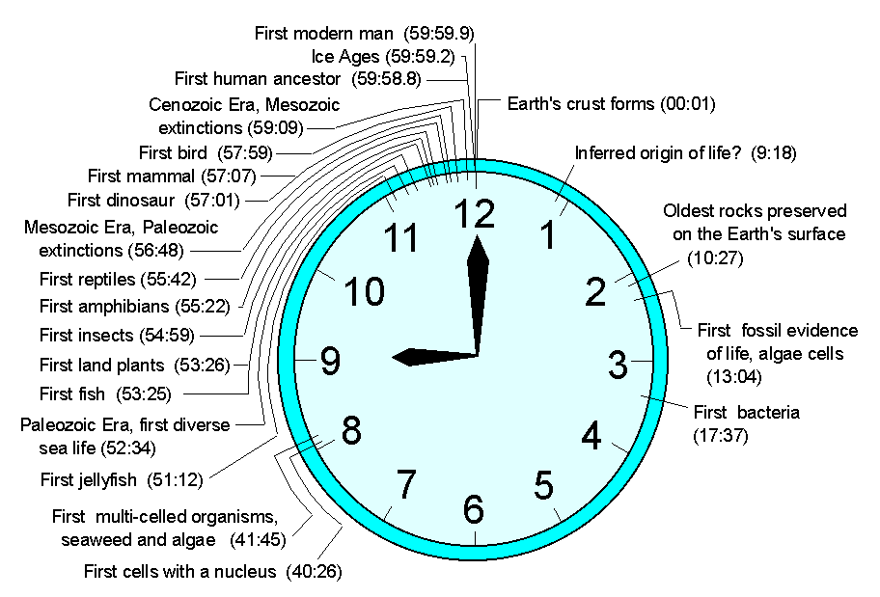
1. Create a Deep Time clock
Here is an example of Deep Time using a clock – why not have a go at making your own?

Slide 56
2. Take a Deep Time Walk
Walk 4.6km through 4.6bn years of Earth history, learn about key concepts from Earth’s evolution and experience a unique perspective of Deep Time with a Deep Time app.
Designed using appropriate technology, the Deep Time Walk app calculates your speed and distance as you journey across 4.6bn years of time, enabling you to learn about key evolutionary events as they occur over the history of the Earth.
The dramatised Deep Time Walk can be experienced anywhere in the world! You can learn more here and download the app for free.
www.deeptimewalk.org
Notes:
URL link: https://www.deeptimewalk.org/

Slide 57
In trios, take a couple of minutes to discuss:
Why might Deep Time help us to respond to the changing climate?

Slide 58
To help think a little more freely about the significance of time, let’s take a look at some of the living things around us that have been here for a long, long time on Earth (although even they have not been here that long when we think about Deep Time.)
Let’s look at:
The oldest tree on Earth.
The oldest animal on Earth.
The oldest species on Earth.
The oldest rock on Earth.

Slide 59
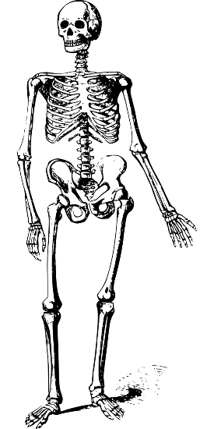
As you go through each of them, think about the difference between:
The impact that each of these different species (and their age) might have in the planet.
Versus
The impact and age of humans in the planet.
The oldest tree on Earth.
The oldest animal on Earth.
The oldest species on Earth.
The oldest rock on Earth.

Slide 60
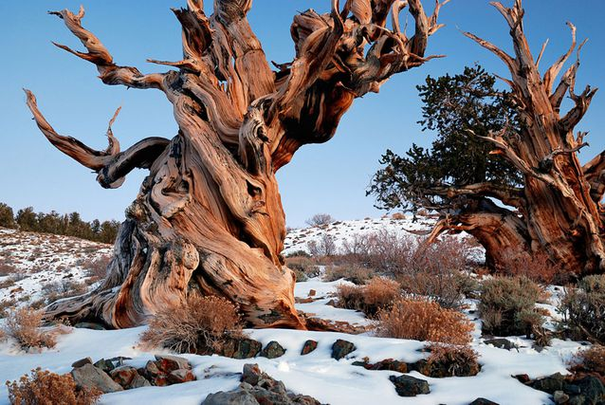
What is the oldest tree on Earth?
The oldest recorded tree on Earth is in California's White Mountains. It is a bristlecone pine tree and has a core which suggests it is 5,067 years old.

Slide 61
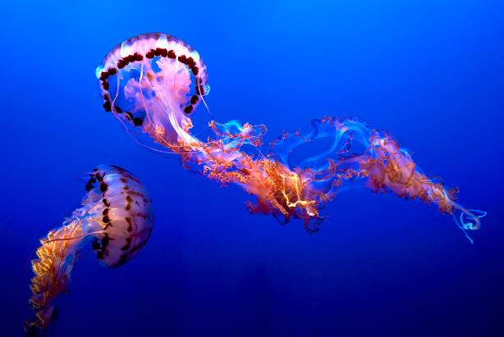
What is the oldest animal on Earth?
The jellyfish evolved on Earth about 550 million years ago and is considered the oldest multi-organ animal in the whole world.

Slide 62
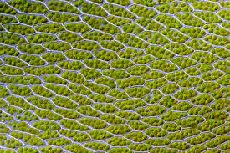
What is the oldest species on Earth?
Cyanobacterium is the oldest known animal species on Earth. They are sometimes called an algae but are actually a bacteria.
They live in the water and can manufacture their own food. They are major contributors of oxygen in the world and sustain all oxygen-breathing organisms on Earth. Cyanobacterium evolved about 2.7 billion years ago.

Slide 63
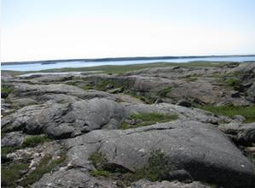
What is the oldest rock on Earth?
There are some pretty old rocks in the Grand Canyon, USA, - about 2 billion years old - but they are mere babies compared to the oldest known rocks on Earth!
The oldest known rock on Earth is in Bedrock along the northeast coast of Hudson Bay, Canada, and dates back to around 4.28 billion years ago.

Slide 64
In small groups, take a couple of minutes to reflect on the following questions:
*Think about this in the perspective of Deep Time and all that exists around you, in your school, community and planet!
What is the oldest thing* you’ve ever laid eyes on? And the youngest?

Slide 65
TURN IDEAS INTO ACTION!
As you walk around outside today, think about what you are seeing and how long these might have been here, e.g. specific plants, trees, animals. Pick one and think about how humans are:
Contributing to its life.
Not contributing to its life.
For example: The trees next to my school.
Humans are contributing to trees next to my school by taking care of them and planting gardens around them, which support the trees’ ecosystem.
Humans are not contributing to the trees next to my school by driving cars next to them and polluting the air they take in.
Maybe even do some research! You might find innovative positive actions that you can share with your class next lesson.

Slide 66
In this lesson, we explored the reasons and consequences for human-led climate change as well as a Deep Time perspective.
Next lesson we are going to learn more about the human actions that are causing climate change. By understanding what and how some actions might be harmful for the planet and ourselves, we can identify which actions we can all work towards instead.

Slide 67
CHANGING CLIMATES
T H I S S O R T O F L E A R N I N G
C A N ’ T W A I T

