Slide 1
EXPLORING NATURAL WORLD
THE

Slide 2
YEARS 9&10 | KS3&4| Ages 13-15
CHANGING CLIMATES
EXPLORING THE NATURAL WORLD

Slide 3
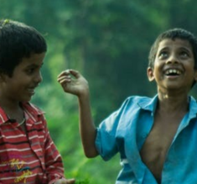
Y9&10 | AGES 13-15
AT A GLANCE | CHANGING CLIMATES| Lesson 2 - Cause and Effect
10 minutes
ECO-ANXIETY: Watch a short video on the facts of Climate Change to then reflect on ‘eco-anxiety’ and coping actions.
15 minutes
THE PROBLEM WITH FOSSIL FUELS: Brainstorm examples for over-consumption, over-production and pollution, and learn about and have a knowledge swap about fossil fuels.
Only got 45 minutes?
We recommend exploring the first, third and last sessions.
Only got 30 minutes?
We recommend exploring first and third sessions.
25 minutes
HUMANS’ HARMFUL HABITS: With the help of images, think about how four small actions have become excessive and harmful for the planet, and in small groups, explore and think of alternatives for fossil fuel activities.
10 minutes
A BRIGHTER TOMORROW: Look at renewable energy sources as a possible alternative for fossil fuels and harmful human habits.

Slide 4
In this lesson you will need:
Internet access
Speakers
Pens or coloured pencils
ThoughtBox Thought-Books or paper
Large sheets of paper (optional for final task)
Information sheets on human habits (click here to print)
Here is a list of resources you will need for this lesson.

Slide 5
LESSON 2 | CHANGING CLIMATES
CAUSE AND EFFECT
6 0 M I N U T E S

Slide 6
In this lesson, students will:
Understand the impact of eco-anxiety and explore our own responses to some of our human habits.
Learn about fossil fuels and how many current human habits have become reliable on these, and think about renewable energies as alternatives.
Connect the dots on the link between increased human activities and increased emissions of greenhouse gases.

Slide 7
ECO-ANXIETY
10 M I N U T E S

Slide 8
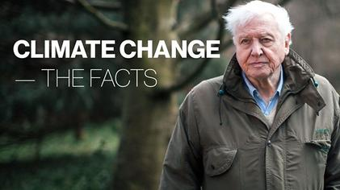
Watch the video (3:42 minutes) featuring David Attenborough made by the BBC entitled:
Climate Change: The Facts
(Click on the link above for the hyperlink)
Notes:
URL video: https://www.youtube.com/watch?v=EOctIuyVfnA

Slide 9
As we’ve explored in Lesson 1, it is important to recognise our emotions and be mindful of our feelings and needs when we are exploring topics that can be overwhelming.
Whatever feelings you are experiencing, these are valid emotions and no-one can tell you that you should be feeling anything different at this stage.
Take a moment of quiet, perhaps close your eyes or put your head on the table, and take a few deep breaths to acknowledge how you are feeling before moving on. During this lesson, if you need a break, look outside the window at the sky, or connect to something in your classroom that is part of the natural world. Even a wooden desk can help us remember how important and beautiful nature can be!

Slide 10
Many people – young people in particular – are struggling with something that is being called ‘eco-anxiety ’.
There are many resources to help support some of the different feelings you may be having surrounding climate change – just look on the ThoughtBox website:
www.thoughtboxeducation.com/student-resources.
This is often due to feeling completely overwhelmed by the extent of the climate crisis or feeling very insignificant in being able to make any changes that will have an impact. It is important to talk to others if you are feeling overwhelmed by what is happening around you.

Slide 11
In pairs, take a few minutes to discuss the following questions:
Did the art activity from Lesson 1 help you express your emotions? Why or why not?
Can you think of actions that could help someone with ‘eco-anxiety’?

Slide 12
Because many people around the world are struggling with eco-anxiety, they are also finding ways to cope with it. Take a moment to look over the following options and reflect which ones might support you if you ever need:
Validate: Acknowledge that it makes sense to feel anxious.
Check your habits: What can you do differently today?
Think small:
Changes are hard. Any change makes a difference and should be celebrated.
Don’t feel ashamed: We can’t do everything perfectly. Wanting to change and trying are already very important steps.
Time out:
Take a break from your news feed (an hour, two hours, a day, etc.).
Find like-minded people:
Engage with people who have the same beliefs and struggles as you do. Talk and support each other.
Protect and nurture local green spaces:
Not only is this good for the planet, but it helps with mental health.
Talk about the changes you make: Celebrate the changes you make and inspire others.
Notes:
For more:
Feel alone in your eco-anxiety? Don’t – it’s remarkably common to feel dread about environmental decline – URL: https://theconversation.com/feel-alone-in-your-eco-anxiety-dont-its-remarkably-common-to-feel-dread-about-environmental-decline-170789
Stressed about climate change? Eight tips for managing eco-anxiety – URL: https://www.newscientist.com/article/2220561-stressed-about-climate-change-eight-tips-for-managing-eco-anxiety/#ixzz7J5ddY8xV

Slide 13
Alongside our self-care and care for others in our community, we can also explore how we can move towards action.
In order to respond to the climate crisis, it is important to understand both the cause and the effect by exploring some of the human actions that are harmful for the planet. This will help us to understand why (and how) we need to change or adapt them.
In this lesson we are going to explore the main human actions that cause climate change.
(e.g. understand how some human actions have become harmful for the planet and ourselves)
Next lesson we will explore some of the effects of climate change around the world.
In the final lesson we will explore actions from across the world and to feel empowered in actions we can all take to respond to the climate crisis.

Slide 14
THE PROBLEM WITH FOSSIL FUELS
1 5 M I N U T E S

Slide 15
The three main human actions which cause harm to the planet are:
1. OVER - CONSUMPTION
2. OVER - PRODUCTION
3. POLLUTION
In pairs, take a couple of minutes to come up with an example for each of these.

Slide 16
When humans first started consuming, producing and polluting, we perhaps didn’t realise the full impact. We were also much fewer in numbers as our population on Earth was much smaller.
However, there are now many people on the planet carrying out these actions, continuing not to recognise the consequences for the Earth as well as for us humans. Many of these actions also mean an overuse of fossil fuels. It’s simply not sustainable and the Earth can no longer cope with the demand we are placing.
This is why we are being asked to adapt or rethink our habits.

Slide 17
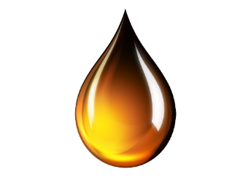
Our overuse and overreliance on fossil fuels is one of the biggest problems in the current consumption, production and pollution cycle:
COAL
OIL
NATURAL GAS

Slide 18
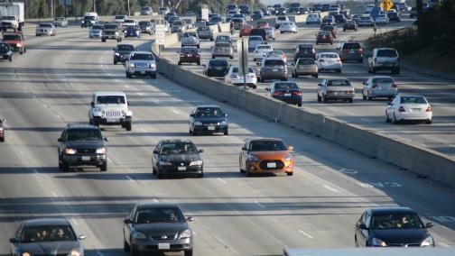
Watch the short video (1:16 minutes) made by National Geographic entitled:
What are fossil fuels?
(Click on the hyperlink above to open)
Make sure to pay extra attention to this video, since it will help you with an activity later on!
Notes:
Video URL: https://www.youtube.com/watch?v=YTnE0OQPTEo

Slide 19
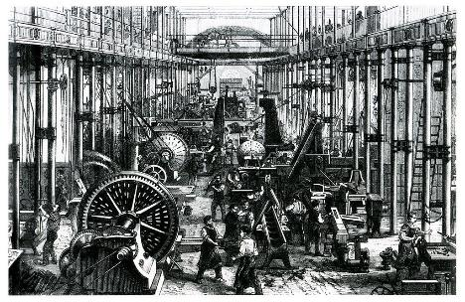
Many of our everyday habits and things we take for granted today originated in the 18th century when the Industrial Revolution began.
It was an exciting time of invention and discovery, much of which changed daily life for many people in different countries. Machines were starting to replace work that had been done by hand, saving time and human labour.
During this time, huge innovations in transport and energy were being developed and created, including railroads, cotton gins and electricity.

Slide 20
Fossil fuels played a major role in the Industrial Revolution, for they were used as energy for factories and for transport. In order to be more productive, humans starting using more and more fossil fuels.

Slide 21
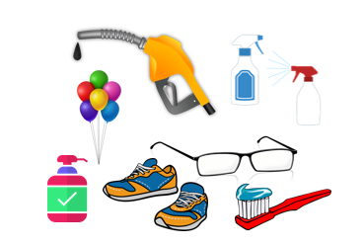
Today many people are consuming large amounts of fossil fuels from the Earth to make lives more productive. Something that was considered revolutionary for humans is now causing problems for the whole planet.
The everyday lives of many people are reliant on fossil fuel use, and yet one of the biggest problems for the planet is exactly that.

Slide 22
Not all humans across the world use fossil fuels – you can learn more about different communities and cultures in some of the other ThoughtBox topics.

Slide 23
It’s time for a knowledge swap!
One of the best ways to learn new ideas is by teaching each other. In pairs, each pick one of the following questions to teach each other in turns. Help each other out if you get stuck. If there’s time, you can choose another question to teach!
What are fossil fuels?
What are the three main types of fossil fuels?
What are some products that contain fossil fuels?
Where do fossil fuels come from?
Why are they non-renewable and finite?

Slide 24
In trios, take a couple of minutes to discuss the following questions:
How can humans reduce our use of fossil fuels?

Slide 25
HUMANS’ HARMFUL HABITS
25 M I N U T E S

Slide 26
A lot of our human actions are heavily reliant on fossil fuel use. As we have seen, fossil fuels are used too much and are tipping the carbon levels in the atmosphere out of balance, which in turn is causing an increase in temperature through the greenhouse effect.
There are many actions and habits that humans have increased over time which release high levels of greenhouse gases into the atmosphere.

Slide 27
As we explored earlier, the three main human habits which cause harm to the planet are:
1. CONSUMPTION
2. PRODUCTION
3. POLLUTION

Slide 28
Humans did not deliberately set out to create actions that are harmful for the planet and for ourselves. However, it is important to recognise that now that we know the long term impacts and consequences of some of these behaviours, we need to respond by changing or adapting these actions and habits.
Let’s look at four actions and think for a moment about how they have gone from small scale, or healthy actions, to excessive habits that are harmful for ourselves and the planet.

Slide 29
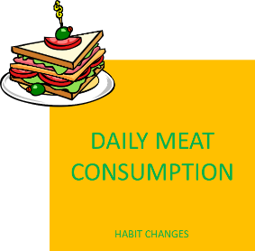
Action # 1:

Slide 30
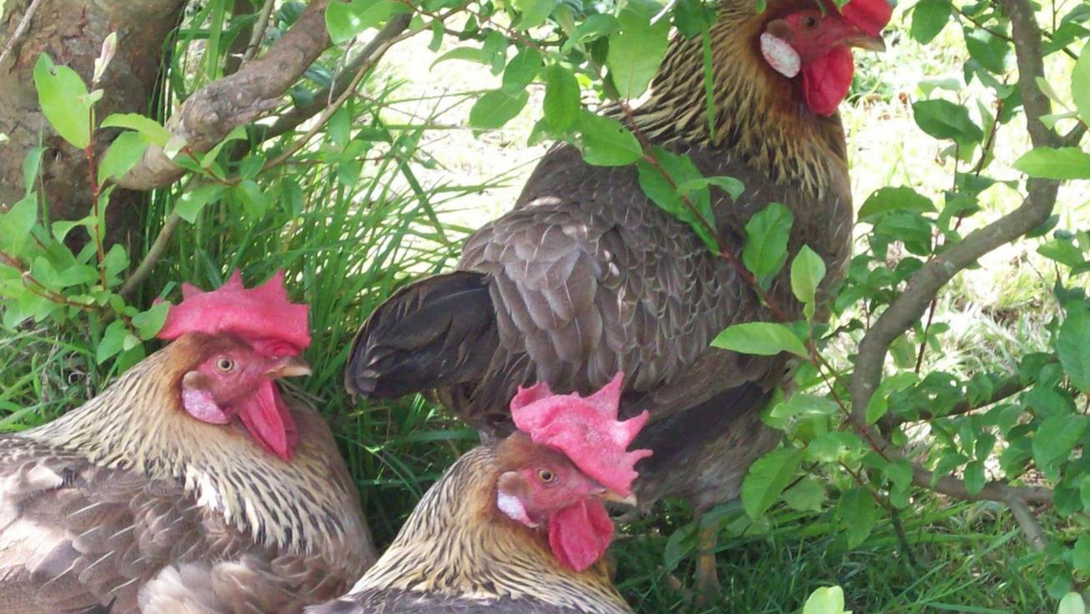
From this…

Slide 31
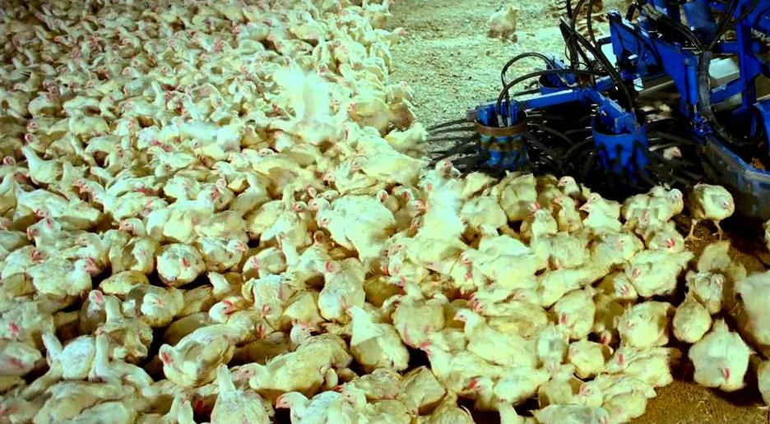
To this…

Slide 32
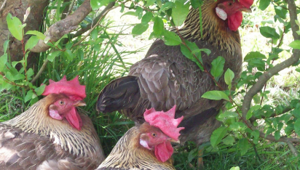
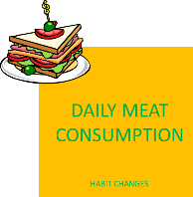
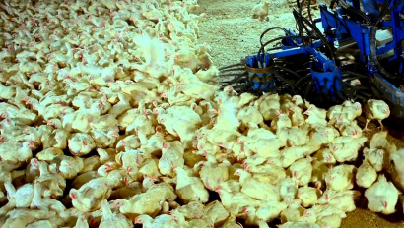
Take two minutes to discuss:
How has this action become a harmful habit for ourselves and the planet?

Slide 33
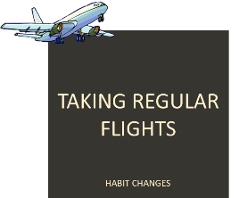
Action # 2:

Slide 34
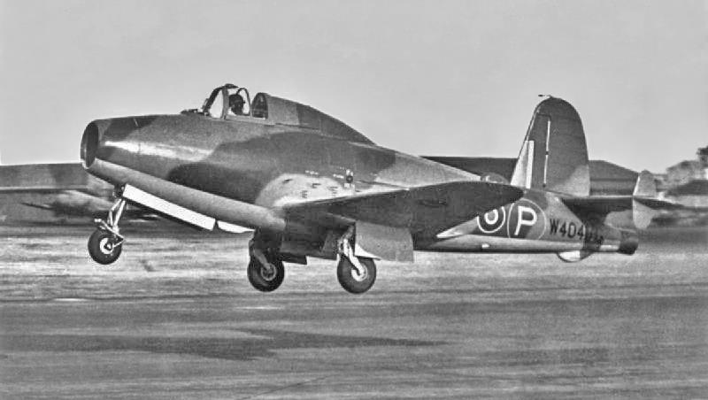
From this…

Slide 35
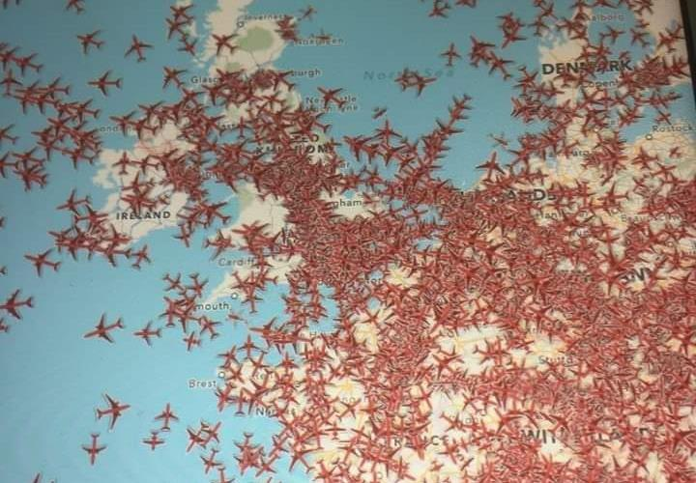
To this…
*This image, taken in August 2019 shows the number of aircraft that were travelling over Europe at one particular moment in the day. There were 2482 visible out of a total of 12906 aircraft in the sky.

Slide 36
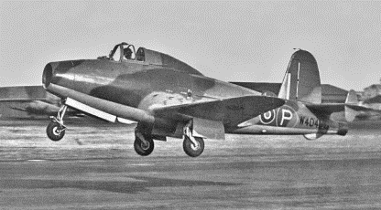
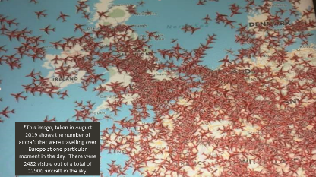
Take two minutes to discuss:
How has this action become a harmful habit for ourselves and the planet?

Slide 37
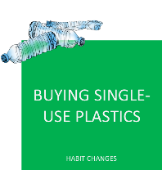
Action # 3:

Slide 38
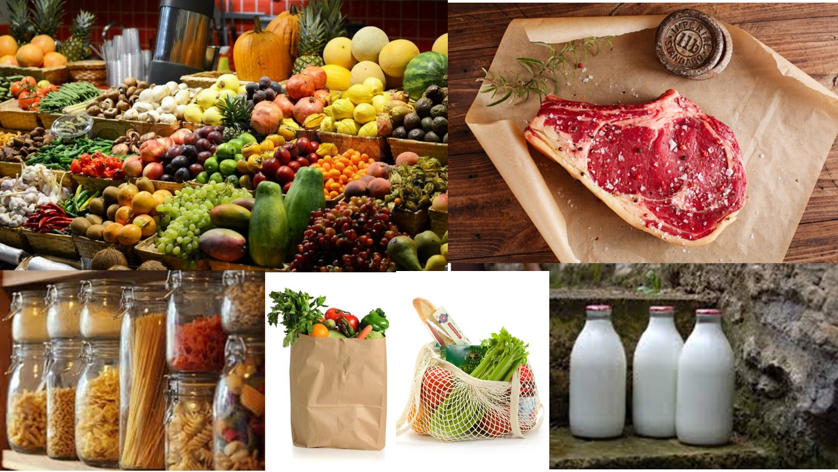
From this…

Slide 39
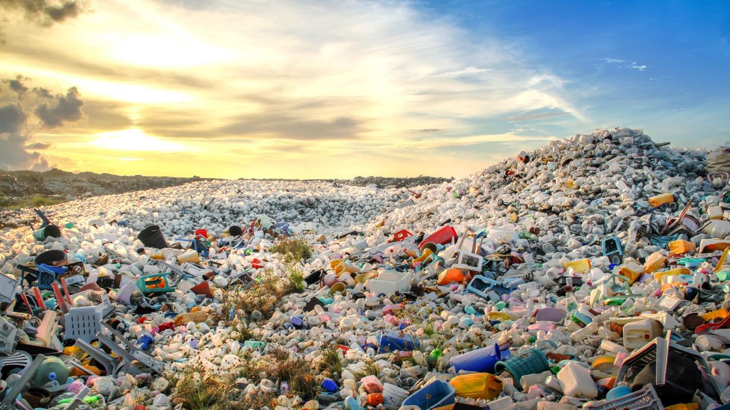
To this…

Slide 40
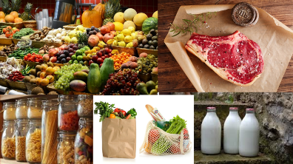
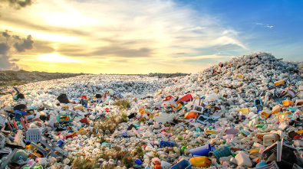
Take two minutes to discuss:
How has this action become an harmful habit for ourselves and the planet?

Slide 41
Action # 4:

Slide 42
@freefoodphotos.com

Slide 43
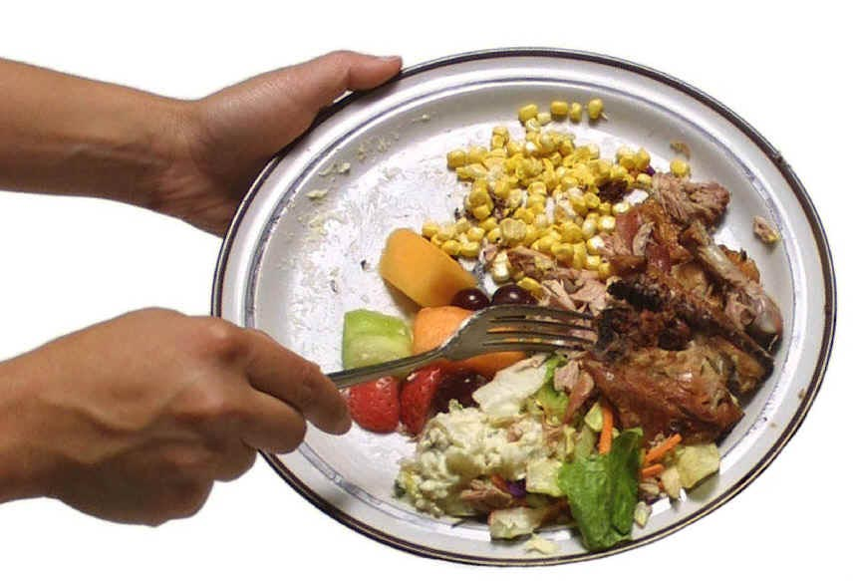

Slide 44
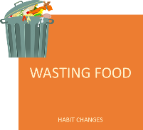
Take two minutes to discuss:
How has this action become an harmful habit for ourselves and the planet?

Slide 45
We’re now going to look at these habits and think about how they relate to fossil fuel use and why they are not good for us or for the planet in the long term.

Slide 46
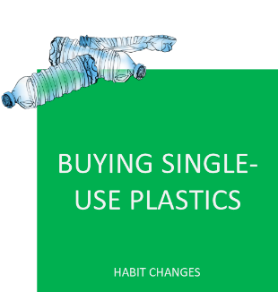
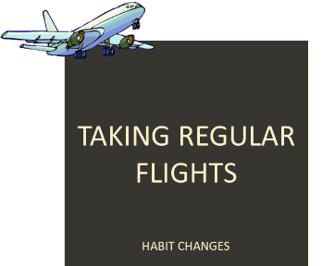

Slide 47
These actions may not have started off as harmful for ourselves and the planet. For example at one point, plastic was considered a revolution and a way to make life easier for humans by being a cheap, versatile material with many amazing uses. Likewise, air travel was a revelation for us humans, allowing access to countries and places all across the world.

Slide 48
However, not only have these actions become excessive, they are all heavily reliant on fossil fuel use or produce high levels of other greenhouse gases. As we have seen, we are tipping the greenhouse gas levels in the atmosphere out of balance, which in turn is causing an increase in temperature, through the greenhouse effect.

Slide 49
In small groups of three or four, pick one of the following habits:

Slide 50
In your groups, thinking about what we have learned so far, take five minutes to discuss:
What fossil fuels are involved.
The advantages of this habit.
The disadvantages of this habit.
How this habit could be altered or replaced by another action.
*If necessary, use the information sheets with information about each habit.

Slide 51
Still in your groups, take a couple of minutes to discuss the following questions:
Can you think of alternatives to replace fossil fuels as an energy source?
What are other habits that are harmful for the planet?

Slide 52
A BRIGHTER TOMORROW
1 0 M I N U T E S

Slide 53
Climate change is a big problem and we can no longer pretend that we can just carry on as normal.
HOWEVER… There are lots and lots of exciting, creative and innovative solutions out there already. People are working across the world to develop positive new actions and habits, from renewable energy to new food production ideas, transport systems and packaging innovations.

Slide 54
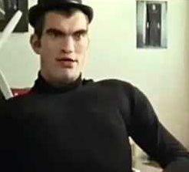
Watch this short video (2:04 minutes) made by energy firm Epruron entitled:
Mr. W
(Click on the link above for the hyperlink)

Slide 55
In pairs, take a couple of moments to discuss the following question:
Do you think the message of this video is effective? Why?

Slide 56
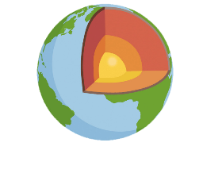
Many people across the world are already switching to renewable energy sources which are much less harmful for the planet and for people. These include:
SUNLIGHT WIND WAVES GEOTHERMAL
As a class, take two minutes to list a couple innovations that use renewable energy that you may know of.

Slide 57
In pairs, take a couple of minutes to brainstorm answers for the following question:
Does having renewable energy as an alternative make you more positive about the future? Why?

Slide 58
TURN IDEAS INTO ACTION!
Choose one or do both!
ACTION 1: Pick a spot where you can observe living things – you can go to a park or simply observe a pot of plant or a line of ants.
Observe what you’ve chosen for at least five minutes.
Then, think about how this living being consumes, produces or pollutes.
Write down your reflections or share with a friend.
ACTION 2: Take one hour of your day (or the entire day if you like) and list what you consume, produce or pollute.
Next to each item, think about how you could change that so it is better for the planet, and yourself.
Write down your reflection or share with a friend.
Try to make at least one of those changes.

Slide 59
In this lesson, we explored the cause & effect of climate change, understanding the influence of human activities over time.
Next lesson we are going to be empathising with the impact of climate change on human and non-human communities in different contexts and environments.

Slide 60
CHANGING CLIMATES
T H I S S O R T O F L E A R N I N G
C A N ’ T W A I T

