Slide 1
EXPLORING NATURAL WORLD
THE

Slide 2
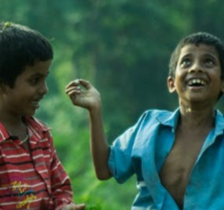
Y9&10 | AGES 13-15
AT A GLANCE | CHANGING CLIMATES| Lesson 3 – The Ripple Effects
10 minutes
THE STORIES WE DON’T ALWAYS HEAR: Explore some of the impacts of climate change, the living beings being affected and whose stories are being told.
Only got 45 minutes?
We recommend exploring the first and second sections, and choosing only one or two changemakers to explore as a class.
Only got 30 minutes?
We recommend exploring section two, looking at one changemaker, and finishing with ‘Turn Ideas Into Action’ (last slide).
25 minutes
U.N. SPECIAL SUMMIT: OUR WORLD, OUR FUTURE: Small groups will represent one character and use fact sheets to understand particular impacts of climate change in their community. Each group will deliver a speech and the class will run a summit.
25 minutes
BRIGHTER TOMORROWS: Begin to imagine a brighter future, and working in groups, learn about ten different changemakers for inspiration.

Slide 3
YEARS 9&10 | KS3&4| Ages 13-15
CHANGING CLIMATES
EXPLORING THE NATURAL WORLD

Slide 4
In this lesson you will need:
Internet access
Speakers
Pens and/or pencils
ThoughtBox Thought-Book or paper
Information sheets for UN Summit (click here to print)
Fact-sheets for Global Changemakers (click here to print)
Here is a list of resources you will need for this lesson.
*We recommend students have a journal-style book for ThoughtBox lessons, in order to capture notes, ideas, drawings, reflections, inspiration and learnings.

Slide 5
LESSON 3 | CHANGING CLIMATES
THE RIPPLE EFFECTS
6 0 M I N U T E S

Slide 6
In this lesson, students will:
Understand and explore some of the consequences of climate change on different species, communities and countries.
Think about some of the impacts of climate change on the human and non-human world, and explore positive responses and actions.
Connect with some inspiring global changemakers and explore some of the innovative ideas being developed for positive futures.

Slide 7
THE STORIES WE DON’T ALWAYS HEAR
1 0 M I N U T E S

Slide 8
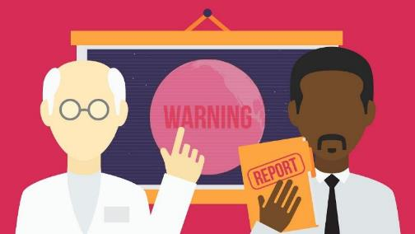
Watch the short cartoon (3:04 minutes) made by Al Jazeera entitled:
How climate change is impacting the globe
(Click on the link above for the hyperlink)
NB: This video was created in 2014, yet it’s data is still relevant (and more dire) today. For a current IPCC video, click here. For an overview of the IPCC 2021 report, click here.
Notes:
Video URL (How climate change is impacting the globe): https://youtu.be/Wp Current IPCC video - IPCC Sixth Assessment Report URL: https://www.youtube.com/watch?v=I1Vx_a6F57Q Overview of the IPCC 2021 URL: reporthttps://www.ipcc.ch/report/sixth-assessment-report-ARWzF3j8U

Slide 9
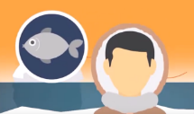
In pairs, take a minute to discuss the following questions:
What are some living beings who are being affected by climate change? (List some examples.)
Why do you think there are some living beings that are being affected that we hear less of?

Slide 10
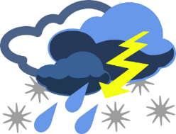
Climate change and global warming are leading to changes across the world, impacting biodiversity, habitats, climate and species (including humans) who are having to migrate in search of alternative habitats.
Many people and many non-human species are leaving home because of flooding or soil erosion, dying crops, drought or extreme weather conditions.

Slide 11
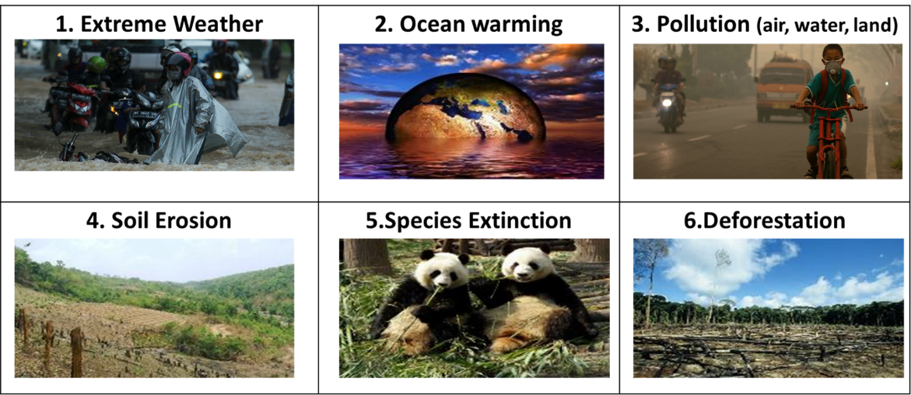
Changes due to climate change and global warming:
Let’s look at six of the most significant impacts that human actions are having across the world:

Slide 12
In trios, discuss the following questions (refer back to the previous slide if needed):
Have you seen or experienced any of these impacts in the area where you live?
What do you know about some of the direct causes and effects of these impacts?
Think about the fossil fuel discussions from last lesson!

Slide 13
Go around the class and share one word to describe what feeling comes up when you see the effects of climate change where you live, or elsewhere in the world.

Slide 14
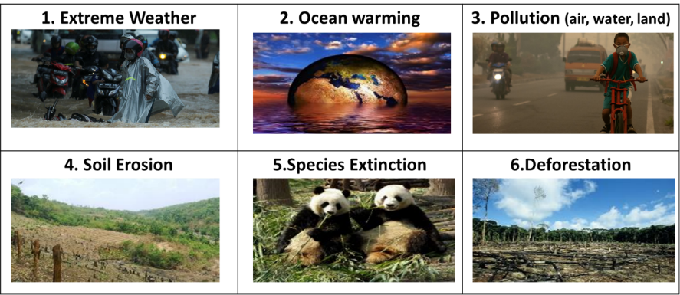
In the next activity, we’re going to explore why these issues are happening and some of the impacts on people and the planet.

Slide 15
U.N. SPECIAL SUMMIT:
OUR WORLD, OUR FUTURE
2 5 M I N U T E S

Slide 16
United Nations Special Summit
You have been cordially invited to attend a special U.N. summit on climate change entitled:
OUR WORLD, OUR FUTURE.

Slide 17
Participants from across the world are invited to offer a 1 minute speech to share stories about how climate change is impacting them in their communities.
Working in groups, you are going to assume the voice of a particular sector impacted by climate change and work together to write your short speech to tell your story.

Slide 18
Instructions:
Get into groups of four.
Each group will be allocated one of the characters on the next slide. (You can have more than one group for each character if you have a large class).
Use the fact sheet about the impact on their community, plus what you already know, and collate your ideas together on a piece of paper.
Working together, turn these ideas into a 1 minute speech (more information on the next slides).
Each of you will be delivering the speech, so make sure you all have a copy written down – either in note form or as a script – and that all of you have a part in the speech.

Slide 19
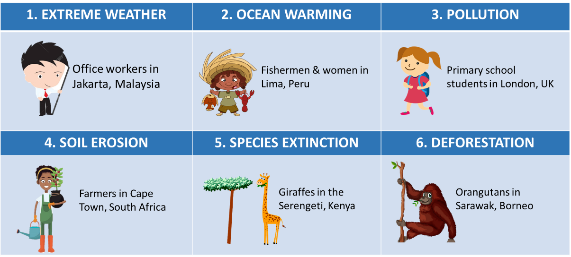
Instructions continue on the next slide

Slide 20
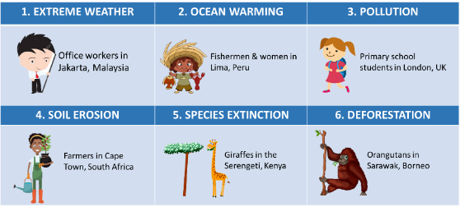
Spend 15 minutes in your group planning and preparing your speech.
Remember to:
Introduce who you are and where you are from.
Explain the physical impact of climate change on your life.
Explain the emotional impact of climate change on your life.

Slide 21
Now you are going to assemble for the summit.
You will need four different tables or sections in the room. One member from each original group needs to sit at each of these tables. The new groups in each table or section should then have a representative of each of the six characters from the original groups. Each representative will have 2 minutes to share their speech with the new group.

Slide 22
In pairs, take a couple moments to discuss the following question:
How was it to represent your character? How did it feel? Why?

Slide 23
BRIGHTER TOMORROWS
25 M I N U T E S

Slide 24
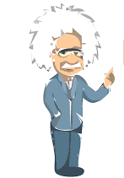
Albert Einstein famously said:
It is more important than ever for us all to make a shift and start addressing the problems of climate change by changing our habits and our behaviour.
This doesn’t need to mean completely giving up on how we live, but rather, changing the way we do things - such as the ways we already are starting to do so with our energy use.
To go on doing the same thing and expect a different result, is the definition of insanity.

Slide 25
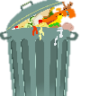
In trios, take a couple of minutes to discuss Einstein’s quote in terms of human habits and our global energy use.
To go on doing the same thing and expect a different result, is the definition of insanity.
- Albert Einstein
HABIT CHANGES

Slide 26
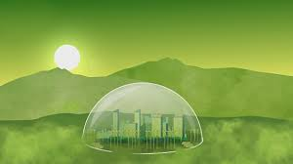
Watch the short video (2:50 minutes) made by BBC Ideas entitled:
Imagine a world without fossil fuels
(Click on the link above for the hyperlink)
Notes:
Video URL: https://www.youtube.com/watch?v=IaqAyc_Q9mM

Slide 27
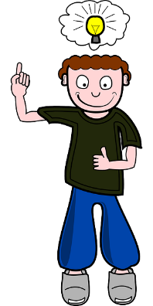
There are already hundreds of thousands of people across the world working on ideas, inventions, solutions and new systems to address the climate crisis. There are new possibilities popping up across the world everyday.
In the face of distress, anxiety and despair, now is the time for innovation, creativity and possibility – and there are so many exciting possibilities for us all to explore!

Slide 28
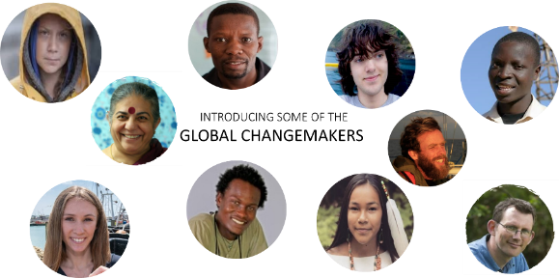
1. Going back to your original groups, each group take one of the ten changemakers introduced on the next slide (one fact-sheet per group).
2. In your group, read your fact-sheet about the work of your changemaker. 3. Spend 5 minutes discussing how their work may impact and/or support issues that the planet is facing.
4. Think about who you are representing at the UN and what is happening in your life.
These are just 10 of the millions of people working on healthy alternatives to some of our habits, developing ideas which are good for both people and the planet (link).
NB: Simply click on the image on the next slide of the person you wish to meet to find out who this changemaker is and what they are doing to change the world for the better!

Slide 29
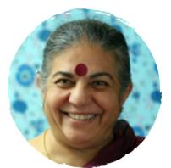
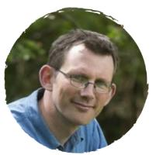
INTRODUCING SOME OF THE GLOBAL CHANGEMAKERS

Slide 30
In pairs, take a couple of minutes to discuss the following questions:
How did it feel like to read about these changemakers? Why?
Do you think anyone can be a changemaker if they’d like? Why?

Slide 31
Just like the characters we have met, humans will have to adapt and make changes to respond to and prevent climate change.
That is why people across the world are changing habits on an individual, local, national and global scale.
With the person next to you, take a moment to share:
What you are already doing for the good of the planet.
A habit you could change that is currently not healthy for the planet.

Slide 32
TURN IDEAS INTO ACTION!
Choose one or do both!
ACTION 1: Empathy with others
Notice as many living beings (human or non-human) that are being impacted by climate change.
Take a moment to empathise how it might be for them.
Brainstorm how these perceptions can influence the way you normally do something in your life.
ACTION 2: The small actions
Notice as many people, groups and actions around you that support the wellbeing of Earth – small or big.
Identify a characteristic that they have in common.
Brainstorm how these can inspire and influence the way you normally do something in your life.

Slide 33
In this lesson, we empathised with the impact of climate change on human and non-human communities in different contexts and environments and met some global changemakers.
Next lesson, we are going to explore ways we can all feel empowered and take actions which will have positive ripple effects across the world.

Slide 34
CHANGING CLIMATES
T H I S S O R T O F L E A R N I N G
C A N ’ T W A I T

