Slide 1
CHANGING
CLIMATES
EXPLORING THE NATURAL WORLD
Years 9&10 | Ages 13-15
KEY STAGE 3 & 4

Slide 2
In this lesson you will need:
Internet access
Speakers
Plain A4 paper
Coloured pens / pencils
Large sheets of paper (optional for final task)
Deep Time printout (optional) – click here to print

Slide 3
LESSON 1 | CHANGING CLIMATES
O U R C H A N G I N G
C L I M A T E
6 0 M I N U T E S

Slide 4
In this lesson, students will:
Think about some of the causes of climate change and introduce "Deep Time" to learn more about the history of the Earth
Understand the importance of exploring the emotions arising from climate change and of finding ways to express how we feel
Explore ideas around deep time and human activities to help us understand the importance of changing some of our habits

Slide 5
WHY IS OUR CLIMATE CHANGING?
2 0 M I N U T E S

Slide 6
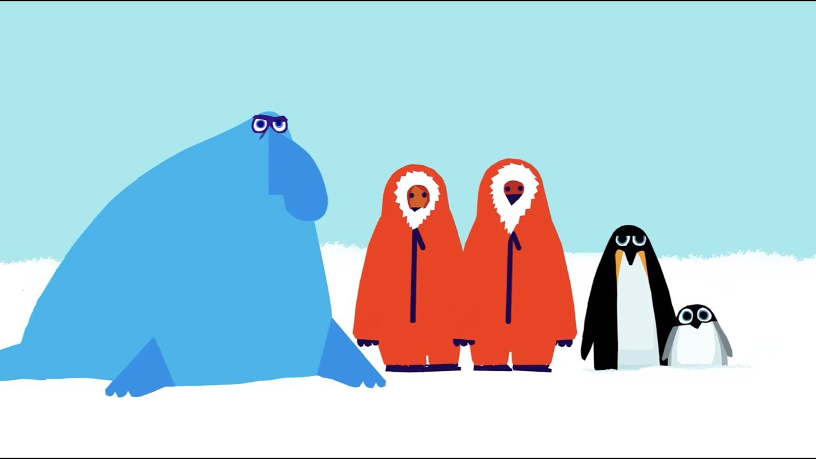
Watch the short film (2:51 minutes) made by Emily Shuckburgh, an oceanographer at the British Antarctic Survey, and Chris Haughton, author and illustrator, entitled:
Message from Antarctica
(Click on the link above for the hyperlink)

Slide 7
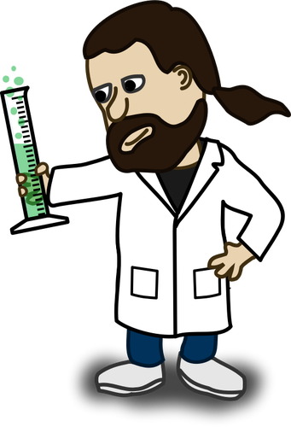
Even though there are periods of natural climate warming, scientists have discovered that humans are responsible for the current levels of global warming.
The reason scientists and many other folks are concerned is because Earth's global climate is changing and our planet is warming up fast—faster than at any other time scientists know about from their studies of Earth's history.

Slide 8
You learned in the video about the changes to carbon-dioxide (CO₂) levels over the Earth’s history and some of the ways that humans have been adding increasing levels of CO₂ in our atmosphere, such as through burning fossil fuels and deforestation.
Increased levels of Co2 causes global warming because of the
greenhouse effect
Turn to the person next to you and share what you already know about the greenhouse effect and what this means.

Slide 9
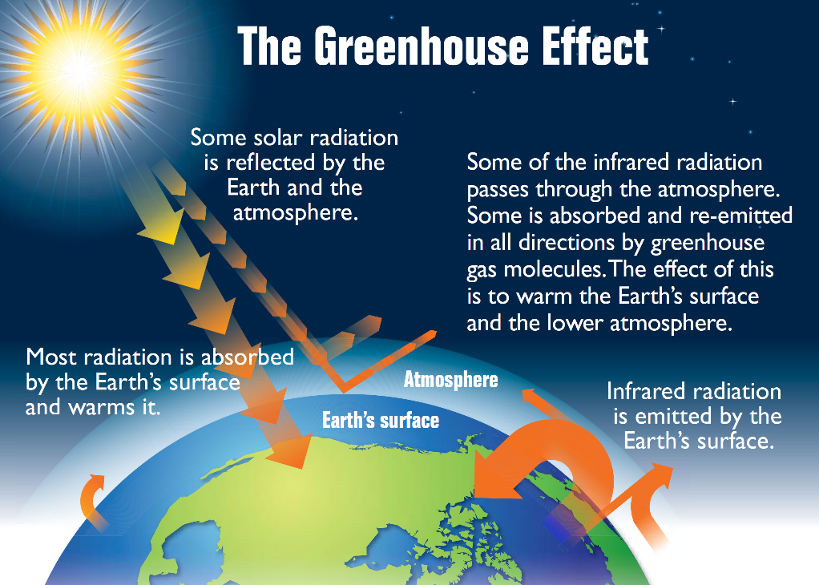
Life on Earth is possible because of the warmth of the Sun. While some of the incoming light, heat and radiation from the Sun bounces right back into space, some of it is trapped by the greenhouse gases that make up our atmosphere. These layers of greenhouse gases are the Earth’s blanket.
Without this layer of insulation, Earth would simply be a frozen rock hurtling through space. Therefore the 'blanket' is a really important layer. However, it has got far too thick and is now causing problems across the globe.

Slide 10
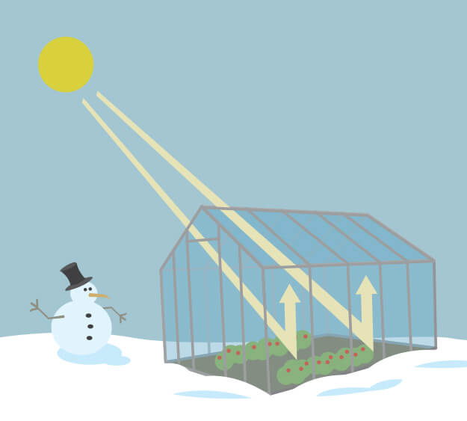
How does the greenhouse effect work?
As you might expect from the name, the greenhouse effect works just like a greenhouse (a glass building used to grow fruits, vegetables and plants).
A greenhouse stays warm inside, even during the winter, because the glass walls of the greenhouse trap the Sun's heat and keep some of it contained inside.

Slide 11
The greenhouse effect works much the same way on Earth. The Earth has a layer of heat-trapping gases in the atmosphere (like the roof of a greenhouse). These heat-trapping gases are known as the greenhouse gases.
During the day, the Sun shines through the atmosphere. Earth's surface warms up in the sunlight. At night, Earth's surface cools, releasing heat back into the air, but some of the heat is trapped by the greenhouse gases in the atmosphere.
Having too much of these greenhouse gases causes the Earth's atmosphere to trap more and more heat which in turn causes the planet to warm up. At this moment, the Earth’s greenhouse gases are higher than at any time in the last 800,000 years, for the most part due to human activities.

Slide 12
There are 6 main greenhouse gases in the earth’s atmosphere that make up “Earth’s blanket”. These are:
CARBON DIOXIDE
METHANE
NITROUS OXIDE
WATER VAPOUR
OZONE
CHLOROFLOROCARBONS

Slide 13
Which of these gases have you heard of before?
Which gases are humans currently producing too much of?

Slide 14
Four fast greenhouse-gas facts:
Trees help to regulate the climate by absorbing carbon dioxide from the atmosphere. When we cut down trees & forests, their beneficial effect is lost whilst carbon stored in the trees is released.
Animal agriculture increases emissions as cows and sheep produce large amounts of methane when they digest their food.
Burning fossil fuels (coal, oil and gas) produces carbon dioxide and nitrous oxide.
Fertilisers which contain nitrogen produce nitrous oxide emissions.

Slide 15
A VISION OF CLIMATE CHANGE
1 5 M I N U T E S

Slide 16
Take a look at the following slide of an image representing global warming.
Talk to the person next to you about how or what the data this image might be showing. Share your thoughts with the class.

Slide 18
This image was made by a climate scientist called Ed Hawkins. He decided to represent each year’s average temperatures from 1850-2018 using data from the UK Met Office and put that into a simple image. The stripes of colour range from blue (cold) to red (hot). Ed and his team have been using weather data from countries across the world to produce images for individual countries and regions, and then collating all of this together to produce the image for the entire globe.
“I wanted to communicate temperature changes in a way that was simple and intuitive, removing all the distractions of standard climate graphics so that the long-term trends and variations in temperature are crystal clear.”
Ed Hawkins | Professor of Climate science | University of Reading
*You can explore more of these images at https://showyourstripes.info/

Slide 19
Take a look at the three pictures on the following slide, which are artistic responses to climate change.
Talk with the person next to you about your thoughts and feelings about each image and what messages each image is expressing.

Slide 20
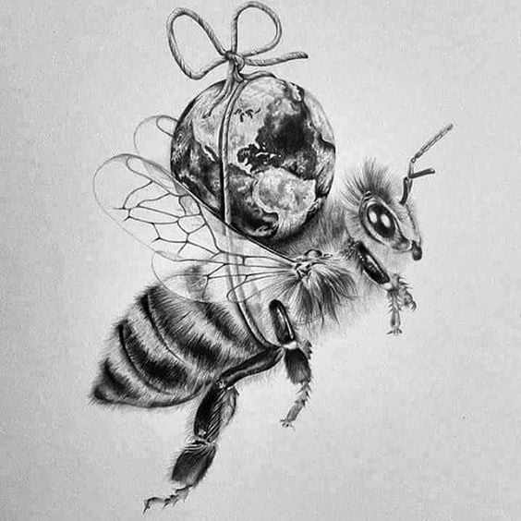
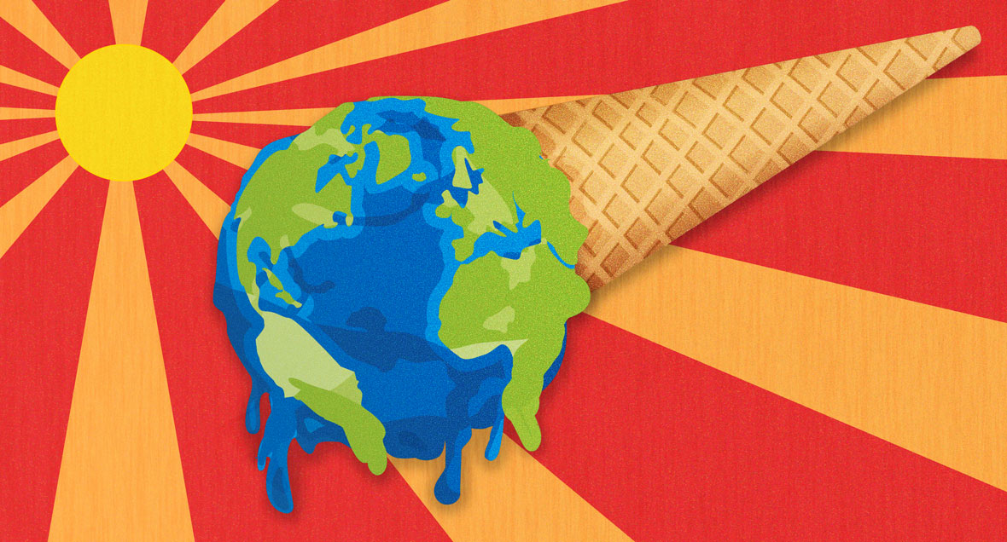
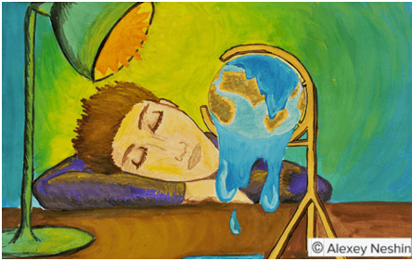
E. Otwell.
Unknown

Slide 21
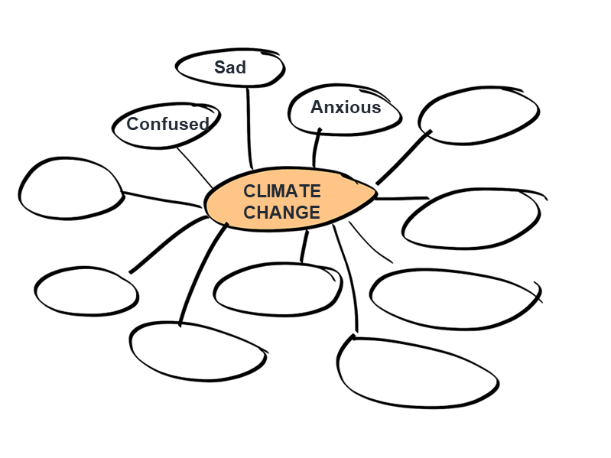
We all have very different responses and very different emotions regarding climate change. Working together as a class, make a quick mind-map on the board of some different moods, emotions and reactions that people have about climate change. Each person can offer a word to add to the map.
Think about the way you feel. Share some of the emotions that you experience or emotions that you are aware other people have.

Slide 22
You are now going to spend five minutes drawing your own response to the phrase ‘Climate Change’. There is no right nor wrong here, you are simply being invited to respond to the idea of climate change using a picture.
You might represent information and facts, represent how you feel, what others are feeling and/or what you think about when you hear the phrase.
Don’t overthink your response. Simply take an A4 piece of paper and draw your response. You can choose to show this at the end or keep it to yourself.

Slide 23
WHAT CHANGES ARE WE SEEING?
1 0 M I N U T E S

Slide 24
We are becoming ever-more aware of human-caused climate change and some of the effects and impacts. All of us, no matter where we live in the world, will have started to see some of the impacts or effects of climate change.
What about you?
What have you seen, experienced or heard of that are examples of impacts of climate change?

Slide 25
Take a look at the five images on the following slides, all showing examples of an impact of climate change from around the world.
For each image, think about and then share with the class:
Where in the world do you think this may be happening?
Why do you think this is happening?
What is the impact of this? What are the wider effects?

Slide 31
You were shown images of
Icebergs melting
Forest fires
Drought
Flooding
Crop failure
Why and how are these caused by climate change?
Think about what we explored earlier

Slide 32
TRAVELLING THROUGH DEEP TIME
1 5 M I N U T E S

Slide 33
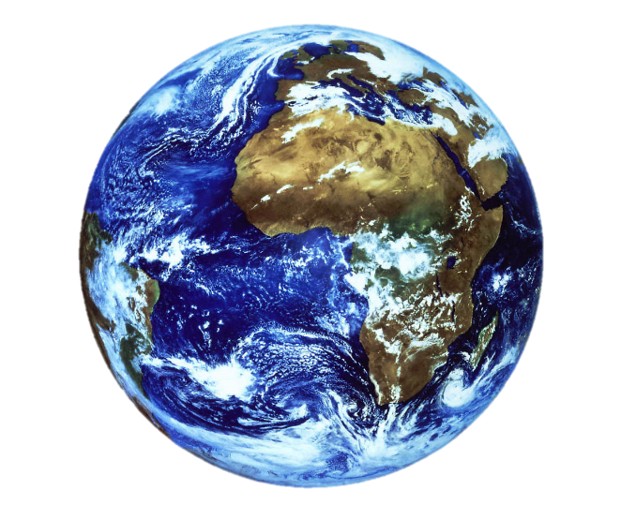
Have you ever heard the phrase 'Deep Time'? What do you think this might mean?

Slide 34
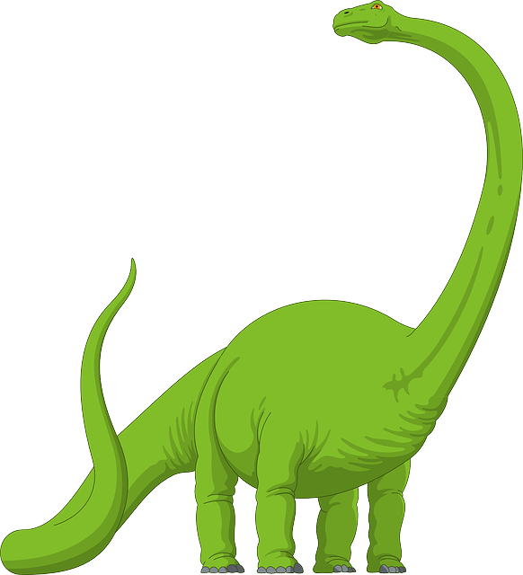
Most of the history we learn about in school focuses on human history and stories of our own life on Earth.
Yet the Earth has a history long before humans came along, long before dinosaurs came along and long before any of us can really imagine.

Slide 35
We’re going to explore the concept of 'Deep Time' by using some metaphors to travel back in time and help us think about the history of planet Earth and the role humans play on this planet.

Slide 36
This number is so huge, it is really difficult for us humans to grasp. When our life expectancy is usually less than 100 years, it’s almost impossible for us to imagine something so vast as geological time or Deep Time, which is the time that the Earth has existed.
The Earth is roughly 4.6 billion years old.

Slide 37
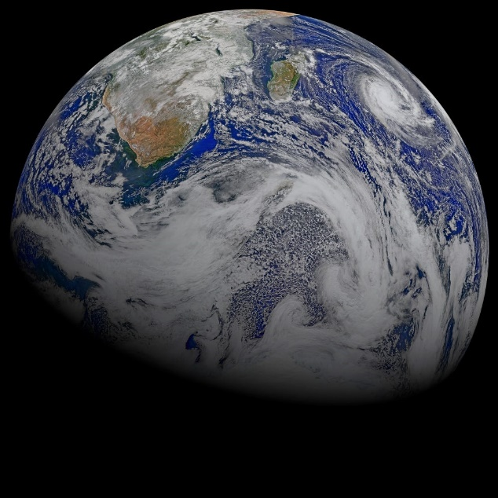
Watch the short video (3:39 minutes) made by Business Insider entitled:
The History of Earth
(Click on the link above for the hyperlink)

Slide 38
This video explores some pretty big ideas, some of which you may never have thought about before.
You might be feeling a bit overwhelmed right now or maybe even excited about these ideas. However you are feeling, let’s have a few minutes of quiet time to reflect.
Put your head onto your hands on the table, close your eyes and take a few deep breaths whilst you think about what you have just explored.

Slide 39
When you start to think about Deep Time, you realise how new human beings are.
Were you aware of how recent human beings are to the Earth? How does this make you feel?

Slide 40
Here are three different ways that we can try to understand deep time. Choose one (or more) of the three journeys and travel together as a class.
*Each of these can be an individual project or a class project – you may just want to look at them today and come back to them another time.
1. Draw a timeline or map of the history of the Earth, using the information on the next slide.
2. Draw a clock of Deep Time, using the second slide to help you.
3. Take a Deep Time Walk using the third slide. NB: this would take a few hours and could be a great school trip or class outing that you may wish to arrange if possible

Slide 41
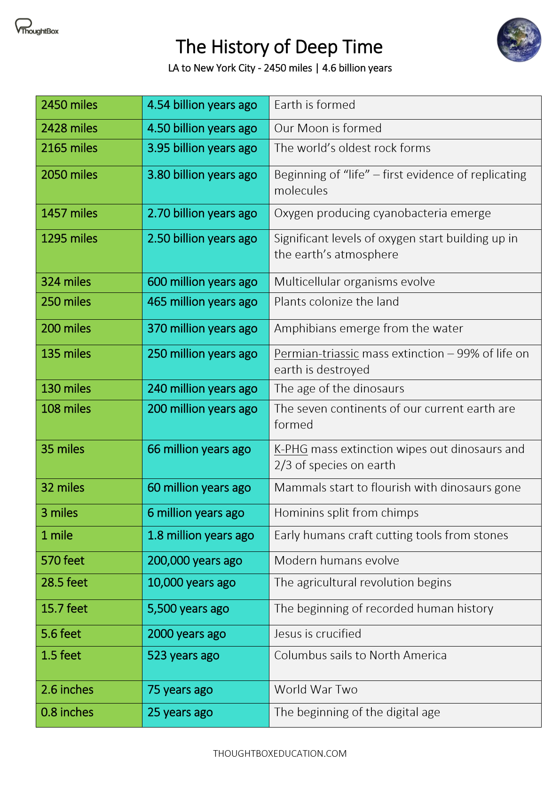
1. Draw a Deep Time timeline
Here are all of the different stages and measurements of time (and distance) from the LA to New York journey in the film that you watched. *click on the image for a larger version or to download
Why not take a huge piece of paper (or stick several together) and create a timeline to go around the classroom? For each moment in time, you could add images and pictures as well as noting down what was happening.

Slide 42
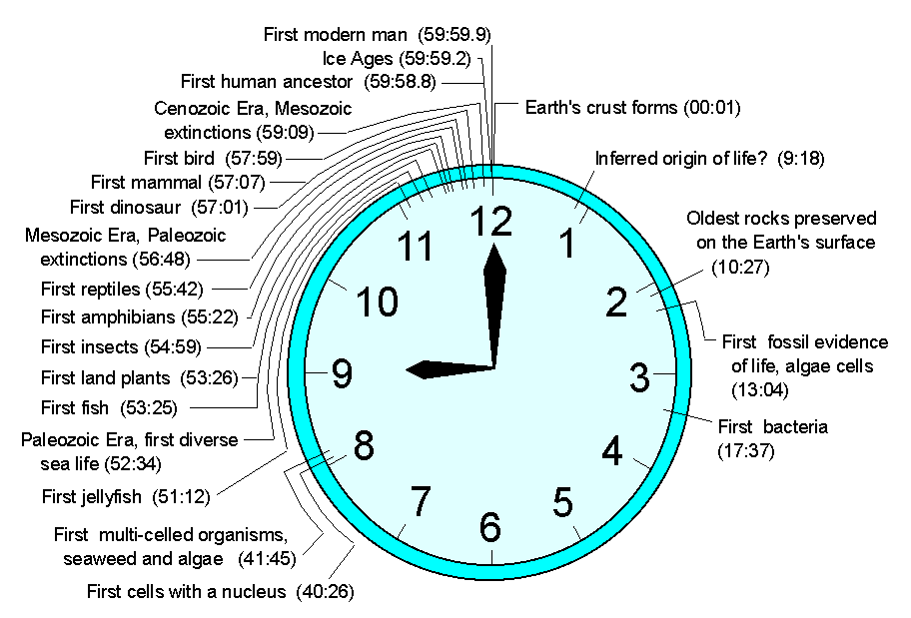
2. Create a Deep Time clock
Here is an example of Deep Time using a clock – why not have a go at making your own?

Slide 43
3. Take a Deep Time Walk
Walk 4.6km through 4.6 billion years of Earth history, learn about key concepts of Earth’s evolution and experience a unique perspective of Deep Time with a Deep Time app.
Designed using appropriate technology, the Deep Time Walk app calculates your speed and distance as you journey across 4.6 billion years of time, enabling you to learn about key evolutionary events as they occur over the history of the Earth.
The dramatised Deep Time Walk can be experienced anywhere in the world! You can learn more here and download the app for free.
www.deeptimewalk.org

Slide 44
Why might Deep Time help us to respond to the changing climate?

Slide 45
To help think a little more freely about the significance of time, let’s take a look at some of the living things around us that have been here for a long, long time on Earth (although even they have not been here that long when we think about Deep Time.)
Let’s meet:
The oldest tree on Earth
The oldest animal on Earth
The oldest species on Earth
The oldest rock on Earth

Slide 46
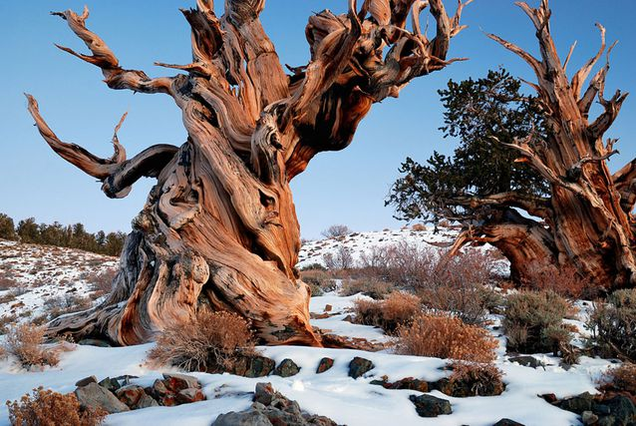
What is the oldest tree on Earth?
The oldest recorded tree on Earth is in California's White Mountains. It is an unnamed bristlecone pine tree and has a core which suggests it is 5,067 years old.

Slide 47
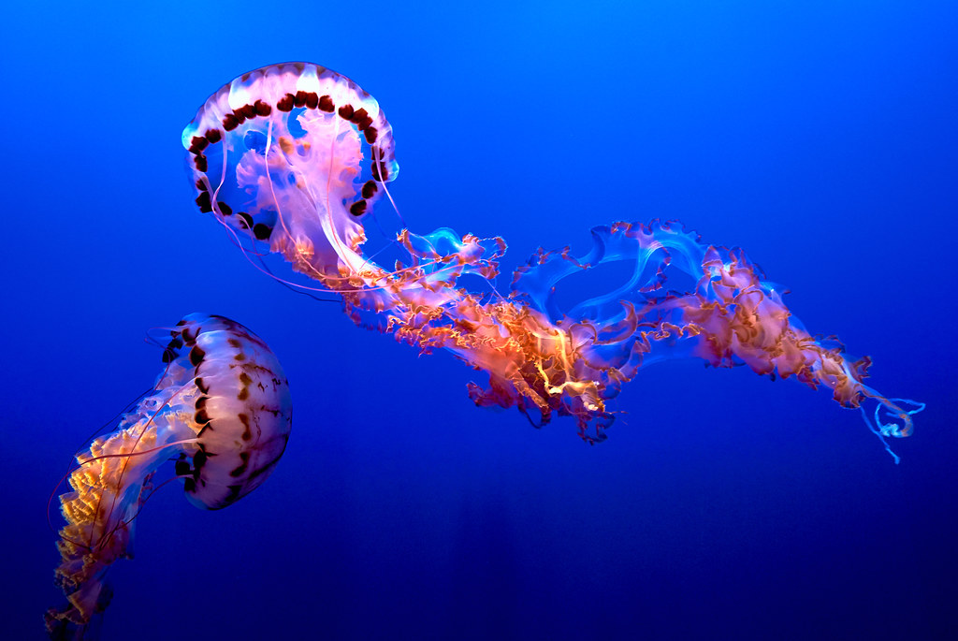
What is the oldest animal on Earth?
The jellyfish evolved on Earth about 550 million years ago and is considered the oldest multi-organ animal in the whole world.

Slide 48
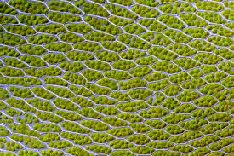
What is the oldest species on Earth?
Cyanobacterium is the oldest known animal species on Earth. They are sometimes called an algae but are actually a bacteria.
They live in the water and can manufacture their own food. They are major contributors of oxygen in the world and sustain all oxygen-breathing organisms on Earth. Cyanobacterium evolved about 2.7 billion years ago.

Slide 49
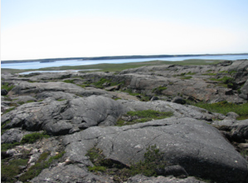
What is the oldest rock on Earth?
There are some pretty old rocks in the Grand Canyon - about 2 billion years old - but they are mere babies compared to the oldest known rocks on Earth!
The oldest known rock on Earth is in Bedrock along the northeast coast of Hudson Bay, Canada, and dates back to around 4.28 billion years ago.

Slide 50
In order to think about ways to change the human habits which are not good for the planet, we need to fully understand what we are doing that is unhealthy – and why - so we can start thinking about what some of the healthy habits are that we can all work towards instead.
There is much we can do to prevent many of these future issues from happening and lots of really positive things that we can do (and that people across the world are already doing)
We will be exploring these ideas more fully in the next lesson of this Changing Climates curriculum.

Slide 51
CHANGING CLIMATES
T H I S S O R T O F L E A R N I N G
C A N ’ T W A I T

