Slide 1
EXPLORING
THE NATURAL
WORLD
KEY STAGE 2 | YEAR 5 & 6
Inspiring connection, curiosity and engagement with the natural world

Slide 2
Internet access to play two short videos (or the videos can be embedded into the PowerPoint)
Speakers for audio track
Internet access and computers/tablets for each group to use or printouts of the factsheets provided
Lined paper or writing paper (one piece per student) and pens
Rough paper for making notes x 2 pieces
Pens / pencils
In this lesson you will need:

Slide 3
WEEK 2
CHANGING LANDS
TOPIC: HABITATS

Slide 4
In this lesson, we will:
Think about how land is being changed through natural and unnatural causes
Understand some the impacts that deforestation has on inhabitants of rainforests in South America
Explore how it may feel to creatures and inhabitants of the rainforest when the land changes around them

Slide 5
T H E R E ‘ S A L O G G E R I N M Y F O R E S T
10 MINUTES

Slide 6
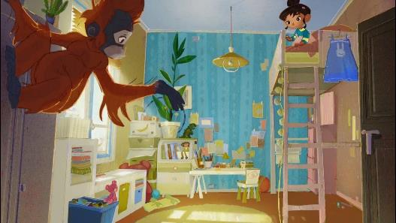
Watch the short video (1.30 mins) made by Greenpeace about the rainforests entitled:
There’s a Rang-tan in my bedroom
(Click on the link above to open the film)

Slide 7
Working in pairs or small groups, discuss and then write down your thoughts on the following three questions. You may need to watch the video again.
What problem does the orangutan share with the girl?
What might some of the solutions to this problem be?
Why is this a problem?

Slide 8
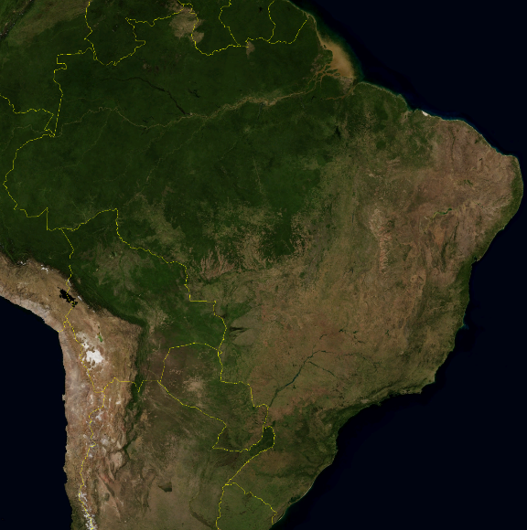
Last lesson, we looked as some maps showing where rainforests were across the world. This is a map showing South America where the Amazon Rainforest is located.
Which part of the continent do you think is the Amazon Rainforest? How can you tell?

Slide 9
Now look at these two images, also taken of the Amazon Rainforest. Try to think about what might have happened in these pictures.

Slide 12
What do you think might have happened to the rainforest in these images?

Slide 13
The images are showing a process called deforestation. This means that most or all of the trees have been cut down or removed from an area of forest by humans. This is normally because the land is going to be used or because the timber is needed.
Logging, which is the cutting of down of trees for timber use, is the reason that an area the size of a football pitch is cut down every few seconds within the Amazon Rainforest.

Slide 14
W H O I S C U T T I N G D O W N T H E F O R E S T ?
20 MINUTES

Slide 15
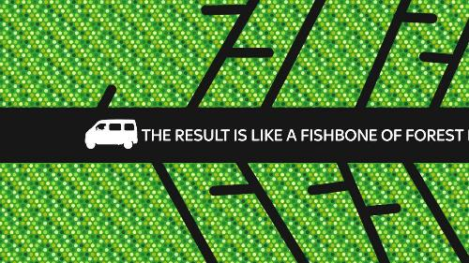
Watch this short video (2.05 minutes) made by WWF called:
The Amazon Fishbone Effect
Click on the link above to open and watch the film

Slide 16
Why do you think people cut down
so many trees in the rainforests?
Working in small groups, write down as many reasons as you can think of as to why people might chop down the rainforest and what they may be doing this for.

Slide 17
Some of the biggest reasons for deforestation are on the following slide.
Before looking, make a list on the board of all of the ideas that the class has come up with, asking each group to share some of their ideas.

Slide 18
Action | Process | End product
1. Cattle ranches | Large areas of forest is cleared and trees cut down to make pasture land for cattle | Hamburgers | Meat products
2. Logging | Trees are cut down and then sold to different people to turn into different products | Wood to burn for fuel Oil for products (e.g. palm oil) Wood to make furniture Wood to build houses Wood to make paper
3. Mining | Large areas of the forest is cleared to make mines to harvest fossil fuels as well as gold and precious metals. | Oil for petrol and fuel Gas for fuel Gold to make jewellery Precious metals such as copper, tin, nickel and iron-ore to make products
4. Urbanising | Large areas of forest are cleared to build roads and houses | Space for people to build houses.

Slide 19
Although many people rely on the rainforest to survive, there is a strong argument that deforestation is mainly done to provide the world with “luxuries”.
Some of the main products that come as a result of deforestation are:
GOLD
MEAT
OIL
MAHOGANY
GAS

Slide 20
GOLD
MEAT
Why might these products be called luxuries?
MAHOGANY
OIL
GAS

Slide 21
Understanding the value of the rainforest is the first step to changing people’s behaviour, so here are some facts about the Amazon Rainforest in Brazil that may be interesting (and important) to share with people:

Slide 22
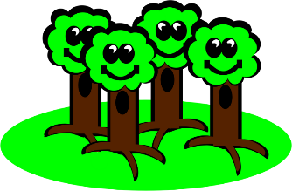
The Amazon rainforest has been described as the “lungs of our planet” because it provides essential recycling of carbon dioxide into oxygen.
One-fifth of the world’s fresh water is in the Amazon basin.
More than 20% of the world’s oxygen is produced in the Amazon rainforest!

Slide 23
Every 2 seconds, humans destroy an area of forest the size of a football field…
We are losing 137 plant, animal and insect species every single day due to rainforest deforestation.
That is about
50,000 species disappearing each year.
As the rainforest species disappear, so do many possible cures for life-threatening diseases. Currently, over 120 prescription drugs sold worldwide come from plant-derived sources.

Slide 24
I F T H E R A I N F O R E S T
C O U L D S P E A K . . .
25 MINUTES

Slide 25
Many images of deforestation in the Amazon Rainforest only show images of trees and land. However we know just how many inhabitants there are in the forest.
Let’s think about how deforestation might impact their lives…

Slide 26
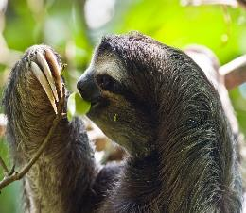
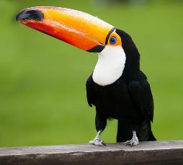
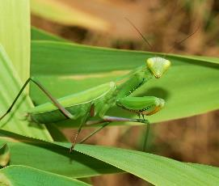
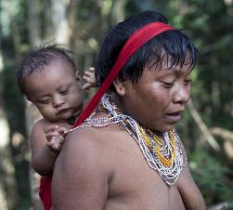
You are going to choose one of the four inhabitants below and try to imagine being them for a while.
SLOTH
TOUCAN
MANTIS
YANOMAMI

Slide 27
In a moment, you will close your eye for a moment and imagine that you are that inhabitant and you live in the Amazon rainforest
In silence, try to think about what it feels like to be your inhabitant and some of the ways of life that you enjoy.
Imagine that the land you live in has changed, there are suddenly humans in the forest.
Imagine how it feels with the noise, with the pollution. Imagine how it feels to have fewer trees all around you. How does it feel to you?
Click play on the speaker symbol for some rainforest sounds and then spend one minute in silence thinking about how you feel (the sound runs for 60 seconds).

Slide 28
You are now going to write a short reflection of how you feel. Remember that you ARE that person or creature, so write as though you are them.
Write about how you feel, what your thoughts are, what your concerns are or your hopes. Use the ideas on the next slide to help you.
Spend about five minutes on this creative task

Slide 29
Try to engage as much as you can with how that inhabitant might feel.
How does the forest feel with fewer trees?
Can you still find food?
What do you wish for?
Is your home the same?
What are you scared of?

Slide 30
Ask some or all of the class to read their reflections aloud. As each person reads, ask the rest of the class to close their eyes and imagine the inhabitant talking. Perhaps play the sound effects again.
SLOTH
TOUCAN
MANTIS
YANOMAMI

Slide 31
T H E W E B
O F L I F E
5 MINUTES

Slide 32
The next slide shows a ‘web of life’ or food chain for the Amazon Rainforest.
Each part of the rainforest has its role in the ‘web’, whether they are the food producers (such as the trees and plants), the primary consumers (such as the herbivores*), the secondary consumers (such as the carnivores*) or the decomposers (such as the fungi).
Look together at the picture and see if you can put any more inhabitants into the web. When you have finished, discuss together what would happen if the trees were removed from the web.
*herbivores are plant eaters
*carnivores are meat eaters

Slide 34
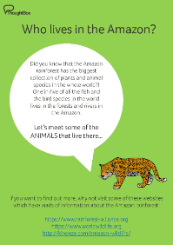
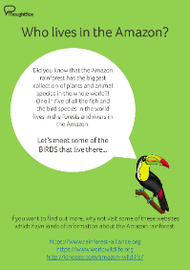
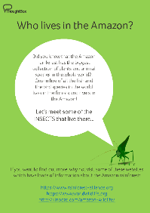
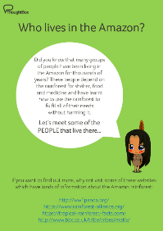
If time allows, why not draw your own Web of Life for the Amazon Rainforest, using the information from your inhabitants factsheets in the last lesson (see below for links).
Start with the trees and plants and move up. An example is on the next slide.

Slide 36
THIS SORT OF LEARNING CAN’T WAIT
WWW.THOUGHTBOXEDUCATION.COM

