Slide 2
Small pieces of paper for writing ideas
Ball / something soft to throw
Line of Happiness template (optional)
Small pieces of card or paper
Coloured pens and / or pencils
Washing line and pegs (optional)
In this lesson you will need:

Slide 3
W E E K 1
WHAT IS HAPPINESS?
TOPIC: HAPPINESS

Slide 4
In this lesson, you will:
Think about and discuss what happiness means and how happiness is different for us all
Understand how we feel when we are happy and where it shows up in our bodies
Explore and unravel some of the ways that we find happiness and the things that make us all happy

Slide 5
WHAT IS
HAPPINESS?
1 0 M I N U T E S +

Slide 6
Write down on a piece of paper what you think of when you see the word below (there is no “right answer” to this question, just write down whatever you think or feel):
Happy

Slide 7
Fold up the pieces of paper and put them into hat or box.
Now your teacher will read these words or phrases or ideas out and share some of the things that makes your class happy.
Listen to all of the ideas that come from the class and think about how each idea makes you feel.

Slide 8
Although there are some things that make all of us feel happy, we will all have very individual ideas about happiness.
For example, some of us might feel really happy seeing particular people or hearing music or going to places – things that don’t make others feel happy at all!

Slide 9
Music in general is something that makes many people happy. Although we might all like different sorts of music, there are often shared feelings that people have when music plays which makes them happy.
What are some of the other things that make lots of people happy? Work with the person sitting next to you, or people on your table and try and write down a list of ideas.

Slide 10
THE FEELING
O F H A P P I N E S S
1 5 M I N U T E S +

Slide 11
How do we know when someone is happy? How can other people tell?
Try and show the rest of the class that you’re happy without saying a word. Look around the room and notice what people are doing.
Share your observations with the group.

Slide 12
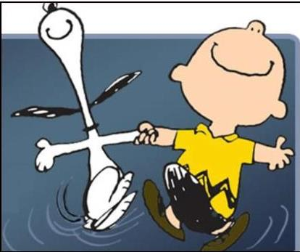
Where does happy live inside you?
Sometimes our emotions can be seen by other people (for example if we smile or frown) but sometimes they can’t be seen. However, we can always feel them inside ourselves.
Whereabouts in your body do you feel happiness? Close your ideas and try to think about feeling happy and where you might get sensations inside your body.
What does your body feel like when you are happy?

Slide 13
What is happiness? How do we know when we are happy?
Think about this question and talk to the person next to you, then share ideas together as a class.

Slide 14
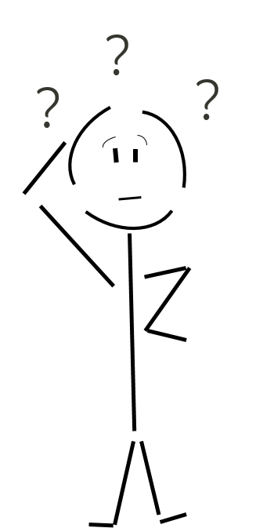
What does happiness feel like?
This might sound like a bit of a tricky question, as sometimes it is hard to describe feelings only using words.
Let’s try. Just think really carefully about the FEELING of happiness and follow the instructions on the next slide.
It might be that you can’t really describe it properly in words – in which case you might need to use words that aren’t real words!

Slide 15
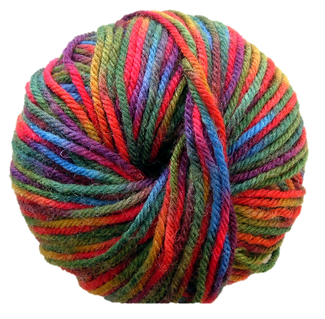
Sit in a circle with a ball or something soft to pass around.
The teacher will start with the ball and say how happiness feels to them – the pass the ball to another pupil in the class. Take it in turns to catch the ball and then share how happiness makes you FEEL.
Try to find ways to describe clearly the feelings you have when you’re happy.

Slide 16
MY HAPPINESS BOARD
3 5 M I N U T E S +

Slide 17
When you think of the word happy, what colours do you think of? What sounds do you hear? What places do you imagine or which people do you remember?
All of us will have very different versions of happiness – and all of us can find happiness in many different ways.
We’re going to use our imaginations and our memories (and our creativity) to make your very own Line of Happiness!

Slide 18
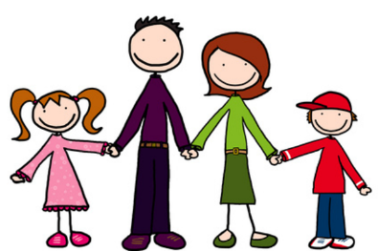
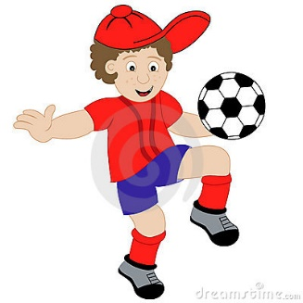
Happiness is…
Happiness is…
Happiness is…
Happiness is…
Happiness is…
Happiness is…
THE COLOUR
YELLOW!
MY FAVOURITE
SONG
THE SCENT OF A
DAFFODIL
MY FAMILY
BEING IN NATURE
PLAYING FOOTBALL

Slide 19
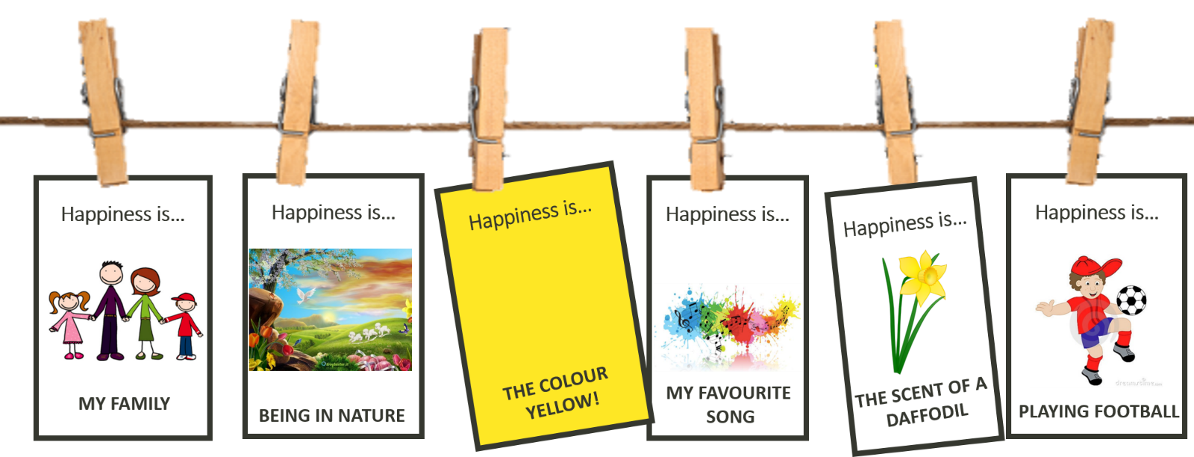
You are going to think about some of the things you think of when you hear the word HAPPINESS and create some small picture postcards to hang on a washing line!
You might decide to make one line that hangs across your entire classroom and make individual cards, or you might decide to make small posters using the washing line template page.

Slide 20
Before you start, plan out what you are going to include on your line. Here are some questions to help you come up with ideas:
Which people make you happy?
Which places make you happy?
Which sounds make you happy?
Which colours make you happy?
Which activities make you happy?
Which thoughts make you happy?
Which foods make you happy?

Slide 21
Think about what to include on each postcard and how to represent each idea.
You might decide to draw a picture or write some words or create a design – whatever best shares your idea for that piece of happiness!

Slide 22
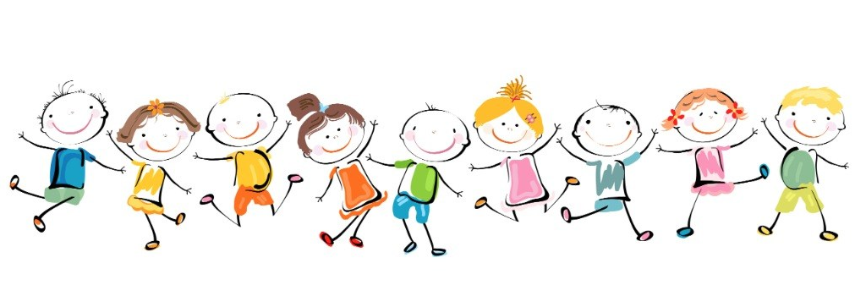
When you have finished, explore other people’s ideas and get to know what some of the things that make other people in your class feel happy.

