Slide 1
IDENTITY
EXPLORING IDENTITY
Y7&8 | 11-13 years

Slide 2
WHO AM I?
W E E K 1
6 0 M I N U T E S

Slide 3
In this lesson, students will:
THINK!
Think about what our different ingredients are and what makes us all unique in the world
Understand and explore how differences are to be celebrated and that diversity is a really positive part of the human population
Connect up some of our understanding of our own unique selves to how we can feel empowered and beautiful in our own skin
FEEL!
CONNECT!

Slide 4
WHAT AM I MADE FROM?
1 0 M I N U T E S +

Slide 5
What makes you you? What are your ingredients? What has gone into making you and what about you is so unique?
There will be many parts of us that we share with others – maybe our gender, our religion, our ethnicity, even our eye colour. But there will be many parts that are totally unique, only found in ourselves.

Slide 6
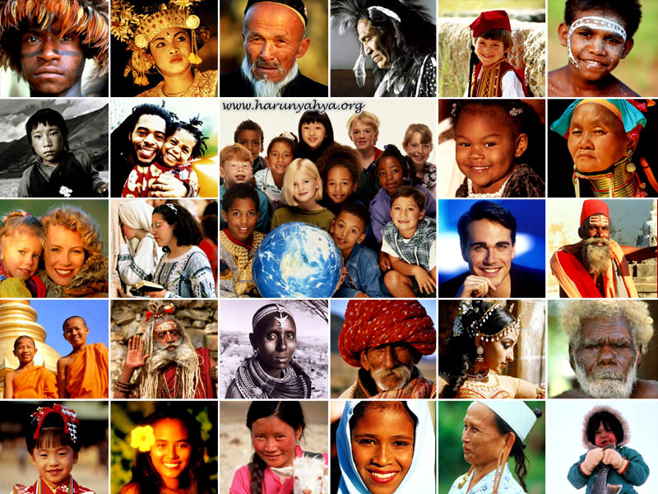
There are over seven billion people living in the world, and we are all connected in so many ways. We all share the same basic needs (the need to eat, drink, breathe, sleep etc.), we have bodies that contain the same organs and cells (for the most part) and we all share the same home – Planet Earth.
We are unique because of how we look
We are unique because of how we act
We are unique because of who we are
Yet each and every single one of us, all seven billion people on this planet, is a completely unique being.

Slide 7
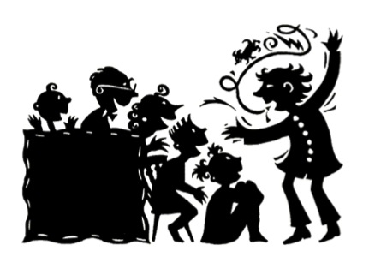
Over the course of your life, you will spend a lot of time telling people about “who you are” - you will be telling your story. All of us have a story hidden inside us – it is the story of us! Our stories are full of the lives we have lived so far, the things we have done, the people we have met along the way, the places we’ve been, the experiences we’ve had.
Our stories are full of experiences, people and reflections that make us who we are.

Slide 8
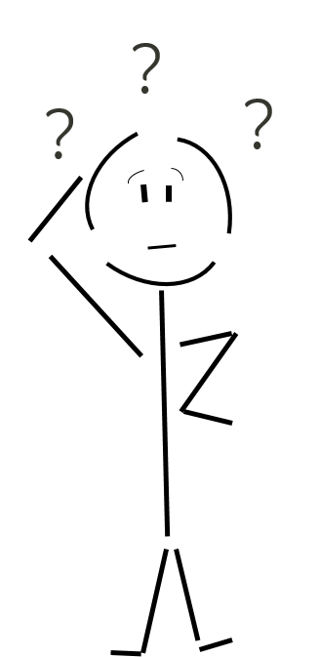
A good story has many elements to it, and your story will have all of these elements also.
Thinking about some of the crucial ingredients that make a good story, what do you think some of the most important pieces of your stories might be?
Have a chat with the person next to you and share ideas with the class. Then take a look at the following slides for some ideas to help you…

Slide 13
Your story will always have some key characters, settings, actions and culture in it, but over time many parts will change (just like in a series). You will also change the way you tell your story as you grow up – some bits which seem really important now will not be important at all (you might not even mention them!) in ten years time.

Slide 14
THE STORY OF ME
2 0 M I N U T E S +

Slide 15
Let’s imagine you were going to write “The Story of Me” today. Who would be your characters? Where would it be set? What would be happening? What cultural elements would it include?

Slide 16
Take a large piece of paper (or a page in your exercise books) and write the title:
The Story of Me
CHARACTERS | SETTING
ACTION | CULTURE
Now split the page into four sections. At the top of the sections write these four titles:

Slide 17
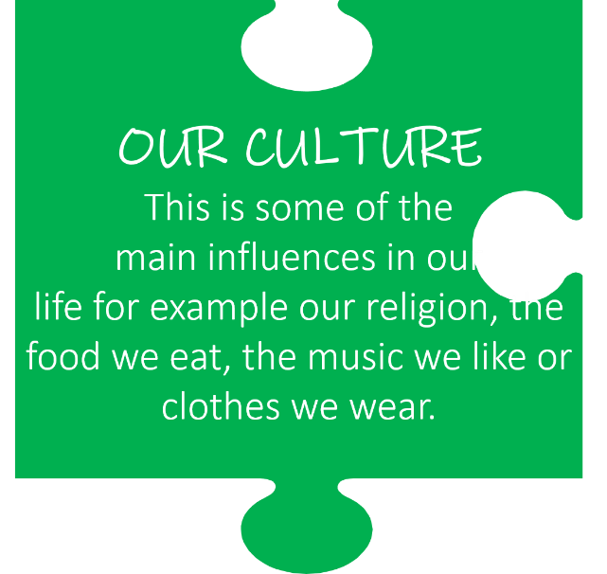
You are going to spend about 10 minutes noting down the different ideas that you would include in each part of your story, if you were to tell it today.
Look again at the meaning of each section to help you:

Slide 18
Now you are going to write the beginning of your story – don’t worry, it will just be a few lines this time!
You might start with “Once Upon a Time” or you might like to start in the middle of an adventure – whatever you choose is great! Spend a few minutes thinking of how to start and then write the FIRST PARAGRAPH of your story:
The Story of Me

Slide 19
If time and interest allows, some of you can read out your story beginnings – it is always interesting to see how different people’s stories are by the time they get going, but many of your beginnings are probably quite similar.
As you listen to your classmates tell their stories, think of all of the ways that you are all connected (what you have in common) and all of the ways that you are all so wonderfully unique!

Slide 20
WHERE ARE YOU FROM?
2 0 M I N U T E S +

Slide 21
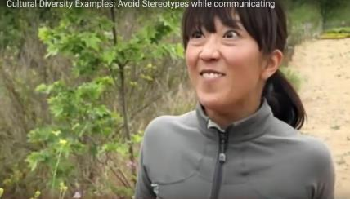
Watch this short video (1.50mins) made by Positive Revolution entitled:
Cultural Diversity (click on the link)
After sharing initial responses, consider the following questions:

Slide 22
One of the first questions we like to ask new people when we meet them is:
Where are you from?
What might someone’s nationality or heritage tell us about them?
Why do you think we ask this question?

Slide 23
Let’s imagine that the only thing we know about these four people is where they are from and what they look like.
What stereotypes or assumptions might we start making about them?
How much do we actually know about them?

Slide 24
What are cultural stereotypes and why do you think we use them?

Slide 25
What are some of the negatives that might come with cultural stereotyping?
(or assuming to know) someone because of their nationality?)

Slide 26
Often when we meet new people, we tend to meet them from the outside in, rather than from the inside out. In other words, we find out about their outer shell first (using what we assume from the way they look, dress, sound or act etc.) and then get to know their inner self second.
Just imagine what might change if you started to ask different questions when meeting people for the first time…

Slide 27
Often, the first questions we ask people when we meet them are OUTSIDE IN questions.
This means that we ask simple questions to get to know a person based on what we can see and understand.
When we get to know them better we might start asking INSIDE OUT questions. These tend to be questions about the person’s thoughts and opinions, their beliefs and emotions.
Some examples can be found on the following slides:

Slide 28
Outside in questions:
Where are you from?
What are your hobbies?
Do you have a religion?
What are you good at in school?
Who is in your family?

Slide 29
Inside out questions:
Does your identity change when you are around different people?
What are you most proud of about yourself?
What has been the biggest influence upon your identity?
How influenced are you (and in what ways) by particular cultures and traditions?
Could you describe yourself in three words?

Slide 30
Working in pairs or small groups, you are going to “meet each other” or interview each other using the OUTSIDE IN and the INSIDE OUT methods.
Each method will give you information about that person from a very different perspective.
Use the questions you just looked at to help you in your interviews – printed again on the following slides:

Slide 31
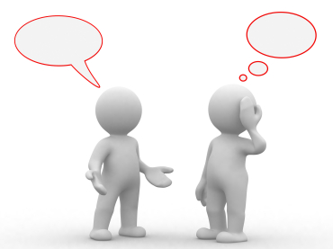
As you are interviewing your partner, think about how the INSIDE OUT questions might be encouraging them to answer in a different way.
For example their answers might take longer, they might think about them more, they may find they want to talk about them more than they do the OUTSIDE IN answers.
Spend about 5 minutes talking to each other – take it in turns to ask questions.

Slide 32
Outside in questions:
Where are you from?
What are your hobbies?
Do you have a religion?
What are you good at in school?
Who is in your family?

Slide 33
Inside out questions:
Does your identity change when you are around different people?
What are you most proud of about yourself?
What has been the biggest influence upon your identity?
How influenced are you (and in what ways) by particular cultures and traditions?
Could you describe yourself in three words?

Slide 34
When you have finished, share some of your thoughts with the rest of the class when you finish and then think about and discuss the following question together:
How might using ‘inside out’ questions help us to feel more connected to people when we meet them?

Slide 35
WE ARE ALL CONNECTED
1 0 M I N U T E S +

Slide 36
For this exercise, you will need a ball of wool or string
We have explored some of our unique gifts, qualities and ingredients in this lesson, and perhaps learned a few things about ourselves as well as other people. It is now time to see how we are all connected, perhaps in ways that we didn’t ever think about.
Let’s play The Connection Game!

Slide 37
The Connection Game: How to play
Everybody stands in a circle or a group space.
One person holds the ball of wool. They will unwind some of the thread and hold onto the end, and then throw the ball of wool to someone else in the that they share something in common with
For example, they will choose someone with the same eye colour, or family size, or hobby, or interest in something, or height or hairstyle etc.
As they throw the ball, they will say the name of the person and what they both share.
The new person will then unravel some more wool and throw the ball to someone different in the class, saying their name and choosing one thing they both have in common.
See how long it takes you to get the whole class connected and back to the first person!

Slide 38
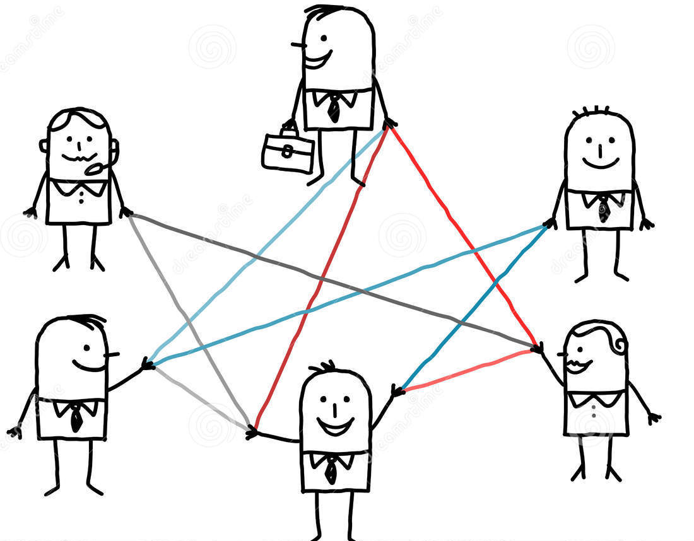
Remember:
We are all beautifully unique and individual human beings who have many parts that people know and many parts that they don’t.
We are also all wonderfully connected and have so much in common with other people, even people we don’t really know.
It is when we start to look for the connections (rather than the differences) that we realise just how wonderfully connected we all are!

Slide 39
IDENTITY
T H I S S O R T O F L E A R N I N G
C A N ’ T W A I T

