Slide 1
IDENTITY
EXPLORING IDENTITY
Y7&8 | 11-13 years

Slide 2
MY BEST SELF
W E E K 3
6 0 M I N U T E S

Slide 3
In this lesson, students will:
THINK!
Think about what perfection means to us and how we are often shown (or told) what beauty should be
Understand and explore how beauty is perceived in cultures and traditions across the world
Connect with some of our own ideas about beauty and think about how we can learn to find beauty in our imperfections
FEEL!
CONNECT!

Slide 4
FEELING THE PRESSURE
1 5 M I N U T E S +

Slide 5
Spend a minute talking with the person next to you and share your thoughts.
If you think of the word BEAUTY, what do you imagine? What words or images come to mind?

Slide 6
All of us will have an idea of what beauty means. This may be because of what we have been shown or told, or it may be because of our own preferences and ideas, or may be because of what we are looking for in ourselves.
Whether it is through films and TV programmes, social media, the news or just images of the world around us that we see in advertising, we are all being shown different ideas of what it means to be beautiful, successful and seemingly ‘perfect’ as human beings.
Even if you are someone who doesn’t watch much television or use the computer very often, you will be exposed to, and influenced by, your culture’s perception of beauty.

Slide 7
The media uses lots of stereotypes to show what is generally classified as a beautiful person.
Working in small groups, come up with some of the characteristics of people that you would normally associate with these sorts of qualities in films, TV and advertisements
(e.g. happy, successful, attractive, confident etc.)

Slide 8
You probably had words or phrases such as:
Popular
Rich
Skinny
Sporty
Pretty or handsome
Powerful
Perfect skin
Cool

Slide 9
One of the pressures felt by many young people is the need to look a certain way, and this pressure is made much worse by the unrealistic standards that we are shown through media perfection.
When the media celebrates certain types of behaviours and appearances, it can leave a strong impression on us, shaping our ideas of what it means to be popular, attractive, and happy.
It can also influence us to have ideas of what it means to be the opposite e.g. unpopular, unattractive, and unhappy.

Slide 10
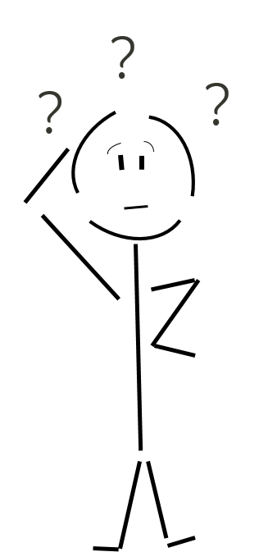
Have you ever been made to think that you should worry about the way you look?
Share thoughts as a class or think about this idea in your own head.

Slide 11
It is less common for people with, for example, larger body types or non-perfect skin to be portrayed in mainstream movies in romantic situations, compared to thin or flawless characters. And yet how many people do you know in ‘real life’ who look this completely perfect? Probably very few indeed.
As well as stereotyping ‘perfection’, the media uses a huge array of editing skills to make people seem perfect. This is both a clever and a dangerous tool, as many of us (young and old) may compare our own appearances to those of celebrities, models, animated TV characters, or toys - body shapes that may be completely unrealistic.
This kind of comparison can lead to body shame and low body esteem.

Slide 12
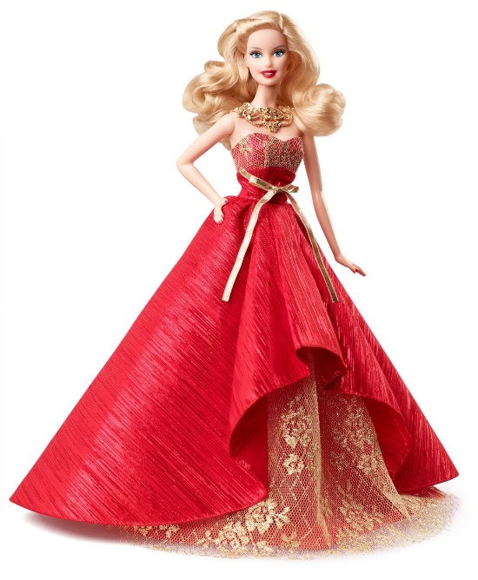
Here’s the truth. Very few people in the world are beautiful in the ways that we are told to see beauty, as they are for the most part impossible to achieve in ‘real life’.
Take Barbie as an example…
Barbie has been shaped and edited in such a way that if she was real, she would be so tall and so thin, she would not be able to walk as her body would not be strong enough. She would have to move around on all fours or use a wheelchair…(take a look at the next slide.)

Slide 13
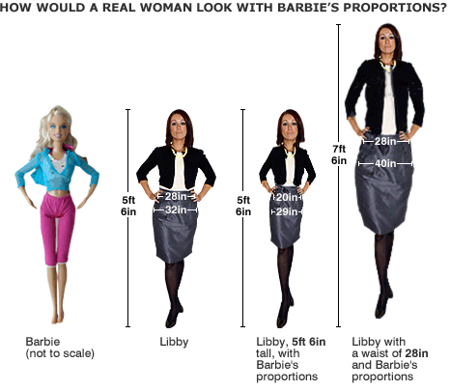

Slide 14
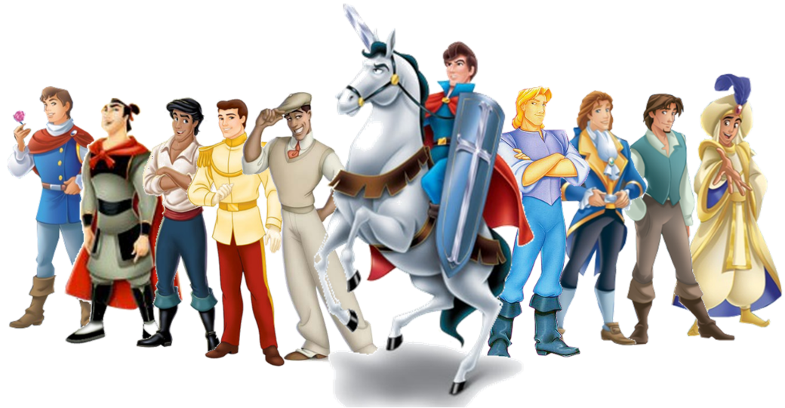
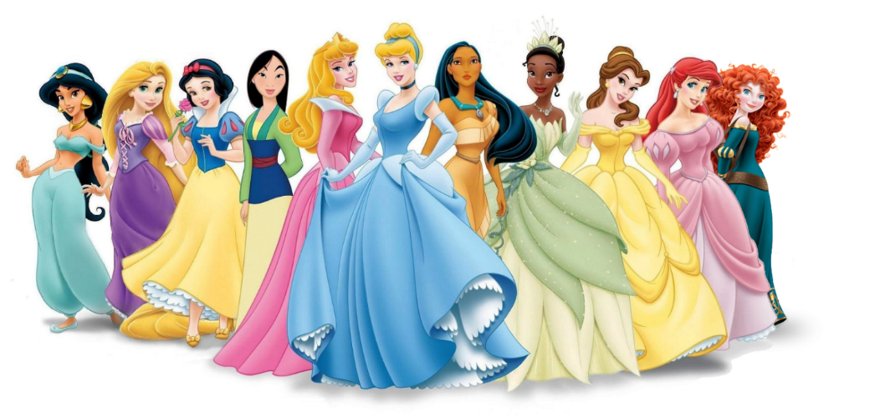
Barbie is often a symbol of beauty and perfection for children, much like the range of Disney characters.
For many of us, Disney is our first ‘exposure’ to images of perceived beauty. Even though the Disney stories have started to include princesses with a huge range of skills and talent and Prince’s who are a bit less ‘perfect’, they are still shaped and edited to have unrealistic styles of beauty.

Slide 15
Do you think that Disney is giving children an unrealistic idea of perfection?
Many of us feel pressured sometimes to look a particular way, or to wear certain things or to act in a particular way. But where do these pressures come from?

Slide 16
Working in small groups, brainstorm as many ideas as you can think of about where pressure comes from to be or act in a particular way that other people have decided is “the right way”. The following slide will help you with some ideas. .

Slide 17
Social media
?
The pressure to BE a certain way comes from…
Bullying
Pop stars
Peer Pressure
Friends

Slide 18
Disney represent some of the first examples of young people’s exposure to the idea of ‘perfection, whether it is the prince, princess or ‘ugly sister’ opposites highlighting the beauty of their heroes and heroines.
The exposure starts at a very young age, for many children even as young as two, three and four.
If we are being taught from early childhood to see beauty in this way, what might that do to our perceptions as we grow up?

Slide 19
Are we under too much pressure to be perfect?

Slide 20
“Beauty is not a matter of cosmetics or money, or about race or social status. But more about just being yourself.”
Do you agree? Share your thoughts with the class.

Slide 21
IDENTITY
T H I S S O R T O F L E A R N I N G
C A N ’ T W A I T

