Slide 2
Internet access to play three short videos (or the videos can be embedded into the PowerPoint)
Rough paper for making notes in groups
Neat paper for drawing activity
Coloured pens and / or pencils
In this lesson you will need:

Slide 3
W E E K 1
SEEKING
SAFETY
TOPIC: JOURNEYS

Slide 4
In this lesson, you will:
Think about why some people have to leave their homes across the world and what their lives might be like
Understand the meaning of the word ‘refugee’ and try to think about how it might feel to be called this word
Explore some of ways that we respond to and connect with people who are refugees

Slide 5
W H A T D O E S
‘ R E F U G E E ’ M E A N ?>
2 5 M I N U T E S +

Slide 6
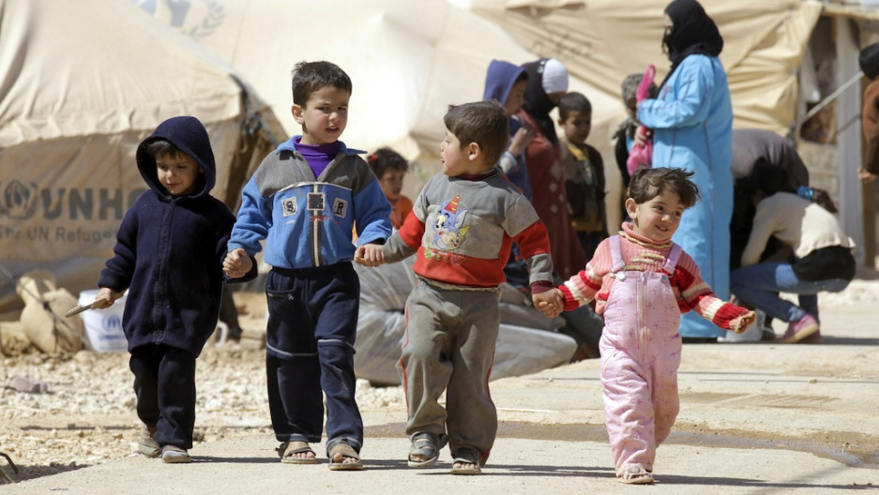
Watch the short video (1.10 mins) made by the Save the Children entitled:
Refugee Child Experience
Click on the link above to open the film

Slide 7
This short film gives a quick introduction to some children who are currently living as refugees. You get a little idea of some of what is happening in their lives right now.
Talking with the person next to you, see if you can come up with some ideas to this question and then share with the rest of the class:
What does it mean to be living as a ‘refugee’?

Slide 8
The word refugee come from the word refuge, which means:
“the state of being sheltered from pursuit, danger or difficulty”.
Refugees are people who are seeking a safe haven, and are forced to leave their homes in search of safety.

Slide 9
A refugee is…
Someone who has left their home country and s unable to return to because they might be harmed.
Often someone who has been forced to leave their country because of their race, religion, nationality or political opinion.
Often fleeing their country because of conflict and violence.

Slide 10
What are some of the reasons that cause people to leave home without wanting to?

Slide 11
There are many reasons why people flee their homes, but some of the most common reasons are:
War
Violence
Discrimination
Climate Change

Slide 12
Over 65 million people around the globe have been forced to leave their homes to escape war, violence and discrimination in recent years.
Many of these people leave their homes but stay within their countries, trying to find safety in other areas. They become known as Internally Displaced Persons.
Those who have managed to leave their own country and tried to find shelter and safety in another land are called Refugees.

Slide 13
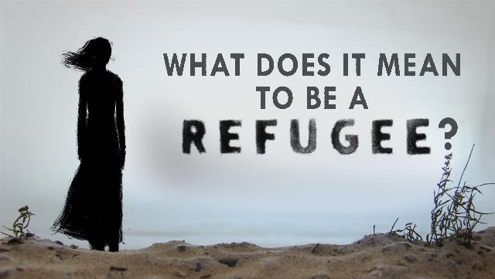
Watch the short video on the next slide(5.43 mins) made by Ted Education entitled:
What does it mean to be a refugee?
(Click on the link above for the hyperlink)

Slide 14
What else have you learned about the term ‘refugee’?

Slide 15
W H A T W O U L D
Y O U T A K E ?
3 0 M I N U T E S +

Slide 16
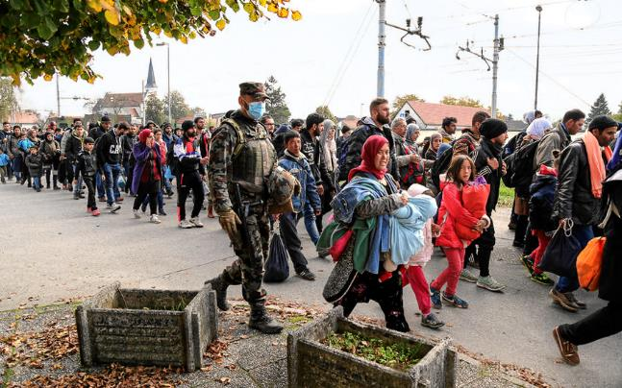
For many of us, the refugee crisis feels like it is something happening a long way away and it is therefore very hard to feel connected.
However, it is something very real and very current for millions of children across the world.
Roughly half the world’s refugees are children, meaning that there are currently over 30 million children without a home.

Slide 17
It is very hard to imagine what it must be like to have to leave your home suddenly, through no choice of your own, and have no idea where you are going.
Thinking about the ideas raised so far in the lesson, turn to the person next to you and share your thoughts on three questions:
What do you imagine being the hardest part about leaving home?
What questions would you have if you were suddenly told to leave home?
What would you hope to find when you searched for a new home?

Slide 18
What do you think of when you hear the word HOME? Your family? Your house? A feeling or atmosphere? A place?
Write the word HOME down in the middle of a page and brainstorm all of the ideas that come to your mind. Try to come up with as many words, phrases, feelings, objects, ideas as you can.
Share this with the person next to you and build up their ideas onto your mind map. Now share with the class and build a big idea of what HOME means to you all.

Slide 19
For many of those who finding themselves as refugees, leaving home comes around quickly and there is often not much time to pack or prepare.
For others, travelling light is often vital as there are long, uncertain journeys ahead and therefore it is difficult to take a lot of luggage.
The few possessions that refugees do manage to take with them are often the only link they have to their old lives and the places they once called home.

Slide 20
Watch the short film(1.50mins) made by AJ+ entitled:
What’s in a refugee’s backpack?
(Click on the link above for the hyperlink)

Slide 21
Were you surprised by any of the items that were in some of these refugees’ bags? If so, which and why?

Slide 22
Now take a look at some more examples of what people chose (or managed) to take with them as they were forced to flee their homes.
Each slide shows the contents of someone’s bag - the only possessions they have left after losing their home, their land and (in many cases) their identities.
After each slide, discuss the items and share your thoughts about the meaning or significance of these items. Remember that these are the only possessions these people have taken from their homes.

Slide 23
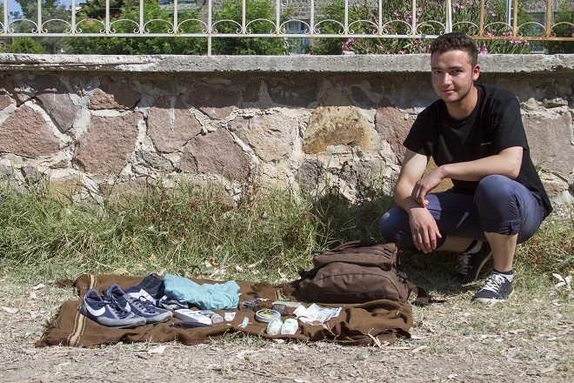
A teenager
Name: Iqbal* Age: 17 From: Kunduz, Afghanistan

Slide 24
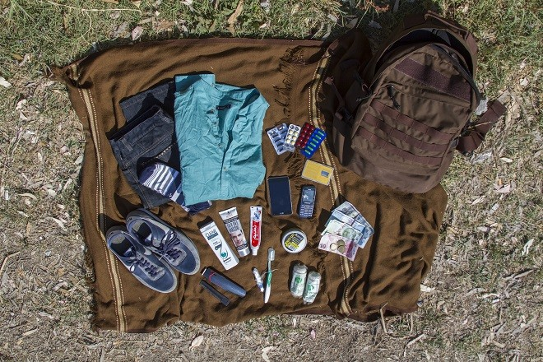
1 pair of pants
1 shirt, 1 pair of shoes and 1 pair of socks
Shampoo and hair gel
Toothbrush and toothpaste, face whitening cream
Comb, nail clipper
Bandages
100 U.S. dollars 130 Turkish liras
Smart phone and back-up cell phone
SIM cards for Afghanistan, Iran and Turkey

Slide 25
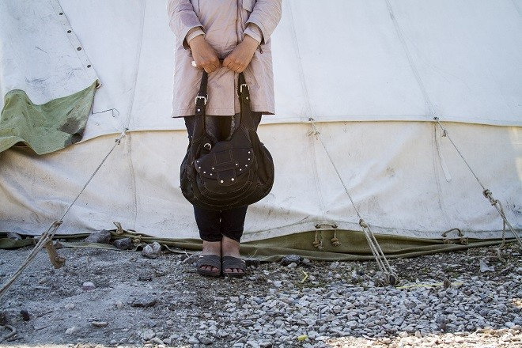
A mother
Name: Aboessa* Age: 20 From: Damascus, Syria

Slide 26
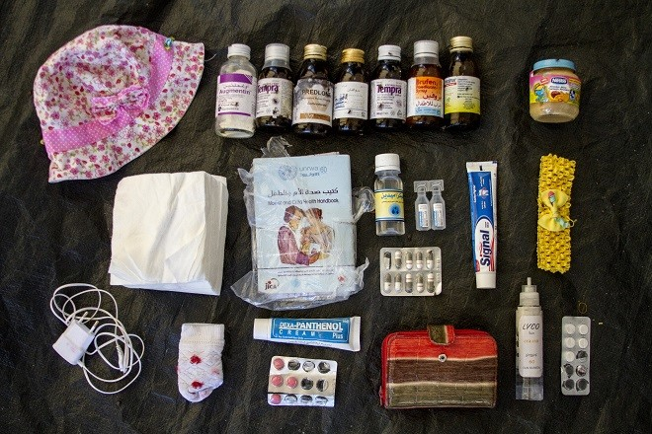
Hat for the baby
An assortment of medication, a bottle of sterile water, and a jar of baby food
A small supply of napkins for diaper changes
A hat and a pair of socks for the baby
Assortment of pain relievers, sunscreen and sunburn ointment, toothpaste
Personal documents (including the baby’s vaccination history)
Wallet (with photo ID and money)
Cell phone charger
Yellow headband

Slide 27
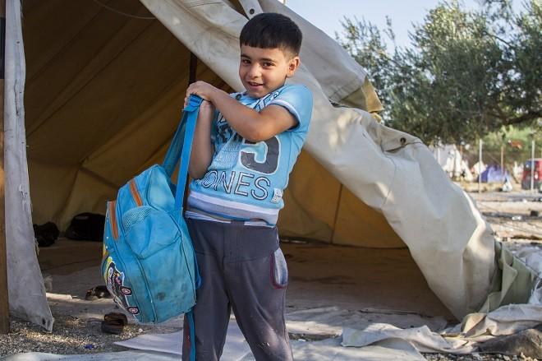
A child
Name: Omran* Age: 6 From: Damascus, Syria

Slide 28
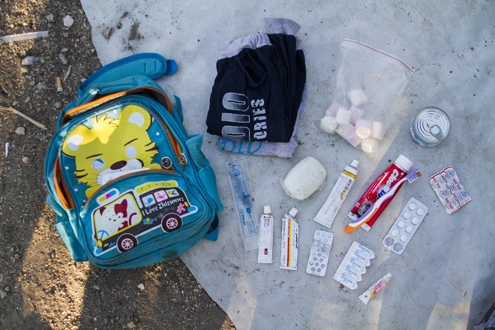
1 pair of pants
1 shirt
A syringe for emergencies
Marshmallows and sweet cream (Omran’s favorite snacks)
Soap, toothbrush and toothpaste
Bandages

Slide 29
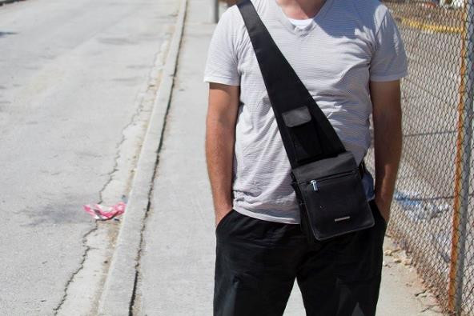
A pharmacist
Name: Anonymous Age: 34 From: Syria

Slide 30
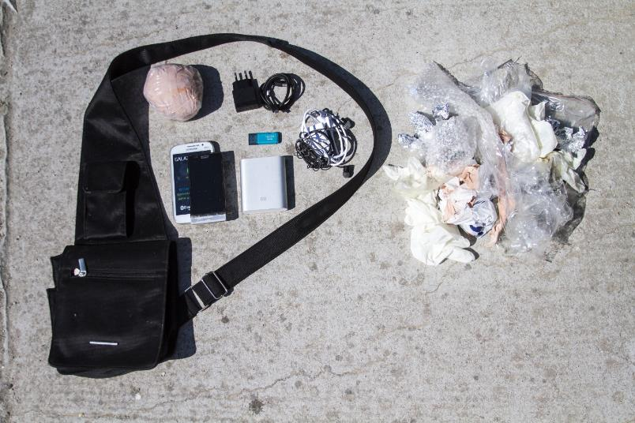
Money (wrapped to protect it from water)
Old phone (wet and unusable) and new smart phone
Phone chargers and headphones (plus extra battery charger)
16GB flash drive (containing family photos)

Slide 31
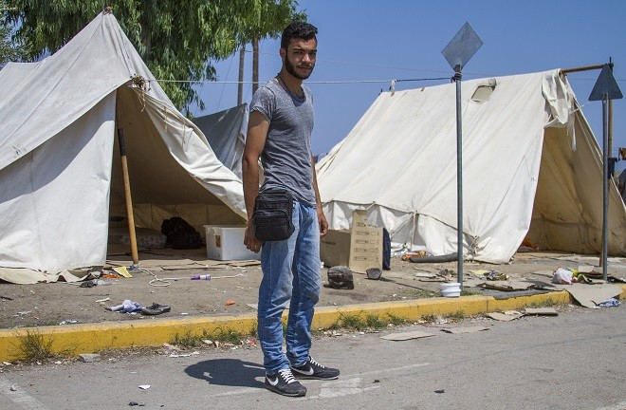
An artist
Name: Nour* Age: 20 From: Syria

Slide 32
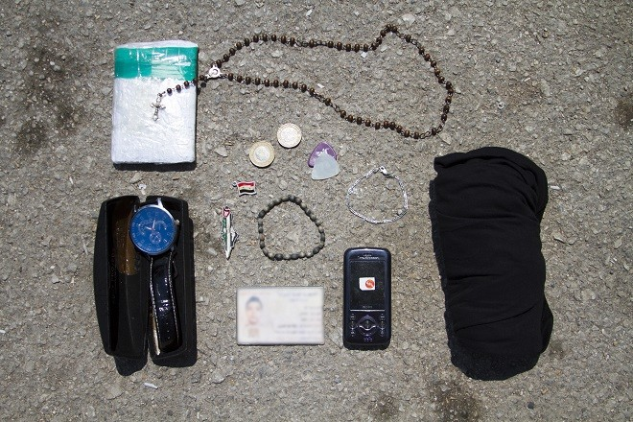
Small bag of personal documents
A rosary (gift from his friend; Nour doesn’t let it touch the floor)
A watch (from his girlfriend; it broke during the journey)
Syrian flag
Palestinian charm
Silver and wooden bracelets (gifts from friends)
Guitar picks (one also a gift from a friend)
Cell phone and Syrian SIM card
Photo ID
1 shirt

Slide 33
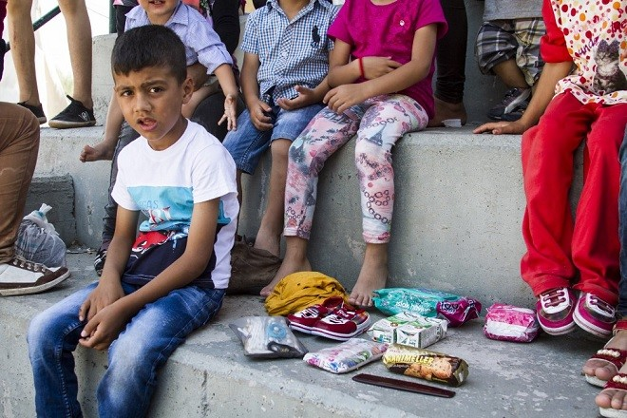
A family
From: Aleppo, Syria

Slide 34
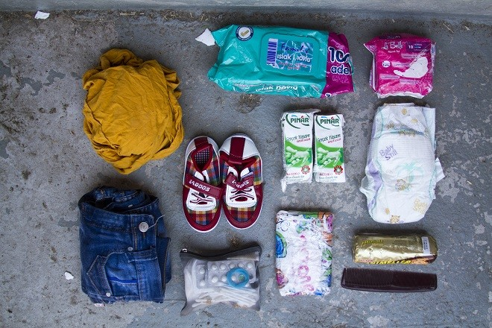
1 shirt
1 pair of jeans,
1 pair of shoes
Toiletries
1 diaper
2 small cartons of milk and some biscuits
Personal documents and money
Sanitary pads
A comb

Slide 35
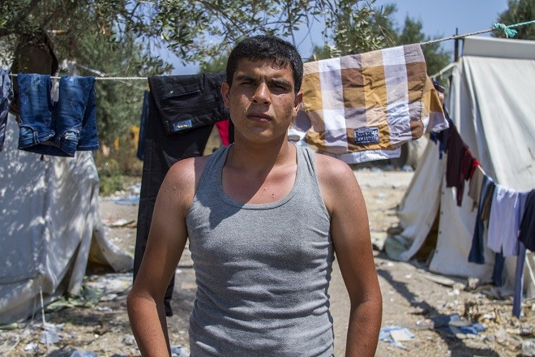
A teacher
Name: Hassan* Age: 25 From: Syria

Slide 36
“They told us we could only bring two things, one extra shirt and pants.
This is all I have…”

Slide 37
Were you surprised by any of the items that were in some of these refugees’ bags? If so, which and why?
Share your thoughts and reactions to the contents of these bags with the person sitting next to you and then with the class.

Slide 38
What would you take?
Imagine you were fleeing their home, like so many children across the world, and you only have a few moments to pack up a small bag before they have to leave the house.
On a blank piece of paper, draw the items that you would take with you and explain why you would take them (see the next slide for an example).

Slide 39
What would you take with you?
This book because…
My phone because…
My teddy bear because…
My headphones because…
A jumper because…

Slide 40
The images and stories about what people carried with them in their bags is taken from a series of short interviews held by the International Rescue Committee published in an article entitled:
What’s in my bag?
If time allows, click on the link above to explore more of these people’s stories and motivations behind their choices.

