Slide 2
This topic’s ThoughtBox Story (available to download and print by clicking here. The story is also printed on the first section of slides within this lesson plan)
Internet access for playing a short video (or video can be embedded into the Powerpoint)
Speakers to be playing music
Space to be able to do some dancing
In this lesson you will need:

Slide 3
W E E K 4
N E W
B E G I N N I N G S
TOPIC: JOURNEYS

Slide 4
In this lesson, pupils will:
Think about and discuss different ways that we like to do things such as dancing
Understand how it feels to move our bodies in different ways and to combine different moves
Connect up some of our different ways of dancing and celebrate our differences and diversity

Slide 5
FOX’S DANCING JOURNEY
1 5 M I N U T E S +

Slide 6
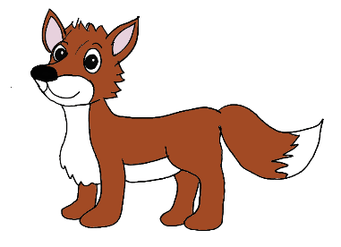
In the last lesson we were learning about passports and some of the wonderful differences that we can learn about from each other.
Can you remember what goes inside your passport?

Slide 7
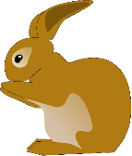
Today we’re going to celebrate our differences and do some dancing!
Let’s start by either re-reading the whole of the ThoughtBox story Fox’s Dancing Journey or just the end of the story (from slide 21 until the end).
Listen carefully for how the two different groups of animals like to dance!

Slide 8
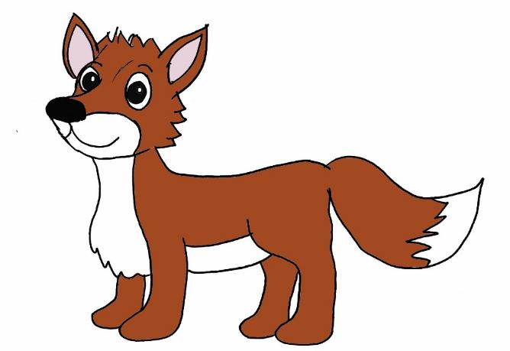
Fox’s Dancing Journey
A THOUGHTBOX STORY

Slide 9
It was Saturday night and time for the weekly woodland dance. Fox always looked forward to Saturdays as she just loved to dance! Her very favourite dance was one that all the folk from the Hollow knew – it was called Jiving Paws. Fox knew that everybody would be dancing the Jiving Paws dance this evening as it was everybody’s favourite dance!
When Fox arrived into the clearing, all of her friends from the hollow were there, dancing happily to their favourite tunes. The full moon was shining down like a disco ball and the music was turned up really loudly.

Slide 10
Fox bounded into the middle of the dancefloor and joined the rest of her friends in five rounds of Jiving Paws without stopping! They danced and danced and danced all night long, everybody shaking their paws and grinning from ear to ear.
Eventually it was time for bed. Exhausted from all of their dancing, the animals headed back home to the hollow to get some sleep. But as they got closer to home, they noticed a strange smell and started to see clouds of black smoke billowing up into the air.

Slide 11
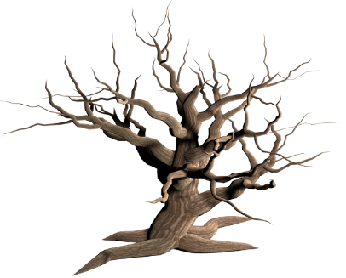
They hurried back to their neighbourhood as fast as they could and couldn’t quite believe what they saw when they arrived. Instead of the cosy copse of trees where they all used to live, there was just a bare, empty space.
All of the trees had disappeared and all that remained in the hollow were smouldering piles of ash. Every single tree and every single home had been burned to a cinder. The creatures stood in shock and disbelief. Everything had gone and their homes and their belongings had all burned to the ground.

Slide 12
Fox raced across the hollow to her home and quickly burrowed back into her den. Its contents had been destroyed, just like the rest of the hollow but as she was turning to leave, she caught sight of a few treasures lying in the charred remains - a picture of her family and her lucky pebble. That was all that was left of home. She quickly put them into a bag and headed back out to the hollow where the rest of the creatures were gathered.
Fox noticed that the fire was still burning nearby and seemed to be spreading - it was not safe for them to stay, and so they agreed to leave quickly and head off to find somewhere safe to rest and a new place to call home.

Slide 13
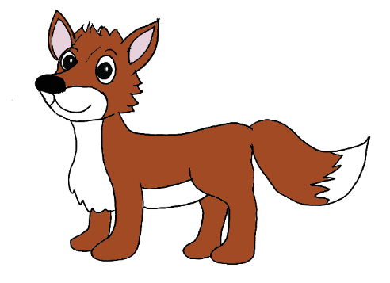
All of the creatures hurriedly packed up anything that they could find in the smoky remains and prepared themselves for a long journey to find somewhere new to live. They said one final goodbye to the hollow and headed swiftly off out of the forest in search of a new home.

Slide 14
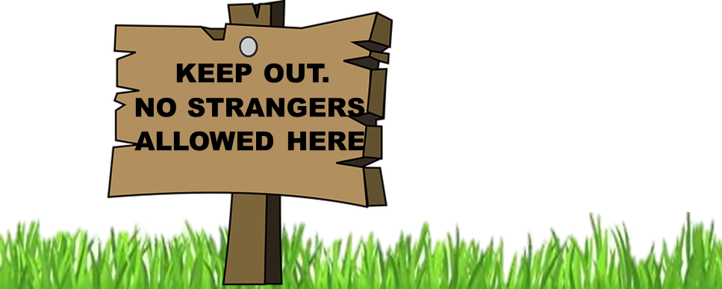
The Hollow-folk walked for hours and hours, trying to get far enough away from the raging fire until it was safe for them to stop. Eventually they heard a noise in the distance, it sounded like the sound of singing and laughter and made them feel hopeful – maybe this was a safe place to rest?
Fox and her best friend Badger ran on ahead to take a look, but as they got closer they noticed a large sign hanging on a tree:

Slide 15
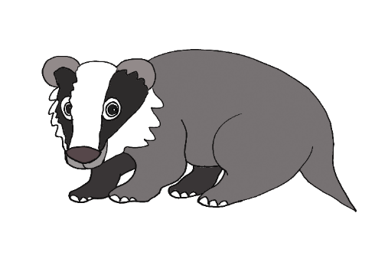
Fox and Badger looked at each other, feeling anxious. They were so very tired and so very hungry and desperately wanted to stop, but they both agreed that they would not be welcome in that place. And so they returned to the rest of the group and carried on walking.
One whole night and one whole day passed before they reached a beautiful looking copse. It seemed very familiar as it reminded them of their old home. As they got closer and closer, feeling hopeful that they might have finally found somewhere safe to live, a figure appeared in the distance, its large eyes shining in the twilight.

Slide 16
As the figure got closer and closer, they started to make out its long muscular legs, its large strong body and its two majestic-looking antlers: it was a stag. As he approached the band of weary travellers, he stood up very tall, stuck out his jaw and grunted loudly at the group:
“Keep walking, keep walking- we don’t have room for newcomers to stay here. Keep walking, you’re not welcome here.”
Fox’s eyes fill with tears when she realised that, once again, they were not welcome and they were still not safe. Resigned and rejected, she lowered her head and joined the rest of the weary group as they turned the other way and kept on walking.

Slide 17
After several more hours of exhausted walking, the Hollow-folk climbed a really, really steep hill. When they eventually got to the top, they noticed a tiny little light shining in the distance.
As they got closer they started to hear the sound of music and singing – there was a party happening in a clearing in the middle of the woods! The creatures hesitated for a moment, uncertain as to whether to keep going as they didn’t want to feel unwelcome again.
Suddenly a figure popped out from behind a bush. It was Hare. “Greetings friends,” said Hare, hoppily, “you must be here for the party! Come and join us, the dancing is just about to start.”

Slide 18
Fox stepped forward nervously and said, “Actually, we don’t live here, we’ve come from far away. Are you sure we are welcome here?”
“Of course, we love welcoming new people into our home. Where are you all from?”
“We used to live far and away, down in the hollow. However, we don’t have a home any more, our houses were destroyed in a great fire and we are searching for a new place to live,” said Fox, feeling tears well up in her eyes as she remembered the homes that they had all lost. “That is so awful,” said Hare, looking kindly at the group, “I couldn’t bear to lose my home, it would make me feel so sad.”

Slide 19
And then Hare thought for a moment, her whiskers twitching. “Maybe you could live here with us?” she said with a smile, looking around the group of weary travellers, “we’d love to welcome you to join our hilltop community…”
Fox couldn’t quite believe what she was hearing. After all of the unwelcoming encounters they had had, it was hard to believe that they might have finally found somewhere safe to stay. She looked around the group and saw smiles on everyone’s faces!
“Come and have some food before the dancing starts, you must be hungry and there’s plenty for us all to share,” said Hare, hopping her way to the top of the hill to join the rest of the Hilltop folk.

Slide 20
The weary group followed Hare into the clearing and were so surprised by what they saw – it was a copse just like where they used to live! Yet when they looked more closely, they realised that everything was somehow slightly different to what they were used to. The food looked rather strange, the drinks were very unusual and the music just didn’t sound like anything they’d ever heard before. Fox started to wonder whether it was a good idea to stay – maybe they didn’t belong here after all…
Whilst the tired animals were eating and drinking, Hare hopped over to some of her friends that also lived in the clearing to tell them about the new visitors and to ask if it was OK for them to stay.

Slide 21
The animals all looked at each other. Was there enough space for them to stay? Would there be enough food to share around? Would there be enough places for them to build their homes? They talked quietly together, some of the animals muttering quietly to one another other. Suddenly, three of them stepped forward:
“I am happy to let them stay,” said Squirrel, “but I am a little unsure because they don’t look like us.” “They don’t sound like us either,” said Woodpecker, also looking a little anxious. “And I bet they don’t move like us,” hissed Snake, uncoiling his long body from around the tree.
“That’s ok,” said Hare, “we don’t all need to be the same! I don’t look like you, Squirrel, and I don’t sound like you Woodpecker and I don’t move like you, Snake, but we all live well together, don’t we?”

Slide 22
And with that, Hare hopped towards the dancefloor and signalled for the music to start and the dancing to begin. As soon as the music started playing, Fox’s feet start tapping and her paws started twitching. She just couldn’t resist – dancing was her very favourite thing no matter where she was!
Pretty soon the dancefloor was buzzing. The Hollow-folk started waving their paws in the air, dancing in unison to the Jiving Paws routine that they all knew and loved. As Fox looked around the dancefloor, she noticed that the Hilltop-Folk were all happily stomping their feet on the ground in unison but not moving their paws at all. Fox looked at Hare and said, “I’ve never seen anyone dance like you before…that looks fun!” At the same time, Hare looked at Fox and said, “And I’ve never seen anyone dance like you before…that looks fun!”

Slide 23
And so Fox started stomping her feet to the music just like the Hilltop-folk, and Hare started waving her paws to the beat like the Hollow-folk. Pretty soon all of the Hollow-folk had joined Fox in the stomping dance, and all of the Hilltop-Folk had joined Hare in the Jiving Paws and everyone was grinning from ear to ear.“ This is great!” hissed Snake, swirling his coils around and around! “What a dance!” chirped Woodpecker, flapping his wings to the beat! “What funky moves!” squealed Squirrel, jiving happily to the music.

Slide 24
Nowadays Saturdays on the Hilltop are the most exciting days of the week because it is the day that everyone comes together to dance! The dancing always begins with the Stomping Strut – the local dance of the Hilltop-folk, and then moves onto the Jiving Paws, which the Hollow-folk soon taught to all of the locals. And then everyone comes together for their very favourite dance, which is when they all stomp their feet and wave their paws at the same time, with everyone dancing together!
THE END

Slide 25
Let’s now learn more about some of the ideas that were explored in Fox’s story…

Slide 26
DANCING MATT
2 0 M I N U T E S +

Slide 27
Who here likes to dance?
Most of us love dancing and wiggling and jiggling around to music! Dancing is one of the things that people from all over the world love to do. Did you know that every single country in the world has its own unique music and unique ways of dancing?
Does anyone in this class know any dances from other countries?

Slide 28
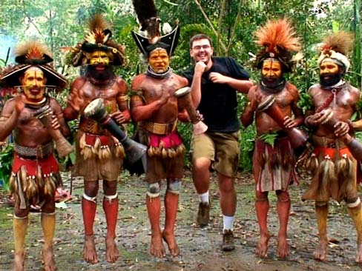
Let’s have a look at some dancing from other countries. We’re going to watch a short (4.52 mins) video made by a man called Dancing Matt! In this video, Matt travels to lots of different countries and learns some of their wonderful dances. He also teaches other people some of his dance moves too! Dancing the World (click on the link to open)

Slide 29
Matt travelled to many different countries on his dancing journey and learned lots of dances!
Can you remember the names of some of the countries that he visited?

Slide 30
Lots of the dances involved jiving hands and lots involved stomping feet – just like the Hollow-folk and the Hilltop-folk!
Let’s watch Dancing Matt again (or just watch a part of the video) and this time we are going to join in with the hand-jives that he does with each country.
Make sure you have some room around you so that you can move your arms freely!
Dancing the World (click on the link to open)

Slide 31
JIVING PAWS AND STOMPING FEET
1 5 M I N U T E S +

Slide 32
In the story, one of Fox’s favourite things to do is dance and she loves Saturday nights because it is the time that everyone comes together to dance!
Can you remember the names of my favourite dance?

Slide 33
When Fox and her friends arrive in the Hilltop community, one of the first things that they notice is that the Hilltop folk dance in a very different way.
Can you remember the name of the dance that the Hilltop folk like to do?

Slide 34
At the end of the story, the two different communities teach each other how they love to dance and then they all enjoy dancing together! Let’s read that part of the story again:
Nowadays Saturdays on the Hillltop are the most exciting days of the week because it is the day that everyone comes together to dance! The dancing always begins with the Stomping Strut – the local dance of the Hilltop-folk, and then moves onto the Jiving Paws, which the Hollow-folk soon taught to all of the locals. And then everyone comes together for their very favourite dance, which is when they all stomp their feet and wave their paws at the same time, with everyone dancing together!

Slide 35
We’re now going to learn to do the Jiving Hands and the Stomping Strut!
Firstly we’re going to split up into four groups.
Groups 3 and 4 are going to design two different short routines for Stomping Strut.
Groups 1 and 2 are going to design two different short routines for Jiving Hands

Slide 36
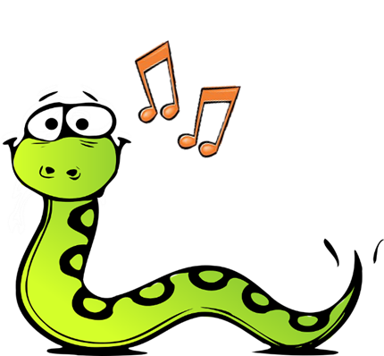
In your group, try to come up with some really simple steps or hand jives that everyone else can copy – because you are going to be teaching the rest of the class to do these later!
Choose one simple move that you can do for four beats.
“one – two – three – four”
and then repeat the move:
“one – two – three – four”

Slide 37
Now let’s put them to music.
You might have your own tune to dance along to, or you might like to dance to Dancing Matt’s song or Pharrell Williams’ Happy Song. Or you can use this special song as your class dance song. It’s called Boogie-Woogie. Click on the speaker symbol to play the song.

Slide 38
Keep practicing your moves to the music until everyone in your group knows the routine.
Make sure you all know what to do as you are going to then teach the rest of the group.

Slide 39
DANCING TOGETHER
1 0 M I N U T E S +

Slide 40
Now let’s add in another Jiving Hands move. Group 2 come and teach the rest of the class your move – remember to do the move for four beats:
“One – two – three – four”
Now let’s add in another Stomping Feed move. Group 4 come and teach the class your move – remember to do the move for four beats:
“One – two – three – four”

Slide 41
Can you do the two moves at the same time?!

Slide 42
Now it’s time to teach the others in the class your moves.
All of you stand up ready to go. First let’s do a Jiving Hands move. Group 1 come and teach the rest of the class your move – remember to do the move for four beats:
“One – two – three – four”
Now let’s add in a Stomping Feed move. Group 3 come and teach the class your move – remember to do the move for four beats:
“One – two – three – four”

Slide 43
You now have 2 jiving hands and 2 stomping legs moves…can you do them all?

Slide 44
Let’s all now dance together to our song and do some Jiving Hands and Stomping feet!

Slide 45
To finish, let’s all take it in turns to share one thing that we have learned in this topic on Journeys.

