Slide 1
1 hour+
Immigration & Refugees
Week 1 – The Language of Fear
Y11-13
15-18 years

Slide 2
In this lesson, students will:
THINK!
Think about some of the words and phrases that are associated with refugees and think about where they may come from and why
Understand the meaning of the term ‘refugee’ and explore some of the emotions behind its label
Explore and unravel some of the stereotypes and perceptions that the media and language encourage when discussing refugees
FEEL!
UNLEARN!

Slide 3
Pre-lesson reflection
3 minutes+

Slide 4
Introduce the following REFLECTIVE QUESTIONS for students to consider during the lesson:
What does the term ‘refugee’ actually mean?
How influenced are you by the media response to immigration and refugees?
How conscious are you of the influences on your language and your responses?

Slide 5
I am a human 5 minutes+

Slide 6
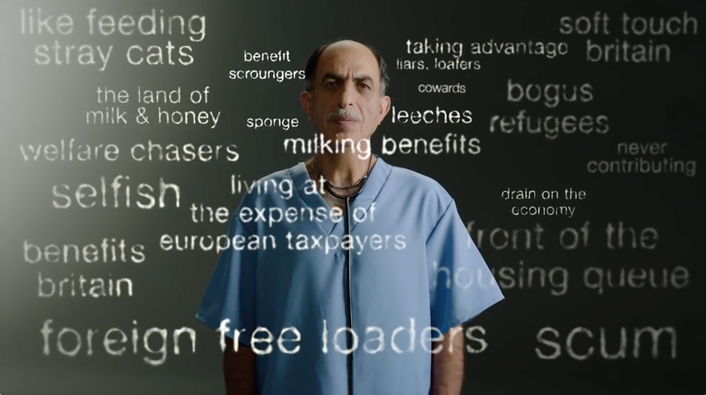
Watch the short video (1.33mins) made by the British Red Cross entitled:
I am a human
Click on the link above to open the film

Slide 7
Allow students a few minutes to respond to the film with people sitting near to them.
After sharing their initial responses, ask them to consider the following questions:

Slide 8
Have you heard or seen any of these derogatory phrases being used before to discuss refugees?
How do you think these ideas are spread? Where do they come from?

Slide 9
The Power of Persuasion 25 minutes+

Slide 10
What are the first three words that come to your mind when you see this picture?
Notes:
Spend 20 seconds getting an idea or an image in your mind and keep these safe for later.

Slide 11
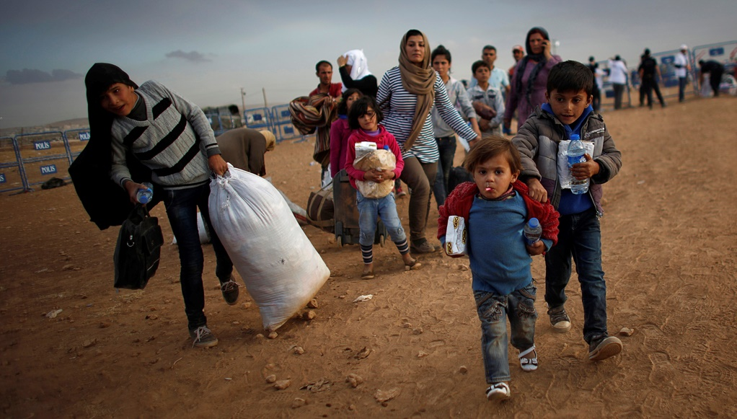

Slide 12
We often use labels to connect to other people, but we also use them to distance ourselves.
By labelling people – “refugee”, “immigrant”, “asylum seeker” - we are able to disassociate and see them as other, rather than as someone with a life just like ours.

Slide 13
Why do we distance ourselves from people with our labels?
Fear?
Distrust?
Ignorance?
Overwhelm?
Indoctrination?

Slide 14
“We must stop the migrant invasion”
“Halt the asylum tide”
“Immigrants bring more crime”
“Migrants shun the English language”

Slide 15
Refugee?
Migrant?
Are you using the right words for each person or circumstance?
Immigrant?
Asylum Seeker?
Notes:
HOW ARE LABELS INFLUENCING US? DO WE KNOW WHAT THESE LABELS ACTUALLY MEAN??

Slide 16
Migrant, immigrant, refugee or asylum seeker?
A migrant is someone who moves from one place to another, in order to live in another country for a while. This tends to be on more of a temporary basis.

Slide 17
Migrant, Immigrant, refugee or asylum seeker?
An immigrant is someone who arrives into a country and intends to settle there more permanently.
They have a desire or plan to make the new country a permanent place of residence for work and living.

Slide 18
Migrant, immigrant, refugee or asylum seeker?
A refugee is a person who has fled armed conflict or persecution.
They need international protection because it is too dangerous for them to return home.
They may be housed somewhere temporarily until the conflict has ended or may apply for asylum in a new country.

Slide 19
Migrant, Immigrant, refugee or asylum seeker?
An Asylum Seeker is someone who is unable to live safely in their own country for fear of being persecuted because of their race, religion, nationality, membership of a particular social group or political opinion.
They are therefore seeking safety by coming to another country.

Slide 20
All of these labels come with stereotypes. Whether we like it or not, we are being programmed to react in a certain way when we hear a particular word, see an image or make associations.
Does the language that we use influence our response to immigrants and refugees?

Slide 21
An Expatriate is someone living in a foreign land who has chosen to make it their home.
There is controversy behind why some migrants are termed “immigrant” whilst others are termed “expats” or “expatriates” and whether the definition is related to skin colour, wealth and/or ethnicity.
What do you think?
What about an Expat?
Notes:
After all, many refugees and immigrants are highly skilled workers in their own countries – doctors, lawyers, accountants, teachers etc. but are unable to get professional work in other countries, often because of limitations to documents, contracts etc.

Slide 22
These labels have become synonymous in many people’s opinions with negativity.
Why?
One of the reasons is how they are used by the press.
For example, immigrant and refugee are frequently used in the media in a fearful or derogatory manner, with the aim to provoke:

Slide 23
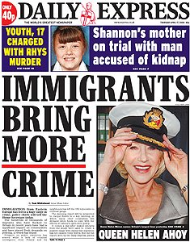
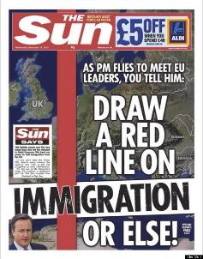
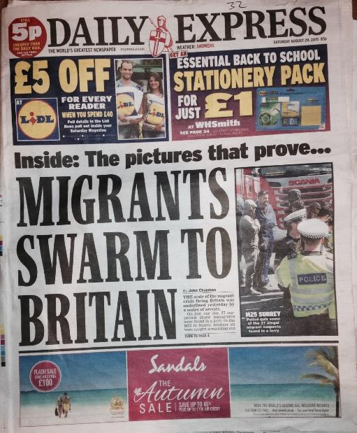
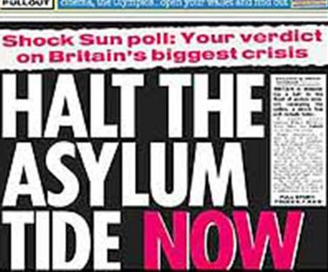
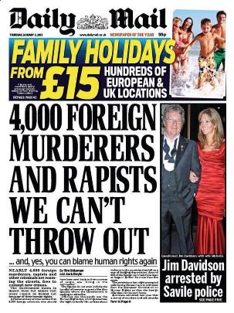
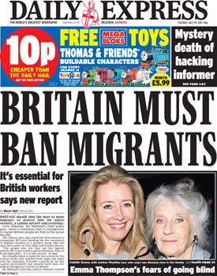

Slide 24
Using such words and phrases like these when discussing migrants creates powerful repercussions in people’s minds and perceptions.
“Asylum tide”
“Invasion”
“Foreign”
“Swarm”

Slide 25
We are constantly surrounded by ideas, opinions and ways to see the world, but how often do we question what we are being told and how much do we just simply accept?
“We are drowning in information whilst starving for wisdom”
Notes:
Edward Wilson Ecologist

Slide 26
Tell it like it is 20 minutes+

Slide 27
Where do you get most of your ideas from to help form your opinions?
Parents?
Teachers?
Friends?
News channels?
Social Media?

Slide 28
Do you often take time to question information that you are given to make sure it is “true” and based on factual information? Why? Why not?

Slide 29
The media is very good at pushing negative stereotypes when it comes to immigration and refugees.
The media is not so good at encouraging us to empathise with immigration and refugees.
Why is “sensationalism” and “fear-tactics” more common in our media channels than empathy and understanding?

Slide 30
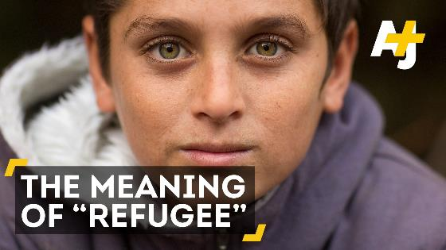
Watch at this short video (1.08mins) made by AJ+ for some more inspiration:
What is the meaning of
the word Refugee?
Click on the link above for the hyperlink

Slide 31
For most people, refugee status comes as a consequence of a tragedy, an uprooting and / or a sudden departure. It is very rarely ever a choice.
For most refugees, the ultimate desire is to go home, but for most home is not safe.
The word ‘refugee’ for many has become synonymous with negativity. The word ‘refugee’ for those who it describes feels often even more bitter as it is a reminder of their displacement and loss.
Read the following thought from recent asylum seeker and now UK citizen Saif Ali. Saif is founder of Integr8UK – an organisation working to support refugees and asylum seekers to find their identity whilst they are in ‘limbo’:

Slide 33
Refugee is not an identity,
It is a life experience.
What do you think this might mean?
Notes:
Take a look at the following advert for TV2 in Denmark. Focus on what we share and how we connect, rather than fear how we are different.

Slide 34
“Each time we define people by their suffering, we deprive them from who they can become beyond it”
Think about what Saif is saying here in relation to the way that we often label people and see them as only that. For example, calling someone a “refugee” stops them from being anything other – they are no longer the teacher, doctor, entrepreneur, artist, father, mother, daughter etc. that they actually are.
Notes:
Take a look at the following advert for TV2 in Denmark. Focus on what we share and how we connect, rather than fear how we are different.

Slide 35
When talking about the problem of refugees, we use dehumanised language, which reduces human tragedy to numbers and statistics.
The suffering of refugees and many immigrants concerns real people, who – just like us - have families, loved ones, friends; their own stories, dreams, goals...
It is only when you start to see the human, and no longer see an anonymous refugee, that you notice the person before you is human, just like you…

Slide 36
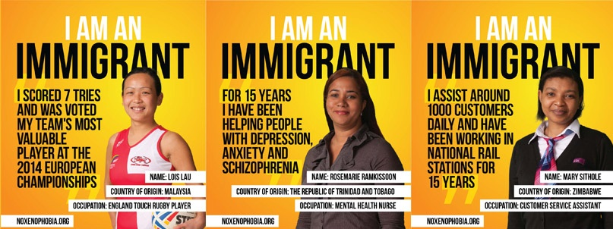

Slide 37
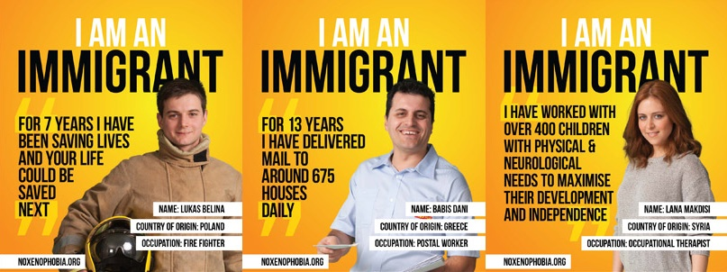

Slide 38
Take a look at the following statistics and ideas, collated by the Refugee Council who, through these images, are trying to spread the reality of life for millions of people fleeing their homes.
Discuss any shocking statistics or ideas that stand out.

Slide 40
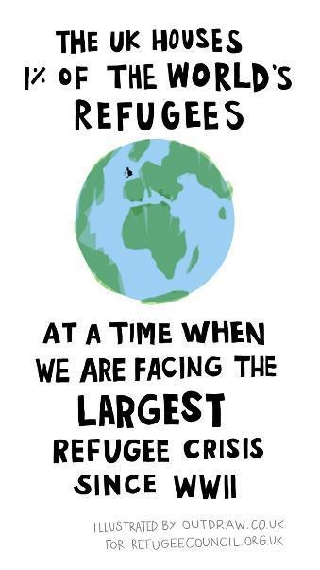

Slide 42
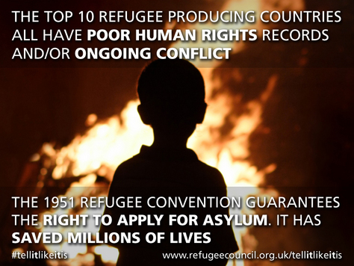

Slide 43
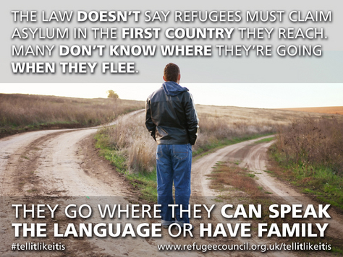

Slide 45
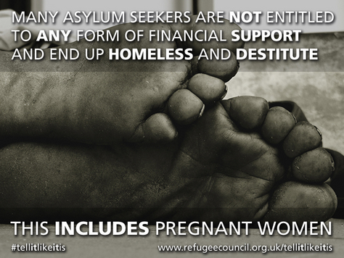

Slide 46
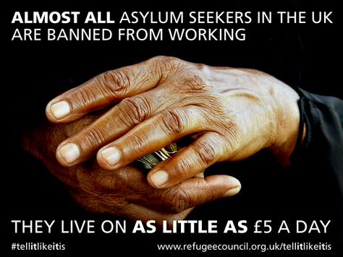

Slide 47
Do you feel you understand the “immigration crisis” and have good sources of information to form your opinions?

Slide 48
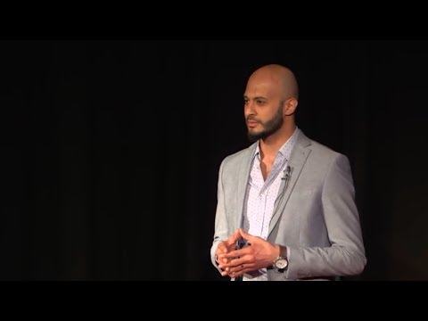
If time allows, watch some or all of Saif Ali’s inspiring Ted Talk (16.42 mins) in which he shares his own story of being a refugee for most of his life, an asylum seeker and finally being granted a home just two years ago.
From seeking asylum to seeking purpose
Click on the link above for the hyperlink

Slide 49
ThoughtBox: This sort of learning can’t wait

