Slide 1
1 hour+
Gangs
Week 1 – For the good of the pack
Y11-13
15-18 years

Slide 2
In this lesson, students will:
Think about and discuss why people join gangs and what need in us this is satisfying
Understand the animalistic qualities within us that encourage pack mentality
Explore and unravel some of the behavioural patterns and moral choices that occur within gangs

Slide 3
Pre-lesson reflection 3-5 minutes+

Slide 4
Introduce the following REFLECTIVE QUESTIONS for students to consider during the lesson (maybe write them up or read them aloud and ask students to think about their own responses):
What is a gang and why do people join them?
What are some of the stereotypes surrounding gangs and where have they come from?
Is wanting to belong to a gang or group a core human need? Why do you think this?

Slide 5
Monkey-behaviour 10 minutes+

Slide 6
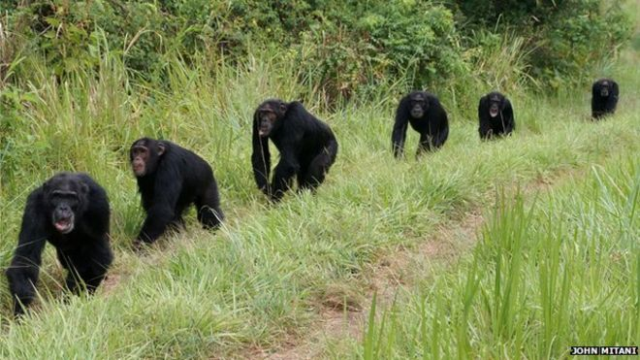
Watch the short extract (3.54 mins) from a documentary made by Planet Earth for the BBC looking at
The Violence of Chimps
The film will play automatically on the next slide, or
alternatively you can click on the link above for the hyperlink

Slide 8
Allow students a few minutes to respond to the film with people sitting near to them.
After sharing their initial responses, ask them to think about the following questions:

Slide 9
What sort of ‘gang-like’ behaviour did you see in the chimps in this clip?
Which of their behaviour patterns seem similar to humans? How and why?
Can you see anything in the clip that reminds you of perceptions of gang culture or behaviour amongst humans?

Slide 10
What is a gang?
Ask students to talk with the person (or people) next to them and come up with a one-line definition for a gang. Share ideas with the class and find what the commonalities of the answers.
Now look at the following question and discuss ideas together as a class:

Slide 11
Why does the word ‘gang’ often bring negative connotations to people’s minds? Is this justified?

Slide 12
Why do people join gangs? 25 minutes+

Slide 13
Gang activity is a language for young people. They are telling us they feel disenfranchised, bored, angry ... “We don’t see opportunity, jobs, pathways ... We don’t see a plan for us.”
A gang gives a young person what is missing: a bond, an identity or being a part of something that they feel attachment to.
Paul McDonald
To begin, take a look at this statement and share your responses and reactions together:

Slide 14
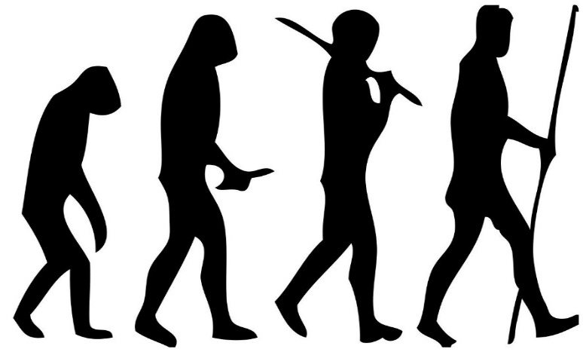
The emergence of gangs
Gang culture is not a new phenomenon. Gangs have been a part of society across the world for hundreds of years. Many people argue that gangs are just another form of tribal community, reasoning that our entire human history is based upon a form of gang-culture.
But why might people choose to join a gang in our modern society?

Slide 15
Why do people choose to join gangs?
Talk with the person next to you and come up with a few ideas – share these together on the board

Slide 16
Were any of these on your list?
Fear or protection
Money or poverty
Ambition or adrenaline
Pushing boundaries
To be part of a community
Take a closer look at some of the reasons that people across the world have become part of a gang on the following slides.

Slide 17
1. A Sense of Belonging
We all share a need to feel we belong somewhere; if this is absent in daily life, a gang may well provide this support network.
Some people maybe don't receive enough support or attention at home and look to feel more connected with friends or groups.
Some may be trying to escape a negative home life, or looking for a role model or surrogate father/mother figure.
Gangs often make promises to give unconditional support, and to become the "family" the members never had.

Slide 18
Do you think this is a common reason for people to join a gang?

Slide 19
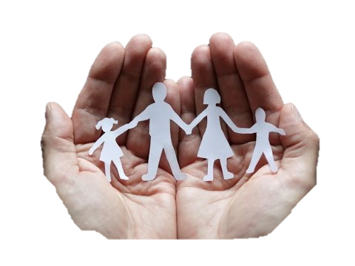
2. A Desire for Protection
There are communities across the world that have very high levels of gang activity, and this often leads to people joining a gang just to survive.
Often it becomes easier to join the gang than to remain vulnerable and unprotected in the neighbourhood. In these instances, it is often a very difficult choice for people to make.

Slide 20
Do you know of anyone joining a gang because of the need for protection?

Slide 21
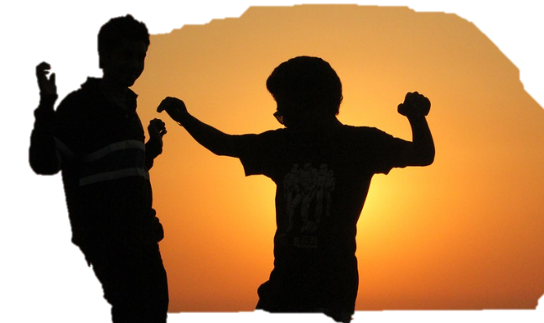
3. Peer Pressure
Across the world, young people (teenagers in particular) face a constant pressure to fit in. Part of the nature of peer pressure is not having support needed to avoid pressure to conform, and this can lead people to make choices beyond their own wishes.
Peer pressure may come in the form of intimidation or coercion; be part of a dare; could be a form of harassment or even friendly persuasion or endless begging.

Slide 22
How common do you think peer pressure is in influencing people to join gangs?

Slide 23
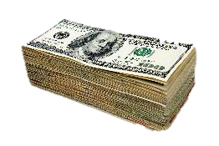
4. Poverty
Many people find themselves joining gangs due to a lack of jobs and opportunities in their community. For many, working within a gang may present a means of survival to someone lacking basic essentials such as food, clothing and shelter. It may also open up opportunities to make money, engaging in a range of legal or illegal activities.

Slide 24
How else might money influence people’s choices surrounding gang culture?

Slide 25
5. Following Family Traditions
Families sometimes have a history of gang involvement spanning over a number of generations, and there is an almost unspoken expectation that children will follow suit. This is one of the toughest forms of pressure to escape, as the gang lifestyle may be very deeply rooted within core traditions and values within the family.

Slide 26
Do you think this is a common reason for people to join a gang?

Slide 27
6. Pushing boundaries
Many young people are looking for boundaries, and they will push the boundaries until they reach a wall they are either unable or unwilling to break down.
This behaviour is (for many) an essential part of the process of growing up and becoming a moral, law abiding member of society.

Slide 28
Have you seen this happen with anyone you know?

Slide 29
7. Adrenaline
Many young people get a rush out of defying authority, engaging in illicit behaviour or even committing crimes. The attraction of gang lifestyle is that it often lives outside of conventions, laws and boundaries and encourages engagement in a range of illicit activities and behaviours.

Slide 30
Do you think this is a common reason for people to join a gang?

Slide 31
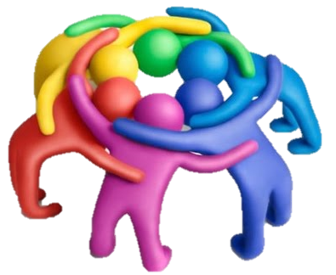
8. Finding Shared Beliefs
We all like to feel connected to people who share our beliefs or ways of thinking in some ways. For some, joining a gang allows a community to form of like-minded people, who can spend time together talking and sharing the ways in which they see the world.

Slide 32
Do you belong to a group, community or gang? Is this an inherent human need do you think?

Slide 33
Are there any other reasons that you thought of earlier that haven’t been explored?
Share your thoughts with the class

Slide 34
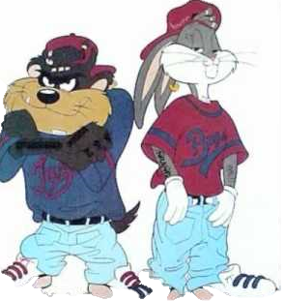
As mentioned earlier, the mention of the word ‘gang’ can elicit both positive and negative reactions from people.
Split the class in half and give allocate one half as POSITIVE and one half as NEGATIVE
Working in pairs or small groups, write down as many positive or negative ideas associated with the word gang (depending on which group you are in)

Slide 35
Share ideas together as a class. Now discuss the following question:
Which side of the class (positive or negative) found that task the easiest? Why do you think that is?
Now read the following two statements about gangs and share your thoughts with the person next to you:

Slide 36
Gangs are about the coming together of a group of people who share the same code, views or beliefs. Much like a religion, a gang can be a collection of people coming together to share values. Positive conduct is upheld and enforced by the elders of the community.
If these codes are based on a respect for society and the individual, there's nothing wrong with the idea of a gang. They are simply groups of people coming together. It is gang behaviour that becomes negative.

Slide 37
Do you agree that it is “gang behaviour” rather than the notion of a gang that creates the negative? Why?
Why do you think that gang behaviour so often becomes negative?
Where does this negativity come from and what do you think it may mean?

Slide 38
What is mob mentality? 25 minutes+

Slide 39
Whilst being part of a pack, herd, swarm or group is a positive for survival, the term “herd mentality” or pack mentality when applied to humans is often used because of something negative.
What does herd mentality mean when talking about humans?
Can you think of an example of herd or mob mentality in humans?

Slide 40
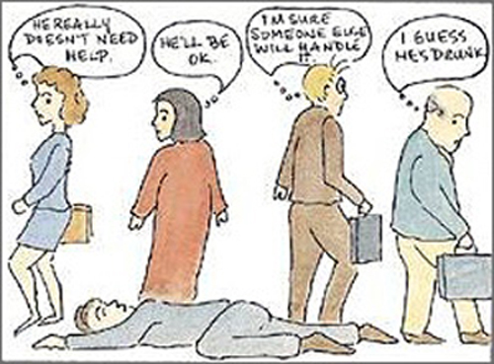
Watch the short video (3.35mins) made by Cool Psychologist entitled:
The Bystander Effect
The film will play automatically on the next slide, or
alternatively you can click on the link above for the hyperlink

Slide 42
Allow students a few minutes to respond to the film with people sitting near to them.
After sharing their initial responses, ask them to think about the following questions:

Slide 43
Why do you think it is much easier to be a part of a group than it is to be an individual doing something different?
Talk to the person next to you and then share ideas with the class.

Slide 44
“People feel safe in a herd, and safer and happier in a herd/tribe that dominates all the other herds/tribes in a particular geographical area they live in. It gives them a sense of security and pride; a behaviour also be amongst animals...
“Morality is inversely proportional to the number of observers. When you have a large group that's relatively anonymous, you can essentially do anything you like."
Dr James Thompson, Psychologist

Slide 45
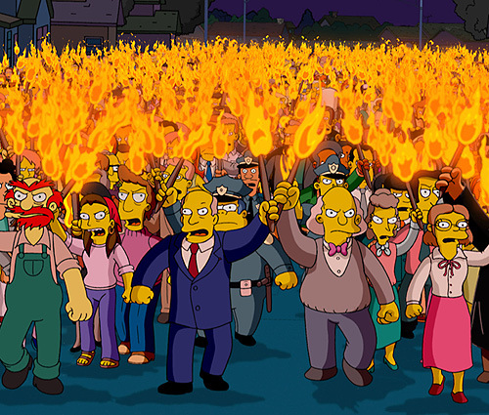
Our Unknown Enemy: Mob Mentality
There have been times in our lives when we’ve heard the expression ‘if your friends jumped off a cliff, would you do the same?’ from our parents or our teachers. We answered with ‘no’ most of the times.
The sad fact is that, every now and then, without realizing why, we would jump with our friends. People follow people. It’s been like this for ages. The reason we blindly follow people is because we lose our sense of individuality and become part of a group’s mechanism. Most of the times, there are negative outcomes when this happens. Football fights, military units, witch trials, all of these are examples of why acting without individual thinking is wrong.
You can do something about mob mentality.

Slide 46
Let’s analyse the London riots, for example. At the beginning of August 2011 some London districts suffered rioting, looting and arson when thousands took the streets, during a protest that turned violent.
“Many who participated in the riots were confronted with scenes that challenged their conscience. A 17-year-old from Islington who, on the second night of the riots, looted a branch of Currys in Enfield, described how her feelings changed as the night progressed. When people she knew smashed their way into a hairdresser’s, stealing shampoo and ripping out the basins, she thought: ‘It’s so dumb. I don’t agree with it.’”
A piece of an article found in The Guardian newspaper stated:

Slide 47
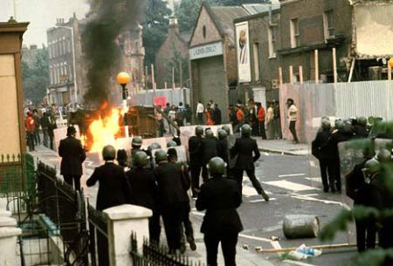
Does disagreeing actually matter? Yes, it does. If you see mobs as an irrational phenomenon, the first response is to repress (why reason with those who have no reason?) and second is to look for problems within the communities from which rioters are drawn. There are ways in which you can say “No, I won’t jump”. Understanding how belonging to a group can influence our thoughts helps us make sense of the behaviour that otherwise will appear irrational and has fundamental implications in how we respond to crowd actions.
We should start asking ourselves why is it so easy for humans to act violently when belonging to a group? The idea of mob mentality was first coined by social psychologist Gustave Le Bon [1], when referring to the belief that a group can act as a single individual. This leads most of the time to destructive behaviour.

Slide 48
The London riots were only the start in a chain of riots that happened in the next three nights all across England. Significant disturbances, involving rioting and looting, were reported in Birmingham, Salford, Liverpool, and Manchester. The capability to control behaviour disappears, therefore exposing individuals to contagion. All acts of love, hatred, anger are immediately approved, spread and repeated.
Have you ever been in a group and acted in a way contrary to your ordinary behaviour? A man, as part of a group, is a very different individual. When studying the effects of behaviour of individuals in a revolution, Le Bon [2] thought that the collective mentalities are very different than personal mentalities. In a mob mentality the individual’s identity disappears, causing anonymity.

Slide 49
Simply by being part of a crowd, folks lose all sense of self and all sense of responsibility, and manage to gain power due to the group’s size. Behaviour in a crowd is mostly influenced by anonymity. Nobody knows who you are when you stand next to a large number of people.
Diener [3] conducted a study on how anonymity influences ones behaviour in a group by observing children that went trick-or-treating on Halloween. The results of the study indicated that children who wore costumes that concealed their identity, or children who went trick-or-treating in a group stole extra candy compared to when they were alone with the candy bowl. So, anonymity enhances the loss of self-awareness within a group that eases the path to anti-social behaviour and encourages individuals to identify with the group. If people don’t know you, there will be fewer consequences for your actions.

Slide 50
Anonymity and loss of individuality eases up the process of behaving anti-social. Festinger, Pepitone and Newcomb’s [4] used the term “deindividuation” to describe the effect of groups on the behaviour of an individual. They stated that when belonging to a crowd, a person will be ‘able to indulge in forms of behaviour in which, when alone, they would not indulge’. Think about how easy it must have been for the participants at the London riots to loot stores in groups rather than when they are be alone. Including one person in a crowd or a group results in the feeling of anonymity and loss of personal identity, which motivates people to act aggressively or deviate from their usual social behaviour.
Humans tend to exhibit certain behaviour when they become members of a group. A group can shape our conformity, and influence our decision making, or even threaten us with ostracism if we do not agree with the overall decisions made by the group.

Slide 51
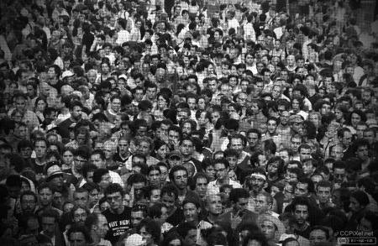
Understanding mob mentality can be the first step in stopping the negative outcomes. The solution lies in preventing deindividuation, rather than punishing the results. For instance, what did the authorities do after the London riots? They started repressing rioters. This was wrong.
A different approach should have been taken such as helping individuals become more self-aware. There are experiments with mirrors [5] which have proven that people become more self-aware of their actions. By forcing an individual to see himself, you force him to think about his actions, and that increases self-awareness and decreases deindividuation.

Slide 52
This was applicable for preventing riots at football matches, where mirrors and cameras have been placed on the walls stadiums. Additionally, it is important to stop unruly behaviour from its early stages. One way to do this is by reinforcing their individual identity. Simply by calling people by their name, pulling them out of a mob and encouraging personal differences in a group can reduce the harmful effects of deindividuation.
If you manage to create non-threatening, non-stressful, and unambiguous situations people may think more clearly about their actions instead of being drawn in by negative group norms.
References
[1] Le Bon, G., (1896) General Characteristics of crowds – Psychological Law of Their Mental Unity. The Crowd: A study of the Popular Mind. Book I, Chapter I.
[2] Le Bon, G., (1913) The Psychology of Revolutionary Crowds, The Psychology of Revolution, 4, 57-63
[3] Diener, E., Fraser, S., Beaman, A., & Kelem, R. (1976). Effects of deindividuation variables on stealing among Halloween trick-ortreaters. Journal of Personality and Social Psychology, 33, 178- 183.
[4] Festinger, L., Pepitone, A., & Newcomb, T. (1952). Some consequences of deindividuation in a group. Journal of Social Psychology, 47, 382-389.
[5] Asendorpf, J.B., Warkentin, V., & Baudonniere, P.M. (1996) Self-Awareness and Other-Awareness II: Mirror Self-Recognition, Social Contingency Awareness, and Synchronic Imitation, Developmental Psychology, Vol.32, No, 2,313-321

Slide 53
Do you agree with ideas in the article?
Were there any statements made that you thought interesting or controversial?
Were there any statements that you do not agree with? Why?
Think about and respond to the following question raised in the article:
“Have you ever been in a group and acted in a way contrary to your ordinary behaviour?”

Slide 54
Now write the following statement on the board:
“Morality is dulled when we are part of a larger group”
Split the class in half
Arrange each half into small groups of no more than 4 people.
Give one side of the room the “for” and one the “against” argument in response to the statement

Slide 55
Use the eight articles on the following slide (maybe spread around the groups) to support the ideas to extend the activity.
Allow students to work in their groups for 5-10 minutes, noting down ideas and thinking of counter-arguments.
Either run as a formal debate (click here for instructions) or as a more general class discussion.

Slide 56
1.The effect of mob-mentality on the brain | 2. Herd behaviour | 3. What turns people into looters?
4 Getting into the mind-set of mob-mentality | 5.The London riots – man jailed for 6 months for stealing water bottle | 6.When good people do bad things
7.Mob-mentality brain suppression | 8.Mob mentality in Lord of the Flies *Relevant to those in the class who have studied William Golding’s text | 9.Lord of the Flies – Simon chapter *Read this if time at the end – relevant to those in the class who have studied William Golding’s text

Slide 57
Think – feel – unlearn
www.thoughtboxeducation.com

