Slide 1
15 minutes+
Immigration & Refugees
Week 1 – The Language of Fear
Y7-8
11-13 years

Slide 2
In this lesson, students will:
THINK!
Think about some of the words and phrases that are associated with refugees and think about where they may come from and why
Understand the meaning of the term ‘refugee’ and explore some of the emotions behind its label
Explore and unravel some of the stereotypes and perceptions that the media and language encourage when discussing refugees
FEEL!
UNLEARN!

Slide 3
Pre-lesson reflection
3 minutes+

Slide 4
Introduce the following REFLECTIVE QUESTIONS for students to consider during the lesson:
What does the word ‘refugee’ mean?
How aware are you of the meaning of words such as “Immigrant”, “Asylum seeker” etc.?
How much do other people’s reactions influence your response to immigrants and refugees?

Slide 5
I am a human 5 minutes+

Slide 6
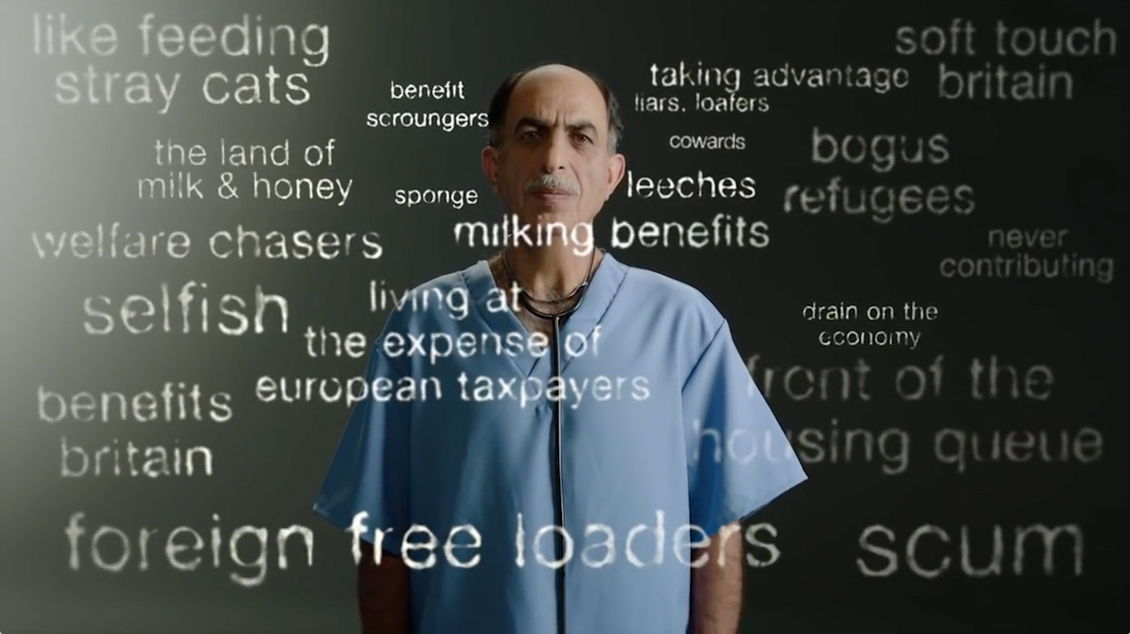
Watch the short video (1.33mins) made by the British Red Cross entitled:
I am a human
Click on the link above to open the film

Slide 7
Allow students a few minutes to respond to the film with people sitting near to them.
After sharing their initial responses, ask them to consider the following questions:

Slide 8
Have you heard or seen any of these derogatory phrases being used before to discuss refugees?
How do you think these ideas are spread? Where do they come from?

Slide 9
What is a ‘Refugee’?
10 minutes+

Slide 10
To begin, ask students what they understand by the terms:
What is the difference?
Migrant
Refugee

Slide 11
Over 65 million people around the globe have been forced to leave their homes to escape war, violence and persecution.
The majority have become Internally Displaced Persons, which means that they fled their homes but are still in their own countries.
Those who have managed to leave their own country and sought shelter in another land are called Refugees.

Slide 12
We often use words and in particular labels to connect to other people, but we also use them to distance ourselves.
By labelling people – “refugee”, “immigrant”, “asylum seeker” - we are able to disassociate and see them as other, rather than as someone with a life just like ours.

Slide 13
We often use labels to connect to other people, but we also use them to distance ourselves.
By labelling people – “refugee”, “immigrant”, “asylum seeker” - we are able to disassociate and see them as other, rather than as someone with a life just like ours.

Slide 14
“We must stop the migrant invasion”
“Halt the asylum tide”
“Immigrants bring more crime”
“Migrants shun the English language”

Slide 15
Refugee?
Migrant?
Are we even using the right label for each person or circumstance?
Immigrant?
Asylum Seeker?
Notes:
HOW ARE LABELS INFLUENCING US? DO WE KNOW WHAT THESE LABELS ACTUALLY MEAN??

Slide 16
Migrant, immigrant, refugee or asylum seeker?
A migrant is someone who moves from one place to another, in order to live in another country for a while. This tends to be on more of a temporary basis.

Slide 17
Migrant, Immigrant, refugee or asylum seeker?
An immigrant is someone who arrives into a country and intends to settle there more permanently.
They have a desire or plan to make the new country a permanent place of residence for work and living.

Slide 18
Migrant, immigrant, refugee or asylum seeker?
A refugee is a person who has fled armed conflict or persecution.
They need international protection because it is too dangerous for them to return home.
They may be housed somewhere temporarily until the conflict has ended or may apply for asylum in a new country.

Slide 19
Migrant, Immigrant, refugee or asylum seeker?
An Asylum Seeker is someone who is unable to live safely in their own country for fear of being persecuted because of their race, religion, nationality, membership of a particular social group or political opinion.
They are therefore seeking safety by coming to another country.

Slide 20
All of these labels come with stereotypes. Whether we like it or not, we are being programmed to react in a certain way when we hear a particular word, see an image or make associations.
Does the language that we use influence our response to immigrants and refugees?

Slide 21
These labels have become synonymous in many people’s opinions with negativity.
Why?
One of the reasons is how they are used by the press.
For example, immigrant and refugee are frequently used in the media in a fearful or derogatory manner, with the aim to provoke:

Slide 22
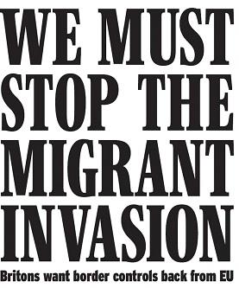
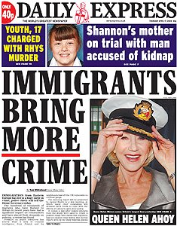
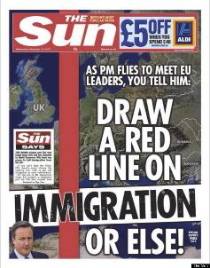
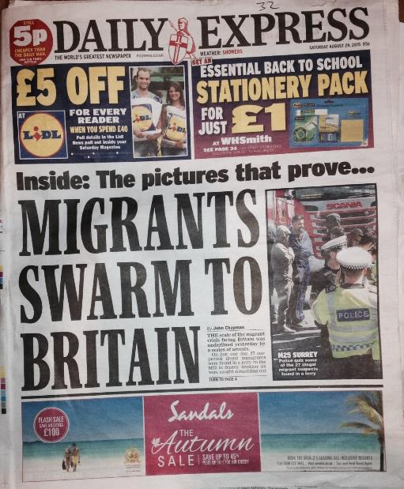
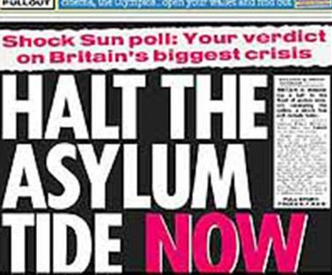
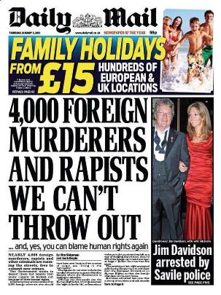
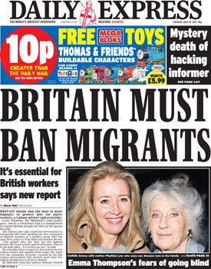

Slide 23
Using such words and phrases like these when discussing migrants creates powerful repercussions in people’s minds and perceptions.
“Asylum tide”
“Invasion”
“Foreign”
“Swarm”

Slide 24
Refugee is not an identity,
It is a life experience.
What do you think this might mean?
Notes:
Take a look at the following advert for TV2 in Denmark. Focus on what we share and how we connect, rather than fear how we are different.

Slide 25
When talking about the problem of refugees, we use dehumanised language, which reduces human tragedy to numbers and statistics.
The suffering of refugees and many immigrants concerns real people, who – just like us - have families, loved ones, friends; their own stories, dreams, goals...
It is only when you start to see the human, and no longer see an anonymous refugee, that you notice the person before you is human, just like you…

Slide 26
ThoughtBox: This sort of learning can’t wait

