Slide 1
G L O B A L
C U L T U R E S
CULTURAL IDENTITIES
Y7&8
11-13 years

Slide 2
W H A T I S C U L T U R E ?
W E E K 1
3 0 M I N U T E S

Slide 3
In this lesson, students will:
THINK!
Think about and discuss the concept of globalisation and its effect upon culture
Understand the impact of development and globalisation upon the loss of our own cultural identities
Explore and unravel some the positives and negatives of globalisation, thinking about the impact of monoculture upon communities and cultural identities
FEEL!
CONNECT!

Slide 4
P R E L E S S O N
R E F L E C T I O N S
3 – 5 M I N U T E S +

Slide 5
Introduce the following REFLECTIVE QUESTIONS for students to consider during the lesson:
What is culture and what does this mean to you?
What are some of the impacts on culture and diversity?
How important is language to culture and to identity?
Is globalisation always a good thing?

Slide 6
W H A T I S C U L T U R E ?
1 0 M I N U T E S +

Slide 7
Watch the short video (1.16mins) put together the Bureau of Educational and Cultural Affairs entitled:
What is Culture?
(click on the link above)

Slide 8
Allow students a few minutes to respond to the film with people sitting near to them.
After sharing their initial responses, look at four of the definitions of culture that were given (shown on the following slide).
Discuss each one and what you think it may mean:

Slide 9
I understand culture as a treasure that is a part of our collective memory of our perception of ourselves
It is the acquired pair of glasses through which we see life
It is a call for individuals to agree upon some common values that bind them in harmony
Culture is something that unites people

Slide 10
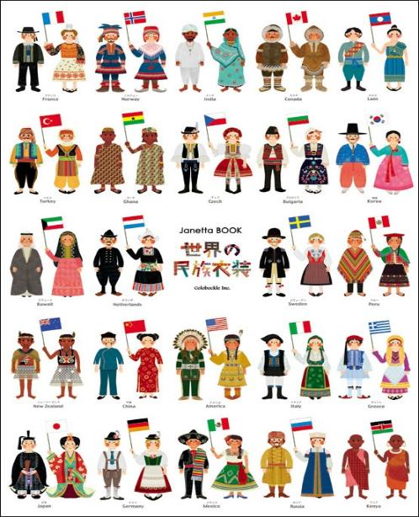
In its simplest term, culture is simply an idea; just one idea of what people on earth could be doing.
When you think about culture in that way, you start to see how beautiful and exciting our cultural diversity – our huge range of ideas about how to be human - actually are!

Slide 11
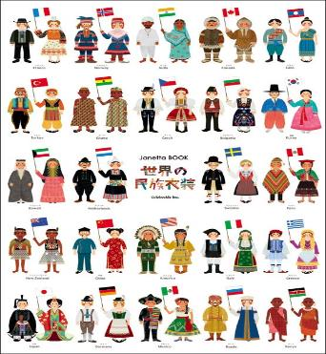
Exposing ourselves to other cultures is a really good way of understanding and celebrating diversity and also of understanding that the way we live (all of our customs and traditions) are just one version of how to live, and are no more right nor wrong than those of another culture.
Look at the quote on the next slide from anthropologist Wade Davis and talk with the person next to you about what you think it may mean. Share your ideas with the class.

Slide 12
Cultures around the world - the myriad voices of humanity - are not failed attempts at being you, failed attempts at being modern. They're unique answers to a fundamental question: what does it mean to be human and alive?

Slide 13
C U L T U R E I N
D A N G E R
2 0 M I N U T E S +

Slide 14
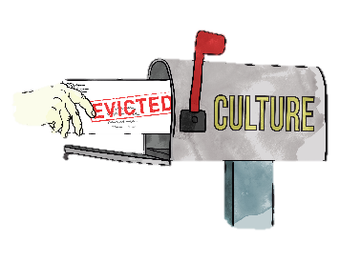
There are sadly many threats to cultural diversity and cultures are dying out rapidly across the world.
What do you think may be some of the reasons that this is happening?

Slide 15
Watch the following short film (1.52 mins) made by a secondary school student, Angel, from KIS International school Thailand entitled:
Impacts of Globalisation on Society
(click on the link above)

Slide 16
Allow students a few minutes to respond to the film with people sitting near to them.

Slide 17
The more we “develop” by spreading western ideas (through education, media, industry, charity, the single story), the more we become globalised or mono-cultural in the way that we are living.
The more we become similar, the more we lose our diversity and the more we lose our diversity, the more cultures are eroded.

Slide 18
Split the class in half and give each half one of these positions:
“Globalisation is positive for the world!”
“Globalisation is negative for the world!”

Slide 19
Working in either pairs or small groups, ask students to note down all of the POSITIVE or NEGATIVE impacts of globalisation (depending on which side they are on).
Share thoughts with the class and discuss together.

Slide 20
What is the link between LANGUAGE and CULTURE?

Slide 21
Language is a really important part of culture and identity. At the moment, there are currently 6500 languages spoken across the world.
However, nearly a third of these languages only have about 2000 native speakers left (as they are no longer teaching their children to speak these languages). Every year, the world loses around 25 languages.

Slide 22
Linguists predict that over 50% of the world’s languages will no longer be spoken in just a few more years.
When languages die, we do not just lose words, but we lose different ways of thinking about and understanding things and, most significantly, we lose cultures.
Why might a language disappearing mean a culture disappears?

Slide 23
Watch the short video (2.20 mins) made by Lindsay Williams entitled:
Do Endangered Languages Matter?
(click on the link above)

Slide 24
Allow students a few minutes to respond to the film with people sitting near to them.
After sharing their initial responses, ask them to consider the following questions:

Slide 25
Linguists predict that over 50% of the world’s languages will no longer be spoken in just a few more years.
When languages die, we do not just lose words, but we lose different ways of thinking about and understanding things and, most significantly, we lose cultures.
Why might a language disappearing mean a culture disappears?

Slide 26
Are endangered languages worth saving?

Slide 27
Ask the class how many languages they speak (and make an average to work out how many languages the class represents).

Slide 28
If time allows, ask students to discuss or debate the statement:
Either run as an informal discussion, or allow students to take part in a more formal debate (click onto the following slides for a quick guide to running a debate).
“Globalisation is a positive development for the world”

Slide 29
A quick guide to running a debate

Slide 30
Structure
A formal debate usually involves three groups: one supporting a resolution (affirmative team), one opposing the resolution (opposing team), and those who are judging the quality of the evidence and arguments and the performance in the debate( in this case the teacher)
In addition to the three specific groups, there may an audience made up of class members not involved in the formal debate. A specific resolution is developed and rules for the debate are established.

Slide 31
2. Preparation
Develop the resolution to be debated.
Organize the teams.
Establish the rules of the debate, including timelines.
Research the topic and prepare logical arguments.
Gather supporting evidence and examples for position taken.
Anticipate counter arguments and prepare rebuttals.
Team members plan order and content of speaking in debate.
Prepare room for debate.

Slide 32
3. Conducting a Debate:
The debate opens with the affirmative team (the team that supports the resolution) presenting their arguments, followed by a member of the opposing team.
This pattern is repeated for the second speaker in each team.
Finally, each team gets an opportunity for rebutting the arguments of the opponent.
Speakers should speak slowly and clearly.
The judges and members of the audience should be taking notes as the debate proceeds.

Slide 33
4. Suggested timeline for a formal debate
The first speaker on the affirmative team presents arguments in support of the resolution. (5 – 10 minutes)
The first speaker on the opposing team presents arguments opposing the resolution. (5 – 10 minutes)
The second speaker on the affirmative team presents further arguments in support of the resolution, identifies areas of conflict, and answers questions that may have been raised by the opposition speaker. (5 – 10 minutes)
The second speaker on the opposing team presents further arguments against the resolution, identifies further areas of conflict, and answers questions that may have been raised by the previous affirmative speaker. (5 – 10 minutes)
The opposing team begins with the rebuttal, attempting to defend the opposing arguments and to defeat the supporting arguments without adding any new information. (3 – 5 minutes)
First rebuttal of the affirmative team (3 – 5 minutes)
Each team gets a second rebuttal for closing statements with the affirmative team having the last opportunity to speak. (3 – 5 minutes each)
There cannot be any interruptions. Speakers must wait their turns. The teacher may need to enforce the rules.

Slide 34
5. Post-debate Discussion
When the formal debate is finished, allow time for debriefing and discussion.
Members of the audience should be given an opportunity to ask questions and to contribute their own thoughts and opinions on the arguments presented.
Members of the debate teams may also wish to reflect on their performance and seek feedback from the audience, including the teacher.

Slide 35
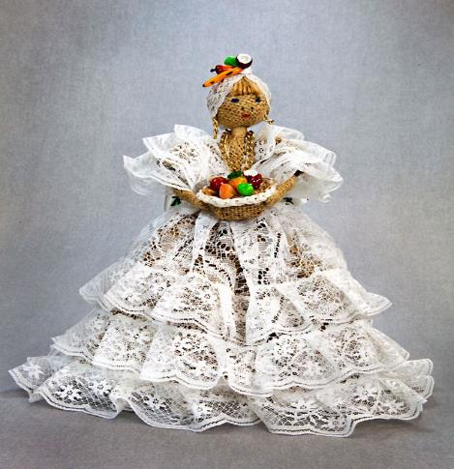
If time allows, try playing some of the cultural diversity games such as;
International Food Puzzle
Country Location
Country Clothing
World Religions

Slide 36
GLOBAL CULTURES
T H I S S O R T O F L E A R N I N G
C A N ’ T W A I T

