Slide 1
30 minutes+
Global Cultures
Week 1 – What is Culture?
Y7&8
11-13 years
thoughtboxeducation.com

Slide 2
In this lesson, students will:
THINK!
Think about and discuss the concept of globalisation and its effect upon culture
Understand the impact of development and globalisation upon the loss of our own cultural identities
Explore and unravel some the positives and negatives of globalisation, thinking about the impact of monoculture upon communities and cultural identities
FEEL!
UNLEARN!

Slide 3
Pre-lesson reflection 3-5 minutes+

Slide 4
Introduce the following REFLECTIVE QUESTIONS for students to consider during the lesson:
What is culture and what does this mean to you?
What are some of the impacts on culture and diversity?
How important is language to culture and to identity?
Is globalisation always a good thing?

Slide 5
What is culture? 10 minutes+

Slide 6
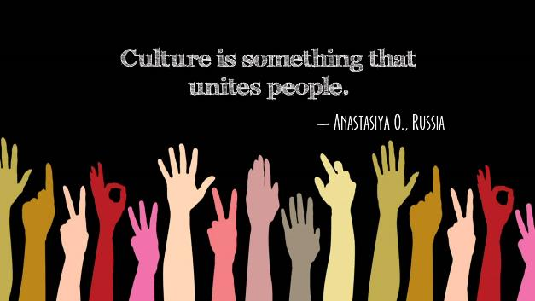
Watch the short video (1.16mins) put together the Bureau of Educational and Cultural Affairs entitled:
What is Culture?
(click on the link above)

Slide 7
Allow students a few minutes to respond to the film with people sitting near to them.
After sharing their initial responses, look at four of the definitions of culture that were given (shown on the following slide).
Discuss each one and what you think it may mean:

Slide 8
I understand culture as a treasure that is a part of our collective memory of our perception of ourselves
It is the acquired pair of glasses through which we see life
It is a call for individuals to agree upon some common values that bind them in harmony
Culture is something that unites people

Slide 9
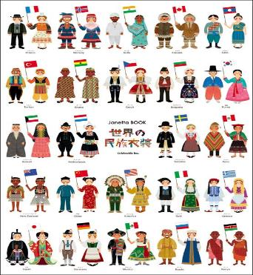
Exposing ourselves to other cultures is a really good way of understanding and celebrating diversity and also of understanding that the way we live (all of our customs and traditions) are just one version of how to live, and are no more right nor wrong than those of another culture.
Look at the quote on the next slide from anthropologist Wade Davis and talk with the person next to you about what you think it may mean. Share your ideas with the class.

Slide 10
Cultures around the world - the myriad voices of humanity - are not failed attempts at being you, failed attempts at being modern. They're unique facets of the human imagination. They're unique answers to a fundamental question: what does it mean to be human and alive?

Slide 11
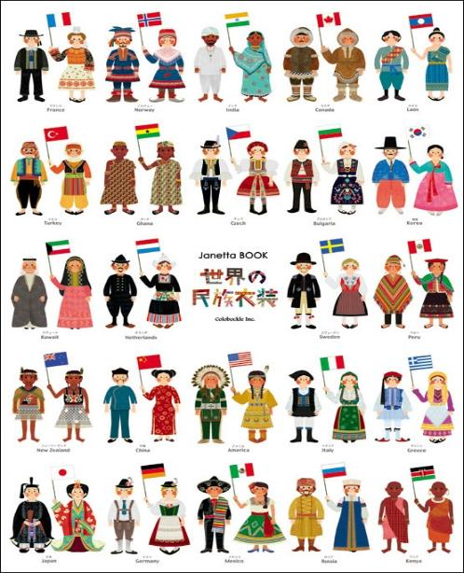
In its simplest term, culture is simply an idea; just one idea of what people on earth could be doing.
When you think about culture in that way, you start to see how beautiful and exciting our cultural diversity – our huge range of ideas about how to be human - actually are!

Slide 12
Culture in danger 20 minutes+

Slide 13
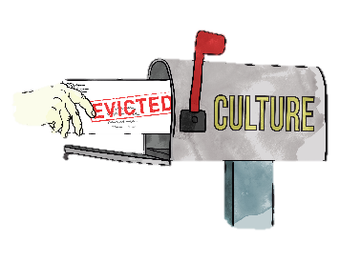
There are sadly many threats to cultural diversity and cultures are dying out rapidly across the world.
What are some of the threats to culture that you can think of?

Slide 14
The biggest threat to the world’s cultural diversity comes with how we are changing, developing and globalising.
Turn to the person next to you and see if you can come up with a definition or an understanding.
Share with the class and see if you can find some common ideas between you all.
What does the term “Globalisation” actually mean?

Slide 15
Watch the following short film (1.52 mins) made by a secondary school student, Angel, from KIS International school Thailand entitled:
Impacts of Globalisation on Society
(click on the link above)

Slide 16
Allow students a few minutes to respond to the film with people sitting near to them.
After sharing their initial responses, ask them to consider the following questions:

Slide 17
Do you agree with the positives and negatives of globalisation reflected upon in the film?
What do you see as being the most positive elements of globalisation? Why?
What do you see as being the most negative elements of globalisation? Why?

Slide 18
The more we “develop” by spreading western ideas (through education, media, industry, charity, the single story), the more we become globalised or mono-cultural in the way that we are living.
The more we become similar, the more we lose our diversity and the more we lose our diversity, the more cultures are eroded.

Slide 19
Are the positives of globalisation good enough to outweigh the negatives?
Split the class in half and give each half one of these positions:
“Globalisation is positive for the world!”
“Globalisation is negative for the world!”

Slide 20
Working in either pairs or small groups, ask students to note down all of the POSITIVE or NEGATIVE impacts of globalisation (depending on which side they are on).
Share thoughts with the class and discuss together.

Slide 21
What is the link between LANGUAGE and CULTURE?

Slide 22
Language is a really important part of culture and identity. At the moment, there are currently 6500 languages spoken across the world.
However, nearly a third of these languages only have about 2000 native speakers left (as they are no longer teaching their children to speak these languages). Every year, the world loses around 25 languages.

Slide 23
Linguists predict that over 50% of the world’s languages will no longer be spoken in just a few more years.
When languages die, we do not just lose words, but we lose different ways of thinking about and understanding things and, most significantly, we lose cultures.
Why might a language disappearing mean a culture disappears?

Slide 24
Watch the short video (2.20 mins) made by Lindsay Williams entitled:
Do Endangered Languages Matter?
(Click on the link above)

Slide 25
Allow students a few minutes to respond to the film with people sitting near to them.
After sharing their initial responses, ask them to consider the following questions:

Slide 26
Are endangered languages worth saving?
Can you understand how language is culture?
Globalisation allows us all to communicate (with English being one of the most common languages) – is this a good thing?

Slide 27
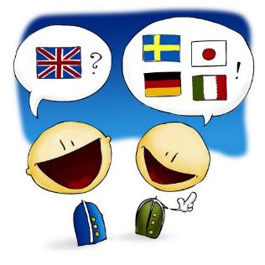
Ask the class how many languages they speak (and make an average to work out how many languages the class represents).

Slide 28
What is a “monoculture”? Can you think of an example of this happening?

Slide 29
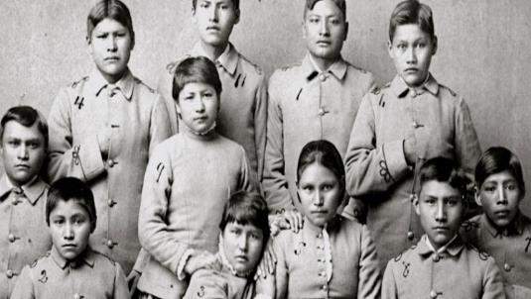
Watch the short trailer (3.30mins) for the documentary made by Lost People Films entitled:
Schooling the World
(Click on the link above)

Slide 30
Allow students a few minutes to respond to the film with people sitting near to them.
After sharing their initial responses, ask them to consider the following questions:

Slide 31
What is the film trying to say about education and globalisation?
How is education impacting cultural diversity?

Slide 32
This sort of learning can’t wait

