Slide 1
IMMIGRATION
& REFUGEES
SOCIAL PERSPECTIVES
Y9&10
13-15 years

Slide 2
T H E L A N G U A G E
O F F E A R
W E E K 1
30 M I N U T E S

Slide 3
In this lesson, students will:
THINK!
Think about some of the words and phrases that are associated with refugees and think about where they may come from and why
Understand the meaning of the term ‘refugee’ and explore some of the emotions behind its label
Explore and unravel some of the stereotypes and perceptions that the media and language encourage when discussing refugees
FEEL!
CONNECT!

Slide 4
P R E L E S S O N
R E F L E C T I O N S
3 – 5 M I N U T E S +

Slide 5
Introduce the following REFLECTIVE QUESTIONS for students to consider during the lesson:
What do you understand by the term “Refugee”?
What image comes to mind when you hear it?
How much do you think your response to refugees is influenced by media bias?

Slide 6
I A M H U M A N
5 M I N U T E S +

Slide 7
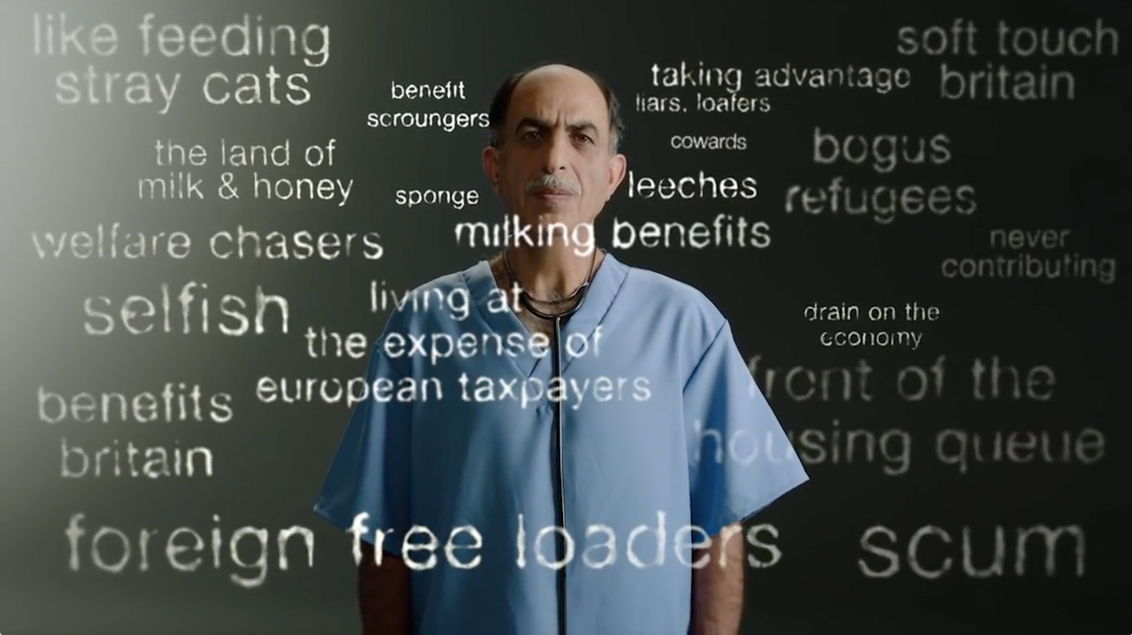
Watch the short video (1.33mins) made by the British Red Cross entitled:
I am a human
Click on the link above to open the film

Slide 8
Allow students a few minutes to respond to the film with people sitting near to them.
After sharing their initial responses, ask them to consider the following questions:

Slide 9
Have you heard or seen any of these derogatory phrases being used before to discuss refugees?
How do you think these ideas are spread? Where do they come from?

Slide 10
T H E P O W E R O F
P E R S U A S I O N
1 5 M I N U T E S +

Slide 11
What are the first three words that come to your mind when you see this picture?
Notes:
Spend 20 seconds getting an idea or an image in your mind and keep these safe for later.

Slide 12
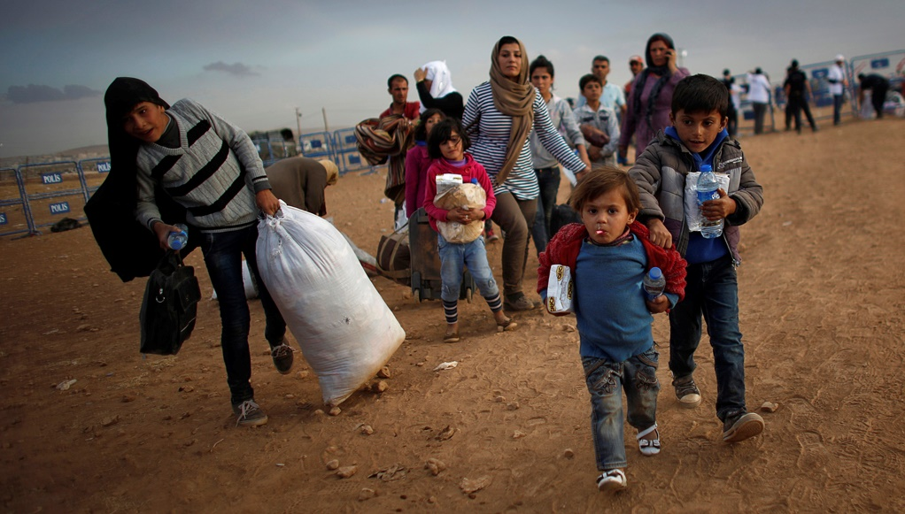

Slide 13
Write the three words down.
Now look at them and think about the following questions:
Are they positive or negative words?
Are they adjectives, verbs, nouns or something else?
Are they words that many people use?
Are they words that you would use?
Why do you think these words came to mind first?
Share your thoughts with the class, or leave this as an individual exercise.

Slide 14
We often use words and in particular labels to connect to other people, but we also use them to distance ourselves.
By labelling people – “refugee”, “immigrant”, “asylum seeker” - we are able to disassociate and see them as other, rather than as someone with a life just like ours.

Slide 15
“We must stop the migrant invasion”
“Halt the asylum tide”
“Immigrants bring more crime”
“Migrants shun the English language”

Slide 16
Talk about why the following ideas could be the reason for some:
Fear?
Distrust?
Ignorance?
Overwhelm?
Indoctrination?
Why do you think we might distance ourselves from people by giving them labels that make them seem different?

Slide 17
These labels have become synonymous in many people’s opinions with negativity.
Why might this be? One of the reasons is how they are used by the press.
For example, immigrant and refugee are frequently used in the media in a fearful or derogatory manner, with the aim to provoke:

Slide 18
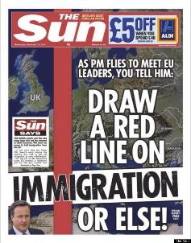
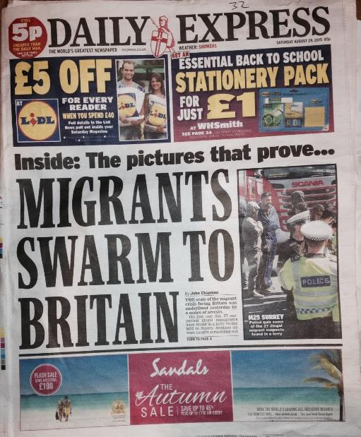
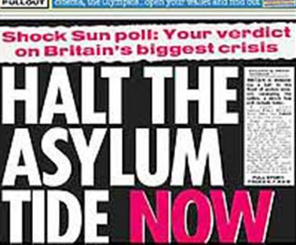

Slide 19
Using such words and phrases like these when discussing migrants creates powerful repercussions in people’s minds and perceptions.
“Asylum tide”
“Invasion”
“Foreign”
“Swarm”

Slide 20
We are constantly surrounded by ideas, opinions and ways to see the world, but how often do we question what we are being told and how much do we just simply accept?
“We are drowning in information whilst starving for wisdom”
Notes:
Edward Wilson Ecologist

Slide 21
R E - H U M A N I S I N G
O U R N E I G H B O U R S
1 5 M I N U T E S +

Slide 22
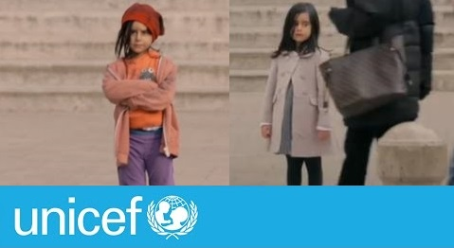
Watch the following short video (3.07mins) made by UNICEF entitled:
Would you stop and help?
Click on the link above for the hyperlink

Slide 23
After watching, allow students to share their thoughts.
Although this video is exploring child neglect, the same dehumanising behaviour can be seen with our response to immigrants and refugees.

Slide 24
Do you think your country is doing enough to support the humanitarian crisis that is unfolding? Why? Why not?

Slide 25
We need to try to look for the stories behind the people; see people as human not “other” and embrace the similarities and connections rather than fear the differences.
On two notable occasions, Western media changed rhetoric and responded to the refugee crisis by suddenly seeing people as humans, both occasions influenced by children:

Slide 26
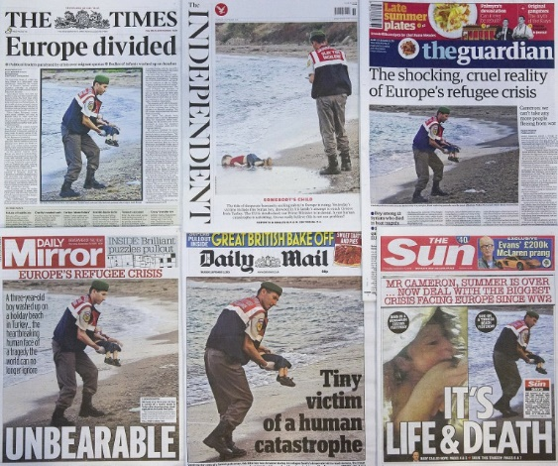

Slide 27
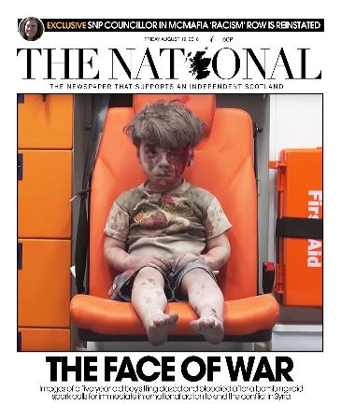
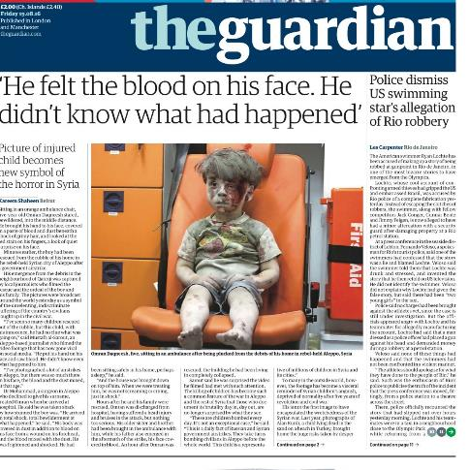
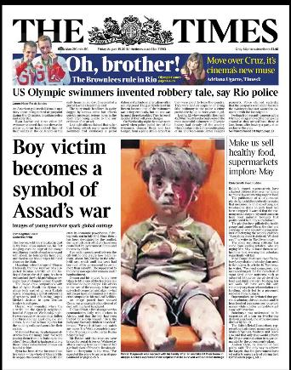

Slide 28
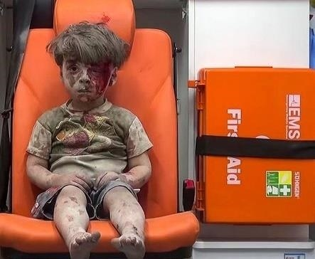
Five-year-old Omran Daqneesh was photographed sitting dazed and bloodied in the back of an ambulance after surviving an airstrike in Aleppo, Syria.

Slide 29
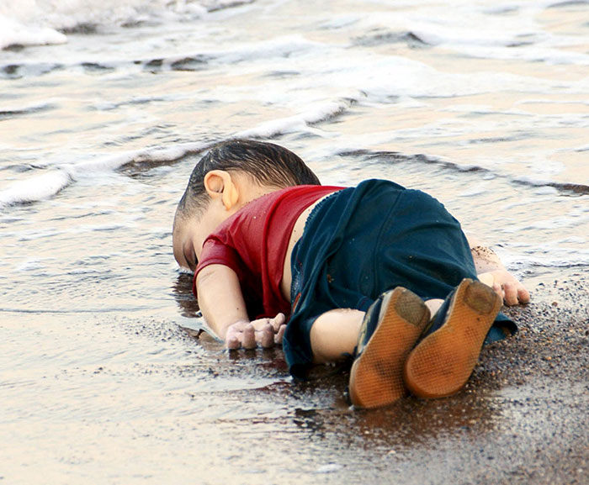
Three-year-old Syrian boy Alan Kurdi’s body was washed up on a beach in Turkey after his family got into a boat attempting to flee the war in Syria.

Slide 30
This photo showed in a very inactive way (with a child, alone) something people are dealing with every day…
Here is this baby alone, not with other people, no mother, no father, no police shouting.
And in its passivity, it made it easier, or perhaps less threatening, for Europeans to talk about – and made it somehow suddenly feel human and relatable.
Clinical psychologist Aya Mhanna who works with Syrians and activists in Turkey responds to the photograph

Slide 31
Why do you think the tone about immigration changed in the media when these pictures were published?

Slide 32
Refugee is not an identity,
It is a life experience.
What do you think this might mean?
Notes:
Take a look at the following advert for TV2 in Denmark. Focus on what we share and how we connect, rather than fear how we are different.

Slide 33
When talking about the problem of refugees, we use dehumanised language, which reduces human tragedy to numbers and statistics.
The suffering of refugees and many immigrants concerns real people, who – just like us - have families, loved ones, friends; their own stories, dreams, goals...
It is only when you start to see the human, and no longer see an anonymous refugee, that you notice the person before you is human, just like you…

Slide 34
Look again at the three words that you wrote down at the start of the class.
Now look again at the picture.
Notes:
Spend 20 seconds getting an idea or an image in your mind and keep these safe for later.

Slide 36
Would you change your words now? Why? Why not?
Discuss together as a class.
Notes:
Spend 20 seconds getting an idea or an image in your mind and keep these safe for later.

Slide 37
I M M I G R A T I O N & R E F U G E E S
T H I S S O R T O F L E A R N I N G
C A N ’ T W A I T

