Slide 1
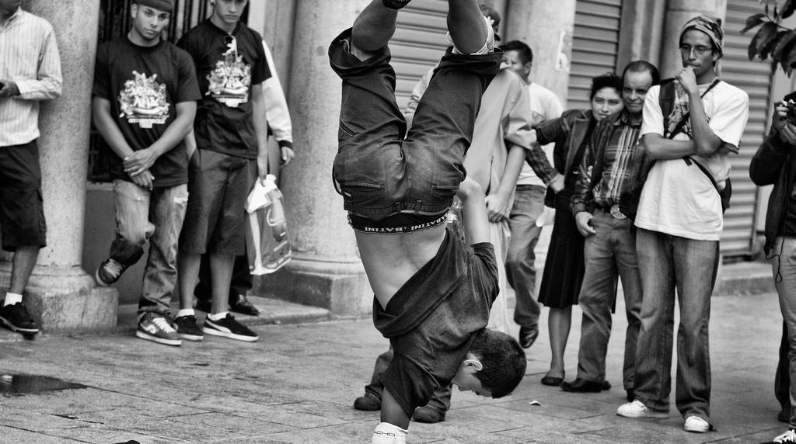
30 minutes+
Gangs
Week 2 – Gangs of El Salvador
Y11-13
15-18 years

Slide 2
In this lesson, students will:
Think about and discuss the pressures within society that encourage people to join gangs
Understand how social inequality and political corruption can influence behaviour within particular cultures and countries
Explore and unravel some of the stereotypes that exist within our perceptions of gang members and gang culture

Slide 3
Pre-lesson reflection 3-5 minutes+

Slide 4
Introduce the following REFLECTIVE QUESTIONS for students to consider during the lesson (maybe write them up or read them aloud and ask students to think about their own responses):
What is “gang loyalty” and what do you think it means?
Can a gang’s behaviour influence a societal change?
What links are there between gang violence and societal dysfunction?

Slide 5
MS-13 25 minutes+

Slide 6
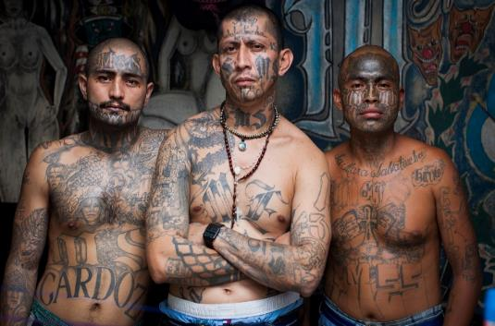
Watch the short documentary (23 minutes) made by Adam Hinton looking at the Mara Salvarucha gang in El Salvador entitled:
MS-13
(click on the link above or copy and paste this hyperlink:
https://vimeo.com/137759704)
Please note that this video contains footage
that some may find disturbing, including the
funeral of a gang member and the dead
body of a young baby. It also contains footage of gang members
smoking marijuana and brandishing guns.

Slide 7
Allow students a few minutes to respond to the film with people sitting near to them.
After sharing their initial responses, ask them to think about the following questions:

Slide 8
What did you learn within the film about gang culture in El Salvador?
What did you learn within the film about society in El Salvador?
What did you find most surprising or shocking within the film? Why

Slide 9
Looking a little closer 5 minutes+

Slide 10
There are many contributing factors from the wider issues affecting society in El Salvador that have led to the dominance of gangs within society.
Ask students to think back to what they have learned and discuss in brief what they know about:
Social problems in El Salvador
Environmental problems in El Salvador
Governmental problems in El Salvador
Economic problems in El Salvador
NB: The country profile (click here) can offer a little more information if required

Slide 11
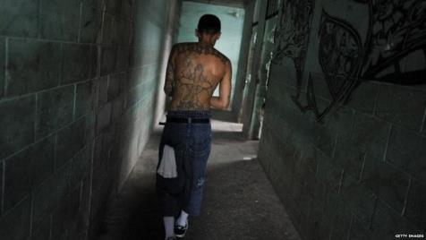
Seeing a person for their history, their context and their environment (not just judging them on their appearance and their present situation) is an important part of developing empathy.
Although these men have all been arrested for committing crimes, understanding why they ended up in this situation is an important step in understanding how our societies need to focus more on supporting (rather than persecuting) the marginalised.
By trying to understand why people might be doing what they are doing and how they ended up there, we are often able to understand better how to work to help people have different choices in the future.

Slide 12
Think – feel – unlearn
www.thoughtboxeducation.com

