Slide 1
15 minutes+
Immigration & Refugees
Week 2 – A Human Story
Y7&8
11-13 years

Slide 2
In this lesson, students will:
THINK!
Think about some of the psychological suffering of refugees and migrants and stereotypes we may form
Understand how it must feel to have to flee your home through no choice of your own
Explore and unravel some of emotions and experiences of people having to leave their homes and become refugees
FEEL!
UNLEARN!

Slide 3
Pre-lesson reflection
3 minutes+

Slide 4
Introduce the following REFLECTIVE QUESTIONS for students to consider during the lesson:
Do you feel that you know much about what is happening in Syria?
Do you feel empathic at all towards refugees who are coming into your country looking for asylum? Why?
Do you think your country is doing the right thing in response to the current crisis? Why?

Slide 5
Out of sight, out of mind? 5 minutes+

Slide 6
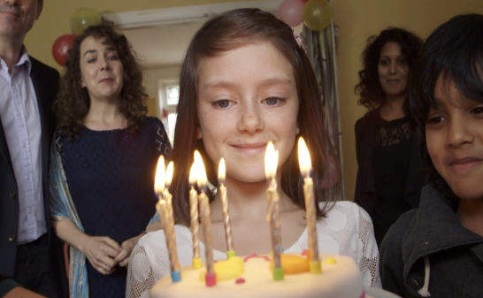
Watch the short video (1.33 mins) made by Save the Children entitled:
If London were Syria
(Click on the hyperlink to watch the film)
The film uses the ‘one second a day’ technique to show an entire year’s happenings in just a few minutes.

Slide 7
Allow students a few minutes to respond to the film with people sitting near to them.
After sharing their initial responses, ask them to consider the following questions:

Slide 8
What is the film trying to say about the problems happening across the world?
What do you think the message of this film is? Is it effective? Why?

Slide 9
Leaving home is rarely a choice 5 minutes+

Slide 10
The poem HOME by Kenyan-born Somali poet Warsan Shire reveals some of the decisions behind mass migration, most significantly the desperation and lack of choice or option that comes with movement.
Her main interest in her poetry is writing about and for people who are generally not heard otherwise, i.e. immigrants and refugees, as well as other marginalized groups of people too

Slide 11
Click on the link below to listen (and read along) to Warsan Shire read her poem ‘Home’:
Home
“no one puts their children in a boat unless the water is safer than the land”
Warsan Shire - Home

Slide 12
Allow students a few moments to reflect upon the poem, either in silence or with the person sitting next to them.
Warsan Shire’s poem is full of imagery: key words and phrases used to present visual images of her emotions to allow people reading to understand by seeing and feeling what other people have experienced.
no-one leaves home unless home chases you…
home is the mouth of a shark…

Slide 13
Home by Warsan Shire
no one leaves home unless home is the mouth of a shark you only run for the border when you see the whole city running as well
your neighbours running faster than you breath bloody in their throats the boy you went to school with who kissed you dizzy behind the old tin factory is holding a gun bigger than his body you only leave home when home won’t let you stay.

Slide 14
no one leaves home unless home chases you fire under feet hot blood in your belly it’s not something you ever thought of doing until the blade burnt threats into your neck and even then you carried the anthem under your breath only tearing up your passport in an airport toilets sobbing as each mouthful of paper made it clear that you wouldn’t be going back.

Slide 15
you have to understand, that no one puts their children in a boat unless the water is safer than the land no one burns their palms under trains beneath carriages no one spends days and nights in the stomach of a truck feeding on newspaper unless the miles travelled means something more than journey. no one crawls under fences no one wants to be beaten pitied

Slide 16
no one chooses refugee camps or strip searches where your body is left aching or prison, because prison is safer than a city of fire and one prison guard in the night is better than a truckload of men who look like your father no one could take it no one could stomach it no one skin would be tough enough

Slide 17
the go home blacks refugees dirty immigrants asylum seekers sucking our country dry niggers with their hands out they smell strange savage messed up their country and now they want to mess ours up how do the words the dirty looks roll off your backs maybe because the blow is softer than a limb torn off

Slide 18
or the words are more tender than fourteen men between your legs or the insults are easier to swallow than rubble than bone than your child body in pieces. i want to go home, but home is the mouth of a shark home is the barrel of the gun

Slide 19
and no one would leave home unless home chased you to the shore unless home told you to quicken your legs leave your clothes behind crawl through the desert wade through the oceans drown save be hunger beg forget pride your survival is more important

Slide 20
no one leaves home
until home is a sweaty voice in your ear saying - leave, run away from me now i dont know what i’ve become but i know that anywhere is safer than here…
Warsan Shire

Slide 21
Re-humanising the “other” 5 minutes+

Slide 22
If we start to see refugees as simply human rather than “other” or “different”, we can start to connect and find the similarities and shared ideas and experiences, rather than fear the differences.
On two occasions, the western media changed its negative response to the refugee crisis by running stories which started showing and seeing people as humans rather than “invaders” or “swarms” or “plagues”.
(NB: the following images may be disturbing to some students)

Slide 23
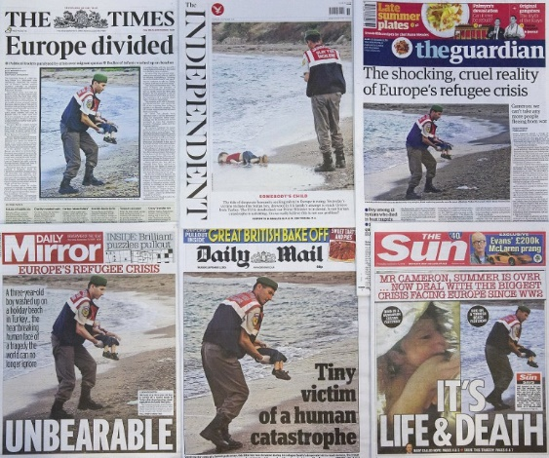

Slide 24
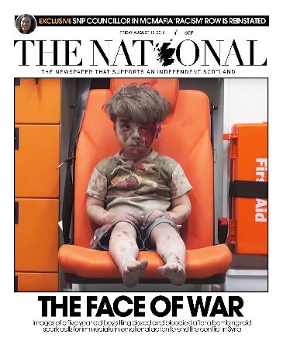
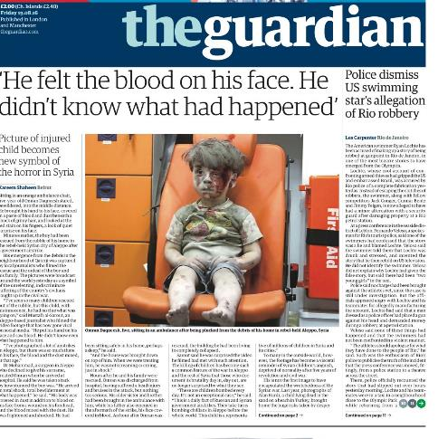
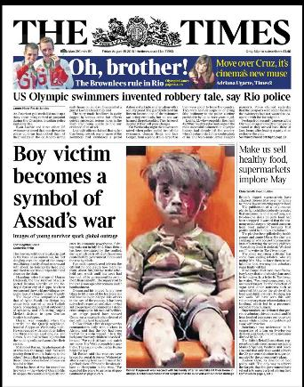

Slide 25
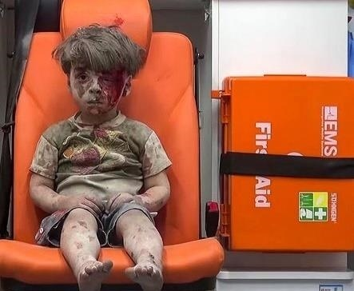
Five-year-old Omran Daqneesh was photographed sitting dazed and bloodied in the back of an ambulance after surviving an airstrike in Aleppo, Syria.

Slide 26
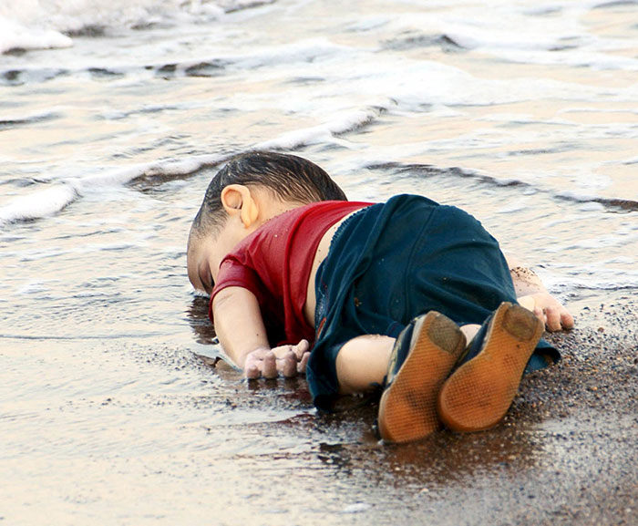
Three-year-old Syrian boy Alan Kurdi’s body was washed up on a beach in Turkey after his family got into a boat attempting to flee the war in Syria.

Slide 27
Why do you think the tone about immigration changed in the media when these pictures were published?
Do you think these images should have been published and shared across the world? Why? Why not?

Slide 28
ThoughtBox: This sort of learning can’t wait

