Slide 1
15 minutes+
Clothes
Week 2 - Slaves to Fashion
Y9&10 13-15 years

Slide 2
In this lesson, students will:
Think about and discuss where our clothes come from and the link between cost and worth within the clothing industry
Understand some of the human stories of slavery behind the creation of fast fashion
Explore and unravel some the negative ripple effects of our cheap clothing industry on individuals, communities and environments cross the world

Slide 3
Pre-lesson reflection 3-5 minutes+

Slide 4
Introduce the following REFLECTIVE QUESTIONS for students to consider during the lesson:
Do you ever think about where your clothes come from and who made them?
Have you ever considered that slavery may be involved in producing cheap clothes?
Who do you think is responsible for allowing slavery to be a part of the clothing industry?

Slide 5
What is the true cost of our clothes? 5 minutes+

Slide 6
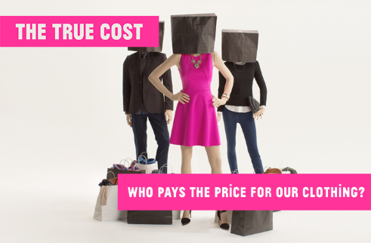
Watch the trailer (2.34 mins) for the documentary directed by Andrew Morgan entitled:
The True Cost
(Click on the hyperlink above)

Slide 7
Allow students a few minutes to respond to the film with people sitting near to them.
After sharing their initial responses, ask them to consider the following questions:

Slide 8
What is the film trying to do show about the fashion industry?
“Why is an industry which is generating so much profit unable to support its workers?”
This is a question raised in the trailer – what do you think some of the reasons might be?

Slide 9
Take it further…
If interested, the full documentary of The True Cost (92 mins) can be accessed by clicking here.

Slide 10
Slave to fashion 10 minutes+

Slide 11
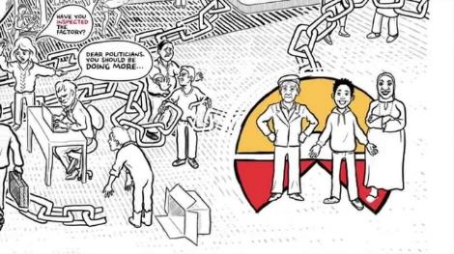
Watch this short animation (4.28mins) made by human rights organisation Walk Free entitled:
Slavery in Supply Chains
(Click on the hyperlink above)

Slide 12
Think about the different people involved in the chain – think back to the film clip – and make a list on the board (e.g. consumer, retailer, supplier, government)
*full list on the next slide
Now ask students to think about the following question and think about their own response, just in their heads for now:
Whose responsibility is it to make sure that slavery is not involved in the clothing chain?

Slide 13
Where does the responsibility for ensuring a slave-free chain lie?
The consumer?
The retailer?
The wholesaler?
The factory owner?
The labourer?
The government in the manufacturing country?
The government in the consumer country?
Follow the exercise on the next slide to see the responses in the class.

Slide 14
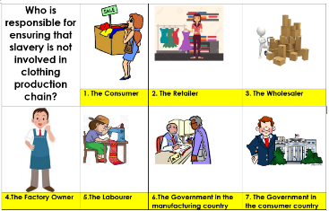
Working in pairs or small groups, ask students to look at each of the people in turn and discuss:
What is that person’s role in the chain of production?
What responsibility do they have in making decisions about employment and working conditions
What level of responsibility they should be taking in ensuring that slavery is not involved in the production chain.
Give each person a score out of 10 to show how responsible they should be - the more responsible they should be, the higher the score. Put these scores on the board and then work out the average for each role.
Make a rank-order of roles/people on the board to show who the class feel is the most to the least responsible for ensuring that slavery is not involved in the production chain. Discuss together.

Slide 15
One in six children in the world today is involved in child labour, doing work that is damaging to his or her mental, physical and emotional development.
Globally, between 210 and 240 million children are child labourers.
126 million of these children are engaged in hazardous work. Every year 22,000 children die in work-related accidents.
73 million working children are under 10.
Sub-Saharan Africa has the largest proportion of working children - nearly one third of children aged 14 and under.
5.7 million children are forced into debt bondage or other forms of slavery.
70 per cent work in agriculture, fishing or forestry, 8 per cent in factories, wholesale and retail trade, restaurants and hotels.

Slide 16
In what ways are we responsible for this? What can we do about it?

Slide 17
Take it further
If time allows, take a look at a range of organisations, articles and videos exploring the issue of slavery within the textile industry:
Fashion Revolution (website)
Slave to Fashion (article)
Garment workers in Bangladesh (video)
Behind the scenes at Nike (video)
Tragedy in Bangladesh (article)

Slide 18
This sort of learning can’t wait
Copyright © 2017ThoughtBox Education.

