Slide 1
30 minutes+
Homelessness
Week 2 – Homeless and Human
Y9&10
13-15 years

Slide 2
In this lesson, students will:
THINK!
Think about and discuss what it might mean to be homeless
Understand some of the causes of homelessness for people and communities across the world
Explore and unravel some the stereotypes that exist about homelessness and think about our own role in perpetuating these stereotypes
FEEL!
UNLEARN!

Slide 3
Pre-lesson reflection
3 minutes+

Slide 4
Introduce the following REFLECTIVE QUESTIONS for students to consider during the lesson:
What are some of the stereotypes linked to homelessness?
Where do you think these come from?
Why do people become homeless do you think?
Is homelessness ever a choice?

Slide 5
Re-think Homelessness
20 minutes+

Slide 6
Watch the short video (1.23 mins) made by Rethink Homelessness entitled:
Cardboard Stories
Click on the link above to open the film

Slide 7
Allow students a few minutes to respond to the film with people sitting near to them.
After sharing their initial responses, ask them to consider the following questions:

Slide 8
What is the film trying to do with regards to stereotypes connected to homelessness?
Is it successful do you think? Why?

Slide 9
Take a look at the following slides which shows some of the most common stereotypes associated with homeless people and for each one ask them to discuss:
Where might this stereotype have come from? Why might this idea be believed?
What can we do to change this stereotype?

Slide 10
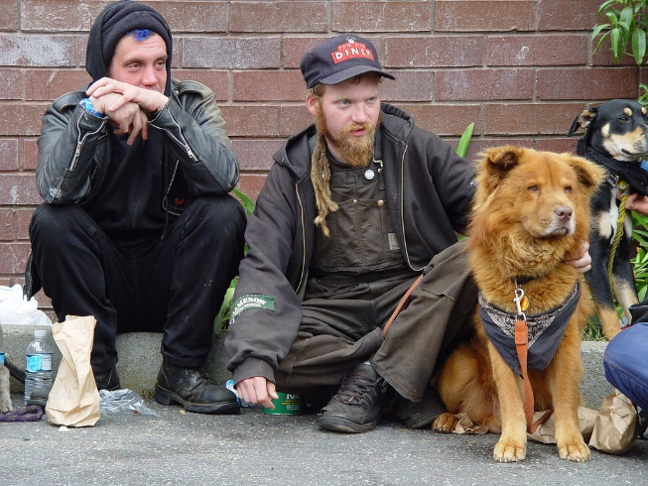
STEREOTYPE: “All homeless people are criminals”

Slide 11
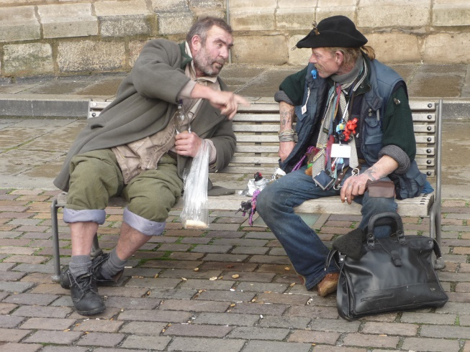
STEREOTYPE: “All homeless people are alcoholics or addicts”

Slide 12
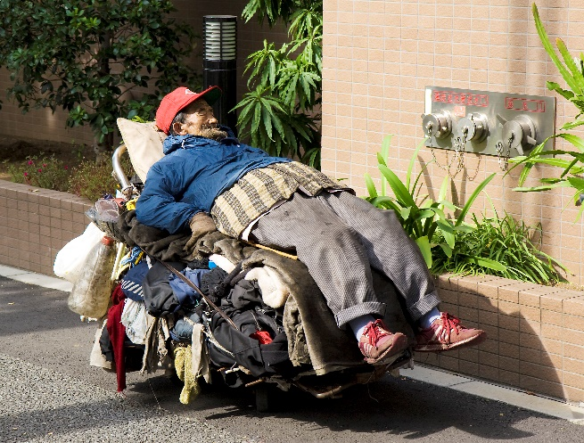
STEREOTYPE: “All homeless people are too lazy to get a job”

Slide 13
What does the word stigma mean?
Discuss your understanding of the word (use this definition to help if necessary)
What are some of the stigmas attached to being homeless?
Think about your response and share your ideas

Slide 14
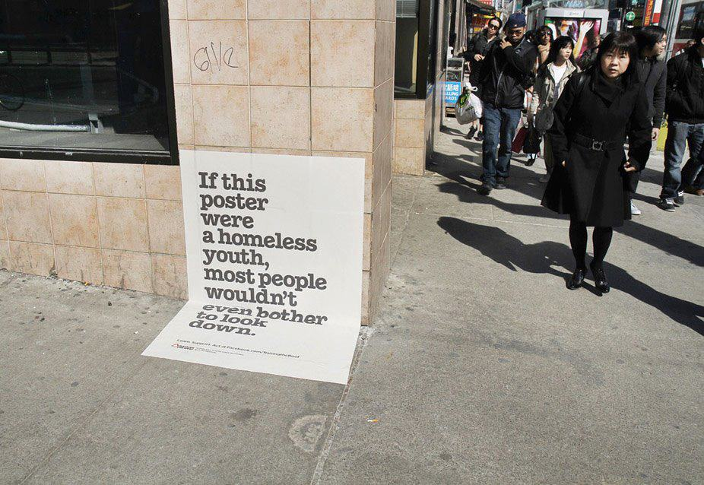
Look at this image (click here for a larger online version) and discuss your thoughts about the picture

Slide 15
Defining homelessness
10 minutes+

Slide 16
What are some of the reasons that someone might become homeless?
Talk with the person next to you and make a list of all the ideas that you can think of.
Feedback to the group and share on the board.

Slide 17
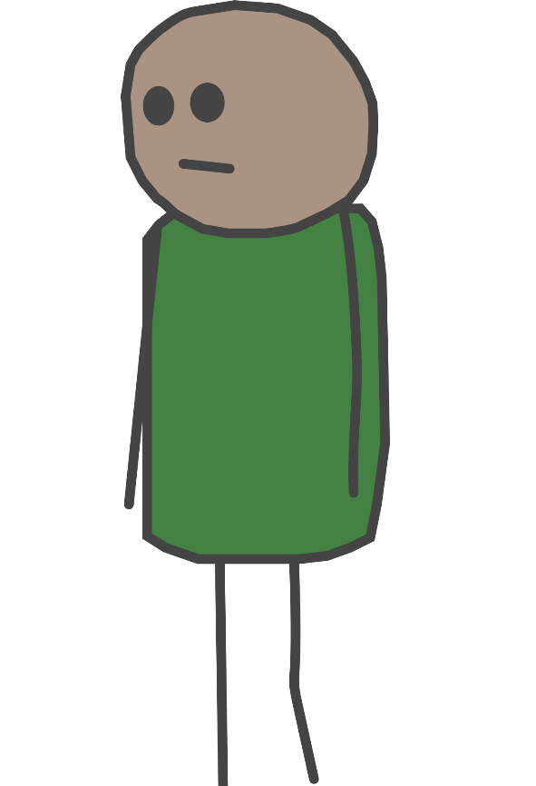
Losing a job
Increased rent
Being made redundant
Health problems
Breakdown of relationship
Overcrowding
Fear of being at home
Crime
Domestic abuse
Lack of affordable housing
Traumatic event
Mental health issues

Slide 18
Figures from research done in the UK in 2015 showed the most common reason for becoming homeless was the ending of a short-term tenancy with a private landlord.
Other reasons included no longer being able to stay with family or friends, relationship breakdowns, mortgage arrears leading to repossession, mental health issues etc.

Slide 19
A person is considered statutorily homeless" by the government in the UK if:
They no longer have a legal right to occupy their accommodation
If it would no longer be reasonable to live there.
or
What do you think this might mean? See if you can think of examples for both cases and discuss.

Slide 20
Nearly 100,000 children in England are living in temporary accommodation after being made homeless.
At the end of June 2015, 66,980 individuals or families were registered as having no home of their own - an increase of 12% from the same date last year. Almost a third of them had lost a home in the private rented sector.
Homelessness charities blamed housing benefit failing to keep pace with rent rises - but the government said there was a "strong welfare safety net".

Slide 21
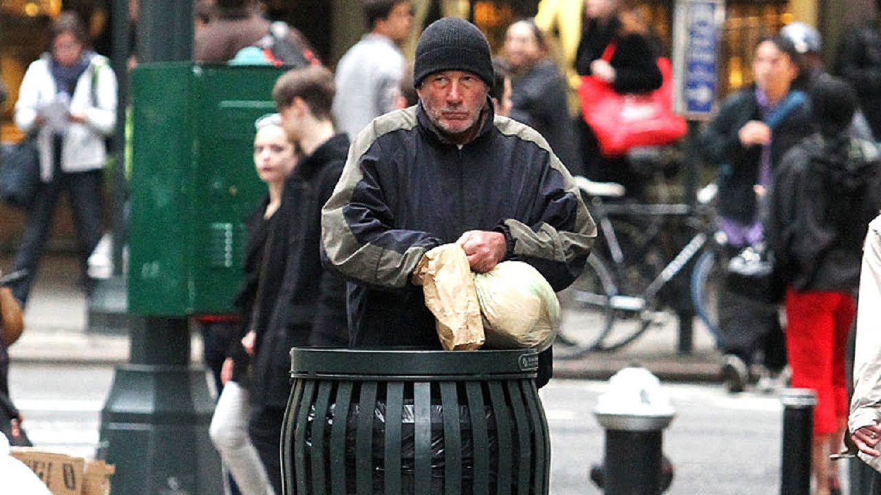
Watch the short trailer (2.09mins) for Richard Gere’s most recent film called TIME OUT OF MIND exploring one man’s descent into homelessness:
Time out of mind
Click on the link above to open the film
Find out more about the film here

Slide 22
Can you think of any other sorts of ‘homelessness’?
As well as the homeless images and causes that we are aware of, there are many other types of homelessness affecting hundreds of thousands of people caused by climate change, war, religious persecution, economic migration etc.

Slide 23
ThoughtBox: This sort of learning can’t wait

