Slide 1
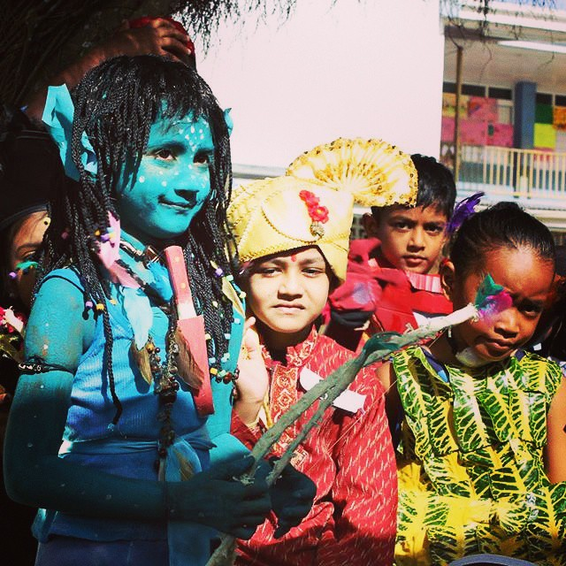
15 minutes+
Global Cultures
Week 3 – Changing the narratives
Y11-13 15-18 years

Slide 2
In this lesson, students will:
Think about cultural stereotypes that exist across the world and understand how to tackle single-story perceptions
Understand some of the negative impacts that cultural stereotypes have upon people and where or why they have emerged over time, as well as how they are perpetuated
Explore and unravel some of the ways that stereotypes are perpetuated and understand how to change perceptions and tackle falsehoods.

Slide 3
Pre-lesson reflection 3-5 minutes+

Slide 4
Introduce the following REFLECTIVE QUESTIONS for students to consider during the lesson:
What is a cultural stereotype and how is it spread?
How are cultural stereotypes used within campaigns to inadvertently promote single stories?
How can parody be used to change perceptions?

Slide 5
Reversing the stereotypes 15 minutes+

Slide 6
Watch the short (3.45mins) spoof video made by Norwegian organisation S.A.I.H entitled:
Radi-Aid
(click on the link above)

Slide 7
Allow students a few minutes to respond to the film with people sitting near to them.
After sharing their initial responses, ask them to consider the following questions:

Slide 8
How is the video using stereotypes of countries / continents?
How is the video trying to reverse stereotypes?
What point do you think the film is trying to make? Why?

Slide 9
Imagine if every person across Africa saw the “Africa for Norway” video and this was the only information they ever got about Norway: that they were all freezing from all of the snow.
What would they think or assume about Norway and Norweigans?
Part of the motivation behind making this video was to challenge the stereotype that all people across the continent of Africa are poor, starving and in need of saving.

Slide 10
In fundraising campaigns and across the wider media, these blanket stereotypes of suffering, deprivation and corruption are the only images we are shown.
The video Radi Aid was made by a group of students in South Africa to challenge stereotypes that pervade about the continent and people of Africa, negative stereotypes that are true for a very small number of people but that ignore the vast majority of the 1.216 billion people living there!
The video was made as a parody of the music charity single “We are the World” made in the USA in the 1980s.
Click here to watch a bit of the music video.

Slide 11
Discuss some of the stereotypes and negative perceptions in the ‘We Are the World’ song that were being parodied in the Radi-Aid video.
Why do you think they chose to use parody to make their point? Is it effective?

Slide 12
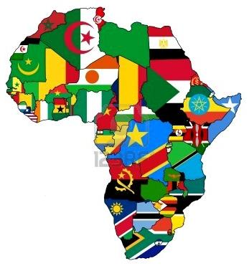
The stereotype of the entire continent of Africa as being poor, starving, needy and suffering is unfortunately a stereotype that is ingrained into many people’s minds, brought about primarily through the media and popular culture.
Although there may be some people living desperately on the continent, it is a continent containing 54 completely different countries and cultures and contains some of the richest, most successful people on the planet!

Slide 13
A few thoughts…
The negative stereotypes of an entire continent tend to miss the positive stereotypes that can also be explored:
Most ‘Africans’ are bilingual, trilingual or multi-lingual – this is almost a fact, rather than a stereotype and somewhat impressive!
Most Africans are very well educated – not necessarily through a formal school system but through a more holistic education, allowing them to have a wide range of skills, knowledge and experience.
Internet and mobile phone use is as widespread across Africa as it is across Europe or America, with Africans using their smartphones for banking, shopping and communications across the world

Slide 14
This sort of learning can’t wait
Copyright © 2017 ThoughtBox Education.

