Slide 1
15 minutes+
Gangs
Week 3 – Hip-Hop saved my life
Y11-13
15-18 years

Slide 2
In this lesson, students will:
Think about and explore some of the links between hip-hop and gang culture
Understand how gang culture can be a positive addition to a community
Explore and unravel some of the cultural perceptions of gang culture and hip-hop within different communities and cultures

Slide 3
Pre-lesson reflection 3-5 minutes+

Slide 4
Introduce the following REFLECTIVE QUESTIONS for students to consider during the lesson (maybe write them up or read them aloud and ask students to think about their own responses):
What are the links between hip-hop and gang culture?
Can gang culture be a force for good as well as for bad?
Does gang violence stem from something tangible and changeable?

Slide 5
The Rubble Kings 5 minutes+

Slide 6
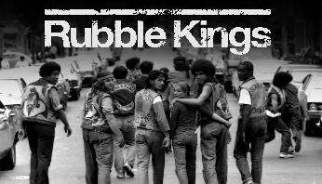
Watch the short trailer (2.15 mins) for a feature length film about New York Gangs directed by Shan Nicholson entitled:
Rubble Kings
click on the link above for the hyperlink

Slide 7
Allow students a few minutes to respond to the film with people sitting near to them.
After sharing their initial responses, ask them to think about the following questions:

Slide 8
What is the film trying to show about Hip-hop?
How do you think hip-hop might have changed or influenced gang behaviour?
Might gang violence often be a product of boredom? Why?

Slide 9
The many sides of Hip-Hop 10 minutes+

Slide 10
Ask students to discuss (either in pairs or small groups) how they would define hip-hop and come up with a short phrase or explanation
Feedback to the group and share ideas
What are some of the links between hip hop and gang culture?
Ask students to share ideas and discuss with the group, sharing what they know as well as ideas raised in the trailer for Rubble Kings.

Slide 11
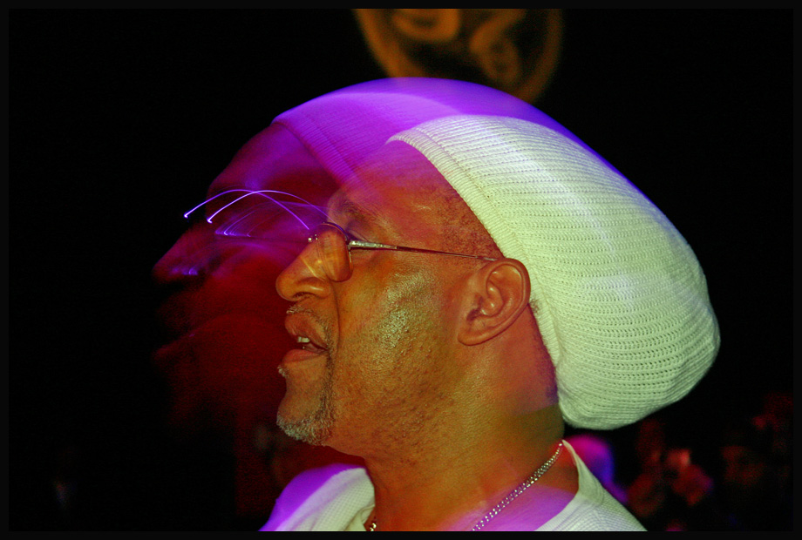
Hip-Hop started with a man named Clive…
Hip-Hop emerged in the 1970’s with the arrival in New York of a man named Mr Clive Campbell.
So who was Clive Campbell?

Slide 12
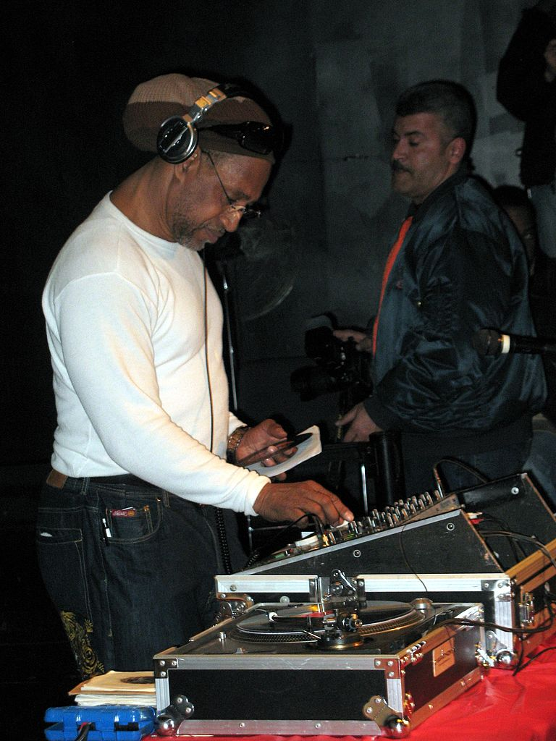
Meet Clive Campbell (aka DJ Kool Herc)
Kool Herc migrated to the United States from Kingston, Jamaica and settled in the West Bronx of New York.
He was a disc jockey and attempted to incorporate his Jamaica style of disc jockeying into the local scene, which involved reciting improvised rhymes over reggae records.

Slide 13
New York wasn’t really interested in his reggae, so Kool Herc had to find another sound to try to please his audiences…which he did.
He adapted a new style, and chanted over the top of instrumental sections of the popular music of the day.
He learned that by taking two identical records using an audio mixer, he could play the popular instrumental segment over and over and over…

Slide 14
After Kool Herc’s early work, rap music began to spread throughout the urban community of New York.
Many people began to use it as a form of expression as it offered unlimited boundaries. There were no set rules, except to be original and to rhyme to the beat of the music.
How do you think Hip-hop was so appealing and helped to alleviate gang tension and violence?
Think back to discussions on why people join gangs and share your thoughts with the class.

Slide 15
DJ
MC-ing (rapping) and DJ-ing were at the core of this emerging culture, but hip-hop was always much bigger than just the music…
MC

Slide 16
Hip-hop was b-boying, breaking or breakdancing, a gymnastic dance-style that calls for improvised, angular athleticism rather than choreographed fluidity.
Breakdance
Hip-hop was also graffiti, a new form of expression that employed spray paint as the medium and subway walls as the canvas.
The police called it vandalism; the people called it art.
Grafitti

Slide 17
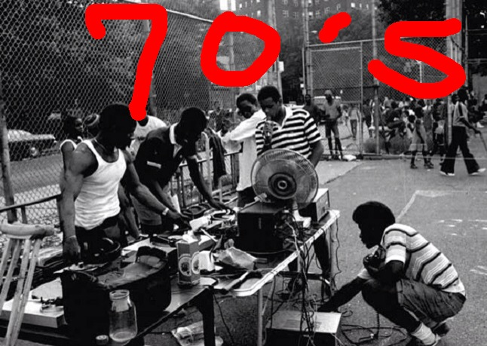
Right from the start, hip-hop was aggressive and oppositional in its four elements.
Hip-hop was a break from the musical traditions it followed and refused to follow the rules. Jazz had refused to be on time, Rock and Roll had refused to be quiet - hip-hop refused to be melodic.
Rappers didn’t have a band, they had a turntable; and the music was no longer focusing on the skillful arrangement of instruments but instead was about the skillful production of sounds, lyrics and language.

Slide 18
Watch a short 2 minute montage of the 4 pillars of hip-hop on the link below
https://youtu.be/1Qyfvc0UHtU

Slide 19
Much of the culture of hip-hop has been defined by frustration, in particular by people’s anger at being marginalised by society because of being:
poor
black
disenfranchised
abused
stereotyped
blamed
mistreated
ignored.
What are some of the political elements that make up the culture of hip-hop?

Slide 20
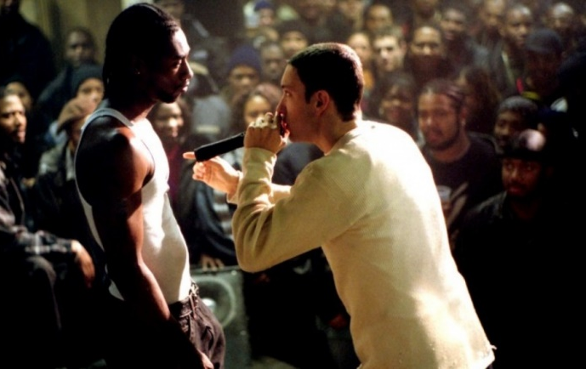
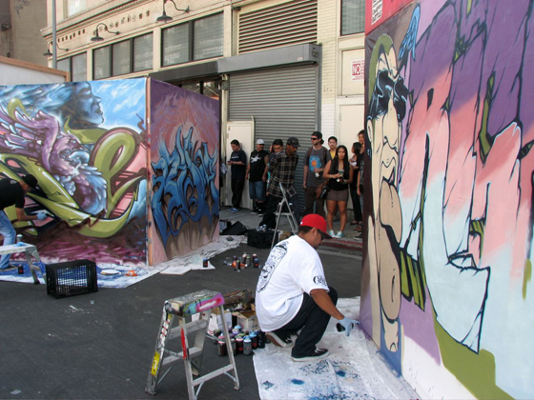
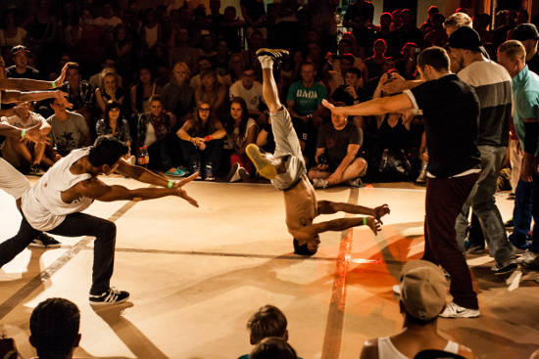
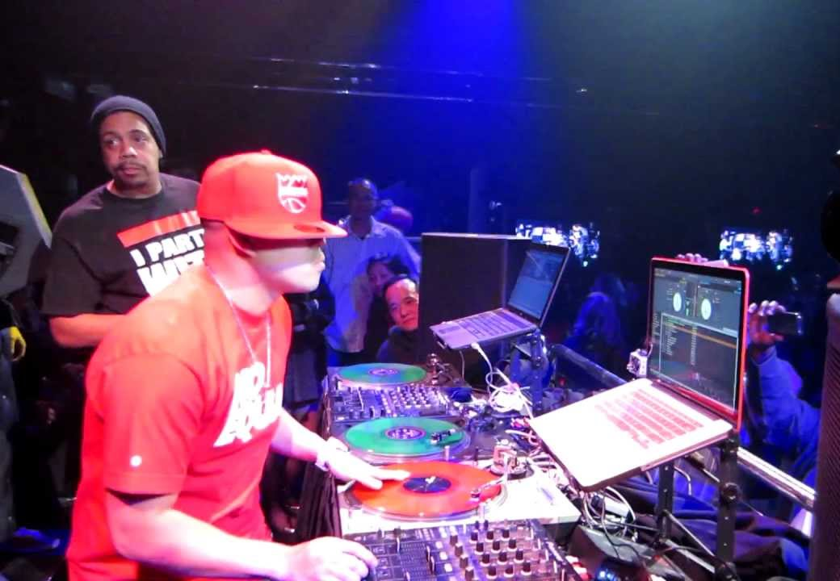
One of the predominant ways that Hip-Hop culture has moved into Gang culture is through the channelling of aggression using battles within each of the four pillars, allowing gangs or crews to rival each other’s artistic abilities:
Rap-battle
Graffiti-battle
Dance-battle
DJ-battle

Slide 21
“In many ways, hip-hop has been built on a rejection of middle-class values and a refusal to be incorporated into larger, more predominant societies.”
Discuss your responses to this statement and what you think it might mean.
Do you agree?

Slide 22
Think – feel – unlearn
www.thoughtboxeducation.com

