Slide 1
15 minutes+
Gangs
Week 3 – Hip-Hop saved my life
Y11-13
15-18 years

Slide 2
In this lesson, students will:
Think about and explore some of the links between hip-hop and gang culture
Understand how gang culture can be a positive addition to a community
Explore and unravel some of the cultural perceptions of gang culture and hip-hop within different communities and cultures

Slide 3
Pre-lesson reflection 3-5 minutes+

Slide 4
Introduce the following REFLECTIVE QUESTIONS for students to consider during the lesson (maybe write them up or read them aloud and ask students to think about their own responses):
What are the links between hip-hop and gang culture?
How can music bring people together?
What are other positive ways to make groups come together in positive rivalry?

Slide 5
The Rubble Kings 5 minutes+

Slide 6
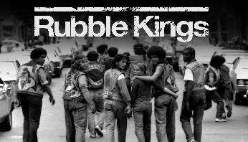
Watch the short trailer (2.15 mins) for a feature length film about New York Gangs directed by Shan Nicholson entitled:
Rubble Kings
click on the link above for the hyperlink

Slide 7
Allow students a few minutes to respond to the film with people sitting near to them.
After sharing their initial responses, ask them to think about the following questions:

Slide 8
What is the film trying to show about Hip-hop?
How do you think hip-hop might have changed or influenced gang behaviour?

Slide 9
The many sides of Hip-Hop 10 minutes+

Slide 10
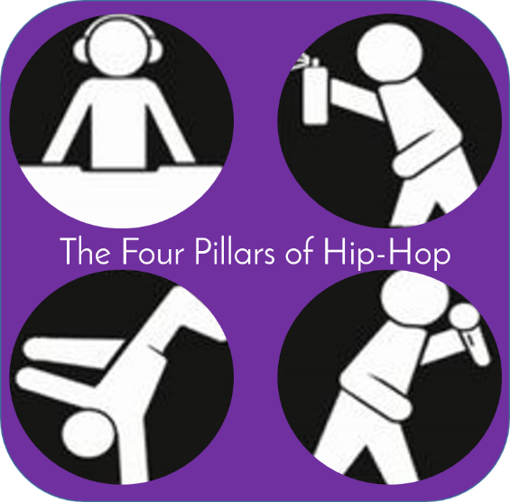
What is Hip-hop?

Slide 11
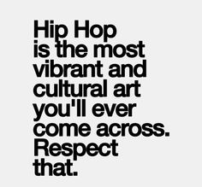
Hip-hop is name for the four elements of the late 70's New York City renaissance which includes break dancing, emceeing, (rapping) graffiti, and turntablism.
Hip-hop is a style of popular music of US black and Hispanic origin, featuring rap with an electronic backing.
Hip-hop is a subculture which includes rap, break dancing and graffiti art.

Slide 12
How did it start?

Slide 13
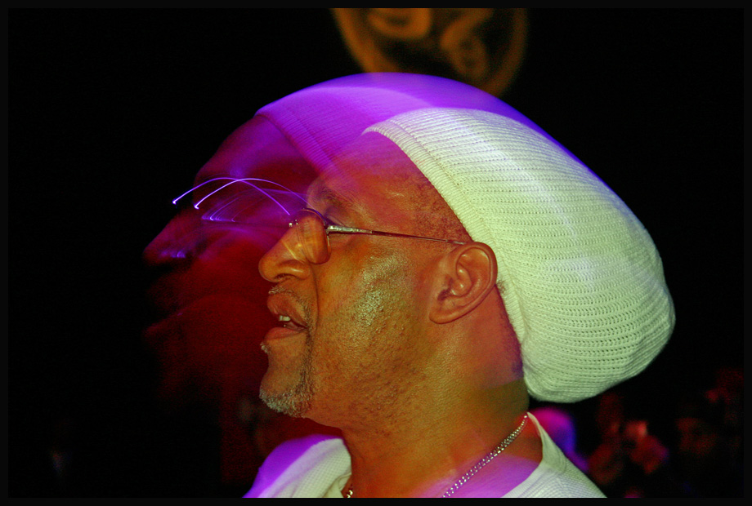
It started with a man named Clive…
Hip-Hop emerged in the 1970’s with the arrival in New York of a man named Mr Clive Campbell.
So who was Clive Campbell?

Slide 14
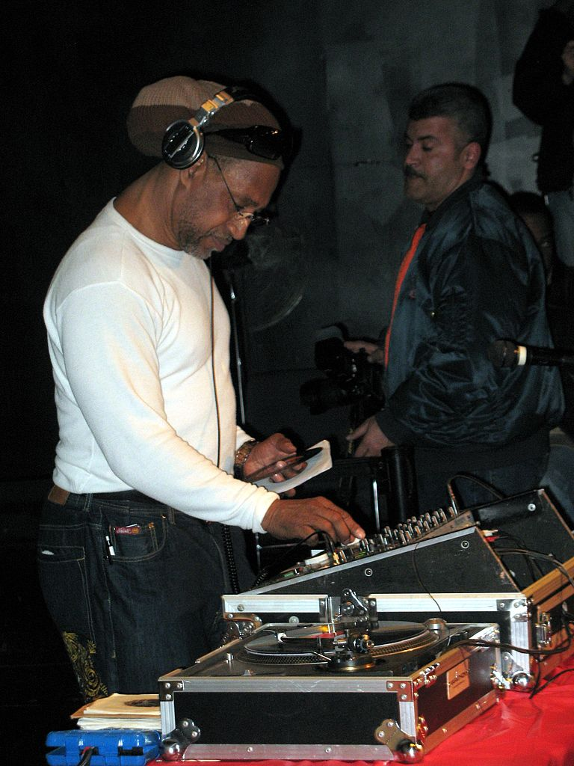
Meet Clive Campbell (aka DJ Kool Herc)
Kool Herc migrated to the United States from Kingston, Jamaica and settled in the West Bronx of New York.
He was a disc jockey and attempted to incorporate his Jamaica style of disc jockeying into the local scene, which involved reciting improvised rhymes over reggae records.

Slide 15
New York wasn’t really interested in his reggae, so Kool Herc had to find another sound to try to please his audiences…which he did.
He adapted a new style, and chanted over the top of instrumental sections of the popular music of the day.
He learned that by taking two identical records using an audio mixer, he could play the popular instrumental segment over and over and over…

Slide 16
Hip-Hop is a lot more than just music…but what else?

Slide 17
DJ
Break- dance
Grafitti
MC

Slide 18
DJ
MC-ing (rapping) and DJ-ing were at the core of this emerging culture, but hip-hop was always much bigger than just the music…
MC

Slide 19
Hip-hop was b-boying, breaking or breakdancing, a gymnastic dance-style that calls for improvised, angular athleticism rather than choreographed fluidity.
Breakdance
Hip-hop was also graffiti, a new form of expression that employed spray paint as the medium and subway walls as the canvas.
The police called it vandalism; the people called it art.
Grafitti

Slide 20
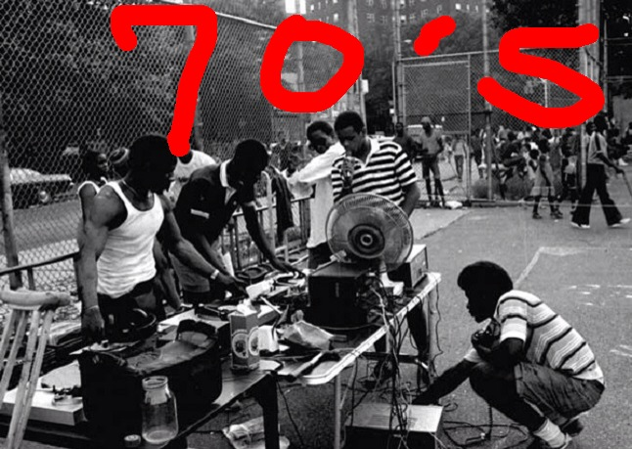
Right from the start, hip-hop was aggressive and oppositional in its four elements.
Hip-hop was a break from the musical traditions it followed and refused to follow the rules. Jazz had refused to be on time, Rock and Roll had refused to be quiet - hip-hop refused to be melodic.
Rappers didn’t have a band, they had a turntable; and the music was no longer focusing on the skillful arrangement of instruments but instead was about the skillful production of sounds.

Slide 21
Watch a short 2 minute montage of the 4 pillars of hip-hop (click on the link below)
https://youtu.be/1Qyfvc0UHtU

Slide 22
Much of the culture of hip-hop has been defined by frustration, in particular by people’s anger at being marginalised by society because of being:
poor
black
disenfranchised
abused
stereotyped
blamed
mistreated
ignored.

Slide 23
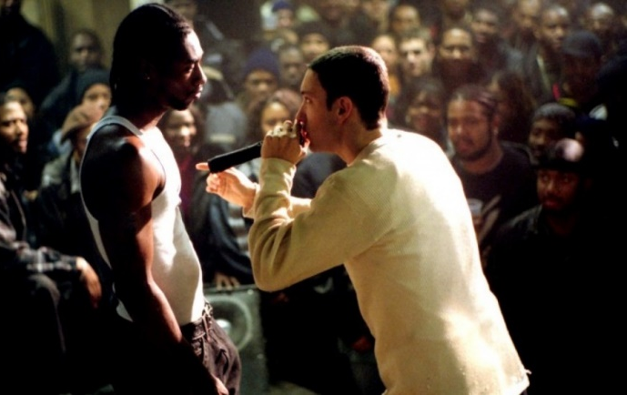
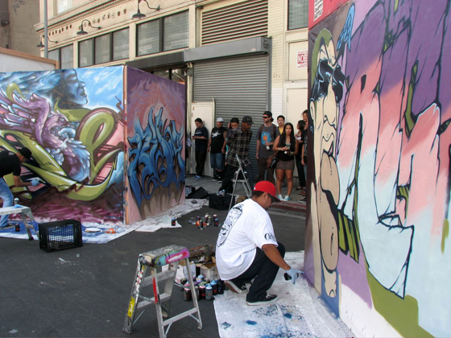
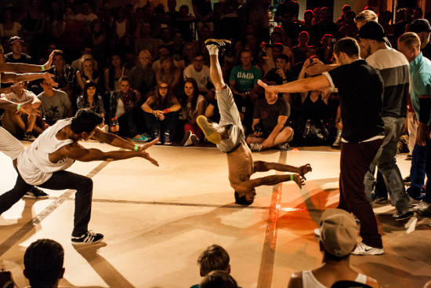
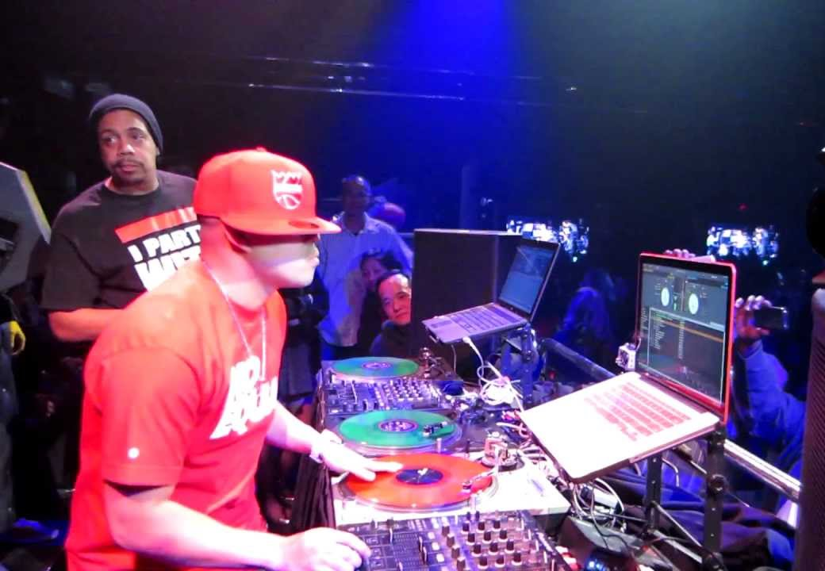
Think about a time when you have been frustrated or annoyed, and try to remember how you felt - think about the feelings in your body as well as in your mind and your heart. Having somewhere to go with this feeling is part of how the four pillars of hip-hop have emerged, firstly allowing frustrations to be voiced, and secondly to allow tensions between gangs, crews and groups to be played out through “battles” rather than battles.
Rap-battle
Graffiti-battle
Dance-battle
DJ-battle

Slide 24
To finish, think again about the following question and discuss your thoughts:
How do you think Hip-hop is helping to alleviate gang tension and violence?

Slide 25
Think – feel – unlearn
www.thoughtboxeducation.com

