Slide 1
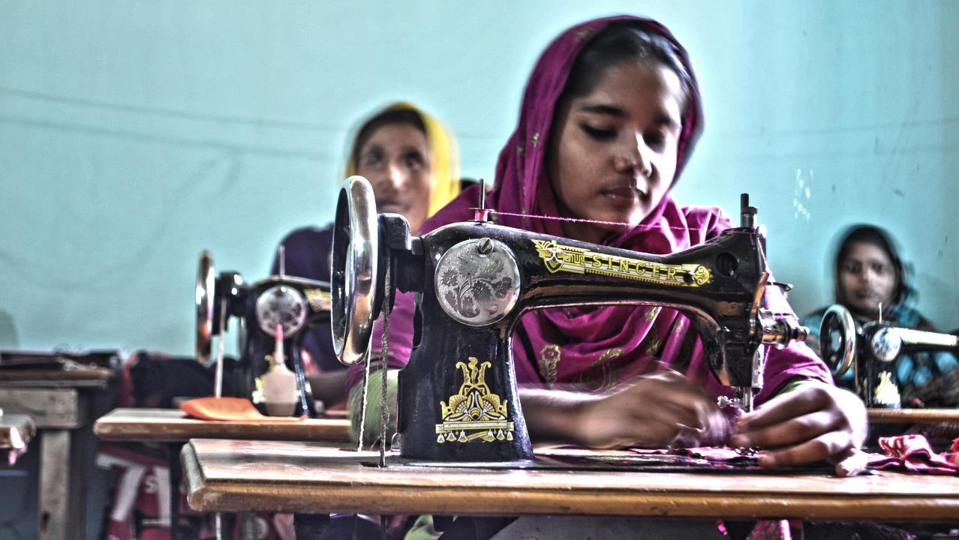
1 hour+
Clothes
Week 3 – Unravelling Ethics
Y9&10 13-15 years

Slide 2
In this lesson, students will:
Think about the concept of ethics and fair trade within the textile industry
Understand some of the processes and ripple effects of the textile industry by exploring individual stories and situations
Explore and unravel some of the sticking points in an ethical clothing industry and examine our own role as consumers within this process

Slide 3
Pre-lesson reflection 3-5 minutes+

Slide 4
Introduce the following REFLECTIVE QUESTIONS for students to consider during the lesson:
Are you an ethical clothes shopper? Would you know how to be one?
What happens to your clothes when you throw them ‘away’?
What is fast-fashion and are you worried about its threat to people and the planet?

Slide 5
Unravelling the narrative 20 minutes+

Slide 6
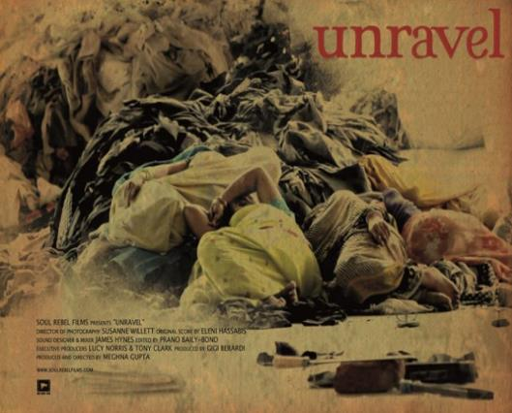
Watch the short documentary (13.30 mins) made by Soul Rebel Films entitled:
Unravel
(Click on the link or visit https://vimeo.com/193725563)
Explore more about the ideas within the film by visiting the website: www.unravelfilm.com

Slide 7
Allow students a few minutes to respond to the film with people sitting near to them.
After sharing their initial responses, ask them to consider the following questions:

Slide 8
What is the film trying to show about how different people think about and value clothes?
Which ideas surprised you the most? Why?

Slide 9
During the film, some of the women explain their thoughts and understanding of why western consumers waste so many of their clothes. Some of the ideas included:
How does it make you feel, listening to these assumptions?
Why do you think these stereotypes or ideas exist?
How easy it is for an idea or assumption about another culture to become “a truth”. What might the impact of that be?
“People obviously don’t like washing their clothes”
“There must be a water shortage in their country”
“Water is expensive, therefore people cannot afford to wash their clothes”

Slide 10
These ideas or assumptions about westerners and how they live come from the same place as ideas or assumptions about other cultures and how/why they live.
By having the stereotype reversed, think about how easy it is to believe something about another country or culture that isn’t true.
Discuss some of the assumptions or comments made in the film that you know are not true and how it makes you feel to hear them.
Now think about some of the assumptions or stereotypes that you might think about other cultures and try to do the same. Think about how easy it is for an idea or assumption about another culture to become “a truth” and the impact this may have on your own level of ignorance and understanding.

Slide 11
What are the real reasons as to why we throw away so many clothes?

Slide 12
An ethical dilemma 20 minutes+

Slide 13
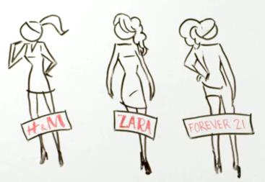
Now take a look at this short video (1.47mins) from Online MBA explaining the meaning and issues behind the concept of FAST FASHION:
The Business of Fast Fashion
(Click on the hyperlink above)

Slide 14
Allow students a few minutes to respond to the film with people sitting near to them.
After sharing their initial responses, ask them to consider the following questions:

Slide 15
What are some of the issues that Fast Fashion is causing?
What are the human issues? What are the environmental issues?

Slide 16
Read the following short article entitled Love your Clothes and learn about some of the impacts of “fast-fashion”.
If time afterwards, visit the website for Love Your Clothes, a campaign running to support ethical shopping and clothes production.

Slide 17
Why are clothes so important when it comes to building a sustainable culture? by Andrea Speranza, Head of Education at Traid.
The importance of clothes transcends cultures, time and geographies. No matter whether we are talking about the present or Victorian times: what we wear on our bodies has meaning. Our clothes indicate who we are as individuals as well as a society. Indeed, some anthropologists refer to clothes as “the social skin.”
In the alarming face of climate change, the biggest threat civilisation has ever faced, it is worth asking ourselves: what meaning do we want to give, or should we give, to clothes, if we are aiming for a sustainable society?
In the current unsustainable model of society, clothes could be described as the elephant in the room. The textiles industry is a huge polluter and massive producer of global carbon emissions. Deforestation, excessive consumption of resources and waste of all types are necessary for our clothes as we want them today: cheap and fast

Slide 18
Around 90% of the clothes we buy in Britain are made abroad. Demand for clothes in the UK drives the production of almost three times more emissions outside of the UK than it drives domestically.
As a nation we love clothes. We spend £44billion a year on them. However, it seems we enjoy buying them more than wearing them. Statistics show some 30% of the clothes that are bought are never worn in one year. And an estimated £140million worth of used clothing goes to landfill.
To return to the initial question: what meaning do we want to give to our clothes?
For a socio-environmental charity such as TRAID, clothes represent a way of protecting our planet. We work to encourage as many people as possible to share this interpretation of clothes with us. Extending the life of clothes by just three more months can lead to a 5% to 10% reduction in carbon, water and waste footprints.

Slide 19
When we buy second hand clothes and donate our unwanted clothes we are extending their life for a few more years. And there is even better news. Seeing our clothes as a way of protecting the environment is not only green, it is inspiring too.
Clothes are a means of expressing our individuality (whether we are formal or serious, whether we are cheeky or a bit “too much”). When lots of people express their individualities, diversity arises; a diversity we all know keeps life alive for us.
Fashion as it is currently promoted is the opposite of diversity. By definition it is something we are all supposed to follow. Someone, somewhere is telling us, with each approaching summer or each new winter, exactly how we should look. But when we visit a second hand shop or go to a clothes swapping event, there is always just one garment waiting for us. Our own intrinsic creative sense informs us how we want to look.
Our current social paradigm promotes the value novophilia (love of something only because it is new) to an unimaginable extreme. Within such a society, how can we encourage the millions who buy new to try second hand?

Slide 20
We cannot change behaviour without first changing values and perception.
WRAP’s new “Love your clothes” campaign is doing a fantastic job of sharing information about the economic value of our unwanted clothes.
However, it is also time to start talking about other values – those we should be putting first; not those that rule the market but values that help us discern what is truly important for us all, and for our planet’s future.
“By doing something as simple as reusing our clothes, we are avoiding the use of raw materials, the destruction of ecosystems, reducing energy consumption and waste.
So, one simple way in which everyone can opt to make sustainability important is by choosing #SecondHandFirst.”
Article taken from http://lcrn.org.uk/clothes-important-comes-building-sustainable-culture/

Slide 21
If time allows, read one of the following articles exploring some of the impacts of textile waste across the world.
Where does our discarded clothing go?
Re-think the throw-out
Where do your old clothes go?
Valuing our clothing
.

Slide 22
What does ETHICS mean?
Ask students to think about what they understand by the term. Feedback to the class and try to agree on a simple definition.
(if necessary, use the definition on the following slide)

Slide 23
Ethics is…
…Rules of behaviour based on ideas about what is morally good and bad
…An area of study that deals with ideas about what is good and bad behaviour

Slide 24
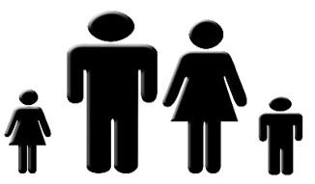
An ethical business is doing good things for people or for the planet, or (ideally) for both.
HUMANITARIAN ETHICS | ENVIRONMENTAL ETHICS

Slide 25
Focusing on the clothing industry (and thinking about all that has been learned and discussed in previous lessons), students are going to consider the ethical implications of the fashion industry.
Split the class into small groups and give each group either HUMANITARIAN or ENVIRONMENTAL as their focus
Ask them to make a list of what some of the concerns and implications might be in the fashion industry within their core area.
For example:
Humanitarian: Is the workplace safe? Are children being employed?
Environmental: Are chemicals being used? What is happening to waste water?

Slide 26
After a few minutes of brainstorming, pose the following question to the class:
Allow students a few minutes in their groups to discuss and consider their responses and then feedback to the class.
Is it possible to be an ethical business and still focus on profit?

Slide 27
Responsible Fashion 15 minutes+

Slide 28
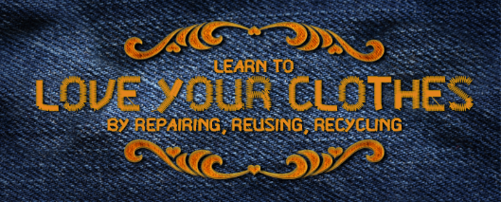
Watch the short video (53 seconds) made by Recycle Devon entitled:
Love your Clothes
(Click on the hyperlink above)

Slide 29
Allow students a few minutes to respond to the film with people sitting near to them.
After sharing their initial responses, ask them to consider the following questions:

Slide 30
Do you ever dump your clothes?
Do you have a responsibility to be ethical in the way you throw away your old or unwanted clothes? Why? Why not?

Slide 31
Either working in pairs or on their own, ask students to design a simple poster or infographic (click here for a selection of infographics on this topic to give ideas) to give advice to people on how to shop ethically and/ or how to get rid of their clothing ethically.
The title is:
5 Top Tips for Ethical Clothes Shopping
Think about all of the ideas covered so far in the curriculum, as well as their own thoughts and knowledge.
Some questions to consider if students are unsure on what to focus on:

Slide 32
Who made my clothes?
Where were my clothes made?
What are my clothes made out of?
Is there a fair trade involved?
What are working conditions like?
What is the waste involved in the production line?
Is the garment only going to last a short time?
Is it really “rubbish” or is it simply not to my taste anymore?

Slide 33
Take it further
If time allows, take a look at these articles and organisations focusing on ethical fashion:
How ethical is H&M? (article)
How ethical is M&S? (article)
Oxfam – ethical trading (website)
Redress (organisation)
People Tree (Organisation)
Ethical Trade Initiative (website)
Fair Trade Cotton (website)

Slide 34
This sort of learning can’t wait
Copyright © 2017ThoughtBox Education.

