Slide 1
1 hour+
Gangs
Week 3 – Hip-Hop saved my life
Y11-13
15-18 years

Slide 2
In this lesson, students will:
Think about and explore some of the links between hip-hop and gang culture
Understand how gang culture can be a positive addition to a community
Explore and unravel some of the cultural perceptions of gang culture and hip-hop within different communities and cultures

Slide 3
Pre-lesson reflection 3-5 minutes+

Slide 4
Introduce the following REFLECTIVE QUESTIONS for students to consider during the lesson (maybe write them up or read them aloud and ask students to think about their own responses):
What are the links between hip-hop and gang culture?
Can gang culture be a force for good as well as for bad?
Does gang violence stem from something tangible and changeable?

Slide 5
The Rubble Kings 10 minutes+

Slide 6
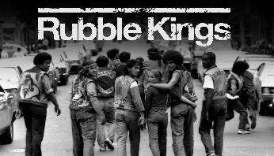
Watch the short trailer (2.15 mins) for a feature length film about New York Gangs directed by Shan Nicholson entitled:
Rubble Kings
click on the link above for the hyperlink

Slide 7
Allow students a few minutes to respond to the film with people sitting near to them.
After sharing their initial responses, ask them to think about the following questions:

Slide 8
What is the film trying to show about Hip-hop?
How do you think hip-hop might have changed or influenced gang behaviour?
Might gang violence often be a product of boredom? Why?

Slide 9
The many sides of Hip-Hop 30 minutes+

Slide 10
Ask students to discuss (either in pairs or small groups) how they would define hip-hop and come up with a short phrase or explanation
Feedback to the group and share ideas
What are some of the links between hip hop and gang culture?
Ask students to share ideas and discuss with the group, sharing what they know as well as ideas raised in the trailer for Rubble Kings.

Slide 11
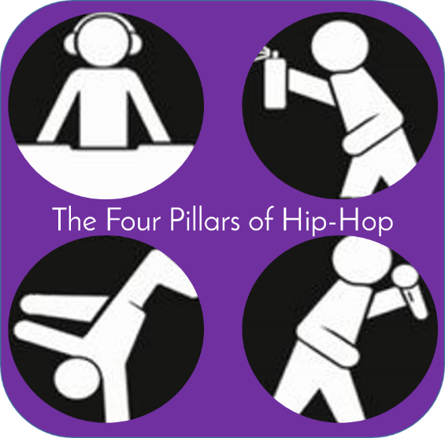
What is Hip-hop?

Slide 12
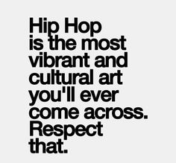
Hip-hop is name for the four elements of the late 70's New York City renaissance which includes break dancing, emceeing, (rapping) graffiti, and turntablism.
Hip-hop is a style of popular music of US black and Hispanic origin, featuring rap with an electronic backing.
Hip-hop is a subculture which includes rap, break dancing and graffiti art.

Slide 13
How did it start?

Slide 14
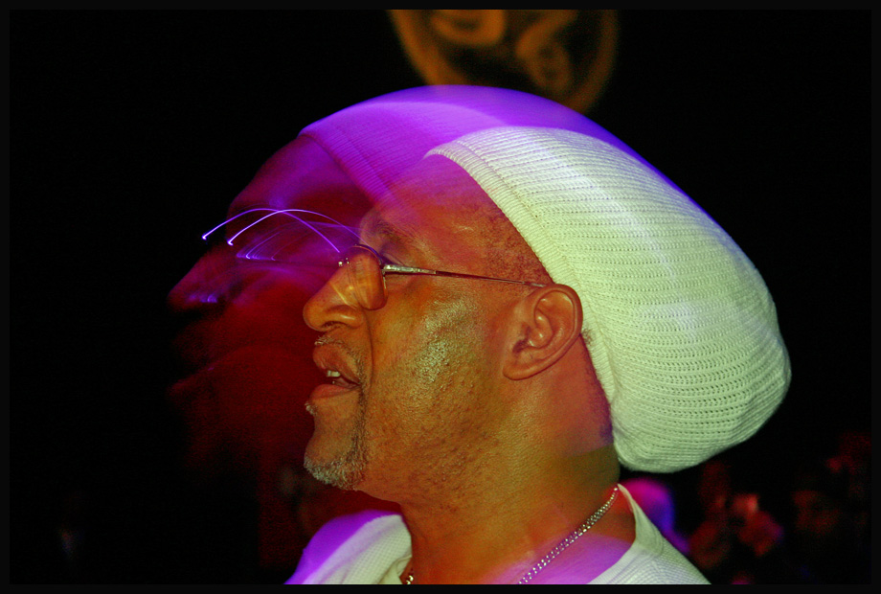
It started with a man named Clive…
Hip-Hop emerged in the 1970’s with the arrival in New York of a man named Mr Clive Campbell.
So who was Clive Campbell?

Slide 15
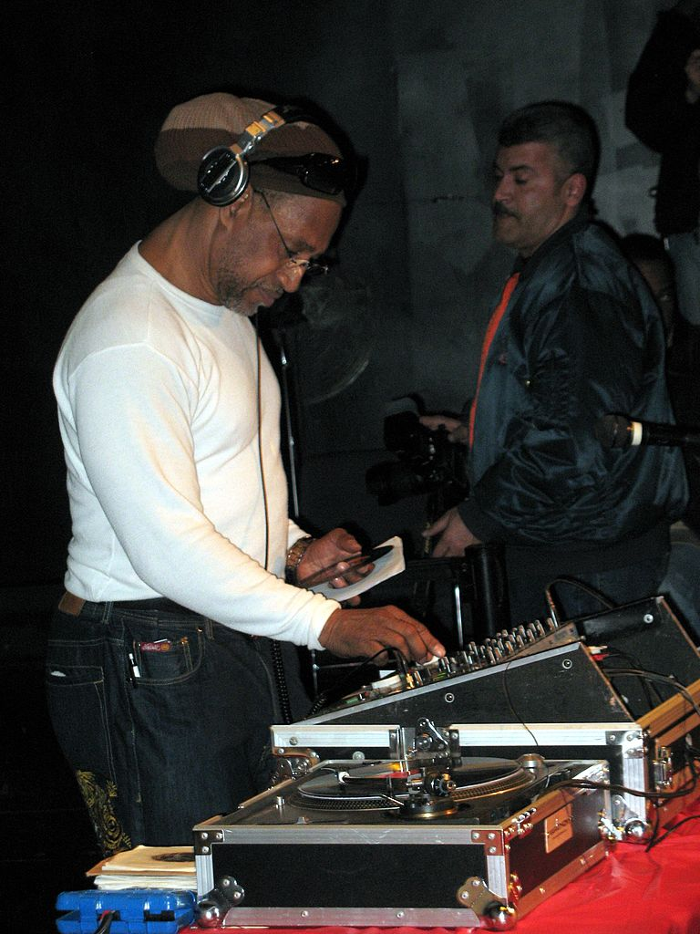
Meet Clive Campbell (aka DJ Kool Herc)
Kool Herc migrated to the United States from Kingston, Jamaica and settled in the West Bronx of New York.
He was a disc jockey and attempted to incorporate his Jamaica style of disc jockeying into the local scene, which involved reciting improvised rhymes over reggae records.

Slide 16
New York wasn’t really interested in his reggae, so Kool Herc had to find another sound to try to please his audiences…which he did.
He adapted a new style, and chanted over the top of instrumental sections of the popular music of the day.
He learned that by taking two identical records using an audio mixer, he could play the popular instrumental segment over and over and over…

Slide 17
Watch a 4 minute introduction to DJ Kool Herc’s music via the link below:
www.youtube.com/watch?v=7qwml-F7zKQ

Slide 18
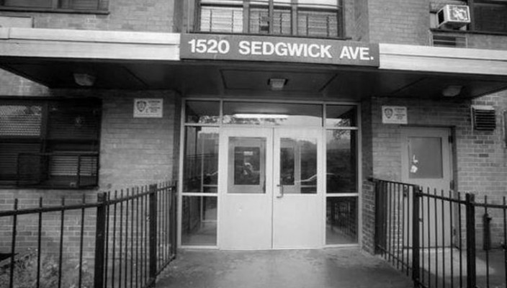
This is the address of Herc’s family and also the location of the recreation room where he would throw many of his first parties as the DJ.

Slide 19
“The sun hadn't gone down yet, and kids were just hanging out, waiting for something to happen. Van pulls up, a bunch of guys come out with a table, crates of records. They unscrew the base of the light pole, take their equipment, attach it to that, get the electricity – Boom! We got a concert right here in the schoolyard and it's this guy Kool Herc. And he's just standing with the turntable, and the guys were studying his hands. There are people dancing, but there's as many people standing, just watching what he's doing. That was my first introduction to in-the-street, hip hop Dj-ing.”
Nelson George -Author/ Music Critic

Slide 20
After Kool Herc’s early work, rap music began to spread throughout the urban community of New York.
Many people began to use it as a form of expression as it offered unlimited boundaries. There were no set rules, except to be original and to rhyme to the beat of the music.
How do you think Hip-hop was so appealing and helped to alleviate gang tension and violence?
Think back to discussions on why people join gangs and share your thoughts with the class.

Slide 21
What are the Four Pillars of Hip-Hop?

Slide 22
DJ
Break- dance
Grafitti
MC

Slide 23
DJ
MC-ing (rapping) and DJ-ing were at the core of this emerging culture, but hip-hop was always much bigger than just the music…
MC

Slide 24
Hip-hop was b-boying, breaking or breakdancing, a gymnastic dance-style that calls for improvised, angular athleticism rather than choreographed fluidity.
Breakdance
Hip-hop was also graffiti, a new form of expression that employed spray paint as the medium and subway walls as the canvas.
The police called it vandalism; the people called it art.
Grafitti

Slide 25
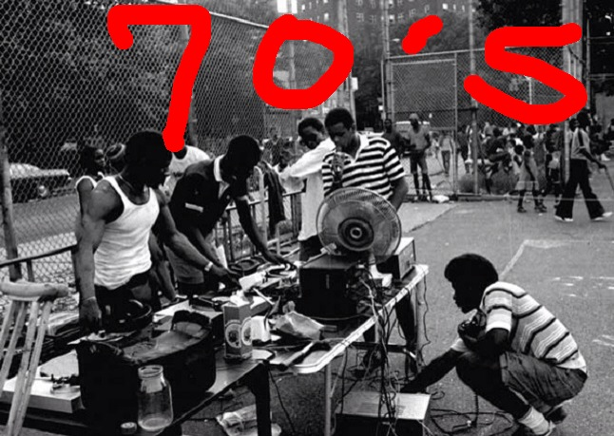
Right from the start, hip-hop was aggressive and oppositional in its four elements.
Hip-hop was a break from the musical traditions it followed and refused to follow the rules. Jazz had refused to be on time, Rock and Roll had refused to be quiet - hip-hop refused to be melodic.
Rappers didn’t have a band, they had a turntable; and the music was no longer focusing on the skillful arrangement of instruments but instead was about the skillful production of sounds.

Slide 26
Watch a short 2 minute montage of the 4 pillars on the link below
https://youtu.be/1Qyfvc0UHtU

Slide 27
Hip-hop culture
The political and the poetic

Slide 28
From its beginnings, Hip-hop has been more than just music and has created a clear culture of music, art, dance, rap, fashion…and politics.
Beyond entertainment and pleasure, the culture has served as a mode of artistic expression for many people, particularly in urban communities and frustration has been a major defining characteristic.
In what ways is hip-hop a form of artistic expression?
In what ways is hip-hop a form of political expression?

Slide 29
Much of the culture of hip-hop has been defined by frustration, in particular by people’s anger at being marginalised by society because of being:
poor
black
disenfranchised
abused
stereotyped
blamed
mistreated
ignored.
What are some of the political elements that make up the culture of hip-hop?

Slide 30
“In many ways, hip-hop has been built on a rejection of middle-class values and a refusal to be incorporated into larger, more predominant societies.”
Discuss your responses to this statement and what you think it might mean.
Do you agree?

Slide 31
Looking beyond the bad 20 minutes+

Slide 32
“Gangs are good for society”
Split the class in half and allocate one side “For” and one side “Against” this statement.
Now spilt each half into smaller groups and ask students to come up with 5 arguments (as well as thinking about the counter-arguments) for their response
Run either as a general class discussion or a formal debate (click here for instructions on how to set up a debate)
NB: See the next slide for further content for the discussion

Slide 33
To help, it may be useful to read this article about some of the positives of gang culture:
Gangs are good for society

Slide 34
Gangs are good for society
Gangs are an essential part of growing up and becoming a law abiding citizen, but you wouldn't know it from the media
Caspar Walsh
"Gangs" get a bad press. The overused noun is now synonymous with the evils of youth culture and its incumbent violence, drugs, guns and sexual misconduct. There is a lot of rooftop shouting and table banging about the breakdown of teenage society: poor education, dysfunctional families, no respect for the older generations. "Wasn't like that when I was young." This dim view is, at best, misguided. At worst, clouded in denial and cushioned in the fiction of the non-existent "good old days". Societies throughout history have each had their share of unlawful, out-of-control youth.

Slide 35
We hear a lot about an epidemic rise in youth crime. The truth is, youth crime has always been a part of society. It is how society deals with it that dictates its trajectory. Much of the reported rise in youth crime is in direct relation to the huge population increase in recent decades and, crucially, in the way the media choose to report youth crime.
I put the blame for the de-meaning of the word gang squarely on the money hungry, narrative-driven media to ramp up our fear of the fiction of "gangs dominating every street corner". The issue is adrenalised in drama, documentaries and rolling news by repeatedly declaring "gang culture" as the cause of teenage societal meltdown. Gang culture is the widely accepted term used directly in connection with youth violence.

Slide 36
I've been working with young people both in and out of prison for more than 20 years, and what's clear is that gangs in and of themselves are not the problem. I was part of a gang in school and it was all about belonging to a group – it had nothing to do with fighting other gangs. It's when gangs start using violence to control turf and territory and make money that we need to take action. Young people join gangs because it is a crucial part of growing up. Gangs do not always revert to violence. If there are positive, older role models involved with these gangs, they can hold the boundaries essential to stopping them spiralling out of control and turning violent and crime driven. This is key.
Young people are looking for boundaries, and these are explored in gangs and in their social interactions with each other and people outside the gang circle. They will push the boundaries until they reach a wall they are either unable or unwilling to break down.

Slide 37
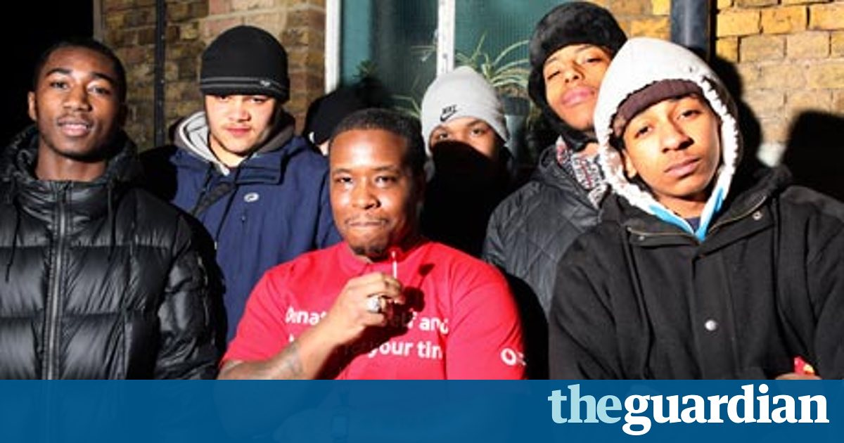
This is an essential part of the process of growing up and becoming an active, law abiding member of society. The proliferation of violence in so many gangs in the UK is largely down to the absence of positive older role models holding the boundary line of acceptable behaviour. Without them, gang culture becomes toxic, loses its moral compass and often resorts to violence in dealing with power struggles and internal conflicts.
But there are many organisations working positively with young people in gangs and helping them through very difficult times in their lives, helping them through the often tough transition of evolving into productive, responsible members of society.

Slide 38
For me, gang is simply another word for tribe. In essence, gangs are good for society. In a healthy state, they are about the formation of groups that operate under ethical and moral codes of conduct upheld and enforced by the elders of the community. If these codes are based in a fundamental respect for society and the individual, there's absolutely nothing wrong with gangs. If the elders in the gangs have been supported and steered into responsible adulthood and are able in turn to guide and contain the fiery energy of future, younger gang members, society will be a far richer, more connected and ultimately less fearful place.
Caspar Walsh is an author and journalist and founder of the charity Write to Freedom

Slide 39
Think – feel – unlearn
www.thoughtboxeducation.com

