Slide 1
15 minutes+
Clothes
Week 4 – A Fashion Revolution
Y11-13 15-18 years

Slide 2
In this lesson, students will:
Think about and explore some of the environmental costs of fast fashion and the role we can play in reducing these costs
Understand and explore the impact of how changing our shopping choices can directly impact the lives of other people
Explore and unravel some of the stigmas that surround second hand clothing and charity shops and think about how we can learn to change our behaviour to have more of a positive impact upon people and planet

Slide 3
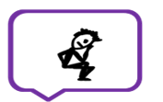
Pre-lesson reflection 3-5 minutes+

Slide 4
Introduce the following REFLECTIVE QUESTIONS for students to consider during the lesson:
Do you think you have a responsibility to try to stop ‘fast fashion’? Why?
What can you do to change the way you think about clothes?
What are some of the stigmas surrounding second hand clothing, and where have they come from?

Slide 5
Let’s slow it down 5 minutes+

Slide 6
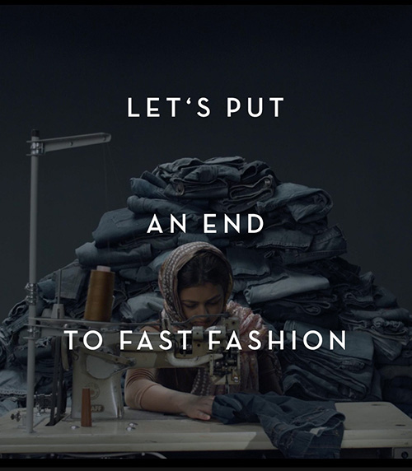
Watch the short video (54 sec) made by ‘fair-fashion’ organisation Armed Angels entitled:
Fashion Revolution
(click on the hyperlink above)

Slide 7
Allow students a few minutes to respond to the film with people sitting near to them.
After sharing their initial responses, ask them to consider the following questions:

Slide 8
What is the message coming out of this short film?
Is it effective? Why?
Why do you think they have equated ‘fast fashion’ with some of our social history’s most shameful mistakes?

Slide 9
Who decides what we should wear and why do we listen? 10 minutes+

Slide 10
Ask students to think about and discuss (either as a class or in small groups) some of the following questions. Either give each group a question to discuss and feedback, or have a series of discussions together as a class:
Why do some people choose to ‘follow fashion’ whilst others make their own?
What is fashion? What does the word or term mean?
Who tells us what to wear or what ‘looks good’ and why do we listen?
Do you feel you are in control of the decisions you make about what you wear?

Slide 11
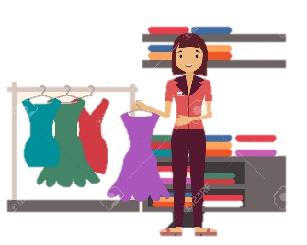
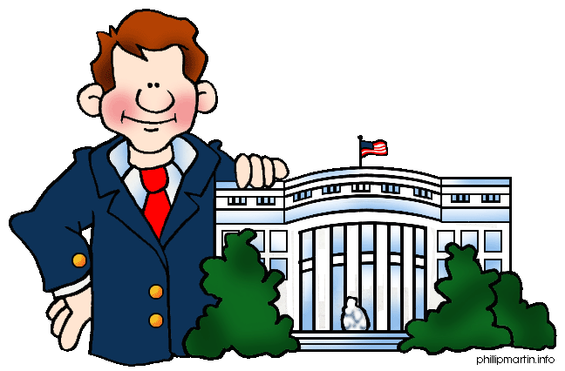
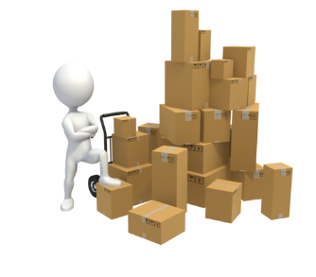
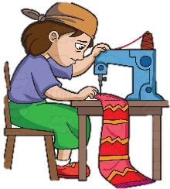
What is the “fashion revolution?”
Across the world, people are taking action to try to change the way our clothing industry is working – and things are happening at every stage of the chain...
…with factory owners
…with retailers
…in government
…with wholesalers
…with labourers

Slide 12
…and (most significantly) with you the consumer.

Slide 13
What are some of the ways that consumers are impacting the clothing industry?

Slide 14
Fashion Revolution Day!
The Fashion Revolution organisation is a world-wide network of activists working to promote a change in our clothing industry, calling on people across the world to come together to change the way we think and act across the fashion supply chain.
Click on the link below for a quick (2.20mins) introduction to their campaign:
Fashion Revolution Day

Slide 15
As part of the campaign, Fashion Revolution are calling upon consumers to change the way that they think about clothes and buy and throw away their fashion. The following seven ideas are suggestions for change…take a look at each idea and discuss together what you think they mean (visit the website to find out more).
Fashion Fix
Broken and beautiful
Second Hand
VINTAGE
Swap Shop
DIY
HIRE

Slide 16
To finish, open the presentation from Fashion Revolution called Fashion – A Love Story (click here) and read and discuss some of the action points encouraged within the campaign.

Slide 17
Take it further
Encourage students to go home and explore the wealth of ideas, resources and campaigns happening with the organisation FASHION REVOLUTION, now active in 92 countries across the world.
There are a range of ideas that students can get involved in, either through school or on their own

Slide 18
This sort of learning can’t wait
Copyright © 2017ThoughtBox Education.

