Slide 1
S U S T A I N A B I L I T Y
ENVIRONMENTAL ENGAGEMENT
Y11-13
15-18 years

Slide 2
B E T H E C H A N G E
W E E K 4
3 0 M I N U T E S

Slide 3
In this lesson, students will:
THINK!
Think about and explore some of the high impact environmental changes happening around the world
Understand and explore our own role and responsibilities in eliciting change in our own lives, homes and communities
Explore and unravel some of the obstacles preventing individual and societal action and how our political climate is influencing our behaviour
FEEL!
CONNECT!

Slide 4
P R E L E S S O N
R E F L E C T I O N S
3 – 5 M I N U T E S +

Slide 5
Introduce the following REFLECTIVE QUESTIONS for students to consider during the lesson:
How much power and responsibility does an individual have to make a difference to climate change?
What can we do to allow people to feel more engaged in positive action (rather than apathy or despair) when it comes to tackling climate change?
Where are examples of positive action and sustainable living happening around the world?

Slide 6
T O M O R R O W
1 5 M I N U T E S +

Slide 7
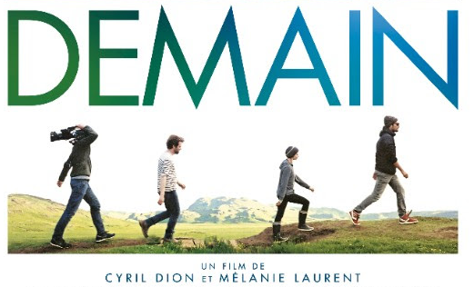
Watch the short trailer (1.46 mins) for the recent film directed by Mélanie Laurent and Cyril Dion entitled:
Demain
(The film will start automatically with the next slide. Click on the link above for the hyperlink if required)

Slide 8
Allow students a few minutes to respond to the film with people sitting near to them.
After sharing their initial responses, ask them to consider the following questions:

Slide 9
What do you think the significance of local communities might be in tackling climate change?
What local action are you aware of in your community?
What is your own school doing to support a sustainable future?

Slide 10
Einstein famously said that to go on doing the same thing and expect a different result, is the definition of insanity.
It is more important than ever for us all to make a shift and start seeing the possibilities in addressing the problems of climate change by changing our behaviour.
This doesn’t need to mean giving up, instead it means we need to re-think some of the ways we do things. And this opens up an endless array of creative possibilities for us all to embrace…

Slide 11
The website for the documentary ‘Demain’ explores several ways that you can take action on a small and immediate scale, looking at individual, community and political actions that you can take.
The following slides introduce the individual and community ideas.
Working in small groups, look at each idea and discuss WHY you think this may be a positive action, and HOW you might go about doing it. Reference your ideas by checking the How and Why sections on the webpage.

Slide 12
INDIVIDUAL ACTIONS
Eating : more organic food and less meat
Opt for a renewable electricity supplier
Buy in local and independent shops
Change your bank
Reducing, re-using, recycling, repairing, sharing
Think about and discuss why and how you may do these actions, and then visit the website page for the film Demain to find out.

Slide 13
COLLECTIVE ACTIONS
Transform your neighbourhood, your village, your city in a vegetable garden
Create a citizens community to produce renewable energy
Create a complementary currency (local, or in your enterprise…)
Create an alternative school
Run for office in your town and get the power back !
Think about and discuss why and how you may do these actions, and then visit the website page for the film Demain to find out.

Slide 14
T H E P O W E R O F U S
5 M I N U T E S +

Slide 15
Watch this short video (2.04mins) made by energy firm Epruron entitled:
Mr W
(Click on the link above for the hyperlink)

Slide 16
Allow students a few minutes to respond to the film with people sitting near to them.
After sharing their initial responses, ask them to consider the following questions:

Slide 17
Do you think this is an effective advertisement? Why?
How conscious are you of green energies being used in your local area?
Do you think we are moving fast enough in changing over our energy sources? Why?

Slide 18
R E – W I L D
T H E C H I L D
1 0 M I N U T E S +

Slide 19
Many educators are calling for young people to spend less time in the classroom taking exams and more time outside.
Take a look at the following video from George Monbiot entitled Re-wild the Child via The Guardian and then discuss these questions:

Slide 20
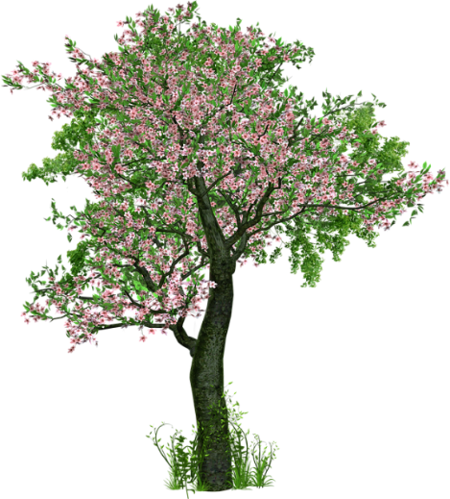
What do you see as being some of the fundamental issues?
What are some of the positives in his arguments?
Do you agree with what he is saying? Why? Why not?

Slide 21
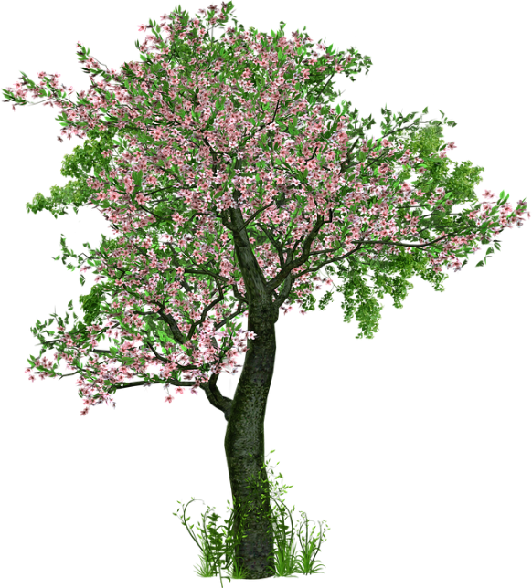
Now read the article by Ben Fogle printed on the following slides.

Slide 22
We need fewer exams and more wilderness in education Ben Fogle, Thursday 17 December 2015
“Instead of pumping time and money into exams, we should focus on wellbeing and encouraging children to connect with the natural world”
Government plans to introduce national tests for seven-year-olds shows just how far our exam obsession has come. Our kids now face constant assessment as politicians attempt to measure the success of schools. Children have become tiny cogs in a box-ticking government machine. Education has lost its way.
This matters to me a great deal, especially since becoming a father to Ludo, five, and Iona, four. I don’t want my children to feel the same sense of failure I did growing up because they’re not good at passing tests. Let’s be honest, some people are better suited to exams than others in the same way that some of us are more sporty or arty. There are a few of us whose minds turn to putty under pressure. Exams left me feeling worthless and lacking in confidence. The worse I did in each test, the more pressure I felt to deliver results that never came. When I failed half my A-levels, and was rejected by my university choices, I spiralled into a depression.

Slide 23
The wilderness rescued me. I have been shaped by my experiences in the great outdoors. Feeling comfortable in the wild gave me the confidence to be who I am, not who others want me to be. There is a natural simplicity to nature; it is far more tactile and tangible than the classroom. It’s a leveller; it strengthened my character and set me back on track.
That’s why, instead of pumping time and money into exams, we should focus on wellbeing and encouraging our children to connect with the natural world. I’m not suggesting the abolition of the exam system, but we could certainly cut back to allow more time for children to explore the world around them.
It doesn’t need a huge investment either. Even if you don’t have immediate access, wilderness camps and schools are waiting to receive inner-city children. Part of the beauty of wilderness schooling is that the overheads are very low. You want a classroom? Build a shelter from nature’s store. You want to eat? Forage for it.
And evidence shows connecting with nature really works. Free play in the outdoors is good for social and emotional development, improves self-awareness, and makes children more co-operative.

Slide 24
A study by the American Medical Association in 2005 concluded that: “Children will be smarter, better able to get along with others, healthier and happier when they have regular opportunities for free and unstructured play in the out-of-doors.” There is also scientific evidence that the wilderness can reduce hyperactivity and has a soothing effect on children, especially those suffering from attention deficit disorder.
We’ve got it all wrong. We need to bring positivity, health and wellbeing back into our schools. It’s time to turn everything on its head and classrooms inside out.
There are many examples to learn from. German visionary Kurt Hahn was one of the early pioneers of outdoor education. He founded Schule Schloss Salem in Germany and the United World Colleges movement that includes Atlantic college in Wales and Gordonston in Scotland. His educational vision encompassed craftsmanship, community service, outdoor pursuits and physical skills.
The Scandinavians have also led the way in this field for many years, not only ensuring class time in the wilderness, but also replacing teaching by subjects with topics. Wilderness schooling involves a similar approach of non-conformist team work, with kids expected to work together in nature. No longer do they sit in rows while their teachers lecture, lessons are now collaborative.

Slide 25
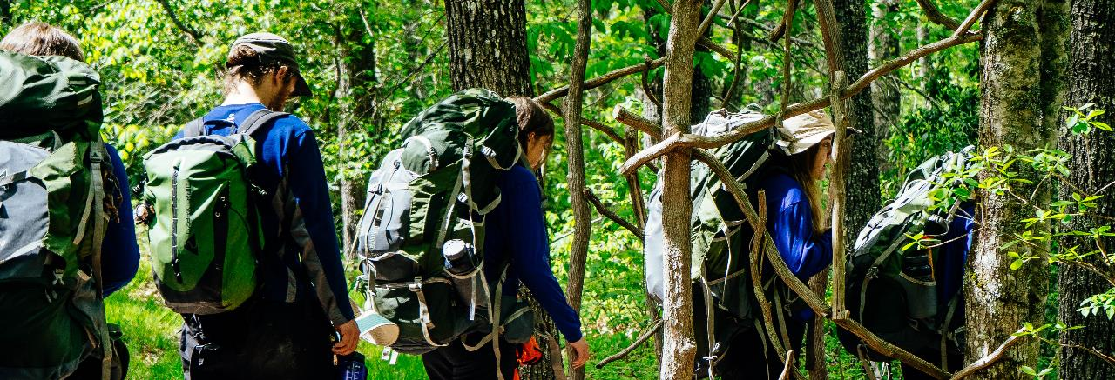
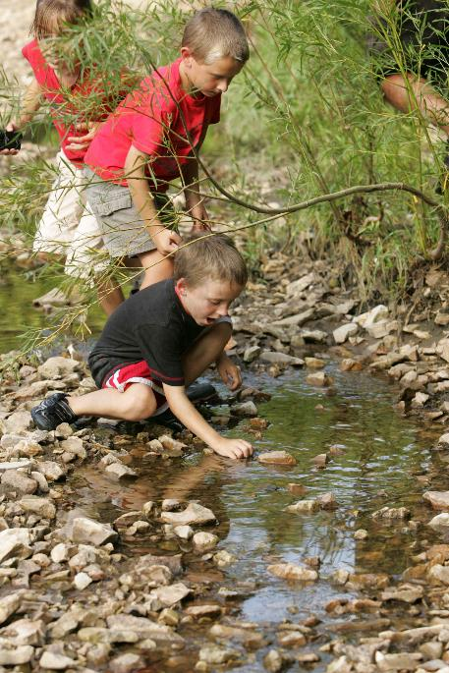

Slide 26
The system is geared towards improving communication, confidence, character and resilience rather than pushing kids through what have essentially become exam factories.
Our once progressive and world-class education system now seems to have ground to a halt. Why are we still using teaching systems that rely on cramming information to be regurgitated in exams?
I want an education system that works inside out. The outdoors becomes a weekly topic – encompassing geography, environment, resourcefulness, home economics, science, and maths – undertaken outside. Classes could be in an inner-city park, scrubland or garden.
As my own children step on to the conveyor belt, I am determined to give them a rounded education. I am in a fortunate position to share some of the wonders of the wilderness with my own kids. But we all have a responsibility to ensure every child has access to the same life-enhancing opportunities. The government should think long and hard before launching another budget-sapping exam and think about investing in the health and wellbeing of future generations.
https://www.theguardian.com/teacher-network/2015/dec/17/we-need-fewer-exams-and-more-wilderness-in-education?CMP=share_btn_fb

Slide 27
What do you see as the biggest challenges of your generation?
What do you see as the greatest solutions?
How do you think we can start to get people to connect more with the world and care about the planet?

Slide 28
To finish, take a look at one of these three ways to engage with the insignificance of humankind on the earth (we have, after all, only been here for 3 seconds!) to allow you to start developing a greater form of respect for the planet.
The History of Earth (using the map of the USA)
Deep Time Walk (using a downloadable App to walk the history of the earth)
Cosmic Eye (using a zoom in and out of perspective)

Slide 29
SUSTAINABILITY
T H I S S O R T O F L E A R N I N G
C A N ’ T W A I T

