Slide 1
G L O B A L
C U L T U R E S
CULTURAL IDENTITIES
Y7&8
11-13 years

Slide 2
A C U L T U R A L
C E L E B R A T I O N
W E E K 4
60 M I N U T E S

Slide 3
In this lesson, students will:
THINK!
Think about and explore the value of culture and diversity and the role we play as global citizens
Understand and explore our own responsibilities as global citizens and the impact of our actions and assumptions when we travel
Explore and unravel the impact of cultural disrespect upon communities and individuals and examine how we can change behaviour patterns to support cultural respect
FEEL!
CONNECT!

Slide 4
P R E - L E S S O N
R E F L E C T I O N S
3 – 5 M I N U T E S +

Slide 5
Introduce the following REFLECTIVE QUESTIONS for students to consider during the lesson:
What is cultural respect? Why might this mean?
Is it important to learn about cultural traditions and behaviours before travelling to another country? Why? Why not?
What is “global citizenship” and how can we practise it?
What does it mean to celebrate culture?

Slide 6
D I V E R S I T Y N O T
D I F F E R E N C E
2 0 M I N U T E S +

Slide 7
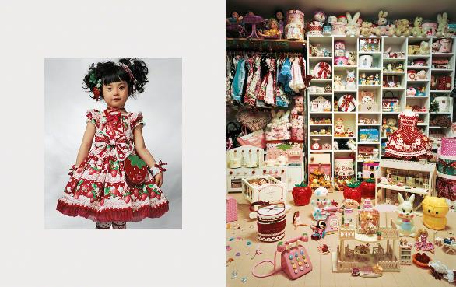
Watch the short video (3.30mins) put together by ThoughtBox featuring pictures by artist James Mollison entitled:
Where Children Sleep
(click on the link above)

Slide 8
Allow students a few minutes to respond to the film with people sitting near to them.
After sharing their initial responses, ask them to consider the following questions:

Slide 9
What do you think the artist is trying to show about what all cultures have in common?
Which pictures in particular stood out? Why?

Slide 10
This is what the photographer, James Mollison, said about his collection of pictures of bedrooms from around the world:
“My bedroom reflected what I had and who I was.
When asked to come up with an idea for engaging with children’s rights, I found myself thinking about my bedroom: how significant it was during my childhood, and how it reflected what I had and who I was.”

Slide 11
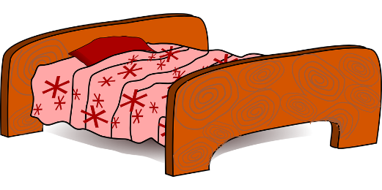
What do you think your bedroom says about you?
If your bedroom was a stereotype for your country or culture, what message would it give about people from your country?

Slide 12
Much of the negative cultural stereotyping across the world comes through making snap judgements based on limited information. It is often much easier to make assumptions than to find out truths.
“An image without a voice to tell its story gives very limited information.”

Slide 13
For example, if you were to “judge” these next two images as being an example of what all American children are like, what stereotypes or assumptions would you form?...

Slide 14
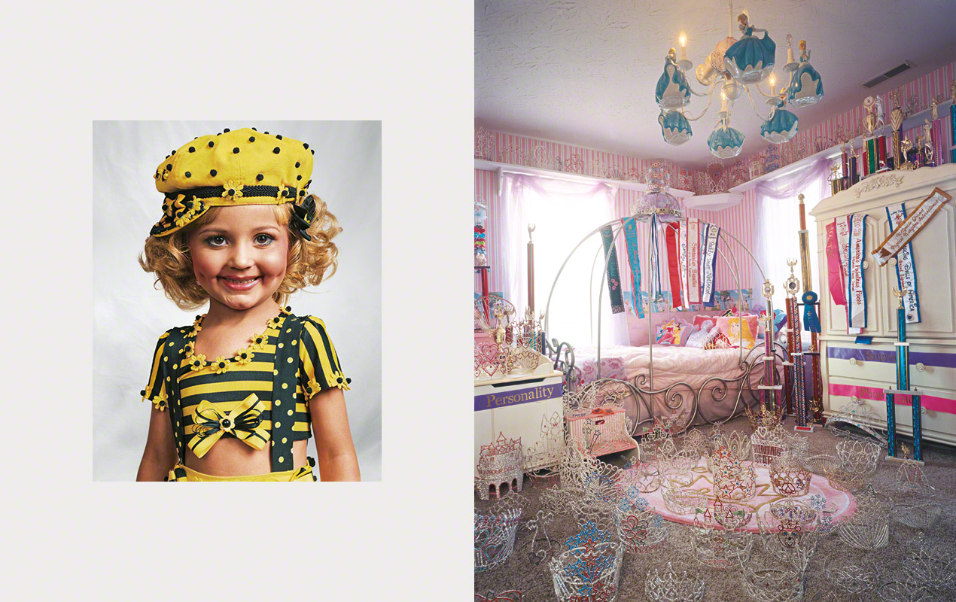
Jazzy, aged 4 - Kentucky, USA

Slide 15
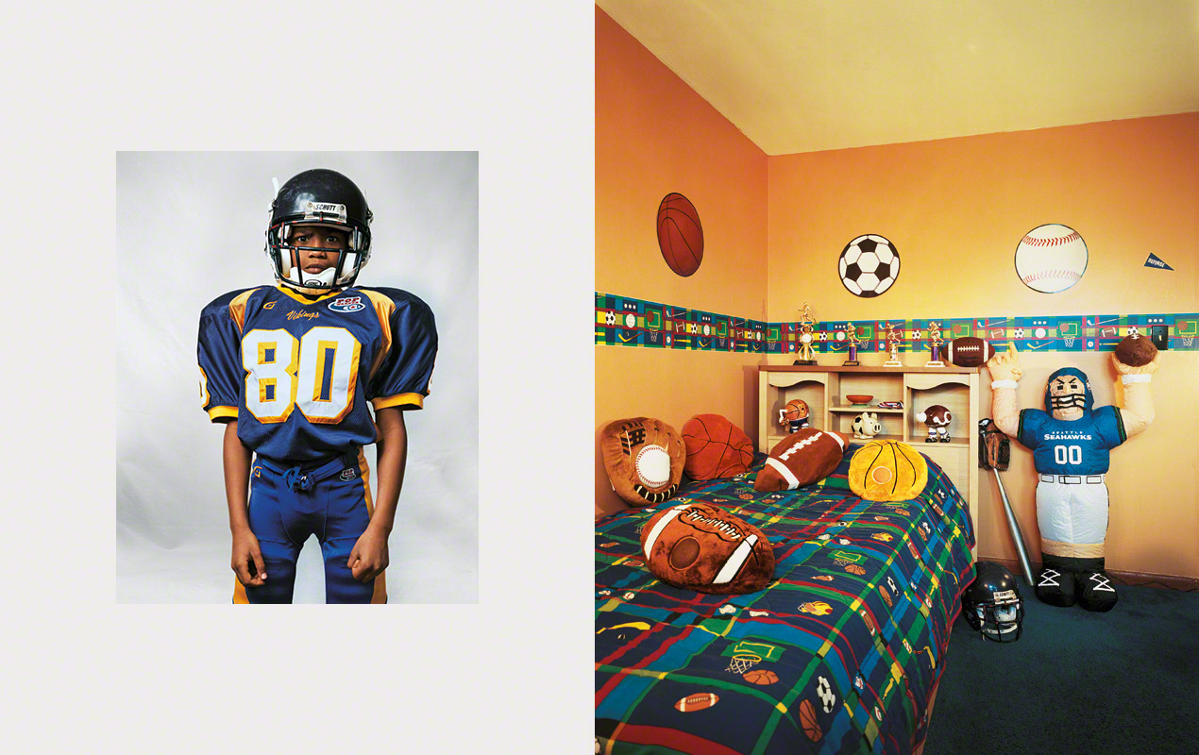
Justin, aged 8 - New Jersey, USA

Slide 16
Do you think all Americans fall into the stereotypes taken from these two images?
Why do we sometimes judge an entire country’s people on a few stereotypes?

Slide 17
Look again at the images and, rather than seeing them as an image of an entire country or culture, this time see them as UNIQUE INDIVIDUALS by looking beyond the cultural stereotypes.
Either split the class up and give one picture to each group, or choose one image each.
Look at the images and make a few notes on ideas about who that person is, what sort of life they live and what they might be like as a child. (You will be using these notes for a longer exercise later on).
TOP TIP: Look for what they have in their bedroom that makes it personal to them – clues about their character, interests and personality.

Slide 18
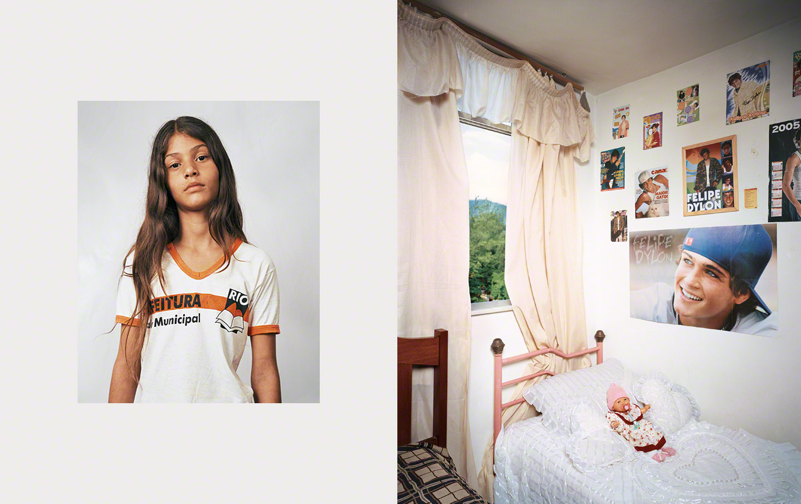
Thais, aged 11 - Rio de Janeiro, Brazil

Slide 19
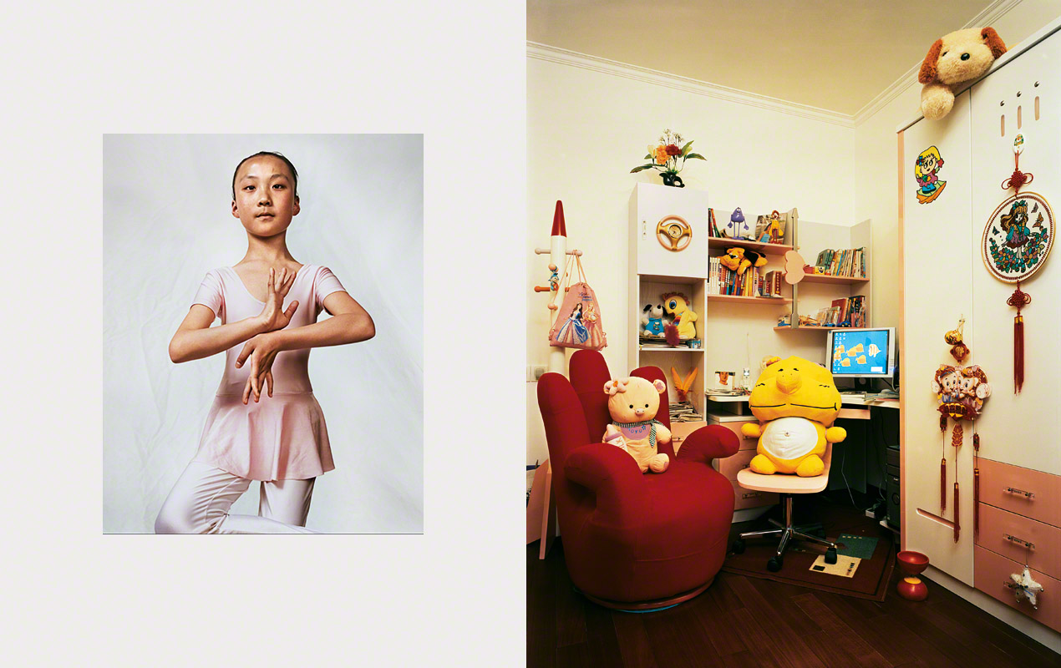
Li, aged 10 - Beijing, China

Slide 20
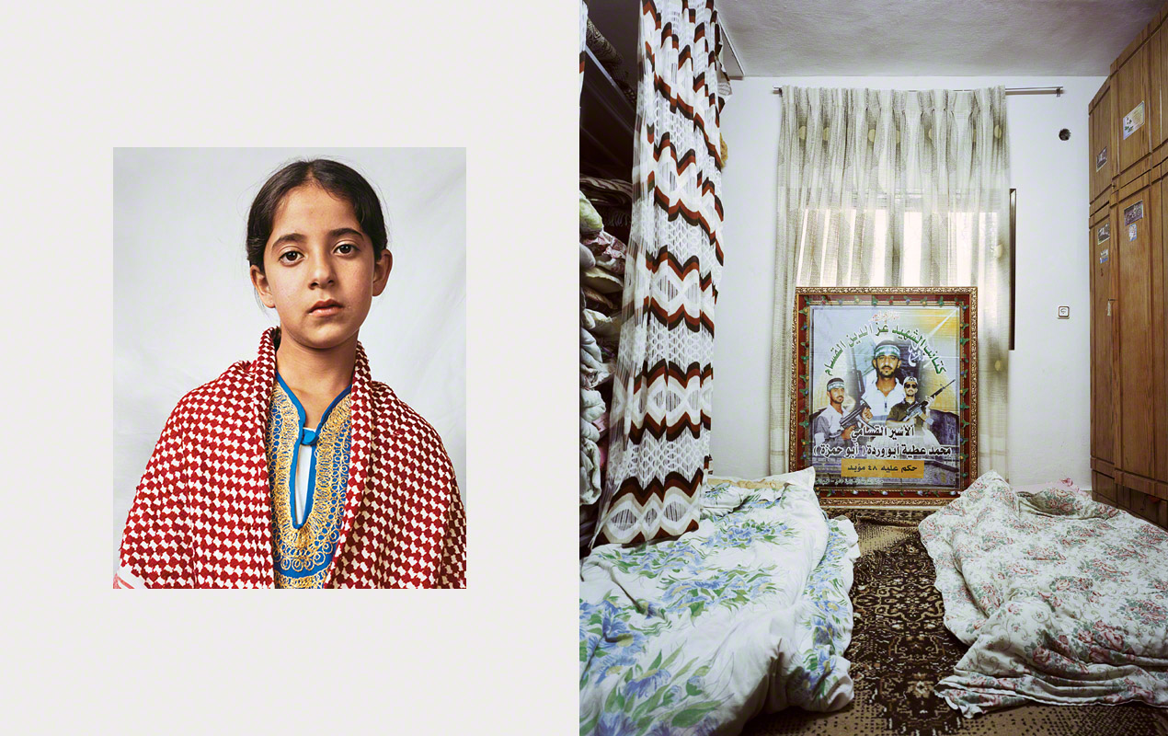
Douha, aged 10 - Hebron, West Bank

Slide 21
Kaya, aged 4 - Tokyo, Japan

Slide 22
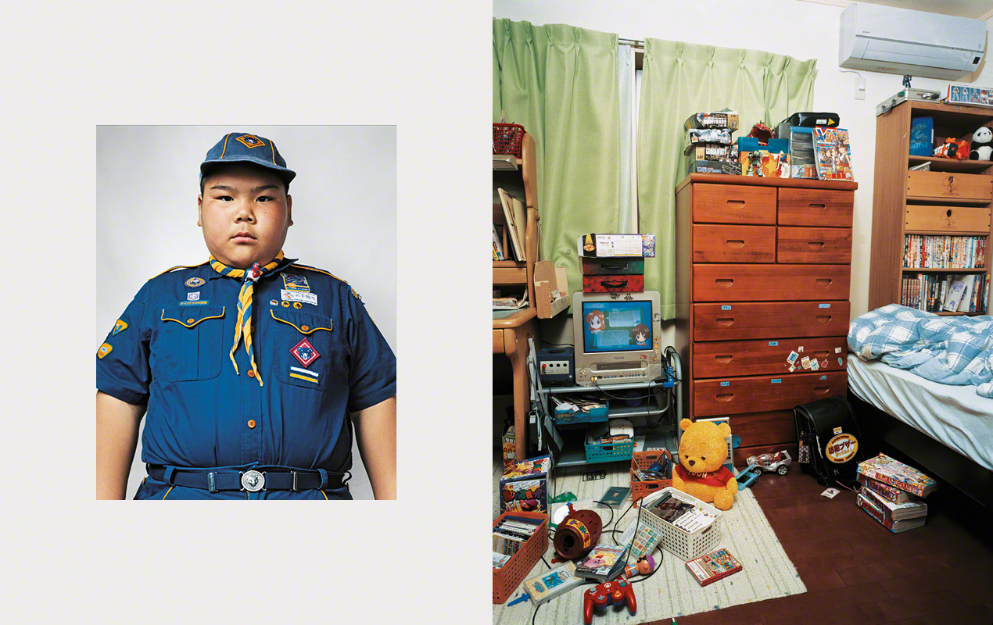
Ryuta, aged 10 - Tokyo, Japan

Slide 23
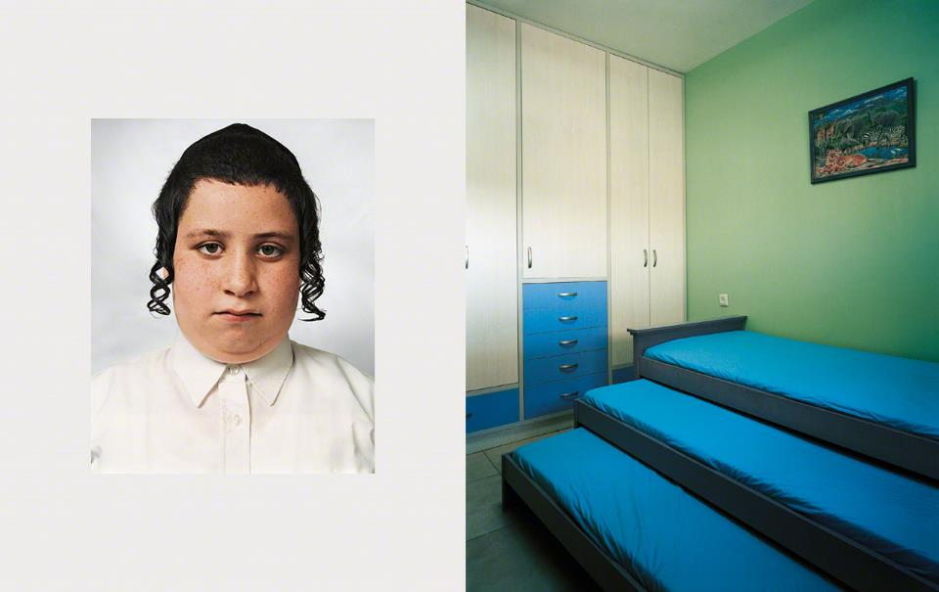
Tzvika, aged 9 - Beitar Illit, West Bank

Slide 24
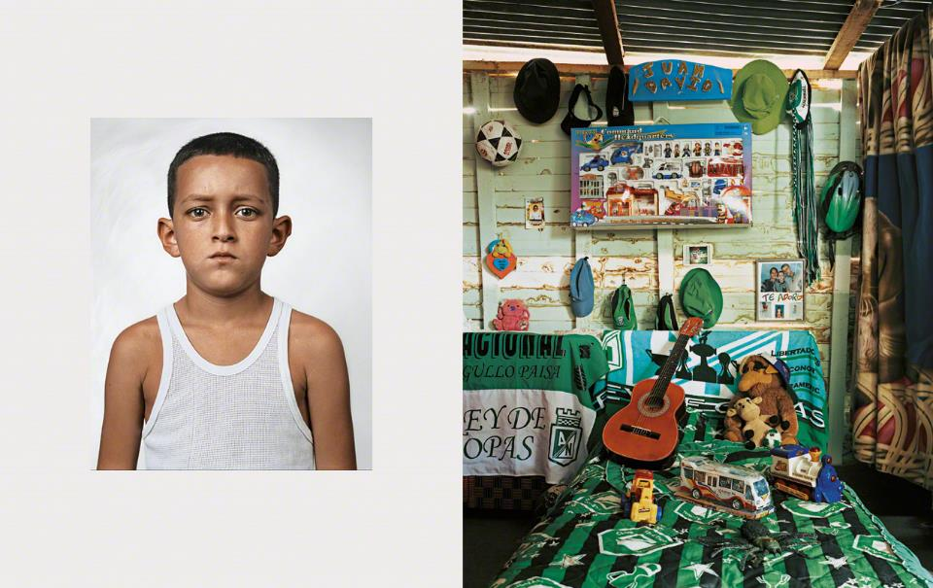
Juang David, aged 10 - Columbia

Slide 25
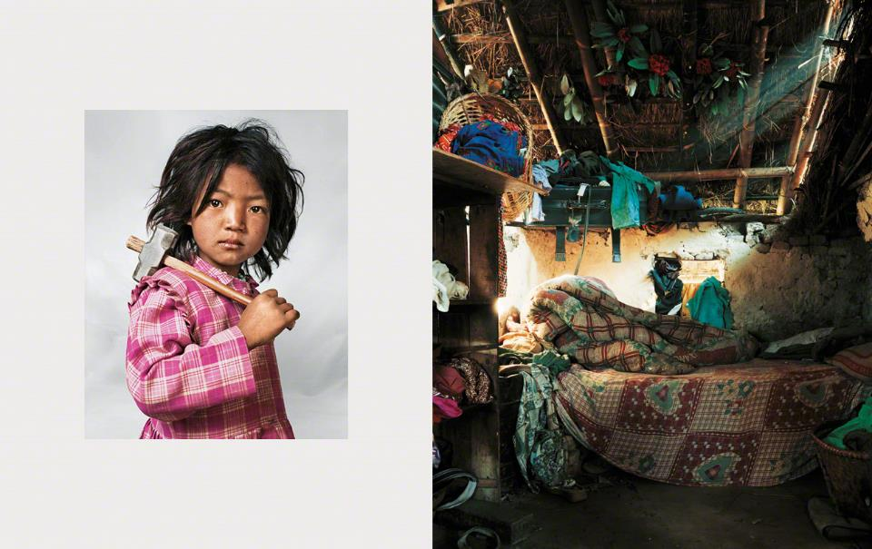
Indira, aged 7 - Kathmandu, Nepal

Slide 26
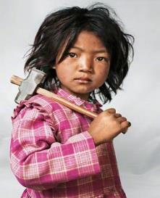
Using these notes and your own ideas, write a short diary extract, speech or (if time is short) a thought bubble exploring a little bit about your life, your thoughts and your feelings.
Use clues in the image to help you to empathise* with that person and explore some of their story.
*what does this word mean?

Slide 27
If time (and interest) allows, ask students to sketch one item from their bedroom that best represents who they are and label with answers to the following questions.
What other items in your bedroom might give clues about your culture or country?
What does this item represent about who you are?

Slide 28
T H E C U L T U R E
O F P L A Y
1 5 M I N U T E S +

Slide 29
Celebrating cultural difference is all about connecting rather than separating. This can mean different things to different people, but if you remember that culture is just another way of being human, you start to realise that there is no “right” or “wrong” culture.
Finding connections with people from different cultures is a great way to overcome barriers and look past stereotypes.

Slide 30
Look at the following pictures from artist James Mollison which show children from countries across the world during playtime / break time at school.
For each picture, try to:
Guess which country it is from
Look for similarities to your own playtime/break time
Look for clues in the clothing, the climate and the environment

Slide 31
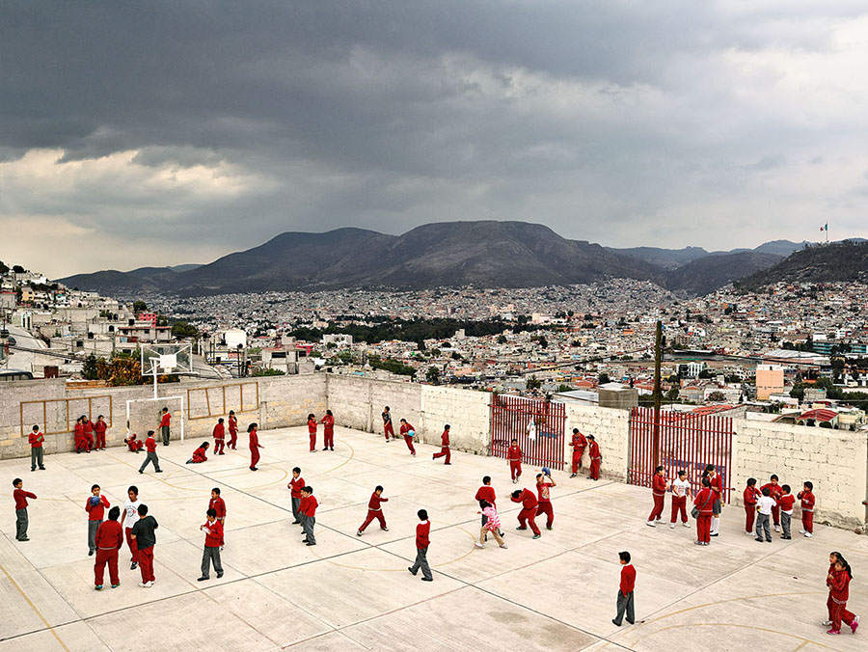

Slide 32
1. Emiliano Zapata Elementary School
Hidalgo
Mexico

Slide 33
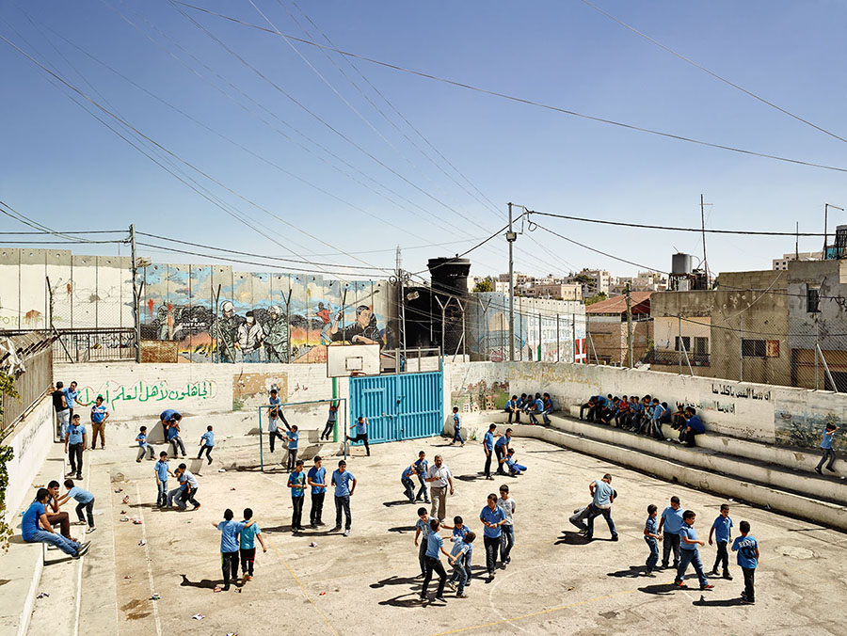

Slide 34
2. Aida Boys School, Bethlehem
West Bank

Slide 35
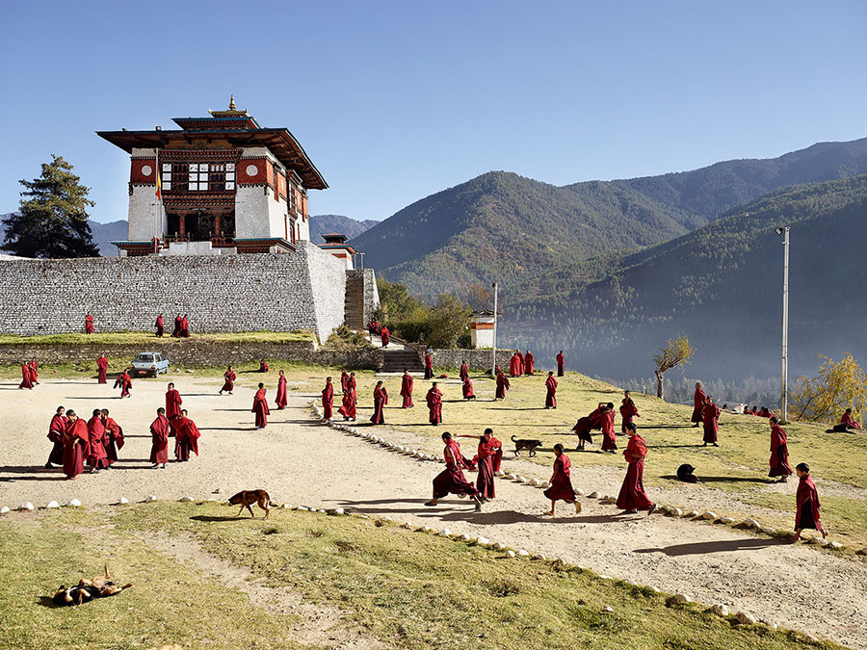

Slide 36
3. Decen Phodrang School
Thumpu
Bhutan

Slide 37
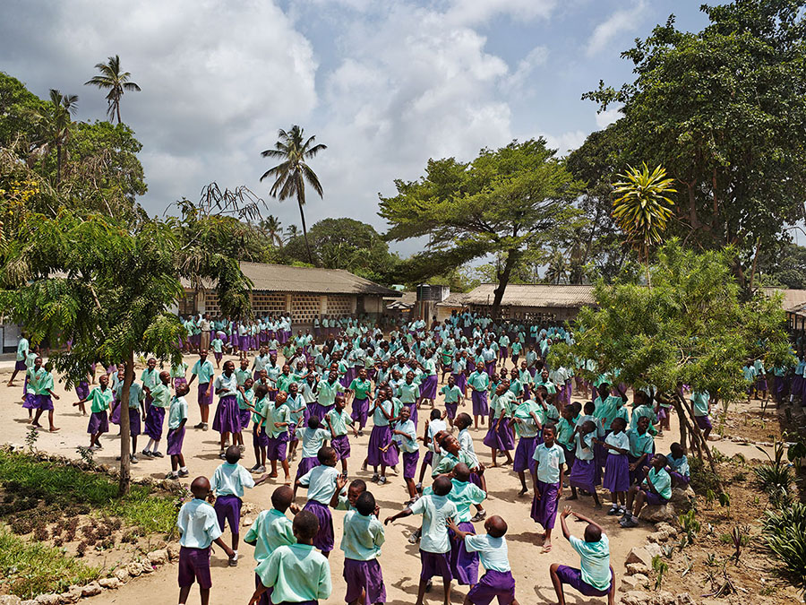

Slide 38
4. Freetown Community Primary School
Mombasa
Kenya

Slide 39
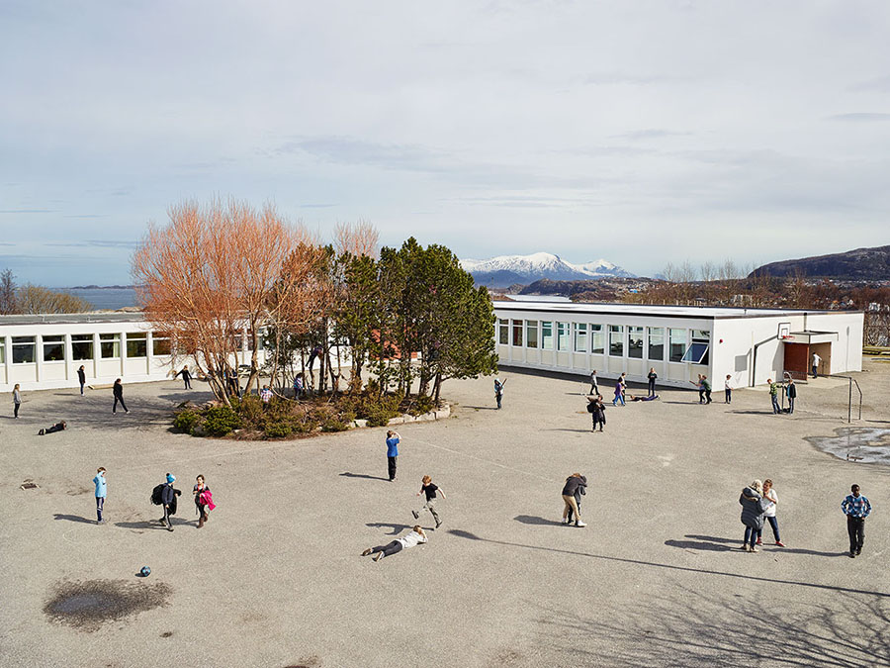

Slide 40
5. Gomalandet Skole School
Kristiansund
Norway

Slide 41
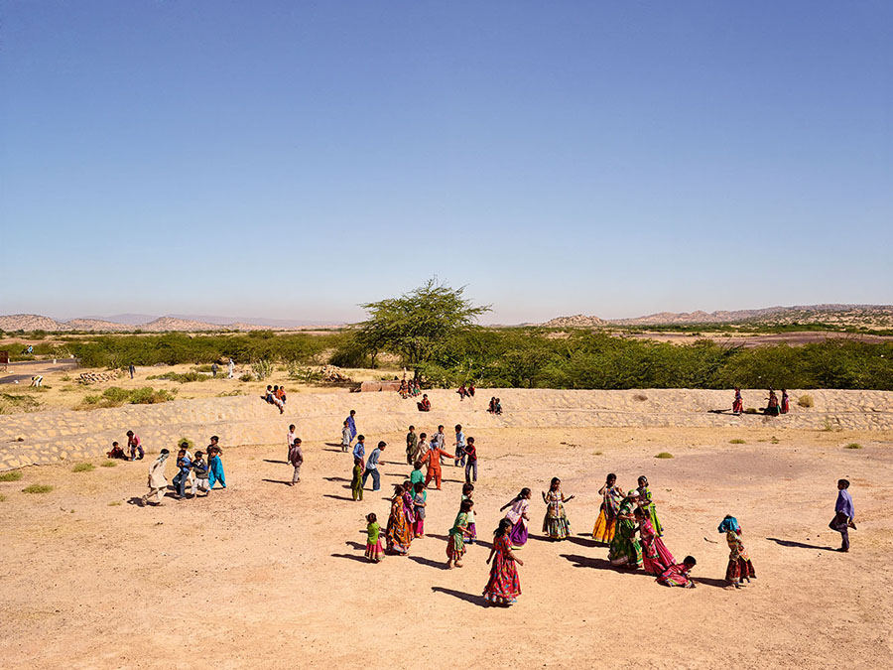

Slide 42
6. Gram Panchayat School
Gujarat
India

Slide 43
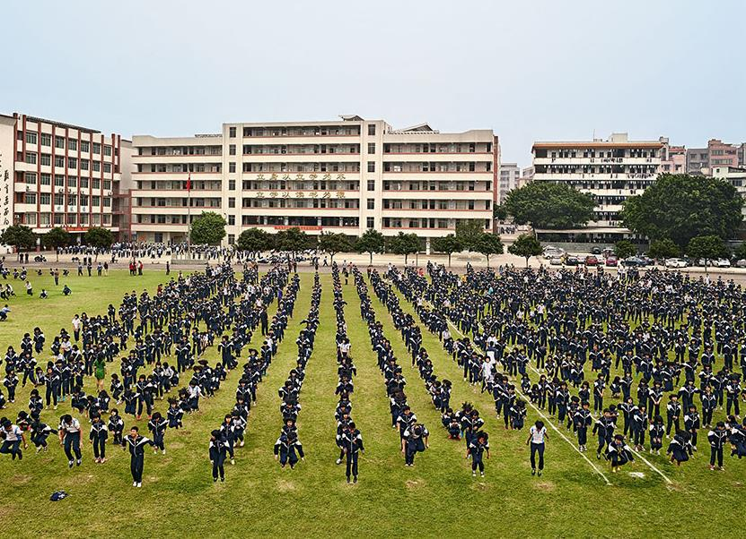

Slide 44
7. He Huang Yu Xiang Middle School
Qingyuan
China

Slide 45
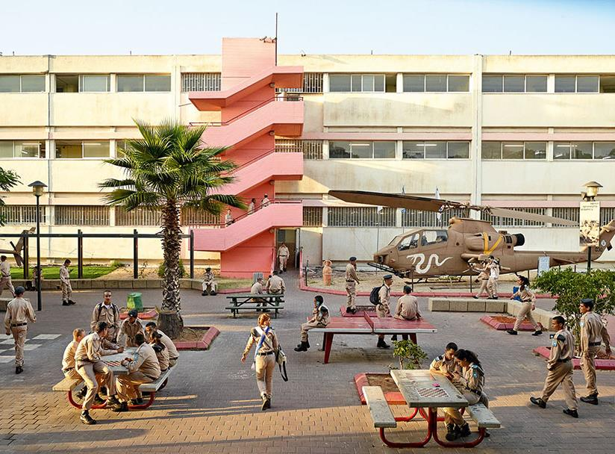

Slide 46
8. Holtz High School
Tel Aviv
Israel

Slide 47
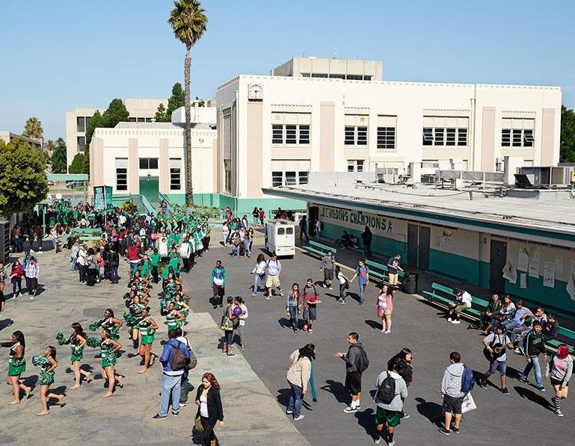

Slide 48
9. Inglewood High School
California
USA

Slide 49
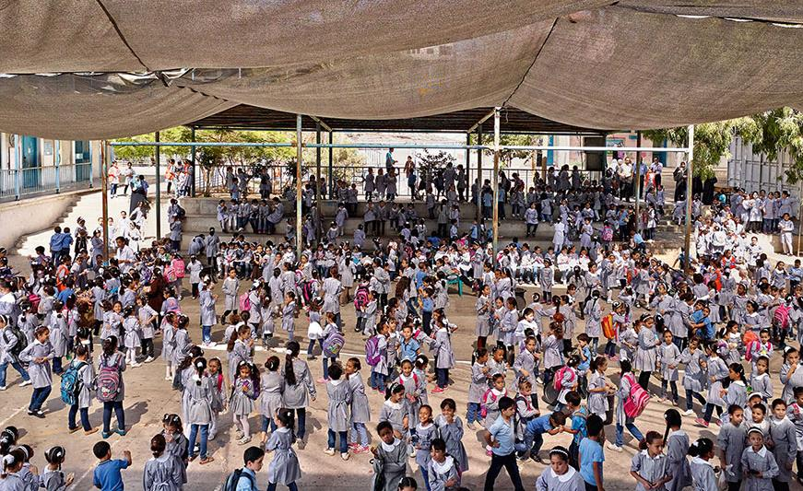

Slide 50
10. Maamounia Elementary School
Gaza City
Gaza

Slide 51
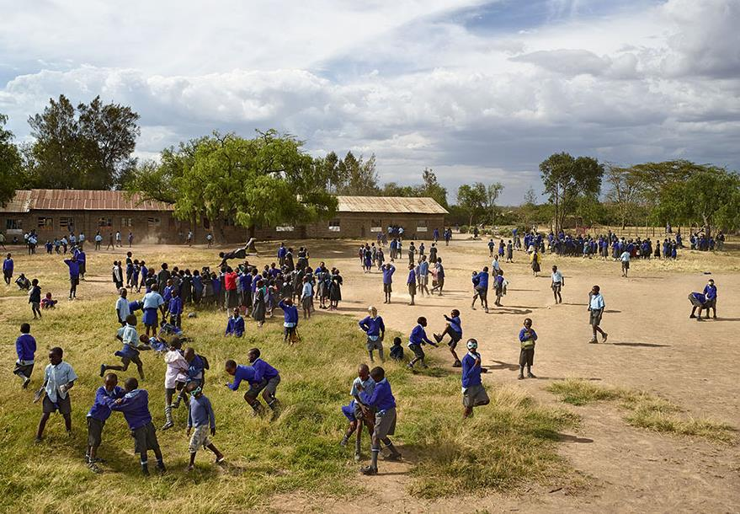

Slide 52
11. Manera Primary School
Naivasha
Kenya

Slide 53
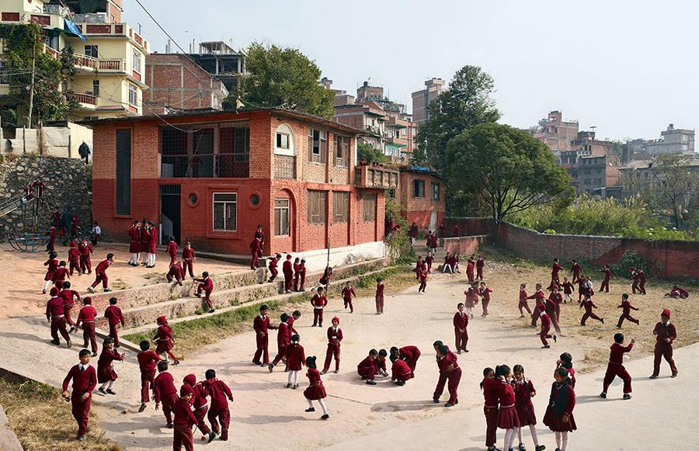

Slide 54
12. Open Day Primary School
Kathmandu
Nepal

Slide 55
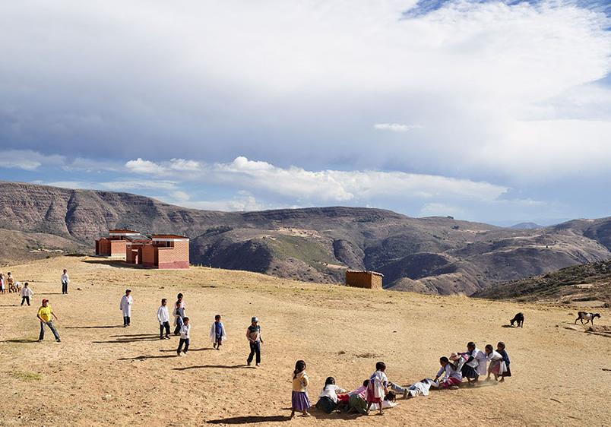

Slide 56
13. Paso Payita School
Chuquisaca
Bolivia

Slide 57
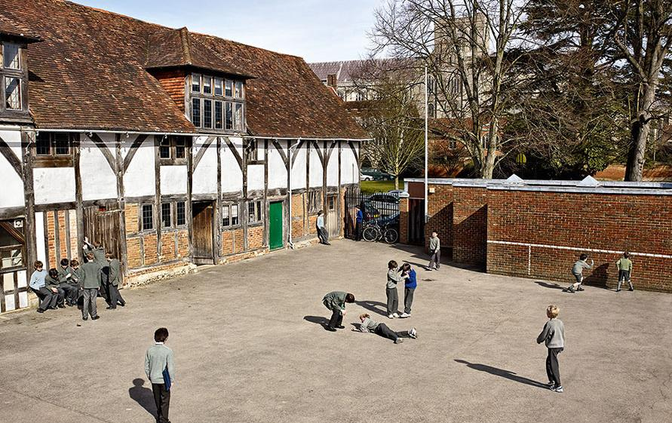

Slide 58
14. Pilgrims School
Winchester
England

Slide 59
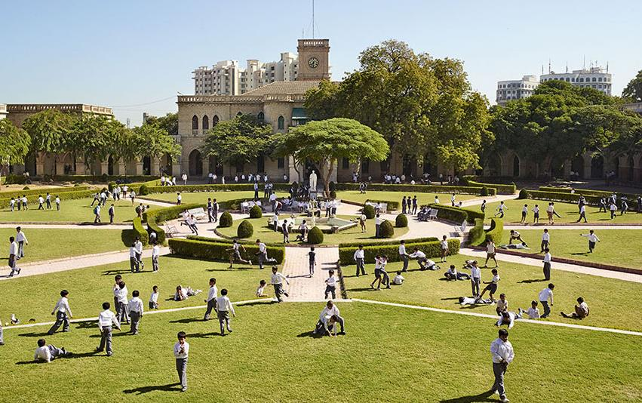

Slide 60
15. Rajkumar College
Gujarat
India

Slide 61
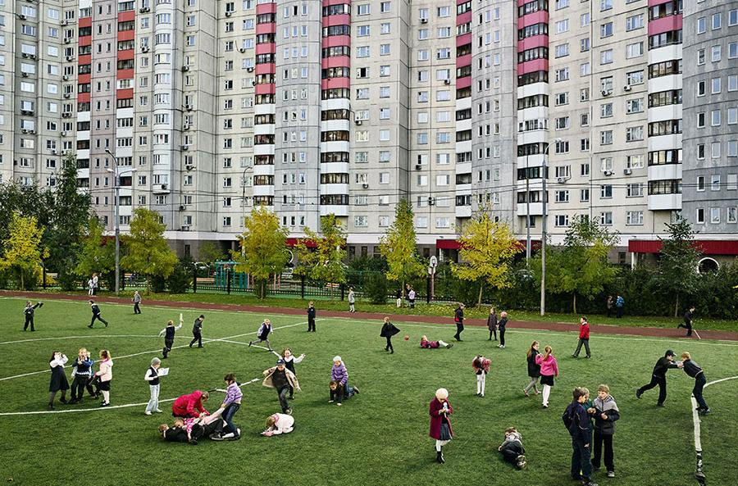

Slide 62
16. School #2014
Moscow
Russia

Slide 63
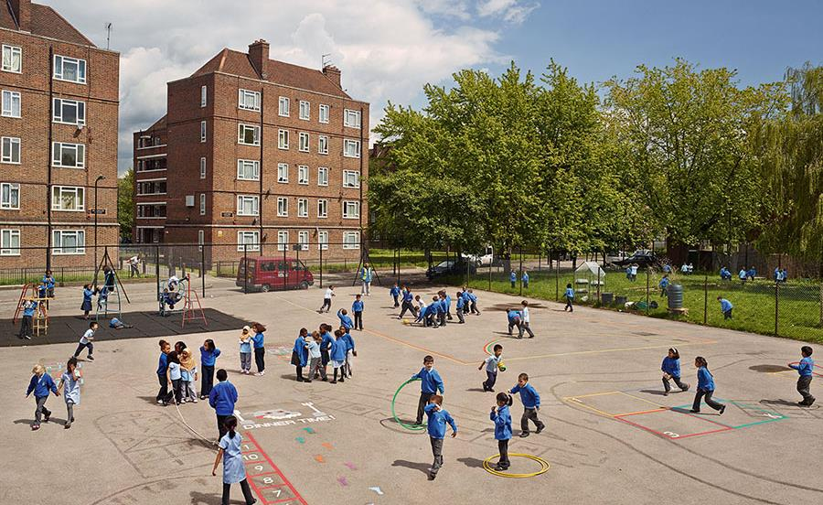

Slide 64
17. Seabright Primary School
London
England

Slide 65
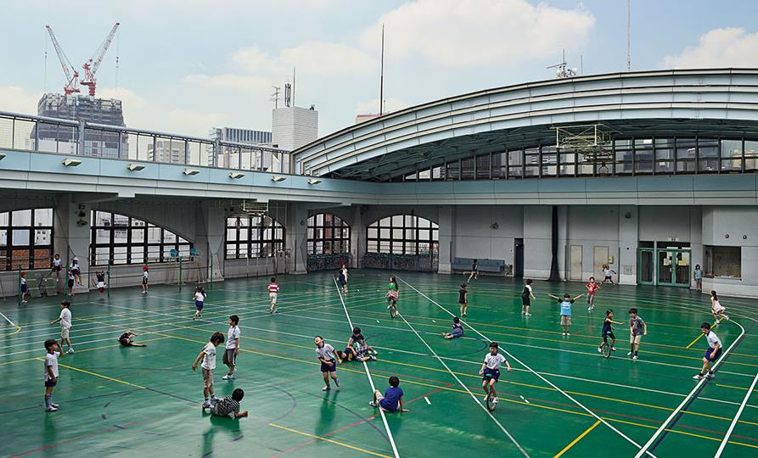

Slide 66
18. Shohei Elementary School
Tokyo
Japan

Slide 67
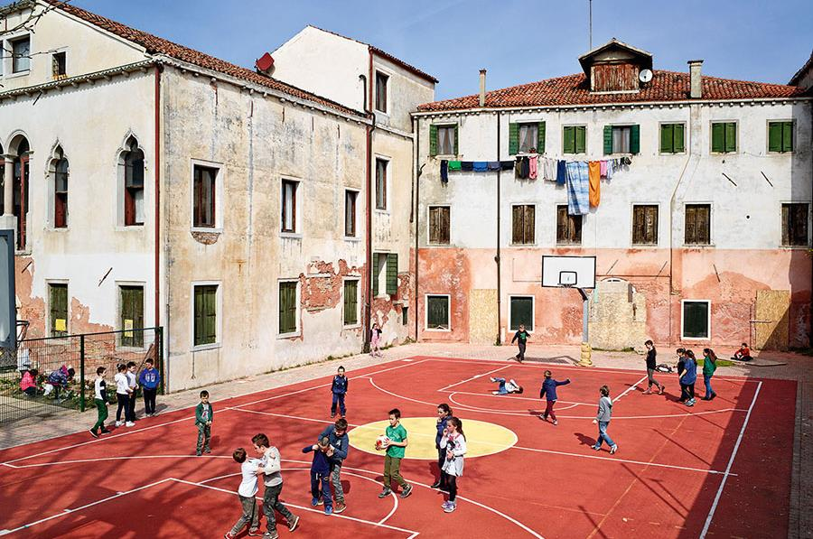

Slide 68
19. Ugo Foscolo Elementary School
Murano
Venice

Slide 69
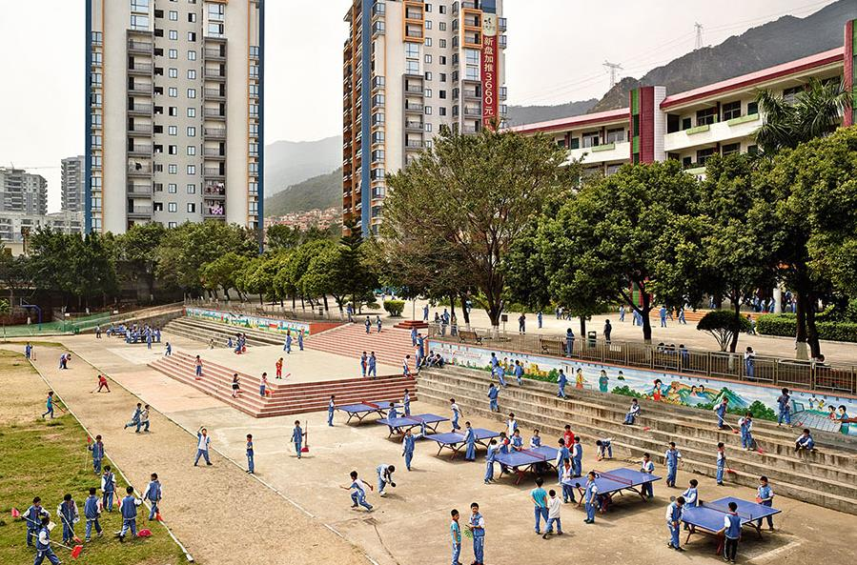

Slide 70
20. Wen Chong Primary School
Qingyuan
China

Slide 71
How many of the countries did you guess?
Did you find any similarities to your own playtime / break time?
Which of the images stood out to you the most? Why?

Slide 72
C U L T U R A L
R E S P E C T
2 0 M I N U T E S +

Slide 73
As we are moving further into the Global Village, it is becoming more and more necessary to learn to respect different cultures and traditions. More and more employers are looking to employ people who exhibit traits of compassion and respect within the role of global connectivity.
Many of us are now travelling to countries and cultures that we would not have had access to just a century ago. For example, on January 1st 1914, one commercial passenger flew on one commercial flight compared to January 1st 2014, when an estimated 8 million people flew on nearly 100,000 flights!

Slide 74
What skills might you need to be a good global citizen?

Slide 75
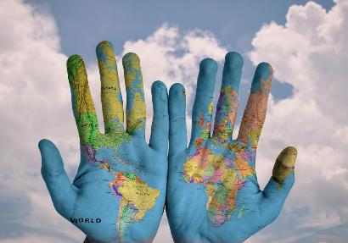
Have a go at the Cultural Respect quiz to see how much you know about particular rules and customs in commonly visited countries.
Split into small groups to form teams of 4-5 people
Number from 1-6 on a piece of scrap paper
Have a go at answering the following questions about countries’ laws and traditions across the world.

Slide 76
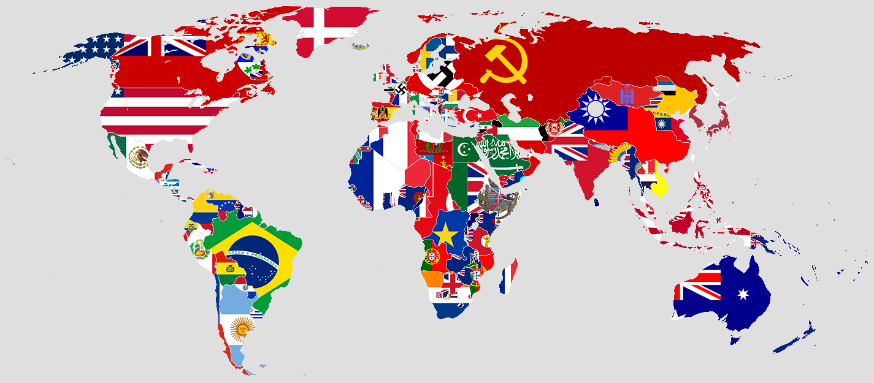
Cultural Respect Quiz

Slide 77
1. In which city can you be fined for spitting?

Slide 78
2. In which country is it illegal to drive without wearing a shirt or top?

Slide 79
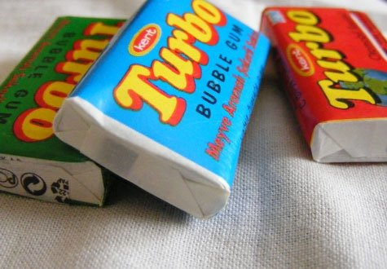
3. In which country is it illegal to chew gum?

Slide 80
4. On a beach in which western country can you be fined for swearing or using offensive language?

Slide 81
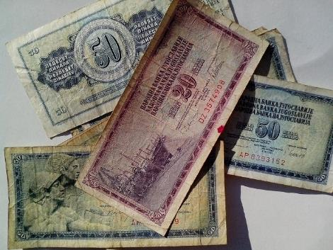
5. In which country is it illegal to step on local currency in public?

Slide 82
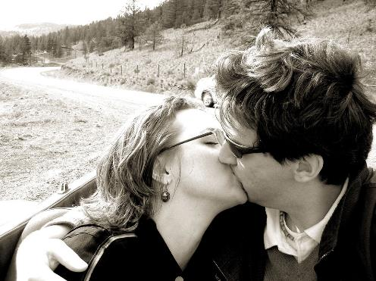
6. In which country can you be arrested and jailed for kissing in public?

Slide 83
The Answers

Slide 84
1. In which city can you be fined for spitting?

Slide 85
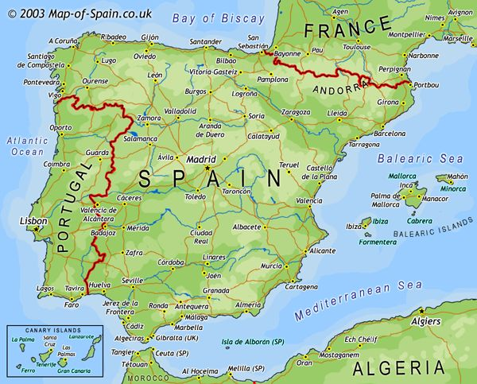
Barcelona

Slide 86
2. In which country is it illegal to drive without wearing a shirt or top?

Slide 87
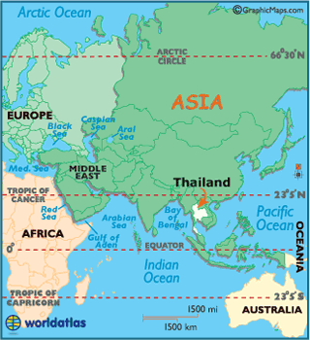
Thailand

Slide 88
3. In which country is it illegal to chew gum?

Slide 89
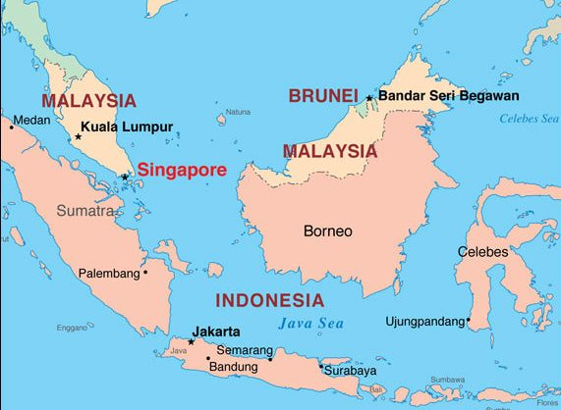
Singapore

Slide 90
4. On a beach in which western country can you be fined for swearing or using offensive language?

Slide 91
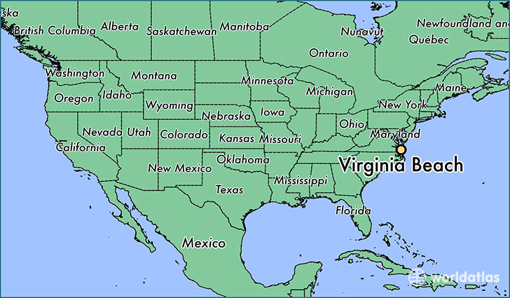
USA
(Virginia Beach)

Slide 92
5. In which country is it illegal to step on local currency in public?

Slide 93
Thailand

Slide 94
6. In which country can you be arrested and jailed for kissing in public?

Slide 95
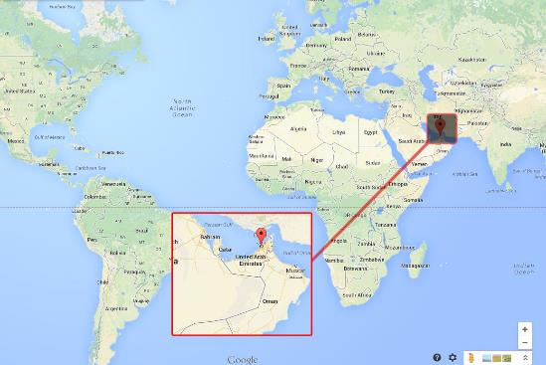
Dubai

Slide 96
Add up your scores and see which group in the class is most aware of some of the world’s interesting cultural rules!
As tourists are “not immune” from rules and laws in other countries, do you think we should teach more about the need for good cultural awareness in school?

Slide 97
Split the class up into six groups and give each group one of the areas of consideration on the next slide.
Think about why doing this activity may be showing cultural disrespect if done in the wrong way/ wrong time when travelling to other countries.
Share ideas with the class and discuss any thoughts.

Slide 98
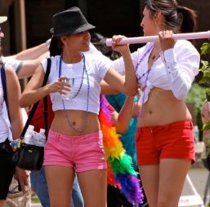
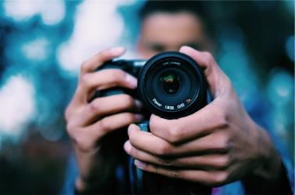
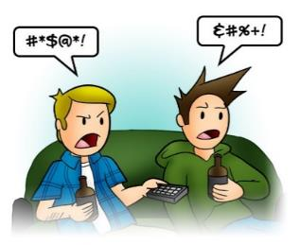
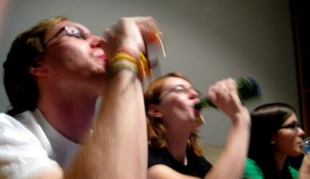
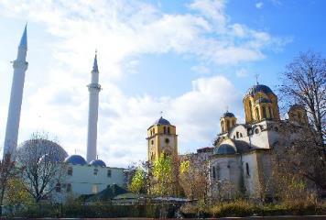
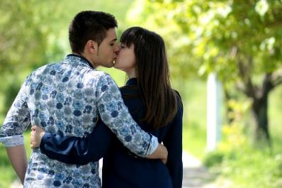
Clothing | Taking photographs | Swearing
Drinking alcohol | Religious beliefs | Being intimate in public

Slide 99
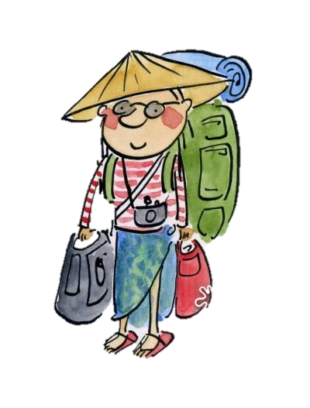
TOP TIPS BEFORE YOU TRAVEL:
1. Do some research before you leave home
2. Learn basic cultural mannerisms and respect different ways of doing things
3. Don’t impose your culture where it may be offensive
4. Respect the local laws, customs and traditions
5. Be aware of how you are representing your own country and culture

Slide 100
L E T ’ S C E L E B R A T E
5 M I N U T E S +

Slide 101
Cultural diversity is something to celebrate! Look at the ideas about cultural diversity on the next slides and think about ways that you can start celebrating culture and cultural diversity in your school.

Slide 102
Culture is invisible to its members!
Culture is like water in a goldfish bowl: to the fish, it’s normal and natural. It’s only when you’re outside the medium that you notice it.

Slide 103
Much of culture is below the surface!
While some aspects of culture are visible (e.g., food, music, clothing), much of culture operates below the surface on the level of values, beliefs, and expectations.

Slide 104
Culture is what makes us all so unique, interesting and thriving!
You are an idea; just one idea of what one person on earth could be doing. Celebrate difference; it is what makes us all beautifully unique!

Slide 105
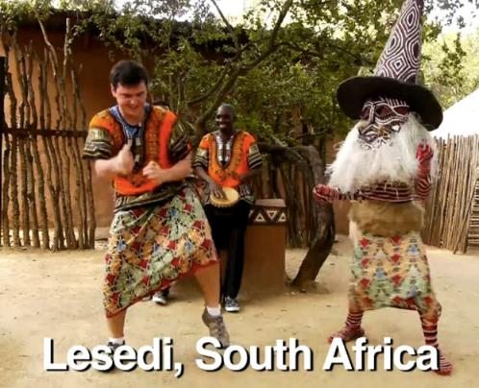
If time allows, finish by watching the short video (4 minutes) featuring dances by traveller and comedian Matt Harding entitled:
Dancing Around the World
(click on the link above)

Slide 106
GLOBAL CULTURES
T H I S S O R T O F L E A R N I N G
C A N ’ T W A I T

