Slide 1
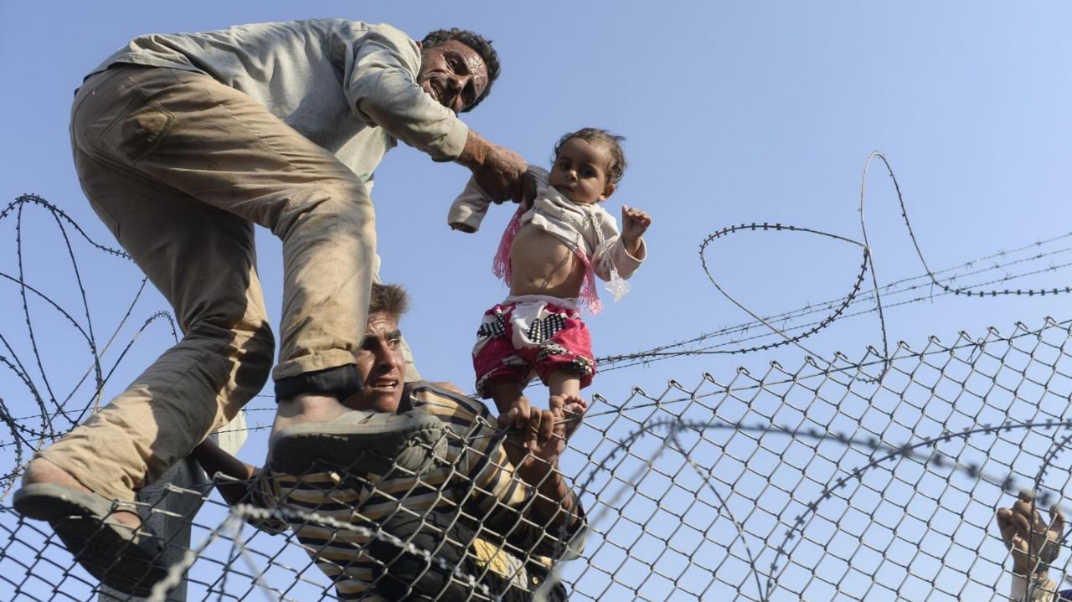
15 minutes+
Immigration & Refugees
Week 4 – Crossing the Seas
Y7&8
11-13 years

Slide 2
In this lesson, students will:
THINK!
Think about some of the human suffering and choices (or lack of) for people when crossing the seas in search of safety
Understand why crossing the sea into uncertainty has become more hopeful for so many compared to staying at home
Explore and unravel some of the choices we all have in responding to immigrants and refugees
FEEL!
UNLEARN!

Slide 3
Pre-lesson reflection
3 minutes+

Slide 4
Introduce the following REFLECTIVE QUESTIONS for students to consider during the lesson:
What are refugee camps actually like?
Do you think that we all have a role to play in the current migration crisis, whether it affects us directly or not? Why?
How have your responses to immigrants and refugees changed during these discussions?
What can we all do, on a personal level, to support the refugee crisis?

Slide 5
Secrets of the sea 10 minutes+

Slide 6
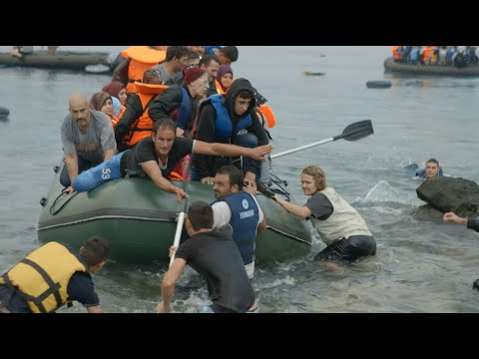
Watch the short film(5.54mins) made by humanitarian organisation Samaritans Purse entitled:
The Rising Tide
Click on the link above for the hyperlink
*You can stop watching at 5.05mins

Slide 7
Allow students a few minutes to respond to the film with people sitting near to them.
After sharing their initial responses, ask them to consider the following questions:

Slide 8
What was the most impactful part of this video for you?
Why did this make an impact?
Why do you think people are still risking their lives at sea, even knowing the risks?

Slide 9
Lost at sea 5 minutes+

Slide 10
In 2016, over 4500 lost their lives in the sea. Over 1000 people had perished by the end of April 2017
According to the UNHCR (the UN Refugee Agency):
Increasing numbers of refugees and migrants take their chances aboard unseaworthy boats and dinghies in a desperate bid to reach Europe. The vast majority of those attempting this dangerous crossing are in need of international protection, fleeing war, violence and persecution in their country of origin. Every year these movements continue to exact a devastating toll on human life.

Slide 11
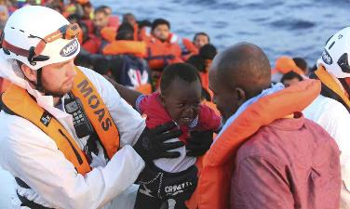
Read this short article from the Guardian Newspaper entitled: In one week, 240 feared drowned in Med and ask students to share their responses and thoughts to some of the ideas raised.
The article is printed on the following slides.

Slide 12
In one week, 240 feared drowned in Med UN reports four accidents, including 130 refugees missing from one boat, bringing this year’s Mediterranean death toll to 4,500
About 240 people are suspected to have drowned this week in four separate incidents in the Mediterranean, raising the total annual death toll to an unprecedented 4,500.
Deaths in the Mediterranean are now nearly 20% higher than last year’s total of 3,771, which was the previous annual record.
About 130 asylum seekers are missing after a rubber boat capsized on Sunday night, while another 100 are thought to have drowned on Tuesday night in a separate incident, the UN refugee agency said. Up to 10 people died in two further tragedies in recent days, bringing the death toll this week to at least 240.

Slide 13
In the accident on Sunday 15 survivors were left in the water for 10 hours, clinging on to a piece of a capsized boat, before being rescued by an oil tanker. Nine are still in hospital, Iosto Ibba, a spokesman for UNHCR, said in a phone call.
Migration between Turkey and Greece has lessened significantly since March, after Turkey agreed to re-admit people deported from Greece. But crossings between Libya and Italy continue unabated. More than 165,000 people have reached Italy so far this year from north Africa, and the final annual total is likely to surpass the previous record of 170,000.
Ibba said the continuing migration flows, and rising death tolls, showed why Europe needed to provide asylum seekers with more legal routes to safety.
“Without alternative ways to reach Europe, refugees will always try to reach safety in dangerous ways,” said Ibba. “That’s why it’s so important to expand legal pathways for refugees, including humanitarian admissions, family reunification programmes, private sponsorship, and student visas for refugees. At the same time it’s also important to support the countries of origin and transit, and to keep up search-and-rescue missions, without which the death toll would be even higher.”

Slide 14
European countries are attempting to stem migration flows by providing more aid to African countries that agree to re-admit deported asylum seekers. Additionally, navies from countries such as Britain are intercepting and destroying Libyan smugglers’ repurposed fishing trawlers after they enter international waters. But that strategy has failed because smugglers have instead packed their customers into disposable rubber boats – which can be operated by the refugees themselves, allowing the smugglers to remain in Libya.
The rising death toll in 2016 can be partly explained by the increasing use of the inflatable boats, which are even more dangerous than the wooden ships they replaced.
Syrians are no longer using Libya as a springboard to reach Europe. Instead, Libya is mainly used by people fleeing war and poverty in Nigeria and Sudan, or repression in Eritrea and Gambia. Others are migrant workers who tried to find jobs in Libya, but fled after the civil war there led to the collapse of law and order.

Slide 15
Many migrants are kept in slavery-like conditions by their Libyan employers, while others are tortured or extorted, sometimes by the authorities. About 70% say they faced some kind of exploitation in Libya, according to research by the International Organisation for Migration.
Patrick Kingsley Migration correspondent
Wednesday 16 November 2016

Slide 16
Data supplied by UNHCR Refugee Agency 2017

Slide 17
Data supplied by UNHCR Refugee Agency 2017

Slide 18
Do you think we should be doing more to support refugees?
Split the class into pairs and ask each pair to come up with three responses to the question, and then for each reason, produce a counter-argument for each idea (examples on next slide).

Slide 19
Using all of the ideas from previous lessons respond to the following question:
What does it mean to be a refugee?

Slide 20
ThoughtBox: This sort of learning can’t wait

