Slide 1
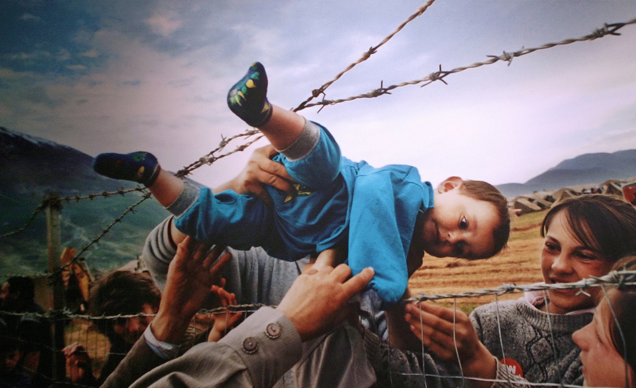
IMMIGRATION
& REFUGEES
SOCIAL PERSPECTIVES
Y7&8
11-13 years

Slide 2
C R O S S I N G T H E S E A S
W E E K 4
15 M I N U T E S

Slide 3
In this lesson, students will:
THINK!
Think about some of the human suffering and choices (or lack of) for people when crossing the seas in search of safety
Understand why crossing the sea into uncertainty has become more hopeful for so many compared to staying at home
Explore and unravel some of the choices we all have in responding to immigrants and refugees
FEEL!
CONNECT!

Slide 4
P R E L E S S O N
R E F L E C T I O N S
3 – 5 M I N U T E S +

Slide 5
Introduce the following REFLECTIVE QUESTIONS for students to consider during the lesson:
What are refugee camps actually like?
Do you think that we all have a role to play in the current migration crisis, whether it affects us directly or not? Why?
How have your responses to immigrants and refugees changed during these discussions?
What can we all do, on a personal level, to support the refugee crisis?

Slide 6
S E C R E T S O F T H E
S E A
1 0 M I N U T E S +

Slide 7
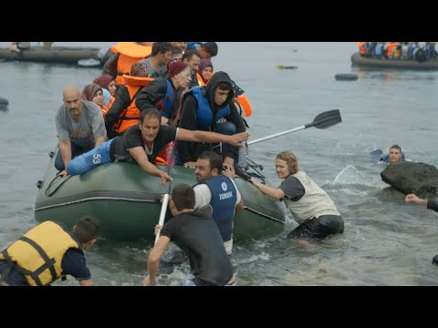
Watch the short film(5.54mins) made by humanitarian organisation Samaritans Purse entitled:
The Rising Tide
Click on the link above for the hyperlink
*You can stop watching at 5.05mins

Slide 8
Allow students a few minutes to respond to the film with people sitting near to them.
After sharing their initial responses, ask them to consider the following questions:

Slide 9
What was the most impactful part of this video for you? Why?
Why do you think people are still risking their lives at sea, even knowing the risks?

Slide 10
L O S T A T S E A
5 M I N U T E S +

Slide 11
In 2016, over 4500 lost their lives in the sea. Over 1000 people had perished by the end of April 2017. According to the UNHCR (the UN Refugee Agency):
Increasing numbers of refugees and migrants take their chances aboard unseaworthy boats and dinghies in a desperate bid to reach Europe. The vast majority of those attempting this dangerous crossing are in need of international protection, fleeing war, violence and persecution in their country of origin. Every year these movements continue to exact a devastating toll on human life.

Slide 12
Why do you think so many people are still risking their lives at sea, even when they know the dangers?

Slide 13
Do you think we should be doing more to support refugees?
Split the class into pairs and ask each pair to come up with three responses to the question, and then for each reason, produce a counter-argument for each idea (examples on next slide).

Slide 14
What can we do?
There are many ways for us (young and old) to support people coming into our countries as refugees – with awareness, compassion and understanding being one of the most powerful tools we can offer. Showing someone friendship and support is a huge offering, that every single one of us can give.
For more ideas, visit one or more of the following websites:

Slide 15
8 Practical ways to help refugees (TED website)
Here’s how you can help (refugee action website)
How can you help? (Government website)
Get involved (Help refugees website)
5 ways to help (Independent article)

Slide 16
I M M I G R A T I O N & R E F U G E E S
T H I S S O R T O F L E A R N I N G
C A N ’ T W A I T

