Slide 1
30 minutes+
Global Cultures
Week 4 – A Cultural Celebration
Y7&8
11-13 years
thoughtboxeducation.com

Slide 2
In this lesson, students will:
THINK!
Think about and explore the value of culture and diversity and the role of cultural respect as global citizens
Understand and explore our own responsibilities as global citizens and the direct and indirect actions and impacts that we can have as we travel
Explore and unravel the impact of cultural disrespect upon communities and individuals and examine how we can change behaviour patterns to support cultural respect
FEEL!
UNLEARN!

Slide 3
Pre-lesson reflection 3-5 minutes+

Slide 4
Introduce the following REFLECTIVE QUESTIONS for students to consider during the lesson:
What is cultural respect? Why might this mean?
Is it important to learn about cultural traditions and behaviours before travelling to another country? Why? Why not?
What is “global citizenship” and how can we practise it?
What does it mean to celebrate culture?

Slide 5
Diversity not difference 5 minutes+

Slide 6
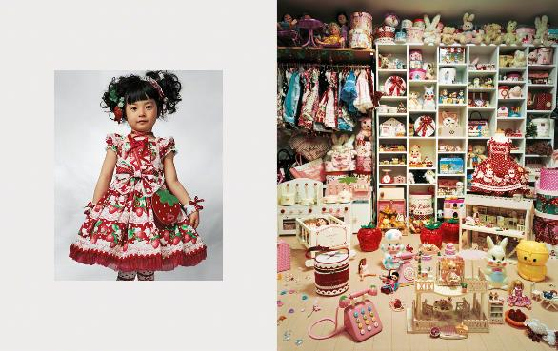
Watch the short video (3.30mins) put together by ThoughtBox featuring pictures by artist James Mollison entitled:
Where Children Sleep
(click on the link above)

Slide 7
Allow students a few minutes to respond to the film with people sitting near to them.
After sharing their initial responses, ask them to consider the following questions:

Slide 8
What do you think the artist is trying to show about culture and identity?
Which pictures in particular stood out? Why?
Did the pictures confirm or challenge their expectation of stereotypes from particular countries?

Slide 9
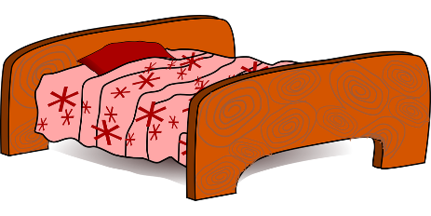
What does your room say about you?
This is what the photographer, James Mollison, said about his collection of pictures of bedrooms from around the world.
“My bedroom reflected what I had and who I was.”
“When asked to come up with an idea for engaging with children’s rights, I found myself thinking about my bedroom: how significant it was during my childhood, and how it reflected what I had and who I was.

Slide 10
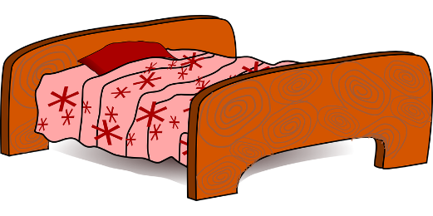
What do you think your bedroom says about you?
If your bedroom was a stereotype for your country or culture, what message would it give?
What about you as an individual?

Slide 11
The culture of play 10 minutes+

Slide 12
Celebrating cultural difference is all about connecting rather than separating. This can mean different things to different people, but if you remember that culture is just another way of being human, you start to realise that there is no “right” or “wrong” culture.
Finding connections with people from different cultures is a great way to overcome barriers and look past stereotypes.

Slide 13
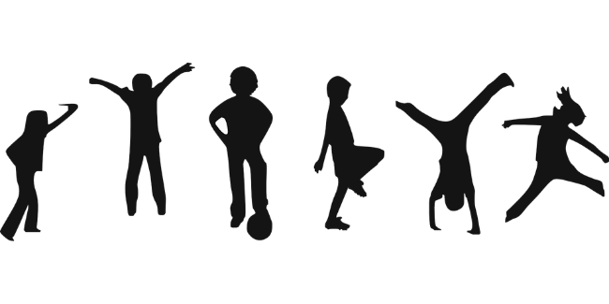
Look at the following pictures from artist James Mollison which show children from countries across the world during playtime / break time at school.
For each picture, try to:
Guess which country it is from
Look for similarities to your own playtime/break time
Look for clues in the clothing, the climate and the environment

Slide 14
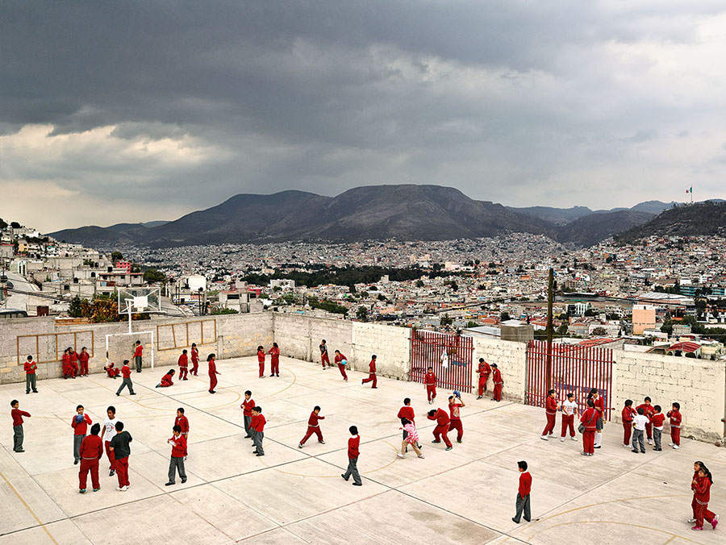

Slide 15
1. Emiliano Zapata Elementary School
Hidalgo
Mexico

Slide 16
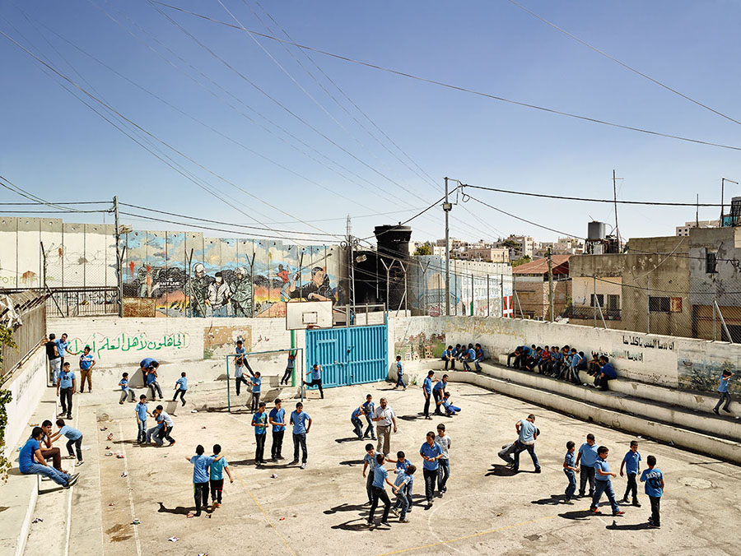

Slide 17
2. Aida Boys School, Bethlehem
West Bank

Slide 18
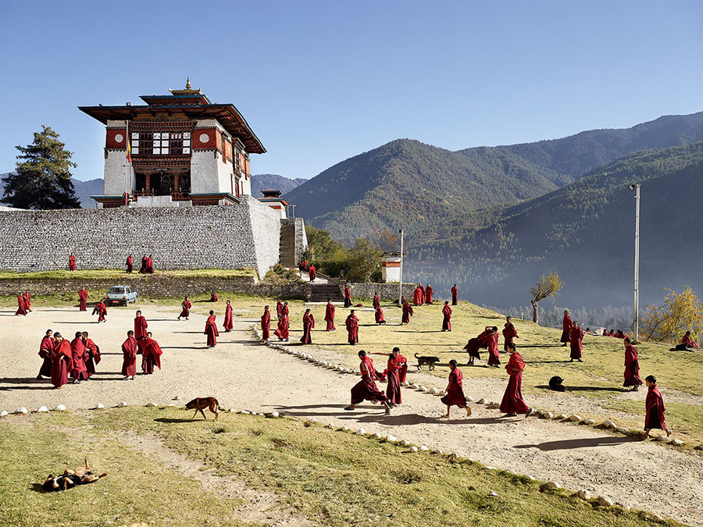

Slide 19
3. Decen Phodrang School
Thumpu
Bhutan

Slide 20
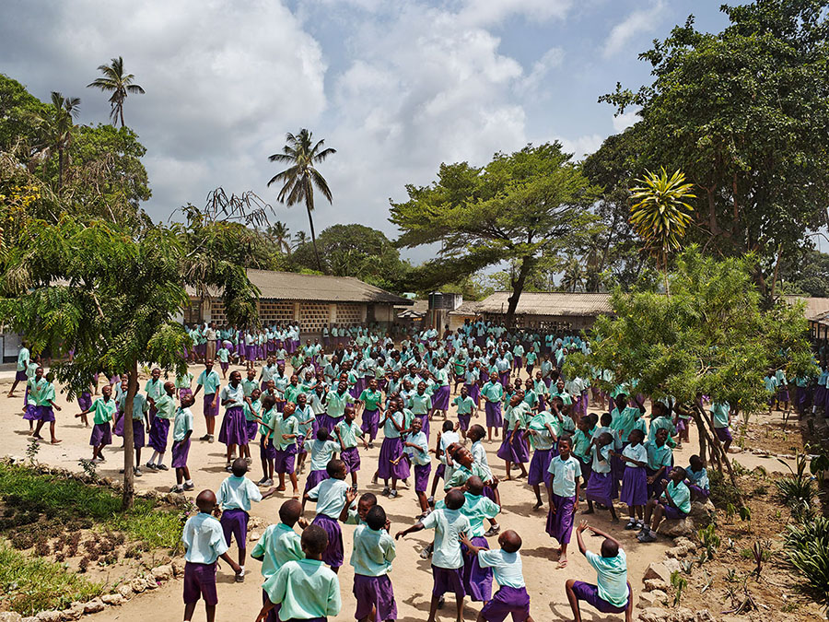

Slide 21
4. Freetown Community Primary School
Mombasa
Kenya

Slide 22
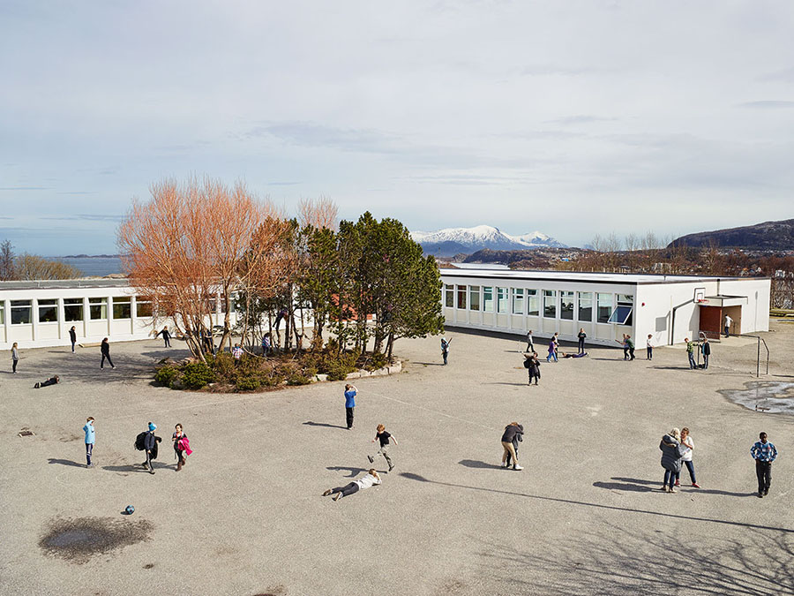

Slide 23
5. Gomalandet Skole School
Kristiansund
Norway

Slide 24
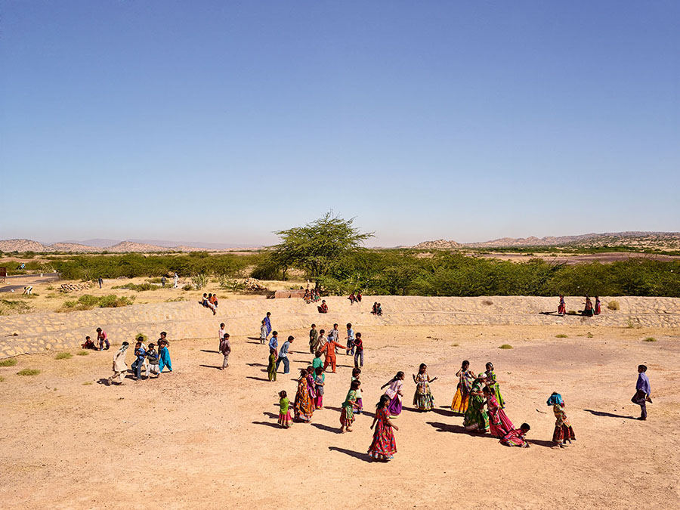

Slide 25
6. Gram Panchayat School
Gujarat
India

Slide 26
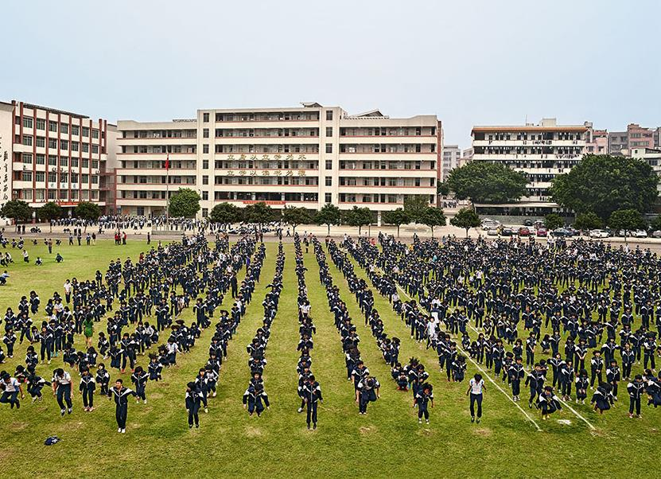

Slide 27
7. He Huang Yu Xiang Middle School
Qingyuan
China

Slide 28
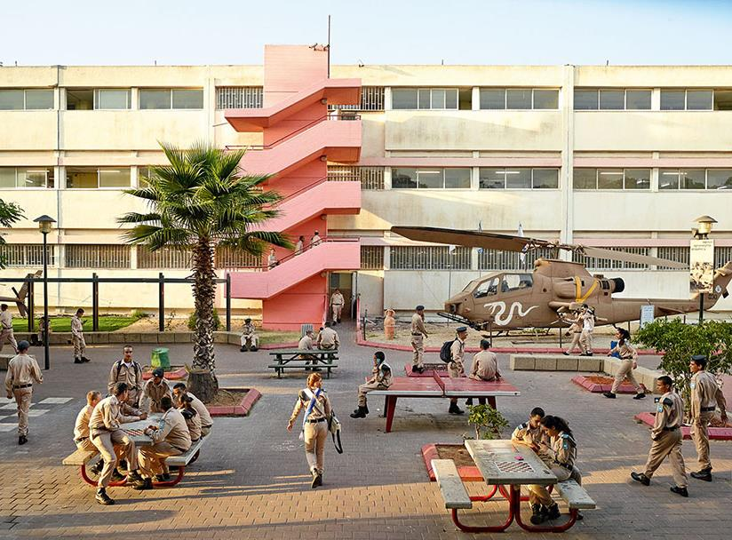

Slide 29
8. Holtz High School
Tel Aviv
Israel

Slide 30
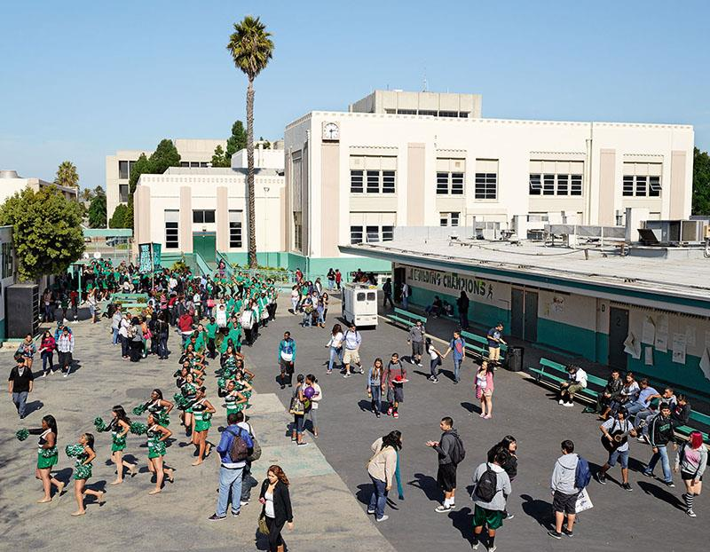

Slide 31
9. Inglewood High School
California
USA

Slide 32
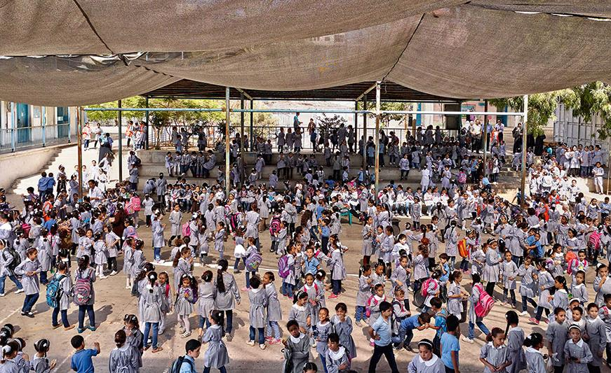

Slide 33
10. Maamounia Elementary School
Gaza City
Gaza

Slide 34
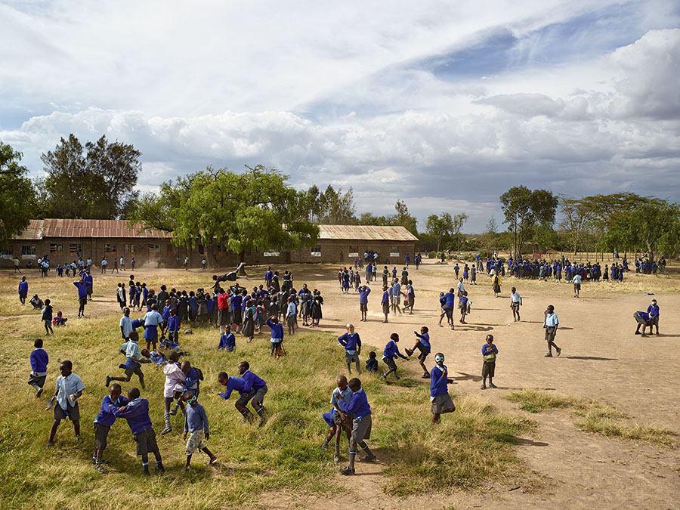

Slide 35
11. Manera Primary School
Naivasha
Kenya

Slide 36
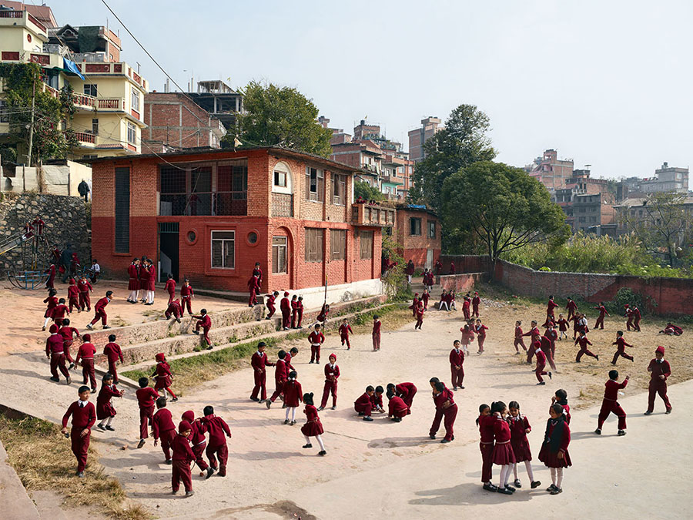

Slide 37
12. Open Day Primary School
Kathmandu
Nepal

Slide 38
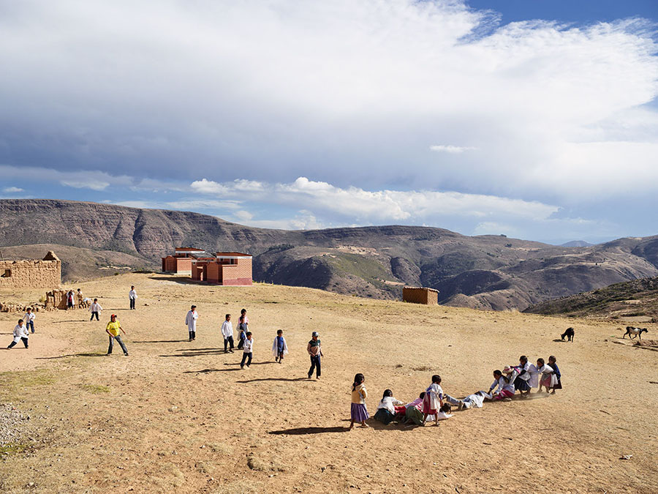

Slide 39
13. Paso Payita School
Chuquisaca
Bolivia

Slide 40
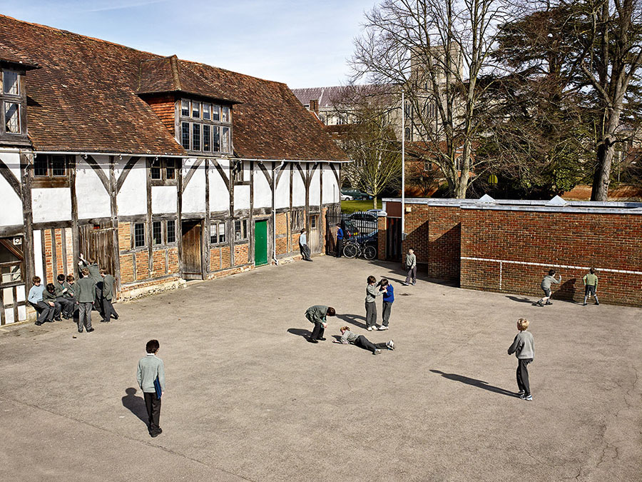

Slide 41
14. Pilgrims School
Winchester
England

Slide 42
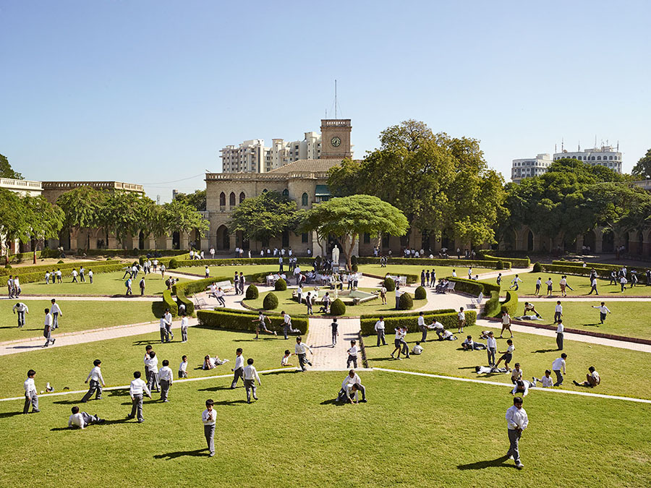

Slide 43
15. Rajkumar College
Gujarat
India

Slide 44
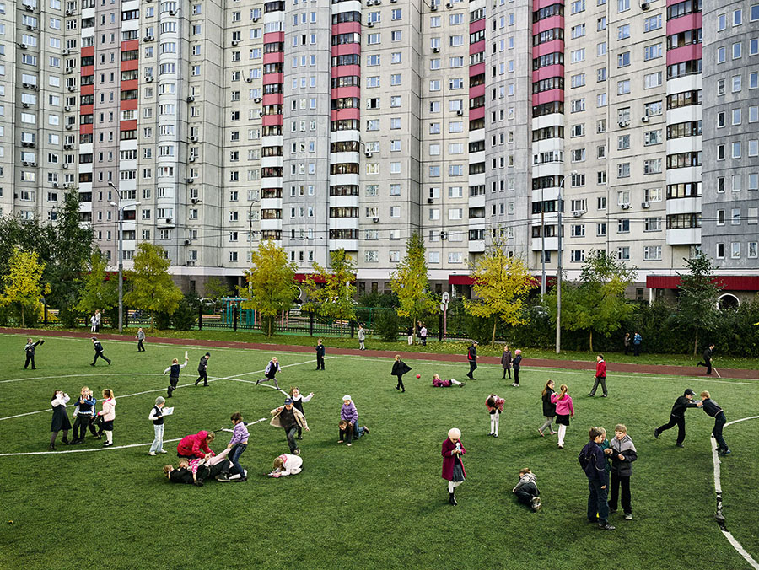

Slide 45
16. School #2014
Moscow
Russia

Slide 46
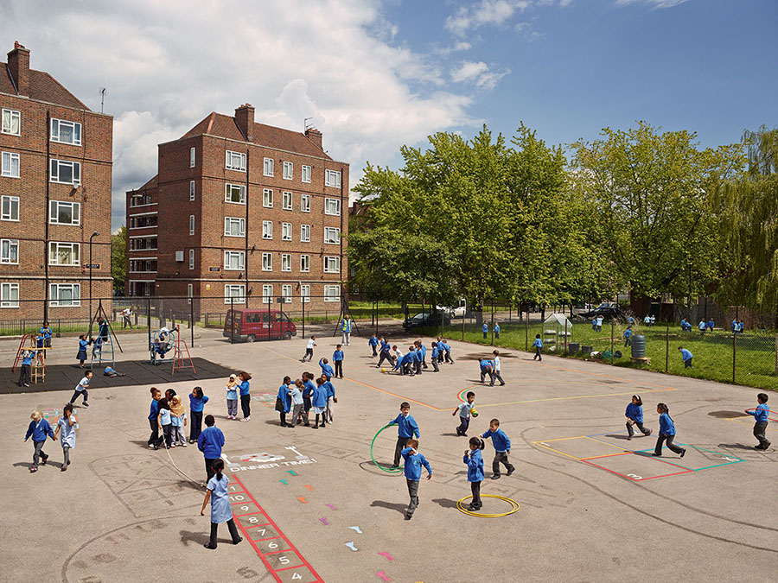

Slide 47
17. Seabright Primary School
London
England

Slide 48
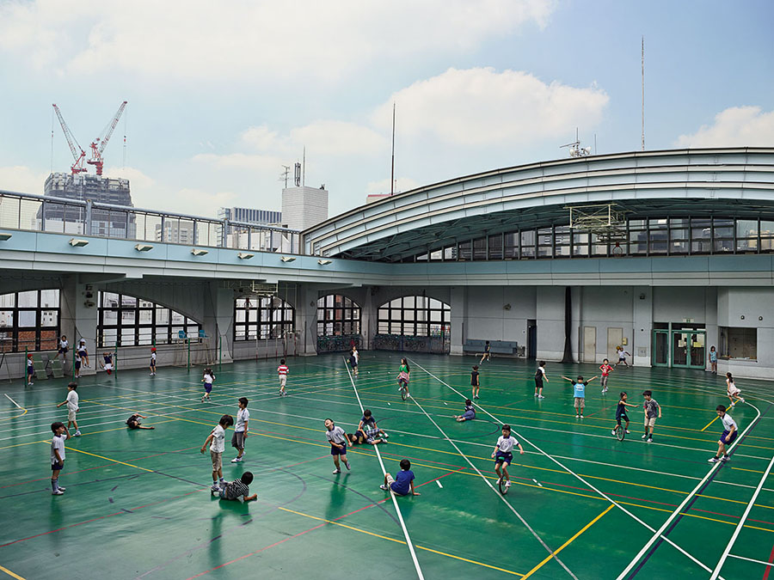

Slide 49
18. Shohei Elementary School
Tokyo
Japan

Slide 50
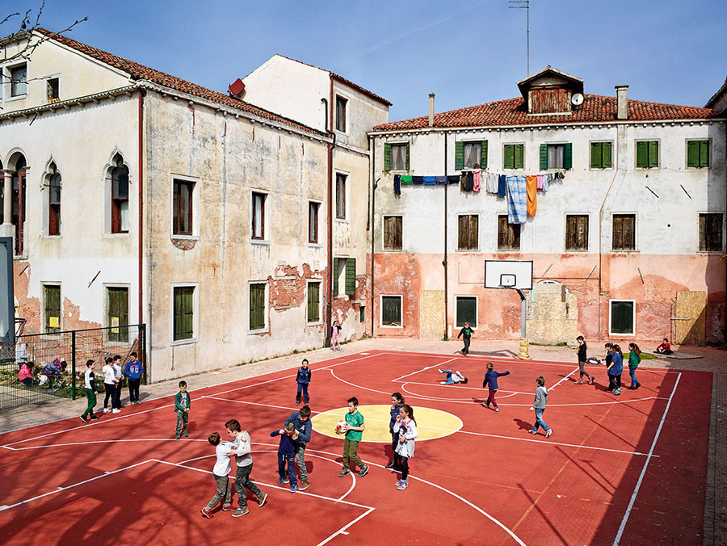

Slide 51
19. Ugo Foscolo Elementary School
Murano
Venice

Slide 52
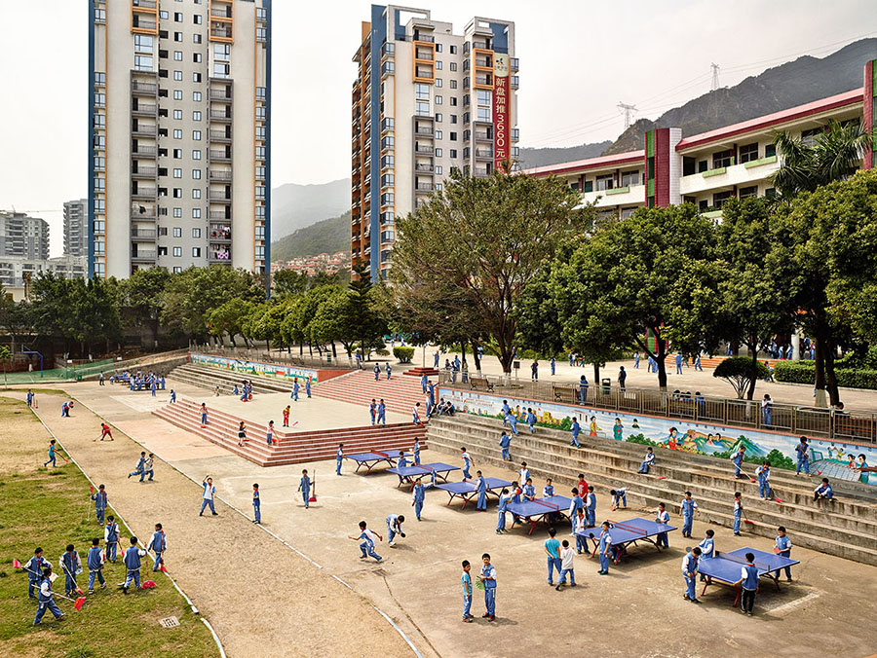

Slide 53
20. Wen Chong Primary School
Qingyuan
China

Slide 54
How many of the countries did you guess?
Did you find any similarities to your own playtime/break time?
Would you say they were “cultural similarities”? Why?
Which of the images stood out to you the most? Why?

Slide 55
Cultural Respect 15 minutes+

Slide 56
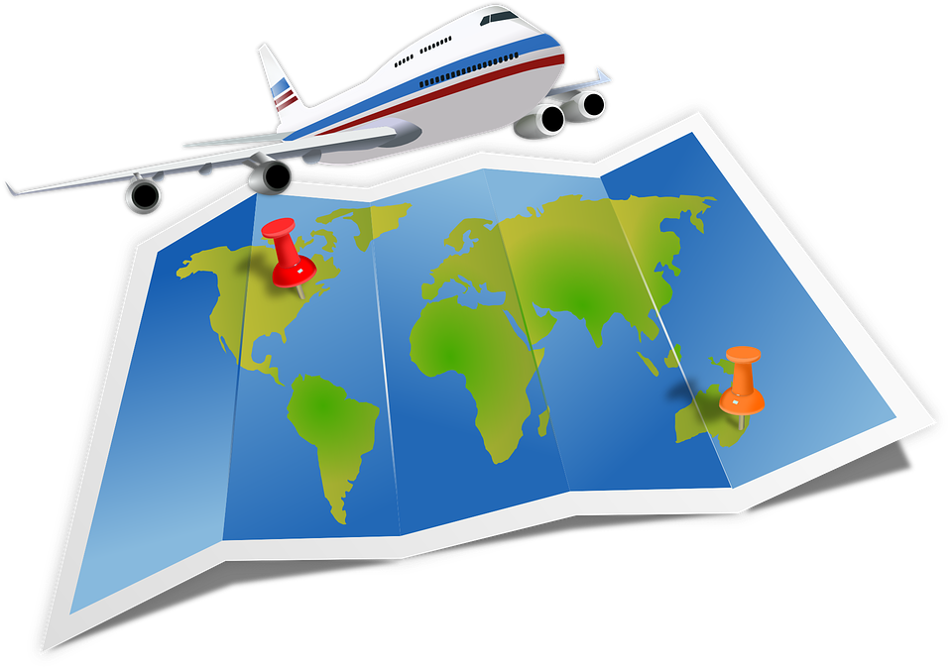
As we are moving further into the Global Village, it is becoming more and more necessary to learn to respect different cultures and traditions. More and more employers are looking to employ people who exhibit traits of compassion and respect within the role of global connectivity.
Many of us are now travelling to countries and cultures that we would not have had access to just a century ago. For example, on January 1st 1914, one commercial passenger flew on one commercial flight compared to January 1st 2014, when an estimated 8 million people flew on nearly 100,000 flights!

Slide 57
We are now familiar with the phrase “Global Citizen”, but what really does this mean?
What do you understand by the term “Global Citizen”?
What might you have to do to become a “positive global citizen”?

Slide 58
Have a go at the Cultural Respect quiz to see how much you know about particular rules and customs in commonly visited countries.
Split into small groups to form teams of 4-5 people
Number from 1-11 on a piece of scrap paper
Have a go at answering the following 11 questions about countries’ laws and traditions across the world.

Slide 59
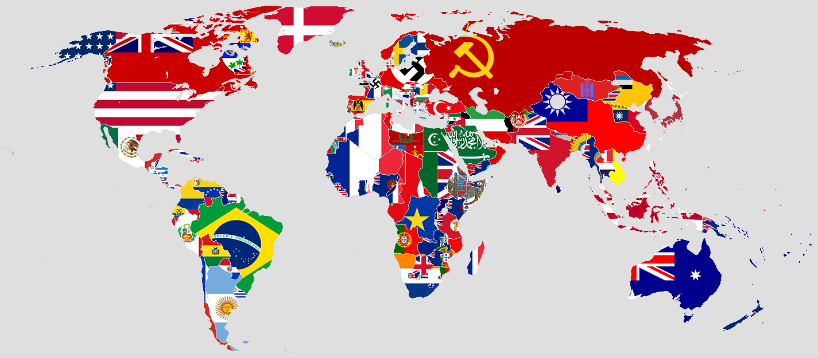
Cultural Respect

Slide 60
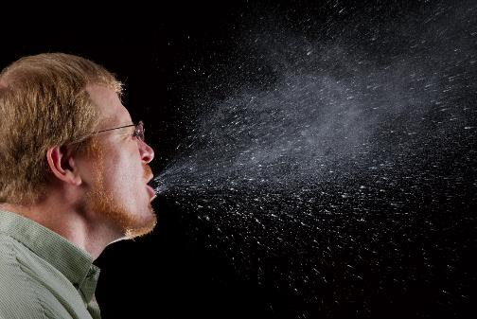
1. In which city can you be fined for spitting?

Slide 61
2. In which country is it illegal to drive without wearing a shirt or top?

Slide 62
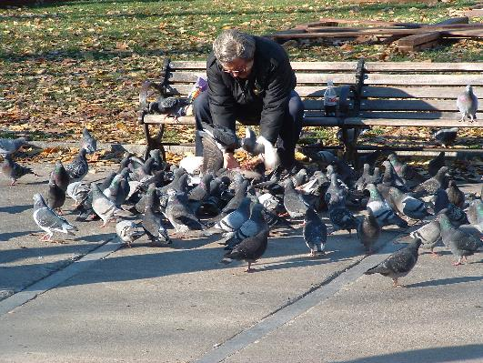
3. In which city is it illegal to feed the birds?

Slide 63
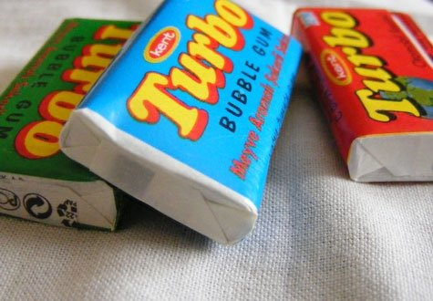
4. In which country is it illegal to chew gum?

Slide 64
5. In which country is it illegal to eat in public places during Ramadan?

Slide 65
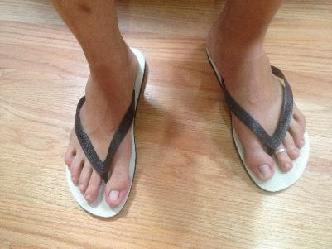
6. In which country is it illegal to drive whilst wearing flip-flops?

Slide 66
7. On which beach can you be fined for swearing or using offensive language?

Slide 67
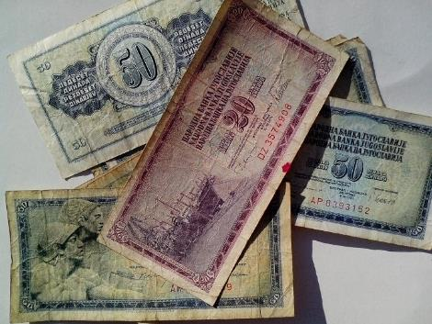
8. In which country is it illegal to step on local currency in public?

Slide 68
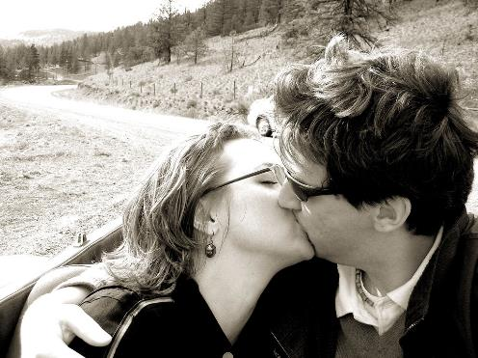
9. In which country can you be arrested and jailed for kissing in public?

Slide 69
10. What punishment can the following countries apply if you are caught in possession of drugs: Indonesia, Thailand, China, Singapore, Malaysia, Vietnam, Sri Lanka and UAE?

Slide 70
11. In which country can you be fined up to $40,000 or imprisoned for up to 4 years for producing, selling or using plastic bags?

Slide 71
The Answers

Slide 72
1. In which city can you be fined for spitting?

Slide 73
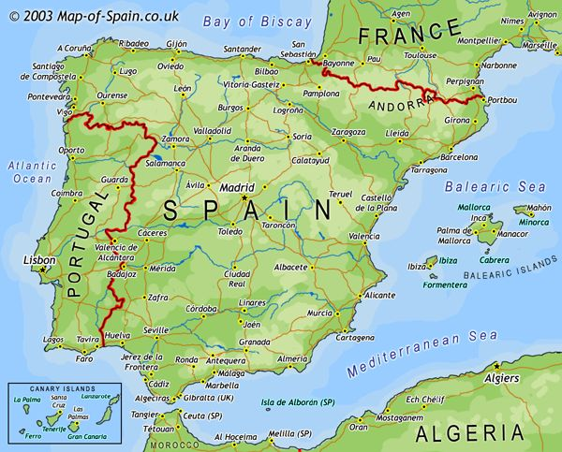
Barcelona

Slide 74
2. In which country is it illegal to drive without wearing a shirt or top?

Slide 75
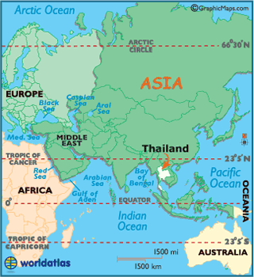
Thailand

Slide 76
3. In which city is it illegal to feed the birds?

Slide 77
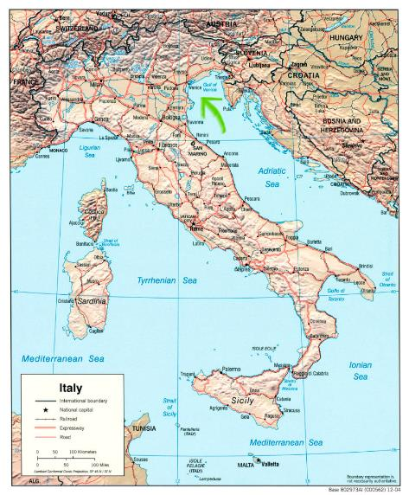
Venice

Slide 78
4. In which country is it illegal to chew gum?

Slide 79
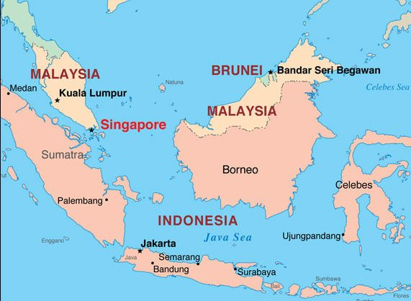
Singapore

Slide 80
5. In which country is it illegal to eat in public places during Ramadan?

Slide 81
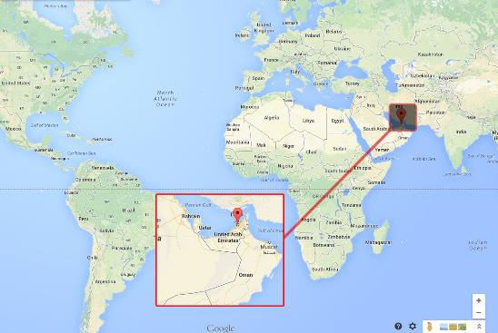
Dubai

Slide 82
6. In which country is it illegal to drive whilst wearing flip-flops?

Slide 83
Spain

Slide 84
7. On a beach in which country can you be fined for swearing or using offensive language?

Slide 85
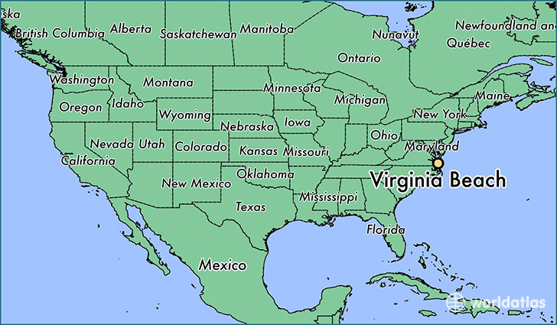
USA
(Virginia Beach)

Slide 86
8. In which country is it illegal to step on local currency in public?

Slide 87
Thailand

Slide 88
9. In which country can you be arrested and jailed for kissing in public?

Slide 89
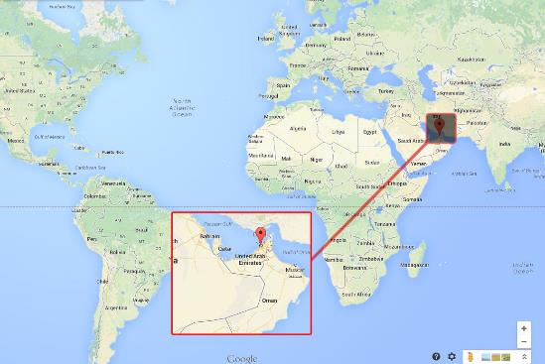
Dubai

Slide 90
10. What punishment can the following countries apply if you are caught in possession of drugs: Indonesia, Thailand, China, Singapore, Malaysia, Vietnam, Sri Lanka and UAE?

Slide 91
The Death Penalty

Slide 92
11. In which country can you be fined up to $40,000 or imprisoned for up to 4 years for producing, selling or using plastic bags?

Slide 93
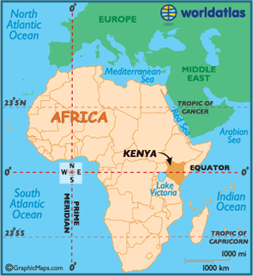
Kenya

Slide 94
Add up your scores and see which group in the class is most aware of some of the world’s interesting cultural rules!
How important is it to research a culture’s rules and traditions before you visit their country?
As tourists are “not immune” from rules and laws in other countries, do you think we should teach more about the need for good cultural awareness in school?

Slide 95
Let’s celebrate! 5 minutes+

Slide 96
Remember: Cultural diversity needs to be celebrated!
You are an idea; just one idea of what one person on earth could be doing. Celebrate difference; it is what makes us all beautifully unique!
Look at the ideas about cultural diversity on the next slides and think about ways that you can start celebrating culture and cultural diversity in your school.

Slide 97
Culture is invisible to its members!
Culture is like water in a goldfish bowl: to the fish, it’s normal and natural. It’s only when you’re outside the medium that you notice it.

Slide 98
Much of culture is below the surface!
While some aspects of culture are visible (e.g., food, music, clothing), much of culture operates below the surface on the level of values, beliefs, and expectations.

Slide 99
Cultures are dynamic and heterogeneous!
Cultures are not uniform and differences within cultures (based on class, ethnicity, region, gender) are often profound. Cultures can and sometimes do change rapidly.

Slide 100
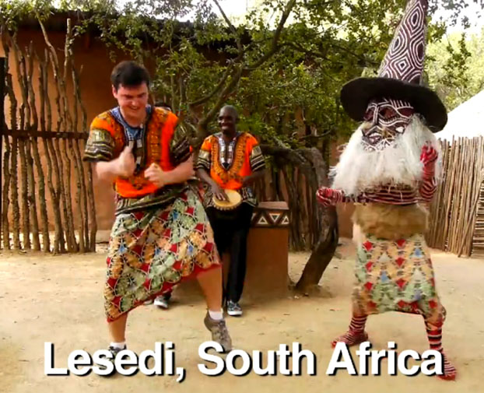
If time allows, finish by watching the short video (4 minutes) featuring dances by traveller and comedian Matt Harding entitled:
Dancing Around the World
(click on the link above)

Slide 101
You are an idea; just one idea of what one person on earth could be doing.
Celebrate difference; it is what makes us all beautifully unique!

Slide 102
This sort of learning can’t wait

