Slide 1
G L O B A L
C U L T U R E S
CULTURAL IDENTITIES
Y9&10
13-15 years

Slide 2
A C U L T U R A L
C E L E B R A T I O N
W E E K 4
3 0 M I N U T E S

Slide 3
In this lesson, students will:
THINK!
Think about and explore the value of culture and diversity and the role of cultural respect as global citizens
Understand and explore our own responsibilities as global citizens and the direct and indirect actions and impacts that we can have as we travel
Explore and unravel the impact of cultural disrespect upon communities and individuals and examine how we can change behaviour patterns to support cultural respect
FEEL!
CONNECT!

Slide 4
P R E - L E S S O N
R E F L E C T I O N S
3 – 5 M I N U T E S +

Slide 5
Introduce the following REFLECTIVE QUESTIONS for students to consider during the lesson:
What is cultural respect? Why might this mean?
Is it important to learn about cultural traditions and behaviours before travelling to another country? Why? Why not?
Is cultural disrespect something that we have a personal responsibility to avoid when we travel?

Slide 6
D I V E R S I T Y N O T
D I F F E R E N C E
5 M I N U T E S +

Slide 7
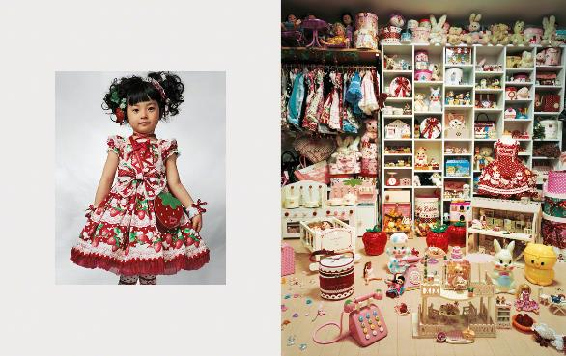
Watch the short video (3.30mins) put together by ThoughtBox featuring pictures by artist James Mollison entitled:
Where Children Sleep
(click on the link above)

Slide 8
Allow students a few minutes to respond to the film with people sitting near to them.
After sharing their initial responses, ask them to consider the following questions:

Slide 9
This is what the photographer, James Mollison, said about his collection of pictures of bedrooms from around the world:
“My bedroom reflected what I had and who I was.
When asked to come up with an idea for engaging with children’s rights, I found myself thinking about my bedroom: how significant it was during my childhood, and how it reflected what I had and who I was.

Slide 10
P O S I T I V E G L O B A L
C I T I Z E N S H I P
1 5 M I N U T E S +

Slide 11
Many of us are now travelling to countries and cultures that we would not have had access to just a century ago. For example, on January 1st 1914, one commercial passenger flew on one commercial flight compared to January 1st 2014, when an estimated 8 million people flew on nearly 100,000 flights!
Click here to open a Map of the World (or use the image on the following slide)
Look at the map and count up how many countries you have travelled to during their lifetime and note down how many countries the class as a whole has visited.
Mark on the map (if using an interactive whiteboard)

Slide 12
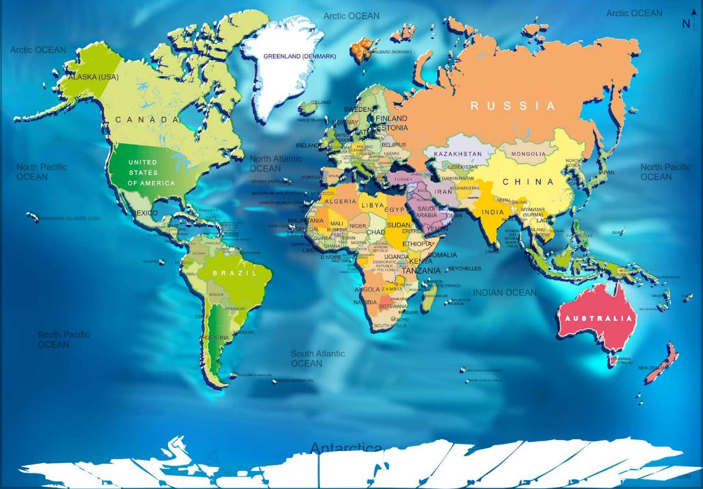

Slide 13
Have you ever spent time in a country with very different cultural traditions to where you now live?
Where was this, and what were the biggest cultural differences that you experienced?

Slide 14
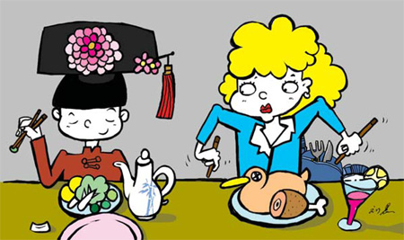
When travelling to different countries or cultures, there are many things that are unusual or surprising, because each culture has their own set of traditions or “ways of doing things.” As well as the climate often being very different to our own, differences exist in language, clothing, food, music, traditions, rules, laws, ideas etc. and these differences can be a lot to take in when first arriving in a new place.

Slide 15
What is meant by the term “culture shock”? Have you ever experienced this?
Have you ever experienced culture shock within your own country or culture?

Slide 16
Think about the following and discuss what “shocks” people may experience when coming to visit your country and its culture for the first time:
Clothing | Religion | Climate | Customs / Traditions | Food and Drink

Slide 17
Why might researching and understanding some of the local customs and traditions of a country be important before you visit?

Slide 18
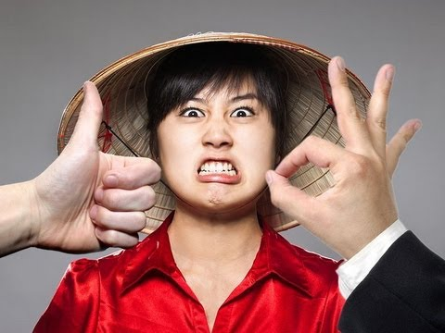
Watch the short video (2.35mins) made by All Time 10s entitled:
10 surprising ways you may offend people in other countries
(click on the link above)

Slide 19
Allow students a few minutes to respond to the film with people sitting near to them.
After sharing their initial responses, ask them to consider the following questions:

Slide 20
What might it mean to be a positive global citizen?

Slide 21
C U L T U R A L
I N T E L L I G E N C E
1 0 M I N U T E S +

Slide 22
Reflect upon and discuss the following questions, taking into account what you have seen, discussed and read so far within this month’s topic:
What do you think the term CULTURAL INTELLIGENCE means?*
How can we learn to promote cultural intelligence?
*Allow students to discuss and come up with their thoughts- click here to see a definition)

Slide 23
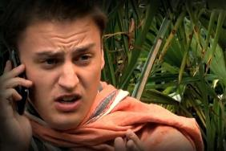
Watch the short spoof video (3.17mins) made by VM Productions entitled:
Gap Yah
(click on the link above)

Slide 24
Allow students a few minutes to respond to the film with people sitting near to them.
After sharing their initial responses, ask them to consider the following questions:

Slide 25
What stereotypes about gap year travellers is the film trying to explore?
How might some travellers be negatively impacting other cultures and communities?

Slide 26
ADVICE TO STUDENTS!!
Being a tourist does not make you in any way immune from the law. Not knowing local laws can get you into serious trouble. Just because something is legal in your own country, doesn't mean it is legal in the country of your choice.
Even as a foreigner, you must obey all a citizen of the country of your choice laws and the laws of other countries to which you are traveling. If you break local laws when in the country of your choice, your home government can do very little to help you. Click on the following link for more information:
Students Abroad

Slide 27
Remember:
Cultural diversity is something to celebrate!
Culture is the acquired pair of glasses through which we see the world.

Slide 28
GLOBAL CULTURES
T H I S S O R T O F L E A R N I N G
C A N ’ T W A I T

