Slide 1
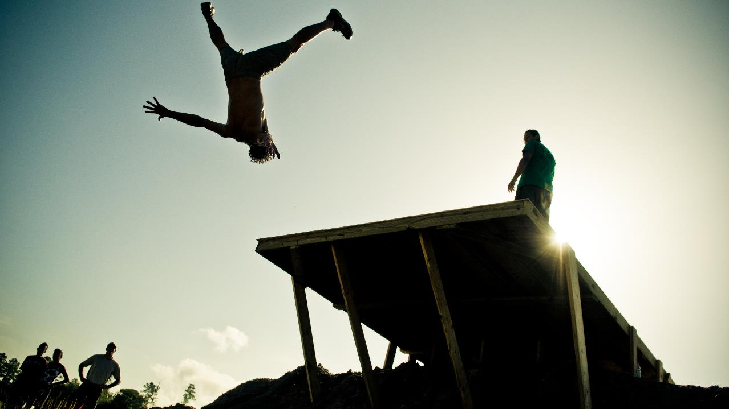
15 minutes+
Faith
Week 1 – Why do we believe?
Y11-13
15-18 years

Slide 2
In this lesson, students will:
Think about and discuss what religion is and why we have so many different versions of religion
Understand the reasons why we need to believe in something bigger than ourselves
Explore and unravel some of the stereotypes and divisions that exist within religions, exploring the links between religion and morality

Slide 3
Pre-lesson reflection 3-5 minutes+

Slide 4
Introduce the following REFLECTIVE QUESTIONS for students to consider during the lesson (maybe write them up or read them aloud and ask students to think about their own responses):
What is faith? What do you think this means?
Are you religious? What does it mean to “be religious”?
What is ‘God’ or what does the idea of ‘God’ mean to you?

Slide 5
The meaning of 'Faith’ 5-10 minutes+

Slide 6
Watch the short video (2.39 mins) made by Our New Normal entitled:
Kids Explain Faith
(Click on the link above for the hyperlink)

Slide 7
Allow students a few minutes to respond to the film with people sitting near to them.
After sharing their initial responses, ask them to think about the following questions:

Slide 8
Do you agree with any of these ideas about faith?
What do you think faith means?
What happens if we don’t have faith?

Slide 9
According to some of the children in the film, faith is:
to believe in something without seeing it.
In other words, faith is having confidence in knowing that something is true, or will happen, even if we can’t see it.
We have faith in people e.g. “I have faith that you’re going to score this goal or pass this exam or finish this deadline etc.”
So, if we stay with this train of thought…

Slide 10
Could we replace the word “Faith” with the word “confidence”?
How might our responses to religion change if we said we had a confidence rather than a faith?
What does ‘faith’ mean when talking about religion?
Discuss your thoughts with the person sitting next to you and then share ideas with the class.

Slide 11
What is religion and why do we believe?

Slide 12
If someone asked you the question ‘What is Religion?’ how do you think you would you answer?
With confidence?
With uncertainty?
With knowledge?
With ideas?
With hopes?
As well as being different in how we answer, you will find that we all have very different responses to this question.

Slide 13
Thinking about your own personal beliefs, how many of the following statements do you believe…
Add them up in your head as you read them…

Slide 14
Religion is…
A way of explaining what happens when people die
Why there is life and death
A way of explaining some of the mysteries in life
How and why the world was created
A moral code for how to live

Slide 15
Religion is…
A way of explaining who or what created the world and all the living beings
A way of explaining how to lead a good life on Earth
A way to explain why there is suffering in the world
A way of explaining something more powerful than humans
A way of describing places beyond the physical world e.g. the spiritual world

Slide 16
We all have our own unique answer to the question ‘What is Religion?’ and we all have our own beliefs.
Is it ok that there are many different answers and beliefs when it comes to religion? Why do you think this?
Discuss with the person sitting next to you and share ideas with the class.

Slide 17
Why do we believe?

Slide 18
Most people will have a sort of faith or belief – even atheism or not believing is a faith of sorts.
For many, religion plays a very important role in life and as the world becomes smaller (though our use of the internet, ability to travel, moving through different countries etc.) we will find that we are all encountering more and more different faiths in our daily lives.
How many different religions are there in your class?
Ask students to write down their religion or belief on a piece of paper (anonymously if they wish) and then tally them up to get a representation of the class.

Slide 19
A quick introduction to The BIG Five

Slide 20
When it comes to popular religion,
there are five dominant religions across the world:

Slide 21
1. Christianity

Slide 22
2. Islam

Slide 23
3. Judaism

Slide 24
4. Buddhism

Slide 25
5. Hinduism

Slide 26
What are some of the stereotypes and stigmas associated with Christianity and Christians?
Where have these come from?
Discuss together to start to think about where and how religious intolerance is associated with Christians and Christianity.

Slide 27
What are some of the stereotypes and stigmas associated with Islam and Muslims?
Where have these come from?
Discuss together to start to think about where and how religious intolerance is associated with Islam and Muslims.

Slide 28
What are some of the stereotypes and stigmas associated with Jews and Judaism?
Where have these come from?
Discuss together to start to think about where and how religious intolerance is associated with Judaism and Jews.

Slide 29
What are some of the stereotypes and stigmas associated with Buddhists and Buddhism?
Where have these come from?
Discuss together to start to think about where and how religious intolerance is associated with Buddhists and Buddhism.

Slide 30
What are some of the stereotypes and stigmas associated with Hindus and Hinduism?
Where have these come from?
Discuss together to start to think about where and how religious intolerance is associated with Hindus and Hinduism.

Slide 31
Why do you think these five religions have become the most popular (or the most followed) religions across the world?

Slide 32
This sort of learning can’t wait
Copyright © 2017 ThoughtBox Education.

