Slide 1
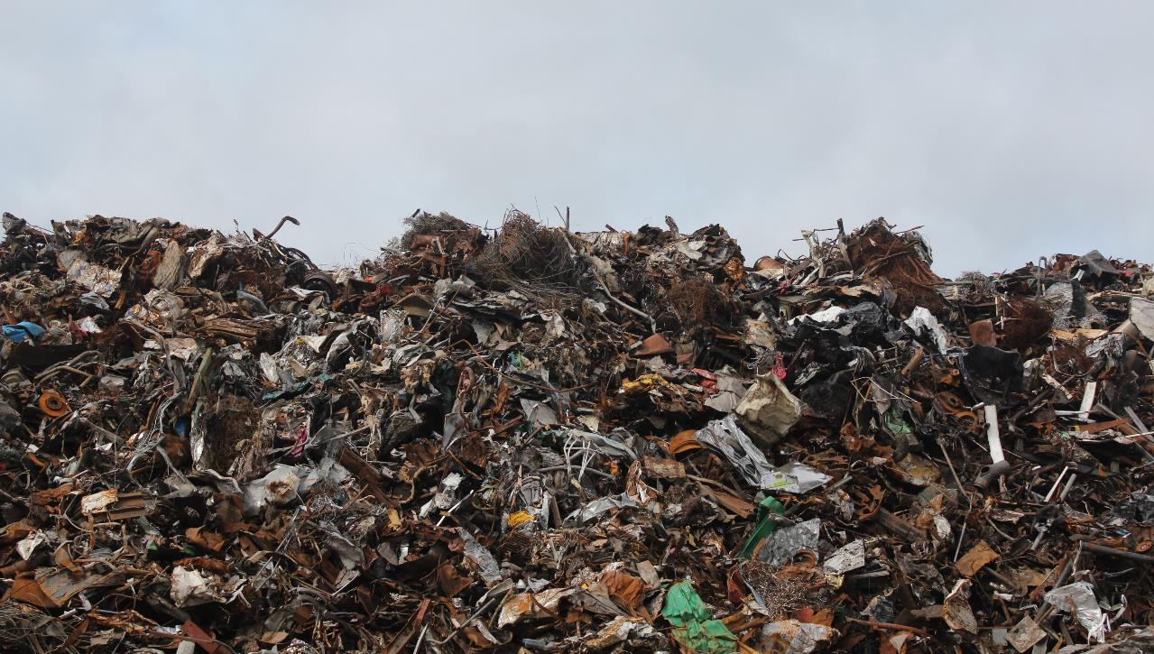
W A S T E
E N V I R O N M E N T A L E N G A G E M E N T
Y11-13
15-18 years

Slide 2
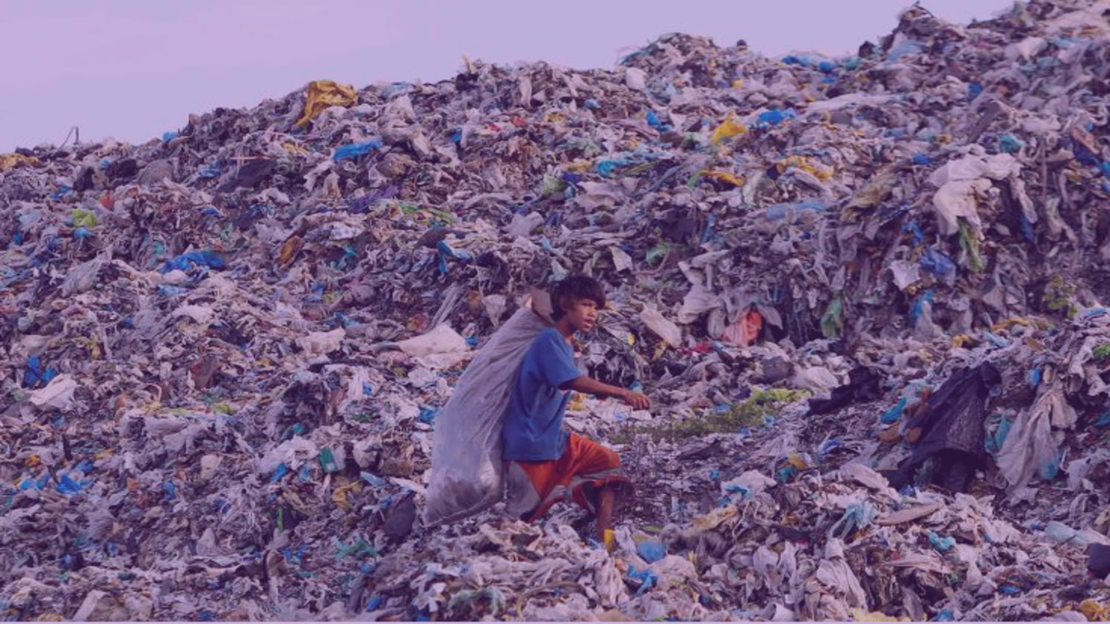
T H E M O N S T E R S
W E M A K E
W E E K 3
1 HOUR

Slide 3
In this lesson, students will:
THINK!
Think about and discuss where all of our waste goes when we throw it “away” (because there is no such place as away!)
Understand how our wasteful habits might be seen by other people and how it might feel to approach waste in another way
Explore and unravel some of the stories of people who live on rubbish dumps and use our unwanted rubbish to make a living
FEEL!
UNLEARN!

Slide 4
P R E – L E S S O N
R E F L E C T I O N S
3 M I N U T E S +

Slide 5
Introduce the following REFLECTIVE QUESTIONS for students to consider during the lesson:
What do you think happens to all of the “stuff” that you throw away?
Whose responsibility is it to deal with our rubbish? Why?
Should we be held to account if we create too much rubbish? Why do you think this?

Slide 6
C H I L D R E N O F T H E D U M P
2 5 M I N U T E S +

Slide 7
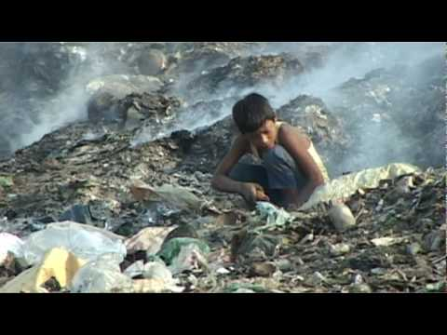
Watch the short documentary (17.04 mins) made by The Small Steps Project, entitled:
Children of the Dump
Click on the link above for the hyperlink

Slide 8
Allow students a few minutes to respond to the film with people sitting near to them.
After sharing their initial responses, ask them to consider the following questions:

Slide 9
What is the film trying to show about the world’s waste?
What are your thoughts about the children living on the rubbish that you create?
Were you aware that many people end up using your waste as part of their livelihood?

Slide 10
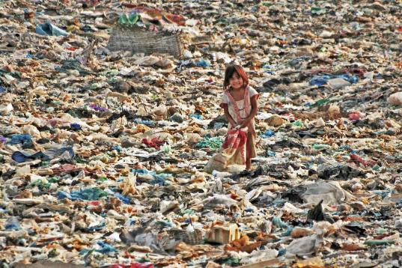
If time (and interest) allows, click on the link and explore some of the stories from rubbish dumps across South East Asia where The Small Steps project (a charity working to support families surviving on rubbish dumps) is working:
Dump Projects
(Click on the link)

Slide 11
W H E R E I S A W A Y ?
2 5 M I N U T E S +

Slide 12
Take a look at one (or both) of the following articles, outlining in a little more depth some of the ways that countries are offloading their rubbish onto someone else:
Where does all our rubbish go?
The UK’s new rubbish dump: China
Alternatively the following slides give a quick overview about where rubbish created in the UK goes to when it is thrown away:

Slide 13
‘From bin to beyond - what happens to our waste?
Take from an article in The Independent | by Malcolm Macalister Hall

Slide 14
PLASTIC
On average, every household in the UK uses 373 plastic bottles each year, of which only 29 (less than 10 per cent) are recycled. The quantity of plastic bottles recycled has more than doubled since 2002. Recycling one can save enough energy to light a 60W bulb for up to six hours.
Plastic is one of the hardest materials to recycle, as it needs to be sorted. Bottles are the easiest. .After being processed into flakes or pellets, they can be remade into fleece jackets, traffic cones, drainage pipes, street furniture, garden furniture, carpets, stuffing for sleeping bags, and toys and playground equipment.

Slide 15
PAPER
Paper is one of the most successful areas of recycling. Some 57 per cent of paper used in Britain is recovered and recycled. Because the UK makes 6 million tons of paper a year - but imports a further 6 million - UK papermills are already using all the recycled paper they can.
To avoid its being dumped or burned, excess "waste" paper must be exported for recycling. UK papermakers use a higher proportion of recycled paper (74 per cent) than any other European country (average 45 per cent).

Slide 16
CANS
Alluminium drinks cans are most likely go to Novelis Recycling in Warrington, which operates Europe's only dedicated alluminium can recycling plant. Five billion alluminium cans are used in the UK each year - but nearly two-thirds are dumped, even though aluminum is one of the easiest materials to recycle, one of the most environmentally beneficial and valuable.
It's the only recyclable material that covers its cost of collection and reprocessing, and can be endlessly recycled with no loss of quality, saving 95 per cent of the energy required to make cans from raw materials. The low recycling rate is mainly because a third of all canned drinks are consumed away from home, and then put in litter bins. "Tin cans" are really steel. Every year some 13 billion are used in the UK, and even though each one is 100 per cent recyclable more than half are landfilled

Slide 17
KITCHEN & GARDEN WASTE
This is composted and either sold on to horticultural suppliers, or used in parks. It is the most-collected type of recycling. Local authorities have made great efforts to collect kitchen and garden waste partly because it is quite heavy - and since their recycling rates are measured by weight, this is a good way to boost tonnage, and meet targets. (Plastic, in contrast, is hugely bulky and very light.)

Slide 18
GLASS
Glass recycling hit record levels in 2005 - 1,272,000 tons. But this is only 50.8 per cent of the total amount of glass we use. So another 1.2m tons were dumped across the country. Glass recycling now reduces carbon dioxide emissions by around200,000 tons each year in the UK, and UK glassmakers used a record 742,000 tons of recycled glass in 2005 (British-made bottles and jars now contain on average 35.5 per cent recycled glass).
Another 250,000 tons of glass from recycling collections were exported to Europe; and 280,000 tons were used in construction or roadmaking. Low-value, crushed green glass (which cannot be mixed with clear or brown to make new clear glass bottles), or mixed glass is used in building or road materials, for filtration systems in swimming pools, and is even being trialled in place of sand for bunkers on golf courses.

Slide 19
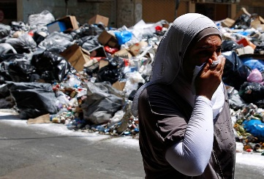
Watch this short film (4 mins) made by ThoughtBox entitled:
Not in my back yard
Click on the link above for the hyperlink
ADD PICTURE FROM THE FILM HERE

Slide 20
Ask students to think about and discuss some of the facts and ideas raised in the film. In particular, consider the following statistics:

Slide 21
Every year, the world produces 2 billion tons of rubbish: enough waste to fill a line of rubbish trucks to circle the earth 24 times.
*World Bank figures 2013
90% of the world’s waste is created by 5% of the world’s population
(mainly those living in the West)
If trends continue, annual global waste will exceed 11 million tons per day. That is 4 billion tons – enough waste to fill a line of rubbish trucks to circle the earth 48 times.
*World Bank figures 2013

Slide 22
As of 1st January 2018, China no longer accepts the plastic waste that the world used to send over.
A ban on imports of millions of tonnes of plastic waste by the Chinese government is already causing a build up of rubbish at recycling plants around the UK and will bring chaos for councils in the weeks ahead, according to industry experts.
British companies alone have shipped more than 2.7m tonnes of plastic waste to China and Hong Kong since 2012 – two-thirds of the UK’s total waste plastic exports, according to data from Greenpeace released last month.
But last summer the Chinese government announced it intended to stop the importation of 24 kinds of solid waste by the end of the year, including polyethylene terephthalate (Pet) drinks bottles, other plastic bottles and containers, and all mixed paper, in a campaign against yang laji or “foreign garbage”.

Slide 23
The ban is already having severe consequences for council recycling in the UK. So what should we do?
Find somewhere else to send our rubbish?
Deal with it in our own country?
Find ways to avoid making this waste in the first place?
What do you think? What at should we do with our rubbish?

Slide 24
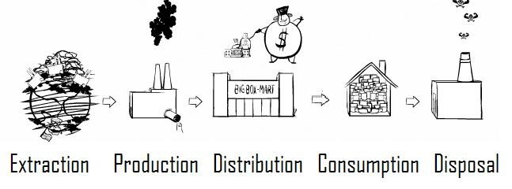
One of the reasons we are able waste so consciously is perhaps because we are so removed from the work involved in the processes of production and of waste removal.
Think back to the production chain mentioned in Week 2’s lesson:

Slide 25
The “externalised cost” is something that we are not often conscious of in our daily lives. This is certainly the case in processed food. Food is now cheap and “fast” to buy; is consumed easily and quickly, thus the time, labour and waste involved in its production is not part of our consciousness during consumption.
However, the “behind the scenes” waste processes involved in much of our fast food are not quite so easy to forget if you are personally involved in one of the stages.

Slide 26
Is being removed from our food production a factor in mindless our waste creation?
How sustainable and ethical are our wasteful actions?

Slide 27
W H O S E
R E S P O N S I B I L I T Y I S O U R R U B B I S H ?
1 0 M I N U T E S +

Slide 28
To finish, ask students to discuss the following question; using their learning so far and thoughts they may have about waste production/reduction in general:
Do individuals have a moral obligation to reduce waste in their communities?
Either run as a general discussion or debate within the class, or split the class into groups and ask them to discuss amongst themselves.
NB: The following slides explain how to run a simple debate

Slide 29
A quick guide to running a debate

Slide 30
Structure
A formal debate usually involves three groups: one supporting a resolution (affirmative team), one opposing the resolution (opposing team), and those who are judging the quality of the evidence and arguments and the performance in the debate( in this case the teacher)
In addition to the three specific groups, there may an audience made up of class members not involved in the formal debate. A specific resolution is developed and rules for the debate are established.

Slide 31
2. Preparation
Develop the resolution to be debated.
Organize the teams.
Establish the rules of the debate, including timelines.
Research the topic and prepare logical arguments.
Gather supporting evidence and examples for position taken.
Anticipate counter arguments and prepare rebuttals.
Team members plan order and content of speaking in debate.
Prepare room for debate.

Slide 32
3. Conducting a Debate:
The debate opens with the affirmative team (the team that supports the resolution) presenting their arguments, followed by a member of the opposing team.
This pattern is repeated for the second speaker in each team.
Finally, each team gets an opportunity for rebutting the arguments of the opponent.
Speakers should speak slowly and clearly.
The judges and members of the audience should be taking notes as the debate proceeds.

Slide 33
4. Suggested timeline for a formal debate
The first speaker on the affirmative team presents arguments in support of the resolution. (5 – 10 minutes)
The first speaker on the opposing team presents arguments opposing the resolution. (5 – 10 minutes)
The second speaker on the affirmative team presents further arguments in support of the resolution, identifies areas of conflict, and answers questions that may have been raised by the opposition speaker. (5 – 10 minutes)
The second speaker on the opposing team presents further arguments against the resolution, identifies further areas of conflict, and answers questions that may have been raised by the previous affirmative speaker. (5 – 10 minutes)
The opposing team begins with the rebuttal, attempting to defend the opposing arguments and to defeat the supporting arguments without adding any new information. (3 – 5 minutes)
First rebuttal of the affirmative team (3 – 5 minutes)
Each team gets a second rebuttal for closing statements with the affirmative team having the last opportunity to speak. (3 – 5 minutes each)
There cannot be any interruptions. Speakers must wait their turns. The teacher may need to enforce the rules.

Slide 34
5. Post-debate Discussion
When the formal debate is finished, allow time for debriefing and discussion.
Members of the audience should be given an opportunity to ask questions and to contribute their own thoughts and opinions on the arguments presented.
Members of the debate teams may also wish to reflect on their performance and seek feedback from the audience, including the teacher.

Slide 35
W A S T E
E N V I R O N M E N T A L E N G A G E M E N T
THIS SORT OF LEARNING CAN’T WAIT

