Slide 1
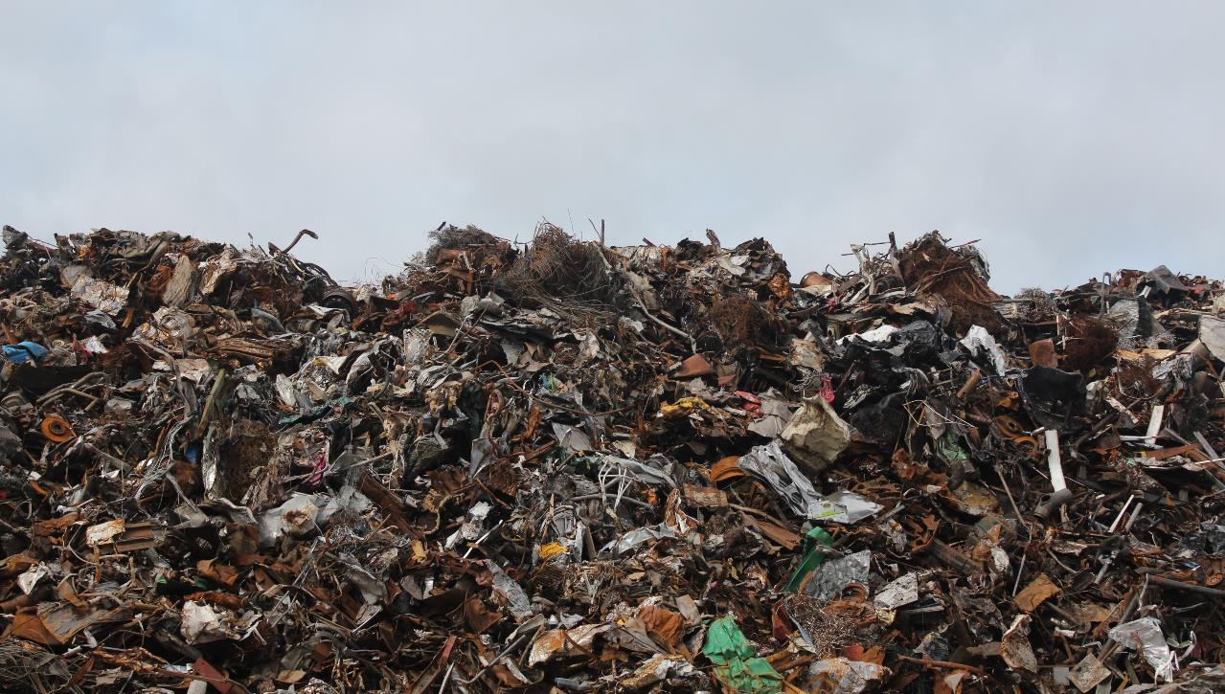
W A S T E
E N V I R O N M E N T A L E N G A G E M E N T
Y11-13
15-18 years

Slide 2
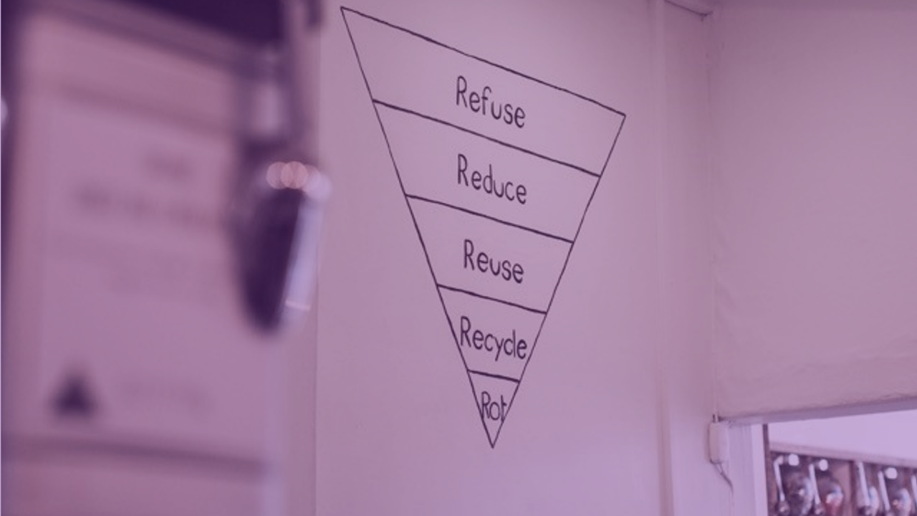
W A S T E F R E E L I V I N G
W E E K 4
1 HOUR

Slide 3
In this lesson, students will:
THINK!
Think about and discuss how we think about our personal waste, and explore ways to reduce any excess waste
Understand how to create a life that isn’t unnecessarily wasteful and the impact that this can have on our own feelings as well as the impact it has on people and planet
Explore and unravel some of our wasteful habits and think about simple ways to change behaviour
FEEL!
UNLEARN!

Slide 4
P R E – L E S S O N
R E F L E C T I O N S
3 M I N U T E S +

Slide 5
Introduce the following REFLECTIVE QUESTIONS for students to consider during the lesson:
What do you understand by the term “zero-waste”?
Do you think you are capable of cutting down how much waste you produce? Why?
What do you think would be the biggest motivator for you to reduce your waste? Why?

Slide 6
Z E R O W A S T E R S
2 0 M I N U T E S +

Slide 7
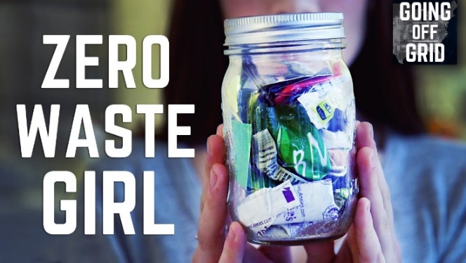
Watch the documentary (4.38 mins) made by Seeker Stories entitled:
You can live without producing trash
Click on the link above for the hyperlink

Slide 8
Allow students a few minutes to respond to the film with people sitting near to them.
After sharing their initial responses, ask them to consider the following questions:

Slide 9
What is your reaction to Lauren’s decision to go “waste-free”?
Were there elements of this idea that you found surprising or interesting? What were they and why?
Do you know anyone who has gone “waste-free”? What is their story?

Slide 10
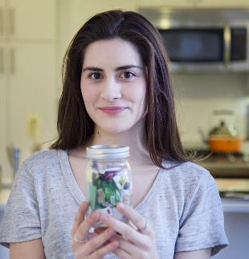
Read the following article written by “Zero-Waste Girl” Lauren Singer about her transition to a waste free life and some of the trials and tribulations along her journey.
Open the link above to read online or click to the next slide to read within this presentation.
After reading, discuss together some of the ideas that she raises and thoughts on whether they could make the transition to a zero-waste life.

Slide 11
I Haven't Made Any Trash In 2 Years.
MindBodyGreen | by Laura Singer
My name is Lauren. I'm a 23-year-old girl living in NYC and I don't make trash. For real. No garbage bin, no landfill. Nada.
I know what you are thinking. This girl must be a total hippie. Or a liar. Or she's not real. But I assure you, I am none of those things. Well, except for real.
I didn't always live what some call a "zero waste" life. But I started making a shift about three years ago, when I was an Environmental Studies major at NYU, protesting against big oil, and president of a club that hosted weekly talks on environmental topics. In my mind I was super environmental, or as my grandma called me, a real "treehugger." Everyone thought of me as the sustainability girl, so that meant that I was totally doing my share for the earth, right?

Slide 12
Wrong.
In one of my classes, there was another student who always brought a plastic bag containing a plastic clamshell full of food, a plastic water bottle, plastic cutlery, and a bag of chips. Class after class I watched her throw it all in the garbage, and I got so angry! I scoffed and sneered, but I never actually said or did anything. I just got mad.
One day I was particularly upset after class and went home to make dinner and try to forget about it, but when I opened my refrigerator I froze. I realized that every item I had in there was wrapped or packaged, one way or another, in plastic.
This was the first time in my life that I felt like I was able to look at myself and say, "YOU HYPOCRITE." I was the green girl, not the plastic girl! What had I been doing my entire life? It was in that moment I made the decision to eliminate all plastic from my life.

Slide 13
Quitting plastic meant learning to make all of my packaged products myself.
This included everything from toothpaste to cleaning products, all things I had no clue how to make and had to learn by doing a lot of online research. One day I stumbled across a blog called Zero Waste Home. It followed the life of Bea Johnson, wife and mother of two children who all live a zero-waste life in California.
By that point I had already eliminated almost all plastic from my life. I thought, "If a family of four can live a zero-waste lifestyle, I, as a (then) 21-year-old single girl in NYC, certainly can." So I took the leap.
How did I go from zero plastic to zero waste?

Slide 14
First, I stopped buying packaged products and began bringing my own bags and jars to fill with bulk products at the supermarket. I stopped buying new clothing, and shopped only secondhand. I continued making all of my own personal care and cleaning products. I downsized significantly by selling, donating, or giving away superfluous things in my life, such as all but one of my six identical spatulas, 10 pairs of jeans that I hadn't worn since high school, and a trillion decorative items that had no significance to me at all.
Most importantly, I started planning potentially wasteful situations; I began saying "NO" to things like straws in my cocktails at a bars, to plastic or paper bags at stores, and to receipts.
Of course, this transition didn't happen overnight.

Slide 15
This process took more than a year and required a lot of effort. The most difficult part was taking a hard look at myself, the environmental studies major, the shining beacon of sustainability, and realizing that I didn't live in a way that aligned with my values.
I realized that while I sincerely cared about a lot of things, I wasn't embodying my philosophies. Once I accepted that, I allowed myself to change and since then my life has been better every day. Here are just a few of the ways life has improved since I went trash free:

Slide 16
1. I save money.
I now make a grocery list when I go shopping, which means being prepared and not grabbing expensive items impulsively. Additionally, buying food in bulk means not paying a premium for packaging. When it comes to my wardrobe, I don't purchase new clothing; I shop secondhand and get my clothes at a heavily discounted price.
2. I eat better.
Since I purchase unpackaged foods, my unhealthy choices are really limited. Instead, I eat a lot of organic fruits and vegetables, bulk whole grains and legumes, as well as a lot of seasonal, local food, since farmers markets offer amazing unpackaged produce.

Slide 17
3. I'm happier.
Before I adopted my zero-waste lifestyle, I would find myself scrambling to the supermarket before it closed, because I didn't shop properly, ordering in takeout because I didn't have food, always going to the pharmacy to get this scrub and that cream, and cleaning constantly because I had so much stuff.
Now, my typical week involves one trip to the store to buy all of the ingredients I need. This trip isn't just for food, but also for cleaning and beauty products, since all of the things I use now can be made with simple, everyday ingredients. Not only is it easier and stress free, it's healthier (no toxic chemicals!).
I never anticipated that actively choosing not to produce waste would turn into my having a higher quality of life. I thought it would just mean not taking out the trash. But what was at first a lifestyle decision became a blog, Trash is for Tossers, which became a catalyst for chatting with interesting, like-minded people, and making friends.

Slide 18
Now it's blossomed into my quitting my great post-grad job as Sustainability Manager for the NYC Department of Environmental Protection to start my own zero-waste company, The Simply Co., where I hand-make and sell the products that I learned to produce over the past two years.
I didn't start living this lifestyle to make a statement — I began living this way because living a zero-waste life is, to me, the absolutely best way I know how to live a life that aligns with everything I believe in.

Slide 19
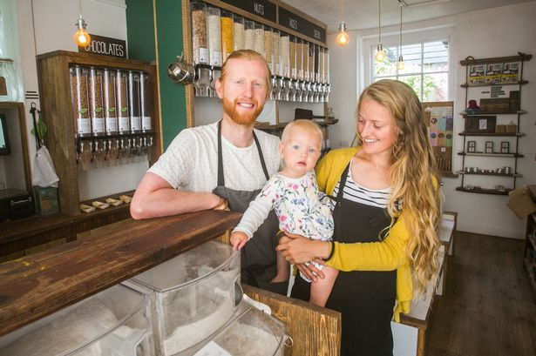
Watch the short introduction (1.09 mins) introducing the UK’s first Zero-Waste shop started by a former Manchester United footballer, Richard Eckersley, entitled:
Earth. Food. Love
Click on the link above for the hyperlink

Slide 20
Allow students a few minutes to respond to the film with people sitting near to them.
After sharing their initial responses, ask them to consider the following questions:

Slide 21
Have your responses to the idea of living a zero-waste life changed now that you’ve learned a little more? Why?

Slide 22
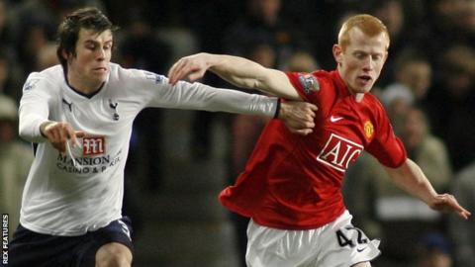
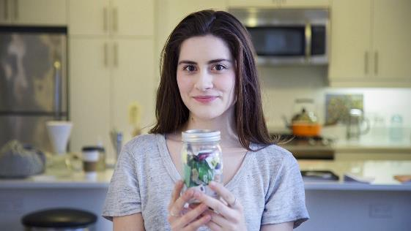
Get involved!
Take a look at Richard Eckersley’s top tips for cutting down your waste:
Reduce your Waste!
Take action!
Visit Lauren Singer’s website and blog for some top tips on how to reduce your waste.
http://trashisfortossers.com/
(*Even international footballers are getting in on the zero-waste action!)
(*The jar she is holding contains all of the waste she has produced in the last two years!)

Slide 23
R U B B I S H
I N N O V A T I O N S
2 0 M I N U T E S +

Slide 24
There are many organisations working to promote waste reduction, recycling and sustainable futures.
Rather than worrying about the difficulties of changing lifestyles, it is often more inspiring to look at the people out there showing new initiatives and campaigns and feel enthused by what is possible with a little effort.

Slide 25
Split the class into four groups (or eight groups if you have a large class) and give each group one of the following four campaigns:

Slide 26
Using the links to the websites on the following slides, ask students to:
Find out more about the campaign (research what it is trying to do, how it works, who is behind it) and then assess its positive and negative elements
Explore the intention behind the campaign – is this a good waste-reduction campaign or initiative? Why? Why not?
No Waste Town
Real Junk Food Café
Toast Ale
Too Good to Waste

Slide 27
Afterwards, feedback to the group and explain:
Who or what the organisation is
What they are doing to reduce waste
Whether they are an ethical and sustainable campaign
Whether it is an effective campaign

Slide 28
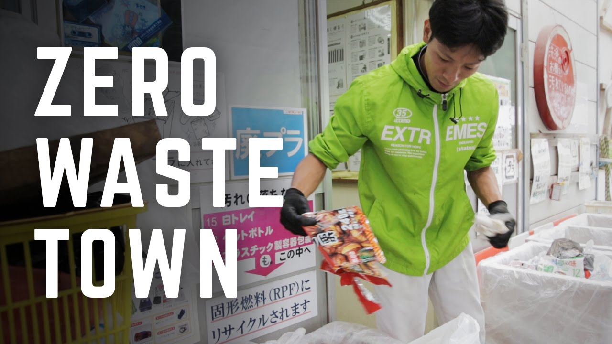
Click here

Slide 29
Click here

Slide 30
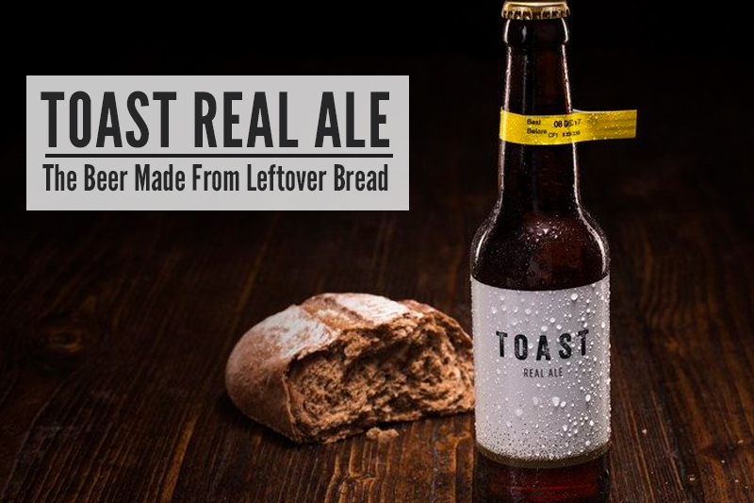
Click here

Slide 31
Click here

Slide 32
D E C L U T T E R
Y O U R L I F E
2 0 M I N U T E S +

Slide 33
Is convenience often more important to us than sustainability? Why?
Is recycling always a good thing? Can it sometimes be an excuse for us to continue making unnecessary waste?
Do we have a collective responsibility to reduce our waste?

Slide 34
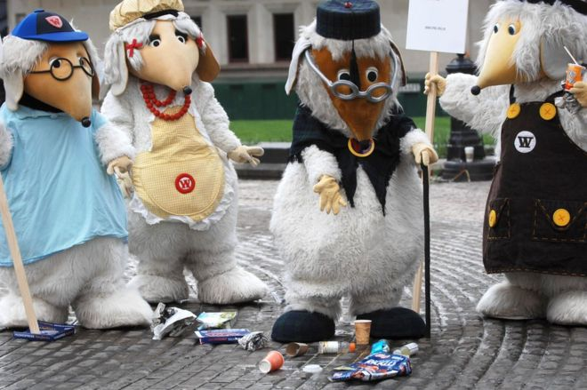
Watch the short introduction (52 seconds) to a TV programme from the 1970s about litter-collecting animals called:
The Wombles
Click on the link above for the hyperlink

Slide 35
Allow students a few minutes to respond to the film with people sitting near to them.
After sharing their initial responses, ask them to consider the following ideas:

Slide 36
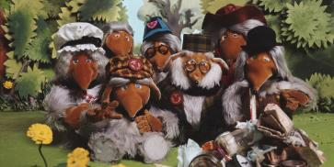
The Wombles was a programme showing young children the importance of litter-picking and being resourceful and were early pioneers of recycling and up-cycling. One of the phrases that was in the theme-song was:
Read the following article called The Wombles at 40 which talks about why the Wombles are more important than ever.
Making good use of the things that we find – the things that they everyday folks leave behind…

Slide 37
The Wombles at 40 – why we need them more than ever
The Guardian | by Stuart Jeffries
Who would win a fight between a Womble and a Teletubby? Why did the Wombles' 1970s mission to teach a nation not to litter fail so abjectly? How did they, as Marvin Gaye would put it, get it on? Forget about the wonders of the ice age: as the Wombles of Wimbledon Common celebrate their 40th birthday, these are the questions that need answering.
Let's tackle the first question. Obviously your Teletubby, while having much the same BMI as your mature Womble, is bigger and thus more terrifying in a smackdown scenario. That said, the former's gaudy colour scheme (Tinky Winky purple, Laa-Laa yellow) would make a surprise attack unlikely on even a very slow-witted Womble (I'm thinking of Tomsk, who has the lowest womble IQ and, as axiomatically follows, likes golf).

Slide 38
Plus, because each Teletubby contains a sweating actor who's going to sack their agent as soon as they get out of their fur suit, they aren't exactly going to chase down their preys like cheetahs. Wombles are stuffed, and have no such motivational issues. Wombles, unlike Teletubbies, have vicious little eyes and snouts that suggest powerful teeth – both good in a scrap. They also have retractable claws, decisive in close combat – and definitive proof that 1970s kids' TV is better than today's.
Wikipedia puts about the nonsense that wombles are raccoons. Do raccoons wear scarfs, spectacles and hats? Aren't raccoons, in fact, known for tipping up bins rather than initiating community-wide, proto-recycling initiatives? A Womble's life span, unlike a raccoon's, may be as long as 300 years (the Womble song Minuetto Allegretto refers to Great Uncle Bulgaria as being a lad in 1780: you do the maths). This may explain how Great Uncle Bulgaria beat Britain's fascistic immigration system. Long-lived, species-non-specific stuffed animals rarely require visas, even when travelling from outside the EU.

Slide 39
The great tragedy of the Wombles is that their mission to make Britain tidier now looks like a sick joke. The concept was dreamed up in 1968 by the late children's author Elisabeth Beresford, and later adapted for TV by means of Ivor Wood's brilliant stop-motion animation, an adorable Bernard Cribbins' narration and Mike Batt's undying theme music. It is as laughable as the Keep Britain Tidy campaign. Think of how last month's snow encouraged some dog owners to believe they had a free pass to let their pets befoul the pavements, rather in the way that Mike Batt's Wombling Merry Christmas befouled the singles chart in December 1974. Actually, that's unfair: there was much worse stuff (Mud's Lonely This Christmas, for one).
Did the Wombles clean up their own mess? A rhetorical question: of course they did! When they went for a walk, Tobermory would lead the way, followed by Orinoco, who carried a bag for Tobermory's waste, followed by Bungo, who was tasked with bagging Orinoco's. Tomsk, Wellington, Madame Cholet, Stepney and even Cousin Cairngorm McWomble the Terrible would follow in orderly fashion. Otherwise, Wimbledon Common would have become a vast Womble latrine. Who bagged Tobermory's waste? We may never know.

Slide 40
The selflessness and communal bonds that the Wombles demonstrated weekly from 1973 to 1975, the basic respect they urged for our streets, commons, one another and by extension, the planet, are widely missing from our age. We need Wombles in 2013 – but where are they? The likely truth is that the Wombles have retreated underground for good, never again to shake their snouts at the overground mess we have made. The same is true around the world: Elisabeth Beresford imagined that each country would have a Womble colony, but they are now nowhere to be found. Apart from the Singapore Wombles, who can and often do eat their dinners off the city's pavements, so clean is it there. (True story.)
Finally, how do Wombles get it on? Well, first they retract their claws. Empathetic in so many ways, they are, we must suppose, thoughtful lovers. And then? None of your business.

Slide 41
What are the challenges of living a more “simple” or minimal life?

Slide 42
To be able to achieve a zero-waste life, and before you do any of these things, you first need to EVALUATE!
Take a look at your daily life and ask yourself the following five questions:

Slide 43
How much rubbish am I currently producing and what types?
E.g: food packaging/ paper/ food waste. This will help you determine the places you can start reducing and looking for alternatives.
2. Why am I actually interested in decreasing my impact?
Is it for environmental reasons; is it to reduce the toxins in my life? To decrease clutter? To save money? Understanding your motivation will help you to achieve your goals.

Slide 44
3. What do I actually use on a daily basis (what is in my daily routine) and what do I not use/need?
This can help you determine the things that you can donate and reduce or simply remove from your life.
4. What products do I use that I can get more sustainable alternatives to?
E.g. exchanging plastic tupperware for glass or mason jars / buying non-packaged fruit and vegetables.

Slide 45
*The most important question…
5. How much and what do I really need to be happy?
Try to think about why you own and horde certain things, and think about whether or not you really need them to be happy.

Slide 46
We all have far too much “stuff”, which contributes tremendously to the amount of waste accumulating across the world.
Do I really need this?
Before you buy anything, try to ask yourself:
Do I actually need this?
What do I use every day and what have I not used for years?
How much of the stuff that I have do I actually need?
Whether it is donating unwanted items, selling your products or simply not buying unnecessary items, you will soon find that your waste reduces.

Slide 47
T A K E I T F U R T H E R
5 M I N U T E S +

Slide 48
If time allows, introduce students to a global action movement planning a giant clean up of the world in 2018: Cleaning the World
Also, you may wish to read one of the following articles, exploring how we can look ahead to find solutions to reducing our “stuff” and changing our wasteful habits:
In a world with too much stuff, solutions are everywhere
It’s our responsibility to act
To finish, why not watch “Zero Waste Girl”, Lauren Singer’s Ted Talk about how and why she chose to change her wasteful lifestyle and become waste-free.

Slide 49
Take action
Many people are starting to take action against the giant supermarkets, championing for them to face up to their responsibility of cutting down on packaging and single-use plastics.
Take a look at some advice on how to approach plastic waste, or follow a few ideas from ThoughtBox Members. What do you think of these approaches?
Dump it at the checkout
Rather than take home all of the unnecessary packing on supermarket food to put straight into your own bin, unpack everything at the check out and leave it on the aisle for the supermarket to have to deal with.
Send it back to them
Send all excess packaging back to the supermarkets using their customer services FREEPOST address with a note enclosed that reads:
“Thankyou I don’t want this. Please cut back on your packaging”.

Slide 50
C O N N E C T T O O U R
Z E R O W A S T E
C H A N G E M A K E R S

Slide 51
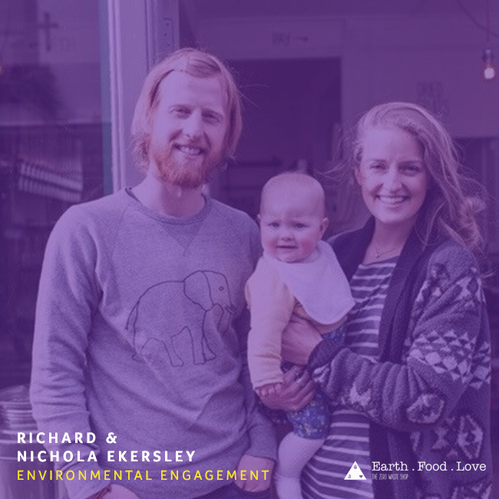
Richard and Nicola Eckersley run the UK’s first Zero Waste shop. Their Devon-based shop sells a wide selection of organic food with no packaging.
They are already proving an inspiration to high streets across the country, with several other towns now starting up Zero Waste shops.
Richard and Nicola would love to offer schools talks about their work and the ethos behind Zero Waste. They are also interested in offering work-experience placements and school visits focused around sustainable living.
Find out how to connect on the following slide:

Slide 52
ThoughtBox works closely with Richard and Nicola, who are part of our NGT network of New Generation Thinkers.
ThoughtBox Members have full access our NGT network. Get in touch to make a booking for one of our changemakers to come and visit you and your school.
Non-members: Get in touch and find out how we can link you up with our changemaker network – from Zero-Waste activists to Round-the-World-Cyclists!
Take a look at our inspiring network of changemakers here!
Bring a Changemaker into your school!
rachel@thoughtboxeducation.com | 018030911070

Slide 53
W A S T E
E N V I R O N M E N T A L E N G A G E M E N T
THIS SORT OF LEARNING CAN’T WAIT

