Slide 1
FOOD
ENVIRONMENTAL ENGAGEMENT
Y11 – 1 3
15-18 years

Slide 2
T H E F U T U R E O F
F O O D
W E E K 4
3 0 M I N U T E S

Slide 3
In this lesson, students will:
THINK!
Think about and discuss some of the developments for feeding the world in the future, and the impacts these may have
Understand how the ethics of GMOs are significant in influencing people’s lives and livelihoods
Explore and unravel some of the ripple effects of new food production and how some of the challenges we will be facing are already being met
FEEL!
UNLEARN!

Slide 4
P R E L E S S O N
R E F L E C T I O N S
3 – 5 M I N U T E S +

Slide 5
Introduce the following REFLECTIVE QUESTIONS for students to consider during the lesson:
How much do you think about the future of our food? Do you think we should be more connected to the food that we are eating in terms of production?
What are some of the biggest challenges about food in the future?
Are you open to try new ideas when it comes to food production in the future?

Slide 6
T H E F U T U R E O F
F O O D
2 5 M I N U T E S +

Slide 7
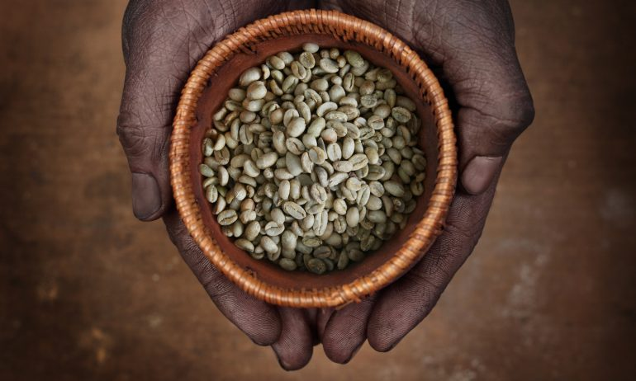
Watch the short film (3.15 mins) made by the Centre for Strategic and International Studies:
The Future of Food
(Click on the link above for the hyperlink)

Slide 8
Allow students a few minutes to respond to the film with people sitting near to them.
After sharing their initial responses, ask them to consider the following questions:

Slide 9
What are some of the biggest challenges that we will face in our food future?
How aware are you of new and innovative farming techniques that are being practiced?
Do you ever think about the future of food? Why?

Slide 10
In the film, they mention three key areas to focus on in the future of our food:
Availability
Access
Stability
Discuss with the person next to you and then feedback to the group.
Why might these be important / crucial areas for us to focus on?

Slide 11
By 2050 we will need to be producing enough food to feed nine billion people. That is almost two billion more people than we are feeding today.
How can we do that without overwhelming the planet?

Slide 12
There are many calls for large scale approaches to address these challenges, such as the following five step plan:
Freeze Agriculture’s Footprint
Grow more on farms that are running already
Use resources more efficiently
Shift our diets
Reduce our food waste

Slide 13
How much should education be playing a role in addressing some of our food issues, such as waste, poor diet, non-sustainable food production?
Many schools across the world are not teaching children about food – about how to cook, what is good to eat, what happens to our food when we throw it away, where our food comes from, what our food is made from, what it takes to make some of our food.
Should we be better educating our children?

Slide 14
Going Local
Many countries are now exporting and importing almost identical quantities of food and produce; with production of food from in-country (and thus a self-sustaining food supply) somehow being ignored.
Organisations and ideas have developed over the past few years to try to encourage us to eat locally, grow locally and find ways to cut out the long and unnecessary food chains between field and table. The rise of popularity in Farmers’ Markets is just one example of how people are starting to turn more to their local community to source their food needs.
Should we all be focusing local when it comes to our food?

Slide 15
As well as localised production and supporting a more balanced education, there are many possibilities for change in our food systems, some which are already growing in popularity and some which are just emerging.
Split the class into small groups of around four or five people and give each group one of the four areas of ‘future food sources’ on the following slide.
Students will then work together in their group to learn more about this idea and feedback the pros and cons of this approach to our food future.

Slide 16
1. Plant based diets | 2. Alternative proteins | 3. Lab-grown food | 4. Artificial substitutes
The following slides give some resources and brief introductions to these areas.
NB: If it is not practical to break up into research groups, you can choose one or two of these areas and explore together as a class.

Slide 17
1. Plant based diets
Carnage trailer (a spoof film about veganism)
If meat-eaters acted like vegans… (article/video)
Go Vegan, Save the planet (article)
Cowspiracy (website/video)
10 reasons for plant based diets (article)
Plant based is the future (article)
Eat less meat (article)

Slide 18
2. Alternative proteins
Eating Insects (short film)
Insects – food of the future? (article)
Could insects be the wonder food of the future? (article)
Why should we eat insects? (article)
Eat Grub (website)
Future foods (article)
The future of food (article)
Grub’s up! (article)

Slide 19
3. Lab-grown food
Super-meat (short film)
Could lab-grown meat feed the world? (article)
Lab-grown meat (video)
Will you eat lab meat? (article)
Lab grown burgers (article)
Super-meat (website)

Slide 20
4. Artificial substitutes
Soylent (website and video)
The end of food (article)
My week on Soylent (article/video)
Are pills and powders the future of food? (article)
Meal in a pill (article)
Artificial food – incredible or edible? (article)

Slide 21
The following articles and websites explore some of these ideas in more depth as well as introducing some of the other organisations focusing on the issue of food sustainability:
Feeding 9 Billion People (National Geographic)
Feeding nine billion
Wanted – innovative ideas on how to feed 9 billion
Global Gardens – teaching students to grow their own food
Healthy Schools Campaign
School meals – World Food Programme
Food for Thought – Oxfam
The Transition Network
Food is Free
Food Rules for a Healthy Planet
The Gaia Foundation

Slide 22
T H E I M P O R T A N C E O F B I O D I V E R S I T Y
5 M I N U T E S +

Slide 23
Food biodiversity is a key ingredient in creating a secure and sustainable food system.
Diversity in plants also gives us a "treasure chest" of options for raising the healthiest and most productive crops. No matter what changes happen in our food system, we will always be able to adapt if we have enough genetic diversity.
The problem is that plant genetic diversity is disappearing and threatens to destroy the system of food and farming that has been built on plant genetics for over 10,000 years. There are still thousands of varieties to choose from, but the vast majority of them are endangered and hundreds are becoming extinct every year.

Slide 24
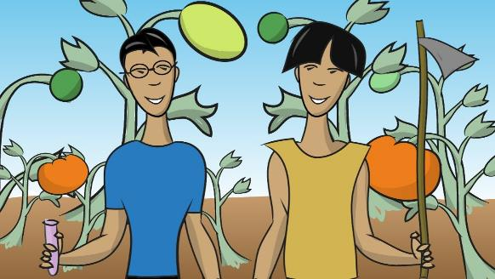
Watch this short video (3.14mins) made by Scientific American entitled:
What is a GM Food?
(click on the link)

Slide 25
Allow students a few minutes to respond to the film with people sitting near to them.
After sharing their initial responses, ask them to consider the following questions:

Slide 26
Talk with the person sitting next to you about your thoughts and then share together as a class.
Why is food diversity important for the future?

Slide 27
What are your biggest questions when it comes to the future of food?
Think about this statement and then talk with the person next to you and share ideas with the class.

Slide 28
F O O D
T H I S S O R T O F L E A R N I N G
C A N ’ T W A I T

