Slide 1
1 hour+
Food
Week 1 – Why are you eating that?
Y7&8
11-13 years

Slide 2
In this lesson, students will:
THINK!
Think about and explore our relationship with food, how it has developed and evolved over history and its many different meanings
Understand how we react to the food that we eat and its direct (and indirect) impact on our physical, emotional and mental health
Explore and unravel some of the ripple effects and consequences of our current dietary choices, thinking about other ways to approach food
FEEL!
UNLEARN!

Slide 3
Pre-lesson reflection 3 minutes+

Slide 4
Introduce the following REFLECTIVE QUESTIONS for students to consider during the lesson:
Why do you eat the food that you eat? Family? Culture? Advertising?
Do you have any food addictions? Is this a bad thing? Why? Why not?
How much control do you have over what you eat? Does this matter to you?

Slide 5
Addictive qualities 5 minutes+

Slide 6
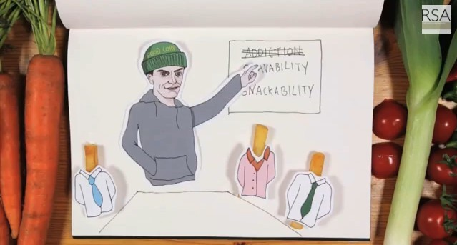
Watch the short film (2.29 mins) made by the Royal Society of the Arts entitled:
Food Addiction
(Click on the link above for the hyperlink)

Slide 7
Allow students a few minutes to respond to the film with people sitting near to them and then discuss the questions below:

Slide 8
Why do you think food cravings are not called “addictions”?
Would you say you suffer from any food addictions?

Slide 9
The History of Food 25 minutes+

Slide 10
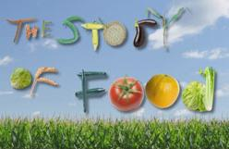
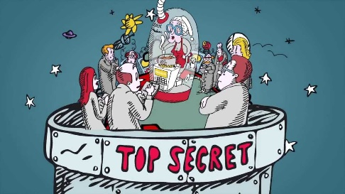
Watch one of the two short films below, exploring the brief history and development of our food:
The Story Of Food
(Click on the link above for the hyperlink)
A Brief History of Food
Click on the link above for the hyperlink
A short film (5.40 mins) made by USC Canada
A short film (3.14 mins) made by Foodtopia

Slide 11
As we are now eating more and more processed foods, foods containing high levels of additives or modified, artificial products, it is becoming harder and harder to really know what it is that we are actually eating.
Added to this, many countries in the world are now importing a large majority of their food supplies, meaning we don’t always know where our food has come from…
How much do you know about the ‘food’ you are consuming every day?

Slide 12
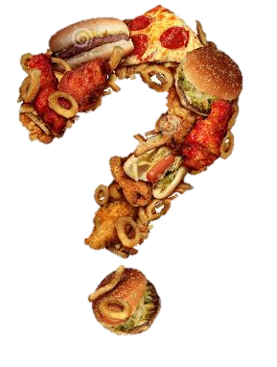
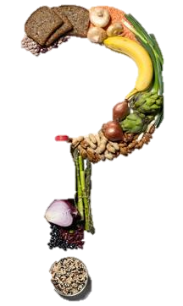
What have you eaten in the last 24 hours?

Slide 13
Write a numbered list of all foods you have eaten in the last 24 hours (or choose a shorter time if preferable), leaving 2 lines between each item.
For example:
Porridge
Cup of coffee x 3
Cheese and Pickle sandwich
Salt and Vinegar crisps
Chocolate cake
Orange Juice x2
Vegetable curry
Rice
Naan bread
Water
Apple pie
Cup of tea x4
What have you eaten in the past twenty-four hours?

Slide 14
Now look at your list, and answer this question:
What are each of these foods made from?

Slide 15
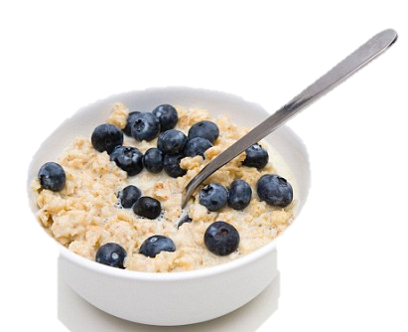
If it is not a natural product, see if you can break the food down to its original raw ingredients. If you don’t know, put a question mark next to the food.
For example:
Bowl of porridge
Oats – milk - honey
Cup of coffee
Roasted coffee beans – milk – sugar (sugarcane)
3. Cheese and Pickle sandwich
Bread - Wheat flour – yeast – water – salt - sugar.
Cheese - whole milk - rennet.
Pickle – apples – sultanas – carrots –vinegar – tomatoes - sugar - salt

Slide 16
Now look at your list, and answer this question for any of the foods you know:
Where (or from what) do these foods come from?

Slide 17
If you don’t know, put a star *next to the food
Porridge
Oats SCOTLAND – milk HOLLAND – ENGLAND
Cup of coffee
Roasted coffee beans GUATAMALA – milk HOLLAND– sugarcane - BRAZIL
3. Cheese and Pickle sandwich
Bread - Wheat flour ENGLAND – yeast ENGLAND –water ENGAND – salt ENGLAND – sugar BRAZIL.
Cheese - whole milk HOLLAND – rennet ENGLAND
Pickle – apples ENGLAND – sultanas USA – carrots ENGLAND –vinegar ENGLAND – tomatoes ENGLAND –limes - CHINA- sugar BRAZIL- salt ENGLAND

Slide 18
Add the total number of foods listed on your page in your original list.
Now count up the number of question marks on your list and take this away from the original number of food items
For example:
21 food items – 12 question marks = 9 foods with known ingredients
3. Now count up the number of stars on your list and take this away from the original number of food items.
For example:
21 food items – 15 stars = 6 foods from known places

Slide 19
Using these numbers, work out the percentage of food that you have eaten in the past 24 hours about which you know what it was made from and/or where it came from.
For example:
(KNOWN FOOD INGREDIENTS: e.g. 9/21 = 43% / KNOWN FOOD ORIGINS: e.g. 6/21 = 29%)
*These are very rough calculations simply to give a quick insight into some of our interactions with food
“I don’t know what 57% of the food actually is that I have eaten in the past 24 hours, and I don’t know where 71% of it has come from”
Share findings by using this sentence above with the class and then discuss the following question, using these findings to support your thoughts:

Slide 20
Is it important to know where our food comes from and what it is made from? Why? Why not?

Slide 21
Making your own food 20 minutes +

Slide 22
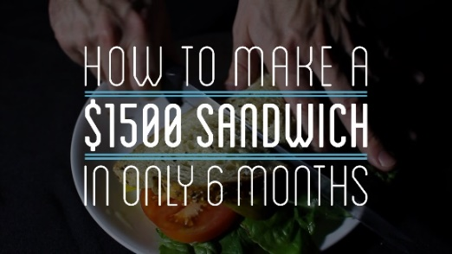
Watch the short film (3.44 mins) made by Andy George entitled:
How to make a $1500 sandwich in only 6 months
Click on the link above for the hyperlink)

Slide 23
ADD PICTURE FROM THE FILM HERE
Allow students a few minutes to respond to the film with people sitting near to them.
After sharing their initial responses, ask them to consider the following questions:

Slide 24
Why do you think Andy decided to “make” his sandwich?
Which element would you find the most challenging? Why?
How might being removed from the production and processing of our food affect our food choices and eating habits?

Slide 25
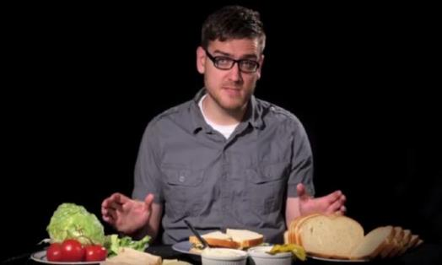
Take a look at an article from The Guardian newspaper exploring some of the reasons behind why Andy George decided to make his sandwich and understand the processes involved.
Discuss some of the ideas raised in the article (printed on the following slides).

Slide 26
The $1,500 sandwich-from-scratch guy: 'Now it's hard for me to waste any food'
The Guardian | by Bailey Peraita
Minneapolis native and YouTuber Andy George took six months to create a sandwich and all its ingredients entirely from scratch; his video documenting the process has gone viral, with more than 1.4m views in the past two weeks.
Without the convenience of a supply chain, cheap labor, technological advancement, global food networks or even substitutes, it took George 16 steps to complete his meal and cost him a staggering $1,500 – for one simple sandwich.

Slide 27
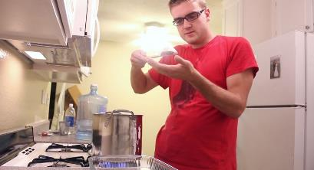
George grew up in the suburbs, without an abundant amount of knowledge of farm life. He says it was pure curiosity that drew him to this experiment.
“The average person is less involved in the creation of their own food supply. And we do lose something by not having that connection,” he said. “It’s good to make your own garden and keep in touch and be aware of where your food actually comes from.”

Slide 28
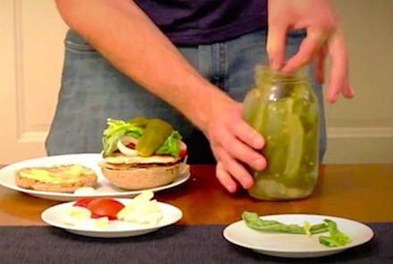
Q: Of all the meals in the world to make, why choose a sandwich?
A sandwich is a complete meal. I thought before of a few different things but I was really curious about making bread. Making a sandwich seems simple, but surprisingly it is super complex.
Q: Did you enjoy the sandwich?
It wasn’t bad. The six months of my life were not bad.

Slide 29
Q: What was your favorite part of the process?
I really enjoyed milking the cow. They were friendly and liked to be rubbed on the base of their tails, but it was also scary because the farmer was telling me that if spooked, they kick with what’s called the “death kick”.
Q: What was your least favorite part of the process?
Probably the [killing of the] chicken, I definitely didn’t look forward to having to do that. it wasn’t as hard as I thought it might be, although I didn’t take much pleasure in having to kill to eat it.

Slide 30
Q: Actually, a lot of people commenting on your video are saying you’re still better than Peta.
There were a lot a lot of comments about the chicken, and it’s understandable. Seeing an animal die is a little revolting to them. Then there are some people who don’t think it is right to kill animals and eat them – I respect that.
Q: Did this experiment change the way you see our global food supply?
Before I was mostly ignorant. I never really thought about it. I knew cheese was fermented from milk. Then I put it all together and mentally made the connection – personally doing every step gives me a new respect. Now it’s hard for me to waste any food, I want to use it all.

Slide 31
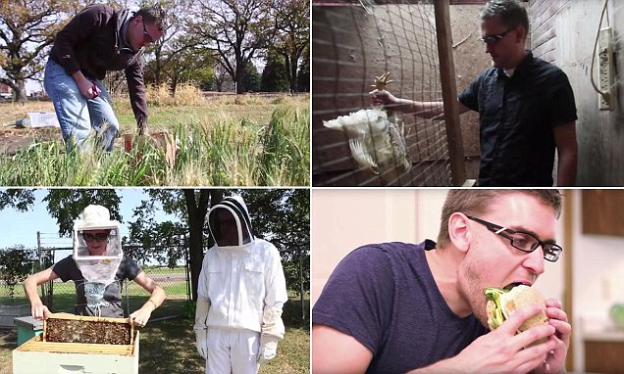
Q: What do you want viewers to take away and learn from your experiment?
An appreciation for the invisible side of the society we live in, and the stuff we use every day. Also to learn about things that go into our food that people take for granted.
Q: You love to cook at home. What’s your specialty?
Lasagna – and I do not make that from scratch.

Slide 32
Hand out a piece of paper to each student
Now read through the following slides, which pose a range of questions. These questions will start to form a clear understanding of our individual relationships to food.
Ask students to note down their responses to each of the questions raised (rather than discuss them) and really think about their own relationship with food.
NB. For some, this is a sensitive and very personal topic, so these responses should be kept private to each individual.

Slide 33
“You are what you eat”
This phrase has more meaning than we sometimes think, in particular when we think about how what we eat is what we are and as well as how what we eat constructs who we are.
1. What is the differences between these two identities created by food?
2. What does the food that you eat say about who and what you are?

Slide 34
We symbolically consume identity through our food and drink choices – more specifically, by what we don’t eat or drink. Eating is an intensely personal act. What we eat communicates to others our beliefs, cultural and social backgrounds and experiences.
3. Do you follow a particular diet (e.g. vegan, kosher, vegetarian, gluten free etc.)?
4. If so, what made you make this choice; when did you make it and how much does it explore or reveal a part of your identity?

Slide 35
5. What influences your food choices the most?
e.g. Price? Taste? Convenience? Nutrition? Culture? Religion?
6. How do you make your food choices and what do you think they are saying about who you are?

Slide 36
Now ask the class to look at some of their answers and think about their relationship to food and think about these four questions:
Are you consciously choosing what to eat?
What are the biggest influences on your eating?
Are you consciously saying something about yourself through your food choices?
Are you happy with the choices that you are (consciously/unconsciously) making?
Invite students to share their thoughts if they would like, but be conscious of the sensitivity of this topic for some.

Slide 37
The Sugary Truth 10 minutes +

Slide 38
Food addiction can take on many qualities and has a range of physical and emotional side effects, which can lead to serious health issues and can have a serious impact on mood, energy and overall health and wellbeing.
If you have ever felt sluggish or tired and then eaten something sugary, you will know the very powerful and immediate effect that sugar can have on the body.

Slide 39
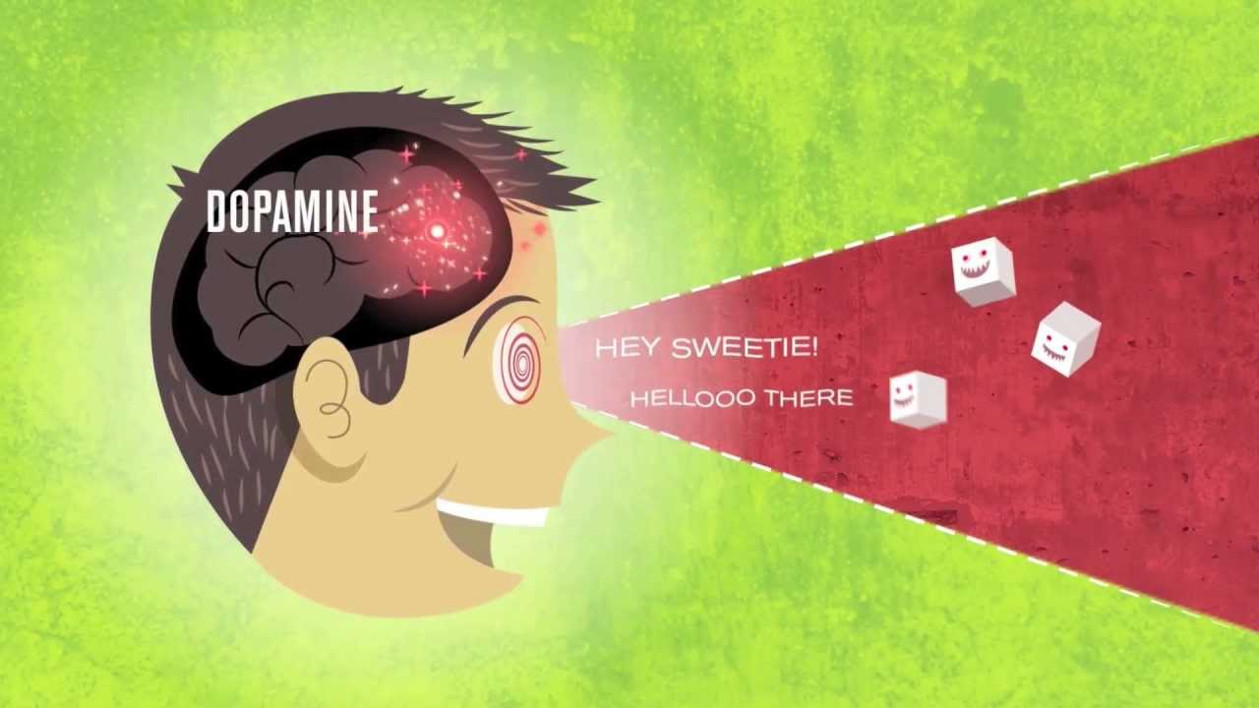
Watch the short film (4.35 mins) made by Tremendousness entitled:
The Sugary Truth
(Click on the link above for the hyperlink)

Slide 40
Allow students a few minutes to respond to the film with people sitting near to them.
After sharing their initial responses, ask them to consider the following:

Slide 41
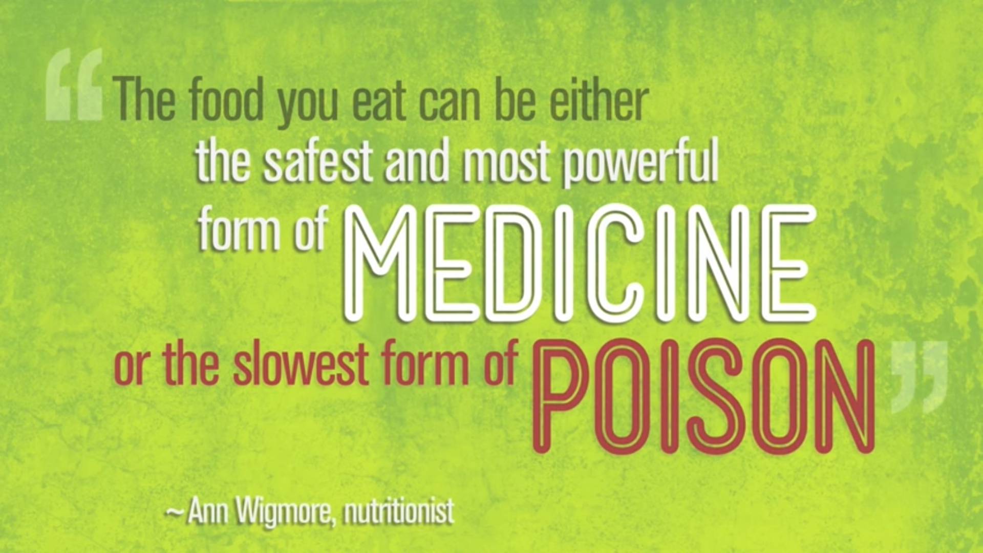
The statement made at the end of the film was:
What do you think this means?
Discuss with the person sitting next to you and feedback to the class.

Slide 42
Should we be more careful about the amount of sugar that we are giving to young children? Why?
Should sugary foods come with a health warning about addiction, such as those for alcohol or cigarettes? Why?

Slide 43
This sort of learning can’t wait
thoughtboxeducation.com

