Slide 1
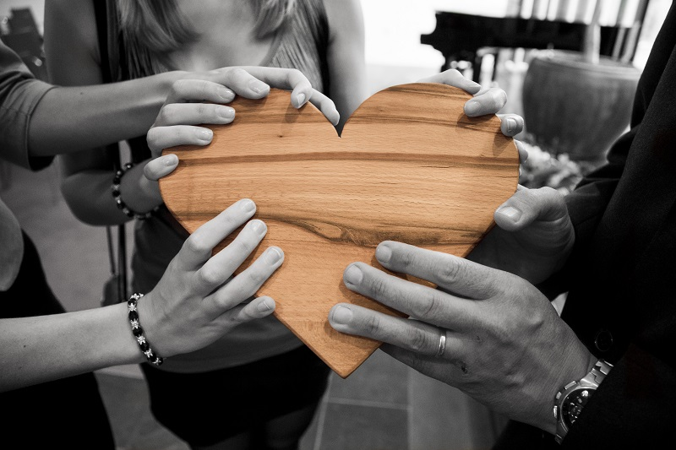
15 minutes+
Voluntourism
Week 1 – Who wants to be a volunteer?
Y7&8
11-13 years

Slide 2
In this lesson, students will:
THINK!
Think about and discuss what volunteering means and explore why many people choose to travel overseas to volunteer
Understand the motivation behind volunteering and explore some of the direct and indirect impacts of our actions
Explore and unravel some of the stereotypes about charities and overseas aid and volunteering that exist, and start to develop a more open-minded approach to the notion of ‘aid’
FEEL!
UNLEARN!

Slide 3
Pre-lesson reflection
3 minutes+

Slide 4
Introduce the following REFLECTIVE QUESTIONS for students to consider during the lesson:
What is volunteering and why do so many people choose to volunteer?
Why might volunteering overseas be such a popular option for many young people?
What is charity? Is charity something we should all be encouraged to engage with?
Is volunteering always helpful, do you think? Why?

Slide 5
Being helpful 20 minutes+

Slide 6
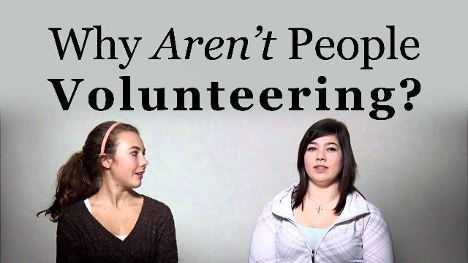
Watch the short video (2.27 mins) made by a global volunteer organisation Pillar Non-Profit entitled:
Youth Volunteering
(Click on the hyperlink above to watch the film)

Slide 7
Allow students a few minutes to respond to the film with people sitting near to them.
After sharing their initial responses, ask them to consider the following questions:

Slide 8
Why do you think people enjoy volunteering?
Have you ever done any volunteer work before?
How did you find the experience? How did it make you feel?

Slide 9
Where are usual places for young people to volunteer?
Work in groups of three or four and note down as many places as you can think of, then share your ideas together with the class.

Slide 10
Primary schools
Animal shelters
??
Where do people volunteer?
Nursing homes
??

Slide 11
Why do people volunteer?
Continue the mind-map on the following slide and think of all of the reasons that people may choose to volunteer.
Include your own experiences and what motivated you to get involved, if you think this is relevant.

Slide 12
To feel good
To help others
Altruism
Why do people volunteer?
To share skills
To support those who need

Slide 13
In the video, some of the students mentioned that it feels good to volunteer. Have you heard of this word before:
Altruism
Why might doing something altruistic make us feel good?
What do you think it means?

Slide 14
When we are volunteering, are we also helping ourselves as well as helping others?
Working in groups of three or four, make two lists or mind-maps on a page and think about the following two ideas to help answer this question:

Slide 15
1. How does volunteering help others?
2. How does volunteering help ourselves?
After five minutes, discuss your ideas with the whole class.

Slide 16
Being good to others makes us feel good – it is in a way a positive feedback loop. Kindness feels good, and so the more we are good to others, the more we are good to ourselves.
As a class, discuss together:
Why is kindness infectious?

Slide 17
Read the short article published by the Mental Health Foundation entitled:
Doing good does you good
(click on the link to open the article)
Share ideas and discuss interesting points together after reading

Slide 18
There are many organisations and charities across the world who offer “aid” and support communities overseas- also offering volunteer projects.
It is becoming very popular now for young people and school students to volunteer overseas, normally with a charity project.
Why might this be a popular thing for people to do?

Slide 19
Look at these two approaches to charity work and see if you can spot the main differences
3.Work with the community
2.Talk with other organisations to discuss ways to support the problem
1.Local community identify a problem and ask for help
1. Assume or identify a problem in another country or community
2.Make a plan to fix it or how you can help
3. Go and help

Slide 20
We know how positive helping others can be, but we also know some of the problems that come with “top down” approaches to charity work.
We are also now beginning to see some of the problems that come with this sort of volunteering.
For example, sending unskilled people to work in countries where they don’t know the language or culture, and are working in projects that could employ a local skilled professional instead means that there are negative ripple effects happening because of the project.

Slide 21
Think about ways you can pledge to do good in your local community, either by getting involved in some charity work, or doing something really simple and effortless like a random act of kindness.
For inspiration on becoming a RAKtivist (a Random Acts of Kindness –ivist!) explore the ‘Random Acts of Kindness’ website:
https://www.randomactsofkindness.org/

Slide 22
ThoughtBox: This sort of learning can’t wait

